Slide 1
Digital business models
Lecture 7. Blockchain-based business models
DSc.Takhir Kuchkarov

Slide 2
Content
What is the Blockchain ?
What is the Blockchain Business Model ?
The types of Blockchain Business Models
Key characteristics of Blockchain
Using blockchain in business

Slide 3
What is the Blockchain ?

Slide 4
What is Blockchain?
Blockchain technology is a structure that stores transactional records, also known as the block, of the public in several databases, known as the “chain,” in a network connected through peer-to-peer nodes. Typically, this storage is referred to as a ‘digital ledger.’
Every transaction in this ledger is authorized by the digital signature of the owner, which authenticates the transaction and safeguards it from tampering. Hence, the information the digital ledger contains is highly secure.
In simpler words, the digital ledger is like a Google spreadsheet shared among numerous computers in a network, in which, the transactional records are stored based on actual purchases. The fascinating angle is that anybody can see the data, but they can’t corrupt it.

Slide 5
History of Blockchain
2008
Satoshi Nakamoto, a pseudonym for a person or group, publishes “Bitcoin: A Peer to Peer Electronic Cash System."
2009
The first successful Bitcoin (BTC) transaction occurs between computer scientist Hal Finney and the mysterious Satoshi Nakamoto.
2011
1 BTC = $1USD, giving the cryptocurrency parity with the US dollar.
2019
China’s President Ji Xinping publicly embraces blockchain as China’s central bank announces it is working on its own cryptocurrency
Twitter & Square CEO Jack Dorsey announces that Square will be hiring blockchain engineers to work on the company’s future crypto plans.The New York Stock Exchange (NYSE) announces the creation of Bakkt - a digital wallet company that includes crypto trading
2020
Bitcoin almost reaches $30,000 by the end of 2020.PayPal announces it will allow users to buy, sell and hold cryptocurrencies
The Bahamas becomes the world’s first country to launch its central bank digital currency, fittingly known as the “Sand Dollar”
Blockchain becomes a key player in the fight against COVID-19, mainly for securely storing medical research data and patient information

Slide 6
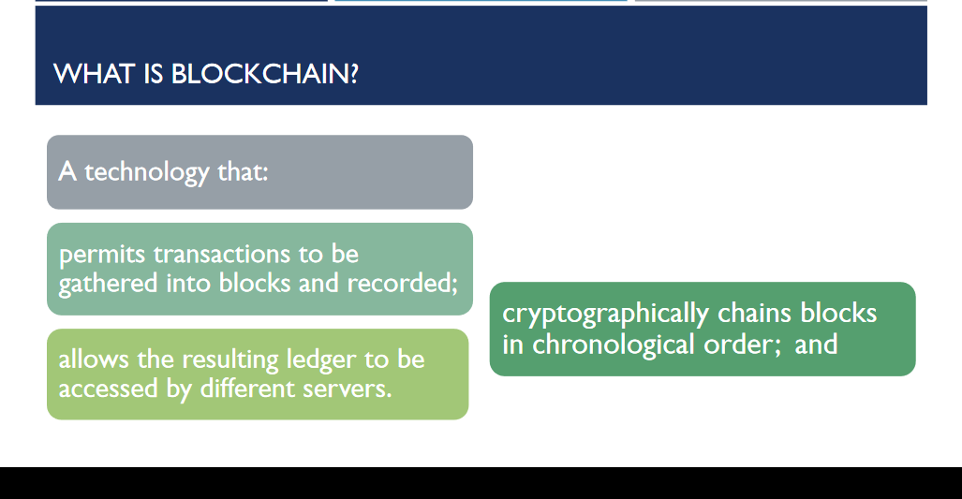
https://www.sec.gov/spotlight/investor-advisory-committee-2012/slides-nancy-liao-brief-intro-to-blockchain-iac-101217.pdf

Slide 7
What is the Blockchain?
Blockchain, sometimes referred to as Distributed Ledger Technology (DLT), makes the history of any digital asset unalterable and transparent through the use of decentralization and cryptographic hashing.

Slide 8
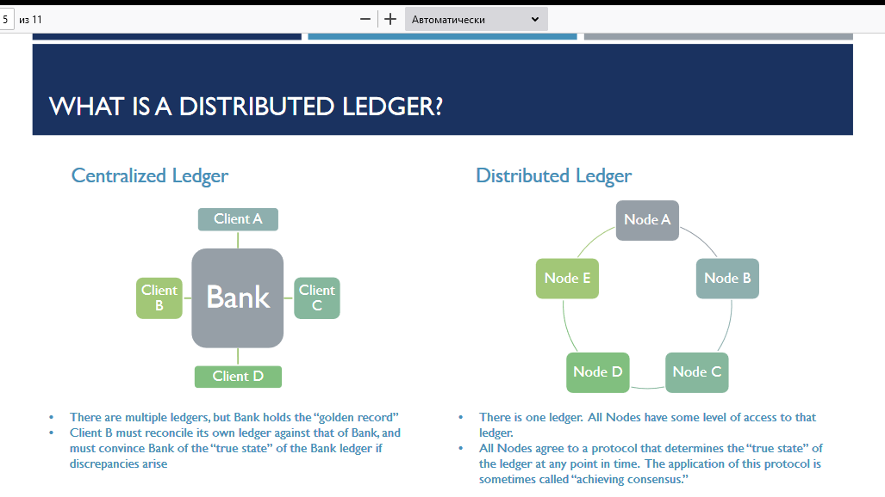
https://www.sec.gov/spotlight/investor-advisory-committee-2012/slides-nancy-liao-brief-intro-to-blockchain-iac-101217.pdf

Slide 9
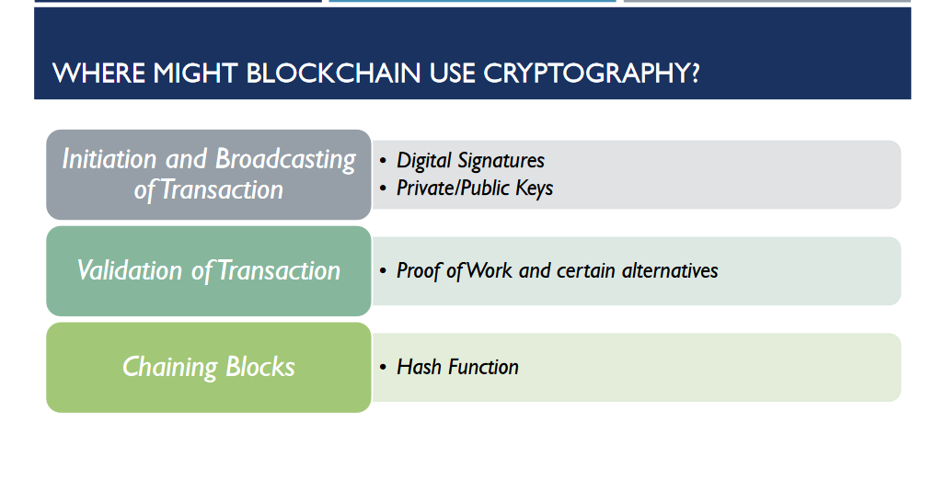

Slide 10
What is the Blockchain ?
Blockchain is a series of immutable records of data, managed by groups of computers that don’t belong to any entity, company, or government. Each of these data blocks is secure and linked to each other using a cryptographic chain. Hence the name “block + chain”. The blockchain is, therefore, a fully automated and secure way of transmitting the information. A part of a transaction starts the process by creating a block. This block is verified by thousands, perhaps millions of computers distributed over the network. The verified block is added to a chain, stored on the network, creating an exclusive record with an also exclusive history. To falsify a single record, it would be necessary to falsify the entire chain in millions of instances. This is practically impossible. And all of this is completely free. Because the block is not regulated by anybody. This technology can replace all business processes and models that depend on charging one for any transaction between two parties.

Slide 11
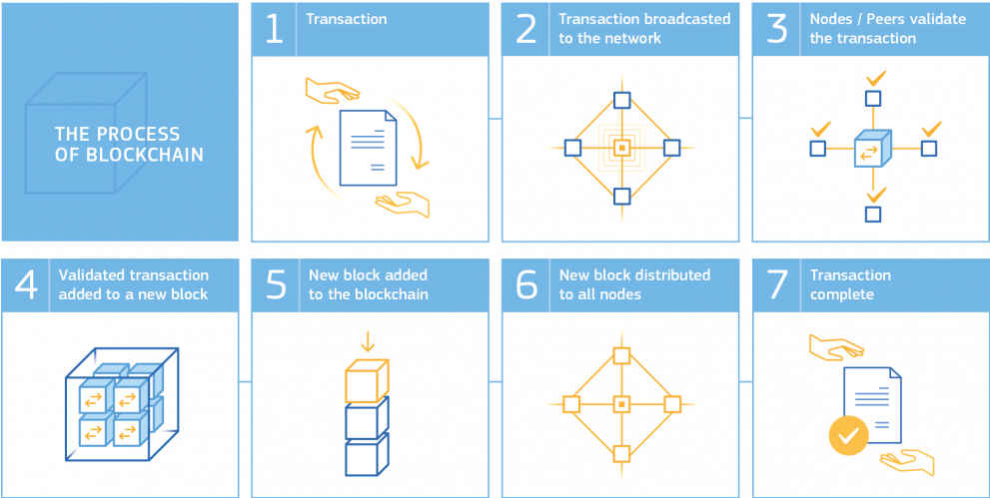
How Blockchain Works ?
https://joint-research-centre.ec.europa.eu/crosscutting-activities/facts4eufuture-series-reports-future-europe/blockchain-now-and-tomorrow-assessing-multidimensional-impacts-distributed-ledger-technologies/blockchain-promising-technology-bottlenecks-and-complex-challenges-lie-ahead_en

Slide 12
Technical background on Blockchain
How a transaction does work?
1
2
3
A undertakes a transaction towards B
Transactions are gathered in a block
The block is validated by the nodes with cryptographic techniques
4
5
The block is then added to the chain of blocks (blockchain), to which all the users have access
B receives A’s transaction

Slide 13
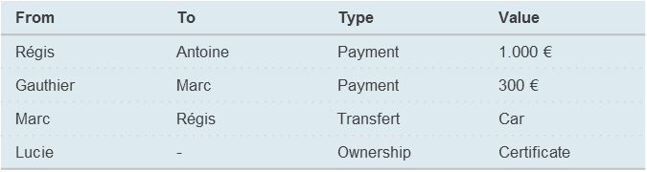
Reminder of important concepts
“Original” Blockchain or “Mutual Distributed Ledger”
The Mutual Distributed Ledger is a ledger replicated on all the nodes (clients) of a peer-to-peer network
Large book: record events, facts, information or transaction
Security: authentic and unalterable data thanks to advanced cryptographic processes
Transparency: available and shared data since their creation by all the members of the network
Resilience: copy of data are distributed and shared by all the nodes of the network
Disintermediation: autonomous way of working in a P2P mode, without central authority
Internet
Ledger
Ledger
Ledger
Ledger
Ledger
13

Slide 14
Reminder of important concepts
“Smart Contract”
A Smart Contract is a computer program that automatically executes the preset terms of a contract when conditions are met
Neither smart nor a contract, it is a code element containing conditions triggering actions to execute
It is an effective way of implementing “straight-through-processing”
Increase speed / time-to-market
Better efficiency of business processes
Certainty that the contract will be executed as agreed
Internet
If / Then
program
Ledger
If / Then
program
If / Then
program
Ledger
Ledger
If / Then
program
If / Then
program
Ledger
Ledger
14

Slide 15
Blockchain is based on three pillars
Decentralization: as mentioned above, the data is stored inside the blockchain and shared by all of the networks. Nobody owns the records.
Immutability: all the data is non-tamperable, through cryptography, ensuring cybersecurity.
Transparency: the identity is hidden via complex cryptography and represented by their public address. So, although the person’s real identity is secure, all the transactions that were done by their public address can still be seen. This level of transparency has never existed before.

Slide 16
Why (re)insurers care about blockchain?
Blockchain enables secured peer-to-peer transactions without “trusted central authority”
Peer-to-Peer relationship
Transparency
Security
Disintermediation
The focus shifts from information held by individual entities to information saved in a secured book shared across all verified members of the network
The trust generated by the blockchain process allows to achieve cross-organizational transactions without “trusted central authority”
All verified members of a blockchain network can have an access to the whole set of transactions that occurred since the blockchain creation
Since the blockchain is also immutable, this transparency property makes it easily auditable
The transaction validation process is based on cryptographic methods
The decentralized architecture is a security since every transaction needs to be validated by more than half of the blockchain network
Every slightest modification on the blockchain enhances the modification of all the following elements (blocks) of the blockchain, thus making it instantly detectable
A blockchain implementation can be disruptive by removing the cost of “trusted central authority” recordkeeper intermediary and thus redefining the traditional boarders of organizations and markets
16

Slide 17
Advantages of Blockchain
Security is probably the most significant advantage. It is almost impossible to corrupt a blockchain because the information is shared and continually reconciled by thousands, even millions, of computers. Blockchain also has no single point of failure.
Transactions can be more efficient than in non-DLT-based transactional systems, though public blockchains can sometimes suffer from slow speed and inefficiency.
It's resilient: There is no problem if one node goes down because all the other nodes have a copy of the ledger.
It provides trust between participants on a network. Confirmed blocks are very difficult to reverse, which means data is difficult to remove or change.
It can be cost effective because it often reduces the expense associated with transactions by eliminating middlemen and third parties.

Slide 18
Disadvantages of blockchain
With public blockchains, there are questions about ownership and who is responsible when problems arise.
There are also questions about whether organizations are capable of or willing to invest in the infrastructure needed to build, participate and maintain a blockchain-based network.
Changing data in a blockchain typically takes a lot of work.
Users have to keep track of their private keys to avoid losing their money.
Storage can grow to be very large over time, which risks the loss of nodes if the ledger becomes too large for users to download.
Blockchain is susceptible to 51% attacks, which is a specific attack designed to overwhelm other participants in the network and change blocks.

Slide 19
What is the Blockchain
Business Model ?

Slide 20
Blockchain technology is transforming business
Although the blockchain technology landscape can be confusing and is constantly changing, it is a technology that is almost certain to impact the business of most IT leaders in the next five years. Whether due to the adoption of blockchain by a competitor or the necessity to participate in a blockchain network, you can’t afford to ignore this powerful technology.

Slide 21
Blockchain Model
Blockchain has the potential to reshape industries by enabling trust, providing transparency and enabling value exchange across business ecosystems. There is a huge potential to lower costs, reduce transaction settlement times and improve cash flow. digital business models
Moreover, in combination with IOT technologies, assets can be traced and tracked from their origin to the point of production or purchase. Often it is the combination of blockchain and other digital technologies that produces more radical digital business models.
As a result, blockchain significantly improves supply logistics and reduces risks associated with counterfeit goods.
Another area in which blockchain has potential is identity management. Smart contracts can be programmed into the blockchain where events can trigger actions; for example, payment is released when goods are received.

Slide 22
What is a Blockchain Business Model ?
Well, in short, a business model describes a plan or strategy of a company to sell a product or service and earn profit from there. Each company will create their ways of handling business. However, there is a centralized model, composed of the owners or the shareholders, the organization, the customers, and the employees. A blockchain business model has all the three main characteristics of blockchain technology: it is decentralized, based on peer-to-peer transactions, within a trusted and reliable network.

Slide 23
The Value Proposition of the Blockchain models
A key component of digital business models is the realization of value. Blockchain potentially drives value in a number of different ways:
Blockchain removes business and technical friction by making the ledger independent of individual applications and participants and replicating the ledger across a distributed network to create an authoritative record of significant events. Everyone with permission access sees the same information, and integration is simplified by having a single shared blockchain model.
Blockchain also enables a distributed trust architecture that allows parties that do not know or inherently trust one another to create and exchange value using a diverse range of assets.
With the use of smart contracts as part of the blockchain, actions can be codified such that changes in the blockchain trigger other actions.

Slide 24
Blockchain on Development Platforms
As blockchain technology and ecosystem is still recent, for it to grow, more developers are needed to enter the environment. Therefore, a lot of startups are creating decentralized applications (Dapps) on development platforms. To understand the relationship between development and the value of the network, we can refer to Metcalfe’s Law. According to this theory, the effect of a network is proportional to the square of the number of users connected to the system. In simple words, the more people involved, the more valuable the network is.

Slide 25
Blockchain on Development Platforms
Network Fee: In this case, there is a network fee associated with the blockchain itself. They charge a small amount for the user for different activities on the network. For example, the Ethereum network charges gas fees for the use of the platform., NEO charges GAS tokens, Golem asks for golem tokens, and so on.
Auditing: This model works in two ways: either the developers hire an auditing company to look over the smart contract for them or put up a bounty on their contract and several independent auditors and developers look up the code and search for flaws. That works out because Dapps deal with a lot of money, so it is imperative for their code to work correctly. Any little bug can lead to a large catastrophe.
Other Services: As a blockchain business requires a lot of work, such as website, content, and frameworks, the startups may save money and time by hiring freelancers of agencies to deal with these services. It is a nice blockchain business model for talented professionals who want to use their skills to do business.

Slide 26
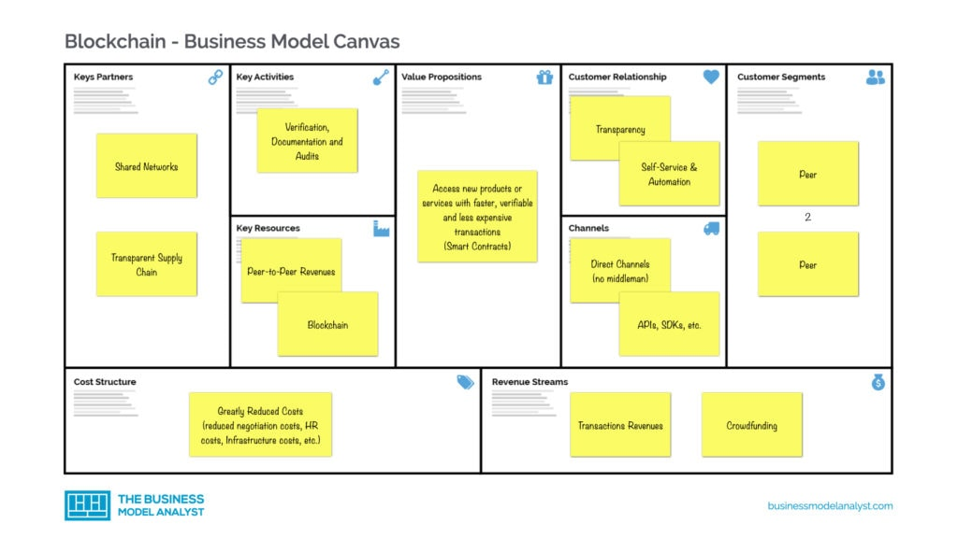

Slide 27
Tokens
Ethereum programmers can create tokens to represent any kind of digital asset, track its ownership and execute its functionality according to a set of programming instructions.
Tokens can be music files, contracts, concert tickets or even a patient's medical records. Most recently, Non-Fungible Tokens (NFTs) have become all the rage. NFTs are unique blockchain-based tokens that store digital media (like a video, music or art). Each NFT has the ability to verify authenticity, past history and sole ownership of the piece of digital media. NFTs have become wildly popular because they offer a new wave of digital creators the ability to buy and sell their creations, while getting proper credit and a fair share of profits.
Newfound uses for blockchain have broadened the potential of the ledger technology to permeate other sectors like media, government and identity security. Thousands of companies are currently researching and developing products and ecosystems that run entirely on the burgeoning technology.
Blockchain is challenging the current status quo of innovation by letting companies experiment with groundbreaking technology like peer-to-peer energy distribution or decentralized forms for news media. Much like the definition of blockchain, the uses for the ledger system will only evolve as technology evolves.

Slide 28
3 major models can be applied for the (re)insurance industry
Internal Processes
Inter-Organizations
Disruption
1
2
3
Enhance efficiency of core (re)insurance business processes
Speed-up market initiative
regarding information exchange
Create new near-autonomous
self-regulated insurance business model
Increases speed of exchange between business units/divisions, reducing overall operational costs
Enables new capabilities to be added to existing services and business processes
Managing large commercial insurance programs where different organizations assume separate layers of risks (incl. Insured-Insurer-Broker-Reinsurer transactions)
Development of a new disruptive player that leverage affinity group or peer-to-peer social insurance mechanisms to take advantage of Blockchain Smart Contracts and fund their own coverage pool
Traditional model
New model
Distribution / UW
Claims
Handling
Administration
Fraud Detection / Risk Prevent°
Insured
Insurer
Reinsurer
Capital Market
Insured
Insurer
Reinsurer
Insured
Insurer
Reinsurer
Information exchange automation
Core business process enhancement
Automated P2P Insurance
Insurance
Intermediaries
Reinsurance
Brokers
28

Slide 29
The types of Blockchain
Business Models

Slide 30
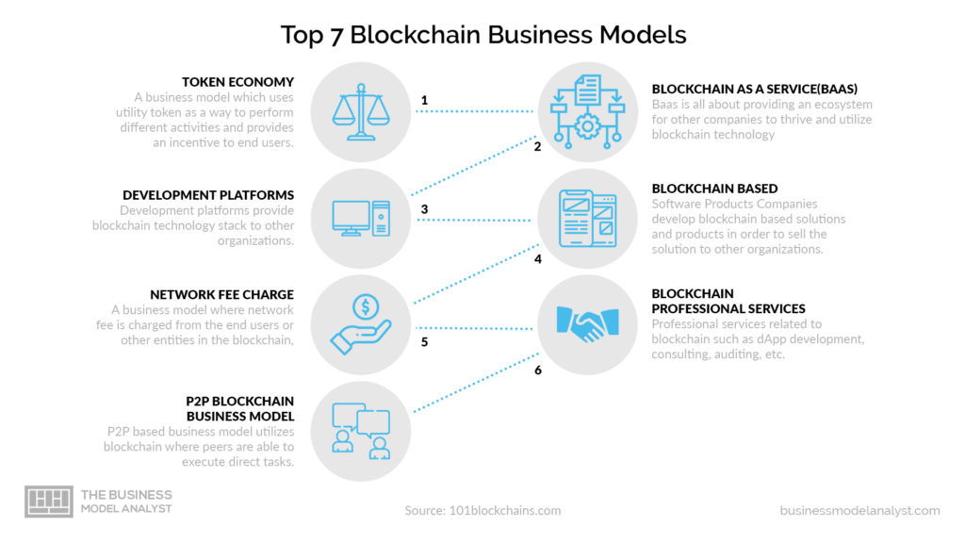

Slide 31
P2P Blockchain Business Model
As said before, blockchain technology has always been peer to peer, allowing end-users to interact with each other. The profit may be made here via tokens, BaaS (Blockchain as a Service), transaction fees, and others. Filecoin and IPFS are popular examples that use this business model, by providing a platform for data storage and sharing.

Slide 32
Blockchain as a Service Business Model (BaaS)
Blockchain technology and ecosystem can be pretty intimidating for people in general. Nevertheless, this Blockchain-as-a-Service (BaaS) business model permits the clients to outsource all the backend structure and focus only on the frontend. Blockchain Business Models - Front-End Back-End.
BaaS companies usually provide services such as user authentication, database management, remote updating, push notifications (for smartphone apps), cloud storage, and hosting. It is, therefore, one of the most popular blockchain business models, with famous operators such as Microsoft (Azure), Amazon (AWS), and IBM (BlueMix). The end-users, in this case, are not usually people, but other businesses and organizations. And they don’t have to worry about how blockchain works nor hardware infrastructure, thus allowing them to experiment, test, and conduct research.

Slide 33
Token Economy – Utility Token Business Model
The utility toke business model drives functionality into business via the use of tokens, which facilitate the network activities. Nowadays, there is plenty of startups, companies, and e-commerce websites that use the utility token business model. The token utility has three important properties: role, feature, and purpose. Utility Token Business Model Each role has its own set of features and purpose:

Slide 34
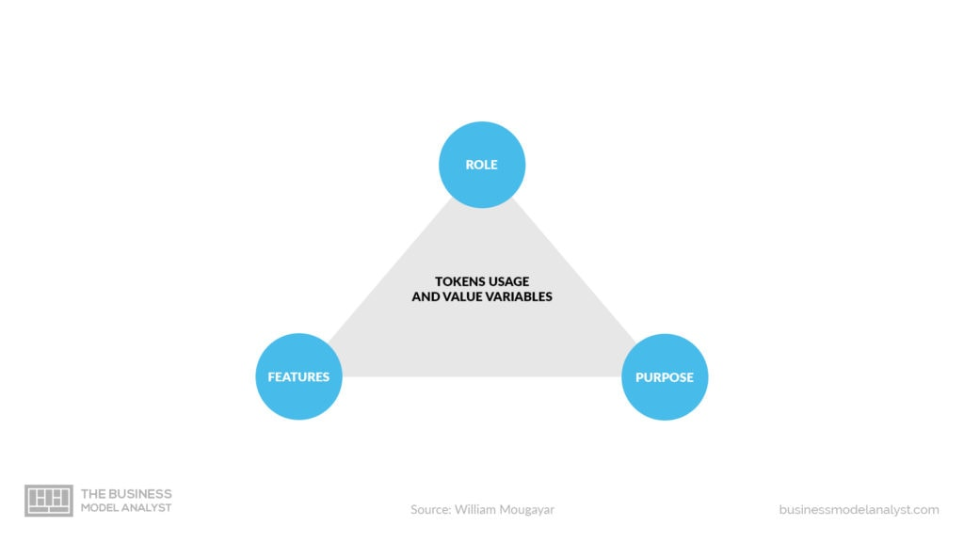
Token Economy – Utility Token Business Model

Slide 35
The rules of token business model
Right: with a particular token, the holder gets a certain amount of rights within the ecosystem.
Value Exchange: the tokens create an internal economic system that can help the buyers and sellers trade value within the ecosystem.
Toll: it acts as a toll gateway to use specific functionalities of a particular system.
Function: the token enables the holder to enrich the user experience inside a particular environment.
Currency: it is a store of value that can be used to conduct transactions both inside and outside the given ecosystem.
Earnings: it allows an equitable distribution of profits and benefits among investors in a particular project.

Slide 36
Blockchain-Based Software Products
There are blockchain companies that create solutions to be sold to bigger companies and organizations, as well as support after implementation. That usually works out fine, because the big companies don’t want to go through the process of selecting and hiring talent. It is much easier to buy a ready-made blockchain solution. Proving blockchain technology to organizations can be extremely profitable. The best example of this is the MediaChain blockchain being sold to Spotify.

Slide 37
Key characteristics of Blockchain

Slide 38
Blockchain characteristics
Digital and distributed ledgers storing signed transactions
  Transactions are stored in blocks and blocks are chained
  Double-spending mechanism
  Shared ledgers increase availability and reduce fraud risks
  Digital signature provides integrity and imputability
  Increased transparency (but no confidentiality)
Extra services
  Smart contract allowing event-based process organization
  Digital identity providing certified authentication process
  Multiple signature mechanisms

Slide 39
Benefits of use Blockchain
Transparency
  Recorded transactions
  Need to define precisely the transaction information
Collaborative network management
  Identity certification
  Cooptation process registering
Distributed BP
  Record processes interactions
  Identify “launching conditions” for each sub-process

Slide 40
Access control in Blockchain
Permissionless blockchain
  Opened and shared ledgers
  Free access for validators
  Users are identified by their avatar
  Public blockchain
Permissioned blockchain
  Authorized validators
  Restricted access to the ledgers
  Users are associated to well known identities
  Used for private blockchain / consortium blockchain

Slide 41
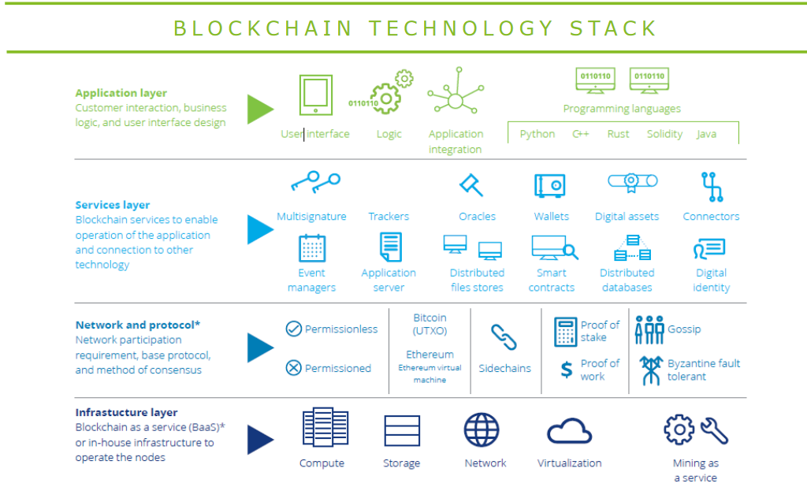
Architecture of Blockchain
Similar to the Cloud stack model . May lead to Blockchain as a Service organisation
Source: https://www2.deloitte.com/content/dam/Deloitte/in/Documents/industries/in-convergence-blockchain-tech-stack-noexp.pdf

Slide 42
What is Architecture of Blockchain ?
Infrastructure
  Computing, communication and storage features
  Mining process
    Adapted hardware
    Optimized cryptographic computation
Organisation and protocols
  Blockchain platform
  Validation strategy
  Consensus method
Services
  End user wallet system
  Trusted services: identity management, distributed files/DB, event manager, digital asset management…

Slide 43
Evolution of blockchain development
Blockchain 1.0
Blockchain2.0: Smart contracts
Blockchain3.0: Smart contracts + IoT

Slide 44


Blockchain 1.0
Easy to pay without taking care of the currency type of the country
trusted exchange
« no charge »
Heavy Carbon cost !
Various real price depending on the cryptocurrency rate
Require adding the cryptocurrency as a payment mean in the reseller information system

Slide 45
Key elements of Blockchain 1.0
First introduced as Bitcoin
Fiat currency
  P2P currency transfer without intermediaries
    But it requires miners!
  No valuable good exchange to support the crypto-currency
Transaction validation
  Solve the double spending problem
  Fees
    Use the blockchain token
    Miners choose “the best transactions” to integrate into blocks
    Paid only if the block is validated

Slide 46
Key elements of Blockchain 1.0 limits
Long delay (10 minutes for a bitcoin block validation)
  Scalability problem
Identity management
  Identity related to a key
  No proven links between the real identity and the avatar
Security risks
  Internal byzantine fault
  Lossing private key
Crypto-currency
  No legal status for the tokens
  Crypto-currency isolation: no exchange mechanisms between different currencies
  Highly volatile value due to speculation of the main actors

Slide 47
Blockchain 2.0
Define once the ordering conditions and do not take care after that
Choose your own trusted sources to define the contract launching conditions
The contract will be automatically launch depending on external context
Only 1 shot contract
Your reseller will have to establish the contract and its connection with its IS
The smart contract has a registration cost and the carbon cost may be heavy
P2P trusted organization which does not allow multi-tenant contract

Slide 48
Key elements of Blockchain 2.0
First implementation in Ethereum
Smart contracts
  Distributed application
  Contract based organization
  Event driven
  Integrates the transaction payment
Distributed application
  Open-source
  Manage its own tokens
  Automated transaction execution
  Data and operations are stored in the blockchain

Slide 49
Key elements of Blockchain 2.0 limits
Smart contract legal status
  Computarized transaction and not a contract
  How parties identity can be proven?
  How to be sure of the capacity of the contracting parties?
  Different regulations depending on the hosting countries
Event driven organization
  Allows reactivity
  Different organization than the traditional control driven logic
“Code is law”
  Code cannot be adapted even in case of failure
  Increased security risks
Blockchain delay and scalability?

Slide 50
Blockchain 3.0
Fully trusted and distributed process organization
Totally new and distributed collaborative and trusted organization
Block registration cost, carbon impact
Change the application design model
Limited to P2P organizations and requires to set the collaboration chain separately

Slide 51
Key elements of Blockchain 3.0
Designed to overcome Blockchain 1.0 and 2.0 main limits
  Lack of scalability
  Lack of interoperability
  Lack of sustainability
  Off-line governance strategy lack of transparency
Main characteristics
  Blockchain middleware approach
  New on line governance strategy
    Scalable validation processes
  Integration of private blockchain requirements and characteristics
  Sustainable block management
  IoT integration

Slide 52
Blockchain hype cycle: Reduced community
Single use
  Blockchain provides a less expensive solution
  Focused solution
  Used to certify and store transactions in a distributed ledger
  Example: micro-payment
Localisation
  Reduced business community
  High novelty
  Mostly FinTech applications
  Example: NASDAQ management

Slide 53
Blockchain hype cycle: large community
Substitution
  Blockchain technology replaces traditional ones
  Use basic blockchain characteristics
    Immutability
    Availability
  Most applications are related to
    Certification (diploma, shipment documents…)
    Exchange (gift cards…)
Transformation
  Rethink applications to fit the digital transformation
  Heavy use of smart contracts
  Example: collaborative and shared economy (energy P2P exchange…)

Slide 54
Blockchain key principles: Previous works
Time-stamped information
  Digital signature including a time-stamp (1991)
  Use hashing techniques
Merkle tree (1979)
  Store hashed information
  Binary tree organization
  Merging blocks involves computing new hash associated to the “father node”
Strong cryptographic foundation but
  How can the Merkle tree be stored
  How to protect it from attacks

Slide 55
Blockchain key principles: characteristics
From transaction to blockchain
  A block stores
    transactions data
    The previous block hash
  A Merkle tree stores the blocks
    Each block is signed with a hash
Decentralized storage of the Merkle tree
  Distributed ledgers
    Safer storage
  Common governance rule
    How to trust the block validation process

Slide 56
Blockchain key principles: governance rules
Proof of Work (PoW)
  Block’s hash is computed according to a mathematical challenge
    Finding the “nonce” in a bruteforce way
  Requires important computing resources and energy
    Trust depend on the hardware investment and on the “consumed” computing resources
Proof of Stake
  Validator is randomly chosen according to the invested currency
  Avoid heavy computation
    Involves less speculation
Proof of Authority
  List of potential certified validators
  Reputation mark

Slide 57
Using blockchain in business

Slide 58
Using blockchain in business
How does blockchain work for business?
Replication: Once a block — the record of an event — is approved, it is automatically created across the ledgers for all participants in that channel. Every network partner sees and shares a single “trusted reality” of the transactions.
Immutability: More blocks can be added, but not removed, so there is a permanent record of every transaction, which increases trust among the stakeholders.
Security: Only authorized entities are allowed to create blocks and access them. Only trusted partners are given access permission.

Slide 59
Using blockchain in business
Applications of blockchain for business. Across industries around the world, blockchain is helping transform business. Greater trust leads to greater efficiency by eliminating duplication of effort. Blockchain is revolutionizing the supply chain, food distribution, financial services, government, retail, and more.
Blockchain ensures safer food. We all eat - and we’ve all had second thoughts about food safety or freshness. What if we could replace those doubts with visibility into every step from farm to fork? Many companies are now doing just that, sharing and using data from IBM Food Trust™, built on the IBM Blockchain Platform.

Slide 60
Using blockchain in business
Applications of blockchain for business. Blockchain tracks every step in shipping. Think of everything you’ve used today. How did it get here? Today’s supply chain is a complex network of relationships, scheduling, systems and data. Even the smallest error can lead to delays that have tremendous ripple effects.
Blockchain spreads trust everywhere. Whether it’s between people or organizations, relationships flourish when there’s more trust. From jewelry to insurance to food, IBM Blockchain can elevate that trust to an entirely new level by helping parties transacting together validate and share immutable transaction records on a private, distributed ledger.
https://www.ibm.com/topics/blockchain-for-business

Slide 61
Using blockchain in business
Examples of industries that benefit from using blockchain
Blockchain's benefits span industry sectors, but some sectors and enterprises are better suited to this technology than others. Businesses that are decentralized by definition, have multiple parties that need access to the same data and need a better way to ensure that data has not been tampered with are piloting programs or brought test cases to full production. The following are a few examples of industries benefiting from blockchain.
Financial institutions -- and their customers -- are seeing faster and less-costly clearing and settlement.
Healthcare entities are finding that blockchain can ensure the security of patient records and to maintain patient privacy while also enabling the ability to share a patient's data only as the patient allows.
Nonprofits and government agencies have adopted smart contracts and other blockchain-based applications to create immutable records that enforce stipulated terms.

Slide 62
Using blockchain in business
International trade and blockchain system
How does foreign trade benefit from blockchain?
Blockchain enables data to be recorded in a secure digital format by providing real-time information on transactions between different parties, be they corporations, supplier networks, investment pools, or an international supply chain.
It provides all parties with a record that is secure, encrypted, transparent, easy to access, and impossible to tamper with. Although blockchain emerged within the financial system with the launch of cryptocurrency Bitcoin, today it is used in a wide range of activities, including ones that are directly or indirectly related to foreign trade.
The long value chain tied to international trade includes vast, complex areas like logistics, transportation, customs administration, financing, and administrative procedures between firms, all of which could be streamlined by adopting this technology.

Slide 63
Using blockchain in business
International trade and blockchain system
How does foreign trade benefit from blockchain?
Blockchain optimizes processes, makes goods traceable, guarantees the security of payments and financing, facilitates the verification of digital quality and origin certifications, enables real-time sharing of information on the different stages of trade, and helps improve how related public and private services operate, among other benefits.
Blockchain provides solutions for trade operations by simplifying cross-border trade, contributing to competitive improvements, and reducing transaction costs. Although blockchain has been used within foreign trade for several years, its significance has increased since the start of the COVID-19 health crisis and it is expected to play an even more prominent role in the post-pandemic world.

Slide 64
Is there money to be made with blockchain technology?
Even though the initial hype surrounding blockchain applications, and the prolonged blockchain “winter” that followed, are beginning to settle, this is no time to rest on our laurels. IT leaders must prepare for the inevitable blockchain tech “spring” on the horizon, bringing with it core-enabling technologies and significant opportunities for digital business.
By 2023, blockchain will support the global movement and tracking of $2 trillion of goods and services annually.

Slide 65
Why (re)insurers care about blockchain?
Blockchain enables secured peer-to-peer transactions without “trusted central authority”
Peer-to-Peer relationship
Transparency
Security
Disintermediation
The focus shifts from information held by individual entities to information saved in a secured book shared across all verified members of the network
The trust generated by the blockchain process allows to achieve cross-organizational transactions without “trusted central authority”
All verified members of a blockchain network can have an access to the whole set of transactions that occurred since the blockchain creation
Since the blockchain is also immutable, this transparency property makes it easily auditable
The transaction validation process is based on cryptographic methods
The decentralized architecture is a security since every transaction needs to be validated by more than half of the blockchain network
Every slightest modification on the blockchain enhances the modification of all the following elements (blocks) of the blockchain, thus making it instantly detectable
A blockchain implementation can be disruptive by removing the cost of “trusted central authority” recordkeeper intermediary and thus redefining the traditional boarders of organizations and markets
65

Slide 66
References
Business analysis life cycle & IT- business analyst: Role in traditional, digital and agile world kindle edition by Subramanyam Gunda (Author) Format: Kindle Edition ASIN ‏ : ‎ B085X3CCSQ Publication date ‏ : ‎ March 13, 2020.
Milani Fredrik. Digital Business Analysis. Springer, 2019. - 432 р. - ISBN 978-3-030-05719-0.
Cadle James, Paul Debra, Turner Paul. Business Analysis Techniques: 99 essential tools for success . 2nd Edition BCS, The Chartered Institute for IT, 2014. - 356 p. - ISBN-10: 1780172737; ISBN-13: 978-1780172736.
Wirtz, B. W. (2018a). Business model management: Design-Instrumente - Erfolgsfaktoren (4th ed.). Wiesbaden: Springer Gabler.
Wirtz, B. W. (2018b). Electronic business (6th ed.). Wiesbaden: Springer Gabler.
Zott, C., Amit, R., & Massa, L. (2011). The business model: Recent developments and future research. Journal of Management, 37(4), 1019–1042
Bernd W. Wirtz. Digital Business Models.Concepts, Models, and the Alphabet Case Study. ISSN 2196-8705. Progress in IS. ISBN 978-3-030-13004-6.

