Slide 1
Digital business models
Lecture 8. Digital Platform as a business model
DSc.Takhir Kuchkarov

Slide 2
CONTENT
What is the platform business model ?
The types of platforms
Advantages and benefits of the platform business model
How to create a platform business model ?
Key skills to create successful platform team

Slide 3
What is the platform business model ?

Slide 4
The main aim of Digital Platforms
The main aim of Digital Platforms is to enhance the collaboration between end-users and producers to transact with each other.
These platforms enable users to share different information like new products and services and connect the platform's ecosystem.

Slide 5
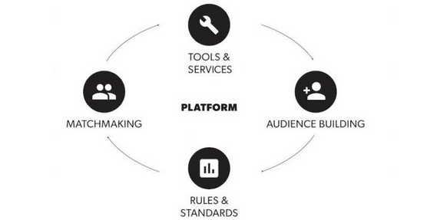
The four functions of the platform business model
https://www.applicoinc.com/blog/what-is-a-platform-business-model/

Slide 6
What is the platform ?
A platform is a combination of culture, services, data, and technology through which additional innovation and value can be delivered quickly and efficiently.
Platform economics is an economic and social activity facilitated by platforms.
Platform economics, also referred to as digital platform or online platform economics, is an economic (purchase, sale, and exchange of goods and services) and social activity facilitated by platforms.
Such activities cover not only commercial operations but also a wider range of activities, such as online collaboration on projects such as Wikipedia.

Slide 7
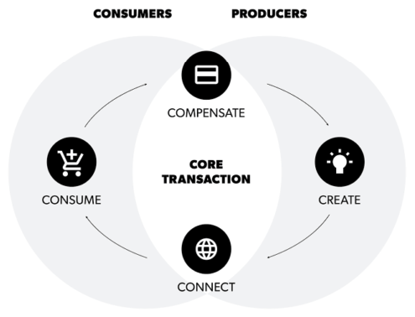
The four steps of the core transaction
https://www.applicoinc.com/blog/what-is-a-platform-business-model/

Slide 8
What is the platform ?
Platforms form a marketplace that’s very different from the traditional fixed and linear value chains familiar to traditional companies.
They generate value by bringing together and connecting the key actors of customers, producers and providers (ecosystem partners), facilitating interactions and transactions in a multi-sided model to create a network effect.

Slide 9
What is the platform business model ?
The term platform first began to be used in the second half of the 20th century, and later in the 2000s as a digital space for wider businesses to find each other.
Especially after the 2008 financial crises, companies operating under a new “platform business model” began to gain a major share of the world’s business activity, sometimes by ending traditional business activities.

Slide 10
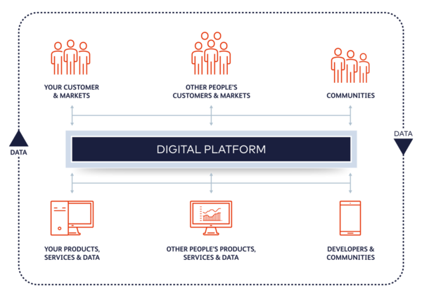
What is the platform business model ?
https://www.beyondnow.com/en/insights/market-insights/how-to-adopt-a-digital-platform-business-model/

Slide 11
What is the platform business model ?
Platform business model definition: A business model that creates value by facilitating exchange between two or more interdependent groups, usually consumers and producers. Like Facebook, Uber, or Alibaba, these companies do not create or control inventory directly through the supply chain, as linear companies do.
Platform businesses have been growing in the past number of years. Unlike traditional product based business models, platform businesses don’t create and sell a products for consumption, they are more akin to a service provider that facilitates activities or interactions on its platform and derives economic benefit through advertising, usage fees, access fees, leveraging the data or some other method of monetization. Platforms also leverage network effects, meaning that the more users on the platform, the better it gets.

Slide 12
What is the platform business model ?
The platform model, also known as peer-to-peer, or two-sided marketplace, is a digital business model in which a provider creates a digital space to connect third-party buyers and sellers.
How It Works: The customers are happy because they have access to a variety of sellers, and vice versa. Meanwhile, the business that provides the platform service makes a profit from transactions, subscriptions, and advertising.
Benefits: The model offers great scalability potential. In addition, if the platform is successful it can be developed further with additional relevant services.
Furthermore, the provider doesn’t need to make a large investment because they don’t supply and/or manage any products.
Setbacks: You need to balance demand and supply to maintain a sustainable system. If you have many customers but few sellers, or vice versa, you will see people leave.
Examples: Some good examples of platform model success are Amazon, Uber, and Airbnb.
Versions: A specialized version of the platform model is the user-generated content model – customers contribute with content that is consumed by other customers.
Examples of the UGC model are YouTube, Wikipedia, TikTok, etc.

Slide 13
What is the digital platform ?
A digital business technology platform provides the architecture to allow software engineers to build initial capabilities and add to them over time as business needs and technology change.
The digital platform is a new business model for the digital economy, a system consisting of a stable core and a changing periphery that provides businesses and the public with various market services. During the operation of the platform, several interest groups are combined, while the usefulness of the product or service provided on the platform increases in proportion to the increase in the number of participants. The platform acts as an intermediary representing the interests of all parties

Slide 14
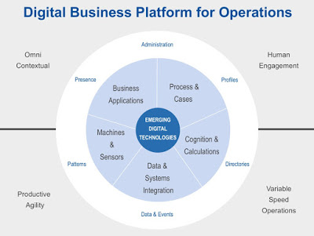
https://www.businessprocessincubator.com/content/predictions-for-digital-business-platforms-2018/

Slide 15
The concept of a platform business model
The concept of a platform business model is not all that new. Think about a shopping centre that provides you with access to several retailers, car parking, restaurants and other services. You are not charged for admission to the centre but the centre charges rent to the retailers and services providers that operate within. This model uses primarily a brick-and-mortar approach to enable customer exchanges. Today, platforms are powered by digital technology infrastructures allowing them to scale globally, serve a larger number of users and leverage data analytics to improve the platform.

Slide 16
The concept of a platform business model
A platform business model is a plan for creating revenue by allowing registered members to create content that can be consumed by a specific user group or general audience.
The platform business model differs from the traditional pipe, or linear business model, in which a company relies on its own resources to deliver a product or service to customers. Some common characteristics of a platform business model include:
Allowing users to both create and consume value. You Tube is a good example of this trait, as users are able to view video content and comment on it, as well as produce video content for others to consume.
Providing open APIs that give external developers the ability to expand the platform's functionality by allowing various application programs to interact and share data.
Creating an ecosystem that encourages registered users and content consumers to add more value to the platform by repeatedly creating more content which will, in turn, attract additional content creators and consumers.

Slide 17
What is a Platform Business Model?
The differences between traditional and platform business model. A traditional, linear business takes in raw materials/components, creates products or services and sells them to its customers. A linear business owns its own inventory.
In contrast, a platform business facilitates value exchanges between two or more interdependent groups, usually consumers and providers. Platform businesses can be both physical and virtual (AliBaba, eBay). Platform businesses are a valid in B2B, B2c and public and private sectors.

Slide 18
What is a Platform Business Model?
In platform businesses, providers both get value from and give value to the platform, and consumers do the same. Platforms can have many more than two sides. For example, Facebook has at least four: it connects users, third-party application developers, advertisers and third-party websites.
Platform businesses exist in a platform ecosystem. The ecosystem consist of the value exchanges that are taking place; the space for conducting platform business; the players who participate; the rules by which platform business is conducted; and the tools which are available to those players. Businesses and individuals participating in a platform ecosystem benefit from network effects where the value of the platform goes up the more participants use it. Platform business ecosystems are most valuable in a market where there are lots of players.

Slide 19
What is the platform model ?
The platform model, also known as peer-to-peer, or two-sided marketplace, is a digital business model in which a provider creates a digital space to connect third-party buyers and sellers.
How It Works: The customers are happy because they have access to a variety of sellers, and vice versa. Meanwhile, the business that provides the platform service makes a profit from transactions, subscriptions, and advertising.
Benefits: The model offers great scalability potential. In addition, if the platform is successful it can be developed further with additional relevant services.
Furthermore, the provider doesn’t need to make a large investment because they don’t supply and/or manage any products.
Setbacks: You need to balance demand and supply to maintain a sustainable system. If you have many customers but few sellers, or vice versa, you will see people leave.
Examples: Some good examples of platform model success are Amazon, Uber, and Airbnb.
Versions: A specialized version of the platform model is the user-generated content model – customers contribute with content that is consumed by other customers.

Slide 20
The types of platforms

Slide 21
The core value being exchanged is (by platform business type)
Services marketplace: a service
Product marketplace: a physical product
Payment platform: payment (P2P or B2C)
Investment platform: investment (money in exchange for a financial instrument, be it equity or a loan, etc.)
Social networks: a network in which the core transaction is a double opt-in (friending) model of interaction
Communication platform: direct social communication (e.g., messaging)
Development platforms
Closed development platform: software built across access to data (usually via an API)
Controlled development platform: software built in a controlled, integrated development environment
Open development platform: open-source and free software
Content platforms
Social: a content platform in which the core transaction focuses on the discovery of and interaction with other people
Media: a content platform in which the core transaction focuses on discovery of and interaction with media
Social gaming platform: a gaming interaction involving multiple users, either competing or cooperating

Slide 22
What are the different types ?
Platform businesses are becoming increasingly integral to business value creation. However, not all platforms are created equal, with some platforms having far more potential to trigger powerful forms of increasing returns that will ultimately marginalise other forms of platforms. It’s important to understand not just the structure, but the dynamics, of different kinds of platforms.

Slide 23
Types of Platform Business Models
Aggregation platforms. They bring users together and facilitate the exchange of goods, services or information, such as eBay and Eats. Aggregation platforms tend to be transaction or task oriented. The platform facilitates user transactions and generates revenue through transaction fees or platform access fees.
Social networking platforms. (Facebook, Instagram, Twitter, YouTube etc.) aggregate users, but not purely for the goal of transaction. They facilitate user interaction (rather than transaction) and they may generate revenue via advertising. Social platforms tend to foster engagement and relationship building between users in a semi-mediated fashion rather than fully orchestrating the interactions for the purpose of creating transactions. In the case, the social platforms goal is to increase the size and activity of its user base by creating a platform that gives value to users as they use it and encourages them to use it more often.

Slide 24
Types of Platform Business Models
Mobilization platforms. These platforms encourage users to collaborate and thus achieve outcomes beyond what an individual could achieve alone. Mobilization platforms tend to encourage non-transactional long-term relationships among users. These are ideal in a B2B context to foster collaboration among your employees, business partners or even customers to solve challenges. For example, Netflix wanted to improve the accuracy of its recommendation engine and used crowdsourcing to mobilize individuals/teams from the general public to suggest ways to achieve this.
Learning platforms. Similar to mobilization platforms, these foster user collaboration and learning over time. For example, Learning Management Systems (LMS) and intranets allow employees to share their knowledge, gain skills, teach each other and learn from your organization.

Slide 25
Main four types of digital platforms
1. Transaction platforms that provide transactions between different groups of individuals and organizations. Examples are Uber, Amazon, eBay.
2. Innovative platforms consisting of technological blocks, on the basis of which a huge number of innovators build secondary products and services. These secondary innovators can be anyone around the world. Together they are part of the platform ecosystem. Because of this, such platforms have an impressive ability to stimulate innovative development. Examples are Android, IOS, Linux, etc.
3. Integration platforms, consisting of a technology, product or service that perform the functions of both transactional and innovative platforms. Examples are App Store, Play Market, etc.
4. Investment platforms, consisting of organizations that have developed investment vehicles and act as either holding companies or active investors, or a combination of these functions. The most famous is Kick starter.

Slide 26
Three Archetyral Platform Business Models
Exchanges. Value emphasis = filtering and matching. These enable buyers and sellers to meet. Dating agencies and online auctions are good examples. The value that is provided by the platform is the bringing together of the parties, helping them find each other, establishing the ground rules of exchange.
Transaction platforms. Value emphasis = removing friction and de-risking. These are similar to exchanges but focus mainly on providing the mechanics for transactions to take place. In a very rudimentary sense, cash itself is a transaction platform; credit cards are perhaps a clearer example.
Component and tool-rich platforms such as software platforms. Value emphasis = faster and higher-quality product creation. These platforms use standards to make sure everything fits together, and building blocks that can be used to quickly create a solution. Microsoft Windows was very helpful to developers when it came along because they didn’t have to create their own methods of displaying windows, managing mouse movements and so on. It was also very helpful to PC users, because it meant that anything written to work with Microsoft Windows would work on their Windows PCs.

Slide 27
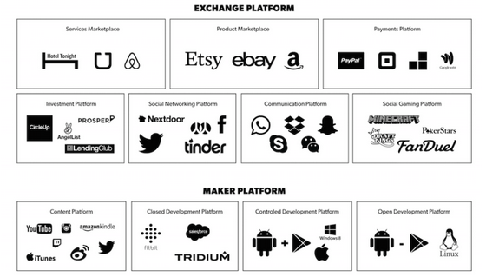
https://www.applicoinc.com/blog/what-is-a-platform-business-model/

Slide 28
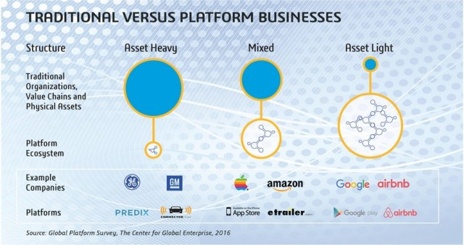
https://platformbusinessmodel.com/platform-business-model-meaning/

Slide 29
Howe its works ?
While traditional product based business models create value by transforming raw materials into finished products for sale or by performing a service directly for the customer, platform business modules are a little different. Rather than focusing on generating revenues from producing and selling goods/services on a transactional basis, the platform business model facilitates valuable connections among users. A platform business may still produce products but they can differentiate themselves by providing an additional layer of value for customers. For example, Nike traditionally sell trainers and sports apparel however using the power of IoT sensors and cloud connectivity, Nike customers can track their run times and compare their performance against other users via Nikes platform. Thus Nike operates a hybrid module blending its products (athletic apparel) with its platform to provide value for customers. Still unclear about platforms? Let’s look at some more examples to illustrate.

Slide 30
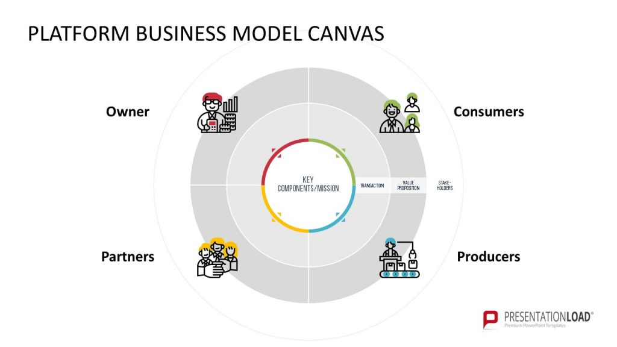
https://blog.presentationload.com/platform-business-model-canvas-ppt/

Slide 31
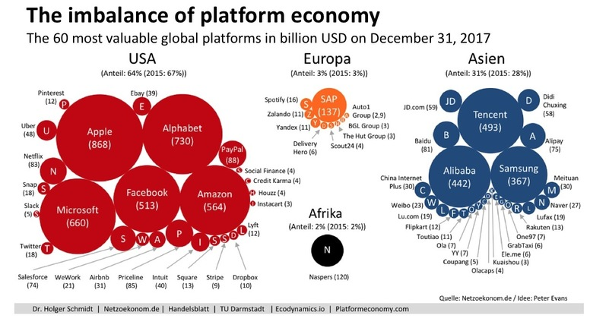

Slide 32
Advantages and benefits of the platform business model

Slide 33
Advantages of the platform business model
The platform business model is particularly compelling because it converts traditional, linear value chains into multi-dimensional value networks and ecosystems. Platforms are flexible and scalable: it’s a more streamlined approach, not only do businesses save on time, they also reduce the possibility of errors.
Platforms also allow a seamless exchange of data. That data can be aggregated and mined for insights and innovation and to generate incremental revenue streams. By collecting data sets around consumer and industry trends, the platform allows users to analyze and ultimately predict and plan for new products.

Slide 34
Benefits of a digital platform
Digital platform has its benefits such as creating new products & services, promotes revenue, enhance profitability and customer experience, operational improvement, reduces cost, fosters collaboration and innovation, faster movement of products to the market.

Slide 35
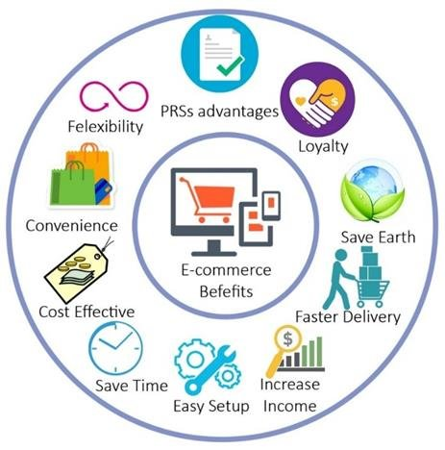
The benefits of online business based on e-commerce platform
https://www.researchgate.net/figure/The-benefits-of-online-business-based-on-e-commerce-platform_fig1_342222975

Slide 36
Benefits of a platform
Platforms have allowed small businesses and start-ups to disrupt major business segments even though the more established businesses had more resources (physical assets, raw materials, etc.), that had traditionally been the predictors of success, than the new businesses. Facebook doesn’t create most of the content on its site, but it attracts 1.3 billion users who regularly consume the news, videos and photos shared on the platform. Uber doesn’t really own any cars, but it’s overtaking the taxi business across the United States. Alibaba doesn’t own a piece of inventory, but it’s a global marketplace.

Slide 37
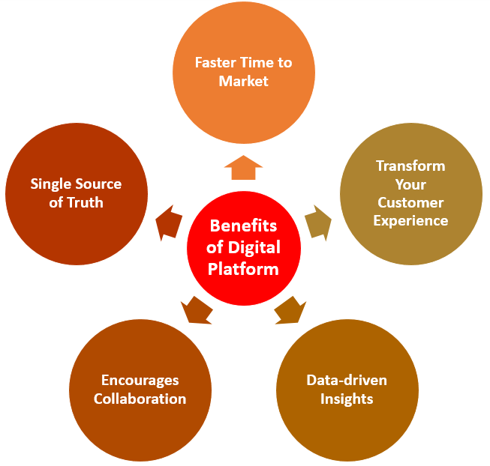
Benefits for Considering A Digital Platform for Business
https://www.credencys.com/blog/what-is-a-digital-platform/

Slide 38
Benefits of a platform
The platform approach is all about figuring out a way that an external ecosystem can be leveraged to do the work and create value. Today, many of the problems that can be automated already have been, so the next way to gain a competitive advantage is to leverage the ecosystem you create on a platform. The better your ecosystem is at creating value, the more successful your business will be.
Platforms have tremendous power because they can unlock new supply and demand streams, eliminate gatekeepers and provide valuable connections to a community to gain insight. Whereas in the 20th century an organization's ability to leverage production efficiencies via economies of scale propelled success, in the 21st century it is creating “demand economies of scale” that use technological improvements to create bigger networks and more value for users. The more valuable a network/platform to the end user, the more successful it becomes.

Slide 39
How to create
a platform business model ?

Slide 40
Howe to create a solid platform strategy
How will your platform support the exchange of value?
How will you attract and drive users to your platform?
How will your platform encourage interactions to become the core of a community that connects people and adds value?

Slide 41
How do create a platform business model ?
1: Understand the overall market size. ...
2: Develop a Customer Value Proposition. ...
3: Develop a monetisable Customer Value Proposition: Value proposition for advertisers. ...
4: Attract participants to your App / Multi-sided platform (MSP) ...
5: Develop the inner workings: network effects (NWE)

Slide 42
10 Steps to Building a Digital Business Technology Platform
Vision and capabilities. The organization’s digital ambitions translate into a digital vision and supporting capabilities for delivering value to customers. You’ll need to decide on the capabilities, the order in which you plan to develop them and the timeline over which you’ll progress. Sequencing helps set the expectation that this is a long-term, multi-part journey, the first major destination along which is a minimum viable product (MVP) that demonstrates progress and allows you to test that the DBTP works.
Sequenced goals. Define the diverse metrics to measure success. Some will be traditional enterprise key performance indicators that quantify operational or financial performance improvement; others will be digital business metrics that indicate progress toward the organization’s ambitions.

Slide 43
10 Steps to Building a Digital Business Technology Platform
Multi-year budget. Digital business is not a project that begins and ends, but a capability that needs to be funded every year. The Gartner 2020 Building Digital Platforms Survey finds that 80% of companies with more than $5 billion in revenue spend more than $5 million a year on digital business software and professional services. Ninety percent of companies with $1 billion to $5 billion in revenue spend more than $2 million annually.
Create organization. Seventy-five percent of global companies have at least 50 people working on their digital business platform. These are cross-functional teams that include software architects, cloud experts, data analysts and business application specialists, among others. Only 45% of organizations place the DBTP team under the umbrella of IT. Assign in-house people who are willing to up skill to develop the capabilities you need, and supplement with external resources.

Slide 44
10 Steps to Building a Digital Business Technology Platform
Engage service provider. Almost 100% of organizations work with a service provider to develop their DBTP. Organizations commonly use providers to help select technology (70%), define ambition (66%) and for long-term development and maintenance (64%).
Plan for skills development. Service providers eventually leave, and when they do, in-house teams need to be prepared to take over. Start by inventorying the needed skills, how many people need them and by when, and where in-house gaps lie. Decide which skills you will train and which you need to hire, and build ongoing development and learning into employees’ weekly work rhythms.

Slide 45
10 Steps to Building a Digital Business Technology Platform
Select technologies. Organizations that report greater success realizing their digital business ambitions use a larger number of new technologies and methods. Examples include cloud-native application architecture, Agile/DevOps application development methods, event-driven architecture, and so on. Most DBTPs are built in the cloud, partly to minimize upfront costs and allow the platform to go live quickly with limited budget. Costs increase as the capabilities (and value) increase.
API and integration strategy. The variety of applications systems and technology capabilities that flow into and out of the DBTP requires effective and secure integration. Many organizations achieve this with a mesh app and service architecture (MASA), which includes an outer layer of APIs to connect to user-facing applications and manage traffic, and inner APIs to connect application systems and micro services to each other inside the platform.

Slide 46
10 Steps to Building a Digital Business Technology Platform
Develop and deploy the MVP. Once the architecture is set, the teams can begin building the capabilities. You may assign feature sets and stories to different groups to work on simultaneously. Prioritize capabilities that can be developed and tested quickly under real-world conditions — even before the team has developed a complete MVP.
Scale and expand. With the value proven, the team can build out the platform capabilities defined as critical for fulfilling the organization’s digital ambition. Regularly revisit and redefine the ambition and related capabilities to adapt to changes in the market. Relevant technologies will also improve, exposing the need to revise aspects of the original architecture.

Slide 47
How do create a platform business model?
Exchange of value
How will participants in your platform benefit from others in the platform? Essential to a successful platform is determining how your platform will create and capture value.
Attract and drive users to your platform
Users won’t come to a platform if it doesn’t have value, and if you don’t have people coming to your platform it will fail. Just imagine what Uber would be without multiple drivers available to respond to many people’s needs for rides. To overcome the “chicken and the egg problem,” you should focus your mindset on “seeding” users to a platform, as this is the most critical step to platform success.
Encourage interactions
A successful platform needs to encourage interactions between participants on the platform—consumers and those who can provide the goods, services or information those consumers want and need. Your goal is to make it THE place where consumers meet and commerce happens. In order to preserve value and an exemplary experience, you will ultimately need to develop some governance policies.

Slide 48
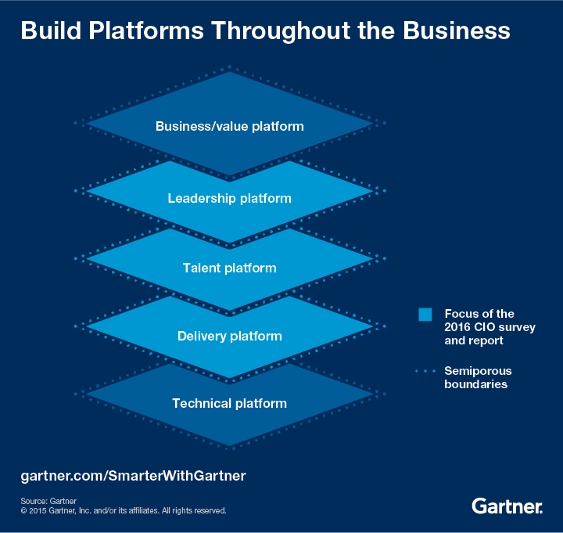
https://www.gartner.com/smarterwithgartner/digital-business-means-platform-business

Slide 49
Three building blocks of successful platforms
The Toolbox creates connection by making it easy for others to plug into the platform. This infrastructure enables interactions between participants.
The Magnet creates pull that attracts participants to the platform with a kind of social gravity. For transaction platforms, both producers and consumers must be present to achieve critical mass.
The Matchmaker fosters the flow of value by making connections between producers and consumers. Data is at the heart of successful matchmaking, and distinguishes platforms from other business models.

Slide 50
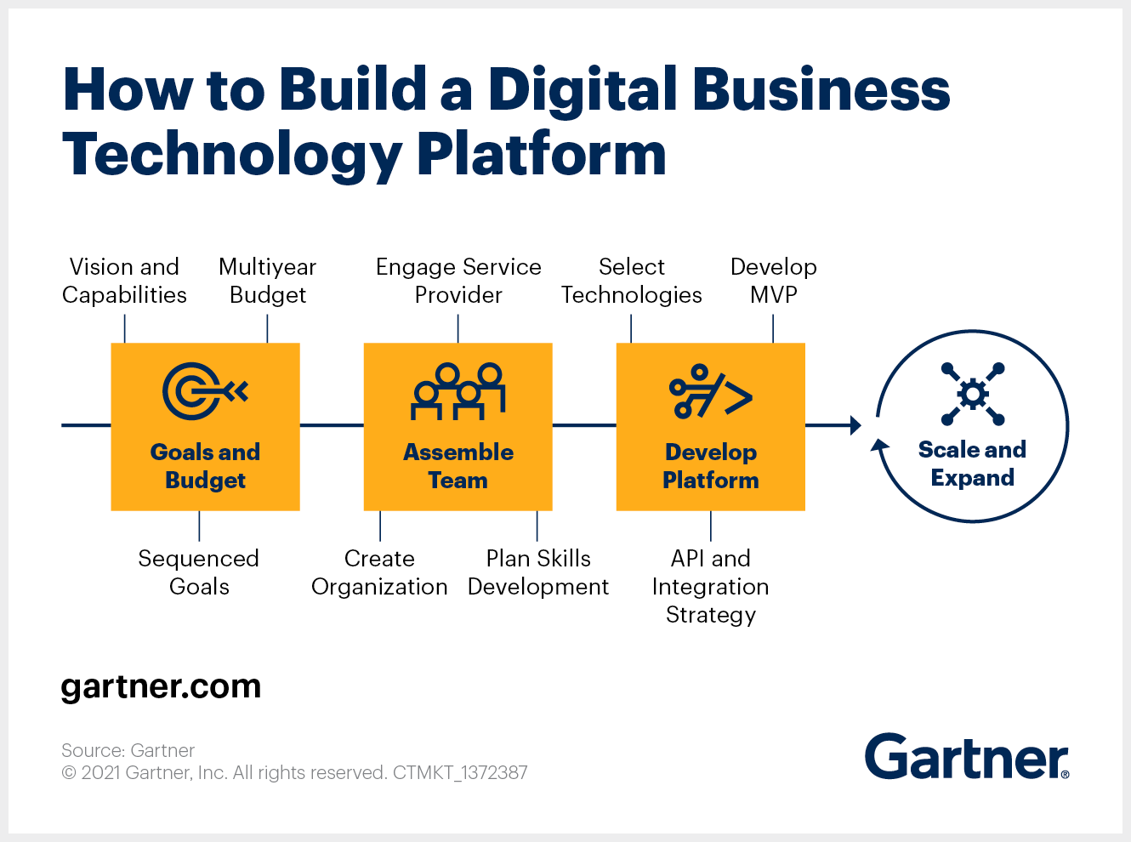

Slide 51
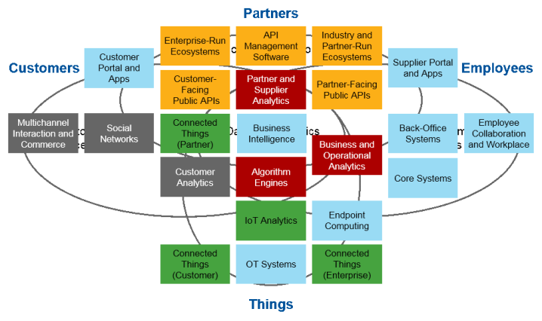
The complete digital business technology platform
https://sameerdhanrajani.wordpress.com/2017/03/31/how-to-build-a-digital-business-technology-platform/

Slide 52
Platform business model Examples
AirBnB: AirBnB does not own hotels or guest houses, rather it provides an exchange platform on which users can find accommodation or provide access to their accommodation. AirBnB generates revenues by charging a fee for this transaction.
Amazon/EBay: Do you want to buy a book, golf clubs, a dining room table or even a car. Peer to peer sales platforms such as Amazon, EBay or Facebook marketplace allow users to sell and buy their goods on the platform. Many of these platforms charge a transaction fee and even provide additional services such as warehousing and distribution of products.
Facebook: One of the most well known and successful platform businesses, Facebook allows users to share content, view other users profiles, chat with other users, list their business, manage event registrations and much more. Facebook generates revenues from advertising.

Slide 53
Platform business model Examples
Hubspot: Hubspot may have started as a product based software as a service (SaaS) business in 2006 but it is shifting toward a platform model. Rather than limiting their products functionality based on what their engineers could develop, Hubspot opened its doors for other developers to create apps that work alongside Hubspot's core products and now have an extensive marketplace of apps available. By allowing these integrations, Hubspot’s users get more functionality and value from Hubspot while some developers charge a fee for use of their app/integration.
Waze: Waze provides mobile navigation assistance but also uses crowdsourcing to allow users to submit their own data and improve the experience for all other users on a similar route. If you are walking or driving and see a road diversion or a car stalled in a lane, you can submit this to Waze who will feed that information to other users in the vicinity. Waze heavily leverages network effects, as more users use the platform, Waze improves the experience for other users thus giving it a competitive advantage over traditional navigation devices.

Slide 54
Key skills to create
successful platform team

Slide 55
Main skillsets needed in a successful platform team
The Visionary: This person is a strategist who will assess market conditions and the competitive landscape and formulate your platform strategy. They will push forward the strategies implementation with road maps and milestones that are appropriate for both your market and technology situation.
The General: This person is a platform manager will possess multi-disciplinary skills needed for the operations or daily running of the platform. The will be skilled in people management, project management, stakeholder management, finance and have a reasonable technical grounding to be able to collaborate with platform engineers, developers etc.

Slide 56
Main skillsets needed in a successful platform team
The Shepard: This person is an ecosystem manager who will establish, manage and grow your external network of partners, developers, users etc. who make up your ecosystem. They must be able to be a bridge between your organizations internal strategy and its relationship with the external eco-system who either use your platform or build upon it to contribute to your success.
The Builder: No technology based platform would be possible without engineers to plan, develop and maintain the technical aspects of your platform. Experience into open source systems will be eye. Soft skills are also key as this person will be responsible for working closely with the ecosystem manager and key ecosystem users/contributors to ensure the platform growth is supported.

Slide 57
Main skillsets needed in a successful platform team
The Data Whizz: This person is the data manager who will create, maintain and leverage a robust information systems infrastructure in your organization. It is said that data is the new gold and this person will create and operate your gold mine. They will also install data governance internal into the firm.
The Protector: This person is a privacy and compliance manager who will remain aware of the regulatory landscape and ensure your organization is compliant. Key compliance areas will include defending against platform misuse by users/contributors, defending against cybercrime/hacking, ensuring user data is secured and helping the eco system manger to build trust among the network.

Slide 58
References
Business analysis life cycle & IT- business analyst: Role in traditional, digital and agile world kindle edition by Subramanyam Gunda (Author) Format: Kindle Edition ASIN ‏ : ‎ B085X3CCSQ Publication date ‏ : ‎ March 13, 2020.
Milani Fredrik. Digital Business Analysis. Springer, 2019. - 432 р. - ISBN 978-3-030-05719-0.
Cadle James, Paul Debra, Turner Paul. Business Analysis Techniques: 99 essential tools for success . 2nd Edition BCS, The Chartered Institute for IT, 2014. - 356 p. - ISBN-10: 1780172737; ISBN-13: 978-1780172736.
Wirtz, B. W. (2018a). Business model management: Design-Instrumente - Erfolgsfaktoren (4th ed.). Wiesbaden: Springer Gabler.
Wirtz, B. W. (2018b). Electronic business (6th ed.). Wiesbaden: Springer Gabler.
Zott, C., Amit, R., & Massa, L. (2011). The business model: Recent developments and future research. Journal of Management, 37(4), 1019–1042
Bernd W. Wirtz. Digital Business Models.Concepts, Models, and the Alphabet Case Study. ISSN 2196-8705. Progress in IS. ISBN 978-3-030-13004-6.

