Slide 1
Digital business models
Lecture 9. Digital Ecosystems
DSc.Takhir Kuchkarov

Slide 2
Content
What is the digital ecosystems ?
Main characteristics of a digital ecosystem
Tipes of a digital ecosystem
How to create a digital ecosystem ?
Benefits of digital ecosystems

Slide 3
What is the digital ecosystems ?

Slide 4
What is the digital ecosystems ?
A digital ecosystem is a distributed, adaptive, open socio-technical system with properties of self-organisation, scalability and sustainability inspired from natural ecosystems. Digital ecosystem models are informed by knowledge of natural ecosystems, especially for aspects related to competition and collaboration among diverse entities. The term is used in the computer industry, the entertainment industry, and the World Economic Forum
https://en.wikipedia.org/wiki/Digital_ecosystem

Slide 5
What is the digital ecosystems ?
A digital ecosystem is a group of interconnected information technology resources that can function as a unit. Digital ecosystems are made up of suppliers, customers, trading partners, applications, third-party data service providers and all respective technologies. Interoperability is the key to the ecosystem's success.
Digital ecosystems are frequently created and controlled by market share leaders; the model has its roots in keiretsu and is quickly influencing change in various industries, including consumer products, automotive and healthcare. The integration of business-to-business (B2B) practices, enterprise applications and data within an ecosystem allows an organization to control new and old technologies, build automated processes around them and consistently grow their business.
https://www.techtarget.com/searchcio/definition/digital-ecosystem

Slide 6
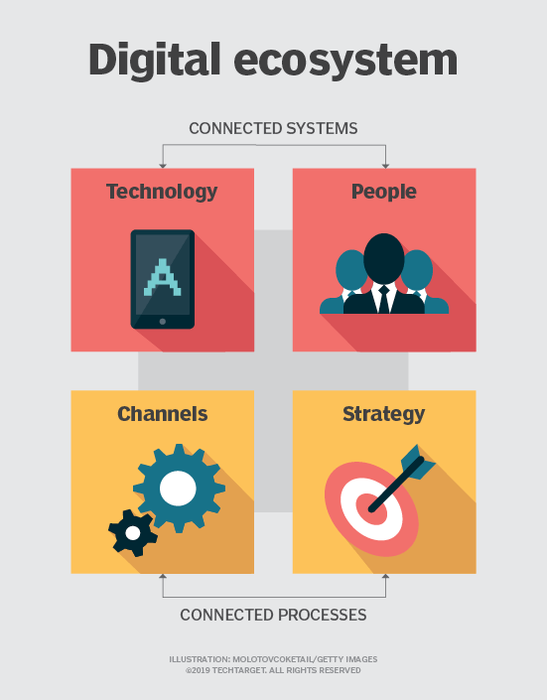
https://www.techtarget.com/searchcio/definition/digital-ecosystem

Slide 7
What is the digital ecosystems ?
A digital ecosystem is a complex network of stakeholders that connect online and interact digitally in ways that create value for all. Every digital ecosystem extends across multiple industries.
The digital ecosystem is a dynamic, interconnected network that necessitates reliable communication among customers and trading partners. When a digital ecosystem is integrated, it allows enterprises to leverage new and legacy technologies – and build automated processes around them – to continually grow a business.

Slide 8
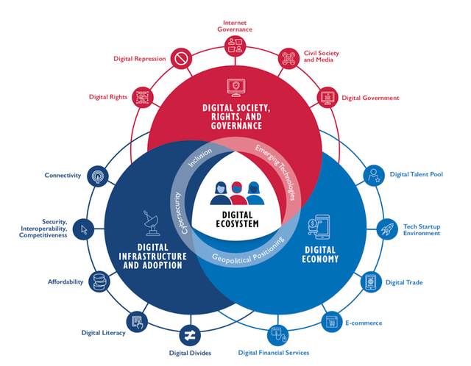
New USAID Digital Ecosystem Framework for International Development
https://www.ictworks.org/usaid-digital-ecosystem-framework/#.YpMTkVRBzIU

Slide 9
What is digital business ecosystem?
DBE (Digital Business Ecosystem) is a free, open source and distributed software platform that is based on Internet technologies. It is designed to enable SMEs, specifically, to create, integrate and provide services (both real world and software) more efficiently and more effectively.
It has been conceived so that SMEs can, at a minimal cost, bridge the digital divide that many experience when trying to offer their goods and services on the Internet.
In practical terms, this means that you can use the software available on the DBE to advertise existing product or service offerings, create new services and combine your own services with those of other SMEs to create new offerings. You can also integrate your own software with that of other SMEs on the DBE to enhance your business processes.
With improved and extended products and services, you can broaden your market reach increase your B2C competitiveness and equally your B2B edge.
http//www.digital- ecosystem.org/

Slide 10
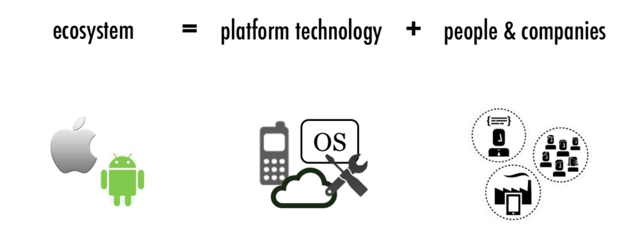
What is an ecosystem?
https://timreview.ca/article/1260

Slide 11
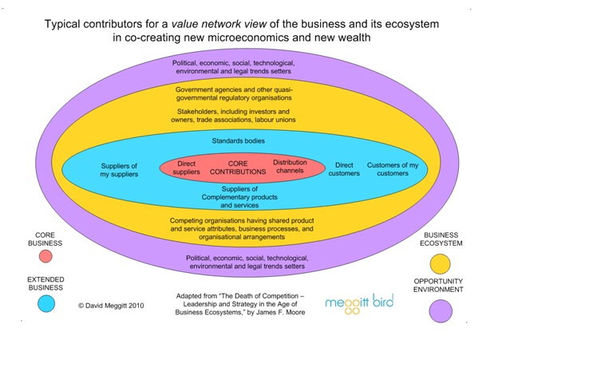
https://aasedb.wordpress.com/2011/03/03/business-ecosystems-%E2%80%93-is-there-a-structure/

Slide 12
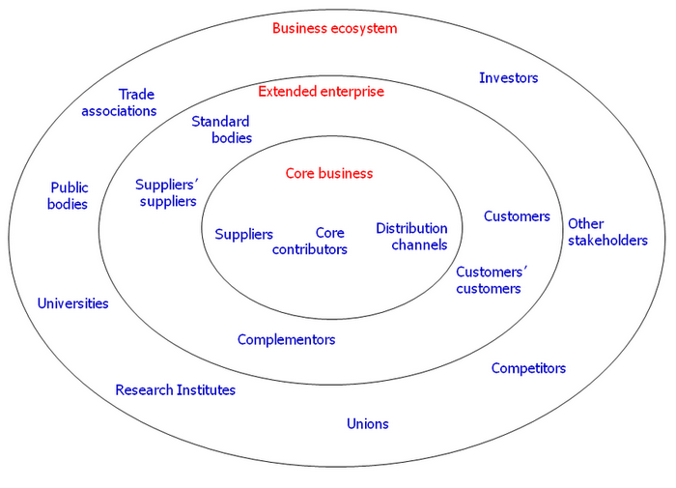
The layers of a business ecosystem adapted from Moore
https://www.researchgate.net/figure/The-layers-of-a-business-ecosystem-adapted-from-Moore-1993_fig1_318350296

Slide 13
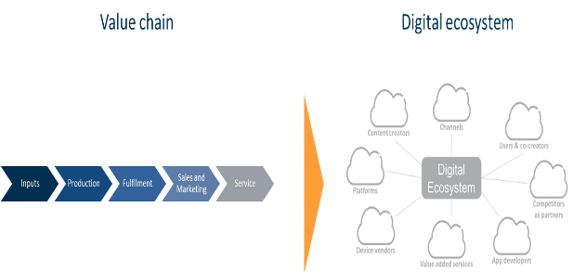
The transition from value chains to value ecosystems
https://timreview.ca/article/1260

Slide 14
The digital business ecosystem networks
Digital ecosystems were made possible by the convergence of three networks :
ICT networks,
Social networks
Knowledge networks

Slide 15
Main characteristics of a digital ecosystem

Slide 16
Main characteristics of a digital ecosystem
Customer-Centric
When looking at the most successful digital ecosystems (I mentioned Amazon earlier) you see the strict focus on creating value. Sometimes these ecosystems didn’t even have a monetization model at the beginning as they focused on the customer and understanding the customer like we will learn in the next chapter about data before they even start to put a price tag on services or offerings. Being customer-centric doesn’t only look at customer service or the personalized advertisements/marketing the company offers, it’s more of a whole spectrum customer centricity which is only possible due to the scale of the business. This means holistic operations and cross-department and cross-product/service collaboration to integrate the customer journey as well as possible.
Data-Driven
One of the main advantages of using a digital ecosystem is the possibility to gather further information about processes, customers, transactions, and more. This makes data one of the key drivers for every digital ecosystem. The more you can know about the customer the better you can offer services, software, technology, and tools to improve the customer journey throughout.

Slide 17
Main characteristics of a digital ecosystem
Automated
Due to the enormous insights, digital ecosystems gather from customers, suppliers, and third parties, it is also possible to make this insight actionable. Automation is one of the key elements in lowering the price, improving customer satisfaction but also offering new services/products to increase the value stream.
Global
You might have already guessed that it’s necessary to have a global footprint. Digital ecosystems are there to scale and by limiting them mostly to countries or regions you will never get the benefit of using a platform and an ecosystem. This means that digital ecosystems also need to be built to make collaboration possible across countries, geographies, and even languages. Sometimes even cultural barriers need to be addressed.

Slide 18
Main characteristics of a digital ecosystem
Dynamic
Due to the scale of digital ecosystems, it’s also worth mentioning that the mindset must be very dynamic. Ecosystems need to adapt fast and react to changing market dynamics fast, otherwise, the user base will move onwards and switch the platform. Business intelligence, fast decision-making, and also the use of new technologies and business models need to be at the heart of every decision.

Slide 19
Key roles in a digital ecosystem
Ecosystem Orchestrator
These companies take the risk, complexity, and also the challenges of building a digital ecosystem. These are companies like Amazon, Alibaba, Ping, etc. who enable others to participate in an ecosystem and sell goods and services through this system.
Modular Producer
These are companies that contribute to the ecosystem and monetize value in different ecosystems. One of the best-known modular producers might be PayPal. With their service, they offer different platforms and ecosystems the service to have a unified payment gateway, so customers can pay easily. A modular producer can add core services to ecosystems that meet consumers, business needs but also buyers and sellers in a way.
Customer
The customer can be a person or an enterprise, and it extracts value from the ecosystem. When you book an Airbnb then you are a customer of the ecosystem that Airbnb has created and orchestrated.

Slide 20
Main characteristics of a digital ecosystem
Features of the P2P technology
Decentralization
Open Environment
Scalability
Robustness
Self-Managing Systems
Open Source tools

Slide 21
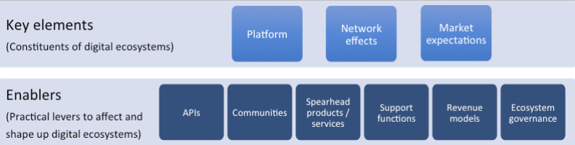
High level characterization of digital ecosystems
https://timreview.ca/article/1260

Slide 22
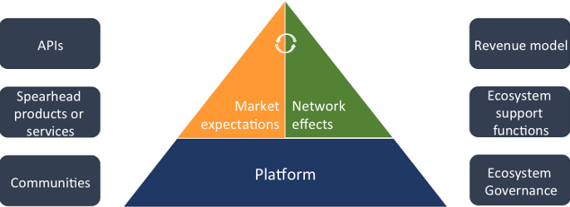

The key elements and enablers for developing digital ecosystems

Slide 23
What is the digital ecosystems ?
A digital ecosystem is focusing on bringing extra value to customers by optimizing data and workflows from different internal departments, tools, systems, as well as customers, suppliers, and external partners. It should remove obstacles from the customer journey and enable every participant in the ecosystem to use state of the art technologies and systems to fulfill their individual needs.
For these ecosystems offer customers a unified and easy to use system that delivers value through a variety of services, products, and insights. This also allows the platforms to grow exponentially and outpace the normal market by using several mechanics involved.
This also means that a variety of business models are possible when scaling an ecosystem. From direct sales of products and services to advertisements, subscriptions, and many more. By understanding the customer better and realigning the product offering it is possible to grow the number of services and products offered with the numbers of insights gathered from the customers. This makes the digital ecosystems so powerful and also so profitable that the list of the most valuable companies in the world is led by companies harvesting the power of digital ecosystems.

Slide 24
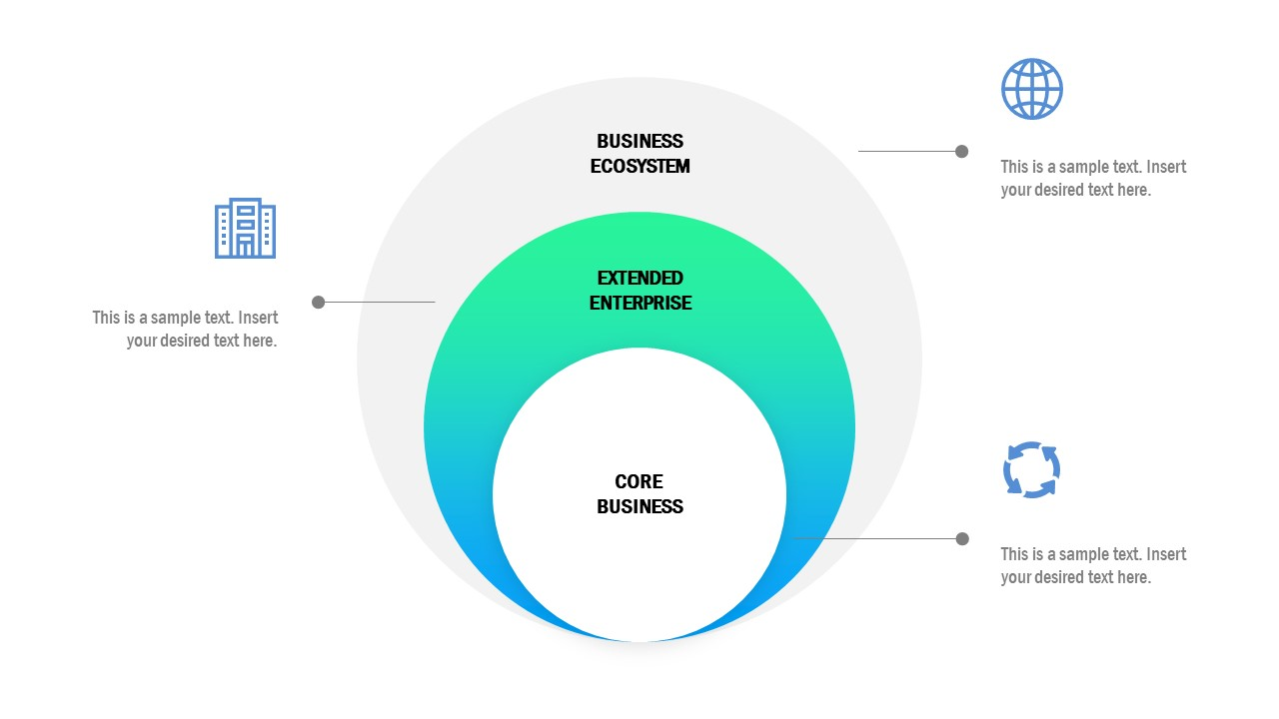
What is the digital ecosystems ?
https://slidemodel.com/templates/business-ecosystem-powerpoint-template/

Slide 25
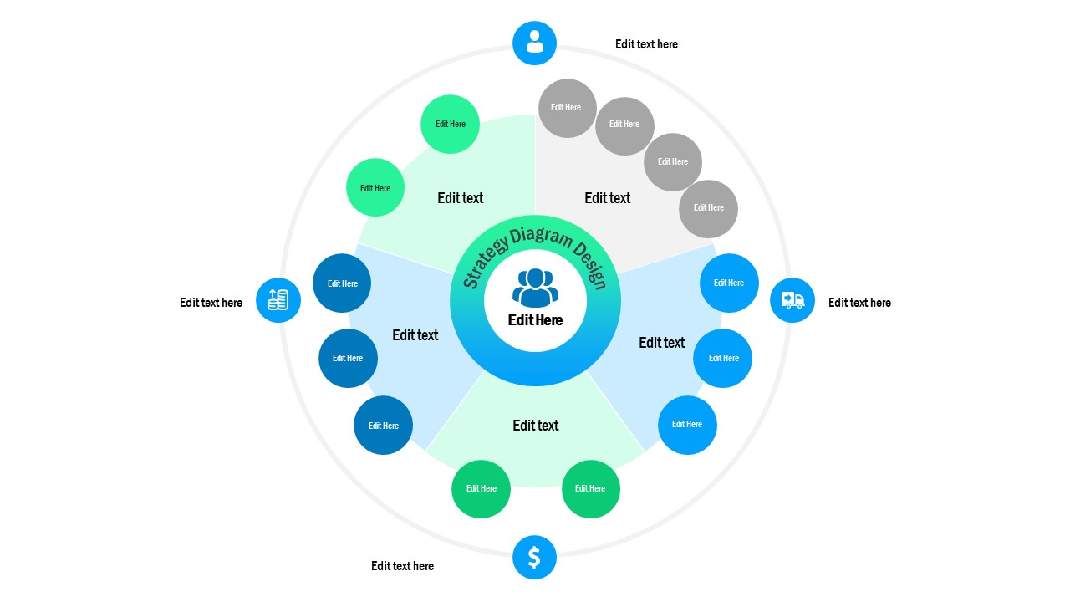
What is the digital ecosystems ?
https://slidemodel.com/templates/business-ecosystem-powerpoint-template/

Slide 26
What is the digital ecosystem ?
1. Is an independent group of actors (people, equipment, and organizations) that share the standardized digital platforms to communicate with each other to achieve commercial or social goal.
2. Socio-technical system inspired in natural ecosystems that connects a group of companies/people/things via digital platforms. It requires a digital infrastructure and digital services to interact with external parties of the organization. Similarly to natural ecosystems, sustainability and safety are critical aspects.
3. A distributed, adaptive, open socio-technical system with properties of scalability, sustainability, and self-organization, inspired from natural ecosystems.
4. It is a digital environment designed for learning which contains the necessary resources to acquire the learning objectives.
5. A business system that goes beyond digital platform and enables all participants to create and deliver value to their target audience and share value and enjoy benefits from the presence of each other in the system.

Slide 27
What is the digital ecosystem ?
6. A distributed, adaptive, open socio-technical system with properties of scalability, sustainability, and self-organization, inspired from natural ecosystems. This is achieved through the use of digital technologies.
7. A digital ecosystem is an interdependent group of enterprises, people and/or things that share standardized digital platforms for a mutually beneficial purpose, such as commercial gain, innovation, or common interest.
8. A group of interconnected information technology resources that can function as one unit.
9. A distributed, adaptive, open socio-technical system that has properties of scalability, sustainability, and self-organization, inspired from natural ecosystems, through the use of digital technology. Digital ecosystem models are informed by information and communication latest technologies.

Slide 28
How digital ecosystems work
The technical, legal and business-related difficulties found in digital ecosystems are significant. Service orchestration, delivery and monetization, as well as customer communication and data management (CCM and CDM, respectively) across the entire ecosystem, are some of the biggest challenges.
The tools for managing an ecosystem can fall into the following categories:
project management tools, such as Agile software development tools, task management software and issue tracking systems;
research applications, including data storage and visualization, resource libraries and archives;
engagement tools, like email marketing, donor management tools and customer relationship management (CRM) software;
collaboration tools, including e-mail, file sharing, instant messaging and video conferencing;
public platforms, such as websites, Mobile apps and social media channels; and
knowledge management platforms, like intranets and wikis.

Slide 29
Why are digital ecosystems important?
Recently, many organizations' strategies have incorporated digital transformation. No matter where in the digital journey a company is, it is essential that a digital ecosystem is established to improve performance and assist with interactions outside the company. The digital ecosystem allows an organization to focus its energies on facilitating business value by removing any frustrations linked to outdated, legacy B2B services. Furthermore, digital ecosystems add value to customer relationships by helping companies consistently meet service-level agreements (SLAs), provide fast fixes and quickly surface expectations.
Digital ecosystems are also transforming supply chains. Supply chains that originally functioned in separate markets are coming together in digital ecosystems to support the development of new products and services, creating supplier ecosystems. Although the traditional supply chain is still the foundation of most companies, the new model -- digital ecosystems -- is transforming the world of business by creating linear paths between suppliers and customers, thus creating new business opportunities.
https://www.techtarget.com/searchcio/definition/digital-ecosystem

Slide 30
Types of Digital Ecosystems

Slide 31
Types of digital ecosystems
The digitizer ecosystem
Digitizer ecosystems focus on digitizing an existing product with the help of business partners, while also maintaining low managerial complexity. Digitizer ecosystems can add new functionality to systems and create digital service revenue. This ecosystem usually incorporates 20 to 100 existing partners across five industries.
The digitizer ecosystem is best suited for businesses with strong product capabilities, limited digital abilities and a primarily internal focus. It works well for organizations looking to make their established product smart and connected. An example of a digitizer ecosystem is an automotive manufacturer that partners in order to obtain the technology and intellectual property (IP) needed to connect their cars with related digital services.

Slide 32
Three main types of digital ecosystems
Functional digital ecosystem
This is one of the simplest ecosystems and gets usually built around an existing product or offering of a company. It has a limited number of companies and partners involved (maybe 10-100) and is very focused on the internal aspect. Due to its simplicity and easy integration, it is also the most widely used ecosystem we can find across the globe. But limitations also apply as the data collection and further integration is complicated as this is most of the time a closed ecosystem.
Examples of these functional ecosystems can be found in the automotive industry where the platforms get connected to the digital services of the partners involved to create a very product-centric ecosystem of a smart and connected car, mostly limited to a limited number of products.

Slide 33
Three main types of digital ecosystems
Platform ecosystem
More advanced ecosystems are the digital platform ecosystems. They can involve millions of partners and also can incorporate a multitude of digital offerings. This digital ecosystem is very much based on the “data first” approach to leverage the customer insights to further upsell or design new offerings due to the data generated. But the biggest differentiator is the common platform under which all the partners participate and create their value with/from. So, the ecosystem orchestrator is offering a common platform under which all the connected parties work together.
Google Home is a good example of this. Google is the provides a common platform under which developers, producers and engineers can work together to create home appliances which use the Google Home platform to become connected and smart. Google itself is developing tools like their home speaker but also partners can use the platform ecosystem to offer their products and services.

Slide 34
Types of digital ecosystems
The platform ecosystem
They focus on flawlessly connecting users and smart devices on a platform, while simultaneously guaranteeing high service levels and limited obstacles. The platform ecosystem creates revenue streams from platform usage. The data generated by the ecosystem can be used for similar businesses and service models. Platform ecosystems typically have 50 to 10 million partners across a maximum of five industries.
The platform ecosystem works best with companies that have solid digital capabilities and a strong focus on external expertise. Established tech startups and companies are more likely to adapt this platform as their core business model than nontech companies. An example of a platform ecosystem is Xiaomi, a Chinese electronics company that makes and invests in a variety of product types, including smartphones, laptops, fitness brands and mobile apps. Xiaomi works closely with its contributors -- the device makers -- to provide a smart home platform, equipped with a variety of smart, connected devices.

Slide 35
Types of digital ecosystems
Super platform ecosystem.
Super platform ecosystems are the most complex type of digital ecosystem. They focus on integrating several platforms into one integrated service, while also capturing user data from the integrated platform. This type of ecosystem provides a wide range of user data and also turns the data into money using adjacent business models. The super platform ecosystem typically has at least 10 million partners across at least 10 different industries.
Super platform ecosystems are best suited to companies that possess advanced digital abilities and an established platform from the start, as well as a willingness to work with external partners. As a result, this ecosystem is preferred by well-established tech companies. A good example of a super platform ecosystem is a virtual assistant that incorporates shopping, payment, transportation and communication services into one user-friendly option.
Many companies find the best results by using more than one type of ecosystem at a time. For example, Amazon Alexa uses all three. The digitizer ecosystem improves the smart speaker's hardware and voice recognition functionality; a platform ecosystem exists for adding skills and applications that are used to increase the services offered by Alexa; and a super platform ecosystem is used to integrate all other platforms.

Slide 36
Three main types of digital ecosystems
Super platform ecosystem
One of the most complex and complicated ecosystem models involves the integration of different platforms and the use of different user journeys including their data. Super platform ecosystems involve usually many different industries, different services and are trying to connect the whole user journey to the ecosystem as good as possible. Most Super platform ecosystems are now found in the hands of tech giants like Apple, Google, Amazon, Tencent and some others.
WeChat, the Chinese Super-App, is a perfect example of creating a Super Platform Ecosystem. The app now covers all important aspects of the user’s life. In a single platform it offers thousands of services and features including everyday banking, social media, shopping, communication and more. With every added offering, WeChat can integrate more into daily life thus enabling better data collection which can lead to new offerings and a “lock-in”.

Slide 37
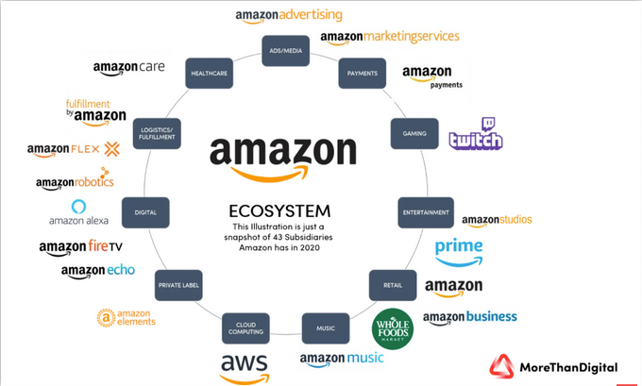
Amazon Ecosystem
https://morethandigital.info/en/what-is-a-digital-ecosystem-understanding-the-most-profitable-business-model/

Slide 38
Amazon Ecosystem
In 2000 Amazon is constantly building on its digital ecosystem. First, the retail giant needed to build a giant server infrastructure around the globe to be able to serve the customers of their e-commerce platform. But soon Amazon began to rent out server capacity to other businesses. This step leads to Amazon Web Services (AWS) and was an important milestone for the company to create this massive ecosystem they have right now.
Amazon used its own AWS infrastructure not only to supply other companies with infrastructure services but also used it as a launchpad for all other services like Amazon Prime Videos, Prime Music, Studio, etc. This led to a fast build-up of services around the Amazon universe and also a kind of lock-in for many users. They had the advantages of being a prime customer and receive packages faster, had access to Amazon Music, and even were able to watch series and movies from the prime library.
Amazon later then involved a lot of outside companies to participate in this ecosystem. So were the e-commerce part the first one to open up and allow even competitors to use this infrastructure of services and tools Amazon offered. This made them a huge success when looking at their whole Amazon ecosystem. There are more than 40 subsidiaries of Amazon today and there will be more in the future.

Slide 39
Howe to create a digital ecosystem ?

Slide 40
The digital ecosystem map
The digital ecosystem map is essential to any digital transformation. The goal of the map is to clarify what an organization has to work with, guarantee they have the proper tools to support their goals, and ensure they are being as efficient and effective as possible in achieving those goals.
(https://www.techtarget.com/searchcio/definition/digital-ecosystem)

Slide 41
The following steps can be used to create a digital ecosystem map
Create a list of tools. Take inventory of all applications and systems used within the organizations.
Document who uses the tools. Identify who uses each system and app and who is responsible for each one. This helps ensure all necessary stakeholders are included in the ecosystem.
Categorize the use of every tool. Define what every system and app does and for which department and purpose. Systems should be categorized by ownership and department.
Form connections between tools. Indicate where data is transferred between tools and whether or not it is done automatically or manually. Note what tasks are being duplicated and which systems possess similar functionalities.
Define the effectiveness of every tool. Investigate whether any tools are underperforming and need to be replaced, upgraded or consolidated. Feedback should be provided by the people who use the specific tool every day.
Prioritize every tool. Rank each tool according to how critical it is to the organization. If tools are going to be replaced or added, consider their importance in terms of their immediate need to the organization and create an order in which they should be implemented.

Slide 42
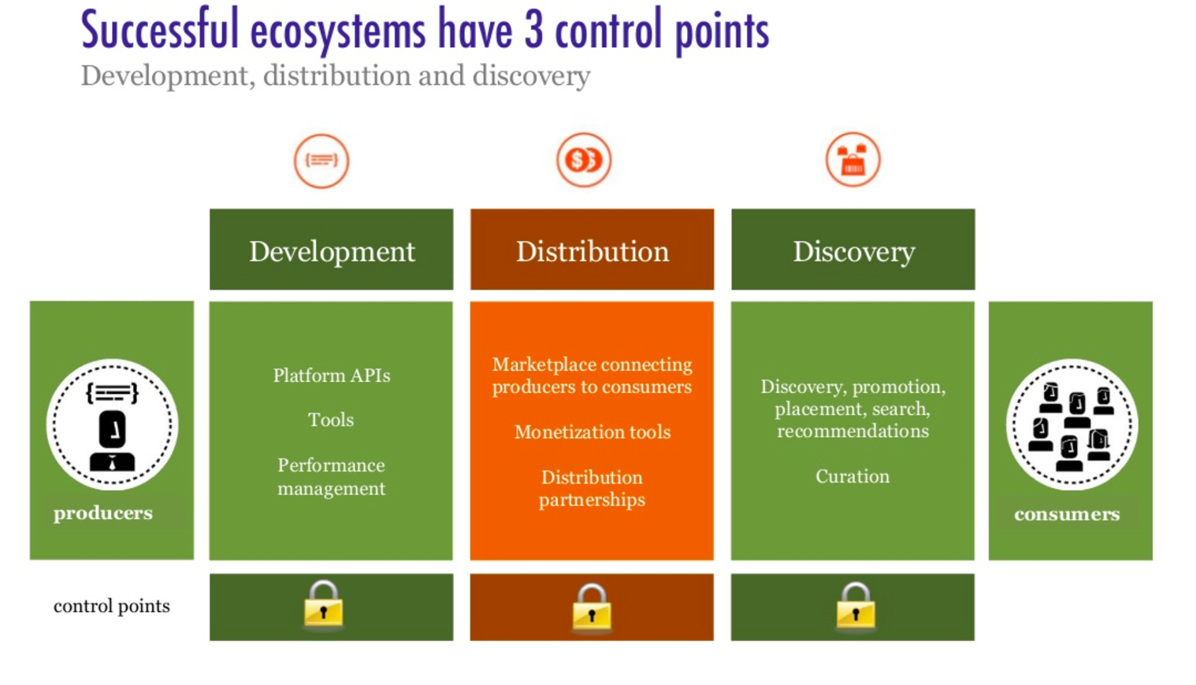
https://www.tribalmind.co/S3/tribalmind-live/Discoveries/Fa01SXZHQUKkWy5VKNSJbg.png?h=3200&w=3200&mode=max&autorotate=true

Slide 43
The following steps can be used to create a digital ecosystem map:
Create a list of tools. Take inventory of all applications and systems used within the organizations.
Document who uses the tools. Identify who uses each system and app and who is responsible for each one. This helps ensure all necessary stakeholders are included in the ecosystem.
Categorize the use of every tool. Define what every system and app does and for which department and purpose. Systems should be categorized by ownership and department.
Form connections between tools. Indicate where data is transferred between tools and whether or not it is done automatically or manually. Note what tasks are being duplicated and which systems possess similar functionalities.
Define the effectiveness of every tool. Investigate whether any tools are underperforming and need to be replaced, upgraded or consolidated. Feedback should be provided by the people who use the specific tool every day.
Prioritize every tool. Rank each tool according to how critical it is to the organization. If tools are going to be replaced or added, consider their importance in terms of their immediate need to the organization and create an order in which they should be implemented.

Slide 44
Five tips for building a clear and beneficial digital ecosystem with scalable collaborations.
Create An Open Collaborative Environment. ...
Foster Cooperative Relationships. ...
Support A Culture Of Innovation. ...
Assemble Agile Management. ...
Invest In The Right Digital Technology. ...
Additional Resources On This Topic:

Slide 45
How should your organization approach digital ecosystems?
While embarking on a digital ecosystem strategy is not an easy task, there are some valuable principles to guide your approach:
Map your existing business to the dimensions of the digital ecosystem in which you operate and would like to operate. This exercise will help you to identify areas where you can deploy new technologies/products/services or attract the appropriate capabilities into the ecosystem.
Invest in reworking and tailoring existing capabilities or attracting new partners that can fill the gaps in your ecosystem.
Design your organization and the ecosystem to create value for participants and customers. Companies that want to orchestrate or participate in digital ecosystems must balance the right organizational model and the value they create for customers and other participants. For example, you must encourage the transparent sharing of data, leave enough value on the table for all participants, and deliver valuable benefits to end customers.

Slide 46
Howe to create a digital ecosystem ?
As data flows through the ecosystem, it is eventually transformed into insights that can be used for sustainable decision.
Raw data: The foundation of a digital ecosystem is numerous data sources, small and big, on the environment together with social and economic data.
Infrastructure: The infrastructure will store, process and connect existing databases. It must seek to improve metadata, discoverability and accessibility.
Algorithms and analytics: Data and supporting infrastructure are the backbone of the digital ecosystem. But these will require algorithms and analytics in order to extract actionable insights and business intelligence.
Insights and applications: End-users need to integrate information streams into metrics and performance dashboards. They must be comprehensible to decision-makers, investors, consumers and citizens.

Slide 47
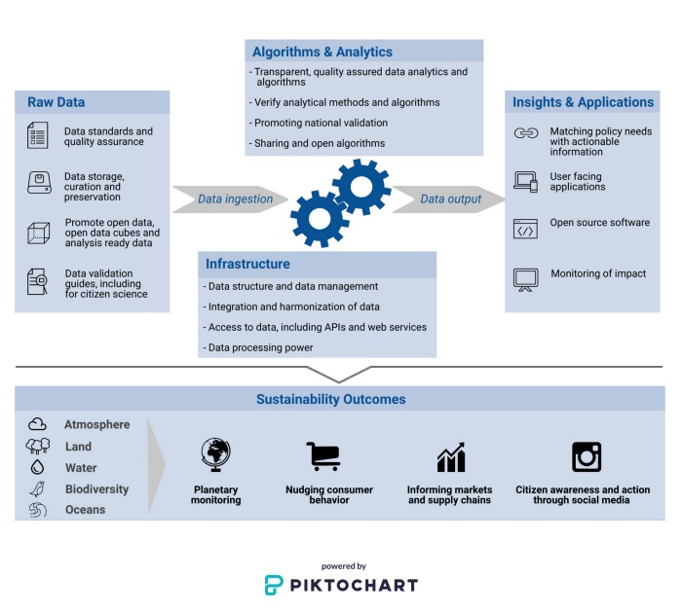
A global digital ecosystem structure
https://undp.medium.com/the-pressing-need-for-a-global-digital-ecosystem-aa10a9f8df56

Slide 48
What is being done?
The foundations of a global digital ecosystem are being built and tested by in the public and private sector. The following examples show how they can provide environmental insights and intelligence that are better, faster, and cheaper.
The European Commission’s Joint Research Centre, Google Earth Engine and UNEP developed the sdg661.app for Water-Related Ecosystems. The Surface Water Viewer shows changes in global water based on satellite images and AI.
The UN Biodiversity Lab aims to help countries increase the amount of spatial data and analysis used in their 6th National Reports to the Convention on Biological Diversity (CBD). It combines over 100 global high-quality spatial data sets with analysis, visualization, and storytelling tools. It was developed by UNDP, UNEP, and the CBD Secretariat, with funding from the Global Environment Facility and UNDP Innovation Facility.
https://undp.medium.com/the-pressing-need-for-a-global-digital-ecosystem-aa10a9f8df56

Slide 49
What does Facebook’s digital ecosystem look like?
When software is eating the world, leaders of almost every industry need to have an understanding of digital ecosystems. In the tech world, the battle between ecosystems has been going on for a while, with Apple, Amazon, Microsoft and Google as the most notable combatants the last couple of years. While Microsoft is falling behind, Facebook is becoming a notable challenger, and perhaps one of the most powerful digital ecosystems there is.
While facebook is being accused of not being cool anymore, it is in reality evolving from a social network to a digital ecosystem and something similar to an operating system for your digital identity. Facebook has probably realized this a long time ago and allows a fragmentation of the front-end by separating Facebook chat as a stand-alone application and leaving both Instagram and Whatsapp as separate applications.
A digital ecosystems horizontal integration should also include both customers, partners and third-party services. Facebook caters to brands and agencies that wish to take advantage of Facebook’s vast user penetration though Atlas and Pages Manager.
At the same time Facebook allows third-party developers to create apps and services through Facebook App Center, Open Graph and Parse. Allowing co-creation and open innovation, while ensuring data collection through Facebook Connect.
https://hernaes.com/2015/10/29/what-is-a-digital-ecossytem/

Slide 50
What does Facebook’s digital ecosystem look like?
One of the questions that remains is how will Oculus Rift, Facebook’s first physical component in their ecosystem fit?
The key to succeeding with a digital ecosystem is to create stickiness through relevance and usefulness. Facebook is not going out of fashion. The ecosystem is evolving, and the ‘old’ social networking site we all know is becoming the infrastructure of Facebook’s digital ecosystem. At the same time Facebook in continually working to launch new relevant services. If done right, Facebook has the potential to render phone numbers, e-mail addresses and bank account numbers obsolete in opinion.
What makes Facebook one of the most potent digital ecosystems is that it is based on managing the digital identity of every user in its user base

Slide 51
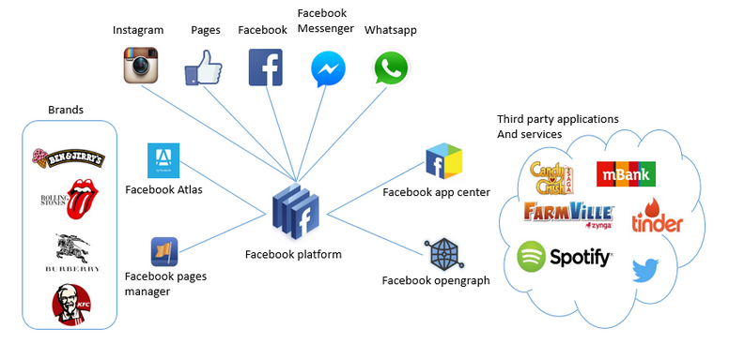
The digital ecosystem of Facebook
https://hernaes.com/2015/10/29/what-is-a-digital-ecossytem/

Slide 52
Overcoming risks
Four governance risks need to be addressed.
1. Monopolies linked to global data sets: Much of big data are held by a handful of companies. This is a risk. It also creates concerns in terms of privacy, data security and dependencies. We need to understand what incentives, safeguards and standards are needed to ensure that environmental data and processing power are used to help humanity solve long-term global environmental challenges rather than exacerbate existing inequalities and digital colonialism.
2. Quality, transparency and openness of data and algorithms: As companies take an increasing role in generating digital public goods, we need to ensure that the quality of data and algorithms are not compromised by the allure of short-term profits.
3. Protecting individual privacy, data security and intellectual property: There must also be a recognition that some data will, of necessity, remain only at the national level and be governed by national priorities, context and culture.
4. Direct environmental impacts: as reliance on computers and data centres grows, governments and technology companies need to implement measures to reduce their direct environmental impact.
https://undp.medium.com/the-pressing-need-for-a-global-digital-ecosystem-aa10a9f8df56

Slide 53
Benefits of digital ecosystems

Slide 54
What is benefits of digital ecosystems ?
Not every company will be an Amazon or Microsoft, but it will at least participate in digital ecosystems that more prominent players orchestrate. The best part is that even a moderately successful digital ecosystem can lead to measurable gains. That’s why it is essential to embrace digital ecosystems with a clear vision and approach.

Slide 55
Benefits of digital ecosystems
Faster adoption of technology. Companies can implement new technology in ways that were previously too complicated and unmanageable, allowing them to take full advantage of cloud services and SaaS
Generation of new sources of revenue. Ecosystem integration creates new revenue streams and allows organizations to track and analyze wide-ranging data that flows through the business. They can use this data to create new products and services with increased value.
Decreased costs with better business processes. Digital transformation and the creation of a digital ecosystem improve workflow efficiency and working relationships with customers and partners. Automated data processes and increased businesswide efficiency also reduce operational costs.

Slide 56
References
Business analysis life cycle & IT- business analyst: Role in traditional, digital and agile world kindle edition by Subramanyam Gunda (Author) Format: Kindle Edition ASIN ‏ : ‎ B085X3CCSQ Publication date ‏ : ‎ March 13, 2020.
Milani Fredrik. Digital Business Analysis. Springer, 2019. - 432 р. - ISBN 978-3-030-05719-0.
Cadle James, Paul Debra, Turner Paul. Business Analysis Techniques: 99 essential tools for success . 2nd Edition BCS, The Chartered Institute for IT, 2014. - 356 p. - ISBN-10: 1780172737; ISBN-13: 978-1780172736.
Wirtz, B. W. (2018a). Business model management: Design-Instrumente - Erfolgsfaktoren (4th ed.). Wiesbaden: Springer Gabler.
Wirtz, B. W. (2018b). Electronic business (6th ed.). Wiesbaden: Springer Gabler.
Zott, C., Amit, R., & Massa, L. (2011). The business model: Recent developments and future research. Journal of Management, 37(4), 1019–1042
Bernd W. Wirtz. Digital Business Models.Concepts, Models, and the Alphabet Case Study. ISSN 2196-8705. Progress in IS. ISBN 978-3-030-13004-6.
https://undp.medium.com/the-pressing-need-for-a-global-digital-ecosystem-aa10a9f8df56

