Slide 1
Digital business models
Lecture 10. Digital Business Strategy
DSc.Takhir Kuchkarov

Slide 2
Content
What is the digital business strategy ?
The types of digital strategy
Key components of digital business strategy
The benefits of digital strategy
How do you create a digital business strategy?

Slide 3
What is the digital business strategy ?

Slide 4
What is the Strategy ?
Strategy is an action that managers take to attain one or more of the organization's goals. Strategy can also be defined as “A general direction set for the company and its various components to achieve a desired state in the future. Strategy results from the detailed strategic planning process”.

Slide 5
What is the Strategy ?
Strategy is a system of means to achieve a goal. This is more than science; it is the application of knowledge in real life, the further development of the original guiding idea in accordance with constantly changing circumstances, the art of acting under the pressure of the most difficult circumstances (Helmuth von Moltke). (Mintzberg G., Alstrand B., Lampel J. Strategic safari. Excursion through the wilds of strategic management. Moscow: Alpina Publisher, 2020)

Slide 6
What is the strategy?
A carefully designed plan or method for achieving a goal, or the ability to develop and implement such a plan or method. It is aimed at studying and long-term planning of business improvement strategies. enterprise development strategy, industry development strategy or other areas of development

Slide 7
What is the business strategy ?
Business strategy is - a clear set of plans, actions and goals that outlines how a business will compete in a particular market, or markets, with a product or number of products or services.

Slide 8
What is the Business Strategy ?
Business strategy is - a plan for achieving superior long-term returns on the capital invested in a business firm
Main generic strategies
  Differentiation
  Cost
  Scope
  Focus
Notes:
A strategy of differentiation refers to all the ways producers can make their
products unique and distinguish them from those of competitors.
A scope strategy is a strategy to compete in all markets around the globe, rather than merely in local, regional, or national markets. The Internet’s global reach, universal standards, and ubiquity can certainly be leveraged to assist businesses in becoming global competi-
tors. Yahoo, for instance, along with all of the other top 20 e-commerce sites, has readily attained a global presence using the Internet. A focus strategy is a strategy to compete within a narrow market segment or product segment. This is a specialization strategy with the goal of becoming the premier provider in a narrow market. For instance, L.L.Bean uses the Web to continue its historic focus on outdoor sports apparel;

Slide 9
What is the Digital Business Strategy ?
Digital business strategy focuses on using technology to improve business performance, whether that means creating new products or reimagining current processes.
It specifies the direction an organization will take to create new competitive advantages with technology, as well as the tactics it will use to achieve these changes.

Slide 10
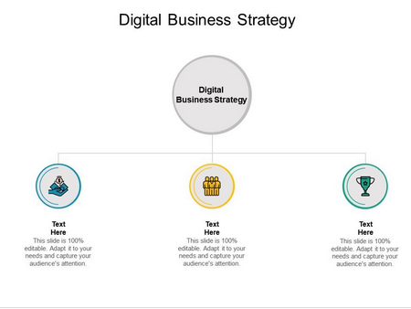
https://www.slideteam.net/digital-business-strategy-ppt-powerpoint-presentation-summary-portfolio-cpb.html

Slide 11
Digital Business Strategy
The Digital Business Strategy is :
the use of digital technology to analyze, formulate implement the organizations strategy
or
the analysis, decision and action that an
organization undertakes using digital technology
in order to create and sustain competitive Advantage

Slide 12
Digital strategy
Digital strategy focuses on using technology to improve business performance, whether that means creating new products or reimagining current processes. It specifies the direction an organization will take to create new competitive advantages with technology, as well as the tactics it will use to achieve these changes. This usually includes changes to business models, as new technology makes it possible for innovative companies to provide services that weren’t previously possible
Today, technology has integrated with business to become something more than hardware or software. As digital technology becomes more pervasive and companies move further in the journey of digital transformation, digital strategy and business strategy will be the same thing. For now, it is still useful to use the term “digital strategy” to focus the effort behind digital initiatives.
https://www.liferay.com/resources/l/digital-strategy

Slide 13
Digital strategy
It’s important to remember that digital strategy is both a concept and a thing — that is, a digital strategy should eventually lead to the creation of a concrete plan or roadmap. While you can keep changing the specific tactics you’ve decided to pursue, there should also be a clear commitment to your understanding of what digital means for your company.
As an example, say your digital strategy (ultimate goal) is to monetize basic productivity software that your business has already developed and uses internally. At first, you lay out a strategy (plan) to package it as a mobile app and sell it to individual users. Later, you realize that it has more value if you sell it to businesses to incorporate into their own mobile apps. Your strategy (ultimate goal) didn’t change, but your strategy (plan) did. Changing the guiding idea of your digital strategy should amount to a big shift or reorientation for your company, but ideally, the concrete steps will be flexible enough to allow you to pivot as needed
https://www.liferay.com/resources/l/digital-strategy

Slide 14
Digital Strategy in the Context of Digital Transformation
There is a tendency to talk about digital transformation interchangeably with digital strategy. The two terms are closely related, but differ in scope. Digital transformation drives change in three areas: customer experience, operational processes and business models. The process of digital transformation requires coordination across the entire organization, and involves business culture changes.
Digital strategy, on the other hand, focuses on technology, not culture. Digital strategy is most relevant to changes in business models, and uses technology to create the capabilities a company needs to become a digital business. Setting down a strategy is a key component of the transformation process, and ensures that technology is being implemented in a way that supports the business objectives.
https://www.liferay.com/resources/l/digital-strategy

Slide 15
Common Elements of Digital Strategy
Choose a Leader — This is arguably the most important part of creating a digital strategy, but choosing the right person will depend on company culture, structure and priorities. Whether companies place leadership with the CEO or an appointed Chief Digital Officer, the leader’s influence will need to match the scope of digital strategy; otherwise, it will be difficult to create the full buy-in from each department necessary to make effective changes.
Attack vs. Defend — McKinsey & Company emphasizes that companies would do well to categorize their potential threats and opportunities in digital business, then compare these against their own purpose. This clarifies whether a proactive or defensive stance needs to guide new initiatives.
Take a Measured Approach — Digital strategy often incorporates a process for assessing whether new technology will really complement or grow the current business. If you fear that your company is already behind on digital, it can be tempting to rush into a project without looking at how it fits your current strategy. By taking a measured approach, you can avoid wasting resources on initiatives that don’t align with your business’s needs and priorities.
Future Proof — The goal of digital transformation is to create an appropriate foundation for digital business. This means creating an organization that can continue to reinvent itself as necessary to keep up with changes in technology and customer expectations. Digital strategy should be visionary enough to carry companies through changes in the digital economy, in a way that continues to bring a digital edge to the business.

Slide 16
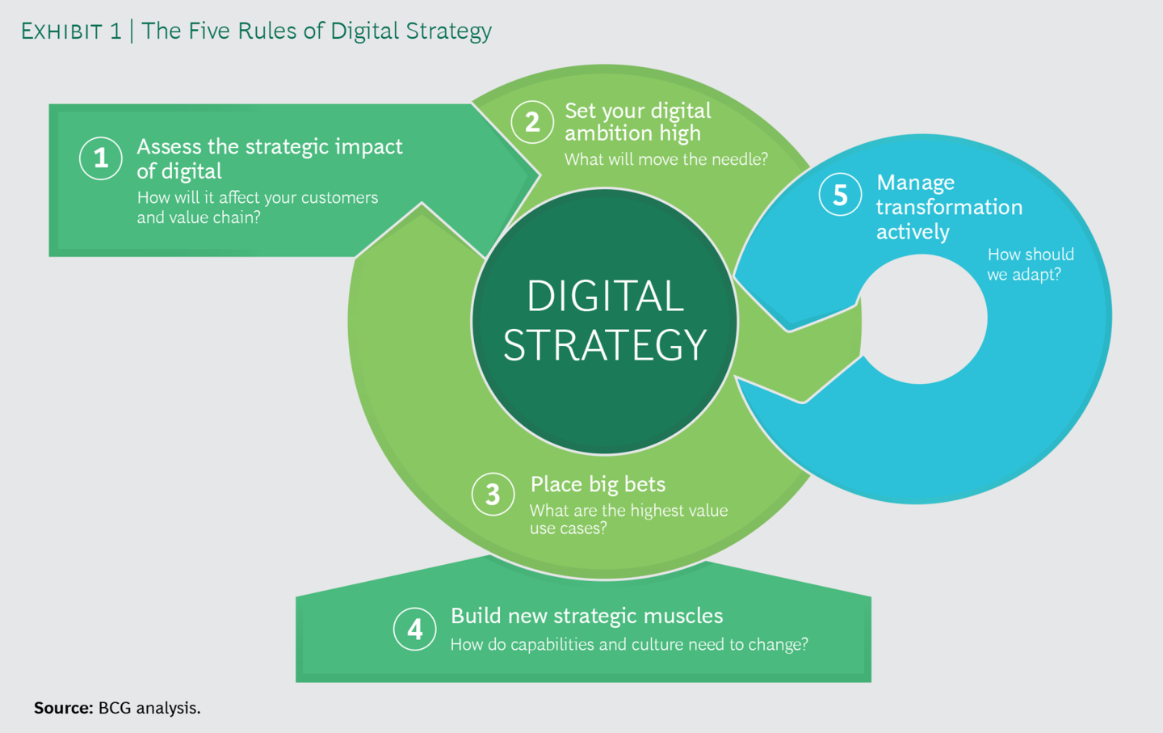
https://www.bcg.com/publications/2019/five-rules-digital-strategy

Slide 17
How does digital business strategy differ from traditional business strategy?
The main difference between digital and traditional marketing is the medium through which an audience encounters a marketing message. While traditional marketing uses traditional media like magazines and newspapers, digital marketing uses digital media, such as social media or websites.

Slide 18
Mixing the generic strategies in the digital strategies
Cost Leadership
Reduce costs efforts
Copycats
Differentiation
Mass customization, value chain
Copycats, becoming main stream
Focus
Open venues
Multiple niches overlapping

Slide 19
The types of digital strategy

Slide 20
What are the types of digital strategy?
Main six types of digital strategies
The platform play. ...
New marginal supply. ...
Digitally enabled products and services. ...
Rebundling and customizing. ...
Digital distribution channels. ...
Cost-efficiency.

Slide 21
What are the 4 types of business strategies?
Four generic business-level strategies emerge from these decisions:
cost leadership;
differentiation;
focused cost leadership;
focused differentiation.
In rare cases, firms are able to offer both low prices and unique features that customers find desirable.

Slide 22
What is a marketing strategy PDF?
At the broadest level, marketing strategy can be defined as an organization's integrated pattern of decisions that specify its crucial choices concerning products, markets, marketing activities and marketing resources in the creation, communication and/or delivery of products that offer value to customers in exchanges ..

Slide 23
What is the main objective of digital marketing?
Develop Revenue. Increasing revenue is the primary objectives of digital marketing. Luckily, the internet gives every company several opportunities to boost their performance. By combining SEO with pay per click, or PPC ads, your company will increase the probability of getting identified by potential clients

Slide 24
8 Types of Digital Marketing Strategies with Examples
Social Media Marketing Platforms. ...
Influencer Marketing. ...
Email Marketing. ...
Content Marketing. ...
Search Engine Optimization (SEO) Marketing. ...
Pay-per-click (PPC) ...
Affiliate Marketing. ...
Mobile Marketing.

Slide 25
Key components
of digital business strategy

Slide 26
Key components of a digital strategy
A digital strategy has 9 key components. You may not need all components for your business type or industry, or to implement them all immediately. Each part focuses on a different digital area.
Review the components below to assess your current digital footprint and implement a digital strategy tailored to your current and future needs.
Review your completed strategy regularly, as your business needs will change over time.

Slide 27
Key components of digital business strategy
Digital or online presence: Which digital or online channels do you plan to have a presence on? It can be a website, social media platforms, online ads, or listing websites.
E-Commerce: Do you plan to sell online? If yes, which channels do you plan to use? An e-Commerce website, a mobile app, social media platforms, etc.?
E-Products or services: Are you planning to launch a fully online product such as a software solution, a gaming app, or an ed-tech platform? Mention its functionalities and target audience.
Digital marketing: How do you plan to promote your products online? Decide on the channels and your budget, and check if you'll need external help for it.
Digital workflows: Digital workflow is the automation of your company's internal processes. Plan which workflows you want to automate and which tools to use for the same.
Digital communication: What is your preferred channel of communication with customers and suppliers? Which communication tools do you plan to use internally
Mobile capabilities: How important are mobile capabilities for your business? Do you plan to develop mobile-friendly versions of your business website or product (if applicable)?

Slide 28
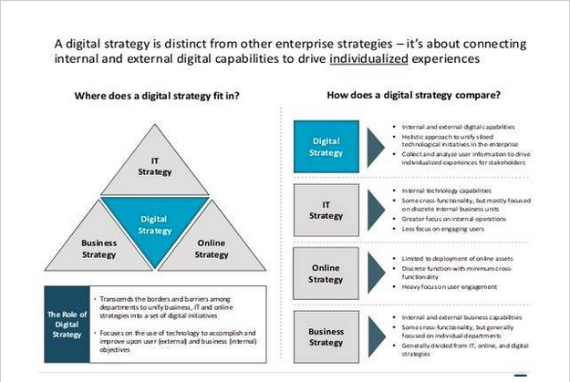
https://bizdiagram.com/digital-strategy-framework-explained/

Slide 29
Key components of a digital strategy
Online presence. Your online presence refers to how and where the community and other businesses see your business online. ...
Digital marketing. ...
Selling online. ...
Customer interaction. ...
Online security. ...
Supplier interaction. ...
Mobile-based solutions. ...
Efficiencies through technology.

Slide 30
Key components of a digital strategy
Digital marketing and advertising is the promotion of your business using various online marketing channels and tools. Digital marketing drives your customers to the digital platforms where you conduct business.
You need to identify what platforms your customers are using and how they are influenced to buy products and services to plan effective marketing and advertising.
Common channels and tools include:
paid-per-click / cost-per-click advertising
search engine optimisation (SEO)
search engine marketing
influencer marketing
content marketing
social media marketing
newsletters and email marketing
content designed to reach grow audiences and develop customer loyalty.
Read more about digital marketing and advertising.
When developing your strategy, consider:
your digital marketing budget
your customers' online behaviour
your competitors' digital marketing activities
your goals for your digital marketing activities.

Slide 31
Key components of a digital strategy
Selling online allows your customers to purchase your products and services anytime and anywhere from any device connected to the internet. It is essential to consider how your business could sell its products and services online.
When developing your strategy, consider:
which of your products and services are suitable to offer online
practical tools used to provide these products and services
current trends in online sales and presentation methods
what your competitors are doing.
read more about selling your products and services.

Slide 32
Key components of a digital strategy
Digital communication is about giving customers ways to engage with your business through the channels they prefer. You should aim to make it as simple as possible for customers to find your information, services or products.
Create a digital communication strategy to ensure your customer service standards are consistent across all the digital channels you use.
You could interact with your customers through:
Emails;
text messaging;
software messaging apps;
website contact forms;
social media direct messages;
live streams;
virtual assistants;

Slide 33
The benefits of digital strategy

Slide 34
Why the digital business strategy important?
It enables you to better understand your market share
Without a clear strategy, you could easily underestimate the demand for your digital services. Moreover, it's likely that you won't fully understand the dynamics of the online marketplace including customer behaviors, competitors, and customer profiles.

Slide 35
What are the benefits ?
Creating a clearly defined plan has obvious advantages for every venture. While digital tools can transform a business, it is important to keep in mind that they should be viewed as enablers. Simply going all in on every latest technological trend is not the answer, and will only do more harm than good.
Developing a blueprint and laying out a digital strategy template can help to see the bigger picture, to pinpoint where digital options can be applied to harness efficiency and effectiveness. This plan can be utilized to reduce waste, keep departments on track, monitor progress and make necessary adjustments.

Slide 36
A digital strategy can help you
set digital goals
plan and manage your digital business components
ensure resources and energy are used effectively.
Your digital strategy will cover:
all digital technology you use to conduct your business
your online or digital presence
the goals you want to achieve using digital technology
the steps and actions you will need to complete to achieve these goals
monitoring and review components.

Slide 37
The benefits of digital strategy
What are the benefits of digital strategy?
One of the biggest benefits of a digital strategy is the ability to track ROI with the tactics put into place.
It's easy to keep track of your progress with analytics online.
Plus, measuring every marketing tactic ensures a cost-effective strategy so you can create the capabilities to support your operations

Slide 38
Why do we need a digital strategy?
A digital strategy will help you outline and create a clear path to strategic goals. It will also help you determine benchmarks to hit, and the tactics that will lead you to success. To do this, determine what success looks like for you and create your strategy around it to help you get there.

Slide 39
How do you create
a digital business strategy?

Slide 40
Steps to develop your digital strategy
Research online tools used by your competitors and other businesses.
Decide which online activities will benefit your business.
Review your budget to work out what you can afford.
Factor in annual costs to maintain or upgrade your devices, renew subscriptions and pay for software licensing and training.
Find the laws and regulations that will apply to your online activities.
Consider your requirements, including software and computer equipment.
Plan for cyber security risks, such as computer viruses, scams, data theft and damage to hardware.
Think about recruiting new roles or training that you or your staff might need.
Be realistic about the time and budget you will need to manage the online aspects of your business.

Slide 41
Know your goals and desired outcomes
Identifying your digital strategy is the key to long-term growth. Your digital strategy is about setting goals and objectives. It's a high-level overview that defines where you are now, outlines where you'd like to go (as an organization), and how you'll get there.
Digital strategy focuses on using technology to improve business performance, whether that means creating new products or reimagining current processes. It specifies the direction an organization will take to create new competitive advantages with technology, as well as the tactics it will use to achieve these changes.

Slide 42
How do you create a digital business strategy?
Here's how to create a solid digital marketing strategy:
Explore the landscape and analyze your results. ...
Map out your strategy. ...
Define your target audience. ...
Build your content strategy. ...
Choose your channels and tactics. ...
Set key performance indicators and benchmarks. ...
Execute with best practices. ...
Analyze and adjust.

Slide 43
Planning your digital strategy
When planning your digital strategy, it's important to:
consider current digital technology your business uses and explore other options that could benefit your business
consider your business's current digital capacity when identifying potential opportunities and additions
regularly review your digital capacity to ensure you can capitalise on technological advancements.
Your digital strategy should remain a part of your business plan and align with your overall business strategy and objectives.

Slide 44
Creating your digital strategy
Your digital strategy will include your business goals, digital audit results and your digital action plan noting your digital activities.
When building your digital strategy, you will need to work through 3 phases:
conduct a digital audit
outline your business goals
complete a digital action plan.

Slide 45
Define Your Digital Business Strategy Research & Tools
Digital Business Strategy Deck – A step-by-step document that walks you through how to identify top value chains and a digitally enabled growth opportunity, transform stakeholder journeys, and build a digital transformation roadmap.
This blueprint guides you through a value-driven approach to digital transformation that allows you to identify what aspects of the business to transform, what technologies to embrace, what processes to automate, and what new business models to create. This approach to digital transformation unifies digital possibilities with your customer experiences.

Slide 46
Phase 1: Complete your digital health check
Action item: Assess your digital readiness.
Assess your business against similar businesses in your industry to understand which tasks are most important. Your business may not need to be digitally advanced in all areas, but you should aim to match or surpass your competitors.

Slide 47
Phase 2: Outline your digital business goals
Your digital business goals summarise your reasons for improving your digital capability.
These goals are the digital achievements you would like to achieve. They're different to your general goals for your business.
Outlining the goals and actionable steps you can take will help you understand which goals to work on first and how you will achieve them.
Follow these steps to outline your digital goals:
Digital business goal—write down your goals
Actions to take—list all the actions you need to take to complete the goal
Key component area—select which key component area the action relates to
Priority code—give each action a priority order ranking

Slide 48
Phase 2: Outline your digital business goals
Add all the actions from step 2 to your digital action plan (phase 3).
Ideas for digital goals include:
streamline business costs
remove redundant technology
provide more secure access to data
implement a bring your device (BYOD) policy
improve communication with customers
move to cloud-based accounting and reporting
create and implement a social media strategy
improve SEO with Google searches
use online advertising
enable automatic backing up of data
install live webchat
add more customer support to your website
create secure socket layer (SSL) certificates to ensure the security of your online assets
digitize processes and find automated solutions
move to a cloud-based software-as-a-service (SaaS) solution.

Slide 49
Phase 3: Develop a digital action plan
A digital action plan collates all information into a list of tasks to complete.
Action plan instructions
Write down the headings for each of the 9 key components of a digital strategy and the topics from the digital audit tools.
List all the action items under each heading that you need to complete for any of the 9 components.
Add all the actions from your digital audit and advice from the digital health check.
Add all the actions from the business goal actions you completed.
Place them in priority order (A–D).

Slide 50
How do you write a digital communication strategy?
Four steps to creating a digital communications strategy:
Identify your business goals. The start of a digital communications strategy begins by determining what you want to achieve for your business. ...
Gain insight into your target audience(s). ...
Determine the best suited digital tactics. ...
Measurement & Analytics.

Slide 51
How to promote your business online?
The use of digital marketing will help you create awareness about your brand. Here is how you can do it.
Social networks: It is the best way to publicize your company’s activities and gain more audience. It is therefore essential to be present on social networks. In addition, these tools can be used free of charge. You can create videos and upload them on YouTube channels, or create a profile on LinkedIn, Facebook, Twitter, Instagram, etc. Still, you can opt for paid ads.
The content: You should optimize your website design, as well as generate interactive and relevant content. It is also possible to add videos or images.
SEO: The idea is to improve your site’s rankings in search engine results. The success of this method is based on the keywords you use, your links, the clarity of your content, etc.

Slide 52
5W1H Framework PowerPoint Diagram
The 5W1H Framework PowerPoint Diagram is a management model template to solve problems. This is a flat vector-based slide with appealing graphic elements. 5W1H stands for 5 whys and 1 how questions to gather information or investigate problem. This is an iterative technique of cause-and-effect analysis by asking 5 W + 1 H questions. It involves research to understand situation, identify problems, and analyze all possible solutions and outcomes.
Therefore, this technique could be used in different contexts to reach conclusion, for instance:
Define scope of work
Solve a problem
Brainstorm new ideas to improve productivity
Develop strategies such as effective communications or target marketing

Slide 53
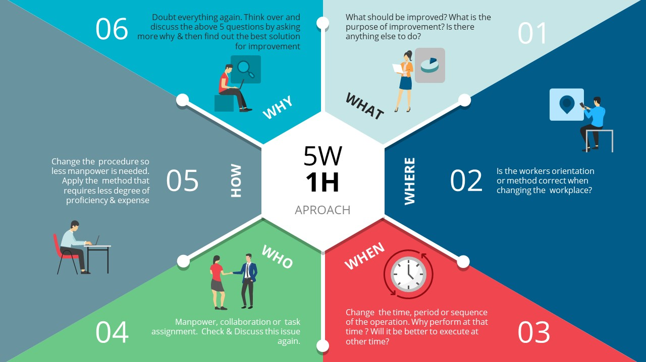
https://slidemodel.com/templates/5w1h-framework-powerpoint-diagram/

Slide 54
5W1H Framework PowerPoint Diagram
5W1H framework questions provide facts and help a team of analysts to make informed decisions and next step further in process. Take a look at one of the 5W1H example:
What – What is the product?
Where – Where is it produced?
When – When it will be ready for quality check?
Who – Who is responsible for development phase?
Why – Why use product features checklist?
How – How to implement quality parameters?

Slide 55
5W1H Framework Power Point Diagram
The 5W1H Framework Power Point Diagram offers pre-explanatory segments for all 6 questions: Who, What, Where, When, Why and How. The 5WH1 template diagram shows a hexagon in the middle. The 6 segments of slide have text placeholders and clipart icons to visualize content of each segment. These latest vector clipart are Power Point shapes that users can edit by resizing or changing colors. Similarly, users can change Power Point background colors or edit text according to presentation topic.

Slide 56
The 5-ForcesThreat of New Entrants
Web-based business
Power of Buyers
Internet tools
Information availability
Search engines
Power of Suppliers
Threat of Substitutes
New retail channel
No Wholesaler retailers
Rivalry

Slide 57
References
Business analysis life cycle & IT- business analyst: Role in traditional, digital and agile world kindle edition by Subramanyam Gunda (Author) Format: Kindle Edition ASIN ‏ : ‎ B085X3CCSQ Publication date ‏ : ‎ March 13, 2020.
Milani Fredrik. Digital Business Analysis. Springer, 2019. - 432 р. - ISBN 978-3-030-05719-0.
Cadle James, Paul Debra, Turner Paul. Business Analysis Techniques: 99 essential tools for success . 2nd Edition BCS, The Chartered Institute for IT, 2014. - 356 p. - ISBN-10: 1780172737; ISBN-13: 978-1780172736.
Wirtz, B. W. (2018a). Business model management: Design-Instrumente - Erfolgsfaktoren (4th ed.). Wiesbaden: Springer Gabler.
Wirtz, B. W. (2018b). Electronic business (6th ed.). Wiesbaden: Springer Gabler.
Zott, C., Amit, R., & Massa, L. (2011). The business model: Recent developments and future research. Journal of Management, 37(4), 1019–1042
Bernd W. Wirtz. Digital Business Models.Concepts, Models, and the Alphabet Case Study. ISSN 2196-8705. Progress in IS. ISBN 978-3-030-13004-6.

