Slide 1
Digital business models
Lecture 11. Ways to develop digital business models
DSc.Takhir Kuchkarov

Slide 2
Content
What is the business model ?
How do you create the business model ?
What is digital business model ?
How do you create the digital business model ?
Development of the digital business models by using Canvas technology

Slide 3
What is the business model ?

Slide 4
What is business model ?
A business model is a company's core strategy for profitably doing business. Models generally include information like products or services the business plans to sell, target markets, and any anticipated expenses. The two levers of a business model are pricing and costs

Slide 5
What should a business model include?
A business model should answer important questions about your business and set out a strong vision for the business. The key components of a business model should include relating to your target customers, the market, organization strengths and challenges, essential elements of the product, and how it will be sold.

Slide 6
Key elements of Business Model that you should understand
Value Proposition
Revenue Model
Market Opportunity
Competitive Environment
Competitive Advantage
Market Strategy
Organization Development
Management Team

Slide 7
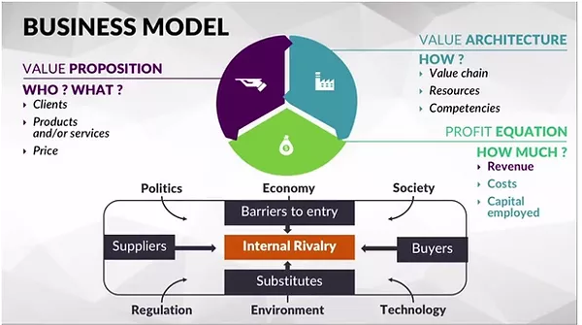
https://www.inotsy.com/business-model-innovation-1

Slide 8
Follow these simple steps to securing a strong business model
Identify your specific audience. ...
Establish business processes. ...
Record key business resources. ...
Develop a strong value proposition. ...
Determine key business partners. ...
Create a demand generation strategy. ...
Leave room for innovation.
https://www.entrepreneur.com/article/243753

Slide 9
There are seven business models for small businesses to consider
1. The manufacturer. ...
2. Bricks and clicks. ...
3. Advertising. ...
4. The marketplace. ...
5. Subscription. ...
6. Direct sales. ...
7. On-demand.

Slide 10
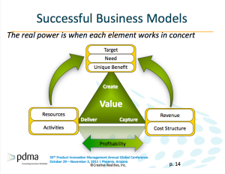
https://www.creativerealities.com/innovationist-blog/bid/77571/Insights-from-the-PDMA-s-2011-Business-Model-Innovation-Lab

Slide 11
The approach: Assumption-based business model development
Problem/Solution-Fit
Product/Market-Fit
Willingness to Pay
Value Delivery Phase
Scaling & KPIs

Slide 12
How do you create
the business model ?

Slide 13
How to Write a Good Business Model ?
Developing a business model typically entails describing how your company operates. Writing a good business model involves answering questions about your company’s customers and product or services, as well as its marketing and distribution strategies. In addition, the model should list the roles and responsibilities of employees in achieving these goals. Analyze your organizational structures and modify them regularly to maintain a competitive edge in today’s dynamic marketplace.

Slide 14
How to Develop Business Model
To develop an effective business model for your company, draw a picture that establishes a structure so your employees can produce products or services for customers in a profitable way. A business model typically includes a description of your customers, how customers use your product, how you distribute your product and details about how you promote your business. The model also describes key operational tasks, staffing and other resource requirements as well as details about how business is conducted. A business model describes your business using visual images, typically on a single page, while a business plan describes your business in a more lengthy document.

Slide 15
How to Develop the Business Model
1.Collect information about your business and analyze it so that you can create a visual description of your company. Keep your business model simple.
2.Define your target market. Summarize how you plan to attract customers who allow you to charge a profitable price for your company’s products or services. Successful business models tend to require minimal marketing expenses by targeting the right population. These customers may also be resellers or distributors of your product.
3.Establish your value proposition. An effective business model relies on clear definition of valuable features and benefits associated with your product or service. Show how your company intends to get or maintain a competitive advantage, such as through better distribution, more innovative solutions to customer problems, lower pricing or faster delivery.

Slide 16
How to Develop the Business Model
4.Describe how you intend to run your business more efficiently and produce higher quality products than your competition. For example, identify opportunities to manufacture products overseas or to use improved technology or processes. Streamline your sales and support operations. Implement quality management systems, such as Six Sigma, as part of your business model to reduce defects, improve quality and decrease costs.
5.Use the resources provided by websites, such as the Small Business Administration Small Business Planner, Business.gov and the Business Valuation Resources website to get data on industry standards that may impact your business operations.

Slide 17
How to Develop the Business Model
6. State your strategy for ensuring customer satisfaction. Operations with extensive technical support and customer service tend to incur high warranty costs but maintain high levels of customer satisfaction, retention and loyalty. Depending on your strategic goals, establishing partnerships with other service providers may be a more cost effective way to conduct business.
7. Describe how you intend to improve your market position. For example, list ways you can locate new customers, add new products or expand your business in other ways. Potential investors typically want to see details about projected growth in your business model and associated plan. Estimate the return on investment. Use the resources provided by the Census.gov website to locate details about the overall outlook for your industry.

Slide 18
What is digital business model ?

Slide 19
What is the digital business model ?
A digital business model might be defined as a model that leverages digital technologies to improve several aspects of an organization. From how the company acquires customers, to what product/service it provides. A digital business model is such when digital technology helps enhance its value proposition.
https://fourweekmba.com/digital-business-models/

Slide 20
What is the digital business ?
A digital business is a business that uses technology to sell to its customers and complete day-to-day operations. Digital businesses use technology to not only automate their daily business processes but also create new value in their business models, customer experience, and internal capabilities.
This can include offering telemedicine services, providing customers a virtual shopping experience at retail outlets, and setting up a remote workforce. Amazon, Netflix, and Uber are some examples of digital businesses.
https://fourweekmba.com/digital-business-models/

Slide 21
What is the digital business model ?
A digital business model focuses on harnessing digital technologies to create a value proposition.
Digital technologies change how value is created as well as change the outcome of innovation.
As an example, by attaching sensors to a large wind turbine engineers can create a digital twin and then use this to understand faults in the current design. In this case, digital technologies are tools that provide new ways to innovate.
On the other hand, digital innovations can be new product-service systems like a Fitbit watch. Fitbit uses sensors on a physical watch that generate digital data and help people to understand their heart rate, fitness level and track their performance.
Because of low cost, global digital infrastructure and the ease with which technologies can be integrated, creating a new and innovative digital business model is within reach of most entrepreneurs.
Add to this the no-code movement and you have the ability for most business people to at least create a prototype digital business model.
https://www.garyfox.co/digital-business-model/

Slide 22
What is the digital business model ?
The digital business model creates value for customers based on digital technologies. Customers are willing to pay for these benefits. Thus, with the help of a digital business model, a clear competitive advantage is achieved.
The development of a digital business model becomes an obligation for companies no later than when they face a digital disruption, i.e. the digital economy becomes.
The digital business model is characterized by digital business innovation, i.e. new services are entering the market. Customer willingness to pay and independent value added are clear manifestations of the digital business model.
Automatics accompanies you throughout the entire process: from idea, strategy and design to implementation: customer-oriented, fast, flexible, innovative.

Slide 23
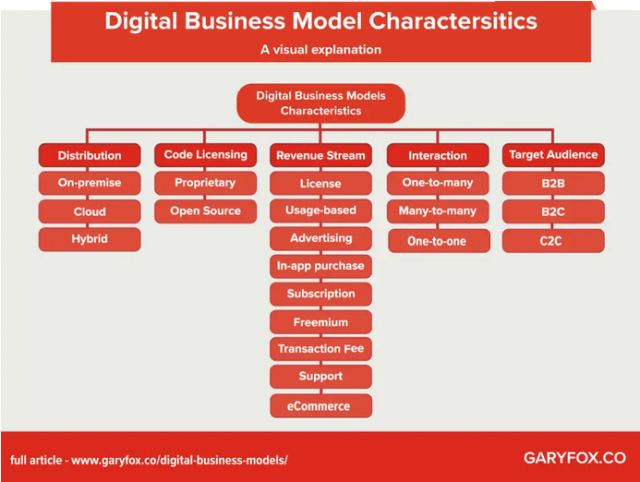
Characteristics of the digital business models
https://www.garyfox.co/digital-business-model/

Slide 24
The three components of digital business model (content, customer experience and platform)
Digital content - information, as well as products and services related to them, provided to subscribers of data networks and mobile networks in digital form, and consumed using digital devices. Electronic content, for example, can mean almost any content of a web resource: text or audio, video, photo files.
Customer experience is mean people's experiences when they shop online for your company's products or services, whether they're digital or physical.
The platform is a consistent system of digitized business processes, information data and infrastructure. The platform has internal and external components, and it must ensure the delivery of not only digital content to customers, but also physical products.

Slide 25
How do you create
the digital business model ?

Slide 26
How to build the digital business ?
Starting a digital business takes less time and doesn’t require heavy investment in physical assets such as office space or inventory. Due to the availability of various free SaaS tools, building a digital business has only become easier.
But to have an agile digital core, you need to think carefully about the nitty-gritty of building your digital business model. Listed below are six steps to set up a successful digital business.

Slide 27
How do you create the digital business model ?
Six key steps to build a successful digital business
Create the right mindset. ...
Put the right leaders in the right place. ...
Launch digital business centers of excellence. ...
Formulate a digital strategy to respond to opportunities and threats. ...
Find and define digital business roles. ...
Create new digital business channels.

Slide 28
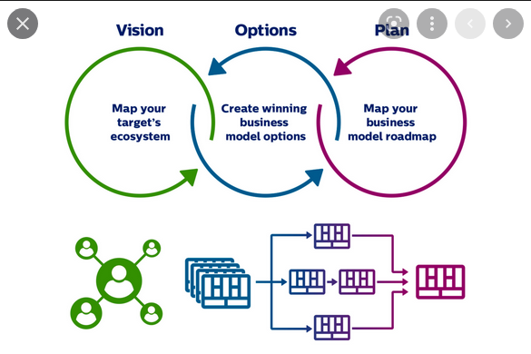
Three steps to digital business models | Philips Engineering Solutions
https://www.engineeringsolutions.philips.com/news/three-steps-to-digital-business-models/

Slide 29
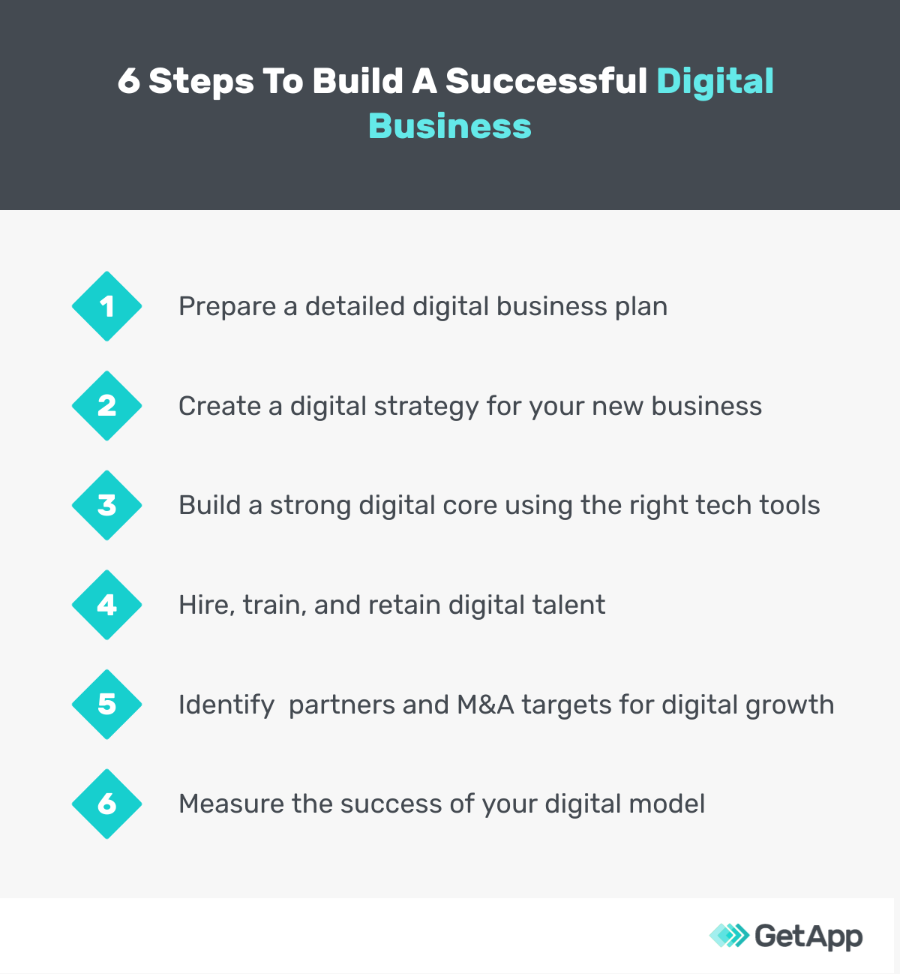
https://www.getapp.com/resources/how-to-build-a-digital-business/

Slide 30
1. Prepare a detailed business plan
A comprehensive business plan is important to start any business. Your business plan should outline what your business is about, who’s going to lead it, what your goals and vision are, and how you plan to achieve them.
Include details about your financing plans, marketing strategies, target customers, and unique value proposition. Also, mention which digital initiatives you plan to implement to meet your goals. For instance, if you’re planning to start an ed-tech business, mention which technologies (e.g., artificial intelligence or AI) you’ll use to build the digital platform and deliver the right courses to students.
Here’s a free downloadable template of a digital business plan you can use to write down your vision, mission, and goals. Feel free to customize it per your brand colors, themes, and ideas.
https://www.getapp.com/resources/how-to-build-a-digital-business/

Slide 31
2. Create a digital strategy for your new business
A strategy is a document that explains “why” and “how” you plan to reach your goals. Creating a brand story (i.e., a story that explains why your business exists), developing buyer personas, and designing customer journey maps are some steps to building your digital strategy.
Your strategy document should also explain how you plan to use technology to reach out to potential customers and manage operations. Align your strategy with your business goals to get maximum leverage, and evaluate it regularly to ensure it reflects the latest market trends and predictions.
https://www.getapp.com/resources/how-to-build-a-digital-business/

Slide 32
3. Build a strong digital core using the right tech tools
Successful digital businesses invest in tech solutions that are scalable, flexible, and help adapt to the changing IT landscape. This helps create a strong digital core, which includes IT infrastructure that positions your business for long-term growth. Thus, invest in the right technology and tools to build a successful online business.
Main tools you’ll need to build your digital business:
Business website: Your website is most likely the first place customers will check when searching for more info about your business.
Social media: You can’t do without social media presence today. Your customers and prospects will use social media platforms such as Facebook and Instagram to share their experiences with your brand and to connect with you for complaints, suggestions, and other needs.
E-Commerce website: If you’re into selling products, having an e-Commerce website is necessary. Ensure your e-Commerce website supports a variety of e-payment methods.
Mobile capabilities: Having a mobile-optimized website or a mobile app will make it easier for customers to reach out to you.
Digital tools for internal use: You'll need various software tools, including CRM, sales enablement, messaging, and marketing automation platforms, to automate your business workflows and communicate internally as well as with clients.
Emerging technologies: Embracing technologies such as IoT, artificial intelligence, blockchain, and augmented or virtual reality will help your digital business stand out from others and be better prepared to meet future customer demands and market trends.

Slide 33
4. Hire, train, and retain digital talent
It’s not easy to hire talent with core digital skills such as cloud computing, machine learning, analytics, and automation. According to a report, there’s stiff competition among employers to hire employees with skills in DevOps, cloud, automation, data management, cyber security, and customer experience. Hiring employees with the digital skills you need to build and run your business must, therefore, be one of your top priorities.
Besides hiring new employees, focus on retraining your existing workforce to help them gain speed on digital technologies. You can reach out to freelance professionals for specific skill sets such as website or mobile app development. You can also consider partnering with colleges and universities to identify potential candidates who can work with you as interns, full-time employees, or for individual projects.

Slide 34
5. Identify business partners and M&A targets for digital growth
Another way to build your digital strength is working with partners specialized in the field. You can outsource the task of building your digital core to somebody who has experience in it rather than trying to do it yourself, which can lead to errors or take more time to get to market.
Look for vendors that offer digital consulting services. They can help plan your digital growth initiatives by providing necessary digital expertise and knowledge.
If you’re an existing business with extra cash to spare, mergers & acquisitions (M&A) can be a good option to build your digital capabilities. Identify potential companies that can be acquired for their digital products, service offerings, or talent.

Slide 35
6. Measure the success of your digital model and innovate it continuously
The digital space is ever so dynamic. If you don’t adapt quickly to its changes, you may fall behind. To keep abreast of developments, read tech blogs, attend events and conferences, and network with peers, among others.
Also, evaluate your digital business model regularly against industry and market changes. Accordingly, adjust your strategy and the way you operate to leverage emerging market trends and grow quickly.

Slide 36
Pitfalls to avoid when building your digital business
A fuzzy or unclear digital business plan or strategy
If you’re unsure of what you want to achieve from digital transformation strategy, your business may end up being half-baked or going in the wrong direction. Target digital goals that are SMART (specific, measurable, achievable, realistic, and timely), and mention them clearly in your digital plan.
Business leaders who aren’t digital-savvy
The vision for digital growth should be top down. If your management isn’t up to date with the latest tech developments, it's likely your digital transformation initiatives won’t bear fruit. Bring in leaders who understand and are equipped in change management, digital technology, and business management.
Investment in the wrong tech and tools
Building a digital business requires investment in a variety of software tools and technologies. Choosing the wrong tools will cost you both money and time, lowering any competitive advantage you have. Therefore, research the technology well and read user reviews to make an informed purchase decision.
Noncompliance with data privacy regulations
Governments across the globe are trying to regulate the digital space and protect the privacy of consumers. Ensure you comply with all local and global data privacy regulations, such as GDPR, CCPA, HIPAA, and PCI-DSS.

Slide 37
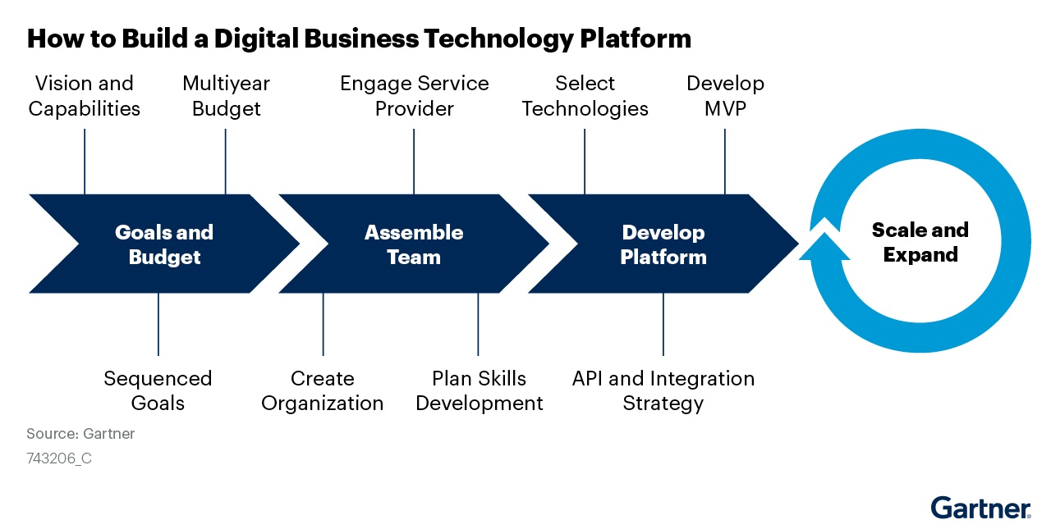
https://blogs.gartner.com/deacon-wan/files/2021/03/Road-map-on-the-series-of-steps-to-create-a-digital-business-technology-platformtarget.jpg

Slide 38
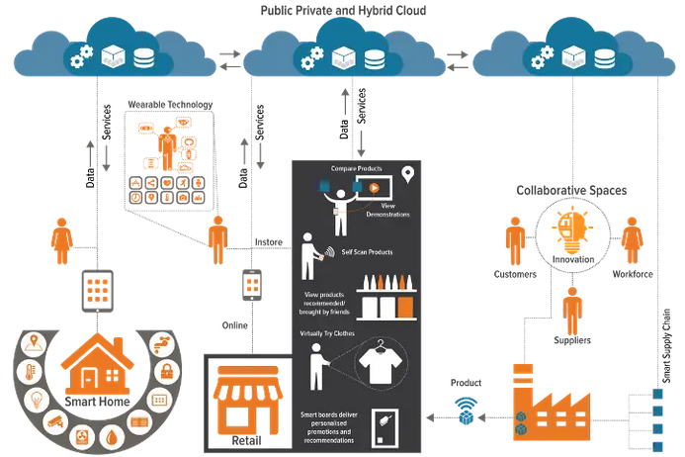
Examples of how digital business models change work, home and consumer behaviour
https://www.garyfox.co/digital-business-model/

Slide 39
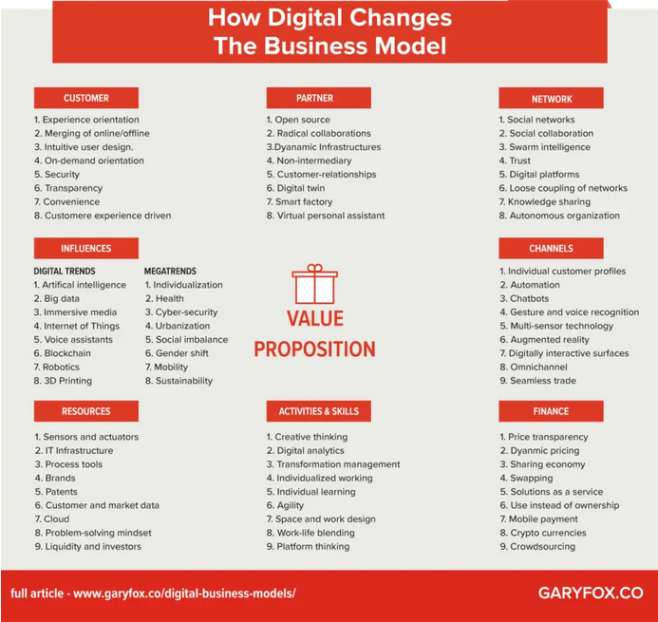
How Digital Technologies Shape Future Digital Business Models
https://www.garyfox.co/digital-business-model/

Slide 40
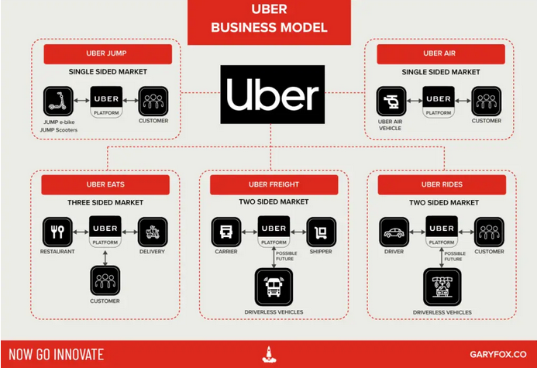
Digital Business Models Examples
Digital Platforms
https://www.garyfox.co/digital-business-model/

Slide 41
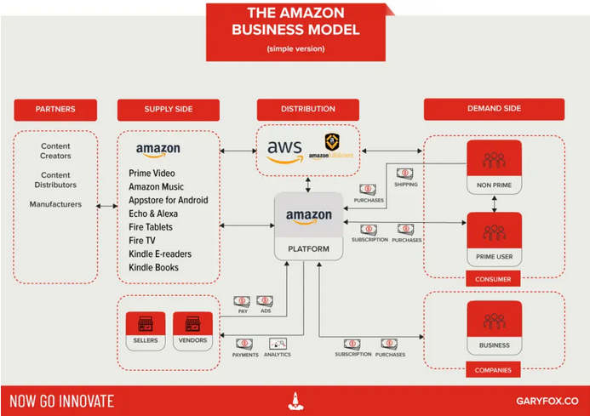
https://www.garyfox.co/digital-business-model/

Slide 42
Development of the
Digital Business Models
by using Canvas technology

Slide 43
The technology of Business Model Canvas
The technology of Business Model Canvas is a strategic management template used for developing new business models and documenting existing ones. It offers a visual chart with elements describing a firm's or product's value proposition, infrastructure, customers, and finances, assisting businesses to align their activities by illustrating potential trade-offs.
The nine "building blocks" of the business model design template that came to be called the Business Model Canvas were initially proposed in 2005 by Alexander Osterwalder, based on his earlier work on business model ontology. Since the release of Osterwalder's work around 2008, new canvases for specific niches have appeared
https://en.wikipedia.org/wiki/Business_Model_Canvas

Slide 44
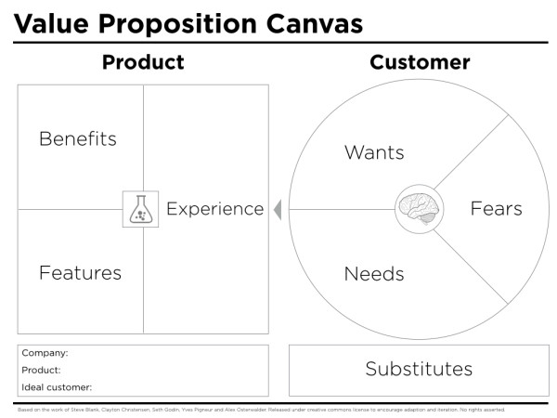
https://www.peterjthomson.com/2013/11/value-proposition-canvas/

Slide 45
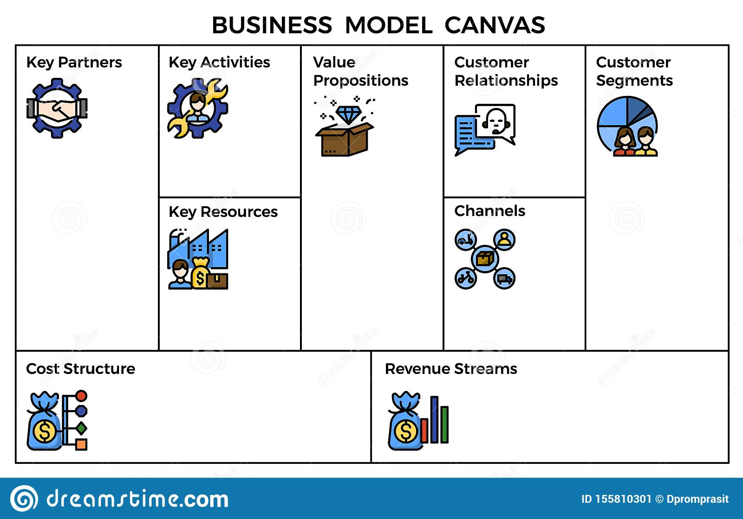
https://www.dreamstime.com/business-model-canvas-template-outline-icons-presentation-book-website-etc-image155810301

Slide 46
The Business Model Canvas
The business model canvas is a great tool to help you understand a business model in a straightforward, structured way. Using this canvas will lead to insights about the customers you serve, what value propositions are offered through what channels, and how your company makes money. You can also use the business model canvas to understand your own business model or that of a competitor. The Business Model Canvas was created by Alexander Osterwalder, of Strategyzer

Slide 47
Description methodology the Business Model Canvas
In order to use business models, destroy old “analogue” ones or create new digital ones, you need to figure out what blocks a business model consists of and how “digital” affects certain blocks. Osterwalder's "business model canvas" is often used to describe business models.

Slide 48
Key Elements of the Osterwalder Business Model Canvas
The canvas consists of nine key blocks: Key Partners, Key Activities, Key Resources, Value Proposition, Customer Relationships, Channels, Customer Segments, Cost Structure, and Revenue Sources.
Typically, a business model is presented in the form of a page, for example, A4 format. An external look at the business model immediately allows you to understand how the business works and how it works.

Slide 49
Block 1 - consumer segments
The first block of the canvas - customer segments - are the customers of the organization. To better meet the demand, the Osterwalder model proposes to divide customers into consumer segments - groups according to needs, behavioral characteristics and other characteristics.
Digital transformation has affected this block of the business model in several ways. First, technology has changed and continues to change consumer behavior patterns. Second, the development of the Internet and digital technologies has given rise to digital platforms, which in turn have given rise to organizations that serve two or more interconnected consumer segments. Thirdly, new approaches to understanding

Slide 50
Block 2 - value proposition
The block includes a description of goods and services that provide value to a particular consumer segment.
The product or service must provide value to the customer. It is very important that the product is created to solve some problem of the client. If the product has value and it is formulated correctly, then we see an increase in sales. The organization literally does not keep up with the service of incoming orders. If there is no value, or you cannot describe it and convey it to the client, then it is very difficult to build a growing business.
Osterwalder defines a value proposition as a set of benefits that a company offers to consumer. The main advantages are proposed to be novelty, performance, customization, pay-per-consumption, design, brand, price, cost reduction, risk reduction, accessibility and convenience.
Digital transformation has brought to this block both new methods for formulating a value proposition, which we will discuss below, and the possibility of creating new digital products or using technologies to digitize analog products.

Slide 51
Block 3 - channels
This block describes how the company communicates value propositions to customer segments. There are 5 main stages for each of the distribution channels:
informing buyers,
value proposition evaluation,
sale of goods,
shipping,
after-sales service.

Slide 52
Block 4 - relationship with customers
The block describes the types of relationships with customer segments. Osterwalder identifies several types of relationships:
personal support,
special personal support self-service.
There are also several types of relationships that arise as a result of digital transformation:
these are automated services,
communities,
co-creation,
self-service has also received a new life.

Slide 53
Block 5 - sources of income
This block is about monetization or how an organization receives income. Ostrewalder distinguishes two types of income streams: one-time transactions and periodic payments. One-time transactions include the sale of an asset, advertising or brokerage interest. To periodic - payment for use, payment for a subscription, payment for rent, licenses.
It is necessary to track and accumulate new monetization models that digital generates. The sources of such models can be technology startups (in particular startups from the FinTech field), as well as just individual technologies. For example, you can use Gartner Hype Cycle. Below is an example of distributed ledger technologies that can provide ideas for new monetization models. For more details about this technology, see a separate chapter.

Slide 54
Block 6 - key resources
This block describes the key resources that are necessary for the functioning of the business model. Osterwalder allocates material, financial, intellectual and human resources. Ask yourself what resources do you need to run and manage your business?
Digital technologies have had a significant impact on this block of the business model. Firstly, digital technologies underlie digital platforms, which actually gave a boost to the development of the digital economy, made it possible to create new business models that use multilateral markets. Secondly, digital technologies have become a tool for the digital transformation of organizations. A company can either own resources or rent them or even take them for free from partners when it comes to the ecosystem business model.

Slide 55
Block 7 - key activities
The block describes the actions of the company that are necessary for the operation of the business model. The following main activities are distinguished: production and problem solving. For example, Microsoft's key activity is the production of software.
Digital technologies have also influenced this block of the business model. For example, a key activity of companies using the platform business model is the creation, management and promotion of the platform. So the key activity of Uber is the development, management and promotion of its platform for connecting drivers and passengers. And for a product-focused business, user learning and product improvement can be a key activity.

Slide 56
Block 8 - key partners
The block describes the key partners that make the business model work. These can be suppliers, contractors, non-competing organizations, and in today's digital world, even competitors.
Collaborations
Digital technologies improve collaboration with supply chain partners and help to more adequately allocate business risk, making cost reduction possible. This is a traditional type of collaboration. Recently, we have also seen new types of collaborations that allow us to create new value for our clients. For example, the launch of MacDonald’s collaboration with Sberbank - we can assume that the client will be able to have a bite to eat at the Sberbank service “office” while he solves one or another of his questions.
We also say that in a number of business models, technology allows one or another consumer segment to become a partner itself. For example, in the Uber business model, partners are the owners of cars, without which it is impossible to provide services. Moreover, platform models, when combined, make it possible to create ecosystems. We talk about this block in more detail in a separate chapter.

Slide 57
Block 9 - cost structure
These are the costs associated with the operation of the business model. Traditionally fixed and variable costs are distinguished. In general, the impact of technology on the cost structure will vary from industry to industry and will depend on certain internal processes.
By According to the research company MGIAnalysys, based on the example of the German market, the greatest potential from the introduction of technologies can be obtained in the hotel industry (72%), in second place - transport and storage, and in third - agriculture. The diagram above also highlights the processes in which it is possible to obtain the maximum effect.

Slide 58
References
Business analysis life cycle & IT- business analyst: Role in traditional, digital and agile world kindle edition by Subramanyam Gunda (Author) Format: Kindle Edition ASIN ‏ : ‎ B085X3CCSQ Publication date ‏ : ‎ March 13, 2020.
Milani Fredrik. Digital Business Analysis. Springer, 2019. - 432 р. - ISBN 978-3-030-05719-0.
Cadle James, Paul Debra, Turner Paul. Business Analysis Techniques: 99 essential tools for success . 2nd Edition BCS, The Chartered Institute for IT, 2014. - 356 p. - ISBN-10: 1780172737; ISBN-13: 978-1780172736.
Wirtz, B. W. (2018a). Business model management: Design-Instrumente - Erfolgsfaktoren (4th ed.). Wiesbaden: Springer Gabler.
Wirtz, B. W. (2018b). Electronic business (6th ed.). Wiesbaden: Springer Gabler.
Zott, C., Amit, R., & Massa, L. (2011). The business model: Recent developments and future research. Journal of Management, 37(4), 1019–1042
Bernd W. Wirtz. Digital Business Models.Concepts, Models, and the Alphabet Case Study. ISSN 2196-8705. Progress in IS. ISBN 978-3-030-13004-6.

