Slide 1
Digital business models
Lecture 12. E-commerce Business Models
DSc.Takhir Kuchkarov

Slide 2
Content
What is e-commerce and e-business?
Advantages and benefits of e-commerce
The types of e-commerce Business Models (B2C,B2B,C2B and C2C)

Slide 3
What is e-commerce and e-business?

Slide 4
What is e-commerce and e-business?
What is e-commerce ?
a communications perspective – the delivery of information, products or services or payment by electronic means.
a business process perspective – the application of technology towards the automation of business transactions and work-flows.
a service perspective – enabling cost cutting at the same time as increasing the speed and quality of service delivery.
an online perspective – the buying and selling of products and information online.
What is e-business ?
All electronically mediated information exchanges, both within an organization and with external stakeholders supporting the range of business processes.
Notes:
4

Slide 5
E-commerce Business Models
Business model
e-commerce Business Models is -"a set of planned activities designed to result in a profit in a marketplace"
Business plan
business plan is -"a document that describes a firm’s business model "
E-commerce business model
e-commerce business model is-"a business model that aims to use and leverage the unique qualities of the Internet and the World Wide
https://docplayer.net/10507006-E-commerce-business-models-and-concepts.html

Slide 6
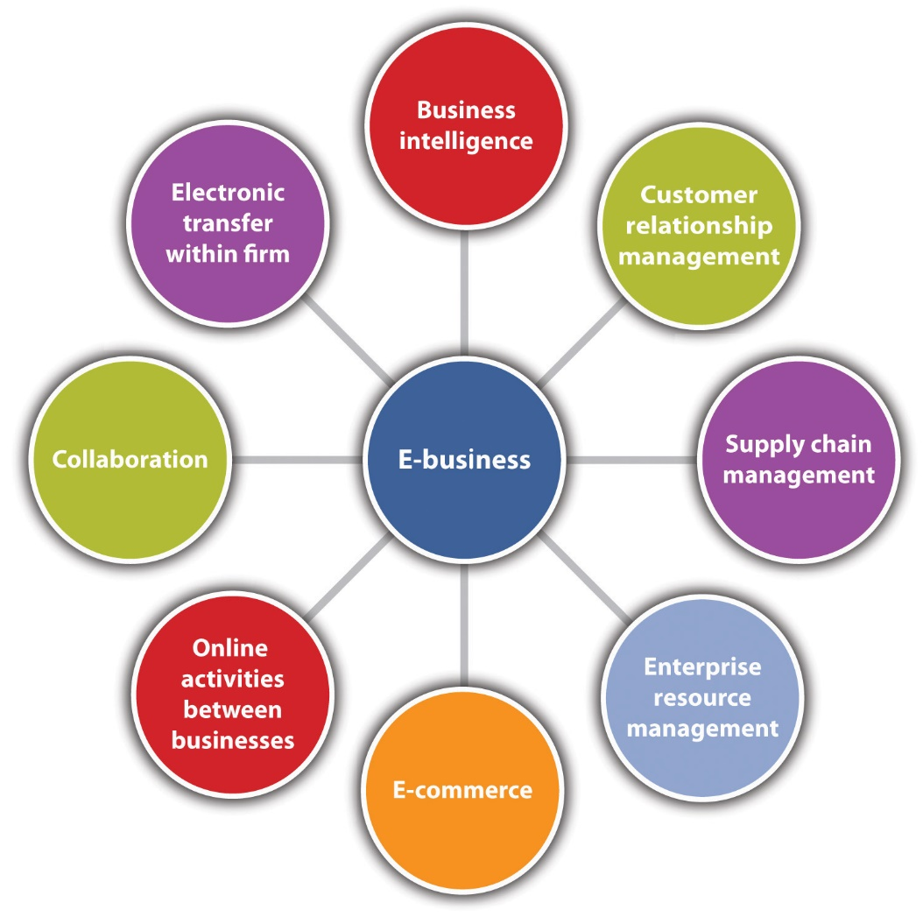
Components of E-Business
https://saylordotorg.github.io/text_small-business-management-in-the-21st-century/s08-01-e-business-and-e-commerce-the-.html

Slide 7
E-business category
E-banks
E-trade
E-consulting
E-engineer
E-learning
E-mail
E-marketing
E-transactions

Slide 8
The relationship between the concepts of e-commerce and e-business
The relationship between the concepts of e-commerce and e-business. E-commerce is generally understood to be a sub-set of e-business. E-commerce refers to financial and non-financial transactions between organizations. These transactions are often considered in the context of a supplier organization distributing and selling its product to consumers. E-business includes transactions from a buy-side and sell-side e-commerce perspective and also the use of communications technology to improve internal process efficiencies

Slide 9
The relationship between the concepts of e-commerce and e-business
sell-side e-commerce: Sell-side e-commerce concerns transactions related to the sale and distribution of goods such as a supermarket selling direct to its customers
buy-side e-commerce: Buy-side e-commerce refers to electronic transactions concerned with the purchase and inbound logistics of goods such as a supermarket coordinating purchases from its suppliers
internal use of electronic communications to support business processes.
E-business is generally understood to include all three elements. E-commerce is commonly used to refer to either the first one or first two of these elements, but less commonly the third. E-business is broader in scope than e-commerce.
https://slidetodoc.com/chapter-1-ecommerce-foundations-infrastructure-objectives-ecommerce-introduction/

Slide 10
Two sides of e-commerce
Buy-side e-commerce
E-commerce transactions between a purchasing organization and its suppliers.
Sell-side e-commerce
E-commerce transactions between a supplier organization and its customers.

Slide 11
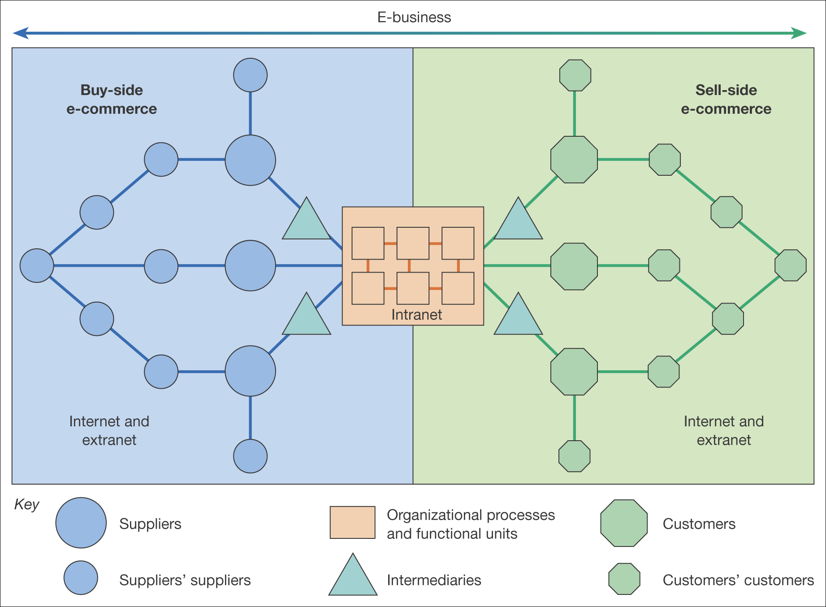
The distinction between buy-side and sell-side e-commerce
https://slidetodoc.com/chapter-1-ecommerce-foundations-infrastructure-objectives-ecommerce-introduction
Notes:
11

Slide 12
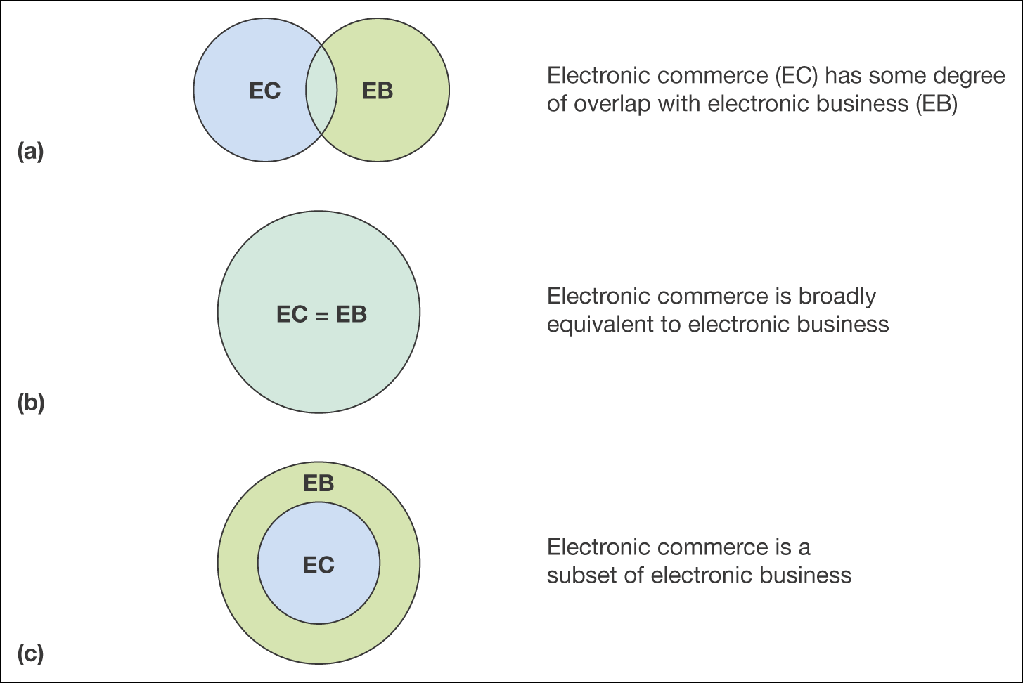
The relationship between e-commerce and e-business
https://slidetodoc.com/chapter-1-ecommerce-foundations-infrastructure-objectives-ecommerce-introduction
Notes:
12

Slide 13
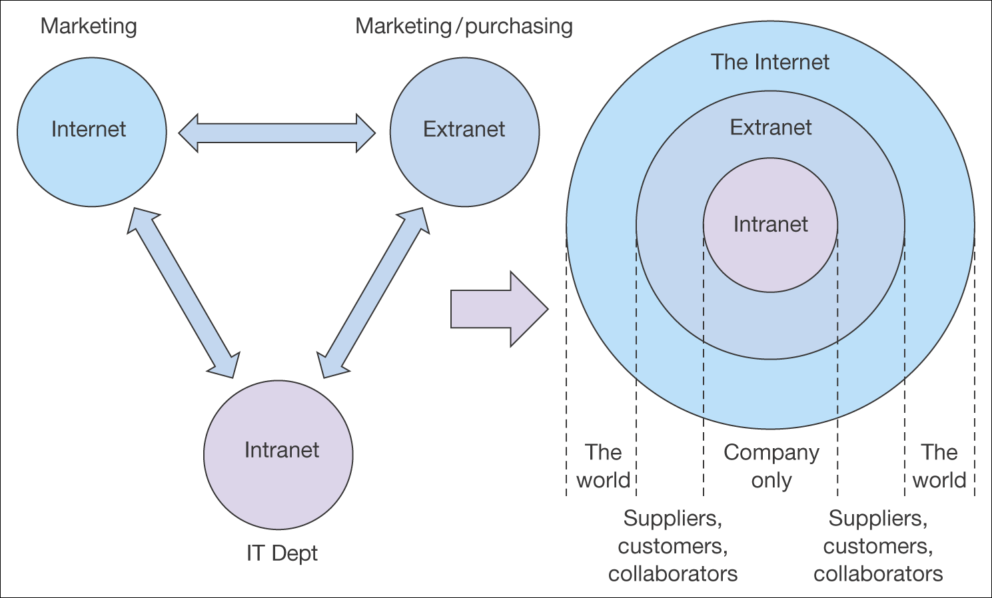
The relationship between intranets, extranets and the Internet
Notes:
13

Slide 14
Concept of e-commerce
e-commerce is the area of commerce that is conducted via computer networks and information systems.
e-commerce started among businesses (supply markets), and expanded into consumer markets when Internet moved to businesses and homes in the mid-1990.
Moving into B2C or B2B is an important business strategy leading to increasing market share, integrating supply chains, improving financial results. E-commerce strategy is mad possible by modern digital technologies (Web, e-payment, e-banking, e-supply chain).

Slide 15
What is the aim of e-commerce?
E-commerce business model aims is to use and leverage the unique qualities of Internet and Web.
The primary goal of e-commerce is to reach maximum customers at the right time to increase sales and profitability of the business. Functions of e-commerce include buying and selling goods, transmitting funds or data over the internet.
When you're starting an e-commerce business, it's important to have a strong e-commerce business model in place. Your business model helps determine how you're going to reach and retain customers, stand out in the marketplace - and how customers are going to get a hold of your products.

Slide 16
What is the main purpose of a business model ?
The main purpose of a business model is identifies the products or services the business plans to sell, its identified target market, and any anticipated expenses. Business models are important for both new and established businesses. They help new, developing companies attract investment, recruit talent, and motivate management and staff.

Slide 17
What is e-сommerce and its business model?
The term electronic commerce (e-commerce) refers to a business model that allows companies and individuals to buy and sell goods and services over the Internet.
E-commerce operates in four major market segments and can be conducted over computers, tablets, smartphones, and other smart devices.

Slide 18
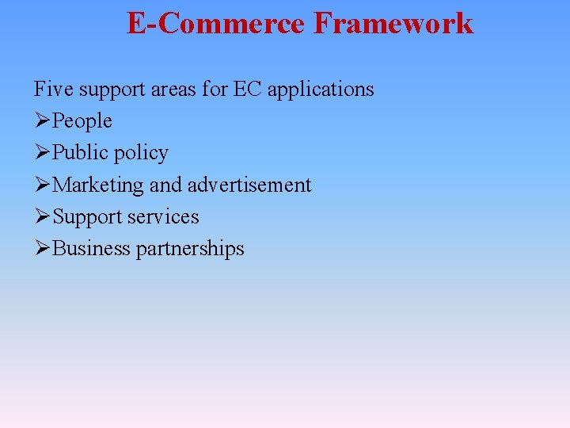

Slide 19
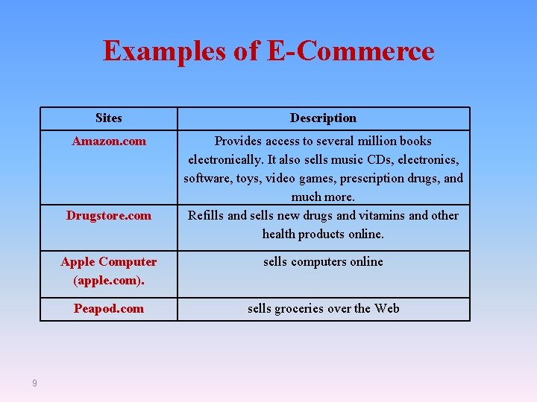

Slide 20
How the Internet and the Web
Change Business
E-commerce changes industry structure by changing:
  Rivalry among existing competitors
  Barriers to entry
  Threat of new substitute products
  Strength of suppliers
  Bargaining power of buyers

Slide 21
E-commerce Enablers:The Gold Rush Model
E-commerce infrastructure companies have profited the most:
  Hardware, software, networking, security
  E-commerce software systems, payment systems
  Media solutions, performance enhancement
  CRM software
  Databases
  Hosting services, etc.

Slide 22
Advantages and benefits
of e-commerce

Slide 23
Advantages of e-commerce
Electronic commerce will substantially lower the transaction cost.
It eliminates many fixed costs of maintaining brick and mortar shops.
This allows the companies to enjoy a much higher margin of profit.
It provides quick delivery of goods with very little effort on part of the customer.

Slide 24
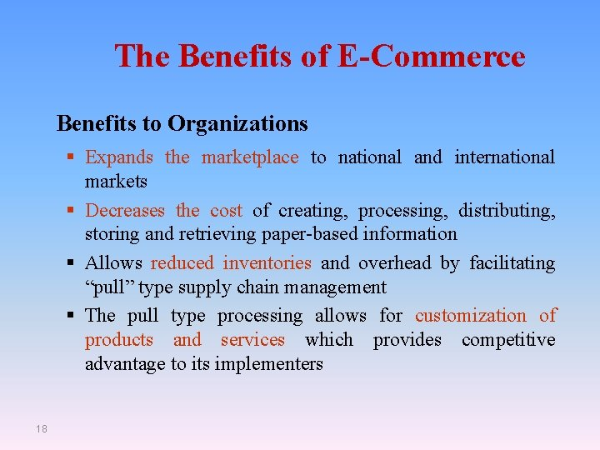

Slide 25
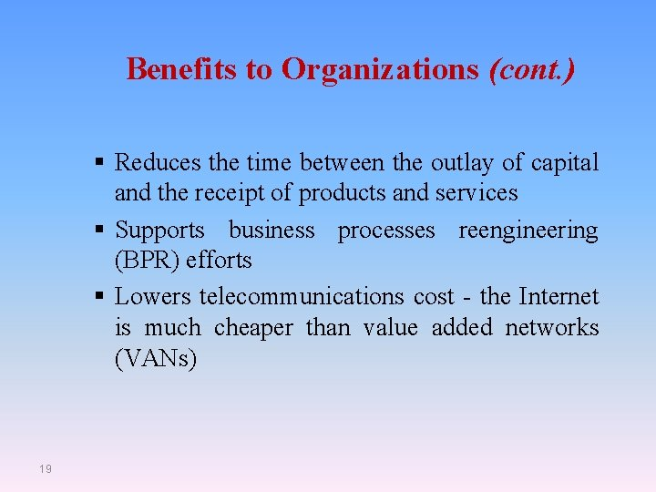

Slide 26
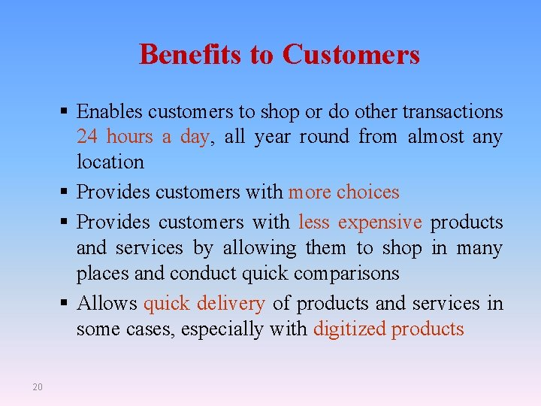

Slide 27
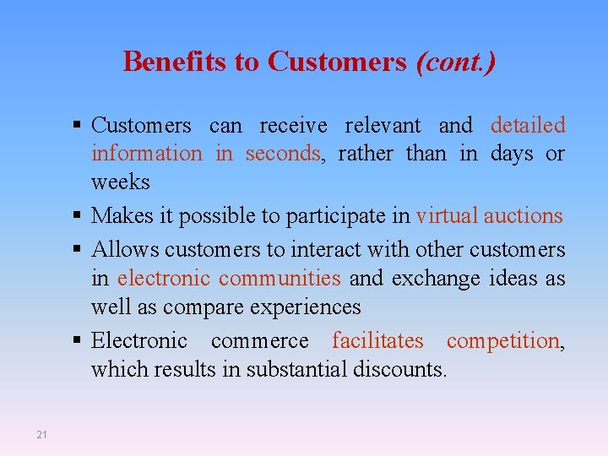

Slide 28
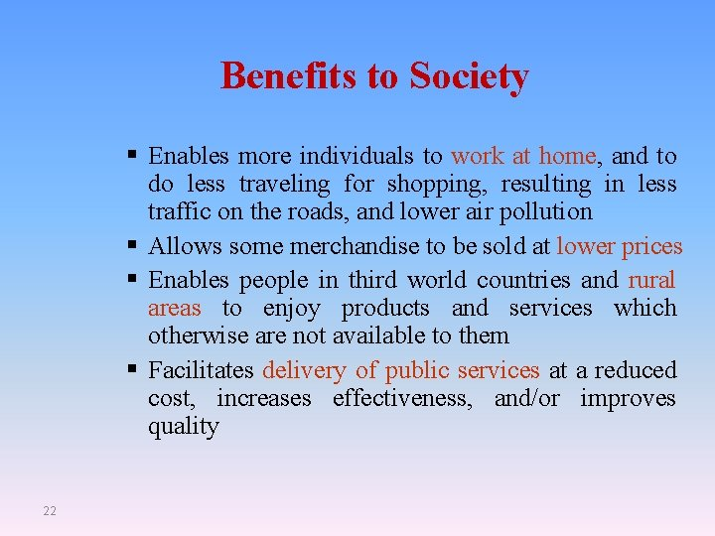

Slide 29
The types of e-commerce
Business Models

Slide 30
What are the Main Types of e-commerce Business Models?
B2C – Business to consumer. B2C businesses sell to their end-user. ...
B2B – Business to business. In a B2B business model, a business sells its product or service to another business. ...
C2B – Consumer to business. ...
C2C – Consumer to consumer
Other Business Models

Slide 31
B2C Business Models

Slide 32
B2C E-commerce
Boom 1994-2000, crash in 2001, recovery afterward. Pure vs. hybrid models.
Share od B2C e-commerce in total retail* in 2019:
- World 14%
- in Canada 10%, in U.S.A. 11%, in UK 22%, in China 37% (and nominally largest, 1.9 trillion vs 587 billion in US)
Global reach & 24/7 sales
Savings on physical stores
Direct marketing (customer profiling via clickstream or search tracking systems*; personalized Web storefronts)
Cross selling (automatic matching of customer profiles)
Consumer: Convenience, selection, some savings
Notes:
*World total retail in 2019 was US$25 trillion; e-retail was 3.5 tril.

Slide 33
What is Business to Consumers (B2C) ?
Refers to businesses selling products or services to end-user consumers.
B2B stands for transaction activities involving two business entities (business-to-business transaction). B2C stands for transaction activities involving a business and a consumer (business-to-consumer transaction).
Electronic commerce comprises commercial transactions, involving both organisations and individuals. From the technical point of view e-commerce is the processing and transmission of digitised data. E-commerce decreases the distance between producers and consumers. Consumers can make their purchase without entering a traditional shop.

Slide 34
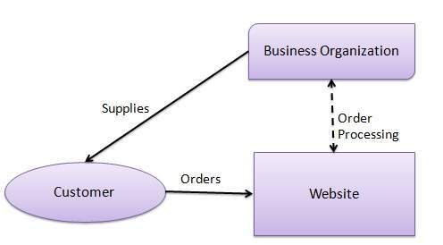
B2C Business Models
https://www.tutorialspoint.com/e_commerce/e_commerce_business_models.htm

Slide 35
B2C Business Models
B2C Business Models is a business-to-consumer, or B2C,business model is one in which a company sells a service or product directly to a consumer.
B2C is the alternative of the business-to-business model (B2B) in which a company sells their products first to another business, which will then sell the product to another business or a customer with a mark-up.
B2C as a business model typically involves a higher volume of clients, but a lower revenue per client with shorter sales cycles.

Slide 36
Major B2C Business Models
E-tailer
Community provider (social network)
Content provider
Portal
Transaction broker
Market creator
Service provider

Slide 37
B2C Models: e-tailer
Online version of traditional retailer
Revenue model: sales
Variations:
  Virtual merchant
  Bricks-and-clicks
  Catalog merchant
  Manufacturer-direct
Low barriers to entry

Slide 38
B2C Models: Community Provider
Provide online environment (social network) where people with similar interests can transact, share content, and communicate
  e.g.: Facebook, LinkedIn, Twitter, Pinterest
Revenue models
  Typically hybrid, combining advertising, subscriptions, sales, transaction fees, affiliate fees
Notes:
community provider sites that create a digital online environment where people with similar interests can transact (buy and sell goods); share interests, photos, and videos; communicate with like-minded people; and receive interest-related information

Slide 39
B2C Business Models: Content Provider
    Information and entertainment companies that provide digital content over the Web
    Second largest source of B2C e-commerce revenue in 2002
    Typically utilizes an subscription, pay for download, or advertising revenue model
    Syndication a variation of standard content provider model

Slide 40
B2C Business Models: Portal
Offers powerful search tools plus an integrated package of content and services
typically utilizes a combines subscription/advertising revenues/transaction fee model
May be general or specialized (portal)

Slide 41
B2C Business Models: Transaction Broker
    Processes online transactions for consumers
    Primary value proposition – saving of time and money
    Typical revenue model – transaction fee
    Industries using this model:
    Financial services
    Travel services
    Job placement services

Slide 42
B2C Models: Market Creator
Create digital environment where buyers and sellers can meet and transact
  e.g.: Priceline, eBay
Revenue model
  Transaction fees
Notes:
Market creators build a digital environment in which buyers and sellers can meet,
display products, search for products, and establish prices. Prior to the Internet and
the Web, market creators relied on physical places to establish a market. There were
few private digital network marketplaces prior to the Web. The Web changed this by
making it possible to separate markets from physical space. A prime example is Price-
line, which allows consumers to set the price they are willing to pay for various travel
accommodations and other products (sometimes referred to as a reverse auction) and
eBay, the online auction site utilized by both businesses and consumers.

Slide 43
B2C Business Model: Service Provider
    Offers services online, e.g.: Google,Google Maps, Gmail, etc.
    Value proposition – valuable, convenient, time-saving, low-cost alternatives to traditional service providers
    Revenue models – subscription fees or one-time payment

Slide 44
B2B Business Models

Slide 45
B2B Business Models
Business to Business (B2B) is a business model that focuses on transactions that occur between businesses. The companies conduct business with each other without involving the final consumer.
For example, if a business sells a piece of software to another business in another industry, this would be classed as a B2B transaction.
B2B sales cycles tend to be longer since the deals and transactions involved tend to be of high value and will often be recurring orders.
B2B marketing, customer success and loyalty tend to be entirely different, too.

Slide 46
What is Business to Business (B2B) ?
B2B stands for "business-to-business," as in businesses doing business with other businesses. The term is most commonly used in connection with e-commerce and advertising, when you are targeting businesses as opposed to consumers
On the Internet, B2B (business-to-business), is the exchange of products, services, or information between businesses. B2B is e-commerce between businesses. B2B Communication using XML over HTTP B2B - the basics
Business-to-business electronic commerce (B2B) typically takes the form of automated processes between trading partners and is performed in much higher volumes than business-to-consumer (B2C) applications

Slide 47
What is it B2B Business Models ?
Business-to-business (B2B), also called B-to-B, is a form of transaction between businesses, such as one involving a manufacturer and wholesaler, or a wholesaler and a retailer. Business-to-business refers to business that is conducted between companies, rather than between a company and individual consumer.
Business-to-business (B2B) is a transaction or business conducted between one business and another, such as a wholesaler and retailer.
B2B transactions tend to happen in the supply chain, where one company will purchase raw materials from another to be used in the manufacturing process.
B2B transactions are also commonplace for auto industry companies, as well as property management, housekeeping, and industrial cleanup companies.

Slide 48
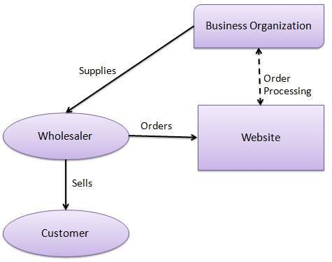
B2B Business Models
https://www.tutorialspoint.com/e_commerce/e_commerce_business_models.htm

Slide 49
B2B Business Models
Net marketplaces
  e-distributor
  e-procurement
  exchange
  Industry consortium
Private industrial network
Notes:
is more than 10 times the size of B2C e-commerce,
even though most of the public attention has focused on B2C.

Slide 50
B2B Models: E-distributor
Companies that supply products and services directly to individual businesses are
  e-distributors. e.g.: Grainger.com
Owned by one company seeking to serve many customers
Revenue model
  Sales of goods
Notes:
Companies that supply products and services directly to individual businesses are
e-distributors.

Slide 51
B2B Models: e-procurement
Creates digital markets where participants transact for indirect goods
  B2B service providers, application service providers (ASPs)
  e.g.: Ariba
Revenue model
  Service fees, supply-chain management, fulfillment services
Notes:
Just as e-distributors provide products to other companies, e-procurement firms
create and sell access to digital electronic markets. Firms such as Ariba, for instance,
have created software that helps large firms organize their procurement process by
creating mini-digital markets for a single firm. Ariba creates custom-integrated online
catalogs (where supplier firms can list their offerings) for purchasing firms.

Slide 52
B2B Models: Exchanges
Independently owned vertical digital marketplace for direct inputs
Revenue model
  Transaction, commission fees
Create powerful competition between suppliers
Tend to force suppliers into powerful price competition; number of exchanges has dropped dramatically
Notes:
An exchange is an independent digital electronic marketplace where
hundreds of suppliers meet a smaller number of very large commercial purchasers.
Exchanges are owned by independent, usually entrepreneurial start-up firms whose
business is making a market, and they generate revenue by charging a commission
or fee based on the size of the transactions conducted among trading parties. They
usually serve a single vertical industry such as steel, polymers, or aluminum, and
focus on the exchange of direct inputs to production and short-term contracts or spot
purchasing. For buyers, B2B exchanges make it possible to gather information, check
out suppliers, collect prices, and keep up to date on the latest happenings all in one
place. Sellers, on the other hand, benefit from expanded access to buyers. The greater
the number of sellers and buyers, the lower the sales cost and the higher the chances
of making a sale. The ease, speed, and volume of transactions are referred to as market

Slide 53
B2B Models: Industry Consortia
Industry-owned vertical digital marketplace open to select suppliers
  E.g.: Exostar
More successful than exchanges
  Sponsored by powerful industry players
  Strengthen traditional purchasing behavior
Revenue model
  Transaction, commission fees
Notes:
Industry consortia are industry-owned vertical marketplaces that serve specific indus-
tries. In contrast, horizontal marketplaces sell specific products and services to a wide
range of companies. Vertical marketplaces supply a smaller number of companies
with products and services of specific interest to their industry,
Exostar is an online trading exchange for the aero-
space and defense industry, founded by BAE Systems, Boeing, Lockheed Martin,
Raytheon, and Rolls-Royce in 2000. Exostar connects with more than 300 procurement
systems and has registered more than 70,000 trading partners in 95 countries around
the world.

Slide 54
Exchanges (B2B Hubs)
An electronic digital marketplace where suppliers and commercial purchasers can conduct transactions
Usually owned by independent firms whose business is making a market
Generate revenue by charging transaction fees
Usually serve a single vertical industry
Number of exchanges has fallen to around 700 in 2003

Slide 55
Consumer-to-Consumer (C2C) Business Models

Slide 56
What is C2C e-commerce ?
C2C e-commerce is a type of trade relations where both sellers and buyers are consumers, not businesses. It presupposes interaction between parties through a third one, mostly an online auction or trade website. Due to this phenomenon, selling and buying via the Internet has never been so easy. Various internet resources help sellers and buyers to find each other by charging a small fee or commission. Outstanding examples of C2C e-commerce sites are Fiverr, Amazon and Flipkart.

Slide 57
What is Consumers to Consumers (C2C) ?
Abbreviation for consumer-to-consumer commerce; that is, commerce with no middle business people. The most notable examples are Web-based auction and classified as sites. Most large venues for such models (for example, eBay and Classifieds2000) are quickly permeated by consumers who participate so actively and regularly that they become small businesses for them
C2C stands for consumer to consumer electronic commerce. The Internet has facilitated new types of C2C although it is important to note that this kind of commerce -- in the form of barter, yard sales, flea markets, swap meets, and the like -- has existed since time immemorial. Notably, most of the highly successful C2C examples using the Internet actually use some type of corporate intermediary and are thus not strictly "pure play" examples of C2C

Slide 58
C2C – Consumer to consumer
A C2C business — also called an online marketplace — connects consumers to exchange goods and services and typically make their money by charging transaction or listing fees.
Online businesses like Craigslist and eBay pioneered this model in the early days of the internet.
C2C businesses benefit from self-propelled growth by motivated buyers and sellers, but face a key challenge in quality control and technology maintenance.

Slide 59
What Is the Consumer to Consumer (C2C) Business Model ?
Consumer to consumer (C2C) is a business model in which third-party companies facilitate transactions for products or services between private consumers without a business participating on either end of the sale

Slide 60
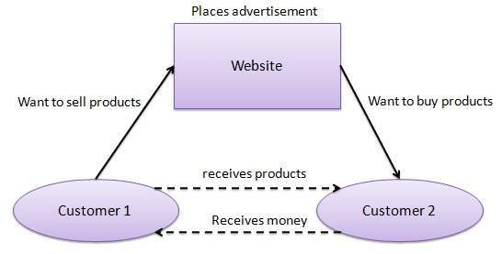
C2C Business Models
https://www.tutorialspoint.com/e_commerce/e_commerce_business_models.htm

Slide 61
Consumer-to-Consumer (C2C) Business Models
The customer-to-consumer model is where consumers trade goods with one another online. Some famous examples of consumer-to-consumer platforms are eBay, Gumtree, and Craigslist.
Provide a way for consumers to sell to each other, with the help of a online marketmaker

Slide 62
How C2C platforms work
Everything is simple — vendors sell their products on the site and buyers purchase what they want. C2C websites benefit from commission fees for listing goods that are normally paid for by the seller. Transactions are made through online payment systems such as PayPal or credit card. Speaking of PayPal, each online transaction is charged a small percentage of the paid sum. Anyway, e-commerce websites are only intermediaries and are not liable for product quality, payment security or refunds.

Slide 63
Main C2C e-commerce advantages
The main advantage of C2C business is that sellers and buyers are reachable. It is also effortless and handy and does not take much time to use. Moreover, it is possible for one customer to be a seller as well as a buyer. What is more, it provides a rich social linking. Numerous community and forum discussions are available.
C2C advantages for Buyers
Buyers benefit greatly from using C2C websites mostly because of the reduced price. What is more, they can deal with different sellers. Besides this, searches using criteria are available. For example, it is possible to select the best sellers, most popular products or offers from your area and much more. One more important thing is that users may choose the best proposal, contacting you directly without intermediary assistance.
C2C advantages for Sellers
The main pros of C2C for vendors are high profitability due to direct sales. Sellers avail themselves mostly through overhead cost reduction. For entrepreneurs, this means that there is no need to spend money on facilities like rent, office supplies or salaries. Furthermore, this type of e-commerce broadens the range of potential clients as it covers not only national but also the international market. That the transaction cost is not high is definitely a plus. Last, but not least, is efficiency in selling personal or unique goods, including handmade products.

Slide 64
Consumer - to – Business (C2B)

Slide 65
What is C2B consumer-to-business model?
A consumer-to-business model, or C2B, is a type of commerce where a consumer or end user provides a product or service to an organization
C2B businesses focus on generating value from their customer base by crowdsourcing ideas, soliciting feedback and more

Slide 66
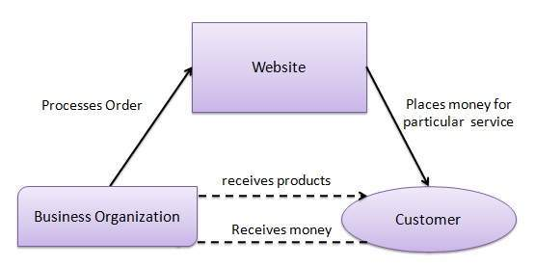
Consumer - to – Business (C2B)
https://www.tutorialspoint.com/e_commerce/e_commerce_business_models.htm

Slide 67
Consumer to Business (C2B)
This business model involves individuals selling goods and services directly to companies.
The most well-known platforms operating this kind of business model are freelance platforms such as Fiverr and Upwork.
Q-commerce, or Quick Commerce, is another form of C2B - delivery drivers/couriers collect orders on behalf of someone else and deliver them.
On these platforms, individuals will market their services.
Businesses or individuals looking for a certain job or task to be fulfilled can bid on or order an individual's services to fulfil that task.
Common services that can be found on these platforms are:
Software and app development
Copywriting, content writing services

Slide 68
Consumer - to – Business (C2B)
In C2B model, a consumer approaches a website showing multiple business organizations for a particular service. The consumer places an estimate of amount he/she wants to spend for a particular service. For example, the comparison of interest rates of personal loan/car loan provided by various banks via websites. A business organization who fulfills the consumer's requirement within the specified budget, approaches the customer and provides its services.

Slide 69
The Future of B2C
E-commerce is here to stay. From 2000 to 2009, sales grew over 500%, and that trajectory continued throughout the 2010s. E-tailing will continue to evolve and expand, thanks to the growing use of tablets and smartphones. These mobile devices have become an integral part of the communications culture. Social media has become the primary marketing tool for businesses.
U.S. retail e-commerce sales grew from $34.1 million in 2009 to $154.5 million in 2019, fueled by new technologies and a decade of U.S. economic recovery. The next decade will no doubt provide new challenges and some corrections as we test the limits of these expanding technologies.
https://www.businessnewsdaily.com/5085-what-is-b2c.html

Slide 70
References
Business analysis life cycle & IT- business analyst: Role in traditional, digital and agile world kindle edition by Subramanyam Gunda (Author) Format: Kindle Edition ASIN ‏ : ‎ B085X3CCSQ Publication date ‏ : ‎ March 13, 2020.
Milani Fredrik. Digital Business Analysis. Springer, 2019. - 432 р. - ISBN 978-3-030-05719-0.
Cadle James, Paul Debra, Turner Paul. Business Analysis Techniques: 99 essential tools for success . 2nd Edition BCS, The Chartered Institute for IT, 2014. - 356 p. - ISBN-10: 1780172737; ISBN-13: 978-1780172736.
Wirtz, B. W. (2018a). Business model management: Design-Instrumente - Erfolgsfaktoren (4th ed.). Wiesbaden: Springer Gabler.
Wirtz, B. W. (2018b). Electronic business (6th ed.). Wiesbaden: Springer Gabler.
Zott, C., Amit, R., & Massa, L. (2011). The business model: Recent developments and future research. Journal of Management, 37(4), 1019–1042
Bernd W. Wirtz. Digital Business Models.Concepts, Models, and the Alphabet Case Study. ISSN 2196-8705. Progress in IS. ISBN 978-3-030-13004-6.

