Slide 1
Computer Science Fundamentals
Lecture topic: Gates and Circuits
Lecturer: Olga Yugay

Slide 2
Today’s focus
Communications
Applications
Operating Systems
Programming
Hardware
Information

Slide 3
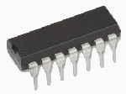
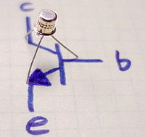
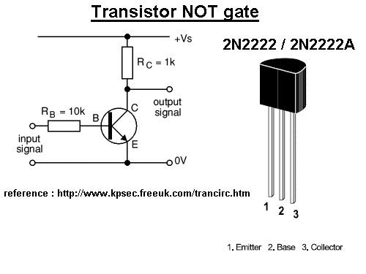
Today’s focus
Hardware
text
Logic gates
numbers
video
audio
Images
01001010101010

Slide 4
Agenda
Explore how computers use electric signals to represent and manipulate binary values
  basic gates
  gates combined into circuits
  behavior gate using Boolean expressions, truth tables, and logic diagrams
  compare and contrast a half adder and a full adder
Python

Slide 5
Why study about circuits? Inside the microchip
Khan Academy and Code.org | Circuits & Logic ¹
¹ Khan Academy and Code.org, 2018, Circuits & Logic. [online] Available at: < https://youtu.be/Sc3lh3D4rCw >

Slide 6
Some background

Slide 7
Background
Logic gates are the building blocks
Anything from small toys to supercomputers will have digital gates in them (phones, washing machines, lifts and etc.)
Whenever a decision needs to be taken based on some inputs, a logic gate can be designed and used
² Dale, N., & Lewis, J. (2020). Computer Science Illuminated (7th ed.). Jones & Bartlett Learning, Ch 4

Slide 8
Background
Major computer components rely on logic gates
  Arithmetic and Logic Unit
  Primary memory a.k.a RAM (Random Access Memory)
  Even secondary memory is now switching to using integrated circuits -> SSD (Solid State drives)³
³ Dale, N., & Lewis, J. (2020). Computer Science Illuminated (7th ed.). Jones & Bartlett Learning, Ch 4

Slide 9
Background
What are Computers?
  electronic devices;
  the most fundamental hardware elements of a computer control the flow of electricity.
87

Slide 10
Electronic signal, 0s and 1s
Any given electronic signal has a level of voltage.
Signals in a computer are constrained to be within one range or the other.⁴
voltage level 0 to 2 volts | voltage level 2 to 5 volts
“low” | “high”
binary 0 | binary 1
⁴ Dale, N., & Lewis, J. (2020). Computer Science Illuminated (7th ed.). Jones & Bartlett Learning, Ch 4

Slide 11

Basic hardware
Gate - A device that performs a basic operation on electrical signals, accepting one or more input signals and producing a single output signal
  There are six most fundamental types
  Each type of gate performs a particular logical function.⁵
⁵ Dale, N., & Lewis, J. (2020). Computer Science Illuminated (7th ed.). Jones & Bartlett Learning, Ch 4

Slide 12
Basic hardware
Circuit - A combination of interacting gates designed to accomplish a specific logical function
  circuits can be designed to perform arithmetic and to store values.
  the output value of one gate often serves as an input value for one or more other gates.
  The flow of electricity through a circuit is controlled by the carefully designed logic of the interacting gates. ⁶
⁶ Dale, N., & Lewis, J. (2020). Computer Science Illuminated (7th ed.). Jones & Bartlett Learning, Ch 4

Slide 13
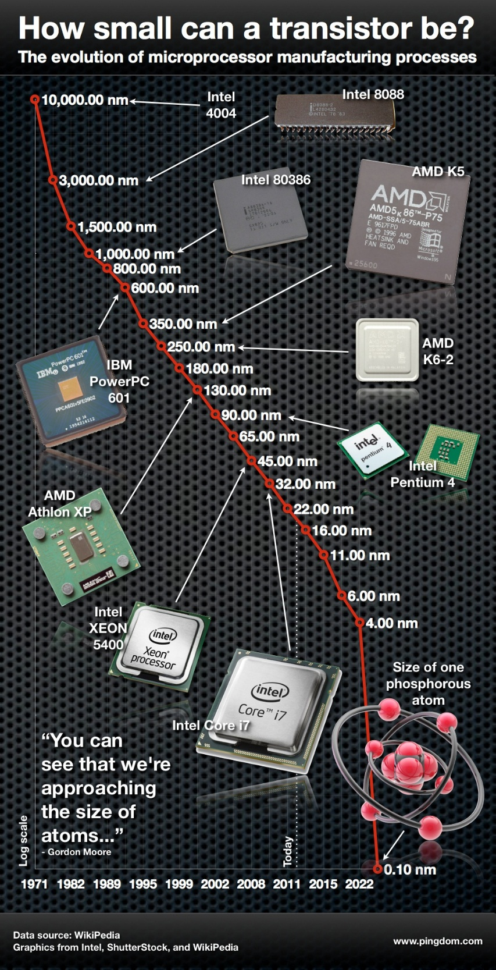
Transistor
"The number of transistors incorporated in a chip
will approximately double every 24 months.“
—Gordon Moore, Intel co-founder
Transistor is basic hardware used to build the logic gates
*nm, nanometer is one millionth of a milimeter
In 2012 a team of researchers in Australia has managed to create a transistor that is the size of an atom. ⁷
⁷ Pingdom, S., 2012. The single-atom transistor is here – the amazing evolution of microprocessors. [Blog] TECH MUSINGS, Available at: <https://www.pingdom.com/blog/the-single-atom-transistor-is-here-the-amazing-evolution-of-microprocessors-infographic/ >

Slide 14
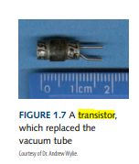
Transistor
Transistor - A device that acts either as a wire or a resistor, depending on the voltage level of an input signal
  Semiconductor - material such as silicon that is neither a good conductor nor a good insulator ⁸
⁸ Dale, N., & Lewis, J. (2020). Computer Science Illuminated (7th ed.). Jones & Bartlett Learning, Ch 4

Slide 15
Transistors Explained - How transistors work
Transistors Explained - How transistors work ⁹
Arduino
Top 10 Arduino projects for beginners to advance
https://www.arduino.cc/en/Guide/Introduction
⁹The Engineering Mindset, 2021, Transistors Explained - How transistors work. [online] Available at: <https://www.youtube.com/watch?v=J4oO7PT_nzQ >
‌

Slide 16
Gates and Circuits: Notational methods
There are three different, but equally powerful, notational methods for describing the behavior of gates and circuits:
Boolean expressions
Logic diagrams
Truth tables ⁸
⁸ Dale, N., & Lewis, J. (2020). Computer Science Illuminated (7th ed.). Jones & Bartlett Learning, Ch 4

Slide 17

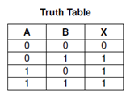
Example: OR gate⁹
X=A+B
2.
3.
⁹ Dale, N., & Lewis, J. (2020). Computer Science Illuminated (7th ed.). Jones & Bartlett Learning, Ch 4

Slide 18
1. Boolean algebra: Boolean expressions¹⁰
An English mathematician named George Boole invented a form of algebra in which variables and functions take on only one of two values (0 and 1).
Specific operations and properties in Boolean algebra allow us to define and manipulate circuit logic using a mathematical notation.
OR gate boolean expression: X=A+B
¹⁰ Dale, N., & Lewis, J. (2020). Computer Science Illuminated (7th ed.). Jones & Bartlett Learning, Ch 4

Slide 19
2. Logic diagram ¹¹
…is a graphical representation of a circuit. Each type of gate is represented by a specific graphical symbol.
By connecting those symbols in various ways we can visually represent the logic of an entire circuit.
OR gate logic diagram:
¹¹ Dale, N., & Lewis, J. (2020). Computer Science Illuminated (7th ed.). Jones & Bartlett Learning, Ch 4

Slide 20
3. Truth table ¹²
defines the function of a gate by listing all possible input combinations that the gate could encounter, and the corresponding output.
OR gate truth table:
¹² Dale, N., & Lewis, J. (2020). Computer Science Illuminated (7th ed.). Jones & Bartlett Learning, Ch 4

Slide 21
6 most fundamental gate types
NOT
AND
OR
XOR
NAND
NOR

Slide 22
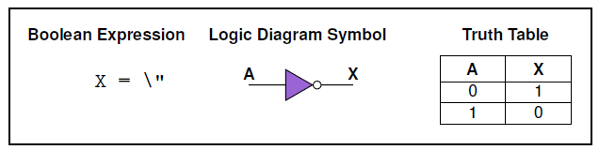
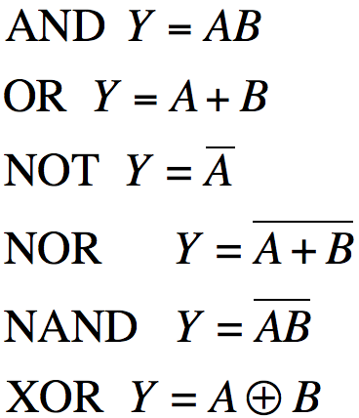
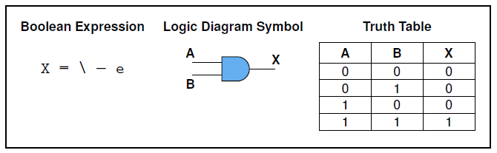
6 most fundamental gate types¹³
NOT gate inverts its single input value.
AND gate produces 1 if both input values are 1.
¹³ Dale, N., & Lewis, J. (2020). Computer Science Illuminated (7th ed.). Jones & Bartlett Learning, Ch 4

Slide 23
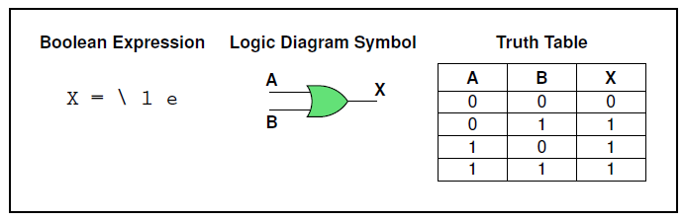
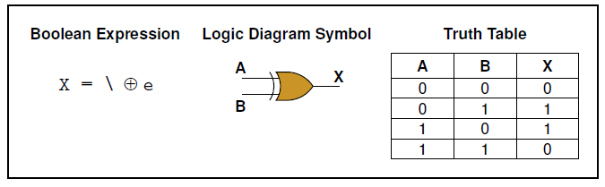
6 most fundamental gate types ¹⁴
OR gate produces 1 if one or the other or both input values are 1.
XOR gate produces 1 if one or the other (but not both) input values are 1.
¹⁴ Dale, N., & Lewis, J. (2020). Computer Science Illuminated (7th ed.). Jones & Bartlett Learning, Ch 4

Slide 24
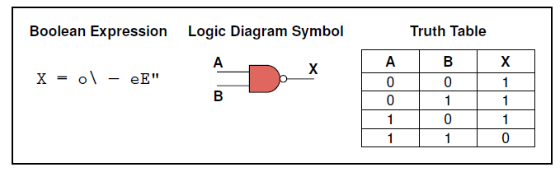
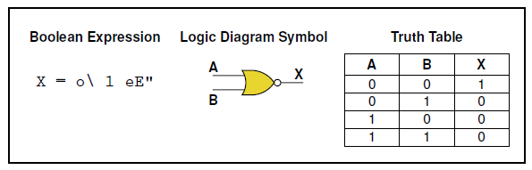
6 most fundamental gate types ¹⁵
NAND gate produces the opposite results of an AND gate.
NOR gate produces the opposite results of an OR gate.
¹⁵ Dale, N., & Lewis, J. (2020). Computer Science Illuminated (7th ed.). Jones & Bartlett Learning, Ch 4

Slide 25

Let’s practice!
Symbol | Truth Table
 | A | B | X
 | 0 | 0 | 0
 | 0 | 1 | 0
 | 1 | 0 | 0
 | 1 | 1 | 1
Boolean Expression X = AB | Read as A AND B gives x

Slide 26

Let’s practice!
Symbol | Truth Table
 | A | B | X
 | 0 | 0 | 0
 | 0 | 1 | 1
 | 1 | 0 | 1
 | 1 | 1 | 1
Boolean Expression X = A+B | Read as A OR B gives x

Slide 27

Let’s practice!
Symbol | Truth Table
 | A | x
 | 0 | 1
 | 1 | 0
Boolean Expression X = A’ | Read as inversion of A gives Not x

Slide 28

Let’s practice!
Symbol | Truth Table
 | A | B | x
 | 0 | 0 | 1
 | 0 | 1 | 1
 | 1 | 0 | 1
 | 1 | 1 | 0
Boolean Expression Q = (AB)’ | Read as A AND B gives NOT-x

Slide 29

Let’s practice!
Symbol | Truth Table
 | A | B | x
 | 0 | 0 | 1
 | 0 | 1 | 0
 | 1 | 0 | 0
 | 1 | 1 | 0
Boolean Expression x = (A+B)’ | Read as A OR B gives NOT-x

Slide 30

Let’s practice!
Symbol | Truth Table
 | A | B | x
 | 0 | 0 | 0
 | 0 | 1 | 1
 | 1 | 0 | 1
 | 1 | 1 | 0
Boolean Expression Q = A⊕B

Slide 31
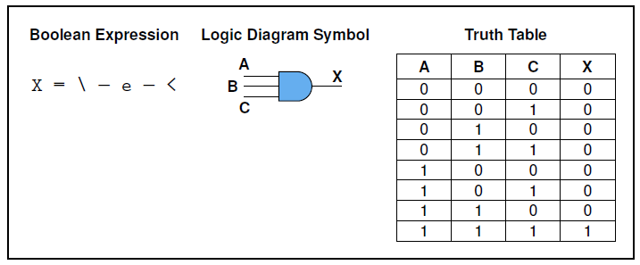
Gates with more inputs¹⁶
Same rules apply but now to three inputs
ABC
¹⁶ Dale, N., & Lewis, J. (2020). Computer Science Illuminated (7th ed.). Jones & Bartlett Learning, Ch 4
Notes:
Gates can be designed to accept three or more input values. A three-input AND gate, for example, produces an output of 1 only if all input values are 1. A three-input OR gate produces an output of 1 if any input value is 1. These definitions are consistent with the two-input versions of these gates
There are 2 to the power of 3 , or 8, possible input combinations for a gate with three inputs, because 2 in power of 3 gives 8
The same rules apply but now to three inputs

Slide 32
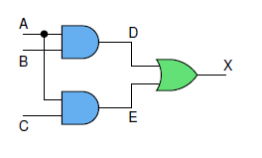
Circuits¹⁷
Combinational circuit - A circuit whose output is solely determined by its input values
Sequential circuit – A circuit whose output is a function of input values and the current state of the circuit (usually depend on clock cycles)
  Normally used for storage
¹⁷ Dale, N., & Lewis, J. (2020). Computer Science Illuminated (7th ed.). Jones & Bartlett Learning, Ch 4

Slide 33
Combinatorial circuit ¹⁸
Gates are combined into circuits by using gate output as an input to another gate
¹⁸ Dale, N., & Lewis, J. (2020). Computer Science Illuminated (7th ed.). Jones & Bartlett Learning, Ch 4

Slide 34
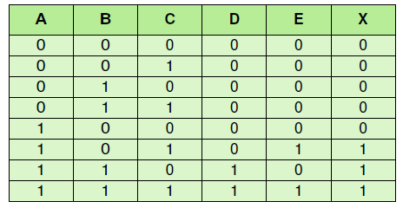
Combinatorial circuit: Example 1
Logic diagram Truth table
Boolean expression
X = (AB + AC)

Slide 35
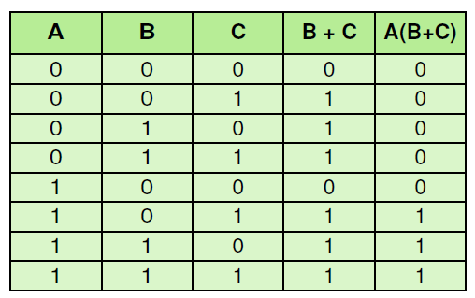
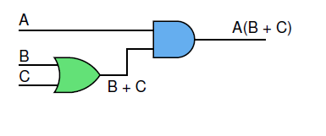
Combinatorial circuit: Example 2
Represent
  A(B + C) using logic diagram and truth table

Slide 36
as good as possible…¹⁹
When we build a combinatorial circuit from some kind of specification, we always try to make it as good as possible.
  In some applications, minimize the number of gates (or the number of transistors).
  In other, optimize a delay (the time it takes a signal to traverse the circuit) , or low power consumption.
In general, a mixture of such criteria must be applied.
¹⁹ Dale, N., & Lewis, J. (2020). Computer Science Illuminated (7th ed.). Jones & Bartlett Learning, Ch 4

Slide 37
Circuit equivalence ²⁰
Circuit equivalence - The same output for each corresponding input value combination for two circuits
A(B+C) = AB + AC
²⁰ Dale, N., & Lewis, J. (2020). Computer Science Illuminated (7th ed.). Jones & Bartlett Learning, Ch 4

Slide 38
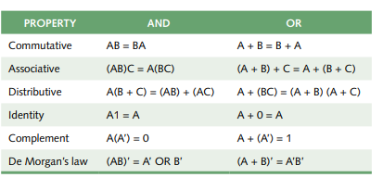
Few properties of Boolean algebra ²¹
²¹ Dale, N., & Lewis, J. (2020). Computer Science Illuminated (7th ed.). Jones & Bartlett Learning, Ch 4

Slide 39
What is the most basic operation of a computer?
What is the most basic operation of a computer?
Add two numbers!
At digital logic level the addition is performed in binary
Special circuits are used to carry out this operation - adders

Slide 40
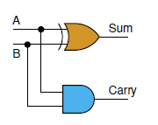
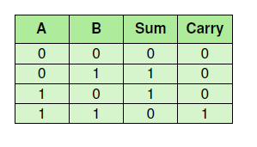
Half Adders ²²
Half adder – A circuit that computes the sum of two bits and produces the correct carry bit
  Half adder is fine for adding two single digits, but it cannot be used as is to compute the sum of two binary values with multiple digits each
²² Dale, N., & Lewis, J. (2020). Computer Science Illuminated (7th ed.). Jones & Bartlett Learning, Ch 4

Slide 41
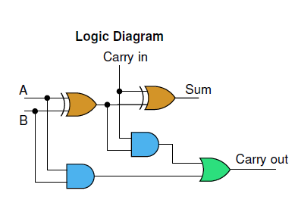
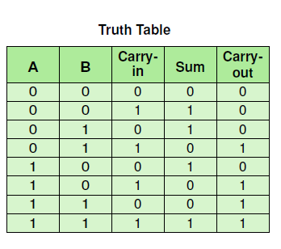
Full Adders ²³
A circuit called a full adder takes the carry-in value into account.
  use two half adders to make a full adder
Homework: review how full adder works (Dale, Ch. 4)
²³ Dale, N., & Lewis, J. (2020). Computer Science Illuminated (7th ed.). Jones & Bartlett Learning, Ch 4

Slide 42
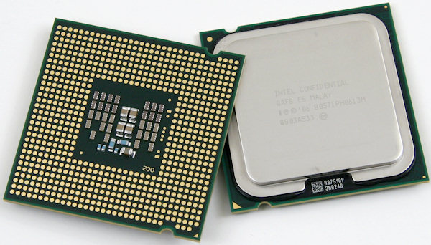
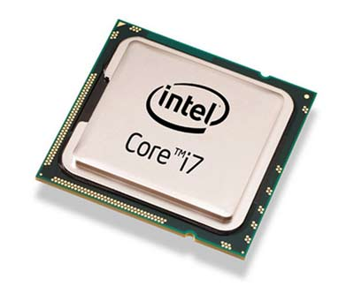
CPU chips
CPU is an advanced circuit with input and output lines

Slide 43
Recommended reading and videos
Dale, N., & Lewis, J. (2020). Computer Science Illuminated (7th ed.). Jones & Bartlett Learning, Chapter 4, end of the chapter exercises
MIT (2020, June 5). If transistors can't get smaller, then software developers have to get smarter. Tech Xplore - Technology and Engineering news. Retrieved May 31, 2022, from https://techxplore.com/news/2020-06-transistors-smaller-software-smarter.html
Youtube.com. 2017. Boolean Logic & Logic Gates: Crash Course Computer Science #3. [online] Available at: <https://www.youtube.com/watch?v=gI-qXk7XojA > [Accessed 29 May 2022].
Youtube.com. 2017. How Computers Calculate - the ALU: Crash Course Computer Science #5 [online] Available at: <https://www.youtube.com/watch?v=1I5ZMmrOfnA&list=PL8dPuuaLjXtNlUrzyH5r6jN9ulIgZBpdo&index=7 > [Accessed 29 May 2022].

Slide 44
Python

Slide 45
Solutions to previous seminars
Recall countdown function, that prints the numbers from 10 to 0 and prints “Blastoff!”
def countdown(n):
if n <= 0:
print('Blastoff!')
else:
print(n)
countdown(n -1)
countdown(10)
*You were asked on write a countup function. Solution is on the right
def countup(n):
if n >= 0:
print('Blastoff!')
else:
print(n)
countup(n+1)
countup(-4)

Slide 46
Solutions to previous seminars
# Code #1 – simple iteration
string_name = "homework"
# Iterate over the string
for element in string_name:
print(element, end=' ')
print("\n")
# Code #2 – range () function
string_name = "HOMEWORK"
# Iterate over index
for element in range(0, len(string_name)):
print(string_name[element])

Slide 47
Reminder: MyMark (homework from TW3)
Write a program that will ask to input the module name and number of components on the module with corresponding weighting. For example:
Module name: Computer science fundamentals
Number of components: 2
Component 1 weighting: 40%, Component 2 weighting: 60%
Enter mark 1: 70, Enter mark 2: 60
It should also ask to enter mark for the components and show you the final mark.
Additionally you may include a feature, where user can input the desired overall mark for the module and program outputs the required marks for the components.
Save it it in TW4/ folder
Push your updates to Github repository.

Slide 48
Python for beginners in one hour
Python for Beginners - Learn Python in 1 Hour.²⁴
²⁴ Hamedani, M., 2020. Python for Beginners - Learn Python in 1 Hour. [online] Youtube.com. Available at: <https://www.youtube.com/watch?v=kqtD5dpn9C8> [Accessed 5 June 2022].

Slide 49
References
Khan Academy and Code.org, 2018, Circuits & Logic. [online] Available at: <https://youtu.be/Sc3lh3D4rCw> [Accessed 30 May 2022].
Dale, N., & Lewis, J. (2020). Computer Science Illuminated (7th ed.). Jones & Bartlett Learning, Chapter 4
Pingdom, S., 2012. The single-atom transistor is here – the amazing evolution of microprocessors. [Blog] TECH MUSINGS, Available at: <https://www.pingdom.com/blog/the-single-atom-transistor-is-here-the-amazing-evolution-of-microprocessors-infographic/> [Accessed 30 May 2022].
Downey, A. (2015). Think python. O'Reilly. Chapter 1, 2
Hamedani, M., 2020. Python for Beginners - Learn Python in 1 Hour. [online] Youtube.com. Available at: <https://www.youtube.com/watch?v=kqtD5dpn9C8> [Accessed 29 May 2022].
Youtube.com. 2017. Boolean Logic & Logic Gates: Crash Course Computer Science #3. [online] Available at: <https://www.youtube.com/watch?v=gI-qXk7XojA> [Accessed 29 May 2022].
Youtube.com. 2017. How Computers Calculate - the ALU: Crash Course Computer Science #5 [online] Available at: <https://www.youtube.com/watch?v=1I5ZMmrOfnA&list=PL8dPuuaLjXtNlUrzyH5r6jN9ulIgZBpdo&index=7> [Accessed 29 May 2022].
The Engineering Mindset, 2021, Transistors Explained - How transistors work. [online] Available at: https://www.youtube.com/watch?v=J4oO7PT_nzQ

