Slide 1
Computer Science Fundamentals
Seminar 4: Logic gates | Python: Lists, Loops
Lecturer: Olga Yugay

Slide 2
Seminar objectives
Part A
Lecture based Q&A
Logic gates exercises (Boolean expressions, logic diagrams, truth tables)
Part B
PyCharm and GitHub
Python
  Lists
  While loop
  For loop

Slide 3
Part A: Logic gates

Slide 4
Lecture recap
Watch Boolean Logic & Logic Gates Crash Course Computer Science

Slide 5
The purpose of gates
With different combinations of logic gates, a computer performs
the math (that is foundation of all computer operations)
data storage

Slide 6
Lecture recap
Distinguish between a gate and a circuit
What are the three notational methods for describing the behavior of gates and circuits?
How many input signals can a gate receive and how many output signals can a gate produce?
For the following questions answer true or false
Boolean expressions are more powerful than logic diagrams in expressing the processing of gates and circuits.
Logic diagrams and truth tables are equally powerful in expressing the processing of gates and circuits.

Slide 7
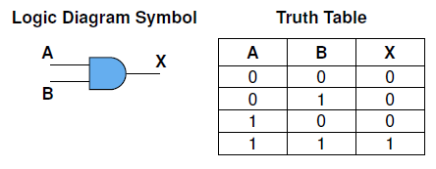
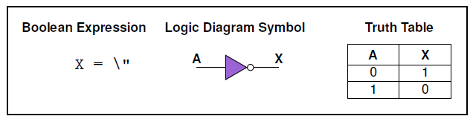
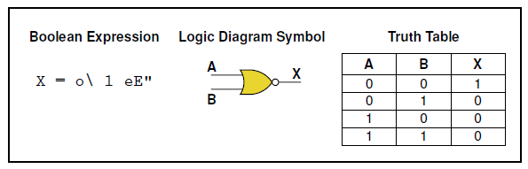
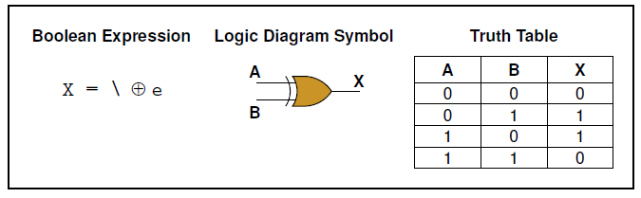
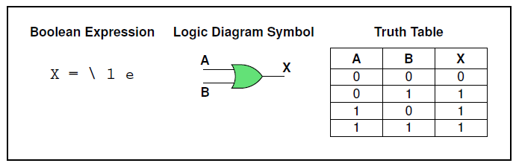
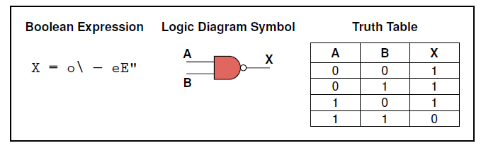
Task 1
d)
e)
f)
Name and explain the following gates. Provide corresponding boolean expressions:
a)
b)
c)

Slide 8
Task 1: answers
d)
e)
f)
Name and explain the following gates. Provide corresponding boolean expressions:
a)
b)
c)
x=AB
x=A’
x=(A+B)’
x=A⊕ B
x=A+B
x=(AB)’

Slide 9
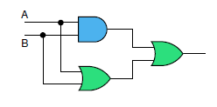
Task 3
Write a boolean algebra expression and show the behavior of the following circuit with a truth table:
You may then check the answer using the simulator
https://academo.org/demos/logic-gate-simulator/

Slide 10

Task 3 answers
Write a boolean algebra expression and show the behavior of the following circuit with a truth table:
You may then check the answer using the simulator
https://academo.org/demos/logic-gate-simulator/

Slide 11
Boolean algebra simplification
Boolean Algebra Logic Circuit Simplification
¹ Khan Academy and Code.org, 2018, Circuits & Logic. [online] Available at: <https://youtu.be/Sc3lh3D4rCw >

Slide 12
Part B: Python

Slide 13
Topics to cover
Lists
For loop
While loop

Slide 14
Lists
list is a sequence of values. In a string, the values are characters; in a list, they can be any type. The values in a list are called elements or sometimes items.
[10, 20, 30, 40]
['crunchy frog', 'ram bladder', 'lark vomit']
['spam', 2.0, 5, [10, 20]]
Nested list

Slide 15
List examples
>>> cheeses = ['Cheddar', 'Edam', 'Gouda']
>>> numbers = [42, 123]
>>> empty = []
>>> print(cheeses, numbers, empty)
['Cheddar', 'Edam', 'Gouda'] [42, 123] []

Slide 16
List examples
The expression inside the brackets specifies the index. Remember that the indices start at 0
planets = [‘mercury’, ‘venus’, ‘earth']
>>> planets[0]
‘mercury'
Unlike strings, lists are mutable. When the bracket operator appears on the left side of an assignment, it identifies the element of the list that will be assigned.
>>> numbers = [42, 123]
>>> numbers[1] = 5
>>> numbers [42, 5]

Slide 17
List examples
The in operator also works on lists.
>>> cheeses = ['Cheddar', 'Edam', 'Gouda']
>>> 'Edam' in cheeses
True
>>> 'Brie' in cheeses
False

Slide 18
Task 5
Write a Python program to display the first and last colors from the following list.
color_list = ["Red","Green","White" ,"Black"]
Commit with message task 5 and push to Github

Slide 19
Iteration
Iteration is the ability to run a block of statements repeatedly.
While loop
For loop

Slide 20
while loop
With the while loop we can execute a set of statements as long as a condition is true.
i = 1
while i <=10:
print (i)
i += 1

Slide 21
Task 6
Update the previous while loop to display
*
**
***
****
*****
******
*******
********
*********
**********
Commit with message task 5 and push to Github

Slide 22
Task 7
Update the code to display
**********
*********
********
*******
******
*****
****
***
**
*
Commit with message task 6 and push to Github

Slide 23
while
With the while loop we can execute a set of statements as long as a condition is true.
def countdown(n):
while n > 0:
print(n)
n = n - 1
print('Blastoff!')

Slide 24
break
Sometimes you don’t know it’s time to end a loop until you get halfway through the body. In that case you can use the break statement to jump out of the loop.
For example, suppose you want to take input from the user until they type done. You could write:
while True:
line = input('> ')
if line == 'done':
break
print(line)
print('Done!')

Slide 25
Task 8
Update previous code to guess the secret number
Commit with message “ task 7 Guess secret number” and push to Github

Slide 26
For loop
A for loop is used for iterating over a sequence (that is either a list, a tuple, a dictionary, a set, or a string).
#Example 1
subjects= ["CSF", "FunPro", "WT"]
for x in subjects:
print(x)
#Example 2
for x in range(6):
print(x)
range() is a function. More about it here

Slide 27
range function
range(start, stop, step)
Parameter | Description
start | Optional. An integer number specifying at which position to start. Default is 0
stop | Required. An integer number specifying at which position to stop (not included).
step | Optional. An integer number specifying the incrementation. Default is 1
#Example 1
x = range(6)
for n in x:
print(n)
#Example 2
x = range(3, 6)
for n in x:
print(n)
#Example 3
x = range(3, 20, 2)
for n in x:
print(n)

Slide 28
Task 9
Write a Python program to construct the following pattern, using a nested for loop.
*
* *
* * *
* * * *
* * * * *
* * * *
* * *
* *
*
Commit with message task 8 and push to Github
Part of the code is given below:
n=10;
for i in range(n):
for j in range(i):
print ('* ', end="")
print('')
The parameter to end line, by default it is \n

Slide 29
Review Run-length encoding given last seminar
def encode(message):
encoded_string = ""
i = 0
while (i <= len(message)-1):
'''first while loop is for going through each letter'''
count = 1
ch = message[i]
j = i #assign current letter index to j in order to count the occurrence of letters
print(ch)
print('this is j', j)
print('this is i ', i)
while (j < len(message)-1): # to loop from particular letter till the end
'''if char at the current index is the same as char at next index, the count is incremented by 1'''
if (message[j] == message[j + 1]): #if letters are equal to each other, keep looping, else break
count = count + 1
j = j + 1
else:
break
'''the count and the character is concatenated to the encoded string'''
encoded_string = encoded_string + str(count) + ch
i = j + 1
return encoded_string
encoded_message = encode("ABBBBCCCCCCCCAB")
print(encoded_message)
Think of decode function logic and push to /TW5

Slide 30
Challenge task:
Think of run length decode function logic and write the code.
Commit with message “Run-length decode task” and push to Github
Once done compare solution with Aluda, T., 2021. Run Length Encoding (RLE) Compression Algorithm in Python. [online] Engineering Education (EngEd) Program | Section. Available at: https://www.section.io/engineering-education/run-length-encoding-algorithm-in-python

Slide 31
Homework
Write a Python program to print alphabet pattern 'D'.
Expected Output:
****
* *
* *
* *
* *
* *
****
Push code to your repository (for example seminar5/) on Github.

Slide 32
Homework
Dale, Computer Science Illuminated, Chapter 4, end of the book exercises
Watch
  Boolean Logic & Logic Gates Crash Course Computer Science #3
  How Computers Calculate - the ALU: Crash Course Computer Science
  Registers and RAM Crash Course Computer Science
Read Ron White, How Computers Work, pp 34-35 and try to understand how Processor does the math
Explore how truth tables can be used to analyze a problem, Computer Science Distilled, Filho pp.10-12
Khan Academy. (2011, June 30). For loops in Python. [Video]. YouTube.
Khan Academy. (2011, June 30). While loops in Python. [Video]. YouTube.
Downey, Think Python, Chapter 10, end of the Chapter exercises
https://www.jetbrains.com/help/pycharm/using-git-integration.html

Slide 33
References and recommended sources
Dale, N., & Lewis, J. (2020). Computer Science Illuminated (7th ed.). Jones & Bartlett Learning, Chapter 4
Downey, A. (2015). Think python. O'Reilly. Chapter 1, 2
Hamedani, M., 2020. Python for Beginners - Learn Python in 1 Hour. [online] Youtube.com. Available at: <https://www.youtube.com/watch?v=kqtD5dpn9C8> [Accessed 5 June 2022].
Aluda, T., 2021. Run Length Encoding (RLE) Compression Algorithm in Python. [online] Engineering Education (EngEd) Program | Section. Available at: <https://www.section.io/engineering-education/run-length-encoding-algorithm-in-python/> [Accessed 6 June 2022].

