Slide 1
Computer Science Fundamentals
Lecture 5: Computer systems architecture
Lecturer: Olga Yugay

Slide 2
Today’s focus
Communications
Applications
Operating Systems
Programming
Hardware
Information

Slide 3
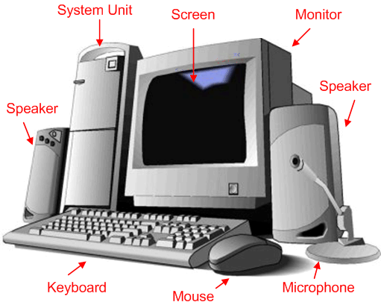
Something familiar...
Hardware

Slide 4
Agenda
Logical structure of Computer System
Computer Architecture
  Levels within computer architecture
  Physical organization of the computer
  Main components of digital logic layer
  Processor
  Control unit
  ALU

Slide 5
Computer Architecture: Basic Levels
7 | SOFTWARE LEVEL
6
5
4 | HARDWARE LEVEL
3
2
1

Slide 6
Computer Architecture: Levels in detail
7 | SOFTWARE LEVEL | Application Layer
6 |  | Higher-Order Software Layer
5 |  | Operating System Layer
4 | HARDWARE LEVEL | Machine Layer Machine language instructions
3 |  | Microprogrammed Layer Interprets the machine language instructions and directly causes the digital logic elements to perform operations
2 |  | Digital Logic Layer Gates that are combined onto a single chip
1 |  | Physical Device Layer Transistors Capacitors Resistors

Slide 7
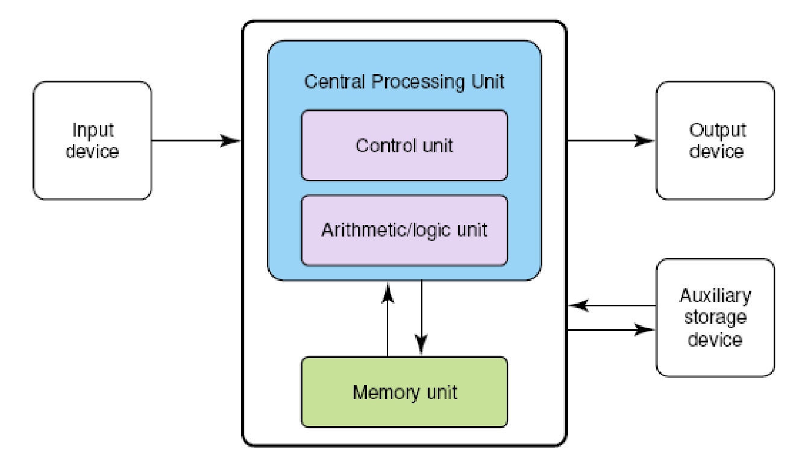
The von Neumann architecture
Is the computer design principle
The basis for computers even today
Main characteristic:
  Units that process information are separate from the units that store information.

Slide 8
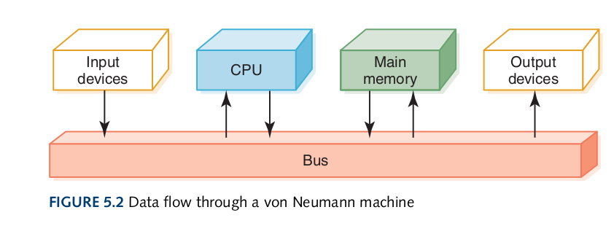
Data flow through a von Neumann machine

Slide 9
The von Neumann architecture ¹
memory unit holds both data and instructions
arithmetic/logic unit is capable of performing arithmetic and logic operations on data
input unit moves data from the outside world into the computer
output unit moves results from inside the computer to the outside world
control unit acts as the stage manager to ensure that all the other components act in concert
¹ Dale, N., & Lewis, J. (2020). Computer Science Illuminated (7th ed.). Jones & Bartlett Learning, Ch 5

Slide 10
Video
Khan Academy and Code.org | CPU, Memory, Input & Output ²
² Youtube.com. 2018. Khan Academy and Code.org | CPU, Memory, Input & Output. [online] Available at: <http://youtube.com/watch?v=MMzdKTtUIFM> [Accessed 7 June 2022].

Slide 11
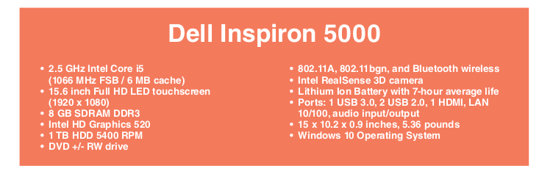
Computer configuration
CoreTM i5 is a type of processor, which runs at a speed of 2.5 GHz
FSB - bus between the processor and the outside world is called the front-side bus.
FSB is pulsing 1066 million (or just over a billion) times per second.
Cache is small, fast memory that is usually built into the processor chip.
Processor have direct access to 6 MB of memory without using the FSB
Synchronous, dynamic RAM
DD3 - Double Data Rate 3, type of memory
Graphics processor unit
Games and other graphics software interact with GPU =>faster image manipulation

Slide 12
Computer configuration ³
In general, a faster clock, faster FSB, and more cache would seem to make for a more powerful computer.
But as in all areas of engineering, there are tradeoffs.
Faster processor => it consumes more power => the circuitry may overheat and shut down.
Faster FSB => requires faster devices in the outside world => their circuitry is more expensive.
Cache gets bigger => access to its data becomes slower => slows down the processors.
³ Dale, N., & Lewis, J. (2020). Computer Science Illuminated (7th ed.). Jones & Bartlett Learning, Ch 5

Slide 13
Hardware and Software
Khan Academy and Code.org | Hardware and Software ⁴
⁴Youtube.com. 2022. Khan Academy and Code.org | Hardware and Software. [online] Available at: <https://www.youtube.com/watch?v=VzVSt6jxiqw> [Accessed 7 June 2022].

Slide 14
Motherboard ⁵
In a PC the components in a von Neumann machine are physically located in a printed circuit board called the motherboard.
Motherboard is the main circuit board of PC
The motherboard also has connections for attaching other devices to the bus:
a mouse
a keyboard
or additional storage devices
⁵ Dale, N., & Lewis, J. (2020). Computer Science Illuminated (7th ed.). Jones & Bartlett Learning, Ch 5

Slide 15
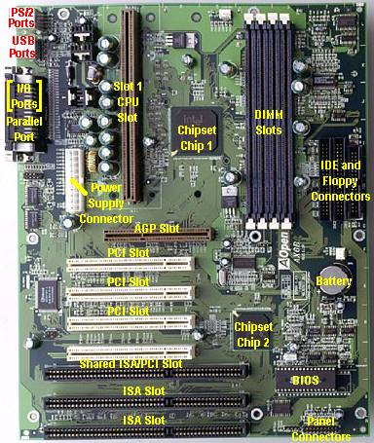
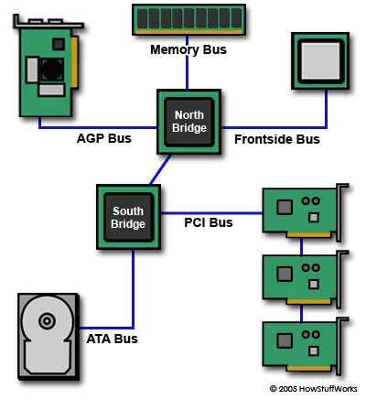
Physical organisation of the computer

Slide 16
Physical organisation of the computer ⁶
Modular construction
    Many different microcomputers contain the same microprocessors
Bus – collection of parallel electrical conductors called “lines” onto which a number of components may be connected
  Internal buses
  External buses
⁶ Dale, N., & Lewis, J. (2020). Computer Science Illuminated (7th ed.). Jones & Bartlett Learning, Ch 5

Slide 17
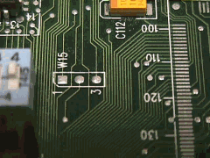
Physical organisation of the computer ⁷
Buses convey:
  Data signals
  Data address signals
  Control signals
  Power
Bus lines
  Data lines (Data bus)
  Address lines (Address bus)
  Control lines (Control bus)
⁷ Dale, N., & Lewis, J. (2020). Computer Science Illuminated (7th ed.). Jones & Bartlett Learning, Ch 5

Slide 18
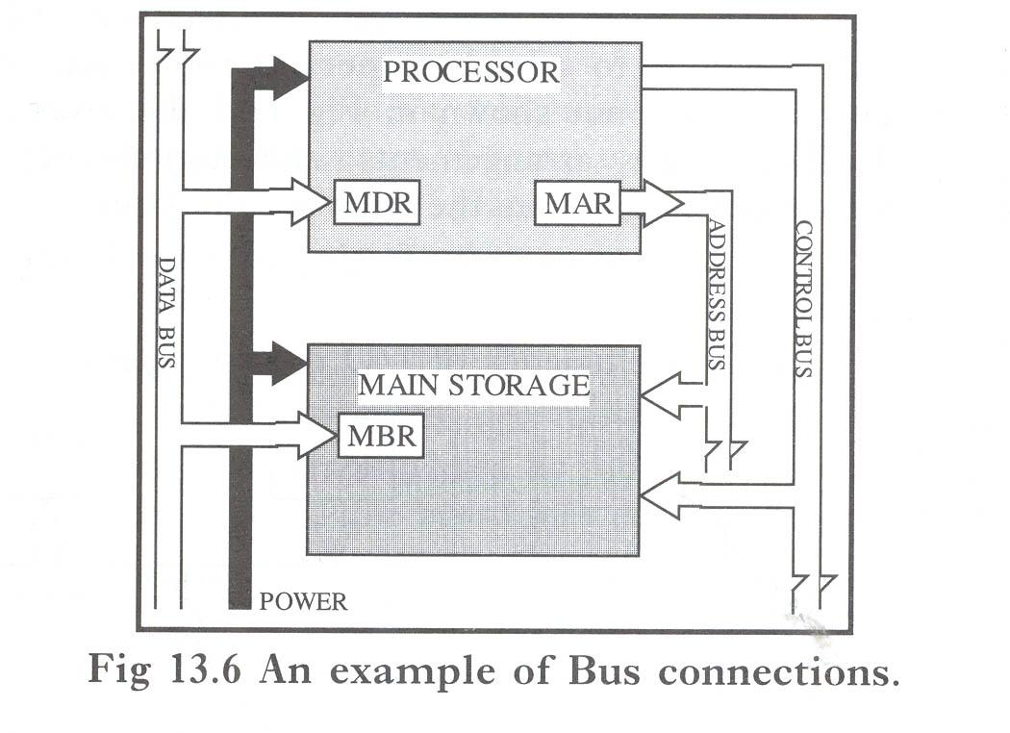
Example of Bus connections
MDR – Memory
Data
Register
MAR – Memory Address Register
MBR -
Memory
Buffer Register

Slide 19
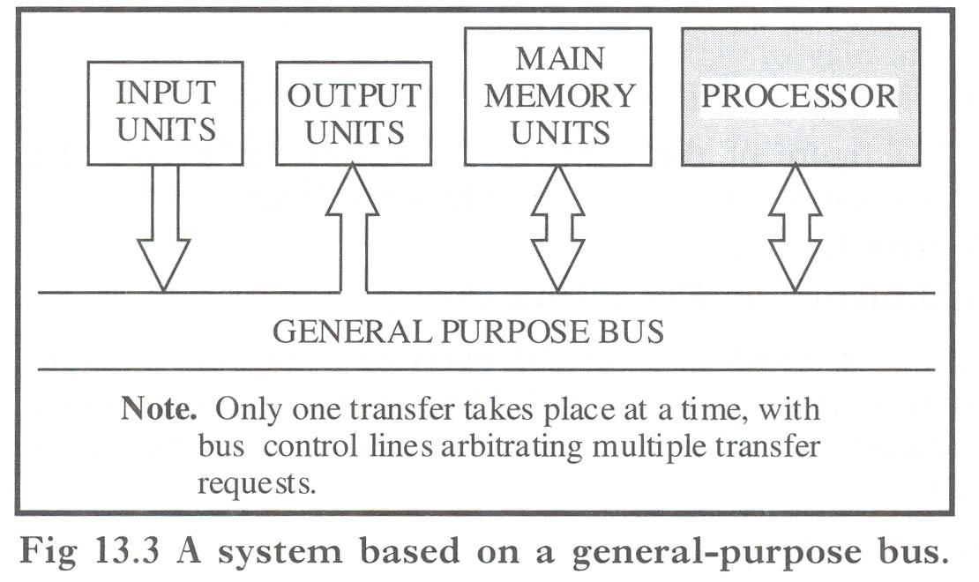
Example of Bus connections

Slide 20
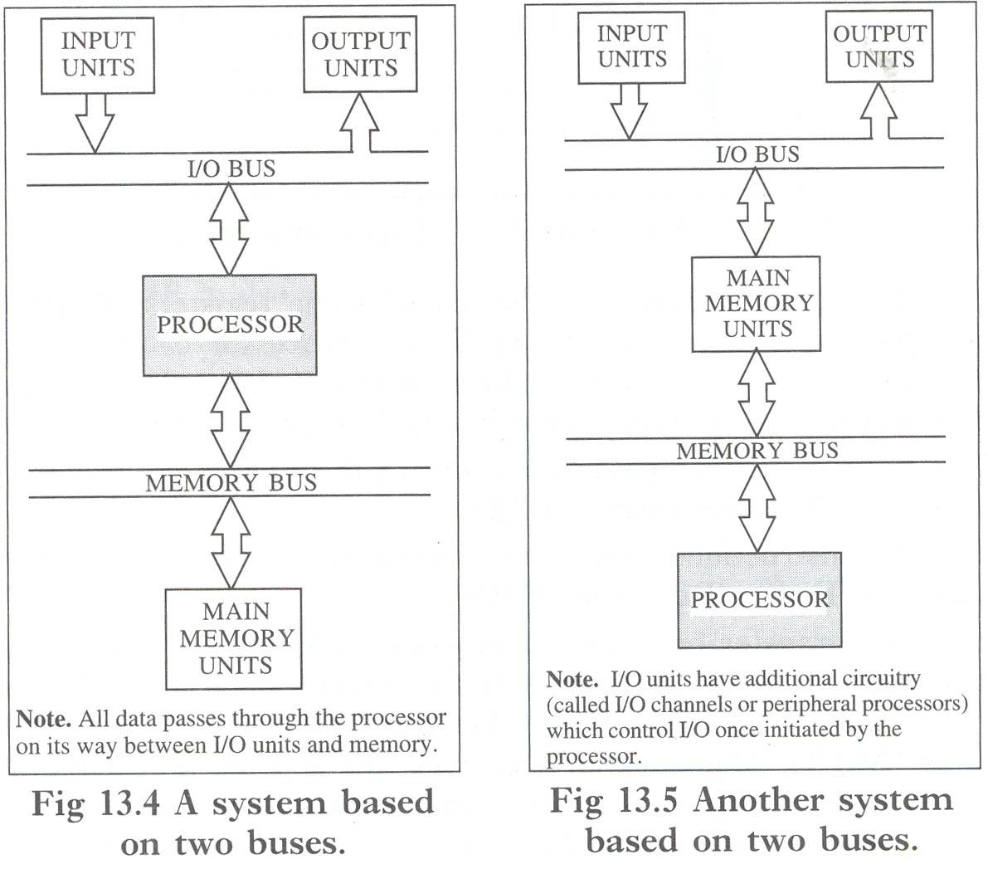
Example of Bus connections

Slide 21
Memory
How your computer memory works ⁸
⁸ Senanan, K., 2016. How computer memory works. [online] Youtube.com. Available at: <https://www.youtube.com/watch?v=p3q5zWCw8J4> [Accessed 7 June 2022].

Slide 22
Processor ⁹
Functions
  To control the use of main storage to store data and instructions
  To control the sequence of operations
  To give commands to all parts of the computer system
  To carry out processing
Consists of two primary elements
  Control Unit (CU)
  Arithmetic and Logic Unit (ALU)
⁹ Dale, N., & Lewis, J. (2020). Computer Science Illuminated (7th ed.). Jones & Bartlett Learning, Ch 5

Slide 23
Processor ¹⁰
Registers – special-purpose temporary-storage locations within the processor or other devices
Types of registers
Memory Data Register (MDR)
  Handles all data and instructions passing in and out of the processor
Memory Buffer Register (MBR)
  Handles all data and instructions passing in and out of main storage
Memory Address Register (MAR)
  Handles location addresses (source/destination) during transfer between the MDR and MBR
Data Buffer Registers
  Exists in I/O units connected to the processor and have similar purpose to the MBR
¹⁰ Dale, N., & Lewis, J. (2020). Computer Science Illuminated (7th ed.). Jones & Bartlett Learning, Ch 5

Slide 24
Example of bus connections related to processor
MDR – Memory
Data
Register
MAR – Memory Address Register
MBR -
Memory
Buffer Register

Slide 25
Processor registers 11
Registers in the processor are constructed so that their contents can be accessed and altered much faster than the contents of locations of main storage
¹¹ Dale, N., & Lewis, J. (2020). Computer Science Illuminated (7th ed.). Jones & Bartlett Learning, Ch 5

Slide 26
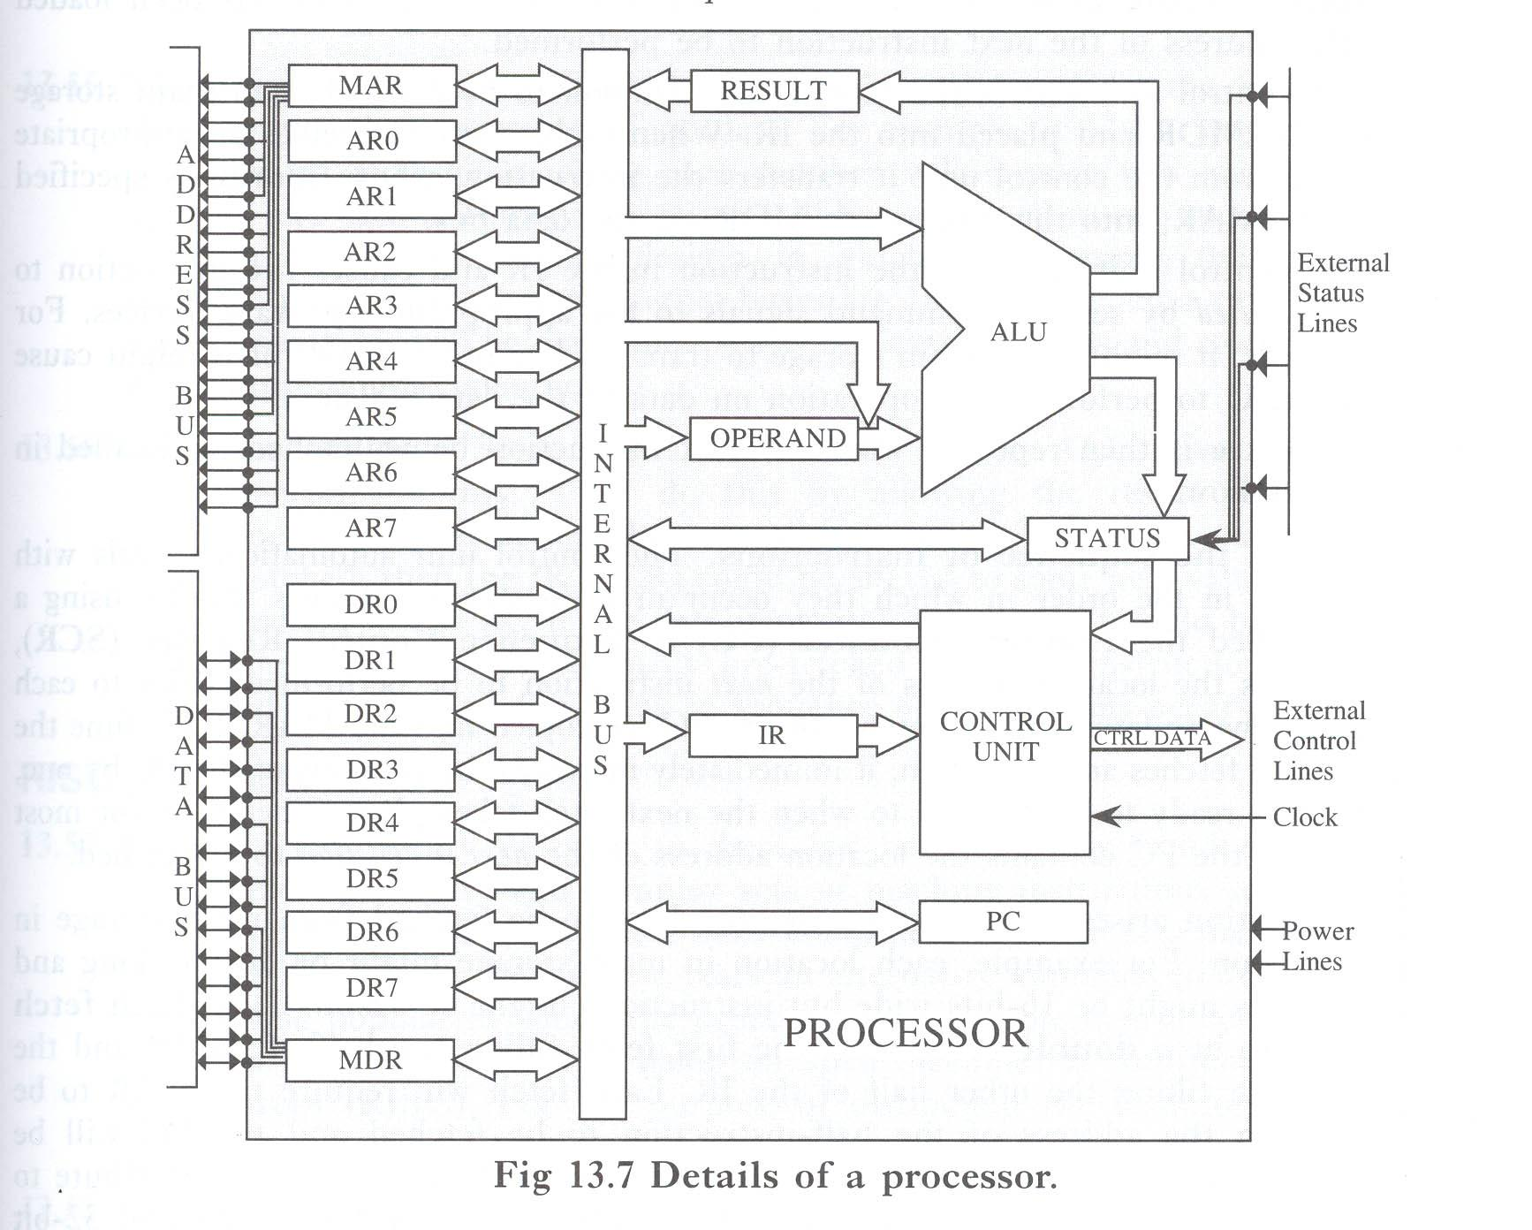
Details of a processor

Slide 27
Processor registers ¹²
IR (Instruction Register)
  Holds an instruction to be executed which was first taken from main storage via the MDR and placed in). There it is rapidly decoded and performed
DR (Data Registers) within ALU
  Hold data to be processed that was taken from main memory via MDR. The required arithmetic or logic operation is rapidly performed. ALU provides result in one DR from which it is taken and stored in main storage
AR (address registers)
  hold addresses from Memory Address Register (MAR), either stores the memory address from which data will be fetched to the CPU, or the address to which data will be sent and stored.
STATUS register
  is used by the control unit as a means of detecting conditions which have occurred such as the ALU detecting the arithmetic error of division by zero.
¹² Dale, N., & Lewis, J. (2020). Computer Science Illuminated (7th ed.). Jones & Bartlett Learning, Ch 5

Slide 28
Details of a processor

Slide 29
Processor: Control Unit ¹³
component of a computer's central processing unit (CPU) that directs the operation of the processor.
Is a nerve centre of the computer
  Coordinates and controls all-hardware operations (ie, those of peripheral units, main memory and the processor itself)
¹³ Dale, N., & Lewis, J. (2020). Computer Science Illuminated (7th ed.). Jones & Bartlett Learning, Ch 5

Slide 30
Control Unit operation ¹⁴
Fetch-execute cycle
  Control unit causes the requisite instruction to be fetched from main storage via the MDR and placed in IR. When main storage receives an appropriate signal from the control unit it transfers the instruction, whose address is specified in the MAR, into the processor’s MDR via the data bus
  The control unit interprets the instruction in the IR and causes the instruction to be executed by sending command signals to the appropriate hardware devices.
¹⁴ Dale, N., & Lewis, J. (2020). Computer Science Illuminated (7th ed.). Jones & Bartlett Learning, Ch 5

Slide 31
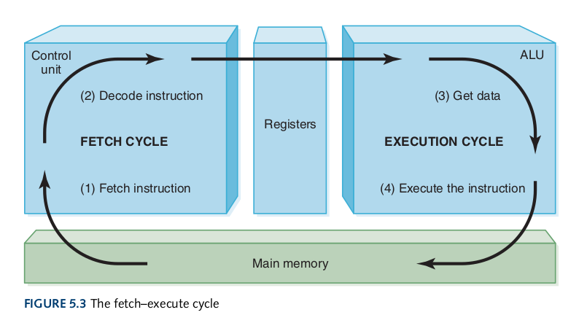
Fetch-execute cycle

Slide 32
Control Unit – Control of sequence of instructions ¹⁵
PC (Program Counter) or SCR (Sequence Control Register) registers
  Hold the location address of the next instruction to be performed
¹⁵ Dale, N., & Lewis, J. (2020). Computer Science Illuminated (7th ed.). Jones & Bartlett Learning, Ch 5

Slide 33
Details of a processor

Slide 34
Processor: Arithmetic and logic unit (ALU) ¹⁶
Functions
  Carries out the arithmetic (add, substract, multiply and divide)
  Performs certain “logical operations” (testing whether two data items match)
¹⁶ Dale, N., & Lewis, J. (2020). Computer Science Illuminated (7th ed.). Jones & Bartlett Learning, Ch 5

Slide 35
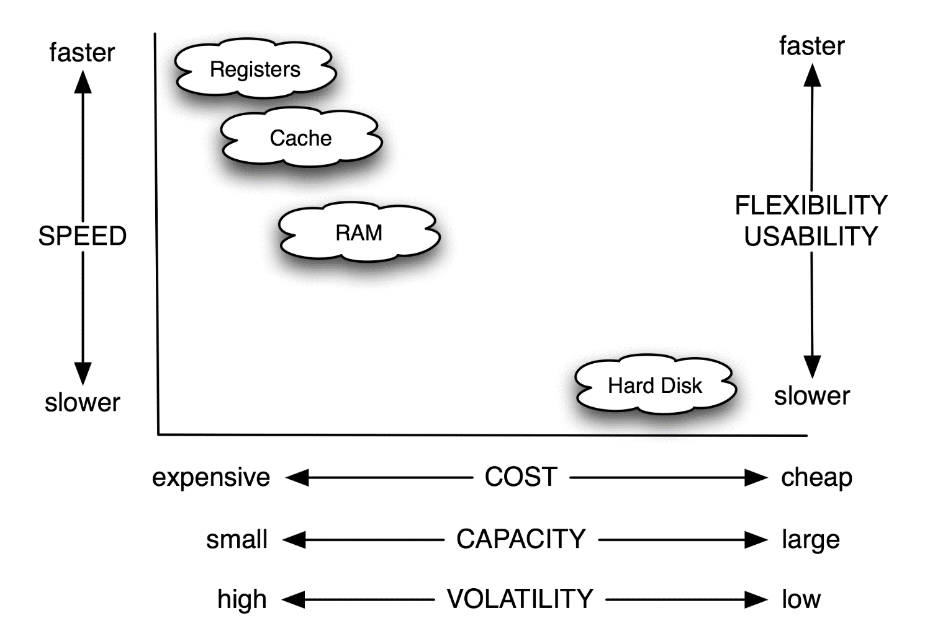
Performance and cost

Slide 36
Cache ¹⁷
is random access memory (RAM) that a computer microprocessor can access more quickly than it can access regular RAM.
Cache management algorithms
  LFU (Least Frequently Used) and LRU (Least Recently Used)
  The difference is that determining which data items to overwrite.
¹⁷ Dale, N., & Lewis, J. (2020). Computer Science Illuminated (7th ed.). Jones & Bartlett Learning, Ch 5

Slide 37
Recommended sources:
Essential material
Dale, “Computer Science Illuminated”, Chapter 5
R. White, “How computers work”, Chapters 2, 3, 4
Advanced material related to the topic:
  What Every Programmer Should Know About Memory
  Computer Architecture Essentials | James Reinders, former Intel Director
  How Computers Calculate - the ALU: Crash Course Computer Science #5
  Registers and RAM: Crash Course Computer Science #6
  The Central Processing Unit (CPU): Crash Course Computer Science #7
  Instructions & Programs: Crash Course Computer Science
  How A CPU Works

Slide 38
References
Dale, N., & Lewis, J. (2020). Computer Science Illuminated (7th ed.). Jones & Bartlett Learning, Chapter 5, end of the chapter exercises
Drepper, U., 2007. [online] People.freebsd.org. Available at: <https://people.freebsd.org/~lstewart/articles/cpumemory.pdf> [Accessed 7 June 2022].
Reinders, J., 2016. Computer Architecture Essentials. [online] Youtube.com. Available at: <https://www.youtube.com/watch?v=yOa0WpMwzWk> [Accessed 7 June 2022].
Youtube.com. 2017. Registers and RAM: Crash Course Computer Science #6 [online] Available at: <https://www.youtube.com/watch?v=fpnE6UAfbtU&t=539s> [Accessed 29 May 2022].
Youtube.com. 2017. The Central Processing Unit (CPU): Crash Course Computer Science #7 [online] Available at: <https://www.youtube.com/watch?v=FZGugFqdr60&t=52s> [Accessed 29 May 2022].
Youtube.com. 2017. Instructions & Programs: Crash Course Computer Science [online] Available at: <https://www.youtube.com/watch?v=zltgXvg6r3k&t=205s> [Accessed 29 May 2022].
Youtube.com. 2013. In One Lesson. [online] Available at: <https://www.youtube.com/watch?v=cNN_tTXABUA> [Accessed 7 June 2022].

Slide 39
References
Youtube.com. 2017. How Computers Calculate - the ALU: Crash Course Computer Science #5 [online] Available at: <https://www.youtube.com/watch?v=1I5ZMmrOfnA&list=PL8dPuuaLjXtNlUrzyH5r6jN9ulIgZBpdo&index=7 > [Accessed 29 May 2022].
Youtube.com. 2018. Khan Academy and Code.org | CPU, Memory, Input & Output. [online] Available at: <http://youtube.com/watch?v=MMzdKTtUIFM> [Accessed 7 June 2022].
Youtube.com. 2022. Khan Academy and Code.org | Hardware and Software. [online] Available at: <https://www.youtube.com/watch?v=VzVSt6jxiqw> [Accessed 7 June 2022].
Senanan, K., 2016. How computer memory works. [online] Youtube.com. Available at: <https://www.youtube.com/watch?v=p3q5zWCw8J4> [Accessed 7 June 2022].

