Slide 1
Computer Science Fundamentals
Seminar 5: Inside your computer| Python: String
Lecturer: Olga Yugay

Slide 2
Agenda
Part A
Lecture based Q&A
Inside your computer
Chipset architecture
How CPU works
Part B: Python
String with for loop and break
Value returning functions a.k.a. fruitful functions

Slide 3
Part A:

Slide 4
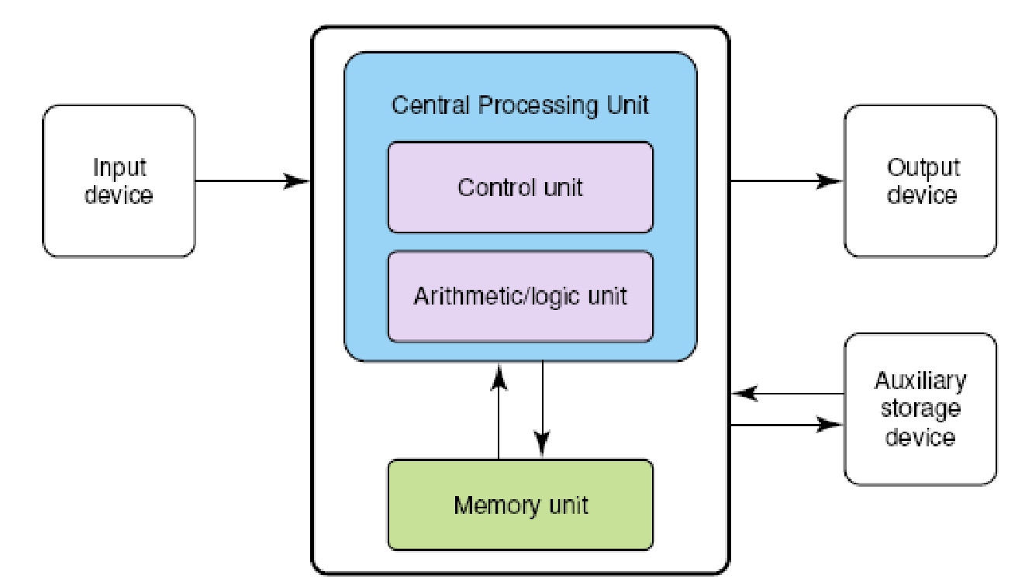
Lecture recap
What is main characteristic of von Neumann architecture?
Explain it on the diagram

Slide 5
Lecture recap
What does it mean to say that a processor is 1.4 GHz?
What does it mean to say that memory is 133MHz?
Compare and contrast RAM and ROM memory.
What is a secondary storage device, and why are such devices important?

Slide 6
Inside your computer
Watch Computer Parts
Map the computer parts from the video to the Neumann architecture

Slide 7
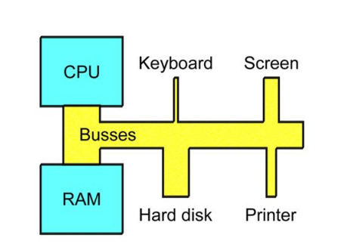
Chipset architecture until 2008 ¹
Buses = data channels
Some handle small transfers
  E.g. keyboard (bytes per second)
Some handle large transfers
  E.g. RAM (GB per second)
¹ book.huihoo.com. (n.d.). PC Architecture. A book by Michael B. Karbo. [online] Available at: https://book.huihoo.com/pc-architecture/ [Accessed 8 Jun. 2022].

Slide 8
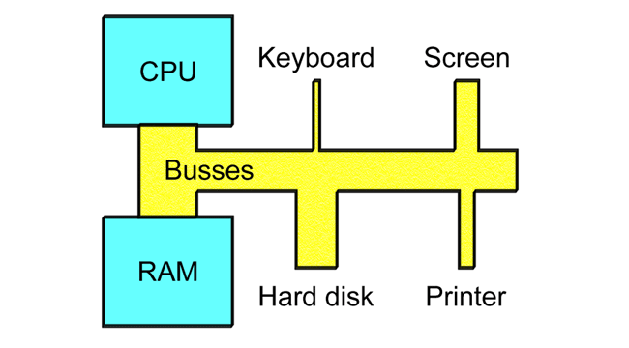
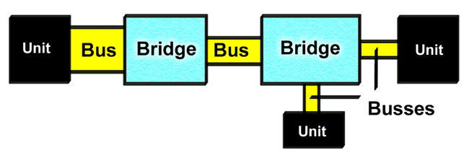
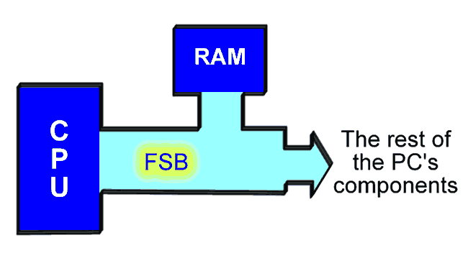
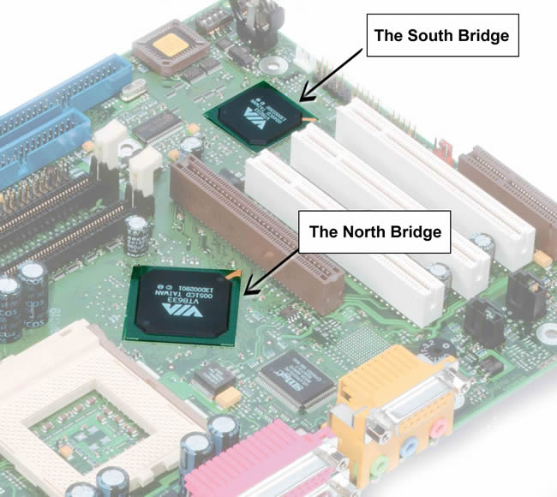
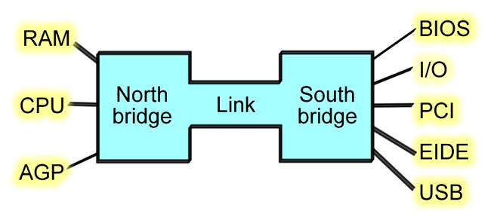
Bridge ²
Bridge – controller between buses with different capacities
² book.huihoo.com. (n.d.). PC Architecture. A book by Michael B. Karbo. [online] Available at: https://book.huihoo.com/pc-architecture/ [Accessed 8 Jun. 2022].

Slide 9
Bridge ³
Until 2008 the most widespread chipset architecture consists of two chips, usually called the north and south bridges.
³book.huihoo.com. (n.d.). PC Architecture. A book by Michael B. Karbo. [online] Available at: https://book.huihoo.com/pc-architecture/ [Accessed 8 Jun. 2022].

Slide 10
Bridge ⁴
This division applies to the most popular chipsets from VIA and Intel.
The north bridge and south bridge are connected by a powerful bus, which sometimes is called a link channel
⁴book.huihoo.com. (n.d.). PC Architecture. A book by Michael B. Karbo. [online] Available at: https://book.huihoo.com/pc-architecture/ [Accessed 8 Jun. 2022].

Slide 11
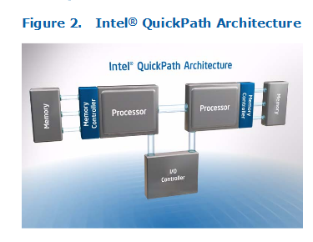
Chipset architecture nowadays… ⁵
More modern designs use point-to-point connections
E.g.: AMD's HyperTransport, Intel's DMI 2.0 or QuickPath Interconnect (QPI).
These implementations remove the traditional northbridge in favor of a direct link from the CPU to the Platform Controller Hub, southbridge or I/O controller.
⁵ Intel. (n.d.). Intel | Data Center Solutions, IoT, and PC Innovation. [online] Available at: https://www.intel.com/content/www/us/en/homepage.html?ref=https://www.intel.com/content/www/us/en/quick-path-interconnect-introduction-paper.html [Accessed 8 Jun. 2017].

Slide 12
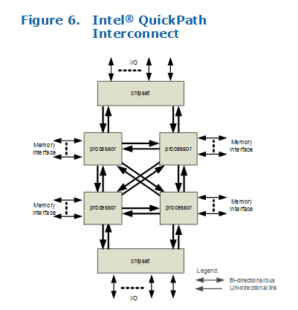
Chipset architecture nowadays… ⁶
memory controllers integrated into the microprocessors, which are connected together with a high-speed, point-to-point interconnect.
Result: high bandwidth and low latency => faster performance
⁶ Intel. (n.d.). Intel | Data Center Solutions, IoT, and PC Innovation. [online] Available at: https://www.intel.com/content/www/us/en/homepage.html?ref=https://www.intel.com/content/www/us/en/quick-path-interconnect-introduction-paper.html [Accessed 8 Jun. 2017].

Slide 13
How a CPU works?
How a CPU works? ⁷
⁷ Futurology — An Optimistic Future. “How a CPU Works | the CPU Explained.” Www.youtube.com, 7 Dec. 2017, www.youtube.com/watch?v=XQq_1yaVDpM. Accessed 8 June 2022.

Slide 14
Part B: Python

Slide 15
Topics to cover
Review Function and return values
Strings
For and While task more advanced with string

Slide 16
Functions and return values
So far most of the functions we wrote were void, they have no return values, in other words their return value is None

Slide 17
Functions and return values
def fancy_hello_world():
fancy_string = """
───▄▀▀▀▄▄▄▄▄▄▄▀▀▀▄───
───█▒▒░░░░░░░░░▒▒█───
────█░░█░░░░░█░░█────
─▄▄──█░░░▀█▀░░░█──▄▄─
█░░█─▀▄░░░░░░░▄▀─█░░█
Triple quotes allow to span string across multiple lines
"""
print(fancy_string)
How to make it return a value?

Slide 18
Functions and return values
So far most of the functions we wrote were void, they have no return values, in other words their return value is None
Calling the function generates a return value, which we usually assign to a variable or use as part of an expression.
def area(radius):
a = math.pi * radius**2
return a
def area(radius):
return math.pi * radius**2

Slide 19
Functions and return values
Since these return statements are in an alternative conditional, only one runs.
def absolute_value(x):
if x < 0:
return -x
else:
return x
absolute_value(3)
As soon as a return statement runs, the function terminates without executing any subsequent statements.

Slide 20
Functions and return values
It is important to ensure that every possible path through the program hits a return statement.
def absolute_value(x):
if x < 0:
return -x
elif x > 0:
return x
absolute_value(0)
Any problem here?

Slide 21
Functions and return values
The function on previous slide is incorrect because if x happens to be 0, neither condition is true, and the function ends without hitting a return statement. If the flow of execution gets to the end of a function, the return value is None , which is not the absolute value of 0.
>>> print(absolute_value(0))
None

Slide 22
Solution
def absolute_value(x):
if x < 0:
return -x
elif x > 0:
return x
elif x == 0:
return 0

Slide 23
Task 4
Write a def compare() function that takes two values, x and y , and returns 1 if x> y , 0 if x == y , and -1 if x < y .
Push code to your GitHub repository

Slide 24
Task 5
Implement the function def test_is_valid(test):
This function must return True if the argument test is an int (no floating point allowed here) and its value is between 1 and 3. To check if a variable is of int type, use the function isinstance().
Example: isinstance(my_variable, int). The former example tests if the variable my_variable is of type int.
Push code to your GitHub repository

Slide 25
String
Strings are not like integers, floats, and booleans.
A string is a sequence, which means it is an ordered collection of other values, i.e. sequence of characters
>>> fruit = 'banana'
>>> letter = fruit[1]
NB: The offset of the first letter is zero
index

Slide 26
String index
As an index you can use an expression that contains variables and operators:
>>> fruit = 'banana'
>>> i = 1
>>> fruit[i]
'a'
>>> fruit[i+1]
'n'
But the value of the index has to be an integer. Otherwise you get:
>>> letter = fruit[1.5]
TypeError: string indices must be integers

Slide 27
len
len is a built-in function that returns the number of characters in a string:
>>> fruit = 'banana'
>>> len(fruit)
6
To get the last letter of a string:
>>> length = len(fruit)
>>> last = fruit[length-1]
Why?

Slide 28
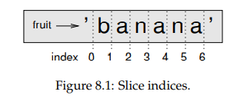
Traversal with a for loop
Traversal - pattern of processing when it often starts at the beginning of the string, selects each character in turn, does something to it, and continues until the end
index = 0
while index < len(fruit):
letter = fruit[index]
print(letter)
index = index + 1
for letter in fruit:
print(letter)

Slide 29
String slices
A segment of a string is called a slice. Selecting a slice is similar to selecting a character:
>>> s = 'Monty Python'
>>> s[0:5]
'Monty'
>>> s[6:12]
'Python'

Slide 30
String slices
If you omit the first index (before the colon), the slice starts at the beginning of the string. If you omit the second index, the slice goes to the end of the string:
>>> fruit = 'banana'
>>> fruit[:3]
'ban'
>>> fruit[3:]
'ana’

Slide 31
Strings are immutable
>>> greeting = 'Hello, world!'
>>> greeting[0] = 'J'
TypeError: 'str' object does not support item assignment
You can’t change an existing string. The best you can do is create a new string that is a variation on the original
>>> greeting = 'Hello, world!'
>>> new_greeting = 'J' + greeting[1:]
>>> new_greeting
'Jello, world!

Slide 32
Searching
def find(word, letter):
index = 0
while index < len(word):
if word[index] == letter:
return index
index = index + 1
return -1
print(find(‘computer’, ‘p’))
Traversing a sequence and returning when we find what we are looking for is called a search.

Slide 33
Task 5
Modify find function from previous slide so that it has a third parameter, the index in word where it should start looking.
Push updates to Github repository

Slide 34
Looping and counting
word = 'banana'
count = 0
for letter in word:
if letter == 'a':
count = count + 1
print(count)
This pattern of computation called a counter. The variable count is initialized to 0 and then incremented each time an a is found. When the loop exits, count contains the result—the total number of a’s.

Slide 35
String methods
dot notation specifies the name of the method, upper, and the name of the string to apply the method to, word. The empty parentheses indicate that this method takes no arguments.
>>> word = 'banana'
>>> new_word = word.upper()
>>> new_word
'BANANA
A method call is called an invocation
we are invoking upper on word.

Slide 36
The in operator
The word in is a boolean operator that takes two strings and returns True if the first appears as a substring in the second:
>>> 'a' in 'banana'
True
>>> 'seed' in 'banana'
False

Slide 37
Homework 0
The following program counts the number of times the letter a appears in a string:
word = 'banana'
count = 0
for letter in word:
if letter == 'a':
count = count + 1
print(count)
Rewrite the function so that instead of traversing the string, it uses the three parameter version of find from slide 26 to count the number of letter ‘a’ occurances. Push code to your GitHub repository

Slide 38
Homework 1
Implement the function def is_the_same(message1, message2):
This function must return True if the arguments message1 and message2 have the same textual content, independently of the characters’ case. The function must abort execution if any of the arguments are not of the type str.
Consider the tests below:
is_the_same("Flamengo", "fLaMeNgO") –> Expected result: True
is_the_same("flamengo", "FLAMENGO") –> Expected result: True
is_the_same("flamengo", "flamingo") –> Expected result: False
Push to https://classroom.github.com/a/U8MfQwDD

Slide 39
Homework 2
Implement the function below
def format_name(name, surname):
This function must return the name and surname formatted according to the following rule: Initial letter of the name + dot + space + surname + " (" + name + ")". Observe the example below and the expected result:
print(format_name("Wallace", "Corbo Ugulino"))
W. Corbo Ugulino (Wallace)
Before formatting the name, this function must validate if the arguments are valid. Name and Surname must be of the type str and must have len >=2. In case of invalid arguments, print the appropriate message (see below) and abort the execution:
inv_name ="Invalid argument. Name must be string (len >= 2)."
inv_surname ="Invalid argument. Surname must be string (len >= 2)."
Push to GitHub

Slide 40
Recommended reading
Dale, Computer Science Illuminated, Chapter 5, end of the book exercises
Downey, Think Python, Chapter 6, 8, end of the Chapter exercises
Refer to motherboard details and study its components.
https://github.community/t/the-difference-between-forking-and-cloning-a-repository/10189
Learn How Chipset directs Traffic
Learn How PCI Express breaks the Bus barrier

Slide 41
Solutions for seminar 5 homework with explanation
https://www.w3resource.com/python-exercises/python-conditional-exercise-4.php

Slide 42
References
Dale, N., & Lewis, J. (2020). Computer Science Illuminated (7th ed.). Jones & Bartlett Learning, Chapter 5
Downey, A. (2015). Think python. O'Reilly. Chapter 6, 8
Hamedani, M., 2020. Python for Beginners - Learn Python in 1 Hour. [online] Youtube.com. Available at: <https://www.youtube.com/watch?v=kqtD5dpn9C8> [Accessed 5 June 2022].
Fernandez, Alex. “The Difference between Forking and Cloning a Repository.” GitHub Support Community, 28 Nov. 2017, github.community/t/the-difference-between-forking-and-cloning-a-repository/10189. Accessed 8 June 2022.
book.huihoo.com. (n.d.). PC Architecture. A book by Michael B. Karbo. [online] Available at: https://book.huihoo.com/pc-architecture/ [Accessed 8 Jun. 2022].
Intel. (n.d.). Intel | Data Center Solutions, IoT, and PC Innovation. [online] Available at: https://www.intel.com/content/www/us/en/homepage.html?ref=https://www.intel.com/content/www/us/en/quick-path-interconnect-introduction-paper.html [Accessed 8 Jun. 2022].‌
Futurology — An Optimistic Future. “How a CPU Works | the CPU Explained.” Www.youtube.com, 7 Dec. 2017, www.youtube.com/watch?v=XQq_1yaVDpM. Accessed 8 June 2022.

