Slide 1
Computer Science Fundamentals
Lecture 6: Operating Systems Layer
Lecturer: Olga Yugay

Slide 2
Today’s focus: Operating Systems
Applications
Operating Systems
Programming
Hardware
Information

Slide 3
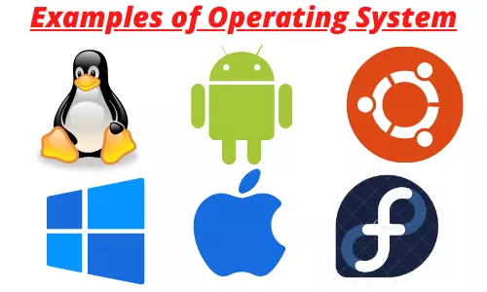
What OS examples do you know?

Slide 4
Agenda
OS role
OS architecture

Slide 5
How do OS work? ¹
How do OS work?
¹ ClickView. “How Do Operating Systems Work?” YouTube, 24 Sept. 2018, www.youtube.com/watch?v=GjNp0bBrjmU. Accessed 8 Nov. 2019.

Slide 6
OS role

Slide 7
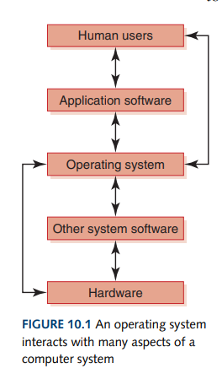
An operating system interacts with many aspects of a computer system

Slide 8
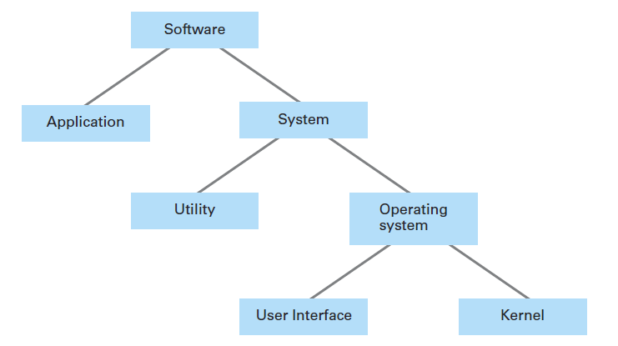
OS in software hierarchy

Slide 9
Types of software ²
Application software
  is written to address our specific needs to solve problems in the real world
  Ex: Word processing programs, games, inventory control systems, automobile, diagnostic programs, and missile guidance programs
System software
  manages a computer system at a fundamental level and interacts directly with the hardware
  provides the tools and an environment in which application software can be created and run. (e.g. library of graphics software that renders images on a display)
² Dale, N., & Lewis, J. (2020). Computer Science Illuminated (7th ed.). Jones & Bartlett Learning, Ch 10

Slide 10
Types of software ³
System software:
  Utility software (antivirus software, backup software and disk tools), device drivers (drivers for keyboards, printers, scanners, digital cameras and external storage devices) and firmware (BIOS (Basic Input/Output system) on PC, timing and control systems for washing machines and etc)
  Operating system (the core of system software)
  manages computer resources, such as memory and input/output devices,
  provides an interface through which a human can interact with the computer.
³ Dale, N., & Lewis, J. (2020). Computer Science Illuminated (7th ed.). Jones & Bartlett Learning, Ch 10

Slide 11
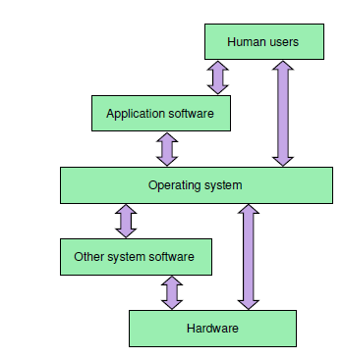
What is OS ⁴
glue
  that holds the hardware and software together.
software foundation
  on which all other software rests, allowing us to write programs that interact with the machine.
policeman (traffic warden)
  an operating system organizes the efficient flow of programs through a computer system.
⁴ Dale, N., & Lewis, J. (2020). Computer Science Illuminated (7th ed.). Jones & Bartlett Learning, Ch 10

Slide 12
OS roles ⁵
Coordinates access to physical resources
  CPU, memory, disk, i/o devices, etc.
Provides services
  Protection
  Scheduling
  Memory management
  File systems
  Synchronization
  etc.
⁵ Dale, N., & Lewis, J. (2020). Computer Science Illuminated (7th ed.). Jones & Bartlett Learning, Ch 10

Slide 13
OS as Government ⁶
Makes lives easy
  Promises everyone a whole machine (dedicated CPU, infinite memory, …)
  Provides standardized services (standard libraries, window systems, …)
Makes lives fair
  Arbitrates competing resource demands
Makes lives safe
  Prevents accidental or malicious damage by one program to another
⁶ Dale, N., & Lewis, J. (2020). Computer Science Illuminated (7th ed.). Jones & Bartlett Learning, Ch 10

Slide 14
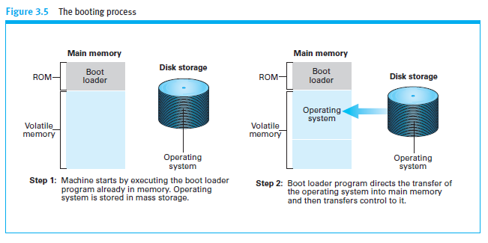
The booting process ⁷
⁷ Dale, N., & Lewis, J. (2020). Computer Science Illuminated (7th ed.). Jones & Bartlett Learning, Ch 10

Slide 15
Dual-boot or multi-boot ⁸
Computer could have two or more OS from which user chooses when the computer is turned on
Only one OS controls the computer at any given time
⁸ Dale, N., & Lewis, J. (2020). Computer Science Illuminated (7th ed.). Jones & Bartlett Learning, Ch 10

Slide 16
OS Architecture

Slide 17
Recall OS main responsibilities ⁹
OS has to:
  manage computer resources
  provide interface for system interaction
OS manages multiprogramming
  process management
  memory management
  CPU scheduling
⁹ Dale, N., & Lewis, J. (2020). Computer Science Illuminated (7th ed.). Jones & Bartlett Learning, Ch 10

Slide 18
Components of OS
USER SPACE
[APPLICATIONS]
KERNEL
Process manager
File Manager
Memory manager
I/O Manager
HARDWARE

Slide 19
Core functions of OS kernel ¹⁰
Process management
Device management
Memory management
Interrupt handling
I/O communication
¹⁰ Dale, N., & Lewis, J. (2020). Computer Science Illuminated (7th ed.). Jones & Bartlett Learning, Ch 10

Slide 20
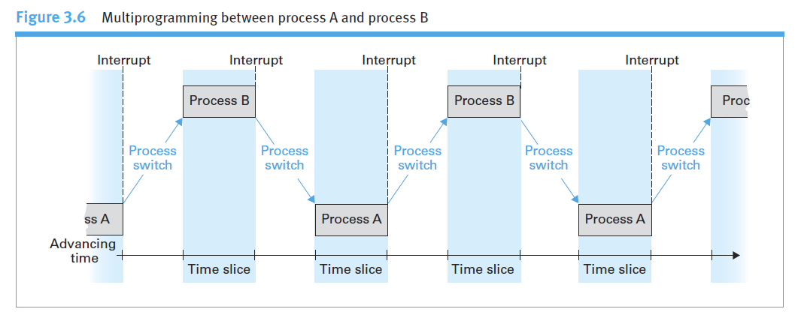
What is multiprogramming? ¹¹
Technique of keeping multiple programs in main memory at the same time, competing for the CPU
¹¹ Dale, N., & Lewis, J. (2020). Computer Science Illuminated (7th ed.). Jones & Bartlett Learning, Ch 10

Slide 21
What is multiprogramming? ¹²
Coordinating the Machine’s Activities
Some terminology:
  Process - The activity of executing a program under the control of the OS
  Process state - current status of the activity
OS manages these processes so that
  each process has needed resources (peripheral devices, space in main memory, access to files, and access to a CPU)
  independent processes do not interfere with one another, and that processes that need to exchange information are able to do so.
¹² Dale, N., & Lewis, J. (2020). Computer Science Illuminated (7th ed.). Jones & Bartlett Learning, Ch 10

Slide 22
Multiprogramming ¹³
Memory management - The act of keeping track of how and where programs are loaded in main memory
Process management - The act of keeping track of information for active processes
CPU scheduling – The act of determining which process in memory is given access to the CPU so that it may execute
¹³ Dale, N., & Lewis, J. (2020). Computer Science Illuminated (7th ed.). Jones & Bartlett Learning, Ch 10

Slide 23
Operating System components ¹⁴
User interface
  Older systems: shell – text based
  Newer systems: GUI, e.g. Window system
Kernel
  File manager - groups files into directories
  collection of device drivers - programs that let the OS communicate with the computer hardware (E.g. Graphic card, Sound card, Computer printer)
  Memory manager - coordinates the machine’s use of main memory.
  Scheduler - determines which activities are to be considered for execution
  Dispatcher - controls the allocation of time to these activities.
¹⁴ Dale, N., & Lewis, J. (2020). Computer Science Illuminated (7th ed.). Jones & Bartlett Learning, Ch 10

Slide 24
User Interface - UI
WIMP
Windows
Icons
Menus
Pointing device
is the most common combination of these elements in a graphical user interface technology.
These elements are usually embedded in the system by widgets.

Slide 25
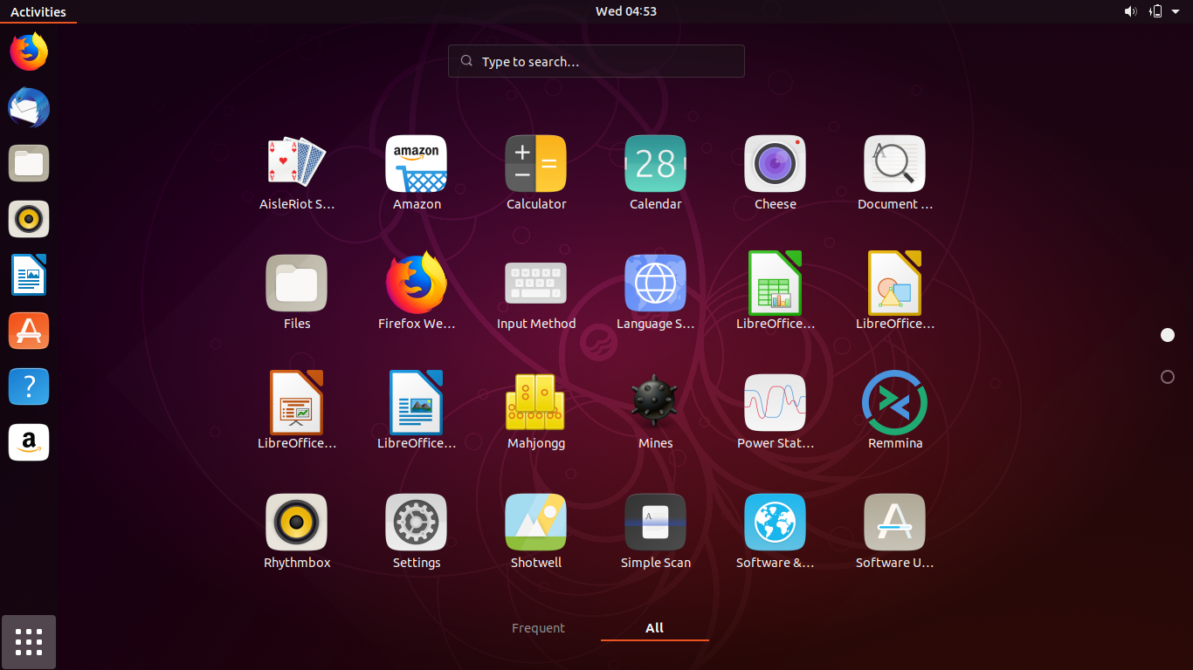
User interface

Slide 26
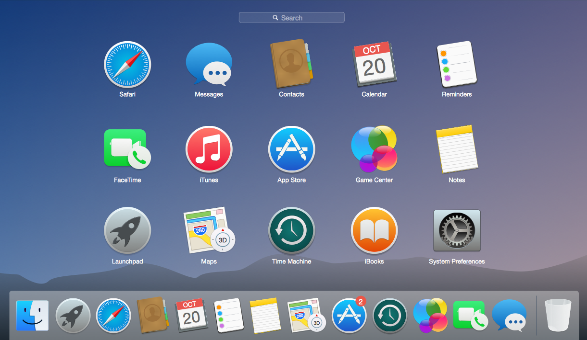

Slide 27
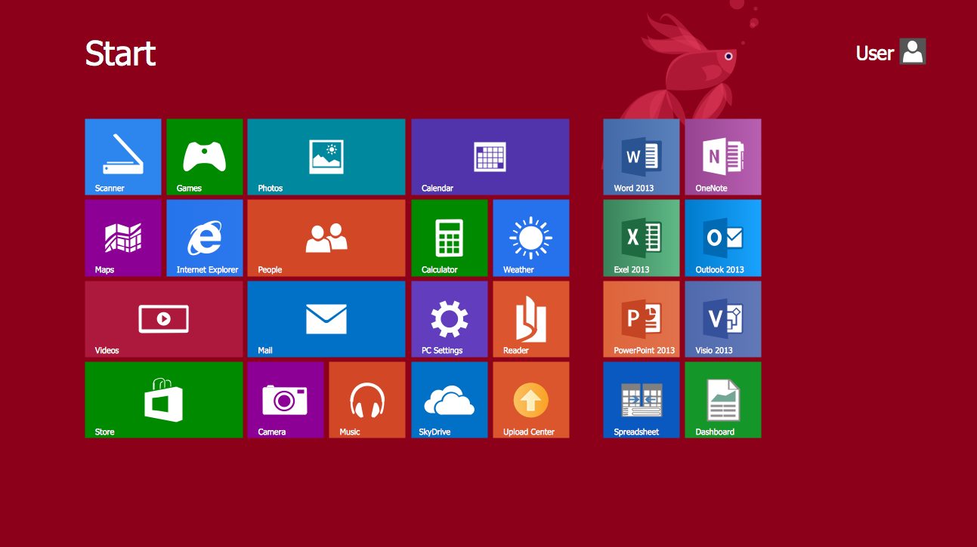

Slide 28
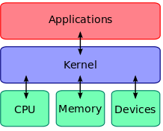
Kernel ¹⁵
A kernel is the central part of an OS.
It manages the tasks of the computer and the hardware
A computer user never interacts directly with the kernel. Kernel runs behind the scenes and cannot be seen, except for the text logs that it prints.
¹⁵ Dale, N., & Lewis, J. (2020). Computer Science Illuminated (7th ed.). Jones & Bartlett Learning, Ch 10

Slide 29
Kernel: File manager ¹⁶
maintains
  records of all the files stored in mass storage
    file location
    which users are allowed to access the various files,
    which portions of mass storage are available for new files or extensions to existing files.
  directory or folder
  directory path - A chain of directories within directories WIUT/Semester2/CSF
¹⁶ Dale, N., & Lewis, J. (2020). Computer Science Illuminated (7th ed.). Jones & Bartlett Learning, Ch 10

Slide 30
Kernel: Device drivers ¹⁷
Device drivers - programs that let OS communicate with the computer hardware (E.g. Graphic card, Sound card, Computer printer)
Each device driver is uniquely designed for its particular type of device (such as a printer, disk drive, or monitor) and translates generic requests into the more technical steps required by the device assigned to that driver.
¹⁷ Dale, N., & Lewis, J. (2020). Computer Science Illuminated (7th ed.). Jones & Bartlett Learning, Ch 10

Slide 31
Kernel: Memory manager ¹⁸
coordinates the machine’s use of main memory.
In multiuser or multitasking environments
  many programs and blocks of data must reside in main memory concurrently.
Memory manager must find and assign memory space for these needs and ensure that the actions of each program are restricted to the program’s allotted space.
Moreover, as the needs of different activities come and go, the memory manager must keep track of those memory areas no longer used.
¹⁸ Dale, N., & Lewis, J. (2020). Computer Science Illuminated (7th ed.). Jones & Bartlett Learning, Ch 10

Slide 32
Kernel: scheduler and dispatcher ¹⁹
scheduler - determines which activities are to be considered for execution, i.e. scheduled for execution,
dispatcher - controls the allocation of time to these activities.
¹⁹ Dale, N., & Lewis, J. (2020). Computer Science Illuminated (7th ed.). Jones & Bartlett Learning, Ch 10

Slide 33
Recommended actions
Dale, Computer Science Illuminated, Chapter 10, 11, end of the book exercises
Major Operating Systems and historical evolution
Watch Crash Course computer science series related to OS
  https://www.youtube.com/watch?v=26QPDBe-NB8&t=2s

Slide 34
References
Dale, N., & Lewis, J. (2020). Computer Science Illuminated (7th ed.). Jones & Bartlett Learning, Chapter 10, 11
“Major Operating Systems and Historical Evolution.” Unideb.hu, 2013, gyires.inf.unideb.hu/GyBITT/20/ch01s02.html.
“Operating Systems: Crash Course Computer Science #18.” Www.youtube.com, CrashCourse, 27 June 2017, www.youtube.com/watch?v=26QPDBe-NB8&t=2s. Accessed 8 June 2022.
P, The Avinash, and ey. “10 Examples of Operating System | Types of Operating System.” Quick Learn Computer, 14 Jan. 2022, quicklearncomputer.com/examples-of-operating-system-types-of-operating-system/. Accessed 8 June 2022.

