Slide 1
Computer Science Fundamentals
Seminar 6: OS| Python: Dictionaries
Lecturer: Olga Yugay

Slide 2
Agenda
Lecture based Q&A
File system using Terminal
Python
Dictionaries
Add item to a dictionary
Create a new dictionary
Look up value
len and in
values()
Looping and dictionaries
Reverse lookup

Slide 3
Part A:

Slide 4
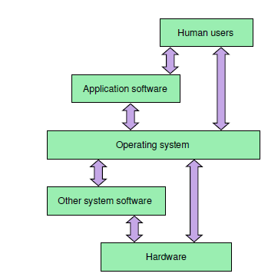
Lecture recap
Refer to the image and
define OS
list OS main roles

Slide 5
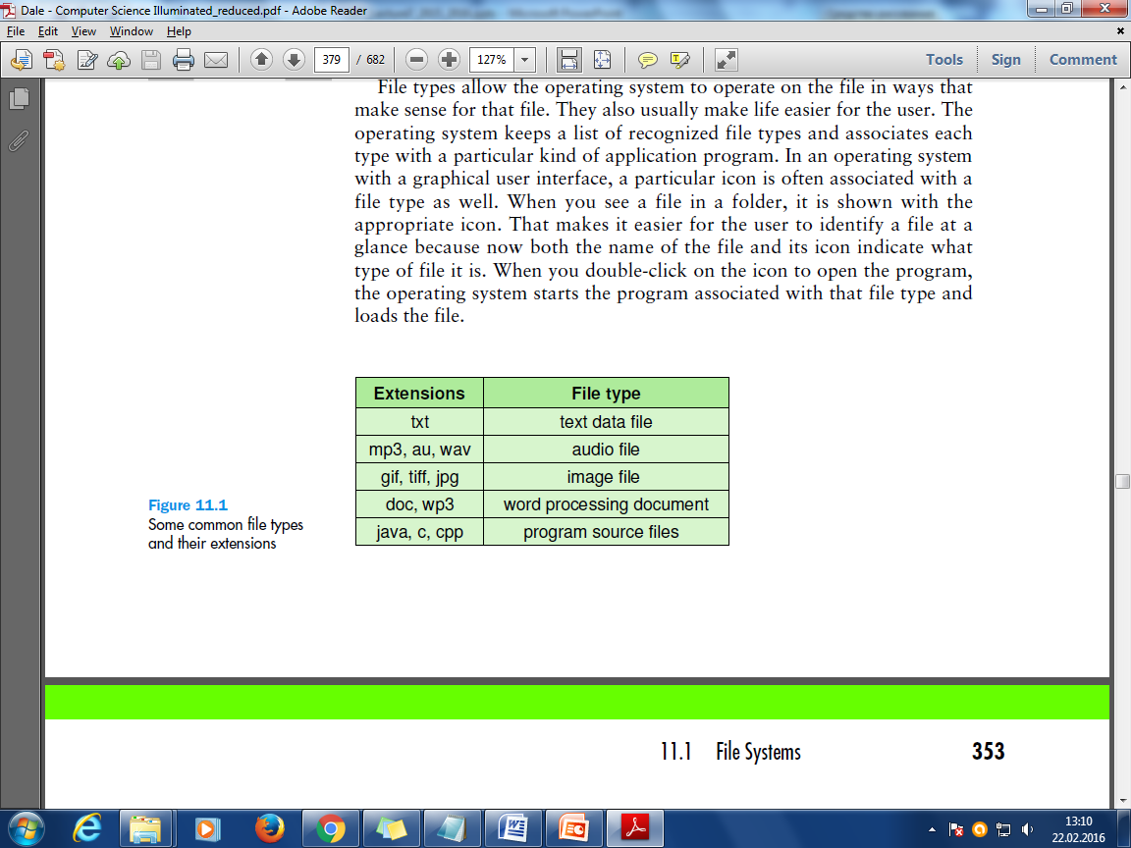
File manager: file systems
File - a named collection of data, used for organizing secondary memory
File system - the operating system’s logical view of the files it manages
Directory - a named group of files
File type - the specific kind of information contained in a file, such as a Java program or a Microsoft Word document
File extension - Part of a file name that indicates the file type

Slide 6
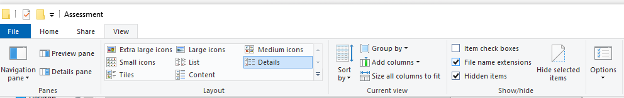
Task 1: Display the extensions
Click the Start menu. …
Type "folder options" (without the quotes). …
A dialog box with the title "Folder Options" will appear. …
Click to uncheck the box for "Hide extensions for known file types".
Click the "OK" button at the bottom of the dialog box.
Navigate to a folder with many different files, e.g. Downloads folder
Note their extensions.
Alternatively:
For MacOS
https://www.howtogeek.com/714021/how-to-show-all-filename-extensions-on-the-mac/

Slide 7
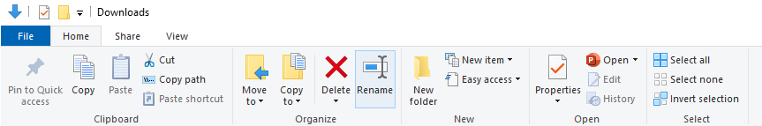
Task 2: Rename multiple files in bulk*
Open File Explorer.
Browse to the folder that includes all the files you want to rename.
Select all the files.
Quick Tip: You can use the Ctrl + A keyboard shortcut to select all the files.
Press the F2 key to rename it.
Type a new name for the file(s) and press Enter.
OR
*It may be useful for uploading files to an environment that does not support space or non-English characters in filenames, and batch renaming can be used to substitute characters with acceptable one. Special programs can be used for advanced cases
For MacOS: https://www.imore.com/how-rename-multiple-files-once-mac
https://www.howtogeek.com/207503/how-to-quickly-batch-rename-files-on-windows-mac-os-x-or-linux/

Slide 8
Task 3: See file metadata
Display File metadata (file owner, permissions, file size, date modified, date created, file type). Right click on file or folder and access Properties.

Slide 9
How to change file associations with a program in Windows (1 method)
Open My Computer or Explorer. (Windows key + E to open Explorer)
Right-click on the file you want to change the file association and click Properties.
In the file Properties, click the Change button next to the "Opens with" option.
After clicking Change, you'll be given a list of programs to open the file.
Select the program you want to use and then click OK or Apply. If the program you want to use is not listed, click the Browse button, find the program's executable (.exe) file on the computer, and click OK to select that program.

Slide 10
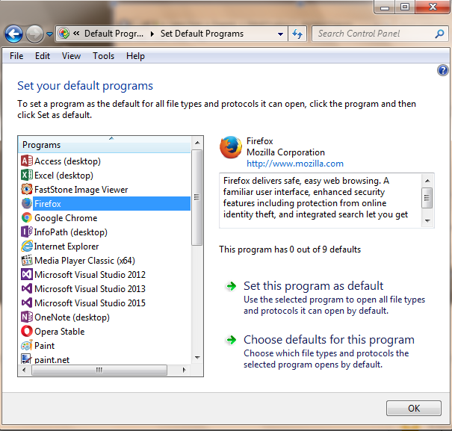
How to change file associations with a program in Windows (2 method)
Open the Control Panel.
In Control Panel, search for Default Programs and open the icon.
Click on a program and either se this program as default
OR
Choose defaults for this program

Slide 11
Task 4
Change the default program for opening py and related files (e.g. switch to PyCharm)

Slide 12
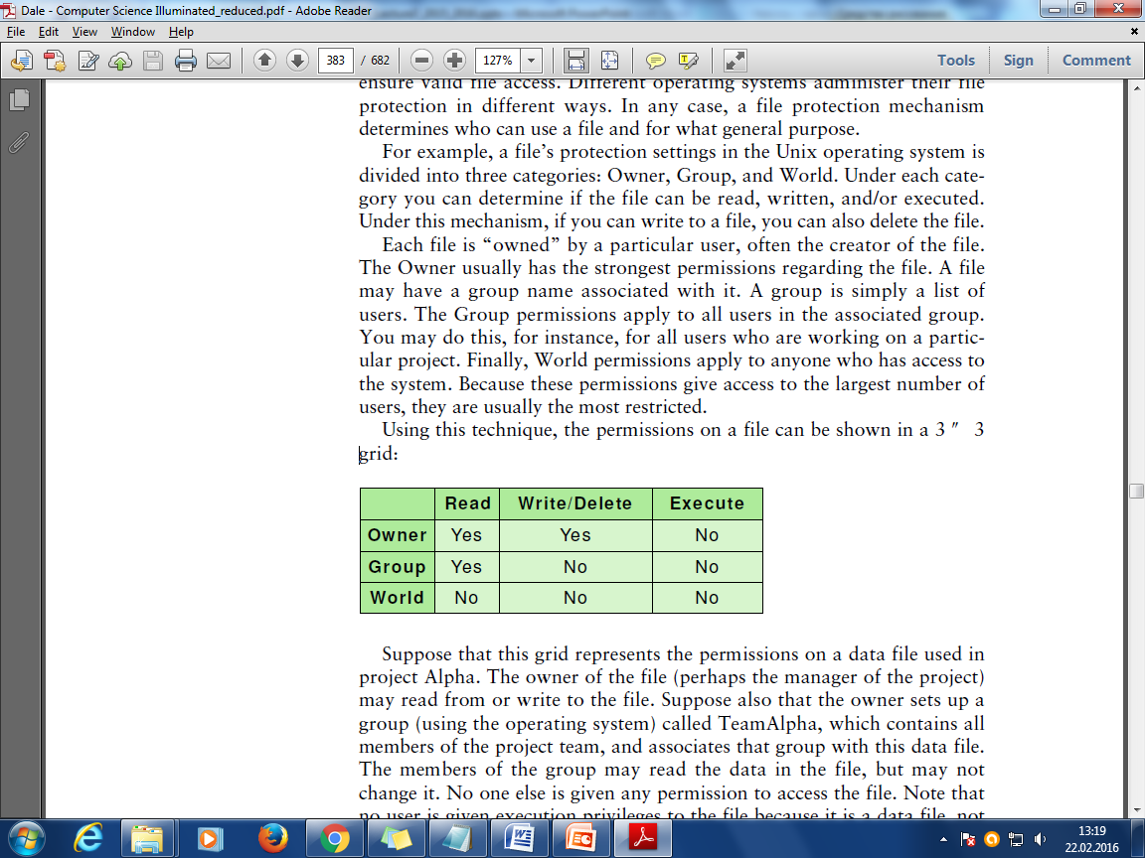
File Manager: file protection
In multiuser systems, file protection is of primary importance. That is, we don’t want one user to be able to access another user’s files unless the access is specifically allowed.
It is the operating system’s responsibility to ensure valid file access.
Different operating systems administer their file protection in different ways.

Slide 13
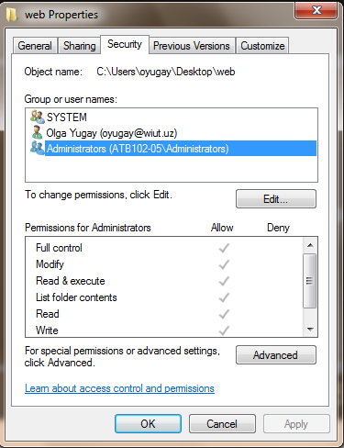
Task 5 Change access permissions
Navigate to Documents folder
Right click on folder, access the security tab and change the access permissions for Administrators/other users

Slide 14
File Manager: directories (recap seminar 2)
A directory, in most operating systems, is represented as a file. The directory file contains data about the other files in the directory.
For any given file, the directory contains the file name, the file type, the address on disk where the file is stored, and the current size of the file.
The directory also contains information about the protections set up for the file. It may also contain information about when the file was created and when it was last modified.

Slide 15
Directories: path
Path - a text designation of the location of a file or subdirectory in a file system
Absolute path - path that begins at the root and includes all successive subdirectories
Relative path - path that begins at the current working directory
Linux/Unix | Windows
/etc/samba.smb.conf /boot/grub/grub.conf | C:\Program Files\Microsoft Office\Office12\VISSHE.DLL D:\MyFolder\CSF\Lecture7.pptx
Linux/Unix | Windows
../samba.smb.conf ../grub.conf | ..\Office12\VISSHE.DLL ..\CSF\Lecture7.pptx

Slide 16
Task 6: review absolute vs relative path
Open command line
Navigate to desired folder using relative path
Navigate to desired folder using absolute path
Which method is most applicable when?

Slide 17
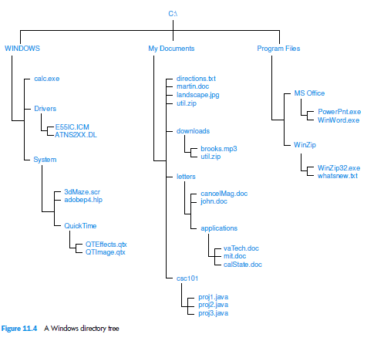
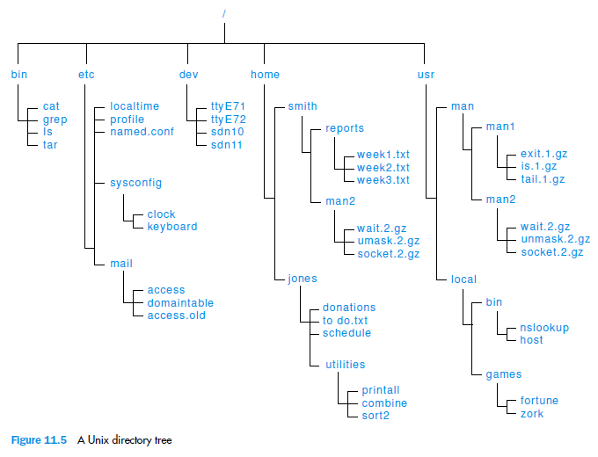
Windows vs Unix directory tree

Slide 18
Part B: Python

Slide 19
Dictionary
Built-in type, which is building blocks of many efficient algorithms
Dictionary is like a list but more general
A dictionary contains a collection of indices, which are called keys, and a collection of values
student = {‘name’: ‘Lola’,
‘age’: ‘19’,
‘course’: ‘BIS’
‘level’: ‘4’
}
key
value

Slide 20
Dictionary
Built-in type, which is building blocks of many efficient algorithms
Dictionary is like a list but more general
A dictionary contains a collection of indices, which are called keys, and a collection of values
student = {‘name’: ‘Lola’,
‘age’: ‘19’,
‘course’: ‘BIS’
‘level’: ‘4’
}
key
value
Key-value pair or item

Slide 21
Dictionary is a mapping
A dictionary represents a mapping from keys to values, so you can also say that each key “maps to” a value
>>> eng2uz = dict()
>>> eng2uz
{}
Curly brackets represent an empty dictionary

Slide 22
Add items to dictionary
>>> eng2uz['one'] = 'bir'
>>> eng2uz
{'one': 'bir'}

Slide 23
Create a new dictionary
>>> eng2uz = {'one': 'bir', 'two': 'ikki', 'three': 'uch'}
Try print eng2uz
>>> eng2uz
{'one': 'bir', 'three': 'uch', 'two': 'ikki'}
The order of the key-value pairs might not be the same. In general, the order of items in a dictionary is unpredictable.
It is not a problem because the elements of a dictionary are never indexed with integer indices. Instead, keys are used to look up the corresponding values

Slide 24
Looking up value
You use the keys to look up the corresponding values
>>> eng2uz['two']
'ikki'
>>> eng2uz['four']
KeyError: 'four'

Slide 25
len()
Remember len function? It works on dictionaries as well!
>>> len(eng2uz)
3

Slide 26
in
in operator works on dictionaries, it tells you whether something appears as a key in the dictionary (appearing as a value is not good enough).
>>> 'one' in eng2uz
True
>>> 'uno' in eng2uz
False

Slide 27
values()
To see whether something appears as a value in a dictionary, you can use the method values, which returns a collection of values, and then use the in operator:
>>> vals = eng2uz.values()
>>> 'bir' in vals
True
Python dictionaries use a data structure called a hashtable that has a remarkable property: the in operator takes about the same amount of time no matter how many items are in the dictionary

Slide 28
Task 7
Write a function that would calculate average for marks presumably received for a set of modules. Use in operator and len() method
For example:
myFinalMarks = {'CSF': 75, 'FunPro': 80, 'WT': 85}
You can enhance task by getting input from user and storing it in the dictionary
Git push updates

Slide 29
Dictionary as a collection of counters
Suppose you are given a string and you want to count how many times each letter appears. Your options:
1. Create 26 variables, one for each letter of the alphabet. Then traverse the string and, for each character, increment the corresponding counter, probably using a chained conditional.
2. Create a list with 26 elements. Then convert each character to a number (using the built-in function ord), use the number as an index into the list, and increment the appropriate counter.
3. Create a dictionary with characters as keys and counters as the corresponding values. The first time you see a character, you would add an item to the dictionary. After that you would increment the value of an existing item.

Slide 30
Potential solution
empty dictionary is created
def histogram(s):
d = dict()
for c in s:
if c not in d:
d[c] = 1
else:
d[c] += 1
return d
for loop traverses the string
if the character c is not in the dictionary, we create a new item with key c and the initial value 1
If c is already in the dictionary we increment d[c].

Slide 31
Try it
>>> h = histogram('brontosaurus')
>>> h
{'a': 1, 'b': 1, 'o': 2, 'n': 1, 's': 2, 'r': 2, 'u': 2, 't': 1}
The histogram indicates that the letters 'a' and 'b' appear once; 'o' appears twice, and so on.

Slide 32
get ()
Dictionaries have a method called get that takes a key and a default value. If the key appears in the dictionary, get returns the corresponding value; otherwise it returns the default value
>>> h = histogram('a')
>>> h
{'a': 1}
>>> h.get('a', 0)
1
>>> h.get('c', 0)
0

Slide 33
Task 8
Write code that would calculate final mark for the module. Marks and weighting are stored in the dictionary. Use get() method
Example:
csf = {
'cw1-weight': 0.4,
'cw1-mark':79,
'exam-weight':0.6,
'exam-mark':65
}
Git push the task to github repository

Slide 34
Looping and dictionaries
If you use a dictionary in a for statement, it traverses the keys of the dictionary. For example, print_hist prints each key and the corresponding value:
def print_hist(h):
for c in h:
print(c, h[c])
>>> h = histogram('parrot')
>>> print_hist(h)
a 1
p 1
r 2
t 1
o 1
You have to have histogram code from slide 32
Why are keys are in no particular order?

Slide 35
Reverse lookup
Given a dictionary d and a key k, it is easy to find the corresponding value
<=This operation is called a lookup.
what if you have v and you want to find k?
Problems:
there might be more than one key that maps to the value v. Depending on the application, you might be able to pick one, or you might have to make a list that contains all of them.
there is no simple syntax to do a reverse lookup; you have to search.

Slide 36
Reverse lookup
def reverse_lookup(d, v):
for k in d:
if d[k] == v:
return k
raise LookupError()
The raise statement causes an exception.
In this case it causes a LookupError, which is a built-in exception used to indicate that a lookup operation failed.

Slide 37
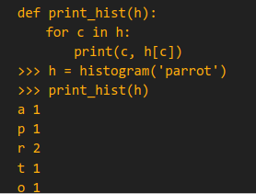
Example of a successful reverse lookup:
Recall slide 37
>>> h = histogram('parrot')
>>> key = reverse_lookup(h, 2)
>>> key
'r'

Slide 38
Example of a unsuccessful reverse lookup:
>>> key = reverse_lookup(h, 3)
Traceback (most recent call last):
File "", line 1, in
File "", line 5, in reverse_lookup
LookupError

Slide 39
Explore Linux family
Ubuntu 20.10: What's New?

Slide 40
Homework 1: Explore Virtual box and Ubuntu
Download and install https://www.virtualbox.org/wiki/Downloads
Open Oracle VM Virtual Box Manager
Install Desktop Ubuntu version https://ubuntu.com/#download
Explore basic apps
Run basic apps using Run command and shortcuts
Read more on Ubuntu
https://www.lifewire.com/beginners-guide-to-ubuntu-2205722
https://www.makeuseof.com/tag/ubuntu-an-absolute-beginners-guide/
Create files and directories using LX Terminal
Virtual Box beginner’s guide https://www.youtube.com/watch?v=sB_5fqiysi4
Install and experiment with Ubuntu https://www.youtube.com/watch?v=lmeDvSgN6zY

Slide 41
Homework 2: Explore terminal commands
Open terminal and explore the following commands
Pwd - Print working directory
Ls - list the files in current directory
Create a file
touch myfile.txt - to create a file
echo "Hello world!" > myfile.txt - to write to file
cat myfile.txt - to print the contents of a file
gedit myfile.txt - to open the file in Text editor gedit
Mkdir seminar7 - to make a directory seminar7
Cd seminar7 - to change directory, access seminar7 directory

Slide 42
Homework 3: Explore terminal commands
Create several .txt files in seminar7 directory. Use commands below to accomplish the tasks listed:
cp - copy files
mv - move files
rm - delete files
rmdir - remove directory
Create a new directory task10
Copy 1 file to task10
Move 1 file from seminar 7 to task10
Delete files and then directory task10

Slide 43
Homework 4
Explore and experiment with commands in Ubuntu terminal:
https://www.howtogeek.com/412055/37-important-linux-commands-you-should-know/
https://garywoodfine.com/linux-terminal-command-cheat-sheets/
https://help.ubuntu.com/lts/installation-guide/armhf/apcs02.html

Slide 44
Homework 5
Downey, Think Python, Chapter 11 end of the Chapter exercises
https://www.jetbrains.com/help/pycharm/contribute-to-projects.html

Slide 45
Solution to seminar 6 task 6 (set as homework)
It is one of many possible options. Feel free to share your solutions
https://github.com/wiut-tutor/sem-6/blob/main/task6.py

Slide 46
References
Dale, N., & Lewis, J. (2020). Computer Science Illuminated (7th ed.). Jones & Bartlett Learning, Chapter 11
Downey, A. (2015). Think python. O'Reilly. Chapter 6, 8
Hamedani, M., 2020. Python for Beginners - Learn Python in 1 Hour. [online] Youtube.com.
Contribute to projects on github: Pycharm. PyCharm Help. (n.d.). Retrieved June 8, 2022, from https://www.jetbrains.com/help/pycharm/contribute-to-projects.html
McKay, D. (2019, May 8). 37 important linux commands you should know. How. Retrieved June 8, 2022, from https://www.howtogeek.com/412055/37-important-linux-commands-you-should-know/
Gary WoodfineTechnical Director at threenine.co.ukGary is Technical Director at threenine.co.uk. (2021, April 28). Linux and Ubuntu Terminal Command Reference Cheat Sheets. Gary Woodfine. Retrieved June 8, 2022, from https://garywoodfine.com/linux-terminal-command-cheat-sheets/
Ubuntu documentation. Official Ubuntu Documentation. (n.d.). Retrieved June 8, 2022, from https://help.ubuntu.com/

