Slide 1
Computer Science Fundamentals
Lecture topic: Programming Layer
Lecturer: Olga Yugay

Slide 2
Today’s focus
Communications
Applications
Operating Systems
Programming
Hardware
Information

Slide 3
Agenda
Problem solving and problem-solving strategies
Algorithm
Algorithm with selection
Algorithm with repetition
Searching algorithms
  Sequential search
  Binary search
Algorithm complexity

Slide 4
Let’s refresh your understanding
What is Programming? | Intro to JS: Drawing & Animation | Computer programming | Khan Academy ¹
¹ Khan Academy. (2015). What is Programming? | Intro to JS: Drawing & Animation | Computer programming . Retrieved June 9, 2022, from https://www.youtube.com/watch?v=FCMxA3m_Imc.

Slide 5
Problem solving
Problem solving - the act of finding a solution to a perplexing question
A computer is not intelligent
  Computer can do nothing without being told what to do.
  Human (the programmer) must analyze the problem, develop the instructions for solving the problem (the program), and then have the computer carry out the instructions. ²
² Dale, N., & Lewis, J. (2020). Computer Science Illuminated (7th ed.). Jones & Bartlett Learning, Ch 7-9

Slide 6
Problem solving strategies - heuristics
=
Ask questions
  What do I know about the problem?
  What is the information that I have to process in order the find the solution?
  What does the solution look like?
  What sort of special cases exist?
  How will I recognize that I have found the solution?
Look for Familiar Things
  never reinvent the wheel. If a solution exists, use it. If you’ve solved the same or a similar problem before, just repeat the successful solution.
  E.g. Use Design Patterns (more about it at level 5)
Divide and Conquer
  break up a large problem into smaller pieces that we can solve individually. ³
³ Dale, N., & Lewis, J. (2020). Computer Science Illuminated (7th ed.). Jones & Bartlett Learning, Ch 7-9

Slide 7
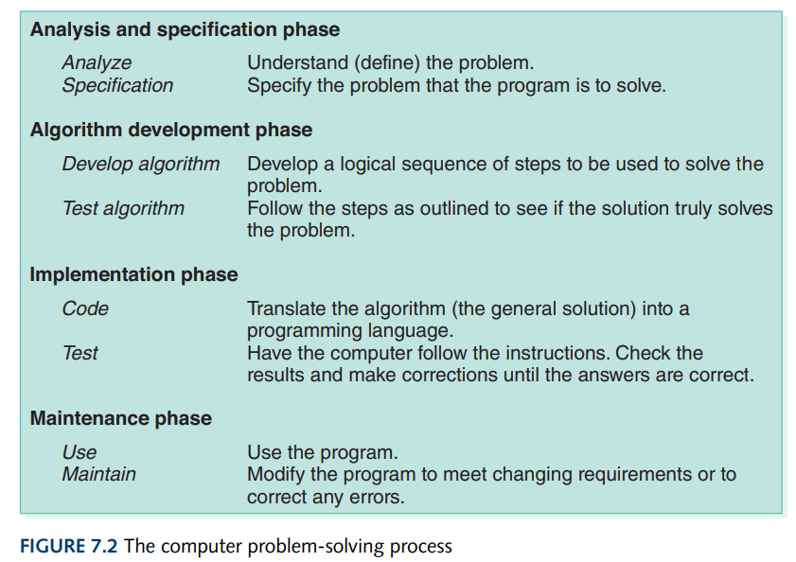
The computer problem-solving process ⁴
⁴ Dale, N., & Lewis, J. (2020). Computer Science Illuminated (7th ed.). Jones & Bartlett Learning, Ch 7-9

Slide 8
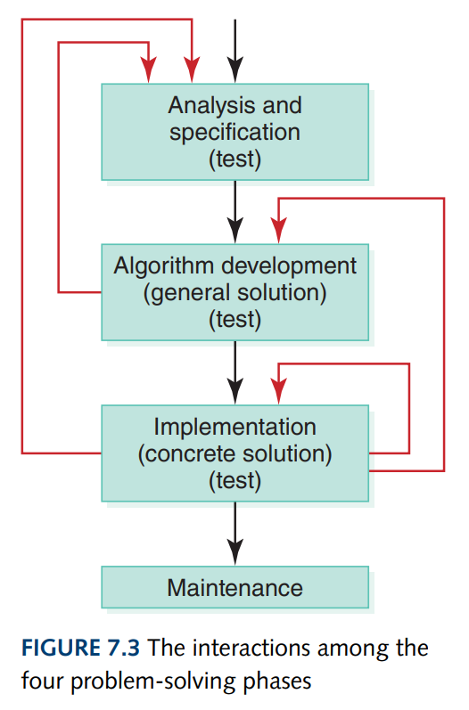
The interactions among the problem solving phases
The black lines show the general flow through the phase.
The red lines represent paths that can be taken to backtrack to a previous phase if a problem occurs. ⁵
⁵ Dale, N., & Lewis, J. (2020). Computer Science Illuminated (7th ed.). Jones & Bartlett Learning, Ch 7-9

Slide 9
Algorithm
Algorithm – set of instructions for solving a problem or subproblem in a finite amount of time using a finite amount of data ⁶
“Algorithm is a tool for solving a well-specified computational problem. The statement of the problem specifies in general terms the desired input/output relationship. The algorithm describes specific computational procedures for achieving input/output relationship.” (Cormen et. al.)
⁶ Dale, N., & Lewis, J. (2020). Computer Science Illuminated (7th ed.). Jones & Bartlett Learning, Ch 7-9

Slide 10
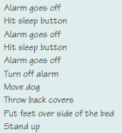
Presenting algorithm - pseudocode
Pseudocode - uses a mixture of English and formatting to make the steps in the solution explicit. Used to present the algorithm
Have a look at sample algorithm for getting up in the morning ⁷
⁷ Dale, N., & Lewis, J. (2020). Computer Science Illuminated (7th ed.). Jones & Bartlett Learning, Ch 7-9

Slide 11
What is algorithm and why you should care?
What's an algorithm? - David J. Malan ⁸
What is algorithm and why should you care? ⁹
⁸ Malan, D. J. (2013, May 20). What's an algorithm? - David J. Malan. YouTube. Retrieved June 9, 2022, from https://youtu.be/6hfOvs8pY1k
⁹ Khan Academy. (2015, July 27). What is an algorithm and why should you care? | algorithms | computer science . YouTube. Retrieved June 9, 2022, from https://www.youtube.com/watch?v=CvSOaYi89B4

Slide 12
Summary of methodology for designing algorithms¹⁰
Analyze the Problem
  list information to work with (data)
  specify potential solution
  list assumptions
  develop overall plan
List the Main Tasks
  Main module
Write the Remaining Modules
  modules on one level can specify more modules on lower levels
Re-sequence and Revise as Necessary
¹⁰Dale, N., & Lewis, J. (2020). Computer Science Illuminated (7th ed.). Jones & Bartlett Learning, Ch 7-9

Slide 13
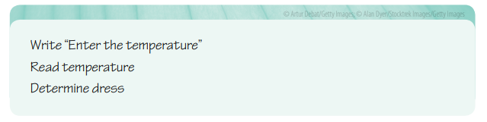
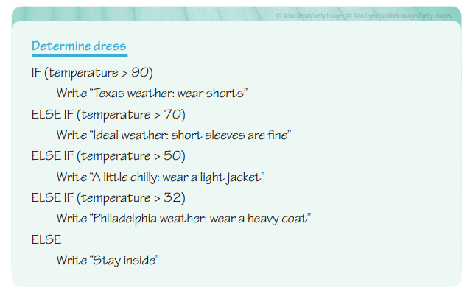
Algorithms with selection¹¹
Case: write an algorithm to express what dress is appropriate for a given outside temperature.
¹¹Dale, N., & Lewis, J. (2020). Computer Science Illuminated (7th ed.). Jones & Bartlett Learning, Ch 7-9

Slide 14
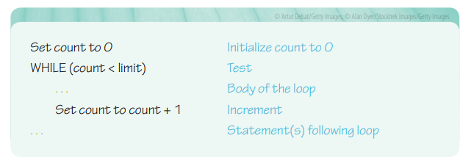
Algorithms with repetition ¹²
Count-controlled loops
¹²Dale, N., & Lewis, J. (2020). Computer Science Illuminated (7th ed.). Jones & Bartlett Learning, Ch 7-9

Slide 15
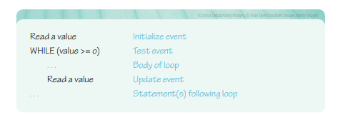
Algorithms with repetition ¹³
Event-controlled loops
When implementing an event-controlled loop using a while statement, there are again three parts to the process:
the event must be initialized
the event must be tested
and the event must be updated
The algorithm o the right reads and sums data values until negative value is read
¹³Dale, N., & Lewis, J. (2020). Computer Science Illuminated (7th ed.). Jones & Bartlett Learning, Ch 7-9

Slide 16
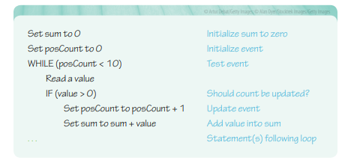
Algorithms with repetition ¹⁴
event controlled loop continued
¹⁴Dale, N., & Lewis, J. (2020). Computer Science Illuminated (7th ed.). Jones & Bartlett Learning, Ch 7-9

Slide 17
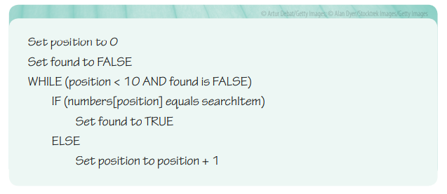
Searching algorithms: sequential search ¹⁵
Each item is looked at in turn and compared to the one being searched.
Stop either when the item is found, or when all items are looked at and not found a match
¹⁵Dale, N., & Lewis, J. (2020). Computer Science Illuminated (7th ed.). Jones & Bartlett Learning, Ch 7-9

Slide 18
Searching algorithm: Binary search ¹⁶
Binary search is an efficient algorithm for finding an item from a sorted list of items. It works by repeatedly dividing in half the portion of the list that could contain the item, until you've narrowed down the possible locations to just one.
Watch video on binary search algorithm ¹⁷
¹⁶Dale, N., & Lewis, J. (2020). Computer Science Illuminated (7th ed.). Jones & Bartlett Learning, Ch 7-9
¹⁷ HackerRank. (2016, September 27). Algorithms: Binary search. YouTube. Retrieved June 9, 2022, from https://www.youtube.com/watch?v=P3YID7liBug
Notes:
HackerRank. (2016, September 27). Algorithms: Binary search. YouTube. Retrieved June 9, 2022, from https://www.youtube.com/watch?v=P3YID7liBug

Slide 19
Example
Given list of numbers find number 5
1, 2, 5, 7, 8, 10, 50, 60, 71, 77, 78, 79, 80
x=5

Slide 20
Example
Given list of numbers find number 5
1, 2, 5, 7, 8, 10, 50, 60, 71, 77, 78, 79, 80
x=5
1) Midpoint is 50 (13/2=6.5, 7th number is the midpoint)
To identify midpoint:
Count the total number of number entries (which is 13 in this example)
Divide the total number by 2 (in this example, 13/2=6.5
Round the result 6.5 ≈ 7, 7th number is the midpoint

Slide 21
Example
Given list of numbers find number 5
1, 2, 5, 7, 8, 10, 50, 60, 71, 77, 78, 79, 80
x=5
1) Midpoint is 50 (13/2=6.5, 7th number is the midpoint)
2) x< midpoint (5<50), ignore the range on the right (50-80)

Slide 22
Example
Given list of numbers find number 5
1, 2, 5, 7, 8, 10, 50, 60, 71, 77, 78, 79, 80
x=5
1) Midpoint is 50 (13/2=6.5, 7th number is the midpoint)
2) x< midpoint (5<50), ignore the range on the right (50-80)
3) Midpoint is 5
To identify new midpoint:
Count the total number of left number entries (which is 6)
Divide the total number by 2 (in this example, 6/2=3,
3rd number is the new midpoint

Slide 23
Example
Given list of numbers find number 5
1, 2, 5, 7, 8, 10, 50, 60, 71, 77, 78, 79, 80
x=5
1) Midpoint is 50 (13/2=6.5, 7th number is the midpoint)
2) x< midpoint (5<50), ignore the range on the right (50-80)
3) Midpoint is 5
4) x is equal to midpoint (5==5). The number is found!

Slide 24
Algorithm complexity¹⁸
Complexity estimates how an algorithm performs regardless the kind of machine it runs on.
time complexity - the amount of time algorithm needs to execute and produce the result
space complexity - the amount of memory used by the algorithm (including the input values to the algorithm) to execute and produce the result.
¹⁸Dale, N., & Lewis, J. (2020). Computer Science Illuminated (7th ed.). Jones & Bartlett Learning, Ch 7-9

Slide 25
Algorithm complexity
Complexity is defined as function of the input size n using Big-O notation.
n indicates the size of the input
O is the worst-case scenario growth rate function.
O(1) - the algorithm takes the same amount of time to compute regardless of the input size.
O(n) - linear time, as the input grows, the algorithms take proportionally longer to complete
O(log n) - logarithmic time complexity, a time execution is proportional to the logarithm of the input size
And others... Have a look here: 8 time complexities that every programmer should know ¹⁹⁸
¹⁹Mejia, A. (2019, September 19). 8 time complexities that every programmer should know. Adrian Mejia Blog. Retrieved June 9, 2022, from https://adrianmejia.com/most-popular-algorithms-time-complexity-every-programmer-should-know-free-online-tutorial-course/

Slide 26
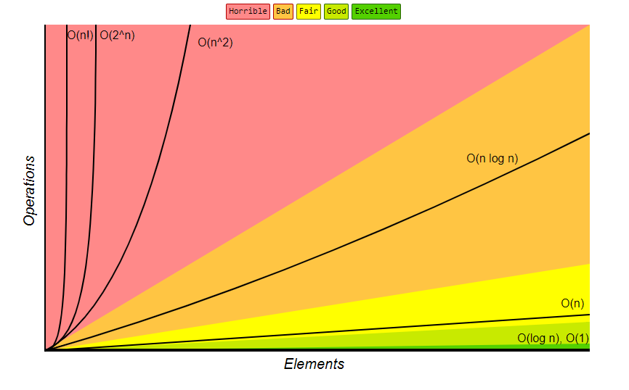
Algorithm complexity
²⁰ Know thy complexities! Big. (n.d.). Retrieved June 9, 2022, from https://www.bigocheatsheet.com/

Slide 27
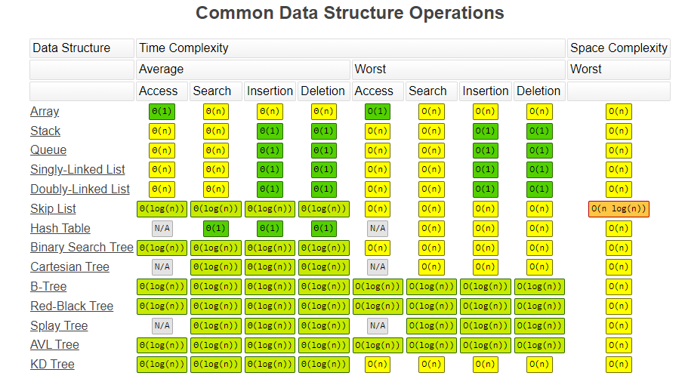
Common data structure operations
²¹Know thy complexities! Big. (n.d.). Retrieved June 9, 2022, from https://www.bigocheatsheet.com/

Slide 28
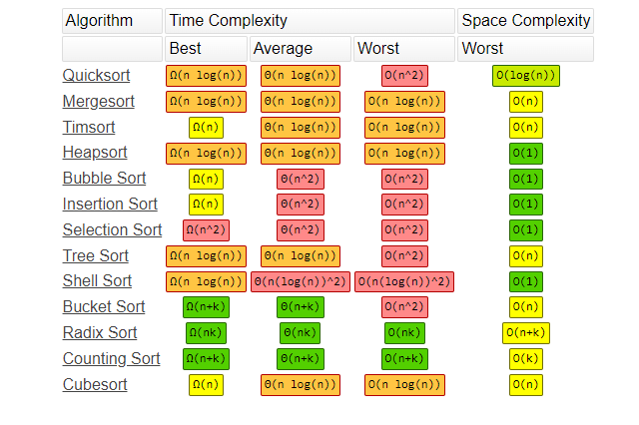
Array sorting algorithms
²²Know thy complexities! Big. (n.d.). Retrieved June 9, 2022, from https://www.bigocheatsheet.com/

Slide 29
Recommended sources:
Computer Science Illuminated, Chapter 7-9, end of the book exercises
What is algorithm and why should you care? [video]
https://adrianmejia.com/most-popular-algorithms-time-complexity-every-programmer-should-know-free-online-tutorial-course/
Explore:
  http://carlcheo.com/startcoding
  http://carlcheo.com/wp-content/uploads/2014/12/which-programming-language-should-i-learn-first-infographic.png

Slide 30
References
Dale, N., & Lewis, J. (2020). Computer Science Illuminated (7th ed.). Jones & Bartlett Learning, Ch 7-9
Khan Academy. (2015). What is Programming? | Intro to JS: Drawing & Animation | Computer programming . Retrieved June 9, 2022, from https://www.youtube.com/watch?v=FCMxA3m_Imc.
Malan, D. J. (2013, May 20). What's an algorithm? - David J. Malan. YouTube. Retrieved June 9, 2022, from https://youtu.be/6hfOvs8pY1k
HackerRank. (2016, September 27). Algorithms: Binary search. YouTube. Retrieved June 9, 2022, from https://www.youtube.com/watch?v=P3YID7liBug
Mejia, A. (2019, September 19). 8 time complexities that every programmer should know. Adrian Mejia Blog. Retrieved June 9, 2022, from https://adrianmejia.com/most-popular-algorithms-time-complexity-every-programmer-should-know-free-online-tutorial-course/
Know thy complexities! Big. (n.d.). Retrieved June 9, 2022, from https://www.bigocheatsheet.com/
Cheo, C. (n.d.). Which programming language should I learn first? [infographic]. CarlCheo.com: Technology, Software, and Computer Tips. Retrieved June 9, 2022, from http://carlcheo.com/startcodin

Slide 31
Thank you

