Slide 1
Computer Science Fundamentals
Seminar title: Algorithms | Binary search
Lecturer: Olga Yugay

Slide 2
Agenda
Lecture review
Algorithms
Binary search

Slide 3
Q&A
What is algorithm?
How do you represent algorithm?

Slide 4
Task 1
Note the three phases of the computer problem-solving model.
Algorithm development phase
Implementation phase
Maintenance phase

Slide 5
Task 1 continued
Match the phases with definitions.
Algorithm Development | The phase includes coding (translating the algorithm into a computer language) and testing (compiling and running the program).
Implementation | The phase involves using the program and modifying the program to add functionality or correct errors.
Maintenance | The phase includes analysis (understanding the problem), proposed solution (logical sequence of solution steps), and testing (following algorithm).

Slide 6
Task 1 answer
Match the phases with definitions.
Algorithm Development | The phase includes analysis (understanding the problem), proposed solution (logical sequence of solution steps), and testing (following algorithm).
Implementation | The phase includes coding (translating the algorithm into a computer language) and testing (compiling and running the program).
Maintenance | The phase involves using the program and modifying the program to add functionality or correct errors.

Slide 7
Task 2
Complete the following quiz:
https://quizizz.com/join/quiz/6190bcfbaa5222001ef6404d/start?studentShare=true

Slide 8
Review binary search:
Given list of numbers find number 5
1, 2, 5, 7, 8, 10, 50, 60, 71, 77, 78, 79, 80
x=5

Slide 9
Review binary search:
Given list of numbers find number 5
1, 2, 5, 7, 8, 10, 50, 60, 71, 77, 78, 79, 80
x=5
1) Midpoint is 50
To identify midpoint:
Count the total number of number entries (which is 13 in this example)
Divide the total number by 2 (in this example, 13/2=6.5
Round the result 6.5 ≈ 7, 7th number is the midpoint

Slide 10
Review binary search:
Given list of numbers find number 5
1, 2, 5, 7, 8, 10, 50, 60, 71, 77, 78, 79, 80
x=5
1) Midpoint is 50 (13/2=6.5, 7th number is the midpoint)
2) x< midpoint (5<50), ignore the range on the right (50-80)

Slide 11
Review binary search:
Given list of numbers find number 5
1, 2, 5, 7, 8, 10, 50, 60, 71, 77, 78, 79, 80
x=5
1) Midpoint is 50 (13/2=6.5 7th number is the midpoint)
2) x< midpoint (5<50), ignore the range on the right (50-80)
3) Midpoint is 5
To identify new midpoint:
Count the total number of left number entries (which is 6)
Divide the total number by 2 (in this example, 6/2=3,
3rd number is the new midpoint

Slide 12
Review binary search:
Given list of numbers find number 5
1, 2, 5, 7, 8, 10, 50, 60, 71, 77, 78, 79, 80
x=5
1) Midpoint is 50
2) x< midpoint (2<50), ignore the range on the right (50-80)
3) Midpoint is 5
4) x is equal to midpoint (5==5). The number is found!

Slide 13
Task 3
Try to apply binary search on a following set of elements:
1, 2, 5, 6, 8, 10, 50, 70, 75, 77, 78, 79, 80, 81, 82, 85
Find number 77
Try to come up with solution

Slide 14
Task 3 answer
1, 2, 5, 6, 8, 10, 50, 70, 75, 77, 78, 79, 80, 81, 82, 85
x=77 (the number we are searching)
Midpoint is 70 (16/2=8, 8th digit)

Slide 15
Task 3 answer
1, 2, 5, 6, 8, 10, 50, 70, 75, 77, 78, 79, 80, 81, 82, 85
x=77 (the number we are searching)
Midpoint is 70 (16/2=8, 8th digit)
x>midpoint (77>70), ignore the range on the left (1-70)
Midpoint is 79 (8/2=4, 4th digit in the remaining set)

Slide 16
Task 3 answer
1, 2, 5, 6, 8, 10, 50, 70, 75, 77, 78, 79, 80, 81, 82, 85
x=77 (the number we are searching)
Midpoint is 70 (16/2=8, 8th digit)
x>midpoint (77>70), ignore the range on the left (1-70)
Midpoint is 79 (8/2=4, 4th digit in the remaining set)
x<midpoint (77<79), ignore the range on the right (79-85)

Slide 17
Task 3 answer
1, 2, 5, 6, 8, 10, 50, 70, 75, 77, 78, 79, 80, 81, 82, 85
x=77 (the number we are searching)
Midpoint is 70 (16/2=8, 8th digit)
x>midpoint (77>70), ignore the range on the left (1-70)
Midpoint is 79 (8/2=4, 4th digit in the remaining set)
x<midpoint (77<79), ignore the range on the right (79-85)
Midpoint is 77(3/2=1.5, 2nd digit)
X is equal to midpoint (77==77), number is found

Slide 18
Task 4.1
Try implementing binary search (recursively) in Python.
Adopt the solution provided during the lecture
Push your solution to Github

Slide 19
Solution to Task 4.1
https://github.com/wiut-tutor/seminar10/blob/main/task4.1.py

Slide 20
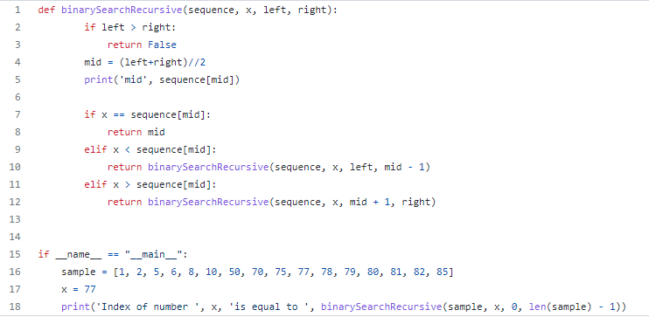
Solution to Task 4.1

Slide 21
Task 4.1
Try to update previous code to make binary search work iteratively
Hint: try while loop
Push your solution to Github

Slide 22
Solution to Task 4.2
https://github.com/wiut-tutor/seminar10/blob/main/task4.2.py

Slide 23
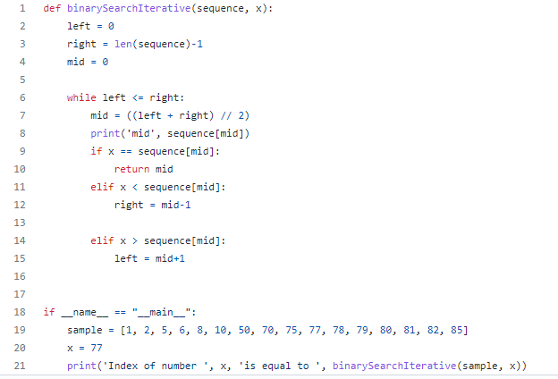
Solution to Task 4.2
def binarySearchIterative(sequence, x):
left = 0
right = len(sequence)-1
mid = 0
while left <= right:
mid = ((left + right) // 2)
print('mid', sequence[mid])
if x == sequence[mid]:
return mid
elif x < sequence[mid]:
right = mid-1
elif x > sequence[mid]:
left = mid+1
if __name__ == "__main__":
sample = [1, 2, 5, 6, 8, 10, 50, 70, 75, 77, 78, 79, 80, 81, 82, 85]
x = 77
print('Index of number ', x, 'is equal to ', binarySearchIterative(sample, x))

Slide 24
Advanced task: applying binary search
Farmer John has built a new long barn, with N (2 <= N <= 100,000) stalls. The stalls are located along a straight line at positions x1,...,xN (0 <= xi <= 1,000,000,000).
His C (2 <= C <= N) cows don't like this barn layout and become aggressive towards each other once put into a stall. To prevent the cows from hurting each other, FJ wants to assign the cows to the stalls, such that the minimum distance between any two of them is as large as possible. What is the largest minimum distance?
Input
t – the number of test cases, then t test cases follows.
* Line 1: Two space-separated integers: N and C
* Lines 2..N+1: Line i+1 contains an integer stall location, xi
Output
For each test case output one integer: the largest minimum distance.

Slide 25
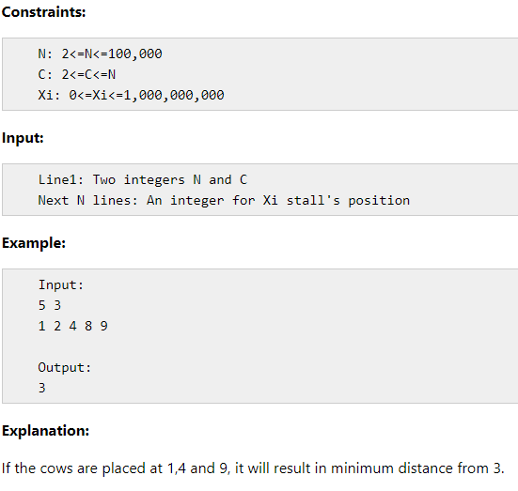
Example
https://www.includehelp.com/data-structure-tutorial/aggressive-cows-on-binary-search.aspx

Slide 26
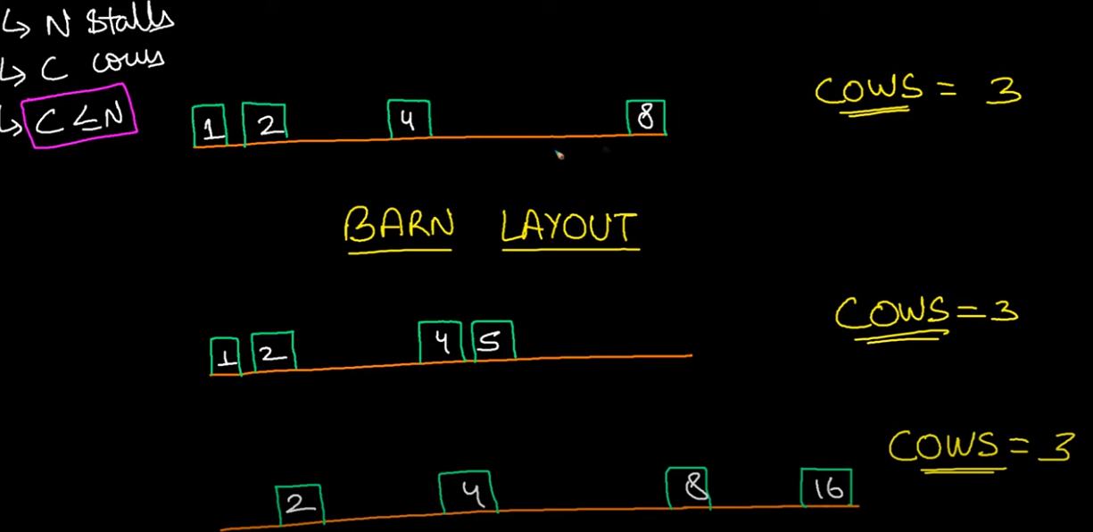
Example
https://www.youtube.com/watch?v=SiE1XFhYoaA

Slide 27
Recommended reading
Computer Science Illuminated, Chapter 7-9, end of the book exercises
https://adrianmejia.com/most-popular-algorithms-time-complexity-every-programmer-should-know-free-online-tutorial-course/
Explore:
http://carlcheo.com/startcoding

Slide 28
Recommended sources
Computer Science Illuminated, Chapter 7-9, end of the book exercises
Intro to Algorithms - Crash course
https://introprogramming.info/english-intro-csharp-book/read-online/chapter-19-data-structures-and-algorithm-complexity/
https://www.khanacademy.org/computing/computer-science/algorithms/binary-search/a/binary-search
https://adrianmejia.com/how-you-can-change-the-world-learning-data-structures-algorithms-free-online-course-tutorial/
https://www.techrepublic.com/article/why-clean-code-is-more-important-than-efficient-code/

Slide 29
References
Dale, N., & Lewis, J. (2020). Computer Science Illuminated (7th ed.). Jones & Bartlett Learning, Chapter 7-9
“Intro to Algorithms: Crash Course Computer Science #13.” YouTube, 24 May 2017, www.youtube.com/watch?v=rL8X2mlNHPM.
Svetlin Nakov. “Introduction to Programming with C# / Java Books» Chapter 19. Data Structures and Algorithm Complexity.” Introprogramming.info, 2019, introprogramming.info/english-intro-csharp-book/read-online/chapter-19-data-structures-and-algorithm-complexity/.
Mejia, Adrian. “How You Can Change the World by Learning Data Structures and Algorithms.” Adrian Mejia Blog, adrianmejia.com/how-you-can-change-the-world-learning-data-structures-algorithms-free-online-course-tutorial/.
TECH DOSE. “Aggressive Cow | SPOJ.” Www.youtube.com, www.youtube.com/watch?v=SiE1XFhYoaA. Accessed 9 June 2022.
apotheon. “Why Clean Code Is More Important than Efficient Code.” TechRepublic, 10 June 2011, www.techrepublic.com/article/why-clean-code-is-more-important-than-efficient-code/. Accessed 9 June 2022.
“Aggressive Cows (on Binary Search).” Www.includehelp.com, www.includehelp.com/data-structure-tutorial/aggressive-cows-on-binary-search.aspx. Accessed 9 June 2022.

Slide 30
Thank you

