Slide 1
Econometrics
 | Course Calendar
Week | Main Content
Week 7 | Extension of Simple Regression: Functional Forms I
Week 8 | Extension of Simple Regression: Functional Forms II
Week 9 | Extension of Simple Regression: Functional Forms III
Week 10 | Multiple Regression
Week 11 | Multiple Regression: Estimation and Interpretation
Week 12 | Multiple Regression: Functional Forms
Week 13 | Introduction to Dummy Variables
Week 14 | Introduction to Dummy Variables and Regression Methods
Week 15 | Regression with Dummy Variables: Hands-on-Exercise
Week 16 | Application of Regression

Slide 2
Econometrics
Lecture 9. Extension of Regression:
Functional Forms-III
Geetha Rani Prakasam, Ph.D.
Professor

Slide 3
Recap
Logarithmic regression models
Basics of Exponential & Logarithmic transformations of variables
Semi-log model:-) lin-log model and log-lin model

Slide 4
Outline
Linear Trend Model
Double log model
Reciprocal Model
The logarithmic reciprocal model
Choice of Functional Form

Slide 5
Linear Trend Model
Instead of estimating model (6.6.6), researchers sometimes estimate the following model:
Y_{t} = β₁ + β_{2t} + u_{t} (6.6.9)
That is, instead of regressing the log of Y on time, they regress Y on time, where Y is the regressand under consideration.
Such a model is called a linear trend model and the time variable t is known as the trend variable.
If the slope coefficient in (6.6.9) is positive, there is an upward trend in Y, whereas if it is negative, there is a downward trend in Y.

Slide 6

Linear Trend Model
For the expenditure on services data that we considered earlier, the results of fitting the linear trend model (6.6.9) are as:
In contrast to Eq. (6.6.8), the interpretation of Eq. (6.6.10) is as follows:
Over the quarterly period 1993-I to 1998-III, on average, expenditure on services increased at the absolute (note: not relative) rate of about 20 billion dollars per quarter.
That is, there was an upward trend in the expenditure on services.

Slide 7
Linear Trend Model
The choice between the growth rate model (6.6.8) and the linear trend model (6.6.10) will depend upon whether one is interested in the relative or absolute change in the expenditure on services, although for comparative purposes it is the relative change that is generally more relevant.
But, observe that we cannot compare the r² values of models (6.6.8) and (6.6.10) because the regressands in the two models are different.

Slide 8
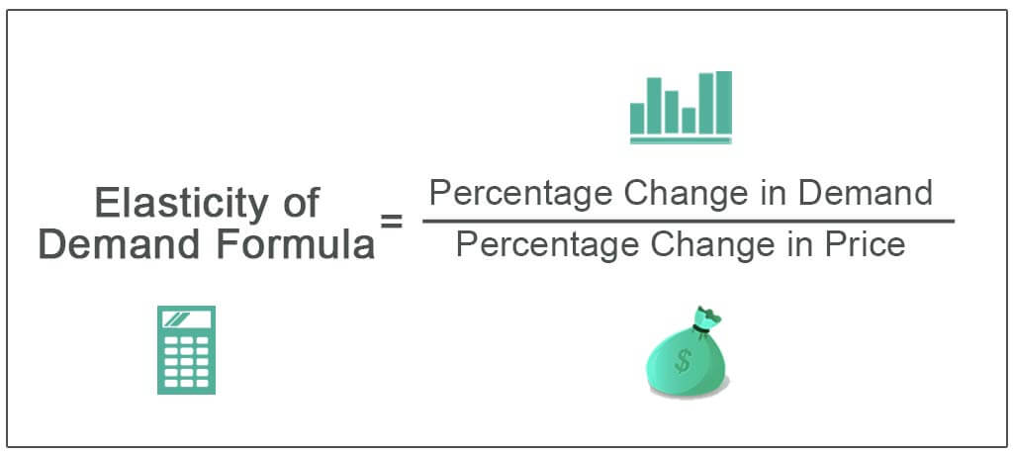
4. Double log models
https://cdn.wallstreetmojo.com/wp-content/uploads/2019/10/Elasticity-of-Demand-Formula.jpg

Slide 9
4. The log-log model: How to measure elasticity ?
Consider the following model, known as the Exponential regression model:
Y_{i}= β₁X_{i} ^{β}2 e ^{u} _{i} (6.4.1)
By taking log to the base e of both side:
lnY_{i} = lnβ₁ +β₂lnX_{i} + u_{i} ,
by setting lnβ₁ = α =>
lnY_{i} = α +β₂lnX_{i} + u_{i} (6.4.3)

Slide 10
4.The log-log model
Because of this linearity, such models are called log-log, double-log, or loglinear models
This can be estimated by OLS by letting
Y*_{i} = α +β₂X*_{i} + u_{i} , where Y*_{i}=lnY_{i}, X*_{i}=lnX_{i} ;
β₂ measures the ELASTICITY of Y respect to X, that is, percentage change in Y for a given (small) percentage change in X.

Slide 11
4.The log-log model
Thus, if Y represents the quantity of a commodity demanded and X its unit price, β2 measures the price elasticity of demand, a parameter of considerable economic interest.
If the relationship between quantity demanded and price is as shown in Figure 6.3a, the double-log transformation as shown in Figure 6.3b will then give the estimate of the price elasticity (−β2).

Slide 12
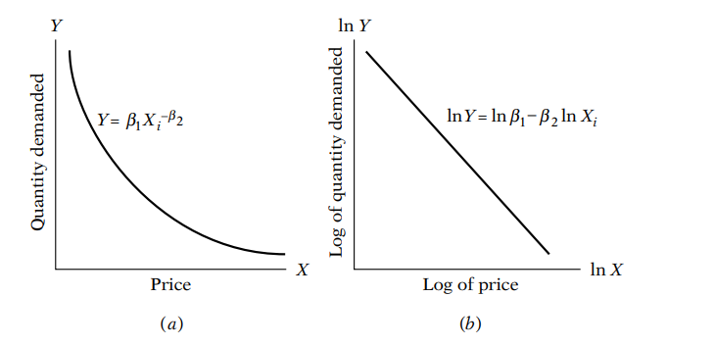
FIG. 6.3 Constant-elasticity model
Source: Basic Econometrics by Damodar Gujarati, page. 176

Slide 13
Special features of the log-log model
Two special features of the log-log model may be noted:
The model assumes that the elasticity coefficient between Y and X, β₂, remains constant throughout (why?), hence the alternative name constant elasticity model.
Because: A constant elasticity model will give a constant total revenue change for a given percentage change in price regardless of the absolute level of price.
Readers should contrast this result with the elasticity conditions implied by a simple linear demand function, Y_{i} = β₁ + β₂X_{i} + u_{i}.
However, a simple linear function gives a constant quantity change per unit change in price.
Contrast this with what the log-linear model implies for a given dollar change in price.

Slide 14
Special features of the log-log model
In other words, as Figure 6.3b shows, the change in ln Y per unit change in ln X (i.e., the elasticity, β₂) remains the same no matter at which ln X we measure the elasticity.
Another feature of the model is that although αˆ and βˆ₂ are unbiased estimates of α and β₂, β₁ (the parameter entering the original model) when estimated as βˆ₁ = antilog (αˆ) is itself a biased estimator.
In most practical problems, however, the intercept term is of secondary importance, and one need not worry about obtaining its unbiased estimate.

Slide 15
Constant-elasticity model
In the two-variable model, the simplest way to decide whether the loglinear model fits the data is to plot the scattergram of lnY_{i} against ln X_{i} and see if the scatter points lie approximately on a straight line, as in Figure 6.3b.
As an illustration, a scatter plot of log of total personal consumption expenditure (LPCEXP) and log of expenditure on durable goods (LEXPDUR) is exhibited in the earlier slides.

Slide 17
Example: Expenditure on Durable Goods in Relation to Total Personal Consumption Expenditure
Table 6.3 presents data on total personal consumption expenditure (PCEXP), expenditure on durable goods (EXPDUR), expenditure on nondurable goods (EXPNONDUR), and expenditure on services (EXPSERVICES), all measured in 1992 billions of dollars.
Suppose we wish to find the elasticity of expenditure on durable goods with respect to total personal consumption expenditure.
Plotting the log of expenditure on durable goods against the log of total personal consumption expenditure, we saw in the previous slide that the relationship between the two variables is linear.
Hence, the double log model may be appropriate.

Slide 18

Example: Expenditure on Durable Goods in Relation to Total Personal Consumption Expenditure
The regression results are as follows:
where * indicates that the p value is extremely small.
As these results show, the elasticity of EXPDUR with respect to PCEX is about 1.90, suggesting that if total personal expenditure goes up by 1 percent, on average, the expenditure on durable goods goes up by about 1.90 percent.

Slide 19
Example: Expenditure on Durable Goods in Relation to Total Personal Consumption Expenditure
Thus, expenditure on durable goods is very responsive to changes in personal consumption expenditure.
This is one reason why producers of durable goods keep a keen eye on changes in personal income and personal consumption expenditure.
You can carry out a similar exercise for nondurable goods expenditure and expenditure on services.

Slide 20
4. The log-linear model
Elasticity E of Y w r. to X is defined as:
E=dY/dX=(% change in Y)/(% change in X)
~ [(ΔY/Y) x 100] / [(ΔX/X) x100]=
= (ΔY/ΔX)x (X/Y) = slope x (X/Y)
In two-variable model, the simplest way to decide whether the loglinear model fits the data is to plot the scattergram of lnYi against ln Xi and see if the scatter points lie approximately on a straight line.

Slide 21
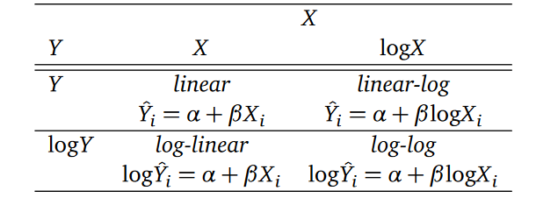
Logarithmic transformations of variables
α=intercept:
Β =slope

Slide 22
Logarithms can be used to transform the depended variable Y, an independent
variable X, or both ( but the variable being transformed must be positive).
The following table summarises these three cases and the interpretations
on the regression slope coefficient β. In each case, β can be estimated by
applying OLS after taking the logarithm of the dependent and/or independent
variables).
Case | Regression Specification | Interpretation of β
I | Y = α + βX + u | One unit change in Y due to one unit change in X
II | Y = α + β*ln(X) + u | A 1% change in X is associated with a change in Y of 0.01* β
III | ln(Y)= α + β*X + u | A change in X by one unit (∆X=1) is associated with a (exp(β) - 1)*100 % change in Y
IV | ln(Y)= α + β *ln(X) + u | A 1% change in X is associated with a β % change in Y, so β is the elasticity of Y with respect to X.

Slide 23
6-6. Reciprocal Models
Models of the following type are known as reciprocal models
Y_{i} = β₁ + β₂( 1/X_{i} ) + u_{i} (6.5.14)
As X increases definitely, the term
β₂( 1/X_{i} ) approaches to zero and Y_{i} approaches the limiting or asymptotic value β₁ .
Although this model is nonlinear in the variable X because it enters inversely or reciprocally, the model is linear in β₁ and β₂ and is therefore a linear regression model.

Slide 24
6-5. Reciprocal Models
This model has these features: As X increases indefinitely, the term β₂(l/X) approaches zero (note: β₂ is a constant) and Y approaches the limiting or asymptotic value β₁.
Therefore, models like (6.7.1) have built in them an asymptote or limit value that the dependent variable will take when the value of the X variable increases indefinitely.
Some likely shapes of the curve corresponding to (6.7.1) are shown in Figure 6.6.

Slide 25
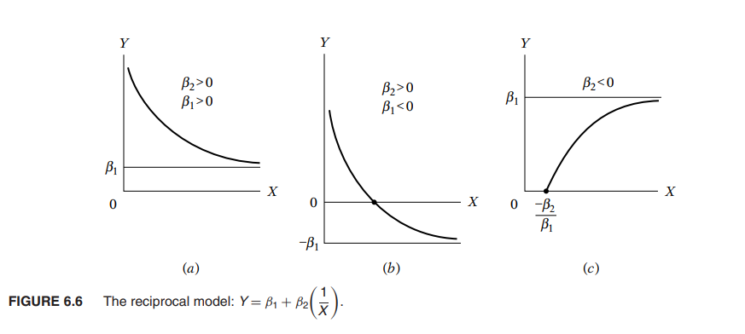
Fig 6.6 Reciprocal Model
Source: Basic Econometrics by Damodar Gujarati, Page.184

Slide 26
6.5.Reciprocal Models: Application
As an illustration of Figure 6.6a, consider the data given in Table 6.4.
These are cross-sectional data for 64 countries on child mortality (CM) and a few other variables.
CM is the number of deaths of children under five per 1000 live births, PGNP is per capita GNP in 1980, Female Literacy Rate measured in percent and Fertility Rate (TFR).
Data in the next two slides
For now, concentrate on the variables, child mortality (CM) and per capita GNP, which are plotted in Figure 6.7. As you can see, this figure resembles Figure 6.6a:

Slide 27
Observation | CM | FLFP | PGNP | TFR | Observation | CM | FLFP | PGNP | TFR
1 | 128 | 37 | 1870 | 6.66 | 33 | 142 | 50 | 8640 | 7.17
2 | 204 | 22 | 130 | 6.15 | 34 | 104 | 62 | 350 | 6.60
3 | 202 | 16 | 310 | 7.00 | 35 | 287 | 31 | 230 | 7.00
4 | 197 | 65 | 570 | 6.25 | 36 | 41 | 66 | 1620 | 3.91
5 | 96 | 76 | 2050 | 3.81 | 37 | 312 | 11 | 190 | 6.70
6 | 209 | 26 | 200 | 6.44 | 38 | 77 | 88 | 2090 | 4.20
7 | 170 | 45 | 670 | 6.19 | 39 | 142 | 22 | 900 | 5.43
8 | 240 | 29 | 300 | 5.89 | 40 | 262 | 22 | 230 | 6.50
9 | 241 | 11 | 120 | 5.89 | 41 | 215 | 12 | 140 | 6.25
10 | 55 | 55 | 290 | 2.36 | 42 | 246 | 9 | 330 | 7.10
11 | 75 | 87 | 1180 | 3.93 | 43 | 191 | 31 | 1010 | 7.10
12 | 129 | 55 | 900 | 5.99 | 44 | 182 | 19 | 300 | 7.00
13 | 24 | 93 | 1730 | 3.50 | 45 | 37 | 88 | 1730 | 3.46
14 | 165 | 31 | 1150 | 7.41 | 46 | 103 | 35 | 780 | 5.66
15 | 94 | 77 | 1160 | 4.21 | 47 | 67 | 85 | 1300 | 4.82
16 | 96 | 80 | 1270 | 5.00 | 48 | 143 | 78 | 930 | 5.00

Slide 28
Observation | CM | FLFP | PGNP | TFR | Observation | CM | FLFP | PGNP | TFR
17 | 148 | 30 | 580 | 5.27 | 49 | 83 | 85 | 690 | 4.74
18 | 98 | 69 | 660 | 5.21 | 50 | 223 | 33 | 200 | 8.49
19 | 161 | 43 | 420 | 6.50 | 51 | 240 | 19 | 450 | 6.50
20 | 118 | 47 | 1080 | 6.12 | 52 | 312 | 21 | 280 | 6.50
21 | 269 | 17 | 290 | 6.19 | 53 | 12 | 79 | 4430 | 1.69
22 | 189 | 35 | 270 | 5.05 | 54 | 52 | 83 | 270 | 3.25
23 | 126 | 58 | 560 | 6.16 | 55 | 79 | 43 | 1340 | 7.17
24 | 12 | 81 | 4240 | 1.80 | 56 | 61 | 88 | 670 | 3.52
25 | 167 | 29 | 240 | 4.75 | 57 | 168 | 28 | 410 | 6.09
26 | 135 | 65 | 430 | 4.10 | 58 | 28 | 95 | 4370 | 2.86
27 | 107 | 87 | 3020 | 6.66 | 59 | 121 | 41 | 1310 | 4.88
28 | 72 | 63 | 1420 | 7.28 | 60 | 115 | 62 | 1470 | 3.89
29 | 128 | 49 | 420 | 8.12 | 61 | 186 | 45 | 300 | 6.90
30 | 27 | 63 | 19830 | 5.23 | 62 | 47 | 85 | 3630 | 4.10
31 | 152 | 84 | 420 | 5.79 | 63 | 178 | 45 | 220 | 6.09
32 | 224 | 23 | 530 | 6.50 | 64 | 142 | 67 | 560 | 7.20

Slide 29
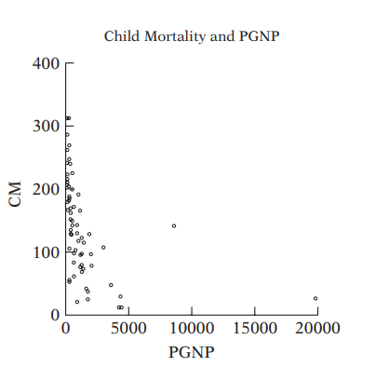
Relationship between child mortality and per capita GNP in 64 countries.
Basic Econometrics by Domodar Gujarati, Page.184

Slide 30
Relationship between child mortality and per capita GNP
As you can see, this figure resembles Figure 6.6a:
As per capita GNP increases, one would expect child mortality to decrease because people can afford to spend more on health care, assuming all other factors remain constant.
But the relationship is not a straight line one:
As per capita GNP increases, initially there is dramatic drop in CM but the drop tapers off as per capita GNP continues to increase.

Slide 31
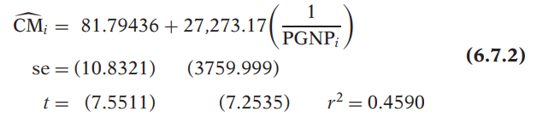
Relationship between child mortality and per capita GNP
If we try to fit the reciprocal model (6.7.1), we obtain the following regression result
As per capita GNP increases indefinitely, child mortality approaches its asymptotic value of about 82 deaths per thousand.

Slide 32
Relationship between child mortality and per capita GNP
The slope of (6.7.1) is: dY/dX = − β₂ (1/X^₂), implying that if β₂ is positive, the slope is negative throughout, and if β₂ is negative, the slope is positive throughout.
See Figures 6.6a and 6.6c, respectively, the positive value of the coefficient of (l/PGNPt) implies that the rate of change of CM with respect to PGNP is negative.

Slide 33
Important Applications of Reciprocal Model
One of the important applications of Figure 6.6b is the celebrated Phillips curve of macroeconomics.
Using the data on percent rate of change of money wages (Y) and the unemployment rate (X) for the United Kingdom for the period 1861–1957, Phillips obtained a curve whose general shape resembles Figure 6.6b (Figure 6.8).

Slide 34
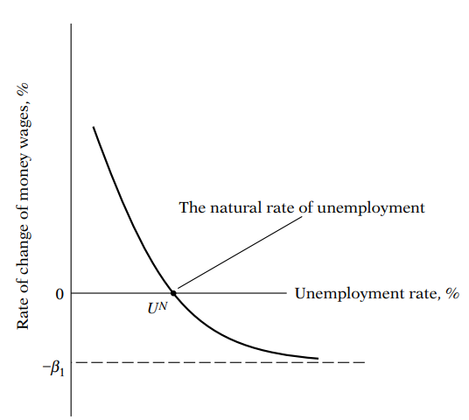
FIG. 6.8: The Phillips Curve
Source: Basic Econometrics by Damodar Gujarti, Page. 186

Slide 35
The Phillips Curve
As Figure 6.8 shows, there is an asymmetry in the response of wage changes to the level of the unemployment rate:
Wages rise faster for a unit change in unemployment if the unemployment rate is below U_{N} , which is called the natural rate of unemployment by economists [defined as the rate of unemployment required to keep (wage) inflation constant], and then they fall for an equivalent change when the unemployment rate is above the natural rate, β₁, indicating the asymptotic floor for wage change.
This particular feature of the Phillips curve may be due to institutional factors, such as union bargaining power, minimum wages, unemployment compensation, etc.

Slide 36
The Phillips Curve
Since the publication of Phillips’ article, there has been very extensive research on the Phillips curve at the theoretical as well as empirical levels.
The Phillips curve itself has gone through several incarnations.
A comparatively recent formulation is provided by Olivier Blanchard.
If we let πt denote the inflation rate at time t, which is defined as the percentage change in the price level as measured by a representative price index, such as the Consumer Price Index (CPI), and U_{Nt} denote the unemployment rate at time t, then a modern version of the Phillips curve can be expressed in the following format:

Slide 37

The Phillips Curve
where π_{t} = actual inflation rate at time t
Π^{e}_{t} = expected inflation rate at time t,
the expectation being formed in year (t − 1).
U_{Nt} = actual unemployment rate prevailing at time t
U_{n} = natural rate of unemployment at time t
u_{t} = stochastic error term

Slide 38
The Phillips Curve
Since π^e t is not directly observable, as a starting point one can make the simplifying assumption that π^{e}_{t} = π_{t-1}; that is, the inflation expected this year is the inflation rate that prevailed in the last year; of course, more complicated assumptions about expectations formation can be made.
Substituting this assumption into (6.7.3) and writing the regression model in the standard form, we obtain the following estimating equation:
π_{t} − π_{t-1} = β₁ + β₂U_{Nt} + u_{t} (6.7.4)
where β₁ = −β₂U_{n}.

Slide 39
The Phillips Curve
Equation (6.7.4) states that the change in the inflation rate between two time periods is linearly related to the current unemployment rate.
A priori, β₂ is expected to be negative and β₁ is expected to be positive (this figures, since β₂ is negative and U_{n} is positive).
Incidentally, the Phillips relationship given in (6.7.3) is known in the literature as the modified Phillips curve, or the expectations-augmented Phillips curve (to indicate that π_{t-1} stands for expected inflation), or the accelerationist Phillips curve (to suggest that a low unemployment rate leads to an increase in the inflation rate and hence an acceleration of the price level).

Slide 40
The Phillips Curve
As an illustration of the modified Phillips curve, we present in Table 6.5 data on inflation as measured by year-to-year percentage in the Consumer Price Index (CPIflation) and the unemployment rate for the period 1960–1998.
The unemployment rate represents the civilian unemployment rate.
From these data we obtained the change in inflation rate (π_{t} − π_{t-1}) and plotted it against the civilian unemployment rate; we are using the CPI as a measure of inflation.
The resulting graph appears in Figure 6.9.

Slide 41
Table 6.5: Inflation Rate and Unemployment Rate, United States, 1960–1998
Observation | INFLRATE | UNRATE | Observation | INFLRATE | UNRATE
1960 | 1.7 | 5.5 | 1980 | 13.5 | 7.1
1961 | 1 | 6.7 | 1981 | 10.3 | 7.6
1962 | 1 | 5.5 | 1982 | 6.2 | 9.7
1963 | 1.3 | 5.7 | 1983 | 3.2 | 9.6
1964 | 1.3 | 5.2 | 1984 | 4.3 | 7.5
1965 | 1.6 | 4.5 | 1985 | 3.6 | 7.2
1966 | 2.9 | 3.8 | 1986 | 1.9 | 7
1967 | 3.1 | 3.8 | 1987 | 3.6 | 6.2
1968 | 4.2 | 3.6 | 1988 | 4.1 | 5.5
1969 | 5.5 | 3.5 | 1989 | 4.8 | 5.3
1970 | 5.7 | 4.9 | 1990 | 5.4 | 5.6

Slide 42
Table 6.5: Inflation Rate and Unemployment Rate, United States, 1960–1998
Observation | INFLRATE | UNRATE | Observation | INFLRATE | UNRATE
1971 | 4.4 | 5.9 | 1991 | 4.2 | 6.8
1972 | 3.2 | 5.6 | 1992 | 3 | 7.5
1973 | 6.2 | 4.9 | 1993 | 3 | 6.9
1974 | 11 | 5.6 | 1994 | 2.6 | 6.1
1975 | 9.1 | 8.5 | 1995 | 2.8 | 5.6
1976 | 5.8 | 7.7 | 1996 | 3 | 5.4
1977 | 6.5 | 7.1 | 1997 | 2.3 | 4.9
1978 | 7.6 | 6.1 | 1998 | 1.6 | 4.5
1979 | 11.3 | 5.8
Note: The inflation rate is the percent year-to-year change in CPI. The unemployment rate is the civilian unemployment rate.
Source: Economic Report of the President, 1999, Table B-63, p. 399, for CPI changes and Table B-42, p. 376, for the unemployment rate.
Source: Basic Econometrics by Damodar Gujarati, Page. 188

Slide 43
The Phillips Curve
As expected, the relation between the change in inflation rate and the unemployment rate is negative—a low unemployment rate leads to an increase in the inflation rate and therefore an acceleration of the price level, hence the name accelerationist Phillips curve.
Looking at Figure 6.9, it is not obvious whether a linear (straight line) regression model or a reciprocal model fits the data; there may be a curvilinear relationship between the two variables.
We present below regressions based on both the models.
However, keep in mind that for the reciprocal model the intercept term is expected to be negative and the slope positive as noted earlier.

Slide 44
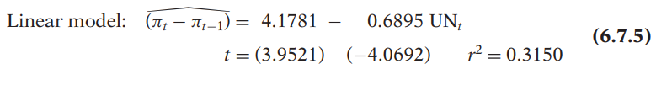
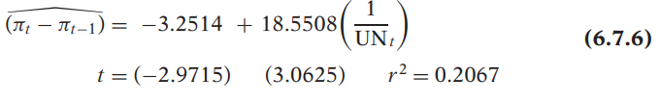
Phillips Curve: Linear and Reciprocal Regression Results
Reciprocal model:
All the estimated coefficients in both the models are individually statistically significant, all the p values being lower than the 0.005 level.

Slide 45
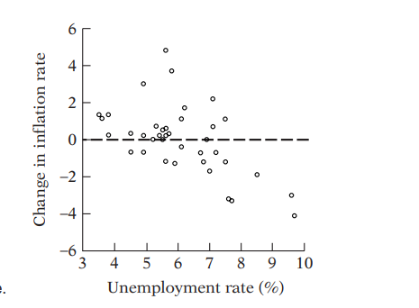
FIG. 6.9: The modified Phillips curve
Source: Basic Econometrics by Damodar Gujarati, Page. 188

Slide 46
Phillips Curve: Linear and Reciprocal Regression Results
Model (6.7.5):- linear regression shows that if the unemployment rate goes down by 1 percentage point, on average, the change in the inflation rate goes up by about 0.7 percentage points, and vice versa.
Model (6.7.6):- Reciprocal form shows that even if the unemployment rate increases indefinitely, the most the change in the inflation rate will go down will be about 3.25 percentage points.
Incidentally, from Eq. (6.7.5), we can compute the underlying natural rate of unemployment as:

Slide 47

Phillips Curve: Linear and Reciprocal Regression Results
That is, the natural rate of unemployment is about 6.06%.
Economists put the natural rate between 5 to 6%, although in the recent past in the United States the actual rate has been much below this rate.

Slide 48

Log Hyperbola or Logarithmic Reciprocal Model
We conclude our discussion of reciprocal models by considering the logarithmic reciprocal model, which takes the following form:
Slope of Y with respect to X = dY /dX = β₂ Y/X^2
Its shape is as depicted in Figure 6.10. As this figure shows, initially Y increases at an increasing rate (i.e., the curve is initially convex) and then it increases at a decreasing rate (i.e., the curve becomes concave).

Slide 49
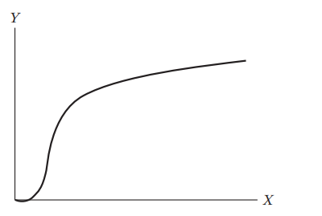
FIG. 6.10: The log reciprocal model
Source: Basic Econometrics by Damodar Gujarati, Page. 189

Slide 50
Log Hyperbola or Logarithmic Reciprocal Model
Such a model may therefore be appropriate to model a short-run production function.
Recall from microeconomics that if labor and capital are the inputs in a production function and if we keep the capital input constant but increase the labor input, the short-run output–labor relationship will resemble Figure 6.10.

Slide 51
Choice of Functional Form
So far, in the Lectures from 7 to 9, we discussed several functional forms an empirical model can assume, even within the confines of the linear-in-parameter regression models.
The choice of a particular functional form may be comparatively easy in the two-variable case, because we can plot the variables and get some rough idea about the appropriate model.
The choice becomes much harder when we consider the multiple regression model involving more than one regressor, as we will discover when we discuss this topic in the next three lectures from 10 to 12.
There is no denying that a great deal of skill and experience are required in choosing an appropriate model for empirical estimation.

Slide 52
Choice of Functional Form
But some guidelines can be offered:
1. The underlying theory (e.g., the Phillips curve) may suggest a particular functional form.
2. It is good practice to find out the rate of change (i.e., the slope) of the regressand with respect to the regressor as well as to find out the elasticity of the regressand with respect to the regressor.
For the various models considered in this chapter, we provide the necessary formulas for the slope and elasticity coefficients of the various models in the next slide in a Table format.
The knowledge of these formulas will help us to compare the various models.

Slide 53
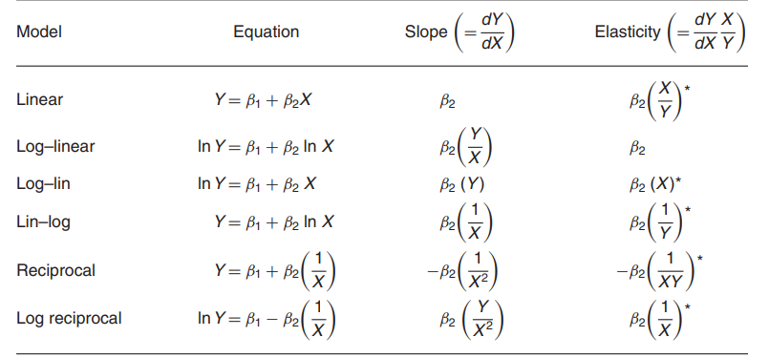
Source: Basic Econometrics by Damodar Gujarati, Page. 190

Slide 54
Summary of Functional Forms
Note: */ indicates that the elasticity coefficient is variable, depending on the value taken by X or Y or both.
when no X and Y values are specified, in practice, very often these elasticities are measured at the mean values E(X) and E(Y).

Slide 55
Choice of Functional Form
3. The coefficients of the model chosen should satisfy certain a priori expectations. For example, if we are considering the demand for automobiles as a function of price and some other variables, we should expect a negative coefficient for the price variable.
4. Sometime more than one model may fit a given set of data reasonably well. In the modified Phillips curve, we fitted both a linear and a reciprocal model to the same data.
In both cases the coefficients were in line with prior expectations and they were all statistically significant.

Slide 56
Choice of Functional Form
One major difference was that the r² value of the linear model was larger than that of the reciprocal model.
One may therefore give a slight edge to the linear model over the reciprocal model.
But make sure that in comparing two r² values the dependent variable, or the regressand, of the two models is the same; the regressor(s) can take any form.

Slide 57
Choice of Functional Form
5. In general one should not overemphasize the r² measure in the sense that the higher the r² the better the model.
As we will discuss in the next chapter, r² increases as we add more regressors to the model.
What is of greater importance is the theoretical underpinning of the chosen model, the signs of the estimated coefficients and their statistical significance.
If a model is good on these criteria, a model with a lower r² may be quite acceptable.

Slide 58
Summary and conclusions
1. Sometimes a regression model may not contain an explicit intercept term.
Such models are known as regression through the origin.
Although the algebra of estimating such models is simple, one should use such models with caution.
In such models the sum of the residuals uˆi is nonzero; additionally, the conventionally computed r² may not be meaningful.

Slide 59
6-9. Summary and conclusions
2. The units and scale in which the regressand and the regressor(s) are expressed are very important because the interpretation of regression coefficients critically depends on them. In empirical research the researcher should not only quote the sources of data but also state explicitly how the variables are measured.
3. Just as important is the functional form of the relationship between the regressand and the regressor(s).
Some of the important functional forms discussed in this chapter are (a) the log-linear or constant elasticity model, (b) lin-log regression models, © log-log models and (d) reciprocal models.

Slide 60
6-9. Summary and conclusions
4. In the log-log model both the regressand and the regressor(s) are expressed in the logarithmic form.
  The regression coefficient attached to the log of a regressor is interpreted as the elasticity of the regressand with respect to the regressor.
5. In the semilog model either the regressand or the regressor(s) are in the log form.
  In the log-lin model where the regressand is logarithmic and the regressor X is time, the estimated slope coefficient (multiplied by 100) measures the (instantaneous) rate of growth of the regressand.

Slide 61
Reciprocal Models: Application
Two important applications – the Engel expenditure curve (describes how household expenditure on a particular good or service varies with household income)
Phillips curve of macroeconomics:
inverse relationship between the level of unemployment and the rate of inflation

Slide 62
Interpretation of Slope in logarithmic models
Y = β₀ + β₁*ln(X) + u ~ A 1% change in X is
associated with a change in Y of 0.01* β₁
ln(Y)= β₀ + β₁*X + u ~ A change in X by one unit
(∆X=1) is associated with a (exp(β₁) - 1)*100 %
change in Y
ln(Y)= β₀ + β₁ *ln(X) + u ~ A 1% change in X is
associated with a β₁ % change in Y, so β₁ is the
elasticity of Y with respect to X.

Slide 63
6-7. Summary of Functional Forms
Model | Equation | Slope = dY/dX | Meaning
Linear | Y = β₁ + β₂ X | β₂ | Slope: ΔY/ΔX
Log-log | lnY = β₁ + β₂ lnX | β₂ (Y/X) | Elasticity: dY/dX
Log-lin | lnY = β₁ + β₂ X | β₂ (Y) | Growth Rate: relative change in Y /absolute change in X
Lin-log | Y = β₁ + β₂ lnX | β₂(1/X) | absolute change in Y / relative change in X
Reciprocal | Y = β₁ + β₂ (1/X) | - β₂(1/X²) | Reciprocal

Slide 64
References
Basic Econometrics, Chapter 6: EXTENSIONS OF THE TWO-VARIABLE LINEAR REGRESSION MODEL in by Domodar Gujarati.
Introduction to Econometrics 5th Edition Christopher Dougherty, 2016. Oxford University Press

Slide 65
What next?
Multiple Regression

