Slide 1

INTRODUCTION TO INFORMATION TECHNOLOGY II
Week 9
Fundamentals of No-Code Programming
Riovan Styx Roring, S.T., M.Kom

Slide 2

LOW-CODE AND NO-CODE DEVELOPMENT
01
“The future of coding is no coding at all.” - Chris Wanstrath, CEO at GitHub.
Image Source: https://belovdigital.agency/blog/low-code-no-code/
Notes:
© Copyright Showeet.com – Free PowerPoint Templates

Slide 3
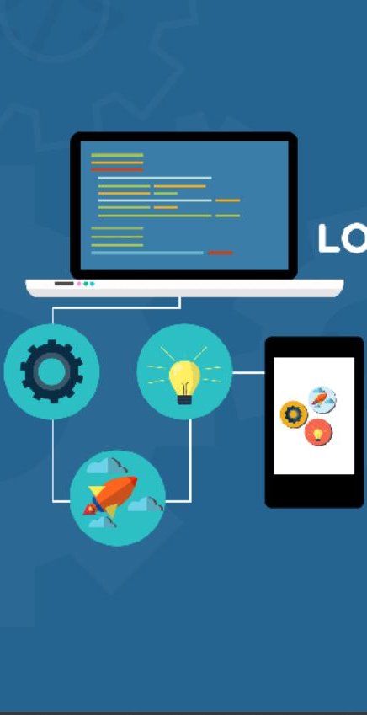
Low-Code Development
Low-code development is a software development platform that requires a little coding to build the applications. It uses visual development interfaces (GUI) to process the simple logic and drag and drop operation features. Low-code development reduces the coding time and helps to accelerate the growth of business applications.
The primary benefit of using a No-code development is that it lowers the initial cost of deployment and maintenance.
Image Source: https://www.neowin.net/news/free-information-brief---whats-new--interesting-in-low-codeno-code/
Notes:
© Copyright Showeet.com – Creative & Free PowerPoint and Google Slides Templates

Slide 4
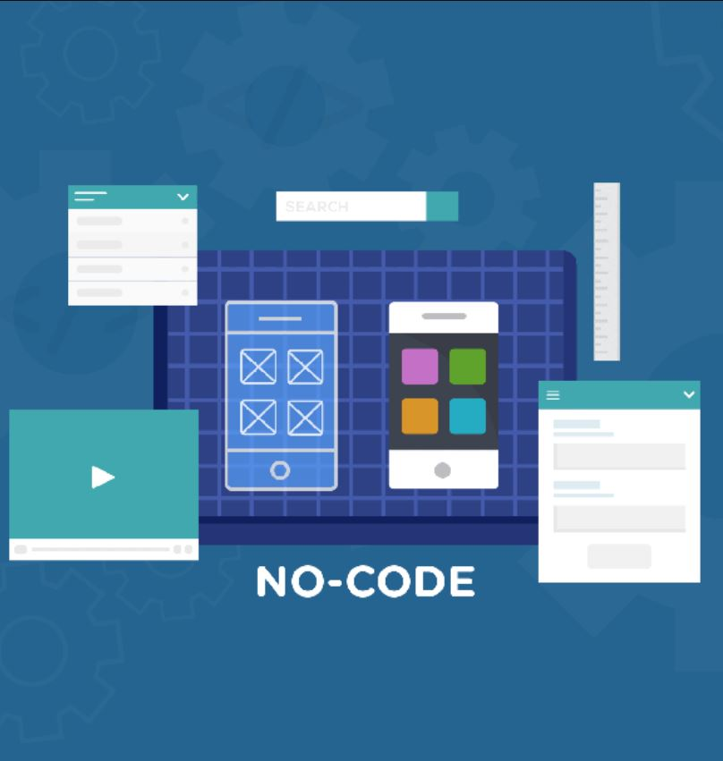
No-Code Development
No-code Development is a platform that is used for building applications without using any coding. Users do not need any coding experience to build the applications. It allows programmers and non-programmers to create software applications. It is closely related to visual programming languages.
The demand for No-code development has grown because of the speed and agility it provides for the businesses to run. By overcoming the limitations of traditional development, it has become one of the best platforms to develop applications.
Image Source: https://www.neowin.net/news/free-information-brief---whats-new--interesting-in-low-codeno-code/
Notes:
© Copyright Showeet.com – Creative & Free PowerPoint and Google Slides Templates

Slide 5

Why Use These Platforms?
The demand for software applications is growing as over 500+ million digital applications are being developed and have been deployed till now. But unfortunately, the developers of these applications have not explored much. To make better use of these applications, new platforms needed to be developed, and so these Low-code and No-code development platforms came into existence.
These platforms provide the best methods to build applications in less time and with high success rates. Since these platforms require fewer developers, the development time and the risk for the developers reduce. Applications developed by these two platforms work as efficiently as those developed using traditional methods involving developers writing the code manually. The use of these platforms is growing phenomenally in the IT industry.
Image Source: https://www.shutterstock.com/image-vector/people-teamwork-working-mobile-application-development-1129492574?irclickid=UBtRKvX1VxyIUD2yq8RqJRtNUkDxbuSwo1gw0A0&irgwc=1&utm_medium=Affiliate&utm_campaign=TinEye&utm_source=77643&utm_term=&c3ch=Affiliate&c3nid=IR-77643

Slide 6
Key Features of Low-Code and No-Code Development
DRAG AND DROP INTERFACE
SECURITY
Every Low-code development platform and No-code development platform has drag and drop abilities that enable the development process.
Security is the key attribute of Low-code and No-code development. Both these development platforms offer a proper security system to protect the applications and the whole platform while building the application.
INTENSITY OF RIVALRY WITHIN THE INDUSTRY
REPORTING AND MONITORING
SCALABILITY
One of the major advantages of Low-code and No-code development is it provides scalability to handle and increase the application and business growth with a small team.
With the feature of Reporting and monitoring it helps to keep the track and process of the applications in Low-code and No-code development. It is also able to track the performance of other applications for useful analysis.

Slide 7
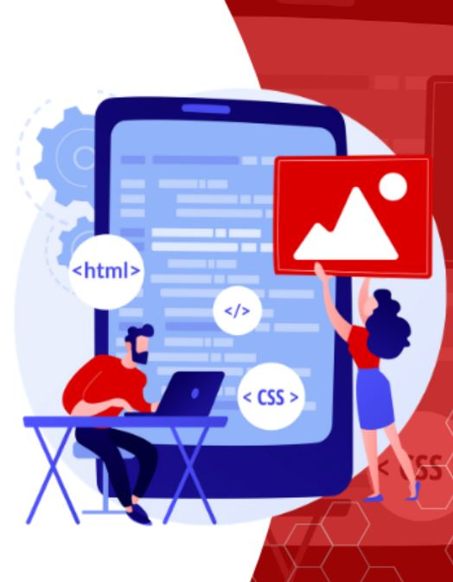
Make an app without code
When users build on a no code platform, they are building with code, they simply don’t have to do any coding. No code platforms have pre-built drag-and-drop elements that have been coded for reuse and scale.
A no code development platform is essentially a user interface builder, where users can rapidly drag-and-drop every web page together, and instantly see how it will look on mobile, tablet and desktop. Using visual models replaces the complexity of coding, allowing them to manage their data easily. No code platforms utilize declarative UI describing what the user should see, instead of how it should be laid out. This allows platform users to render the same app across multiple devices.
Image Source: https://sp.depositphotos.com/vector-images/programmeing.html

Slide 8
Make an app without code [cont..]
No-code applications are not primarily just drag-and-drop user interfaces.
A major misconception with no code applications is that they are only for simple apps. This is not the case. In a rapidly evolving technological age, no code application builders have become extremely sophisticated to support rich functionality in all apps, in order to meet business demands. It is now possible to build many end-to-end enterprise applications using a no code platform.
Image Source: https://sp.depositphotos.com/vector-images/programmeing.html

Slide 9
What is Low-Code and No-Code development best used for?
It’s hard to argue against the value proposition of no code development platforms, particularly when it comes to simple mobile app development. That being said, they aren’t always a suitable alternative to low code or custom software development, as the trade-offs associated with their use could ultimately cost you and your business far more in the future.
No code development platforms are best suited to businesses that require simple, out-of-the-box solutions with minimal customisation. Often this applies to internal systems rather than customer facing software.
Notes:
© Copyright Showeet.com – Creative & Free PowerPoint and Google Slides Templates

Slide 10

ADVANTAGES AND DISADVANTAGES
02
OF LOW-CODE AND NO-CODE DEVELOPMENT
There are a lot of advantages and disadvantages of low-code and no-code development. Let's walk through them one by one.
Image Source: https://www.shutterstock.com/image-vector/user-programming-coding-flat-design-stylish-238248217?irclickid=UBtRKvX1VxyIUD2yq8RqJRtNUkDxbrX8o1gw0A0&irgwc=1&utm_medium=Affiliate&utm_campaign=TinEye&utm_source=77643&utm_term=&c3ch=Affiliate&c3nid=IR-77643

Slide 11

ADVANTAGES OF LOW-CODE DEVELOPMENT:
Low-code development allows applications to build in less time to make real innovations.
Making changes in the applications requires less time and does not require much coding in giving the updates to the application.
Low-Code development reduces the complexity of the applications and smoothens the application.
Building the applications in less time helps reduce the cost and improves investors' ability.
Image Source: https://code.likeagirl.io/low-code-vs-traditional-development-fa2830f18488

Slide 12
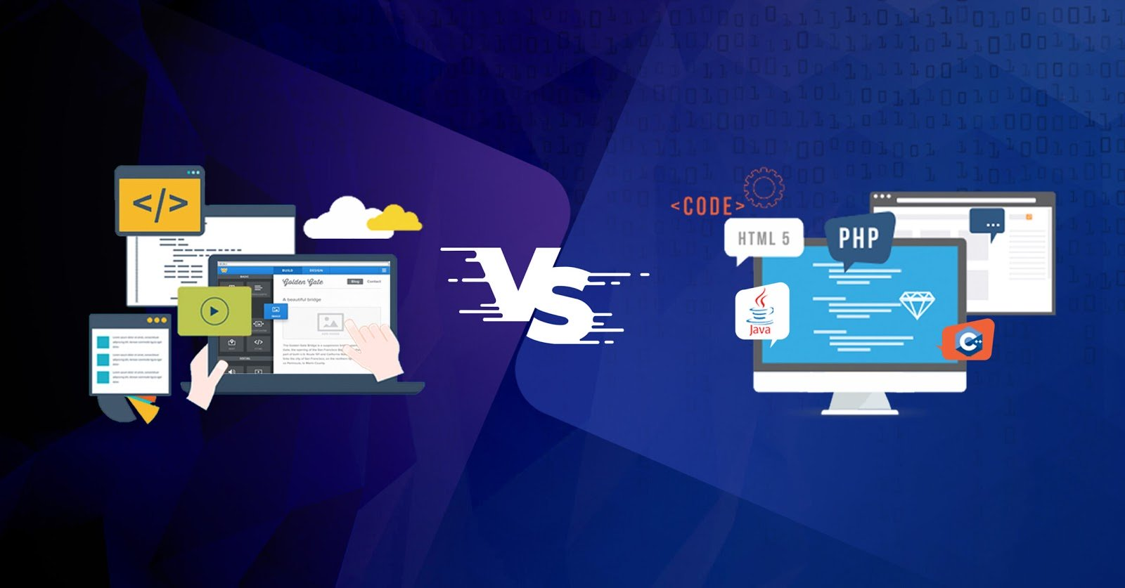
ADVANTAGES OF NO-CODE DEVELOPMENT:
While building an application, budget plays a massive role. It is easy to reduce the issues related to cost by lowering the budget.
The No-code development requires less effort, which helps in reducing the burden on the developers and making it easier to build.
Making changes or giving updates for the application is easy and takes less time in a No-code development platform
Building an application using any other development tools requires a bigger development team, while a No-code development group requires fewer developers.
Image Source: https://code.likeagirl.io/low-code-vs-traditional-development-fa2830f18488

Slide 13
DISADVANTAGES OF LOW-CODE DEVELOPMENT
Low-Code development cannot provide a proper API which leads to issues in the application.
Applications of Low-code development provide a limited functionality that leads to lower performance and inability to find the unique features.
Low-code offers complete access to the data, which leads to security breach making it impossible to provide the potential vulnerabilities.
Image Source: https://code.likeagirl.io/low-code-vs-traditional-development-fa2830f18488

Slide 14
DISADVANTAGES OF NO-CODE DEVELOPMENT
Applications developed using No-code development platforms will have some issues in sorting the data. It will always be a challenge to sort data in those applications.
No-code development is not highly scalable and offers limited possibilities to integrate into the private cloud.
The application built using no-code development will have some issues while functioning the application.
The No-code development offers limited options and possibilities while building the application.
Image Source: https://code.likeagirl.io/low-code-vs-traditional-development-fa2830f18488

Slide 15
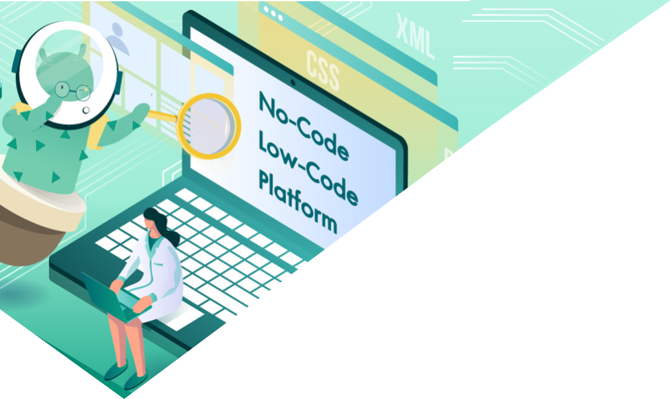
LOW-CODE AND NO-CODE PLATFORM VENDORS
03
“No-code allows people who don’t know how to write code to develop the same applications that a software engineer would.”
Image Source: https://thegrowthmaster.com/blog/no-code-low-code-platform
Notes:
© Copyright Showeet.com – Free PowerPoint Templates

Slide 16
Choosing the right software solution for users business.
Before working with any software development vendor, user should confirm the built-in security capabilities, and consider using enterprise-oriented tools. Even if they use a tool or platform, they are responsible for their own (and their customer’s) data, and ensuring the appropriate security measures have been implemented. If in doubt, ask the development tool vendor they select to provide the security certifications for any mission-critical software. Make sure users adequately test any mobile app binaries that they managed to develop, and that their security testing tools use dynamic testing to cover risks. Outsourcing penetration testing to third-party experts is a good idea to ensure total security.

Slide 17
Vendors of Low-Code Development
Whether people decide to use no code, low code, or a rapid application development tool, it’s important that you protect your business by adopting a few best practice behavior, in order to manage and mitigate potential organizing risk.
In this case, Low code development platforms contain the features of visual modeling, drag-and-drop interfaces, mobility, security, and scalability.
Microsoft PowerApps
Google AppSheet
Zoho Creator
Mendix
Appian

Slide 18
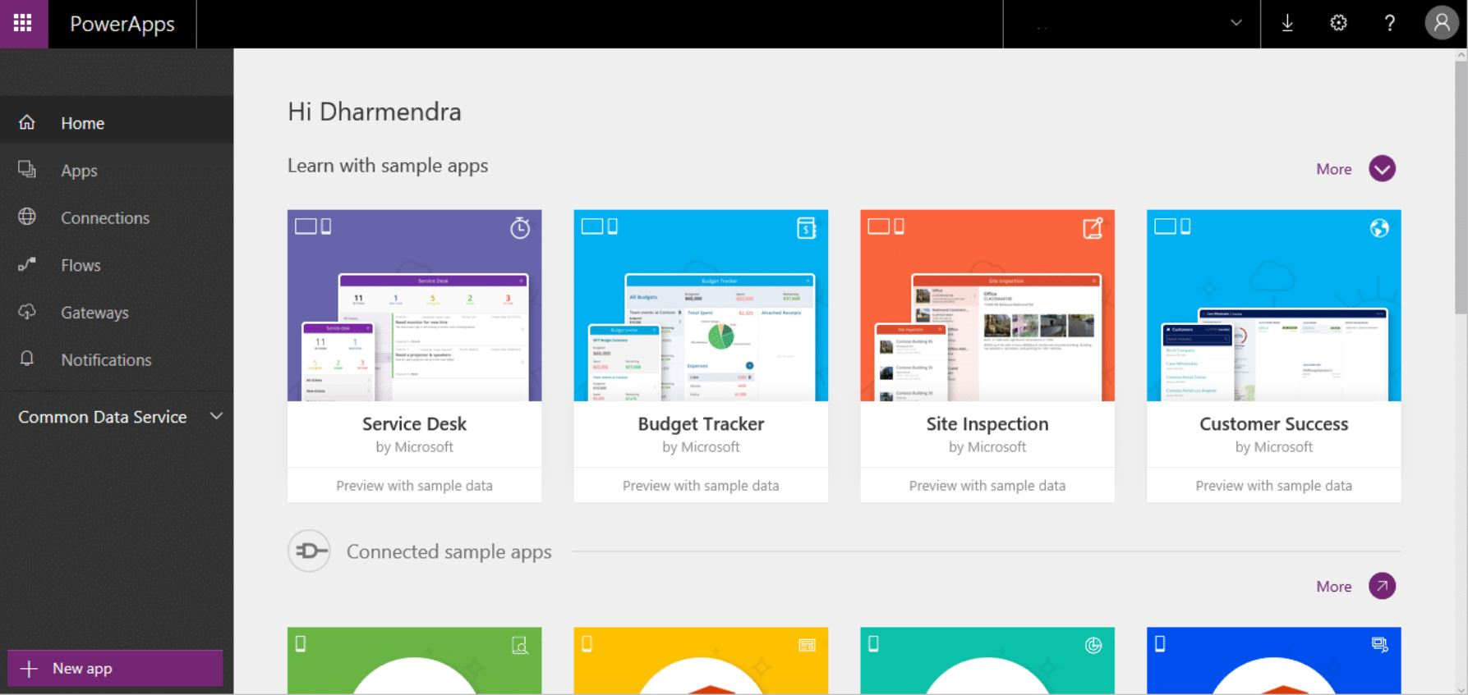
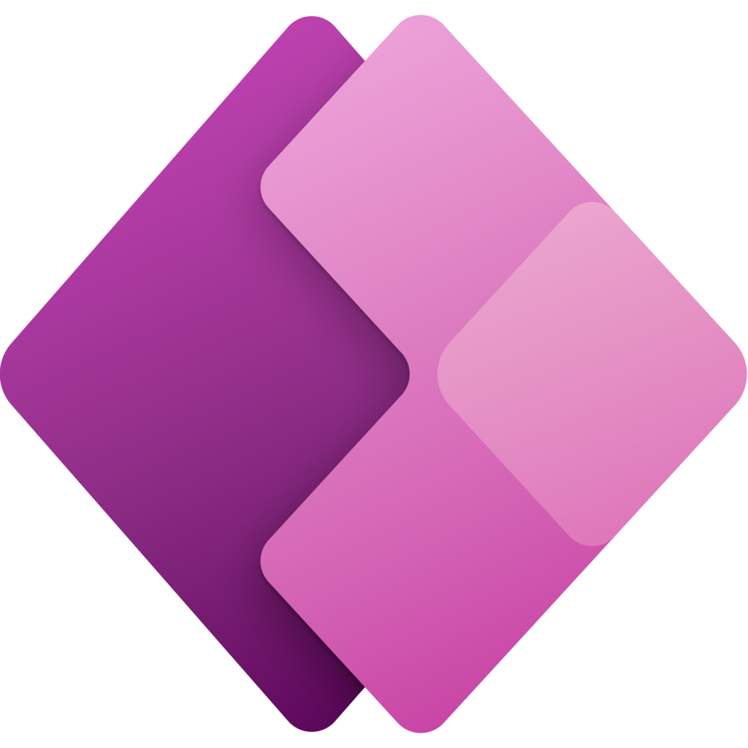
Microsoft PowerApp
Microsoft PowerApps is Microsoft's Low-code development platform that offers to build applications in hours and easily connect to the data. It uses Excel-like expressions to add logic and run on the devices.
Vendors of Low-Code Development
Image Source: http://powerapp.com

Slide 19
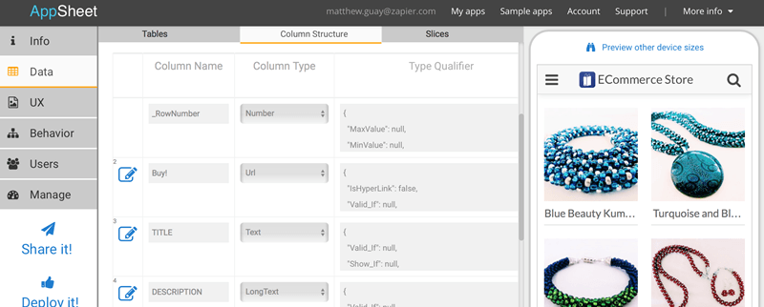

Google Appsheet
Google AppSheet is Google’s Low-code development platform to build applications within a less time using the existing data. It also enables applications to extend without any coding.
Vendors of Low-Code Development
Image Source: https://tecnologiafacil.org/10-complementos-de-google-sheets-que-deberia-considerar-utilizar

Slide 20
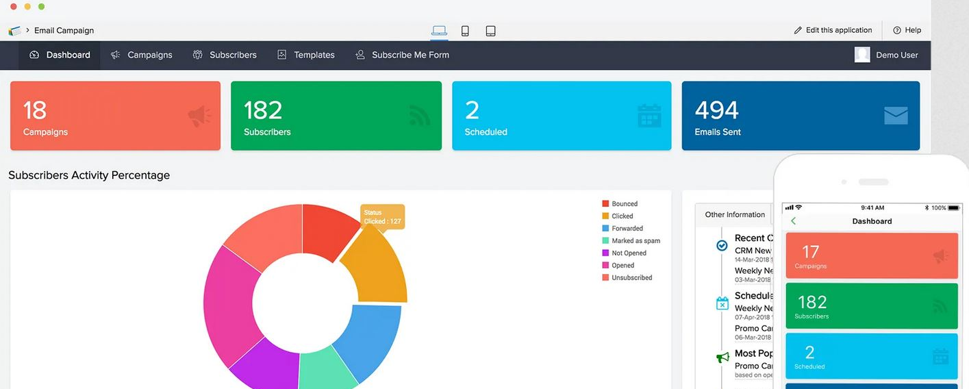

Zoho Creator
Zoho Creator is a cloud software used for the creation of custom applications without any coding experience. The main advantage of using Zoho Creator is to accelerate the development speed.
Vendors of Low-Code Development
Image Source: https://www.zoho.com/creator/newhelp/pages/understand_pages.html

Slide 21
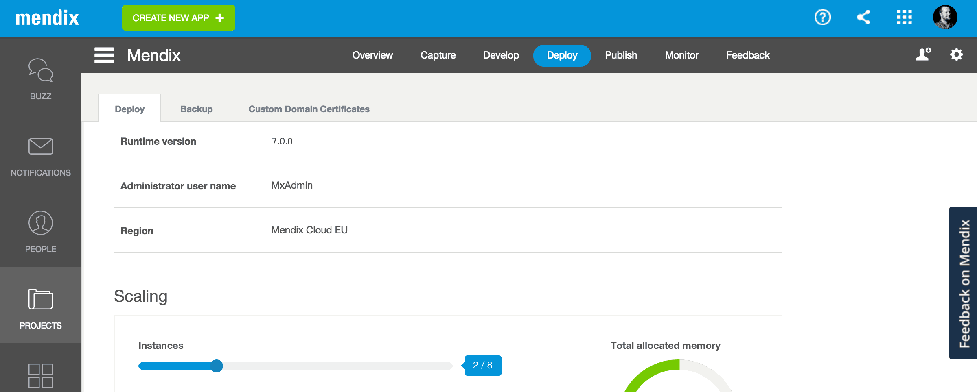
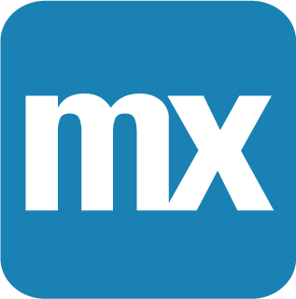
Mendix
Mendix is an American No-code development platform that helps test, build, deploy, and iterate the applications and show better success rates.
Vendors of Low-Code Development
Image Source: https://www.mendix.com/press/mendix-flexible-low-code-platform-cloud/

Slide 22
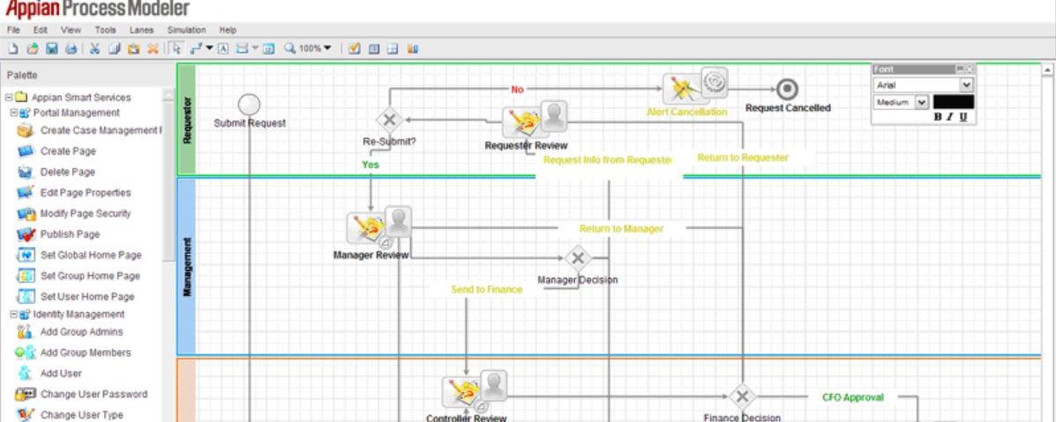
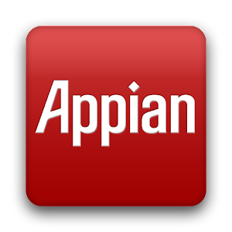
Appian
Appian is a Low-code automation development platform that helps organizations to build their applications and workflows rapidly.
Vendors of Low-Code Development
Image Source: https://www.butleranalytics.com/appian-review/

Slide 23
Vendors of No-code Development
Airtable
No-code development platforms allow users to create applications without using traditional text-based programming languages. These tools offer a wide range of complexity in the applications they are able to create. Some no-code development platforms are designed for simple process automation, while others can be used to develop and deploy complex applications with custom user interfaces.
Nintex
Bubble
Zapier
Kissflow

Slide 24
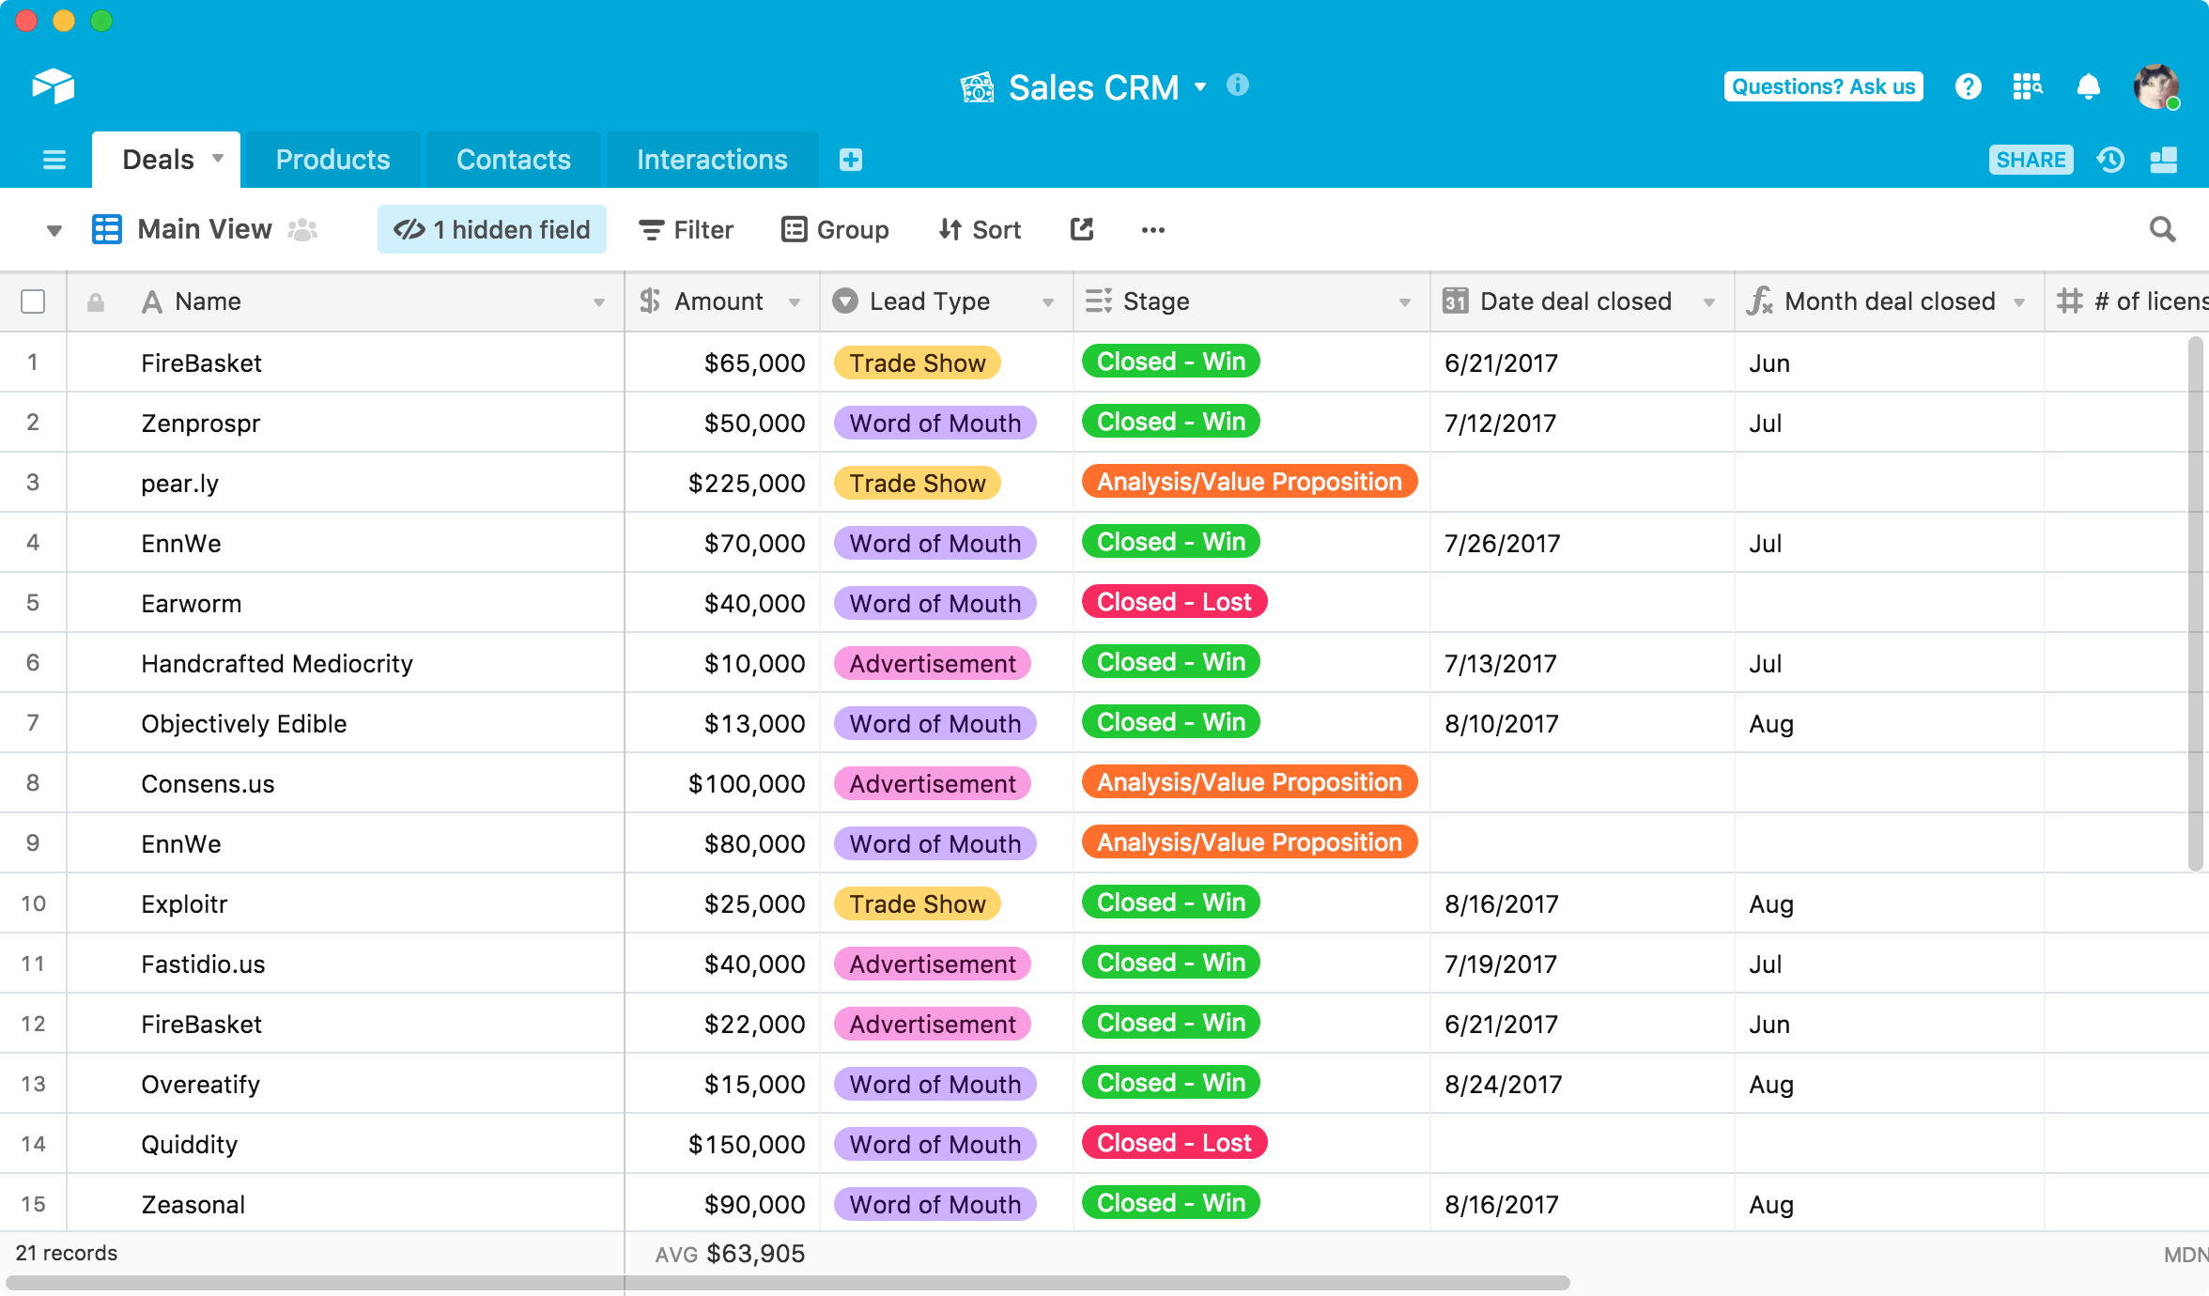
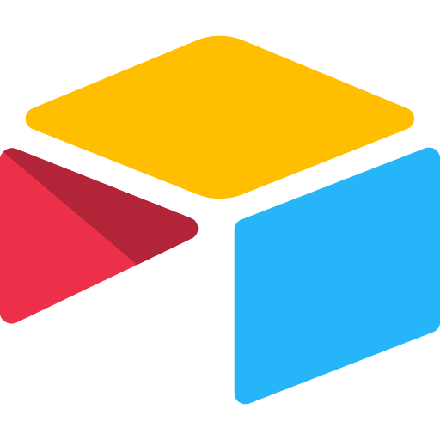
Airtable
Airtable is a cloud-based company used for building applications using no-code development. Airtable is used for a board to set business use cases, including Project Management and Customer Relationship Management.
Vendors of No-Code Development
Image Source:https://www.airtable.com/newsroom/company/introducing-airtable-for-education-3

Slide 25
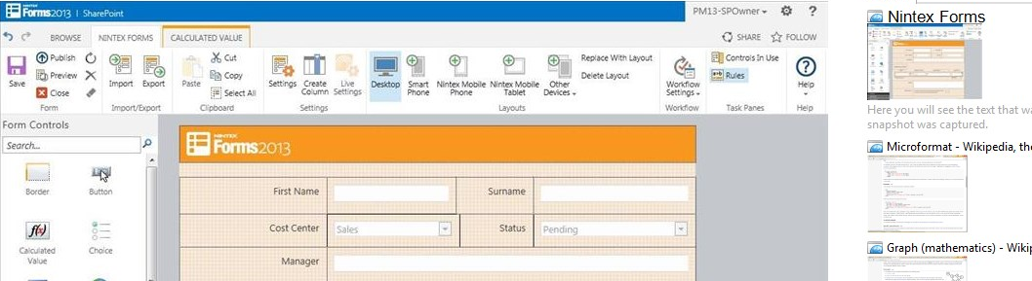

Nintex
Nintex is an end-to-end project management and workflow automation platform used to quickly and easily standardize business processes. One can process, manage, optimize and automate the applications without using any code.
Vendors of No-Code Development
Image Source:https://atidan.files.wordpress.com/2014/03/nintex-forms-for-sharepoint-from-atidan.png?w=487

Slide 26
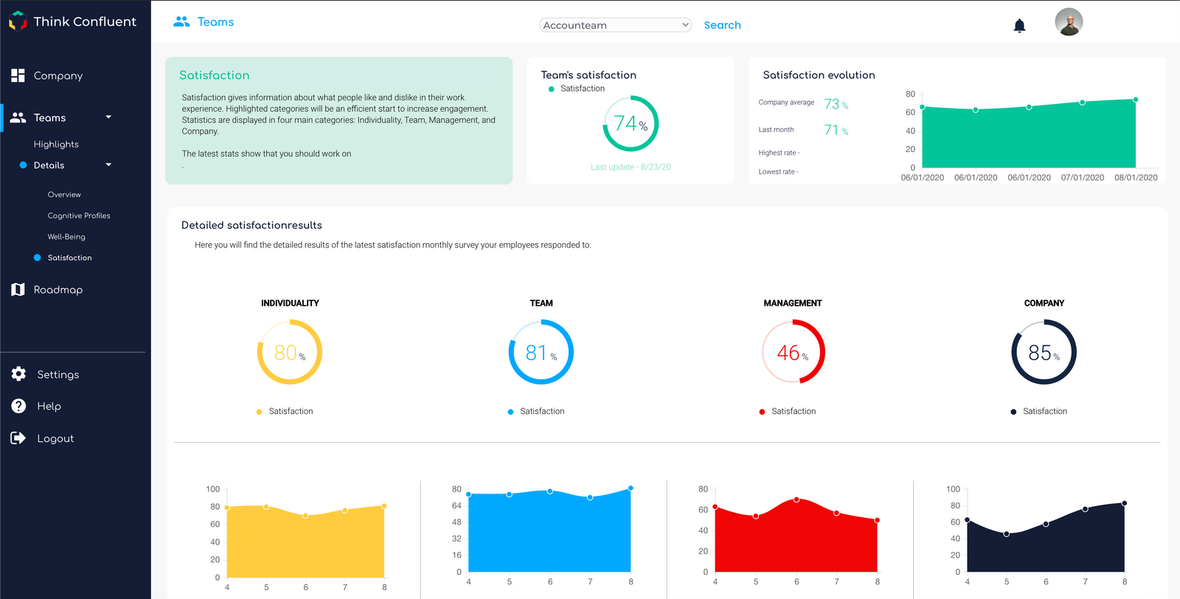

.bubble
.bubble is a visual programming language, no-code development platform and an application building service developed by Bubble group that enables non-technical persons to build applications without having to code.
Vendors of No-Code Development
Image Source:https://bubble.io/blog/no-code-app-examples/

Slide 27
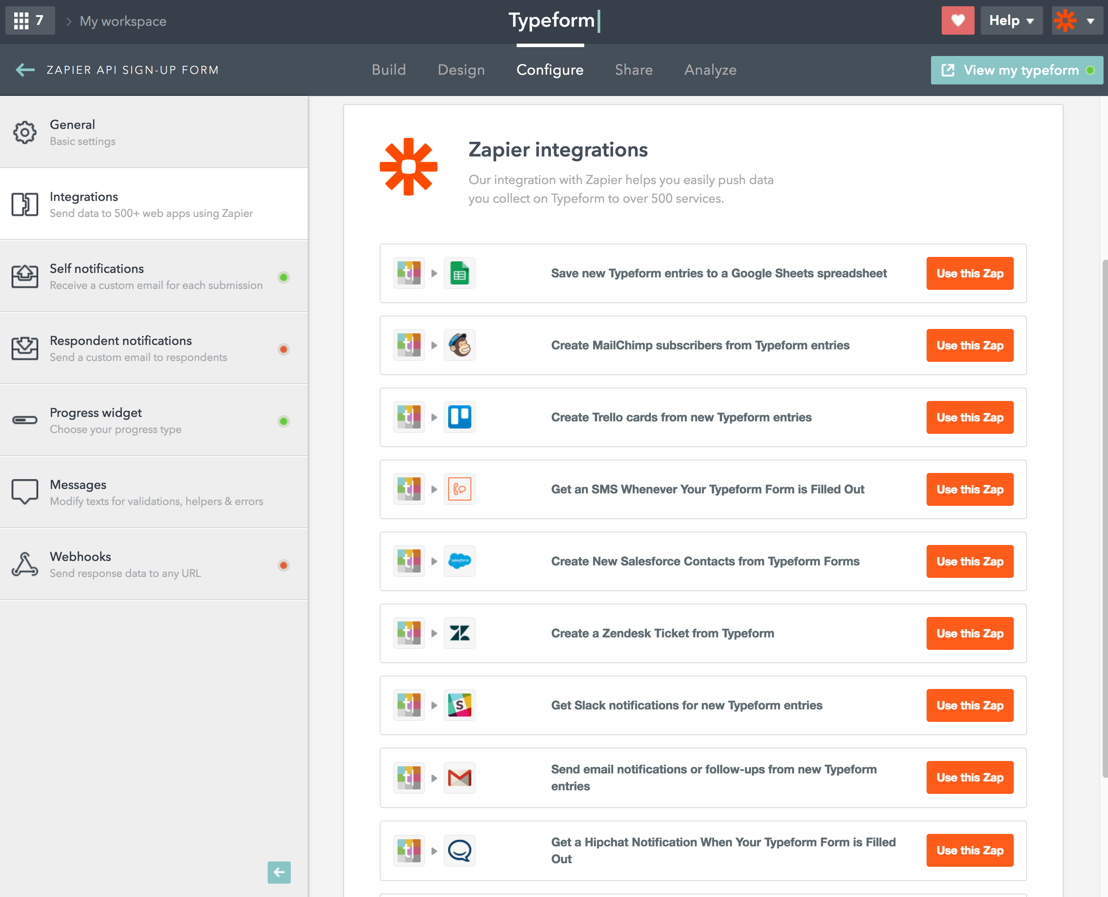

Zapier
Zapier is a global remote company that allows integrating web applications. It provides a workflow to automate web applications together and is described as a translator between Web APIs.
Vendors of No-Code Development
Image Source:https://apievangelist.com/2017/04/26/zapier-was-pretty-savvy-in-their-approach-to-launching-their-partner-api/

Slide 28

Kissflow
Kissflow is one of the best workflow automation software development platforms that offers comprehensive solutions. Kissflow is designed to work with Google apps to provide user experiences like Google apps such as Gmail and Google Docs.
Vendors of No-Code Development
Image Source:https://www.liventerprise.com/tool/Kissflow/

Slide 29
Future of No-Code and Low-Code Development
The development of software applications has been elaborate and includes complex processes. However, introduction of platforms like No-code and Low-code development has reduced the burden and complexity of building the applications. These platforms are making software development quick, easy and accessible. With all these capabilities, the development of applications is increasing in the modern world. It also makes using the Graphical User Interface (GUI) convenient, allowing third-party applications and components to be hooked and tested together. With all these advantages, No-code and Low-code are growing and implementing their mark in all fields.
Notes:
© Copyright Showeet.com – Creative & Free PowerPoint and Google Slides Templates

Slide 30
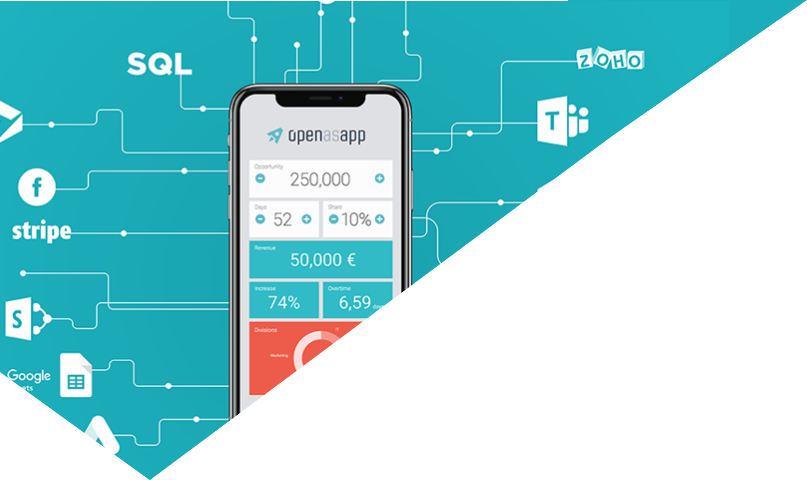
CONCLUSION
Low-code and No-code platforms will shorten the gap between professional programmers and non-programmers, will maximise productivity in the workplace, and reduce the time needed to go from idea to a fully working app.
These platforms are the perfect solution for MVP / POC products. It's important to note that the more customised solution user project needs, then the more custom development will be required.
Image Source: https://www.openasapp.com/open-as-app-raises-5-2-million-euro/
Notes:
© Copyright Showeet.com – Free PowerPoint Templates

Slide 31
References
Karl Seguin “Foundation of Programming”, www.codebetter.com

