Slide 1

INTRODUCTION TO INFORMATION TECHNOLOGY II
Week 10
No-Code Web-Based Programming
Riovan Styx Roring, S.T., M.Kom

Slide 2

WEB-BASED PROGRAMMING
01
Without software, modern computers are just complicated machines for turning electricity into heat.
Image Source: https://mews.agency/wp-content/uploads/2019/05/How-to-Make-a-Small-Business-Website-in-5-Simple-Steps-Ftrd32.jpg
Notes:
© Copyright Showeet.com – Free PowerPoint Templates

Slide 3
WHAT IS PROGRAMMING?
“Programming is how you get computers to solve problems.”
Programming is the process of creating a set of instructions that tell a computer how to perform a task. Programming can be done using a variety of computer programming languages, such as JavaScript, Python, and C++. Created by Pamela Fox.
Computer programs (or software) are what makes computers work. Without software, modern computers are just complicated machines for turning electricity into heat. It’s software on your computer that runs your operating system, browser, email, games, movie player
Notes:
© Copyright Showeet.com – Creative & Free PowerPoint and Google Slides Templates

Slide 4




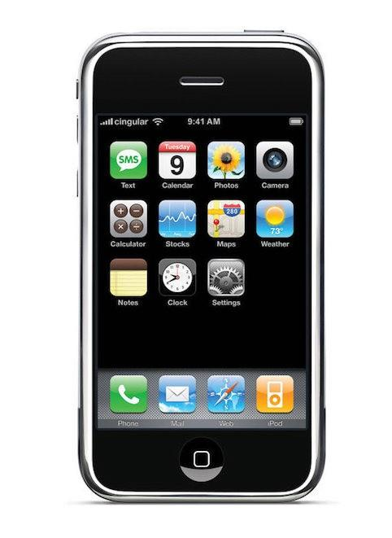
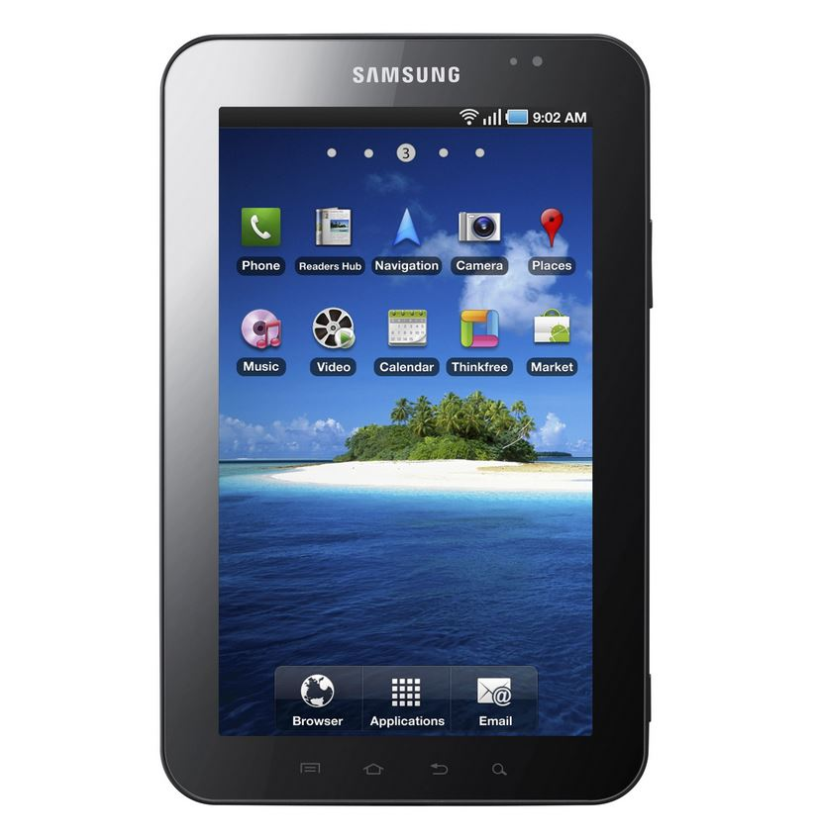

Time Line of the Web
Internet (1960s)
World Wide Web (1991)
Netscape (1994)
Google (1998)
Facebook (2004)
Smartphone (2007)
Tablets (2010)
Image Source: https://estaticos.muyhistoria.es/uploads/images/article/58a313405bafe8acf18b456e/historiadeinternet-h.jpg.
https://www.klipartz.com/en/sticker-png-tnxvo, https://imgbin.com/png/c1Rzdzyj/netscape-web-browser-computer-icons-font-png. https://www.pngwing.com/id/free-png-hsqkx, https://www.logo.wine/logo/Facebook, https://www.devicespecifications.com/en/model-camera/48792734, https://www.newegg.com/samsung-sm-t220nzsbxar-tab-a7-lite-8-7-silver/p/0EJ-000P-008G7

Slide 5




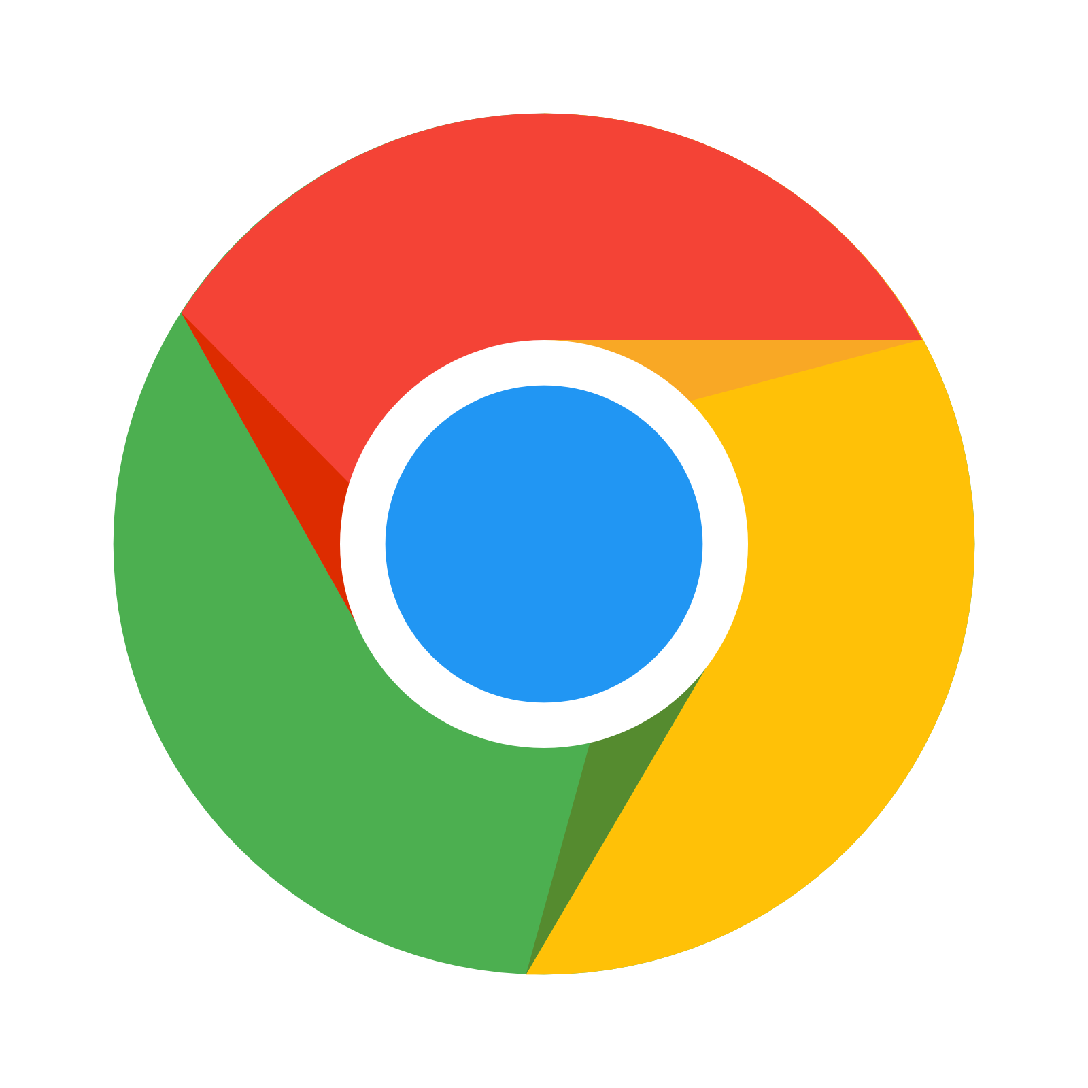
Web Browser
A web browser is application software for accessing the World Wide Web or a local website. When a user requests a web page from a particular website, the web browser retrieves the necessary content from a web server and then displays the page on the user's device.
Internet Explorer
A web browser is not the same thing as a search engine, though the two are often confused. A search engine is a website that provides links to other websites. However, to connect to a website's server and display its web pages, a user must have a web browser installed.
Opera
Chrome
Safari
Mozilla Firefox
Image Source: https://freepngimg.com/png/10484-browsers-png-image/icon
Notes:
© Copyright Showeet.com – Creative & Free PowerPoint and Google Slides Templates

Slide 6
Internet Explorer
Developer: Microsoft
Internet Explorer and Windows Internet Explorer is a discontinued series of graphical web browsers developed by Microsoft and included in the Microsoft Windows line of operating systems, starting in 1995.
It was first released as part of the add-on package Plus! for Windows 95 that year. Later versions were available as free downloads, or in-service packs, and included in the original equipment manufacturer (OEM) service releases of Windows 95 and later versions of Windows. New feature development for the browser was discontinued in 2016 in favor of new browser Microsoft Edge. Since Internet Explorer is a Windows component and is included in long-term lifecycle versions of Windows such as Windows Server 2019, it will continue to receive security updates until at least 2029.
Microsoft 365 ended support for Internet Explorer on August 17, 2021, and Microsoft Teams ended support for IE on November 30, 2020. Internet Explorer is set for discontinuation on June 15, 2022, after which the alternative will be Microsoft Edge with IE mode for legacy sites.
Web Browser
Image Source: https://freepngimg.com/png/10484-browsers-png-image/icon

Slide 7
Safari
Developer: Apple Inc.
Safari is a graphical web browser developed by Apple. It is primarily based on open-source software, and mainly WebKit. It succeeded Netscape Navigator, Cyberdog and Internet Explorer for Mac as the default web browser for Macintosh computers. It is supported on macOS, iOS, and iPadOS; a Windows version was offered from 2007 to 2010.
Safari was introduced within Mac OS X Panther in January 2003, and as of 2021, has progressed through fifteen major versions. The third generation (January 2007) brought compatibility to the iPhone via iPhone OS 1, while the Macintosh edition was topped with the fastest browser performance at that time. The fifth version (June 2010) introduced a less distracted page reader, extension and developer tools; it was also the final version for Windows. In the eleventh version (September 2017), it added support for Intelligent Tracking Prevention. The thirteenth version included various privacy and application updates such as the FIDO2 USB security key authentication and web Apple Pay support. The fourteenth version, released in November 2020, was 50% faster than Google Chrome, and consumed less battery than other standard competitors.The fifteenth version (July 2021) is the current revision, featuring a redesigned interface.
Web Browser
Image Source: https://freepngimg.com/png/10484-browsers-png-image/icon
Notes:
© Copyright Showeet.com – Creative & Free PowerPoint and Google Slides Templates

Slide 8
Opera
Developer: Opera
Opera is a multi-platform web browser developed by its namesake company Opera. Opera is a Chromium-based browser. It distinguishes itself from other browsers through its user interface and other features.
Opera was initially released on 10 April 1995, making it one of the oldest desktop web browsers still actively developed today. It was commercial software for the first ten years and had its own proprietary layout engine, Presto. In 2013, Opera switched from the Presto engine to Chromium.
The web browser can be used on Microsoft Windows, Android, iOS, macOS, and Linux operating systems. There are also mobile versions called Opera Mobile and Opera Mini. Additionally, Opera users have access to a news app based on an AI-platform, Opera News.
The company released a gaming-oriented version of the browser called Opera GX in 2019, and a blockchain-focused Opera Crypto Browser into public beta in January 2022.
Web Browser
Image Source: https://freepngimg.com/png/10484-browsers-png-image/icon
Notes:
© Copyright Showeet.com – Creative & Free PowerPoint and Google Slides Templates

Slide 9
Mozilla Firefox
Developer: Mozilla Foundation
The web browser lets one access information in form of text, audio, images, and videos from all around the world. Mozilla Firefox was developed by Mozilla Foundation in 2002 under the Phoenix community. Nowadays, it is called Firefox only as it is derived from Mozilla Web Browser it is also known as Mozilla Firefox.
Mozilla Firefox can also be used to browse via android and ios. Firefox officially was released on Nov 2004 and gave tough competition to Microsoft’s Internet Explorer with its add-ons, security, and speed. Firefox got it’s the highest popularity at the end of 2009 when it had reached 32+% of total market usage. But after the introduction of Google Chrome, the popularity of Firefox declined. As of now, it has around 5%, market users.
Web Browser
Image Source: https://freepngimg.com/png/10484-browsers-png-image/icon
Notes:
© Copyright Showeet.com – Creative & Free PowerPoint and Google Slides Templates

Slide 10
Google Chrome
Developer: Google
Google Chrome is a cross-platform web browser developed by Google. It was first released in 2008 for Microsoft Windows, built with free software components from Apple WebKit and Mozilla Firefox. It was later ported to Linux, macOS, iOS, and Android, where it is the default browser. The browser is also the main component of Chrome OS, where it serves as the platform for web applications.
Most of Chrome's source code comes from Google's free and open-source software project Chromium, but Chrome is licensed as proprietary freeware. WebKit was the original rendering engine, but Google eventually forked it to create the Blink engine; all Chrome variants except iOS now use Blink.[16]
As of October 2021, StatCounter estimates that Chrome has a 68% worldwide browser market share (after peaking at 72.38% in November 2018) on personal computers (PC), is most used on tablets, and is also dominant on smartphones, and at 65% across all platforms combined.
Web Browser
Image Source: https://freepngimg.com/png/10484-browsers-png-image/icon
Notes:
© Copyright Showeet.com – Creative & Free PowerPoint and Google Slides Templates

Slide 11





THE WEB PROGRAMMING TRIANGLE
02
The most basic tools that every web developer needs because they are the languages through which webpages are built.
Image Source: https://www.kindpng.com/imgv/iihiToo_html-css-javascript-png-transparent-png/
Notes:
© Copyright Showeet.com – Free PowerPoint Templates

Slide 12
The Web Programming Triangle
HTML
Use HTML to define the content of the web pages
CSS
JavaScript
Use CSS to specify the layout of the web pages
Use JavaScript to program the behavior of the web pages
Image Source: https://www.kindpng.com/imgv/iihiToo_html-css-javascript-png-transparent-png/

Slide 13
HTML (HyperText Markup Language)
The HTML (HyperText Markup Language) is the main programming language for web development. It defines the basic structure of a site, such as texts, heading, paragraphs, lists e.t.c
The HTML language is formed from a bunch of established tags, which represent a variety of functions that are then "translated" into readable information on the screen. Tags are separated by angle brackets.
Image Source: https://www.kindpng.com/imgv/iihiToo_html-css-javascript-png-transparent-png/
Notes:
© Copyright Showeet.com – Creative & Free PowerPoint and Google Slides Templates

Slide 14
CSS (Cascading Style Sheets)
CSS (Cascading Style Sheets) is a way to specify how HTML elements will appear on a webpage. This style sheet can be used to apply RGB values, border colors, background images, and other formatting to a website.
CSS defines a set of rules, which include a number of properties and their values.
Image Source: https://www.kindpng.com/imgv/iihiToo_html-css-javascript-png-transparent-png/
Notes:
© Copyright Showeet.com – Creative & Free PowerPoint and Google Slides Templates

Slide 15
Why CSS is needed
HTML was never intended to contain tags for formatting a document. HTML was intended to define the content of a document, like:
• <h1>This is a heading</h1>
• <p>This is a paragraph.</p>
When tags like <font>, and color attributes were added to the HTML 3.2 specification, it started a nightmare for web developers. Development of large web sites, where fonts and color information were added to every single page, became a long and expensive process. To solve this problem, the World Wide Web Consortium (W3C) created CSS. In HTML 4.0, all formatting could be removed from the HTML document, and stored in a separate CSS file. All browsers support CSS today.
Image Source: https://www.kindpng.com/imgv/iihiToo_html-css-javascript-png-transparent-png/
Notes:
© Copyright Showeet.com – Creative & Free PowerPoint and Google Slides Templates

Slide 16
JavaScript
JavaScript allows users to control the behavior of their web page. If they are serious about web development, they will need to learn the basics of JavaScript. The language offers a low entry barrier and immediate results based on the success of their code, making it one of the most popular and widely used programming languages globally.
JavaScript lets users interact with websites by manipulating HTML and CSS. For example, clicking a button, scrolling to the bottom of the page, or displaying photos in a carousel move.
Image Source: https://www.kindpng.com/imgv/iihiToo_html-css-javascript-png-transparent-png/
Notes:
© Copyright Showeet.com – Creative & Free PowerPoint and Google Slides Templates

Slide 17
JavaScript (cont..)
This programming language is dynamically typed and classless. It gives programmers the choice of object-oriented, procedural, or functional programming, making it a highly versatile programming language. This is especially apparent in web browsers. For example, JavaScript can be used to dynamically change websites, validate form entries even before they are sent to the target server, switch dialog boxes as well as integrate scripts for downloading and uploading.
JavaScript has also become an essential tool for online marketing, as many advertisements are programmed with it. This language can also be used to read and write cookies, which makes modern marketing strategies such as targeting possible. In short, JavaScript has helped shape the modern internet and is an integral part of today's web browsing experience.
Image Source: https://www.kindpng.com/imgv/iihiToo_html-css-javascript-png-transparent-png/
Notes:
© Copyright Showeet.com – Creative & Free PowerPoint and Google Slides Templates

Slide 18
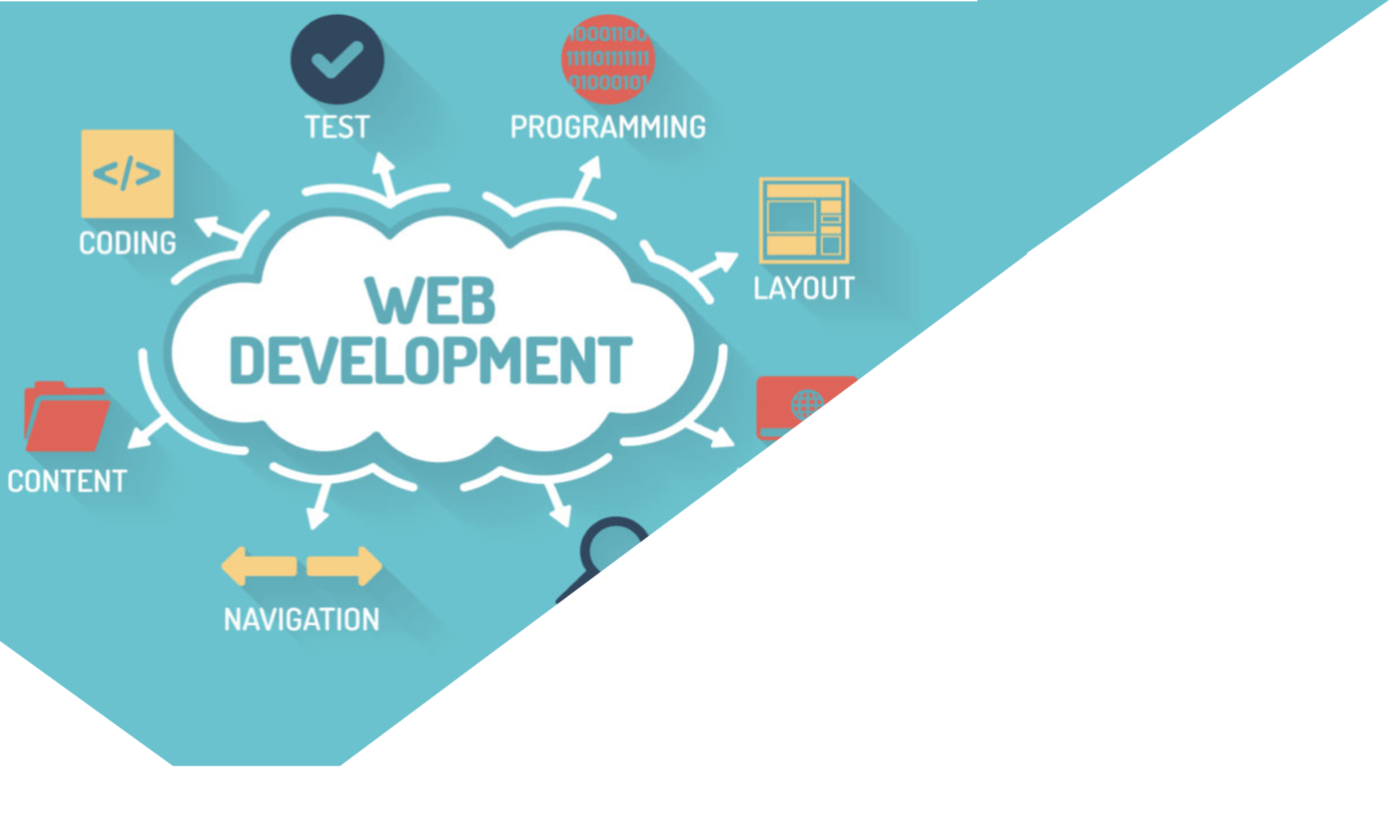
NO-CODE WEB-BASED PROGRAMMING
03
No-code programming platforms are usually designed with a smooth, user-friendly interface
Image Source: https://www.indiamart.com/proddetail/web-development-company-in-pune-22077951897.html
Notes:
© Copyright Showeet.com – Free PowerPoint Templates

Slide 19
No-code Web-based programming
No-code frameworks are software design mechanisms that let non-technical users create and implement software without requiring any knowledge about coding. No-code programming platforms are usually designed with a smooth, user-friendly interface. They also have drag and drop features, allowing users to see the implementation procedure and comprehend the overall logic easily.
Notes:
© Copyright Showeet.com – Creative & Free PowerPoint and Google Slides Templates

Slide 20
What can users build with no-code?
With these programming platforms, developers can create simple applications for performing specific functions. Don’t expect these applications to be highly robust and highly compatible. Some of how no-code programming can be used is enlisted below:
Developing back office mobile applications like KPI monitoring and invoice processing.
Designing web applications like restaurant booking apps and online shopping apps.
For the mobile app development process.
To monitor workflow, such as set internal service level contracts, so that employees can acknowledge after completing a task.
Notes:
© Copyright Showeet.com – Creative & Free PowerPoint and Google Slides Templates

Slide 21
Advantages of a no-code platform
Gives space to create something innovative
Developers can concentrate on their clients’ needs and create something they can enjoy. Developers can choose to offer rich models to configure and utilize most of the no-code programming framework. With this programming platform, there’s no need to start from scratch. Hence, it saves your time, allowing you to invest your time in something else.
Lowers software development cost by 80%
The conventional software developing approaches were expensive, they required employers to hire professor technical staff, but with a no-code programming framework, there’s no need to invest in professional technical staff. Since there’s no need for coding for using no-code programming platforms, even non-technical people can very well do the job.
Notes:
© Copyright Showeet.com – Creative & Free PowerPoint and Google Slides Templates

Slide 22
Drawbacks of No-Code
Application integration. Depending on the aforementioned low-code/no-code spectrum, it may be difficult to pull in data from other existing applications. Some ostensibly no-code programs actually provide tools for integration. Even these, however, require some basic programming.
Limited usability. The tradeoff for simplicity and ease of use is that no-code typically doesn't extend to support complex capabilities. Some no-code vendors add "escape hatches" and other features to let technically savvy users do some coding to create more varied customization and critical business apps. For example, Betty Blocks offers users a split-view: citizen developers access drag-and-drop modules on the left side of the screen, and coders click on the right side of the screen to enter programming code and access more extensive options.
Notes:
© Copyright Showeet.com – Creative & Free PowerPoint and Google Slides Templates

Slide 23
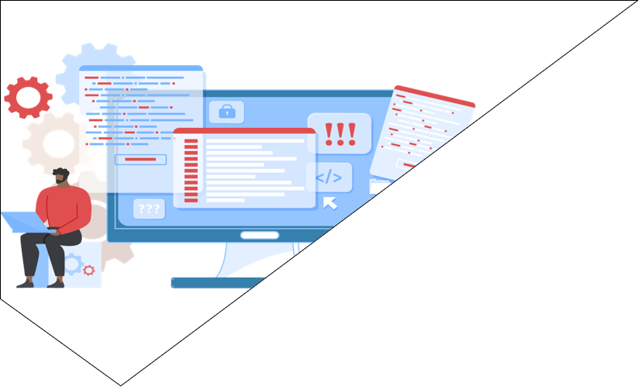
NO-CODE WEBSITE BUILDERS
04
Website builders out there have all sorts of tools and will surely be able to help you get what you need
Image Source: https://charumindworks.com/node-js-development/
Notes:
© Copyright Showeet.com – Free PowerPoint Templates

Slide 24





No-code tools and vendors
Squarespace
Weebly
It doesn’t matter if you’re showing off your work, promoting your small business, or creating a hub for a community group—you don’t need to know a single line of HTML or CSS code to get a professional-looking, fully functional website.
Even if your needs extend to more advanced features, like an online shop or a web-based booking system, website builders out there have all sorts of tools and will surely be able to help you get what you need.
Few example of those vendors are
Jimdo
Tumblr
Wix
Image Source: https://www.codeinwp.com/blog/wix-vs-squarespace-vs-virb-vs-weebly-vs-wordpress-theme-builders/

Slide 25
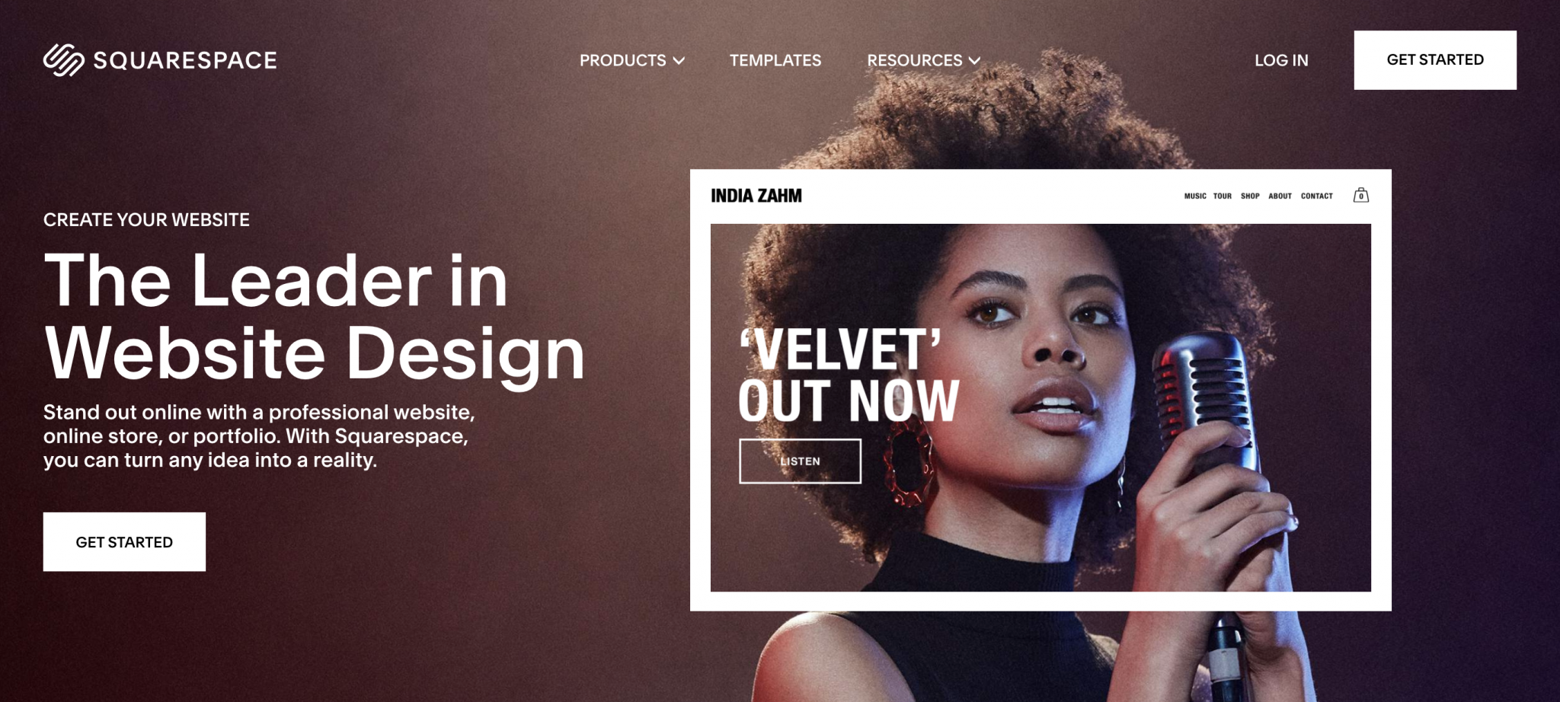
Squarespace
Squarespace is undoubtedly one of the most comprehensive website builders out there. Users can use it to build sites for everything from small businesses to their upcoming wedding, and at the heart of it they’ll find dozens of superbly designed templates to get them started.
Image Source: https://markey.id/wp-content/uploads/2019/05/squarespace.gif

Slide 26
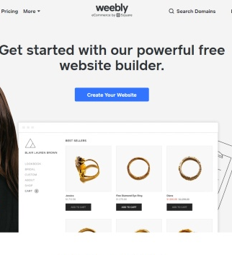
Weebly
Weebly hits a nice balance between being easy to use and offering some advanced site features.
The drag-and-drop editor is one of the more straightforward ones out there—it’s just like designing a newsletter in a word processor. Though Weebly’s editor doesn’t offer quite the level of flexibility as some of its rivals, users will still be able to easily put together some attractive-looking pages.
Image Source: https://www.wikihow.com/images/thumb/8/83/Design-a-Website-Step-1-Version-12.jpg/v4-728px-Design-a-Website-Step-1-Version-12.jpg

Slide 27

Jimdo
Jimdo tries to boil website building down into as few steps as possible—if users want something that looks good and they want it in the fastest time possible, this platform might be for them.
As with most services, once user have signed up for Jimdo, they will be asked to pick a template. These template are all smart, without being spectacular, and cover all the basics, including portfolios, blogs, and small businesses. Its editing tools are far from being the most advanced, but that’s not necessarily a problem if users are looking for something straightforward and easy to use.
Image Source: jimdo.com

Slide 28
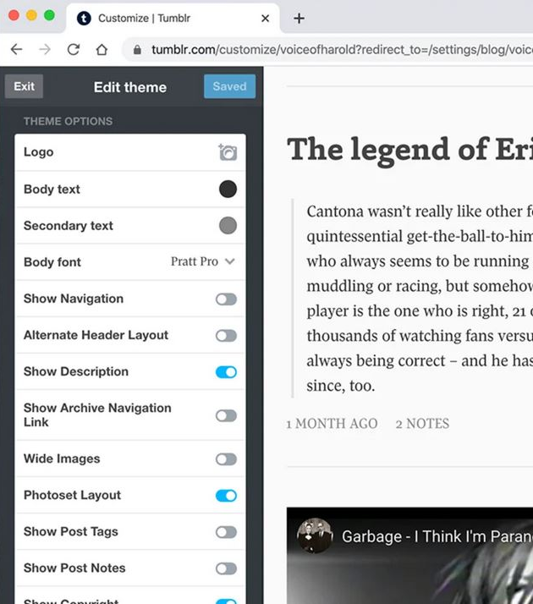
Tumblr
Posts are built around particular types of content—text, images, video, and links—and the emphasis of the platform is to get them up as quickly and as easily as possible. If users know some HTML, they can also tweak posts as required, though Tumblr includes plenty of customization options for non-coders, too.
Dig a little deeper into Tumblr and its credentials as a website builder become apparent. Users can create static pages alongside their blog posts; they can assign their own domain name to their site rather than using a free .tumblr address, and they can invite multiple users to manage and post to their site.
Image Source: https://www.poynter.org/wp-content/uploads/2013/05/overall-dashboard-screenshot.png

Slide 29
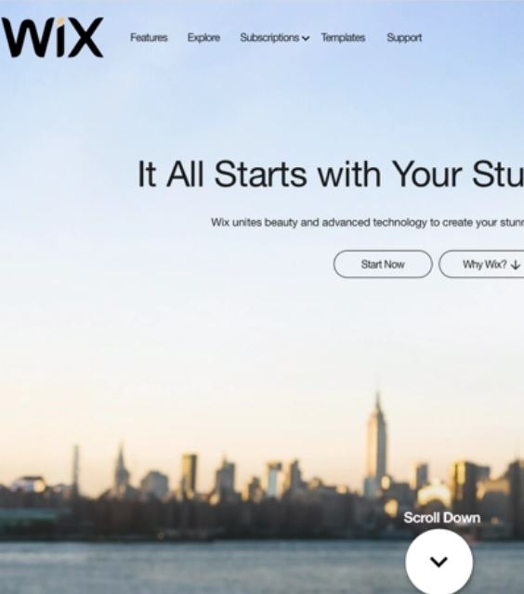
Wix
With Wix, users get two choices when it comes to building their first website. First, they have got the Wix ADI (artificial design intelligence) creator, which asks them a few questions and then produces a website for them. Second, they have the Wix Editor, which gives them a bit more of a hands-on experience in terms of layout, fonts, colors, and other page elements.
This shows just how versatile Wix is—whether they have never built a website before or have some previous experience, the platform can adapt accordingly.
Image Source: https://images.ctfassets.net/b4k16c7lw5ut/blog-2016-09-19-WIX-front-page.jpg/1c758482818b9fcd6515323ef90938dc/2016-09-19-WIX-front-page.jpg?w=1199&h=612&q=50&fm=webp

Slide 30
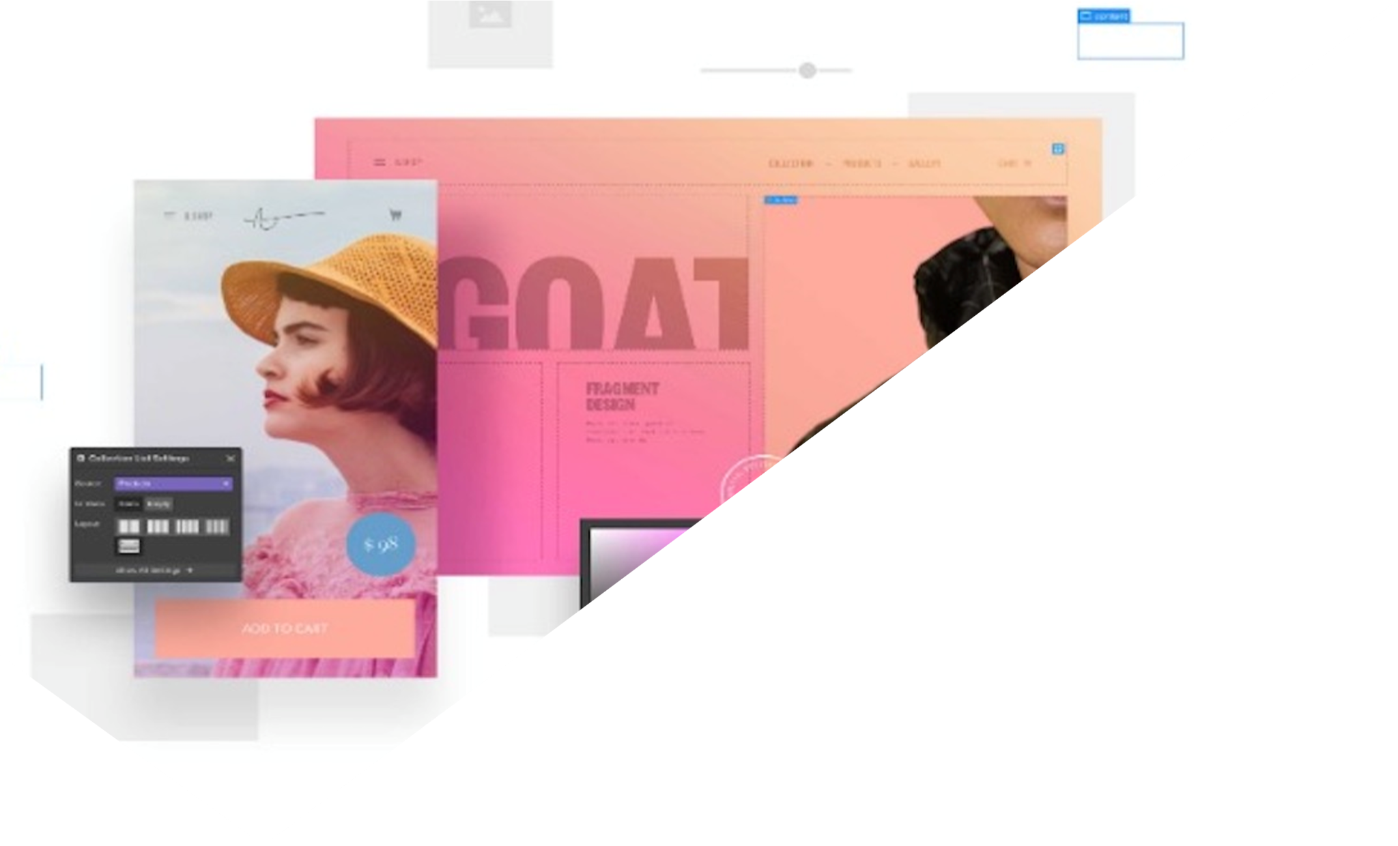
CONCLUSION
A modern application development platform that combines the speed and efficiency of no-code development with the expressiveness and capability of traditional development represent a chance for organizations to completely change how they deliver applications.
It can also alter the dynamic between business and IT so that they work together instead of at cross-purposes, which can happen especially with niche and ecosystem no-code tools.
Image Source: https://www.lapa.ninja/post/webflow-4/
Notes:
© Copyright Showeet.com – Free PowerPoint Templates

Slide 31
References
HTML Tutorial:http://www.w3schools.com/html
CSS Tutorial: http://www.w3schools.com/css
JavaScript Tutorial:http://www.w3schools.com/js

