Slide 1

INTRODUCTION TO INFORMATION TECHNOLOGY II
Week 11
No-Code Game Programming
Riovan Styx Roring, S.T., M.Kom

Slide 2

GAME PROGRAMMING
01
no amount of planning can fully safeguard you against production bottlenecks or impending deadlines, undertaking a project without a plan is a sure way to fail.
Image Source: https://aie.edu.au/wp-content/uploads/2018/02/game-programming-04.jpg

Slide 3
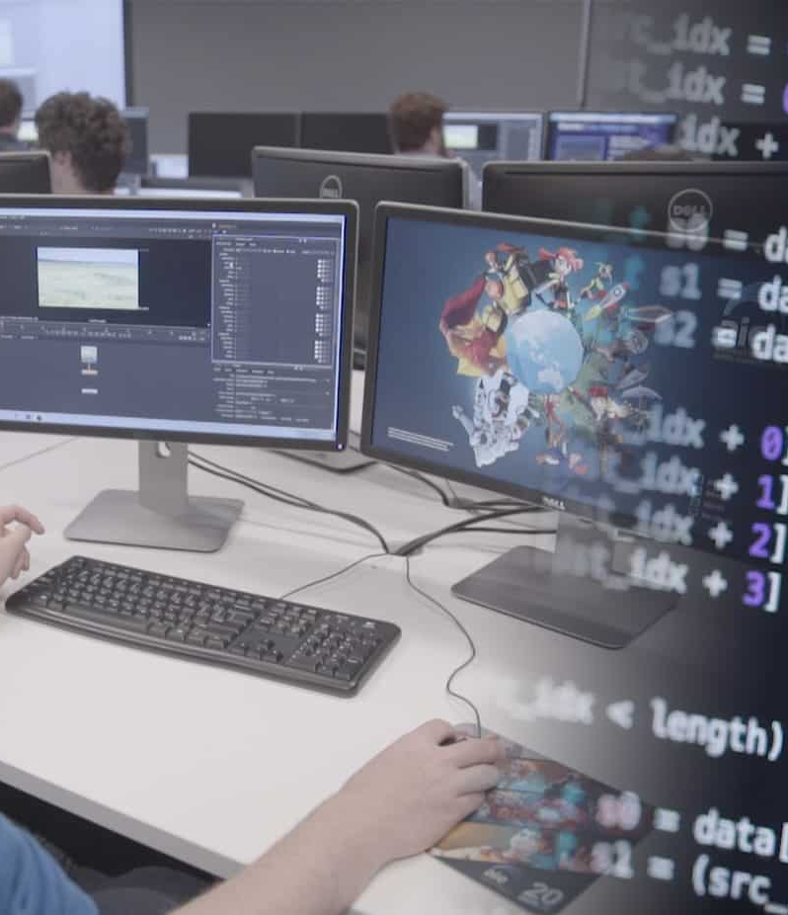
What is Game development?
Game development is the process of developing a Game, from the initial concept to the finished product.
Depending on the game and the studio undertaking the project, this process can take anything from a few weeks to over a decade. It can involve thousands of designers, artists, programmers, writers, and testers, or be carried out by a single indie developer.
Image Source: https://aie.edu.au/wp-content/uploads/2018/02/game-programming-04.jpg

Slide 4

Game design vs. game development
Game development and game design are two different terms, though they are often used interchangeably:
Game design refers to the conceptual side of things: the initial vision, the mechanics, the story, the characters, the locations, and so on.
Game development is a broader term that covers game design and additionally includes the technical implementation of the game concepts.
At many smaller game development studios, the same team members wear many hats and are responsible for both fields. At larger companies, however, design and development are often handled separately.
Image Source: https://www.codingninjas.com/blog/wp-content/uploads/2020/08/blog-13.png

Slide 5

STAGES OF THE GAME DEVELOPMENT PROCESS
02
The game development process can be broken down into three main stages.
Image Source: https://www.redappletech.com/wp-content/uploads/2017/08/mobile-game-dev.jpg

Slide 6


02A
Pre-production
Pre-production is the planning phase. You may have an amazing idea for a game, but to successfully turn it into a reality you need a detailed plan of action.
The first step is to create a game design document (GDD). It will serve as a blueprint from which your game is to be built, it is a unified workspace where teams can bring all their knowledge, docs, and projects together.
Image Source: https://www.appjetty.com/blog/wp-content/uploads/2021/05/How-to-Assign-Team-Specific-Activities-with-Dynamics-CRM-Calendar-App_F.png

Slide 7
02A
Pre-production (Questions to Ask)
Pre-production is the stage when the writers, artists, designers, and developers collaborate to determine the scope of the game. That includes coming up with ideas for how the game will function, its characters, its look, and its story. The most basic questions that need to be answered are:
What is the core idea behind the game? How can it be summarized in a pitch?
What is the genre of the game?
Who is the target audience?
When and where does the game take place?
Who are the characters?
What is our estimated cost to develop this game?
Will we need to hire additional team members?
How will we monetize the game?
What is our estimated timeframe for the launch?
The answers to these questions become the backbone of developer’s game design document. Some details are likely to change over the course of the game development process

Slide 8
02A
Pre-production (Prototype)
During the pre-production stage, it’s also common to prototype the environments, characters, control schemes, and other in-game elements. A lot of effort is invested into worldbuilding. Ideas are fleshed out in the form of storyboards, concept art, interface mockups, and so on, to see how they look, feel, and interact with one another.

Slide 9
02B
Production
Design
The production stage of game development is when studio takes the concepts created during pre-production and turns them into source code and various assets. It's where the bulk of development time, effort, and resources go.
During this stage, several teams work in parallel:
Programming
Art, graphics, and audio
Testing

Slide 10
02B
Production (cont..)
Design.
The design team continues their work from the pre-production stage. Working together with the artists, they render character models, craft dynamic and immersive level designs and environments, iterate on the interfaces, and so on. The designs become more detailed and granular, some ideas get refined while others are thrown out.
Programming.
Even in case you decide to use an existing game engine, the programmers will have plenty of work prototyping ideas, incorporating new features, and fixing the bugs introduced along the way. If you are also planning to release an API for your game, your developer team will need to allocate enough additional resources to work on related technical tasks.

Slide 11
02B
Production (cont..)
Art, graphics, and audio.
Most games require a great number of creative assets. Artists, music composers, and voice actors need to work together with the designers and developers to make sure all elements fit together.
Testing.
Making sure the game works as intended is critical. Testers don't wait till the game is finished, they start their work as soon as anything is playable. Early on, testing a game occupies a relatively small amount of time, but as development draws to a close, it requires multiple people working full-time.

Slide 12

02C
Post-production
After the final version of the game is released, it enters the final stage of the game development process – the post-production. The main purpose of this stage is game maintenance, which mainly includes:
Bug-fixing.
Despite the efforts of testers, most games still contain minor bugs at the moment of their launch. The first few months during the post-production stage are typically spent identifying and squashing these bugs.
New content.
Post-production also includes regular software updates for the game, ranging from game-balancing patches to new DLCs.
Image Source: https://www.redappletech.com/wp-content/uploads/2017/08/mobile-game-dev.jpg

Slide 13
02C
Post-production (cont..)
No two games are the same, and even seasoned game development studios with hundreds of games under their belts often struggle with last-minutes changes, tight deadlines, creative differences, and other challenges. This is the nature of the industry. There are many things that contribute to a game’s success that are not under the developer’s immediate control. Having a structured game development process with clear deadlines and production goals is the most straightforwards way to do it.
Image Source: https://www.redappletech.com/wp-content/uploads/2017/08/mobile-game-dev.jpg

Slide 14

CODING LANGUAGES FOR GAME DEVELOPMENT
03
Coding provides the basis for a whole world of technological systems and devices used in our society today.
Image Source: https://qph.fs.quoracdn.net/main-qimg-9db1a974286bed1c4a431f77aa70c08f-pjlq

Slide 15

C++
Developer: ISO/IEC JTC1
The quintessential coding language for developing Games is C++. It has been used for years by PC and console game makers. While learning C++ can help you grasp other languages, it should be noted that it’s not an easy language to learn. Once it is learned however, you will have the ability to create complex graphics in games engines like Unreal, Unity, and Sony’s PhyreEngine.
Programming Language
Image Source: https://seqtek.com/wp-content/uploads/2021/06/New-Project-5.svg

Slide 16
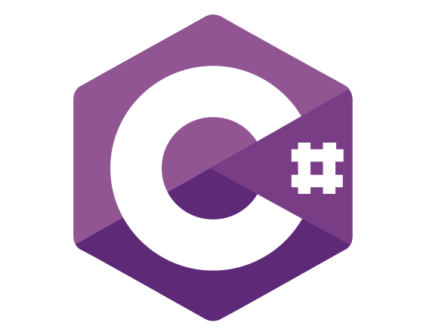
C#
Developer: Mads Torgersen (Microsoft)
The language is basically added power for developing games on Windows and Xbox, since the language was developed by Windows. The majority of games using C# are developed on the Unity engine, which is used for, among other things, training simulators and software created for first responders. Because Unity utilizes visual actions and is not made for asset-creation, C# is an intuitive language to learn, although not necessarily best for beginners.
Programming Language
Image Source: https://seqtek.com/wp-content/uploads/2021/06/New-Project-5.svg

Slide 17

Swift
Developer: Apple Inc.
The explosive growth of cell phone use and development has no doubt made mobile gaming a contender in the traditionally console dominated war for gamers. Swift is similar to Objective C and is used in creating games for OS X and iOS, anything played on a MAC, iPhone, or iPad. The language is used in the frameworks Cocoa and Cocoa Touch, with the app development software Xcode relying on it almost exclusively.
Programming Language
Image Source: http://getdrawings.com/get-icon#swift-icon-63.png

Slide 18

Java
Developer: Oracle Corporation
A great language to learn if you’re just getting into Game coding, Java is a computer programming program that’s been around for a while. Java isn’t widely used in Game development, but it is the main programming language used to make mobile Android games. Web-based games also use Java, in conjunction with Flash.
Programming Language
Image Source: https://seqtek.com/wp-content/uploads/2021/06/New-Project-5.svg

Slide 19

Lua
Developer: Mads Torgersen (Microsoft)
Lua is a multi-platform language that is considered lightweight and easy to learn. These qualities make it a fast, fun, and efficient language to use for Game development.
Lua is used in a lot of game engines due to its simple language structure and syntax. The garbage collection feature is often quite useful in games which consume a lot of memory due to rich graphics that is used.
Programming Language
Image Source: https://seqtek.com/wp-content/uploads/2021/06/New-Project-5.svg

Slide 20
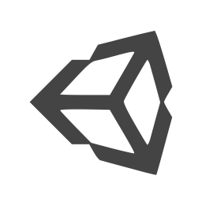


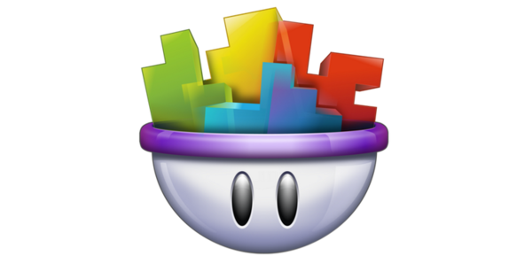


NO-CODE GAME ENGINES
04
Even if you don’t have a knack for programming, you can still achieve a lot
Image Source: https://s6r5k6w8.rocketcdn.me/wp-content/uploads/2021/11/20211124_225806.jpg, https://user-images.githubusercontent.com/2244442/53168879-75ea7680-35ba-11e9-9708-afa6de46b2ff.png, https://images-wixmp-ed30a86b8c4ca887773594c2.wixmp.com/i/6ded0954-c083-45cf-a8e5-b47390e9b280/d54whq5-dfa4017e-8775-4503-bdc2-fe37136d9e98.png

Slide 21
No-code Game Engines
Contrary to popular belief, the world of app and game development doesn’t have to be filled with monotonous lines of code and endless bug fixes, thanks to a growing number of powerful tools that allow you to build pro-level apps and games without having to wade through an endless sea of complex programming languages.
There are game engines that let users write scripts by connecting visual blocks of code. This way, they only have to focus on the logical aspect of things instead of worrying about code syntax.

Slide 22
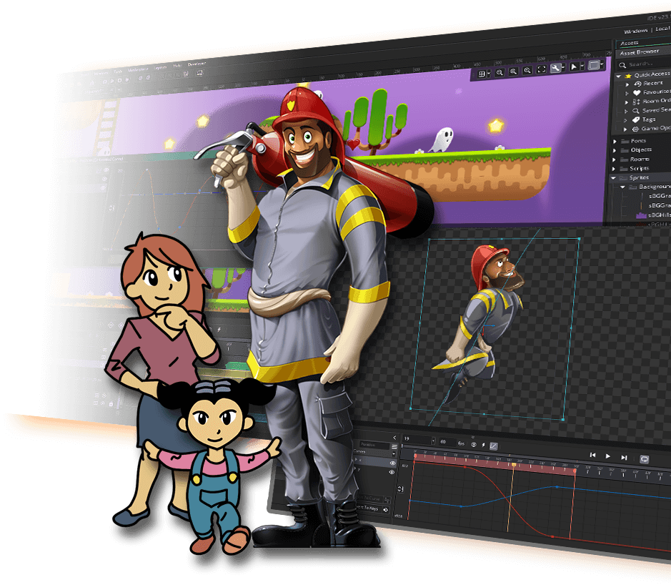
GameMaker: Studio
The drag-and-drop options and other easy features allow anyone who has never programmed in their life to make a game. Despite the simplicity, it’s still possible to make good games as evident by the fact that Hotline Miami and Spelunky, two popular indie games, saw their first version made on GameMaker.
The best part is that GameMaker does come with a built-in scripting language that allows people with some programming experience to do more with the tool. This makes GameMaker perfect for those looking to get familiar with a game creation program in hopes that they can continue learning more and not run into the limitations of other programs.
Image Source: https://gamemaker.io/en/gamemaker

Slide 23
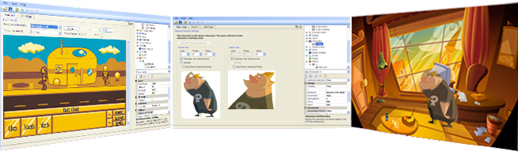
Adventure Game Studio
Aimed at developers with more experience than beginners, Adventure Game Studio lets users make point-and-click or keyboard-controlled adventure games like the Monkey Island series.
A few recent indie titles that saw success used this tool, including Wadjet Eye Games’ Gemini Rue and Blackwell series.
Even if users are just starting out, Adventure Game Studio is still pretty easy to use as their first game making software. The editor used is a Windows-based IDE that lets them do just about anything fast and easy, including writing game scripts, importing graphics, and so on.
Image Source: https://www.adventuregamestudio.co.uk/

Slide 24
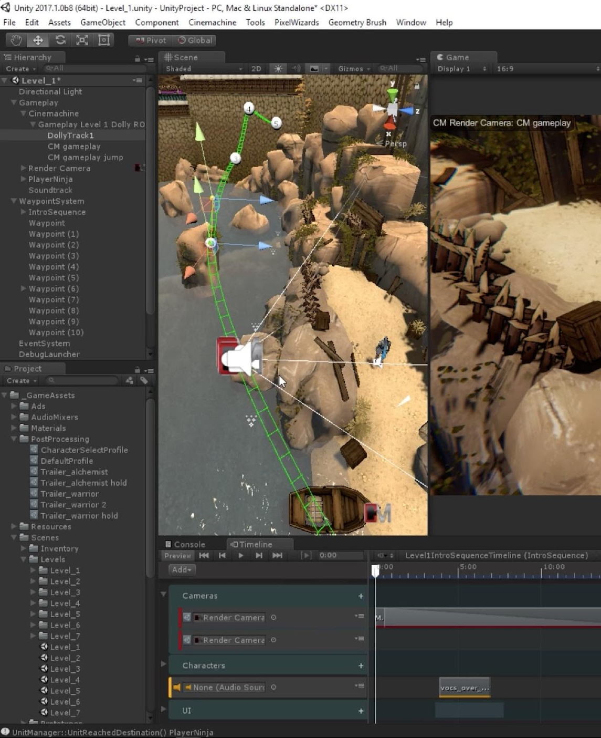
Unity
Unity not only supports an incredible library of platforms, but it also comes with its own built-in IDE. It is also used to make both 3D and 2D games and boasts a massive store of assets and resources.
Many high-profile game developers like Obsidian Entertainment (Pillars of Eternity) and inXile Entertainment (Wasteland 2) have started using Unity. Several successful indie devs like Facepunch Studios (Rust) and Press Play (Max: The Curse of Brotherhood) have also jumped on board.
Image Source: https://architosh.com/wp-content/uploads/2017/07/Cinemachine.jpg

Slide 25
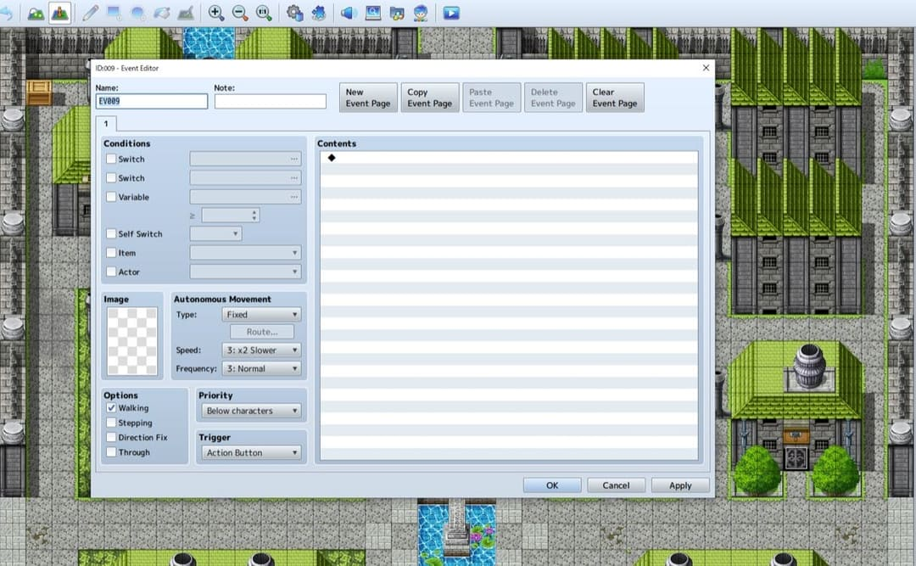
RPG Maker
RPG Maker is a program that allows users to create their own role-playing Games. Most versions include a tile set based map editor, a simple scripting language for scripting events, and a battle editor. All versions include initial premade tilesets, characters, and events which can be used in creating new games. One feature of the PC versions of RPG Maker programs is that a user can create new tilesets and characters, and add any new graphics the user wants.
Despite being geared towards creating role-playing Games, the engine also has the capability to create games of other genres, such as adventure games, story-driven games or visual novels with minimal tweaking.
Image Source: https://www.rpgmakerweb.com/

Slide 26
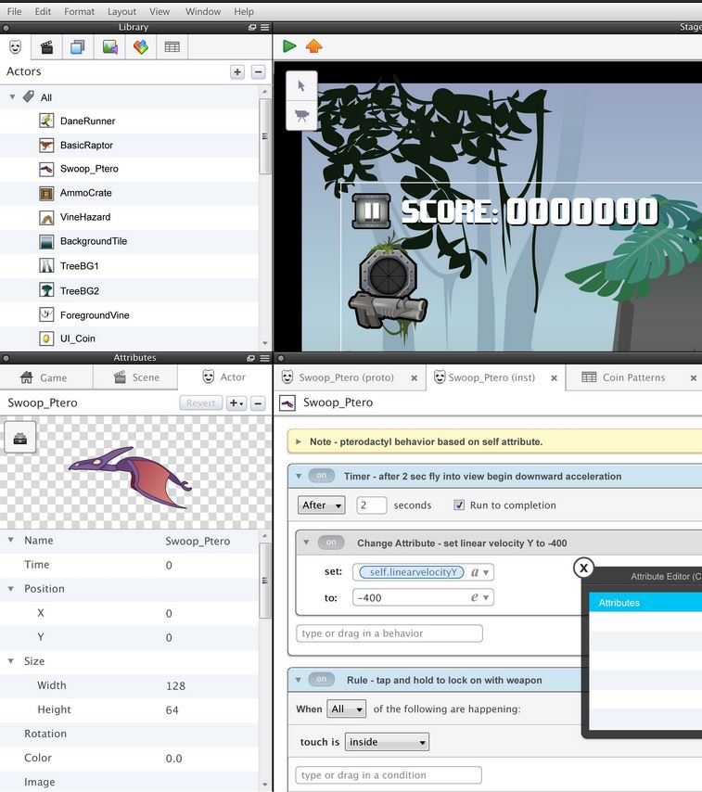
GameSalad
GameSalad is similar to GameMaker in that it allows you to make and publish games on several platforms, as well as having its own intuitive drag-and-drop interface that’s easy for anyone to use.
Most impressive is the behavior library which allows developers to implement complex behaviors that someone without coding knowledge would have a hard time executing if they had to use a computer language.
Image Source: https://gamesalad.com/

Slide 27

ADVANTAGES AND DISADVANTAGES OF NO-CODE GAME PROGRAMMING
05
As all coins have two sides, a well crafted, comprehensive game development tool, also has its own short-comings among its numerous positives.
Image Source: https://image.shutterstock.com/image-photo/two-hands-thumb-thumbs-down-600w-308608184.jpg

Slide 28
Advantages
Most if not all of the coding is done for you, so all you have to worry about is content, level layout, etc.
Along those lines, memory management, asset loading, lighting (in complex engines), etc has all been designed and tested thoroughly.
If the engine is cross platform you will have to do little to no work to port your game.

Slide 29
Disadvantages
If you are modifying anything, you now need to become familiar with a new codebase.
If there is a bug in the engine, unless it is open source you can't fix it.
The engine was not designed specifically for your game, so it may be less efficient than code you write specifically for your game.
Game engines generally are not free.
If a game is small, the overhead of using an engine may not be worth the time invested to write code yourself.

Slide 30

CONCLUSION
No-code approach of game programming are for those less code-savvy individuals who can’t even write a single line of code but want a shot at game development. These game engines can let anyone create games without coding using visual scripting approach.
Although these game engines are pretty self-sufficient for lightweight game development needs, but at some point, when the game becomes too complex with nodes going all over the screen, debugging and maintenance can become quite challenging.
Image Source: https://www.codingninjas.com/blog/wp-content/uploads/2020/08/blog-13.png

Slide 31
References
Mike Kernell - PYTHON PROGRAMMING FOR BEGINNERS
Mesquita A., Technology for Creativity and Innovation: Tools, Techniques and Applications, ISCAP/IPP and Algoritmi Centre, University of Minho, Portugal 2011

