Slide 1

INTRODUCTION TO INFORMATION TECHNOLOGY II
Week 12
No-Code Mobile Game Programming
Riovan Styx Roring, S.T., M.Kom

Slide 2

MOBILE GAME PROGRAMMING
01
How to Create a Game App Without Coding
Image Source: https://images.squarespace-cdn.com/content/v1/5d923da5addd6c4d88a0f981/1607473170176-HBCH0ECQ7I02TMSMOL1E/unnamed%252Bcopy.jpg?format=1500w

Slide 3
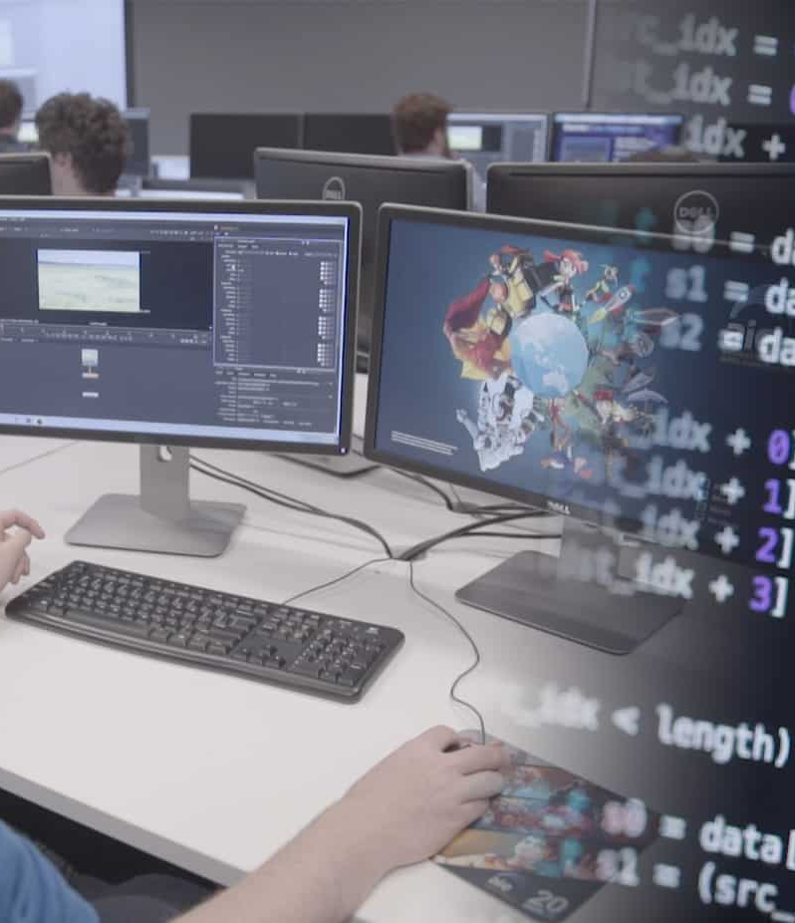
Mobile Game Apps
Game apps created a long time ago used to be chunks of manually written codes. They were complicated. Making things move on the screen along with managing the graphics and adding features with the help of text inputs only aren’t easy at all.
These days, things have changed. Users may still need a little coding knowledge to make professional games with the latest features. But, for starters, there are software that help them create games without any codes or requiring programming skills.
Image Source: https://aie.edu.au/wp-content/uploads/2018/02/game-programming-04.jpg

Slide 4

Does Game Development Require Coding?
It isn’t a necessity. In fact, with the presence of powerful engines like Unity and Game Maker Studio, users are able to create entire games without a single line of code. But if they are serious about the game development business and are looking to take it as a career, they will need to have substantial programming skills.
Having some coding knowledge will help them know what’s happening behind the scenes. It will make it easier for them to tweak elements in the game when they have to, as coding will always be more accurate than drag-and-drop. It gives them better control over the game they are developing.
Image Source: http://www.alle-spielothekspiele.com/wp-content/uploads/2019/05/Mobile-Game-Development.png

Slide 5

How Difficult is it to Program a Game?
Game development is one of the most difficult types of programming. It requires developer to do a lot of things from planning, designing graphics, coding (or drag-and-drop), and more. All of these game development phases demand a lot of dedication and hard work.
Game development is one of those fields that people can take only if they sincerely love what they are doing. Creating a single game is one thing. It will take them hours to master the craft until they can build everything that their mind can imagine.
Image Source: https://media.https://media.credencys.com/wp-content/uploads/2019/06/web-app-development-frameworks.jpgcredencys.com/wp-content/uploads/2019/06/web-app-development-frameworks.jpg

Slide 6
MAKING MOBILE APP GAME
02
General process of creating a game app
Image Source: https://images.squarespace-cdn.com/content/v1/5d923da5addd6c4d88a0f981/1607473170176-HBCH0ECQ7I02TMSMOL1E/unnamed%252Bcopy.jpg?format=1500w

Slide 7

A. Develop an Idea
For every step of making something the first thing that developer need to do is develop an idea, of what the mobile are going to be, whether it is going to be a gacha game, RPG game or a fantasy game.
Most of the successful games like Angry Birds, Flappy Bird and Temple Run have numbers to boast because of their ideas. Their developers gave people a new experience. Thinking out of the box, they changed in one way or another people’s conventional view about games.
Image Source: https://i0.wp.com/www.wakeforestinnovations.com/wp-content/uploads/FS-DevelopIdea-i3Bulb.png?resize=768%2C973&ssl=1

Slide 8
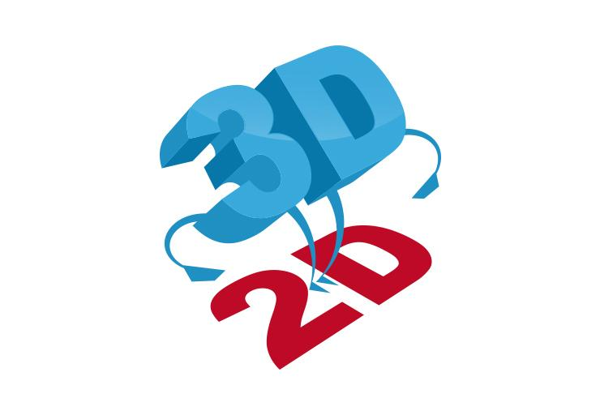
B. Decide if it is 2D or 3D
Another step is deciding if the game should be in 2D or 3D. The idea is to make the game look and feel right, and even if 3D is more advanced, it may not always be the right decision.
Creating a 3D game needs more resources and powerful systems. A 3D game may seem unnecessary in some cases. Flappy Bird is a great example. No matter how many studios have copied the game and some even making it 3D, the original 2D version has always been the best.
Image Source: https://www.jensen-consulting.co.uk/wp-content/uploads/2018/04/2D-to-3D-CAD-Conversion-Company.png

Slide 9

C. Choose a Platform
The next step is choosing a platform. Developer can create a game natively for one environment, or they could also go for cross-platform or web applications.
A native app is one that has been created explicitly for one operating system. On the other hand, a cross-platform game can run on more than one operating system, and a web-based application can directly run on web browsers.
Image Source: https://dzuyel7n94hma.cloudfront.net/img/saas-startup-example-golang-project-website-homepage.png

Slide 10

D. Code the Game
Learning Java is the baseline for most game programmers because it is a simple dynamic language with a lot of applications. Also, people choose Java because it is similar to another programming language for games, C++, which gives better control of the hardware. It is easy to learn them side by side.
Games like Star Wars Galaxies and Runescape were created in Java while Counter-Strike and Football Pro use C++. As programmer learn Java and C++, they will find it simpler to learn other languages.
JavaScript is a more straightforward language to learn, and even if programmers need to use it alongside HTML and CSS, they can create the best web-based games. It can also develop games that can run on a phone; Angry Birds was based on JavaScript.
Image Source: https://gadgetguy-assets.s3.ap-southeast-2.amazonaws.com/wordpress/wp-content/uploads/2019/07/02200949/mobile-game-development.jpg

Slide 11

CODING LANGUAGES FOR MOBILE GAME DEVELOPMENT
03
Coding provides the basis for a whole world of technological systems and devices used in our society today.
Image Source: https://qph.fs.quoracdn.net/main-qimg-9db1a974286bed1c4a431f77aa70c08f-pjlq

Slide 12

Kotlin
Developer: JetBrains
Easy adoption for existing Java programmers
Kotlin runs on the JVM and Java interoperability has been one of the main objectives since the language was born. It runs everywhere Java does; web servers, mobile devices (Android), and desktop applications. It also works with all the major tools in the Java ecosystem like Eclipse, IntelliJ, Maven, Ant, Gradle, Spring Boot, etc. All of this makes adoption extremely easy even for existing Java projects. On top of this there's also ensured Type safety and less boilerplate code needed.
Since Kotlin is made by Jetbrains (the developers of IntelliJ IDEA) so it stands to reason that the IntelliJ support for Kotlin is also great. Besides that, Kotlin also works well with existing Java tools such as Eclipse, Maven, Gradle, Android Studio, etc...
Programming Language
Image Source: https://seqtek.com/wp-content/uploads/2021/06/New-Project-5.svg

Slide 13

JavaScript
Designed by : Brendan Eich of Netscape
Runs on both the browser and the server
With Node.js, it is now possible to run JavaScript as a web server. This would allow programmers to be able to create server based applications sooner than would if they had to learn a separate programming language as well for server side code. As JavaScript is the only language supported by web browsers it puts it in the unique situation of being the only programming language that's available on both the client side and server side.
The only downside of this language is that it is very confusing to read.
Programming Language
Image Source: https://seqtek.com/wp-content/uploads/2021/06/New-Project-5.svg

Slide 14

C#
Developer: Mads Torgersen (Microsoft)
Clean and simple syntax suitable for beginners
The Lua syntax is modeled from Modula, a language known for being a fantastic introduction to programming. Lua's performance compares very well to other languages. If performance needs to be further improved programmers can implement critical parts in C Use the LuaJIT compiler.
Due to the growing popularity, Lua has a rather large and helpful community surrounding it.
The problem that programmers might encounter with this language is that it is easy to make mistake when declaring variables.
Programming Language
Image Source: https://seqtek.com/wp-content/uploads/2021/06/New-Project-5.svg

Slide 15
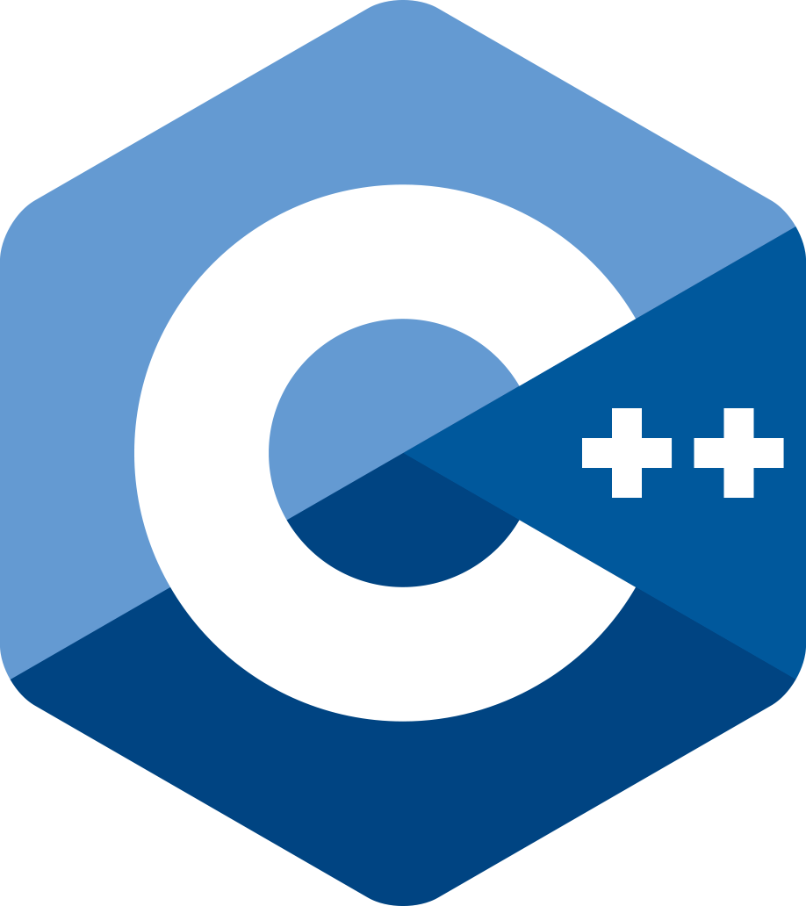
C++
Developer: ISO/IEC JTC1
Huge language supports most everything
C++ is a large language with an even larger community and following. It has libraries for every kind of task that is possible to do with C++
Because C++ (and its precursor C) are "lower level" than a lot of popular programming languages they are also faster at executing code than Java or C# which require VMs and garbage collection threads.
This language however has a disadvantage of undefined behavior, in which Subtle errors can render the entire program "undefined" by the complicated C++ standard. The standard imposes no requirements in such cases. Thus C++ compiler writers are free to ignore the existence of such cases and Bad Things are prone to happen instead. Even experts can't reliably avoid undefined cases in C++
Programming Language
Image Source: https://seqtek.com/wp-content/uploads/2021/06/New-Project-5.svg

Slide 16
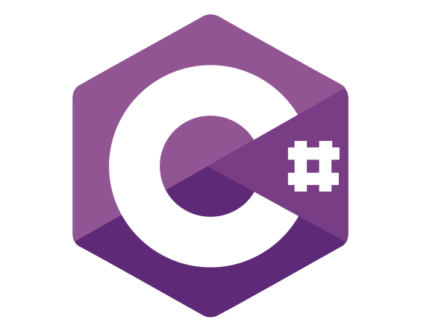
C#
Developer: Mads Torgersen (Microsoft)
C# allows developers to build all kind of applications including Windows clients, consoles, Web apps, mobile apps, and backend systems.
C# developers can build native iOS and Android mobile apps with the help of Xamarin. Xamarin is a tool as a part of Visual Studio which allows developers to write C# code that is compiled to native iOS and native Android binaries. These binaries work exactly as any native app written using other iOS and Android languages such as Swift or Kotlin works.
C# offers developers the ability to build native iOS and Android mobile apps without learning a new programming language.
Programming Language
Image Source: https://seqtek.com/wp-content/uploads/2021/06/New-Project-5.svg

Slide 17
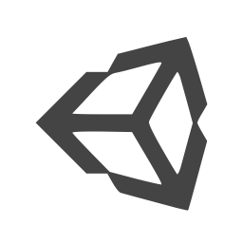




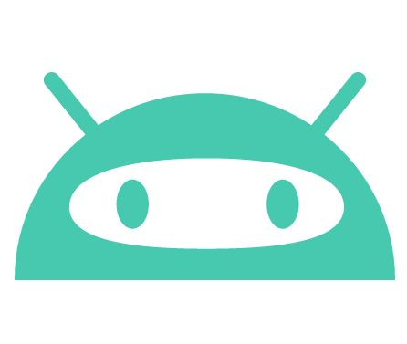
NO-CODE MOBILE GAME ENGINES
04
Even if you don’t have a knack for programming, you can still achieve a lot
Image Source: https://s6r5k6w8.rocketcdn.me/wp-content/uploads/2021/11/20211124_225806.jpg, https://user-images.githubusercontent.com/2244442/53168879-75ea7680-35ba-11e9-9708-afa6de46b2ff.png, https://images-wixmp-ed30a86b8c4ca887773594c2.wixmp.com/i/6ded0954-c083-45cf-a8e5-b47390e9b280/d54whq5-dfa4017e-8775-4503-bdc2-fe37136d9e98.png

Slide 18
How to Make a Game Without Coding
If developer want to make game without coding they need to install a game engine that allows them to design and create game elements with drag-and-drop or with point-and-click. Instead of having to write codes, they can work with the Graphical elements on their screen. Although the end result may not be a AAA game like PUBG or GTA San Andreas but that is the best that developer have without using actual codes.
However, even with just that they can still get a popular game if the idea become popular.
These are the engines that you can download to start making games without coding:

Slide 19
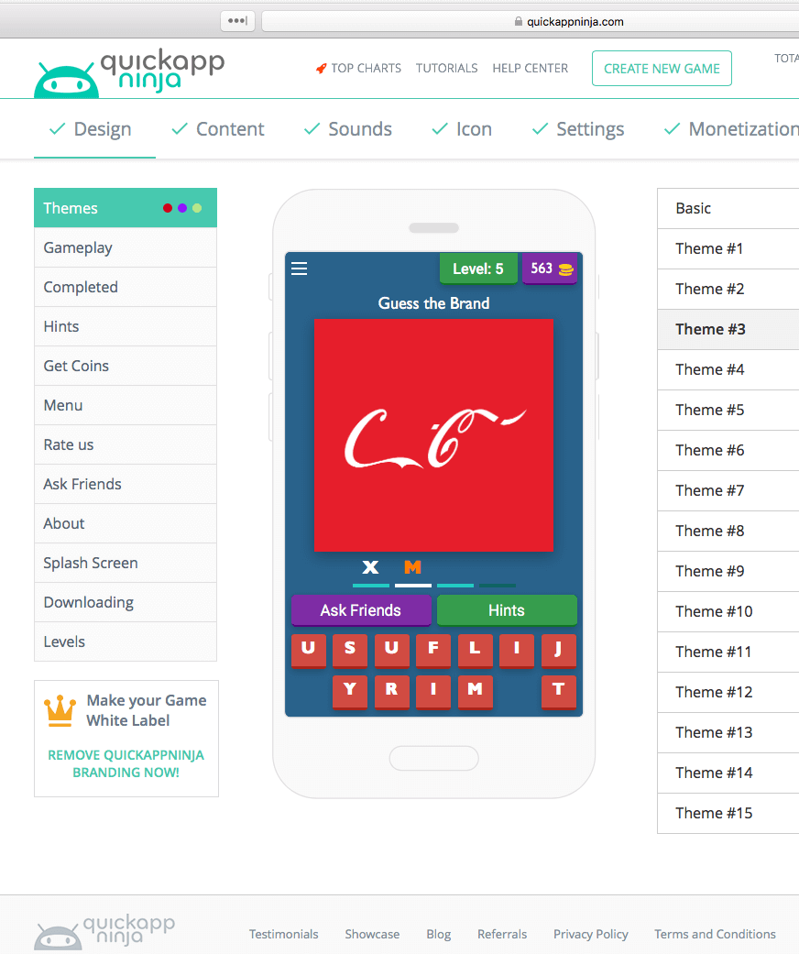
QuickApp Ninja
QuickAppNinja is a game app builder with templates that allow users to easily create their own quiz games.
They make money from ads shown in their games. They also don't need any special skills or coding knowledge.
Build games via the easy, intuitive drag-n-drop game wizard.
Image Source: https://quickappninja.com/

Slide 20
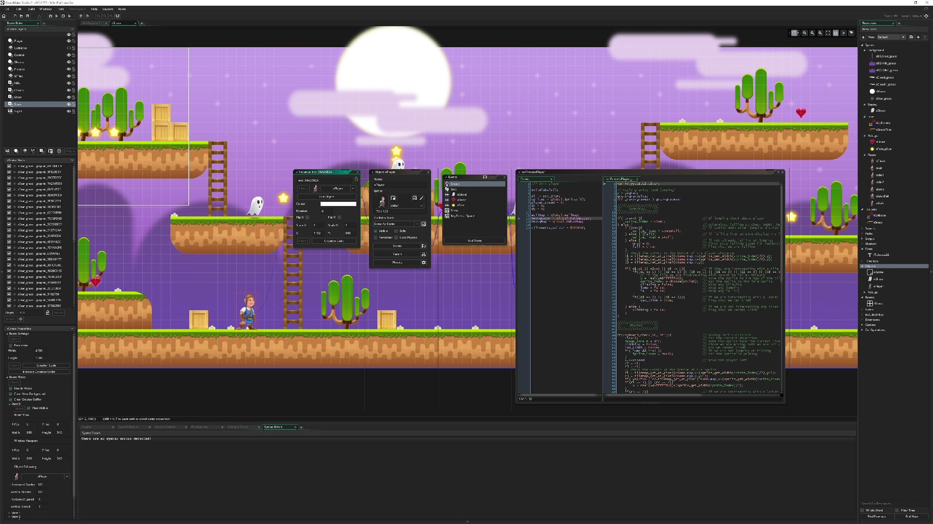
GameMaker: Studio
Their slogan being “Making Games is for Everyone”, Game Maker 2 studio lets people of all backgrounds and expertise level build excellent playable games. They’ve rightfully claimed – on their website – that they have done everything possible to make the development process simple and give you the resources so there are “no limits to what you can achieve”.
The Game Maker 2 Studio platform is mostly drag-and-drop and also comes with a built-in scripting language which will help you to understand the actual code or even edit them if you have some basic knowledge. Also, on their website, they have many essential tutorials which will be enough for you to learn and start creating games.
Image Source: https://gamemaker.io/en/gamemaker

Slide 21
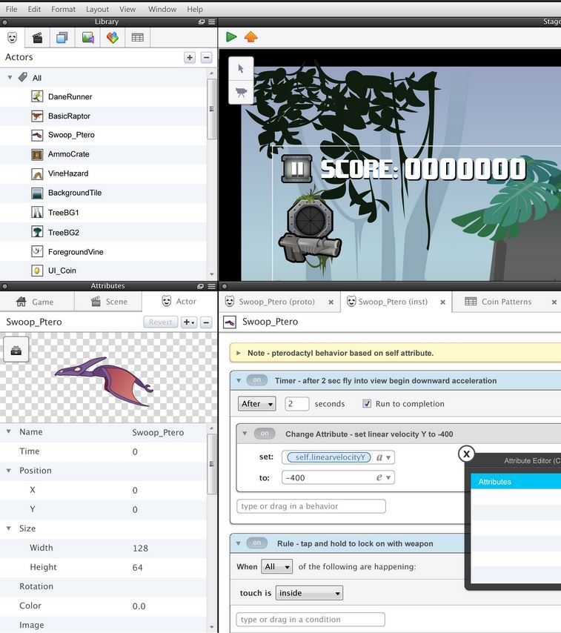
GameSalad
GameSalad’s main initiative is to help people learn computer science by creating games. Even if the proposition may not sound too appealing to many, you can’t underestimate the tool.
GameSalad lets you create amazing 2D games for mobile phone platforms, including iOS, Android and Windows. You can also publish the games on Amazon KindleFire, Mac OS and Tizen. Furthermore, they have a platform called the “GaleSalad Arcade”, where GameSalad users can upload their games, play them, and learn from each other. Built on an “If This, Then That” logic, GameSalad is a compelling program, letting people with no programming knowledge brag about the games they created.
Image Source: https://gamesalad.com/

Slide 22
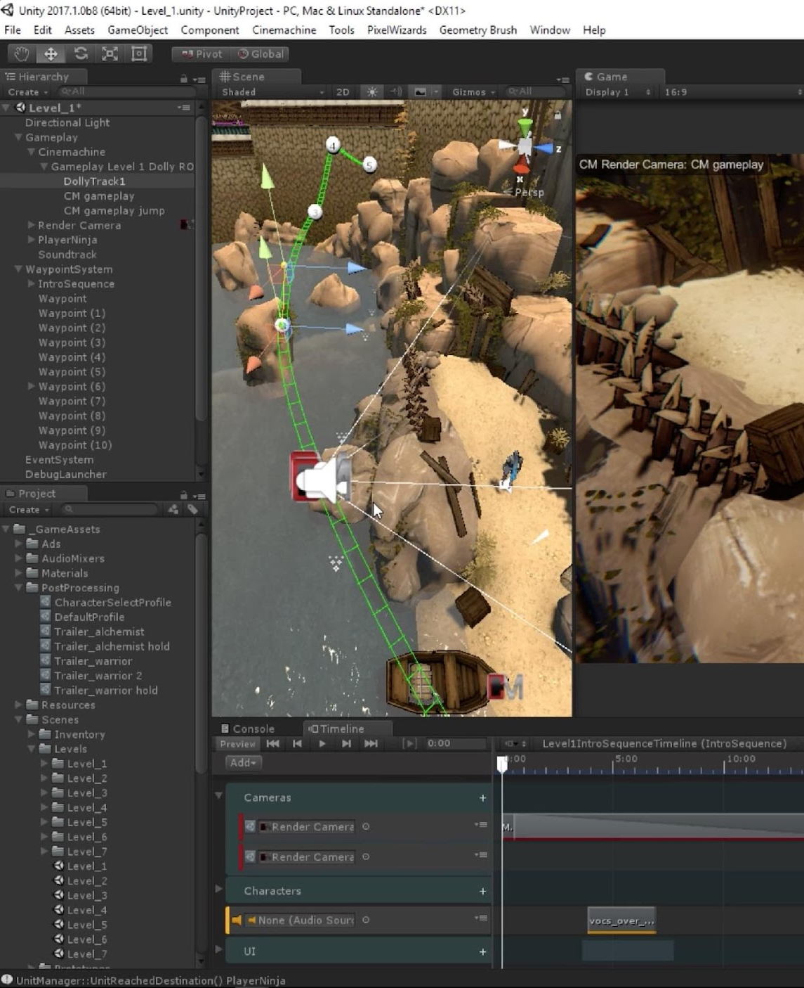
Unity
Unity already had more than 5.5 million registered users in 2016. Also, according to Unity CEO, people download 2 billion copies of unity games every month. These two stats show how popular and preferable Unity has been as a game engine around the time.
Unity supports every platform and also has an IDE. If you know to code, you can use C#, UnityScript (javascript), and Boo. Furthermore, you can build both 2D and 3D games on it. Some games that use Unity are Rochard, In the Valley of Gods, and Deus Ex: The Fall.
Image Source: https://architosh.com/wp-content/uploads/2017/07/Cinemachine.jpg

Slide 23
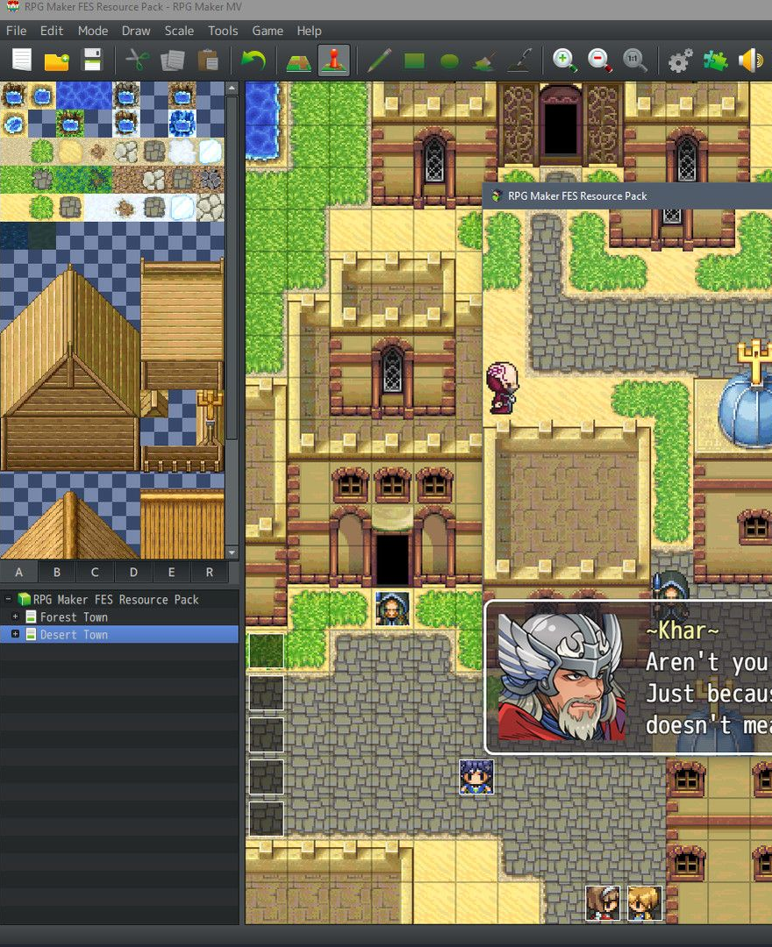
RPG Creator
Tokyo-based Degica Games has announced that an English version of RPG Creator, a tool enabling players to build their very own RPGs, is coming to iOS on September 25th.
In the vein of the classic RPG Maker console and PC franchise (which Degica Games also had a hand in), the game will cater to players who’ve always dreamed of crafting their own old-school RPG.
Image Source: https://www.rpgmakerweb.com/

Slide 24
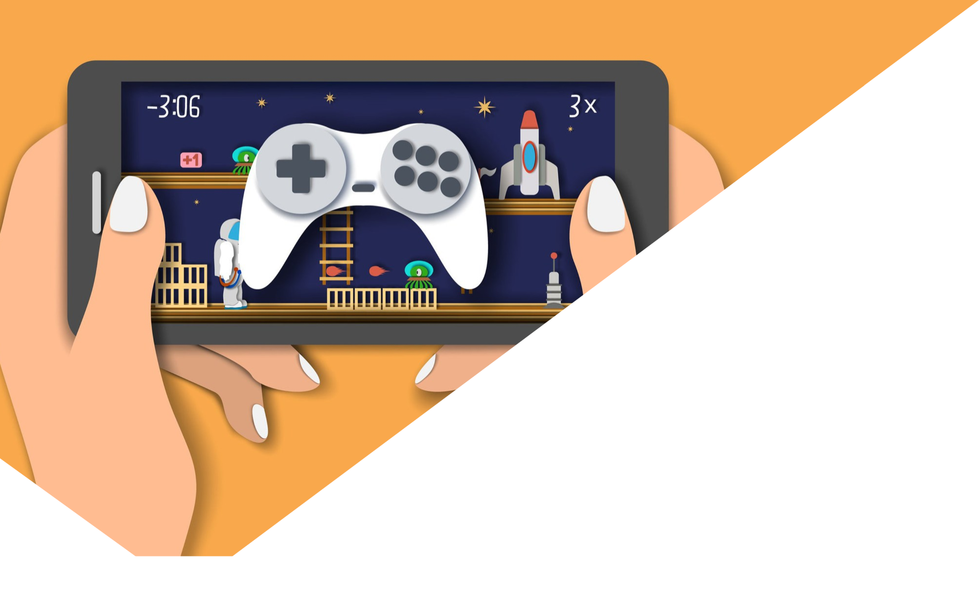
WAYS TO COME UP WITH GREAT MOBILE GAME IDEAS
05
To develop a successful game, you should drill into the market trends. Analyze which mobile games top the charts, in which categories, and why.
Image Source: https://www.dreamstime.com/mobile-games-vector-flat-style-design-illustration-mobile-games-vector-flat-style-design-illustration-hands-holding-smartphone-image179935445

Slide 25

Follow the Mobile Gaming Market Trends
Many games were created based on this approach. In order to awaken your creativity and start generating brilliant ideas for games, you should observe the world around you. Pay attention to details: your surroundings, people, and all the other little things that you may not usually notice. Ask yourself, “Can I implement this in my game? If yes, how?” Write down everything that comes to your mind. The answers may surprise you. Almost anything can trigger inspiration when you are fully aware of the processes around. You never know what can drive an idea for a new interesting gameplay concept.
Image Source: https://images.rawpixel.com/image_1000/czNmcy1wcml2YXRlL3Jhd3BpeGVsX2ltYWdlcy93ZWJzaXRlX2NvbnRlbnQvbHIvdjIxMWJhdGNoMTEtYXVtLTcxLWxlYWRlcl80LmpwZw.jpg

Slide 26
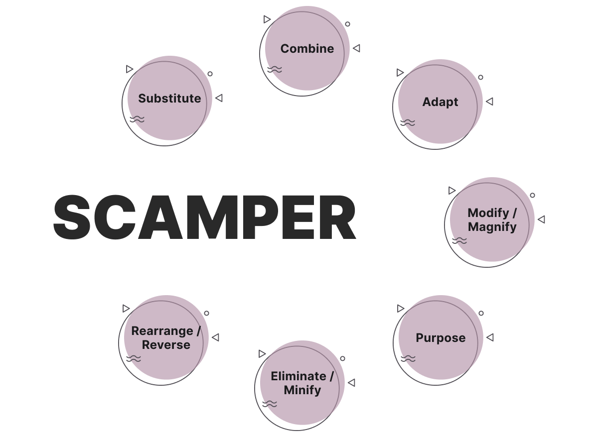
SCAMPER Method
David Reichelt created a hit mobile game Color Switch which is the fastest game in the App Store history to reach 50 million downloads and was the #1 game in over 150 countries.
In an interview, when he was sharing how he came up with the game idea, he referred to the SCAMPER method from "Thinkertoys" by Michael Michalko. It’s a list of transformations or approaches that can be implemented to change an existing object or idea in order to create something new. Each letter in the acronym stands for one or several ideas that trigger questions you are to ask yourself.
Image Source: https://img.orangesoft.co/media/scamper.png

Slide 27

Brainstorm
It may be useful to plan brainstorming sessions. Set up the timeframe of 20-25 minutes for one session and stop as soon as the timer goes off. Choose the most comfortable location and time of the day. This method works best when several people practice it together as it implies discussing ideas from multiple angles and stimulates comments and suggestions.
To start, one can turn to mind mapping. It’s a visual method of brainstorming, where you use words, images, and colors to combine ideas that relate to a single topic. Such a technique allows us to quickly generate a plethora of gaming ideas. It’s also an interesting way of managing a creative process.
Image Source: https://www.open.edu/openlearn/pluginfile.php/1210041/mod_resource/content/0/mss_1_olhp_786x400.jpg

Slide 28

PROS AND CONS OF NO-CODE MOBILE GAME PROGRAMMING
06
As all coins have two sides, a well crafted, comprehensive game development tool, also has its own short-comings among its numerous positives.
Image Source: https://seoportfolio.info/wp-content/uploads/2022/01/unnamed.jpg

Slide 29
Disadvantages
Developers need to familiarize with new codebase, if they want to modify anything.
Unless the engine is open source, developer can fix bug they encounter in it.
Since much of the codes are not designed specifically for one’s game, it may be less efficient than code that progarammer write specifically for that game.
Most game engines are not free

Slide 30
Advantages
If the engine is cross platform you will have to do little to no work to port your game.
Most if not all of the coding is done for you, so all you have to worry about is content, level layout, etc.
Along those lines, memory management, asset loading, lighting (in complex engines), etc has all been designed and tested thoroughly.

Slide 31

CONCLUSION
The basics of creating a game app are just like developing any other apps; developers need to plan, look for an idea, create and publish. Learning to code is the best way to move forward in the business, but they can also create basic games with no coding skills at all.
Developers will need a lot of perseverance and patience, as it takes time for a person to be an outstanding game developer.
Image Source: https://www.redappletech.com/wp-content/uploads/2017/08/mobile-game-dev.jpg
Notes:
© Copyright Showeet.com – Free PowerPoint Templates

Slide 32
References
Mike Kernell - PYTHON PROGRAMMING FOR BEGINNERS
Mesquita A., Technology for Creativity and Innovation: Tools, Techniques and Applications, ISCAP/IPP and Algoritmi Centre, University of Minho, Portugal 2011

