Slide 1

INTRODUCTION TO INFORMATION TECHNOLOGY II
Week 13
Cross-platform Support
Riovan Styx Roring, S.T., M.Kom

Slide 2

CROSS-PLATFORM SUPPORT
01
Cross-platform software is computer software that is designed to work in several computing platforms
Image Source: https://dzuyel7n94hma.cloudfront.net/img/saas-startup-example-golang-project-website-homepage.png

Slide 3

PLATFORM [COMPUTING]
Platform can refer to the type of processor (CPU) or other hardware on which an operating system (OS) or application runs, the type of OS, or a combination of the two. An example of a common platform is the Microsoft Windows OS running on the x86 architecture. Other well-known desktop platforms are Linux/Unix and macOS - both of which are themselves cross-platform. There are, however, many devices such as smartphones that are also platforms. Applications can be written to depend on the features of a particular platform—either the hardware, OS, or virtual machine (VM) it runs on. For example, the Java platform is a common VM platform which runs on many OSs and hardware types.
Image Source: https://dzuyel7n94hma.cloudfront.net/img/saas-startup-example-golang-project-website-homepage.png

Slide 4

What is cross-platform?
A cross-platform computer product or system is a product or system that can work across multiple types of platforms or operating environments. Different kinds of cross-platform systems include both hardware and software systems, as well as systems that involve separate builds for each platform, as well as other broader systems that are designed to work the same way across multiple platforms.
Cross platform is also known as multiplatform or platform independent.
Image Source: https://as2.ftcdn.net/v2/jpg/02/08/19/65/1000_F_208196560_YtcH8Ldk7enIiBQRF4X67jU4tGv9HWcg.jpg

Slide 5
What is cross-platform? (cont..)
Each device and operating system has its own programming interface for dealing with applications. Manipulating these in various ways can help IT systems run effectively in many different environments. One common type of cross-platform system is a virtual product or system that will run in a cloud computing or wireless network environment. Here, developers will look for synergy between front-end and back-end systems that may be connected remotely through a global IP connection.
Developers or users may talk about cross-platform systems that can be made to function on an end-user’s device regardless of the manufacturer, or on any number of vendor-supplied or open-source end-user environments. In many cases, cross-platform operations include not only working with application programming interfaces, but also with any licensing requirements that exist. Open-source software and operating systems have decreased the use of the traditional software licensing agreement, but many of the top operating systems and other environments are still provided under traditional licenses.
Image Source: https://as2.ftcdn.net/v2/jpg/02/08/19/65/1000_F_208196560_YtcH8Ldk7enIiBQRF4X67jU4tGv9HWcg.jpg

Slide 6
Benefit of developing cross-platform
Cost-effective– Having a single code base, it provides cost-effectiveness of re-writing codes for various platforms from time to time. The developmental cost comes down to a single type code development for all, having translated into various programming languages as per necessity.
Access Plugins– Cross-Platform apps have the added advantage of easy access to plug-ins. Plug-ins help to make development fluid and changes on requirement. APIs can be used to make developmental modifications and changes easily.
Reusable codes– It completely eliminates the time consumption that is utilized to write codes individually. Reusable code provides an upper hand as it does not require repeated development.
Uniformity– One prominent advantage would be maintaining uniformity among multiple platforms. User experience must be balanced across these trajectories and inefficiency in maintaining those would mean unproductive results.
Quicker development time– An undeniable benefit of having a single scripting feature is quick development. The solution/product reaches the market on time and consumer satisfaction is achieved.

Slide 7

CROSS-PLATFORM IMPLEMENTATION
02
Cross-platform software is computer software that is designed to work in several computing platforms
Image Source: https://leverageedublog.s3.ap-south-1.amazonaws.com/blog/wp-content/uploads/2020/01/09185920/MCAMasters-of-Computer-Applications.jpg

Slide 8
Implementation
For software to be considered cross-platform, it must be function on more than one computer architecture or OS. Developing such software can be a time-consuming task because different OSs have different application programming interfaces (API). For example, Linux uses a different API from Windows.
Software written for one OS may not automatically work on all architectures that OS supports. One example is OpenOffice.org, which in 2006 did not natively run on AMD64 or Intel 64 processors implementing the x86-64 standards; by 2012 it was "mostly" ported to these systems. Just because software is written in a popular programming language such as C or C++, it does not mean it will run on all OSs that support that language—or even on different versions of the same OS.
Image Source: https://as2.ftcdn.net/v2/jpg/02/08/19/65/1000_F_208196560_YtcH8Ldk7enIiBQRF4X67jU4tGv9HWcg.jpg

Slide 9
Implementation (cont..)
*Mean of Implementing Cross-platform
RESPONSIVE WEB DESIGN
THIRD-PARTY LIBRARIES
SINGLE CODEBASE
Responsive web design (RWD) is a Web design approach aimed at crafting the visual layout of sites to provide an optimal viewing experience across a wide range of devices, from mobile phones to desktop computer monitors.
This strategy relies on having one codebase that may be compiled to multiple platform-specific formats. One technique is conditional compilation. With this technique, code that is common to all platforms is not repeated. Blocks of code that are only relevant to certain platforms are made conditional, so that they are only interpreted or compiled when needed.
Third-party libraries attempt to simplify cross-platform capability by hiding the complexities of client differentiation behind a single, unified API, at the expense of vendor lock-in.
GRACEFUL DEGRADATION
Graceful degradation attempts to provide the same or similar functionality to all users and platforms, while diminishing that functionality to a least common denominator for more limited client browsers.
TESTING
Cross-platform applications need much more integration testing. Some web browsers prohibit installation of different versions on the same machine. There are several approaches used to target multiple platforms, but all of them result in software that requires substantial manual effort for testing and maintenance.
MULTIPLE CODEBASES
Some software is maintained in distinct codebases for different (hardware and OS) platforms, with equivalent functionality. This requires more effort to maintain the code, but can be worthwhile where the amount of platform-specific code is high.
03
04
02
DESIGN
05
Because of the competing interests of compatibility and functionality, numerous design strategies have emerged. Many software systems use a layered architecture where platform-dependent code is restricted to the upper- and lowermost layers.
01
06
07

Slide 10
Challenges in Implementing Cross-platform
Testing cross-platform applications may be considerably more complicated, since different platforms can exhibit slightly different behaviors or subtle bugs.
Developers are often restricted to using the lowest common denominator subset of features which are available on all platforms.
Different platforms often have different user interface conventions, which cross-platform applications do not always accommodate.
Scripting languages and VM bytecode must be translated into native executable code each time they are used, imposing a performance penalty.
Different platforms require the use of native package formats such as RPM and MSI. Multi-platform installers such as InstallAnywhere address this need.
Cross-platform execution environments may suffer cross-platform security flaws, creating a fertile environment for cross-platform malware.

Slide 11

MOBILE APP DEVELOPMENT
03
The mobile phone operating system landscape was much more diverse 10 to 15 years ago.
Image Source: https://temp-ca.s3.amazonaws.com/cdn-files/ris_ss138246326sst1654065756.jpg?X-Amz-Content-Sha256=UNSIGNED-PAYLOAD&X-Amz-Algorithm=AWS4-HMAC-SHA256&X-Amz-Credential=AKIA2YDWKLAVUAFT3HFY%2F20220601%2Fus-east-1%2Fs3%2Faws4_request&X-Amz-Date=20220601T064237Z&X-Amz-SignedHeaders=host&X-Amz-Expires=300&X-Amz-Signature=6e07d736985ca6e56beb1bbbb052e1795ca906cd8b5d63f49c55f31d9e065e6f

Slide 12
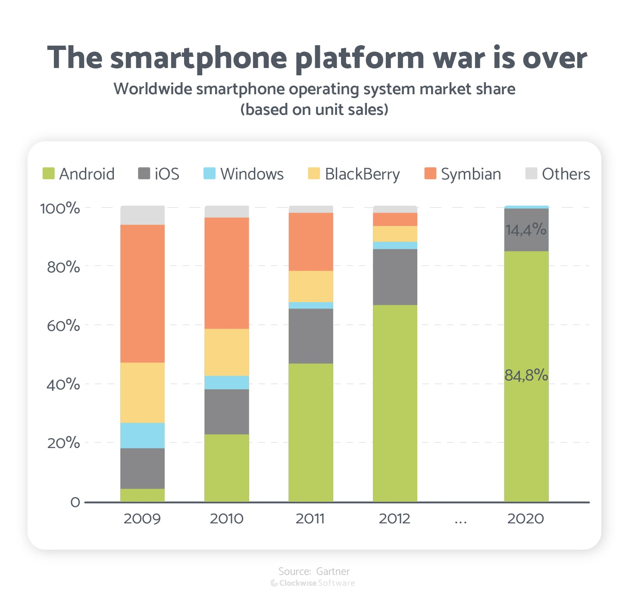
Mobile App Development
The variety of operating systems was a real challenge for software developers, who had to build a whole new app for each platform they wanted to support. The development process a decade ago was much harder and more expensive than it is now. Developers released their apps on the operating systems that were most popular among their target audiences and ignored less popular OSs.
Symbian, BlackBerry OS, and Windows Phone ultimately proved less popular than iOS and Android, and supporting them didn’t pay off. So these platforms died, and the world of mobile operating systems is now binary: only iOS and Android have been competing for the last few years.
Image Source:https://cdn.statcdn.com/Infographic/images/normal/4112.jpeg

Slide 13
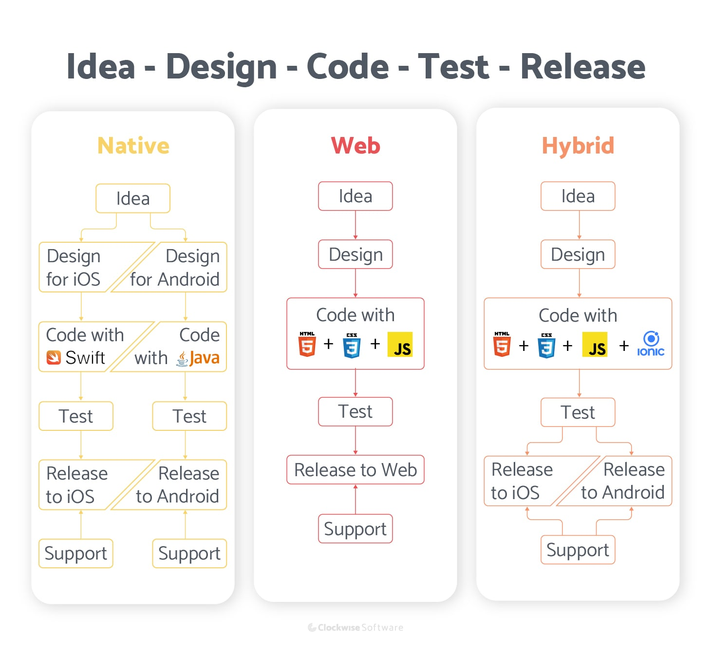
Image Source: https://seqtek.com/wp-content/uploads/2021/06/New-Project-5.svg

Slide 14
Mobile App Development
This has made life easier for app developers, as they can build two versions of their apps and reach the majority of smartphone users worldwide.
But things can be even better. Developers can now reach both iOS and Android users with a single cross-platform app. And along with targeting smartphones, they can use a cross-platform app to target other devices such as smartwatches and smart TVs — no matter what platform they operate on. With one app to rule them all.

Slide 15
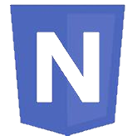
A. Native Apps
Native applications are classic apps. They’re built specifically for each platform. Usually, developers build native apps for iOS and Android.
iOS — Apps for iPhones and iPads are built using the Swift or Objective-C programming language.
Android — Apps built for Android smartphones and tablets are written in Java or Kotlin.
As stated above, apps for iOS and Android are built with completely different programming languages, which means to create apps they have to hire a separate team of developers to build, update, and support each of them.
Image Source: https://seqtek.com/wp-content/uploads/2021/06/New-Project-5.svg

Slide 16
Advantages and Disadvantages of Native Apps
Exceptional performance. Native apps can handle high-end graphics and animations and provide fast response times.
Consistent user experience. Native apps use the same UI elements and gestures as other platform-specific apps.
Advantages
Need to hire a separate team for each platform. Each native app is developed from scratch, and there’s no chance to share the codebase across platforms. Testing and bug fixing take twice as long
Most startups can’t afford the cost. The number of specialists required and the time invested in app development affects the cost of the project.
Disadvantages
Conclusion:
Developing a native app is expensive, but it’s well worth it when it comes to performance-critical apps.
When starting a business, developers likely can’t allocate the budget needed to build two separate apps. And the development time also doesn’t look inspiring. But, there are much cheaper and faster options.
Image Source: https://seqtek.com/wp-content/uploads/2021/06/New-Project-5.svg

Slide 17

B. Web apps
Web applications work in browsers. This means they can run on any device with a browser, regardless of the particular browser and the operating system. However, there are significant differences between native apps and web apps. For starters, web apps use browsers to run, and they’re usually written in CSS, HTML5, or JavaScript. Such apps redirect the user to the URL and then offer them the option to install the app. They simply create a bookmark on their page. That’s why they require minimum device memory.
Since all of the personal databases will be saved on the server, users can only use the application if they have an internet connection. This is the main drawback of web apps – they always require a good internet connection. Otherwise, you risk delivering a subpar user experience.
Image Source: https://seqtek.com/wp-content/uploads/2021/06/New-Project-5.svg

Slide 18
Advantages and Disadvantages of Web Apps
Available on all platforms. Build just one version of your app and everybody can access it from their smartphones, tablets, laptops, and even smart TVs.
No installation needed. People don’t like installing new apps without a compelling reason. Web apps, on the contrary, are available at a link.
Advantages
Limited performance. Web apps can’t perform heavy calculations since they can’t directly access a device’s hardware.
Lack a native look and feel. Since there’s only one version of a web app, there’s no way to adjust it to each platform’s design guidelines
Disadvantages
Conclusion:
Web apps can be built fast and cost much less than native apps. They’re also easy to update, which is great if developers want to be on the edge of web development trends.
Generally, web apps are a perfect choice for startups when time to market is critical. They give a chance to test ideas without risking a fortune.
Image Source: https://seqtek.com/wp-content/uploads/2021/06/New-Project-5.svg

Slide 19

C. Cross-platform Apps
Cross-platform applications combine the best of two worlds: these are real apps you install on your smartphone, and in most cases, users can’t tell they aren’t using a native app. At the same time, there’s no need to hire two separate development teams since iOS and Android apps are built with exactly the same toolset: one of several JavaScript frameworks or Google’s new Flutter.
Image Source: https://temp-ca.s3.amazonaws.com/cdn-files/ris_ss847639604sst1654068744.png?X-Amz-Content-Sha256=UNSIGNED-PAYLOAD&X-Amz-Algorithm=AWS4-HMAC-SHA256&X-Amz-Credential=AKIA2YDWKLAVUAFT3HFY%2F20220601%2Fus-east-1%2Fs3%2Faws4_request&X-Amz-Date=20220601T073225Z&X-Amz-SignedHeaders=host&X-Amz-Expires=300&X-Amz-Signature=e0e6c90195282de7ac9d67c4f71a794b178e20fdbd4194521b58c3651239f5e7

Slide 20
Advantages and Disadvantages of Cross-platform Apps
Advantages
Disadvantages
High performance. A cross-platform mobile app demonstrates higher performance than a web-based application and is able to meet almost any requirements.
Cost-effective and fast development. Compared to a native app, a cross-platform app has a significantly shorter development time and lower cost.
Limited capabilities. Certain platform-specific features can be accessed only with native code. For example, you won’t be able to employ augmented reality in a cross-platform app.
Conclusion:
The capabilities of cross-platform apps can cover the needs of almost any small to medium-sized business. The only cases when cross-platform apps may be insufficient are when performance is critical or you need to access platform- or device-specific functionality. However, these issues can be solved by employing third-party plugins or including native code in the app.

Slide 21
Types of Cross-platform Apps
Cross-platform application development is a silver bullet for almost any type of software, where applications for various platforms can be built with the same toolset. However, development approaches differ according to project needs, a developer’s skills, and the allocated budget. There are two variations on the cross-platform approach:
Hybrid app development (Ionic, Cordova)
Native cross-platform mobile app development (React Native, Flutter, NativeScript)

Slide 22

Hybrid development
With the hybrid development approach, you can build a single mobile application using web technologies: HTML, CSS, and JavaScript, to be exact. These technologies run within a browser embedded in a native application: WKWebView for iOS and WebView for Android.
To make the website code available to the embedded browser, you need a wrapper. The most popular solutions currently are Cordova and Ionic. Both of these wrappers support a variety of plugins that extend the capabilities of the browser and can access most platform-specific features. Moreover, you can make your hybrid app available via the App Store and Google Play Market.
With a hybrid app, users never notice that they’re using a browser since WebView and WKWebView perfectly imitate a native application interface, gestures, and controllers.
A significant advantage of hybrid apps is that any updates to your software are instantly available to users — there’s no need to install updates from an app store.
Image Source: https://www.21twelveinteractive.com/flutter-vs-react-native-vs-ionic-vs-nativescript/

Slide 23

When to choose hybrid app development?
You want to test your startup idea but are short on money
This is a classic use case for hybrid development. With this approach, you can release an app in a short time and test it with real users without risking much money. After you prove your idea and attract investors, you can focus on native cross-platform app development for better results.
You’re building a simple application but value the user experience
Weather applications, currency exchange rate apps, habit tracking apps, and similar products are based on one simple core feature. They’re not performance-critical, so building native apps for this purpose would be a waste of time and money. By opting for hybrid development, you can achieve a high-level user experience in exchange for reasonable investments.
You have a web app and want to release a mobile version
Once you’ve developed a web app, you can reuse much of your existing code for hybrid mobile apps. Also, hybrid apps for iOS and Android share 80% of code on average, which is extremely attractive for software developers. Overall, code sharing is one of the best things about hybrid app development.
Image Source: https://www.21twelveinteractive.com/flutter-vs-react-native-vs-ionic-vs-nativescript/

Slide 24

Cross-platform native development
When it comes to native cross-platform technologies, there’s one clear leader: React Native based on JavaScript. The recently released Flutter based on Dart is a promising technology as well, but due to its youth, it’s still far behind its main competitor. For more on these two technologies, check out our detailed review of React Native and Flutter.
Even though these frameworks are different, they share the same goal: to build custom apps for multiple platforms using the same technology stack. React Native and Flutter apps for iOS and Android may share much of the codebase, but there’s still platform-specific code that needs to be written from scratch for each app.
Cross-platform native app doesn’t need an intermediary (a browser) to run on a smartphone. React Native compiles JavaScript into native code (Java or Swift, depending on the platform). Developers also have the chance to create a platform-specific UI and ensure a native look and feel.
Image Source: https://www.21twelveinteractive.com/flutter-vs-react-native-vs-ionic-vs-nativescript/

Slide 25


When to choose native cross-platform development?
You care for the user experience.
iPhone and Android smartphone owners are used to different user interfaces: gestures, button styles, and controllers differ between these platforms. With cross-platform development, you can adjust the app’s interface to each platform and satisfy both groups of users.
Your desired functionality requires high app performance.
An embedded mobile browser can’t handle everything. But a native application can. Even if a feature is extremely complicated and can’t be implemented with JavaScript, React Native enables you to use platform-specific code (Java or Swift) to implement that specific functionality.
Image Source: https://www.21twelveinteractive.com/flutter-vs-react-native-vs-ionic-vs-nativescript/

Slide 26

CROSS PLATFORM SOFTWARE DEVELOPMENT KIT
03
There are many smart phones available in the market and therefore SDK’s-Software development kit needs cross-platform access in the mobile market.
Image Source: https://st2.depositphotos.com/25453930/42329/v/1600/depositphotos_423297978-stock-illustration-cross-platform-software-illustration-concept.jpg

Slide 27
Flutter
Developer: Google and community
Flutter is a by-product of Google , making it a sustainable software development kit [SDK] for developing web-based applications. Its iconic 'Hot Reload' feature facilitates developers to view live variations in the coding without saving it.
It helps build high-performance apps on Android, iOS, desktop, and web from a single codebase. Launched in May 2017, Flutter has quickly become a favorite of developers as it allows them to customize the apps using slick animations.
It also utilizes the programming language Dart, which can be easily understood by Java developers. Flutter also offers many widgets that help in enhancing the look of an app. They can help developers provide a full native-like app performance to the users — from scrolling and navigation to changing fonts and icons.
Famous brands or apps using Flutter: Google Ads, Alibaba
Software Development Kit
Image Source: https://www.21twelveinteractive.com/flutter-vs-react-native-vs-ionic-vs-nativescript/

Slide 28
React Native
Developer: Facebook
Written in JavaScript, React Native is one of the best mobile app development tools for creating apps for both Android and iOS. It interprets the source code and converts it into native elements in a shorter time frame.
Not only is it highly compatible with secure third-party plugins, but it also takes up little space in memory. React Native simplifies the app development process and ensures that businesses can launch an app on both platforms promptly without compromising quality.
Introduced by Facebook in March 2015, React Native is preferred by a whopping 42% of developers for developing apps. It enables them to write modules in various native languages such as Java, Swift, C++, Objective, and Python.
Moreover, it lets you do other exciting activities, including video processing and image editing—both of which are not possible with other API frameworks. React Native is the perfect choice for startups, small-sized businesses, and even large enterprises.
Famous brands using React Native: Facebook, Walmart, Uber Eats, Skype, and Instagram
Software Development Kit
Image Source: https://www.21twelveinteractive.com/flutter-vs-react-native-vs-ionic-vs-nativescript/

Slide 29

NativeScript
Original author(s) : Telerik by Progress.
NativeScript is an open-source framework to develop mobile apps on the Apple iOS and Android platforms. It was originally conceived and developed by Progress. At the end of 2019 responsibility for the NativeScript project was taken over by long-time Progress partner, nStudio. In December 2020 nStudio also oversaw the induction of NativeScript into OpenJS Foundation as an Incubating Project. NativeScript apps are built using JavaScript, or by using any programming language that transpiles to JavaScript, such as TypeScript. NativeScript supports the Angular and Vue JavaScript frameworks. Mobile applications built with NativeScript result in fully native apps, which use the same APIs as if they were developed in Xcode or Android Studio. Additionally, software developers can re-purpose third-party libraries from CocoaPods, Maven, and npm.js in their mobile applications without the need for wrappers
Software Development Kit
Image Source: https://www.21twelveinteractive.com/flutter-vs-react-native-vs-ionic-vs-nativescript/

Slide 30
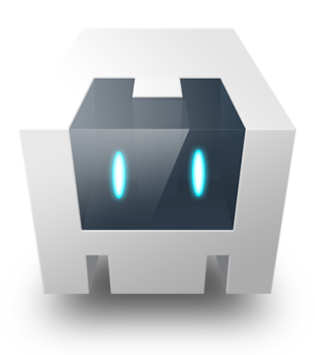
Apache Cordova
Original author(s) : Joe Bowser, Michael Brooks, and co
If you are looking to create an app in real-time with the best features available, use Cordova! It allows software programmers to build hybrid web applications for mobile devices Cordova utilizes CSS3, HTML5, and JavaScript, instead of relying on platform-specific APIs like those used in Android, iOS, or Windows.
That means you can build more compelling applications by using the properties of Native app functionalities and features, including compass, contacts, phone camera, accelerometer, geolocation, notifications, and networks.
Cordova also uses CSS, HTML, and JavaScript codebases depending upon the operating platform and deploy standard web technologies and plugins to make apps as efficiently and quickly as possible. This makes it cost-effective since it leverages multiple features during the development process in real-time.
Famous brands using Apache Cordova: Walmart, Teleport, Hogangnono
Software Development Kit
Image Source: https://www.21twelveinteractive.com/flutter-vs-react-native-vs-ionic-vs-nativescript/

Slide 31
Ionic
Developer: Drifty
Free and open-source, Ionic is a mobile UI toolkit that is used for building high-quality and cross-platform native and web applications that run everywhere with JavaScript.
Ionic has a potent HTML5 SDK that allows you to develop mobile apps by utilizing advanced technologies such as HTML, CSS, and Javascript. This SDK mainly focuses on delivering the highest-quality UI interactions of the applications.
The cross-platform development tool provides pre-designed components, interactive paradigms, and attractive themes. It is also easy to use, and it makes use of APIs such as Virtual DOM, async, JSX, and TypeScript that are best suited for Progressive Web Apps.
If you want to develop highly interactive and engaging apps in a shorter period, do not hesitate to leverage the brilliant library of mobile-optimized and reusable UI components, tools, and gestures provided by Iconic.
Another fantastic feature of this tool is its massive community support, which helps Iconic developers to do their job in the best possible way.
Famous brands using Iconic: McDonald's, NationWide, ChefSteps, Pacifica, Market Watch
Software Development Kit
Image Source: https://www.21twelveinteractive.com/flutter-vs-react-native-vs-ionic-vs-nativescript/

Slide 32

CONCLUSION
Cross-platform development used to be a low-cost yet poor quality compromise solution that only startups with no initial investment would choose. However, these times are over.
Today, unicorns like Uber and Pinterest use React Native to reduce development speed and deliver high-quality updates faster. Banks choose Ionic for security-critical apps because it satisfies their requirements. And startups opt for Ionic because of the accelerated development speed, ability to iterate fast, and unquestionable reliability.
Image Source: https://blog.adengage.in/wp-content/uploads/2020/10/business-insights-analytics-455.png

Slide 33
References
https://www.intuz.com/blog/cross-platform-development-tools
https://clockwise.software/blog/cross-platform-app-development/

