Slide 1
Mathematics for Science
Lecture 7
Decomposing Rational Functions: CASE III and IV
Lecturer: Kahenya, N.P

Slide 2
Introduction to Lecture 7
This lecture is a continuation to Lecture 6. It will introduce the two other cases i.e., CASE III and CASE IV. These are cases where the denominator is a product of quadratic factors.

Slide 3
Intended learning outcomes
At the end of this lecture, you will be able to;
Differentiate between CASE III and CASE IV.
Decompose rational functions CASES III and IV.

Slide 4
Further Readings
This lecture notes should be complemented with relevant topics in (Kahenya, 2017; Murray & Robert, 2009; Stewart, 2012).
Murray & Robert (2009) have more additional details on rational functions especially on the asymptotes and graphing of rational functions while Stewart (2012) has application of decomposition of rational functions in integration.

Slide 5
Rules of decomposing a proper fraction
In lecture 6 we dealt with Rules 1 and 2. In this lecture we shall deal with Rules 3 and 4. i.e.,
Rule 3: If the denominator can be factorized into quadratic factors that occurs once, then we have what we call CASE III.
Rule 4: If the denominator can factorize into quadratic factors with some being repeated then we call this CASE IV.
Cases III and IV is where the factors of the denominator are
quadratic factors and, in some cases, we also have some linear factors.

Slide 6
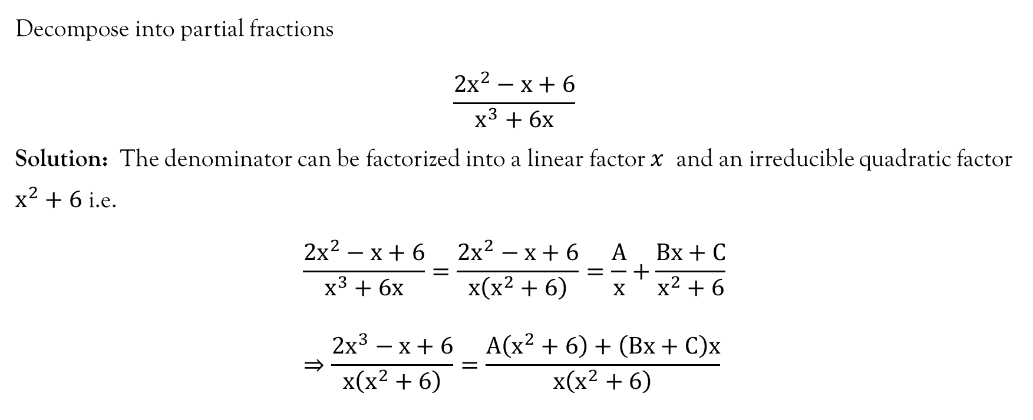
Example 1

Slide 7
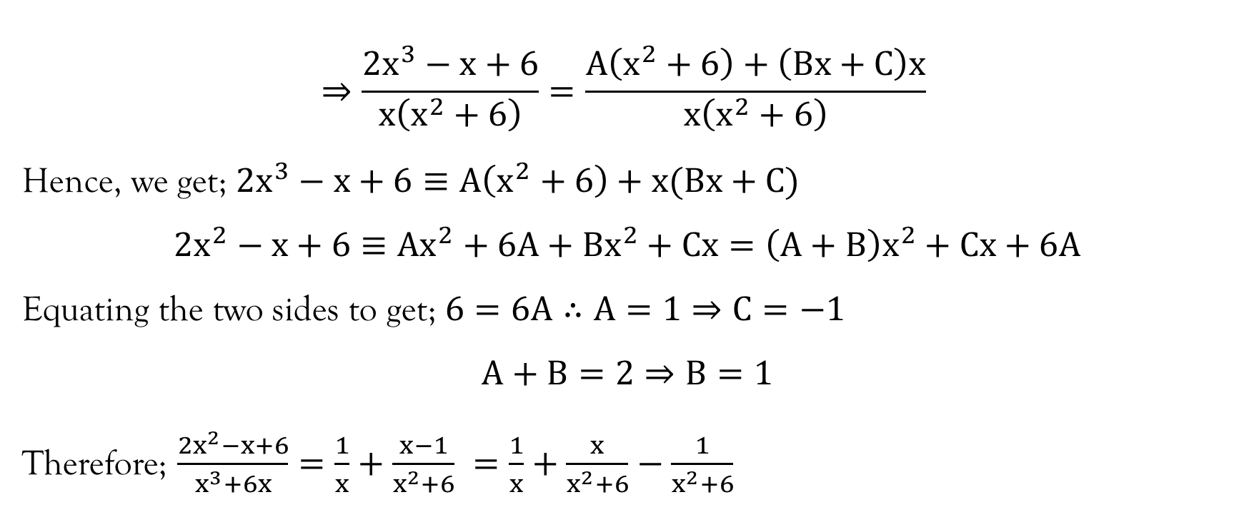
Example 1…Contd…

Slide 8
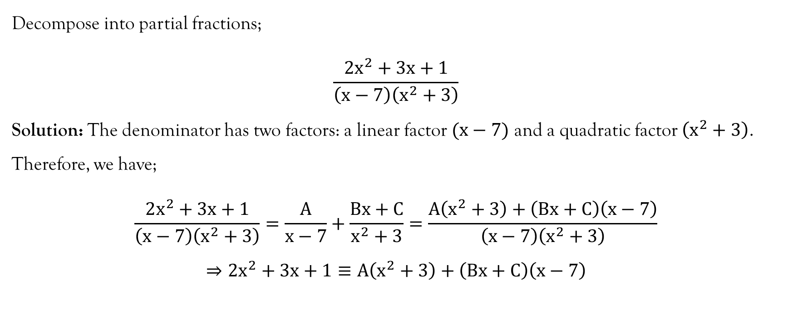
Example 2

Slide 9
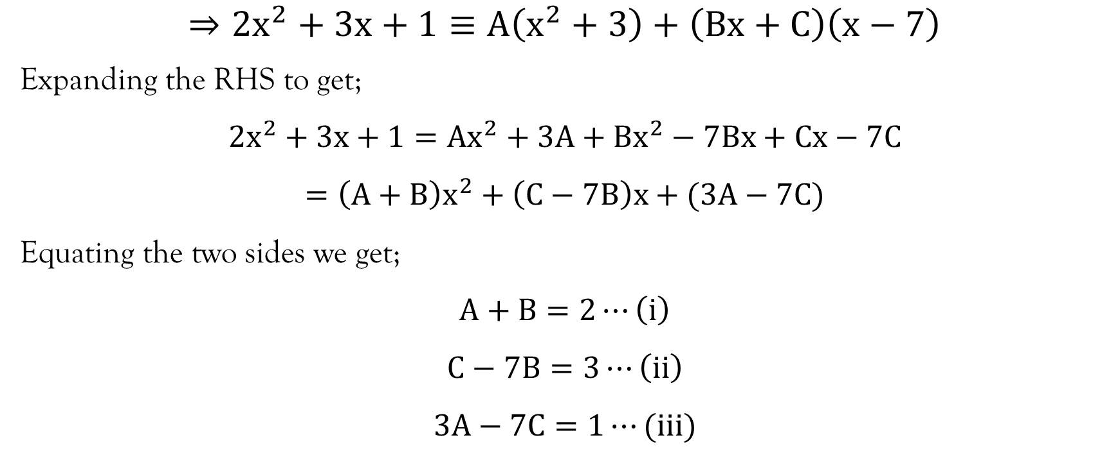
Example 2…contd…

Slide 10
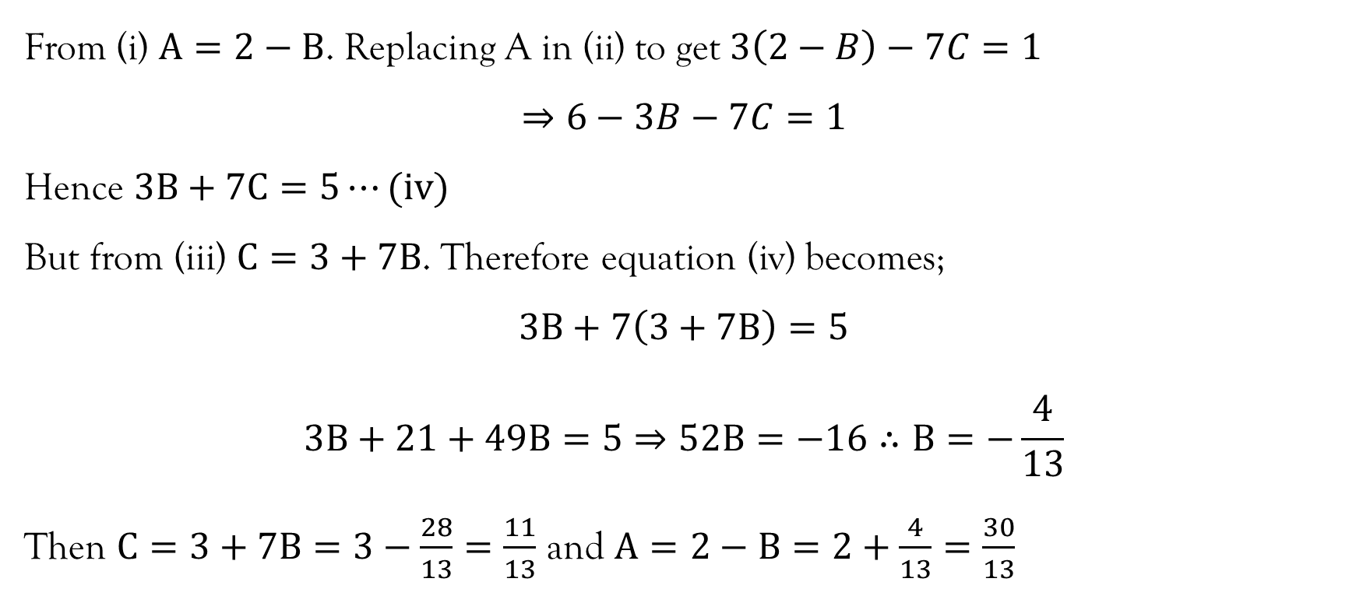
Example 2…contd…

Slide 11
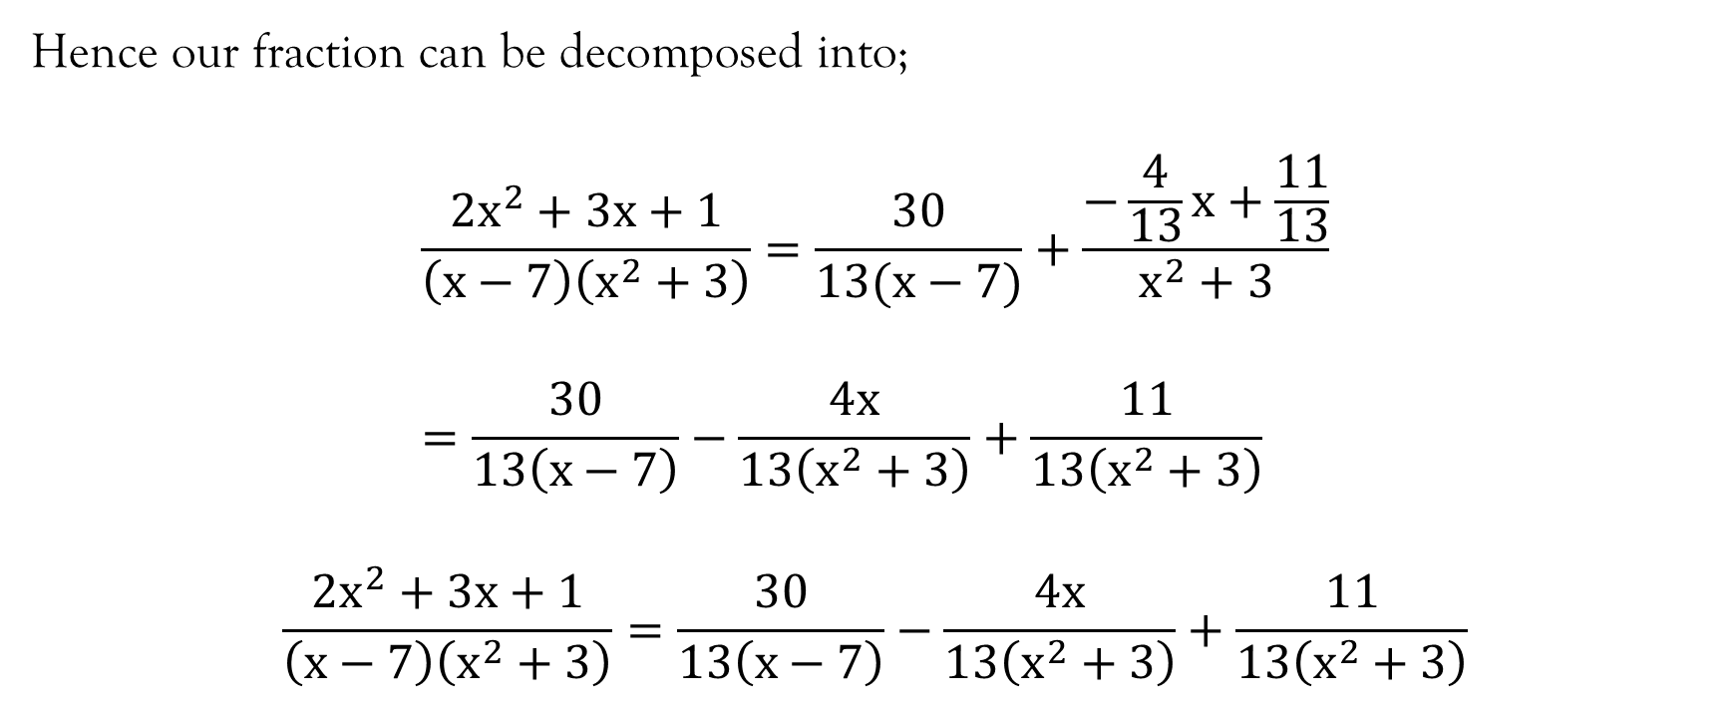
Example 2…contd…

Slide 12
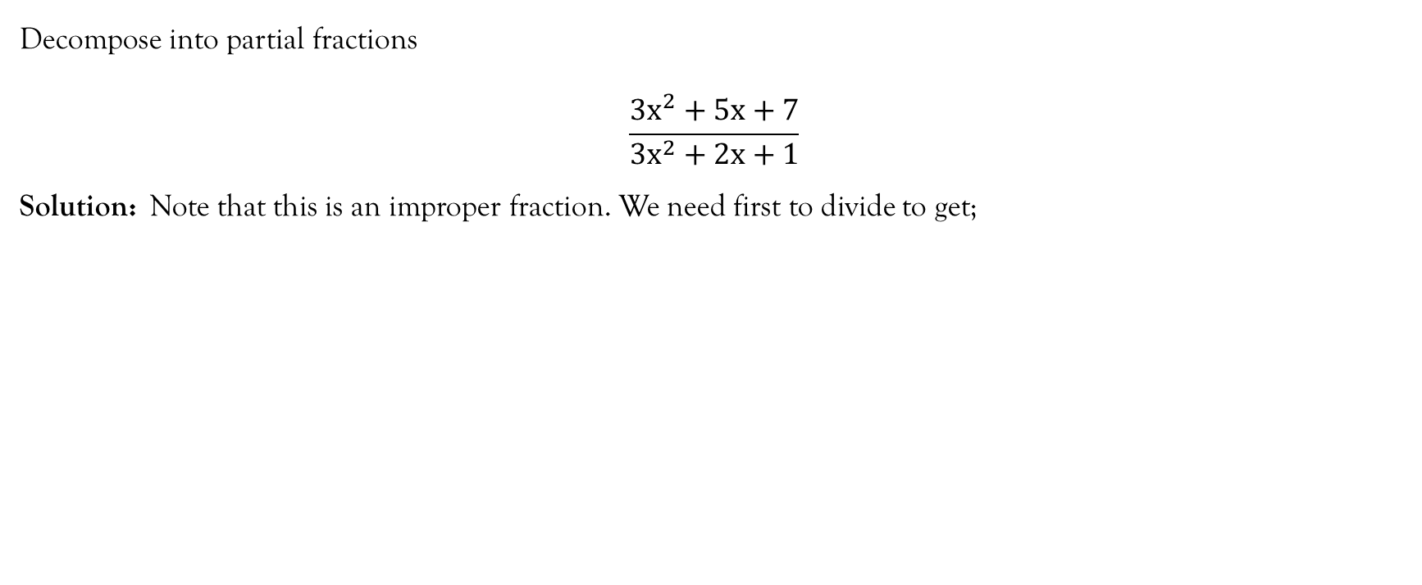
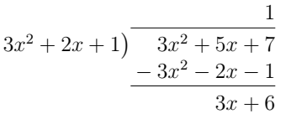
Example 3

Slide 13
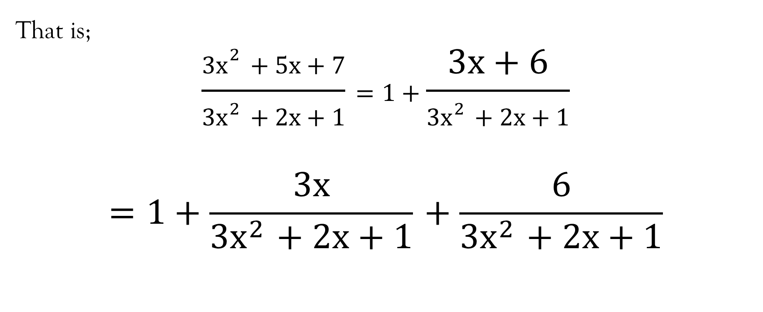
Example 3…contd…

Slide 14
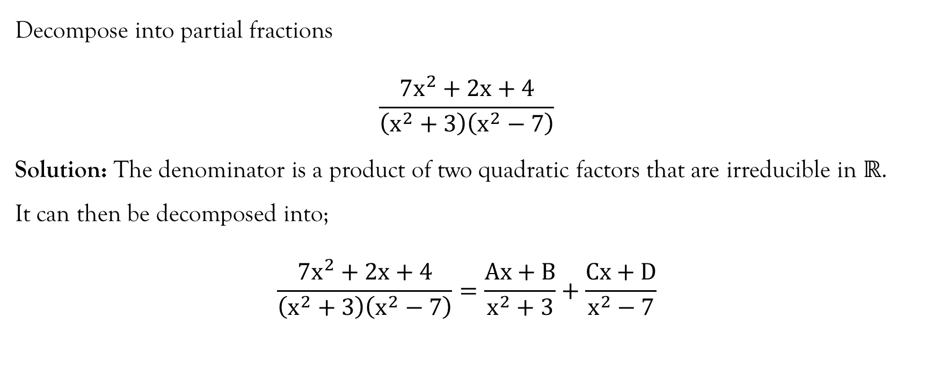
Example 4

Slide 15
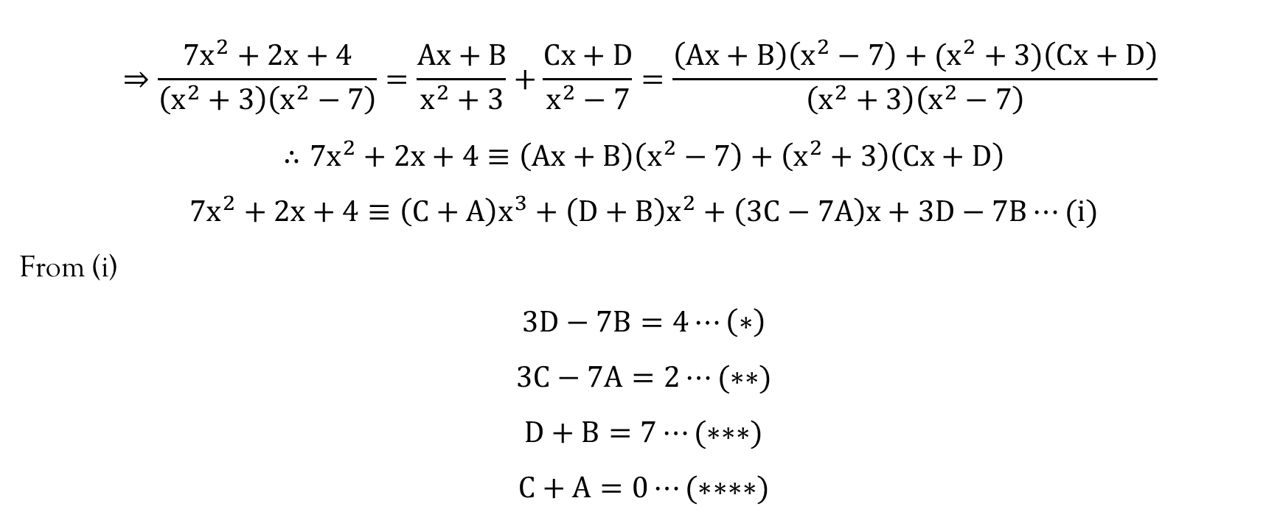
Example 4…contd…

Slide 16
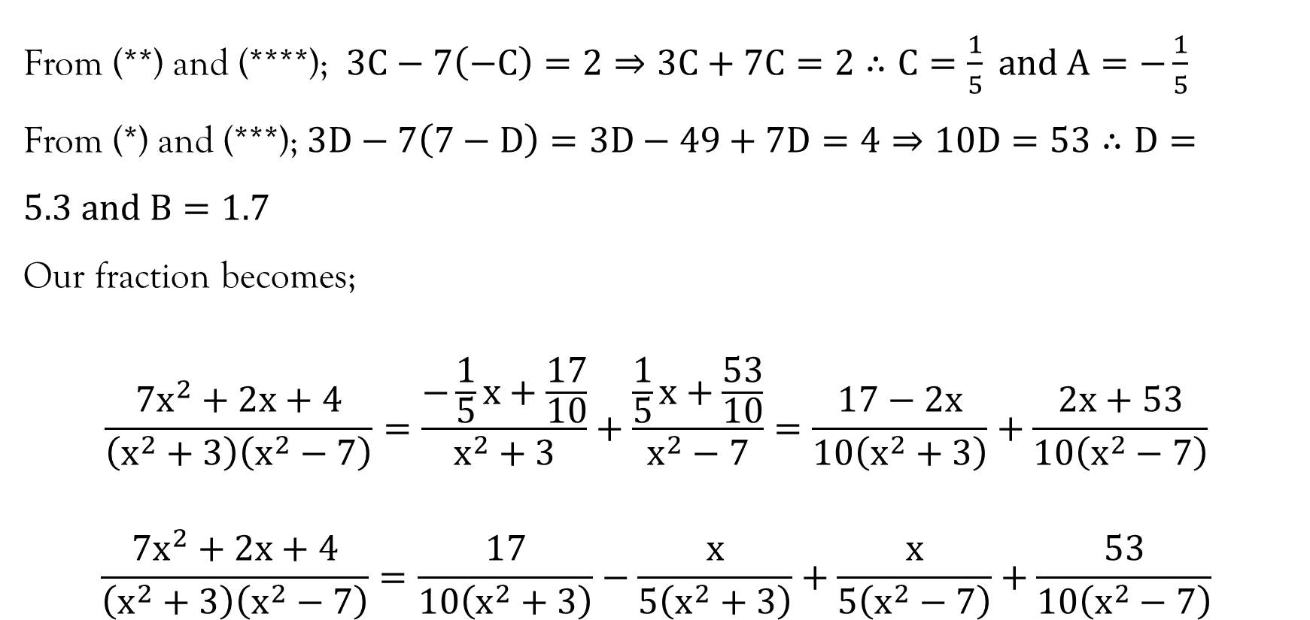
Example 4…contd…

Slide 17
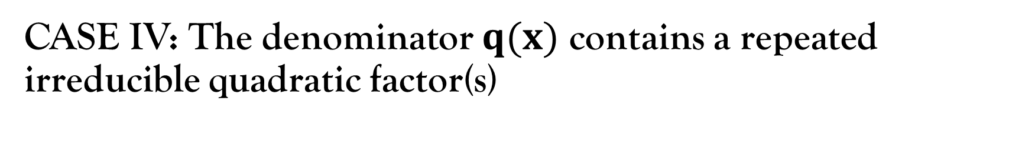
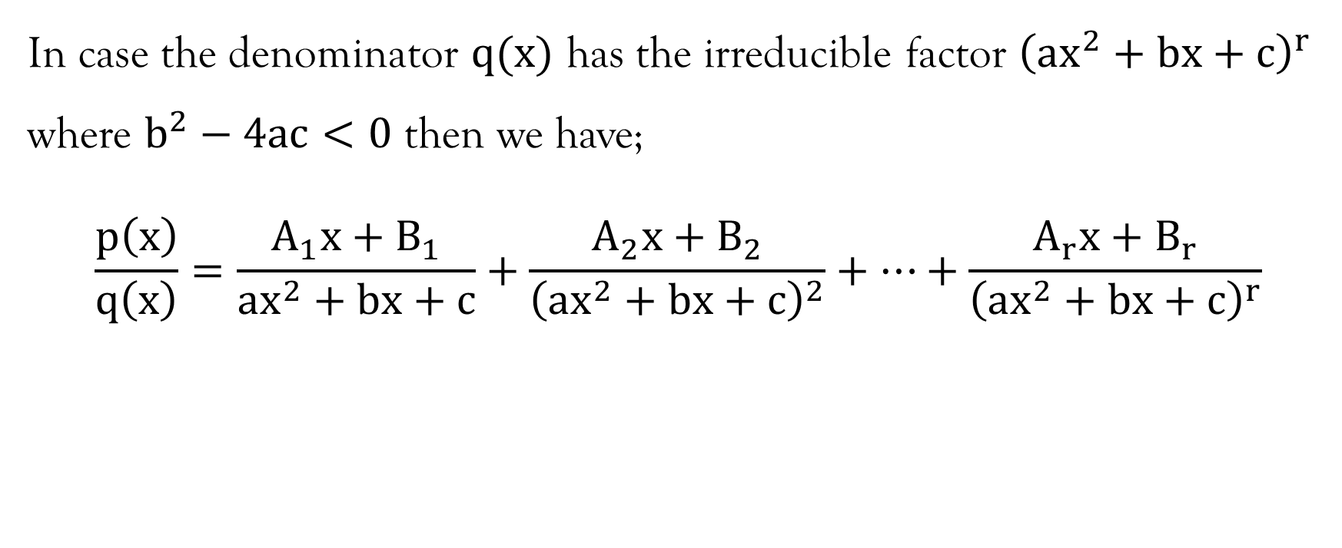

Slide 18
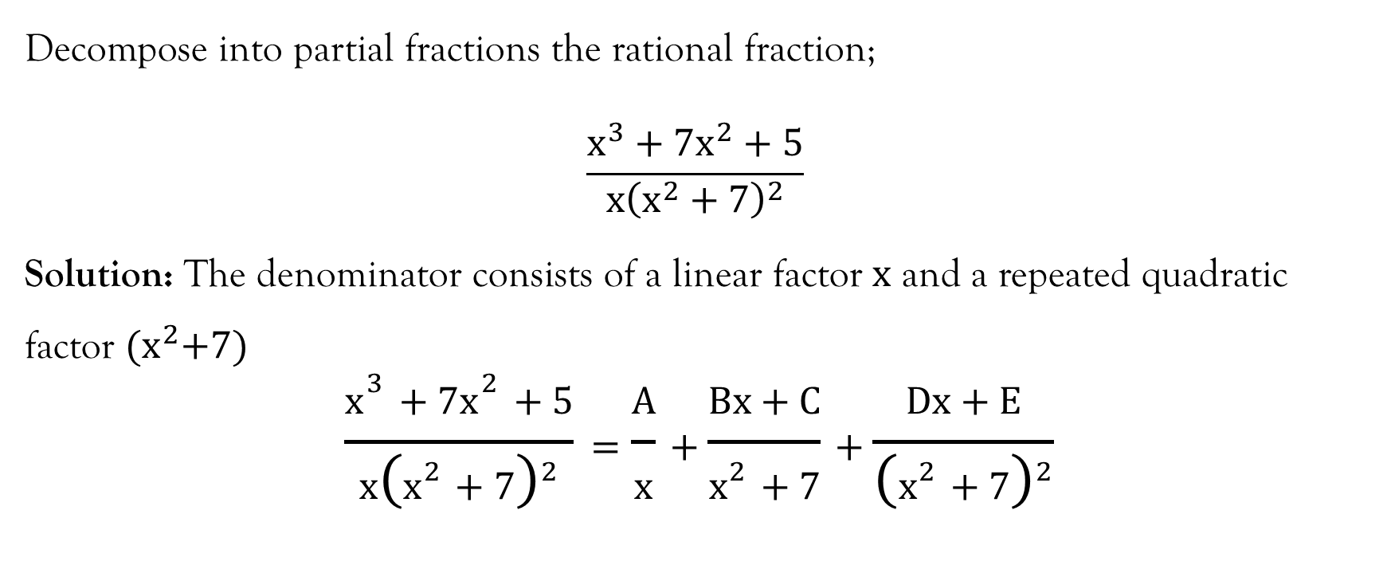
Example 1

Slide 19
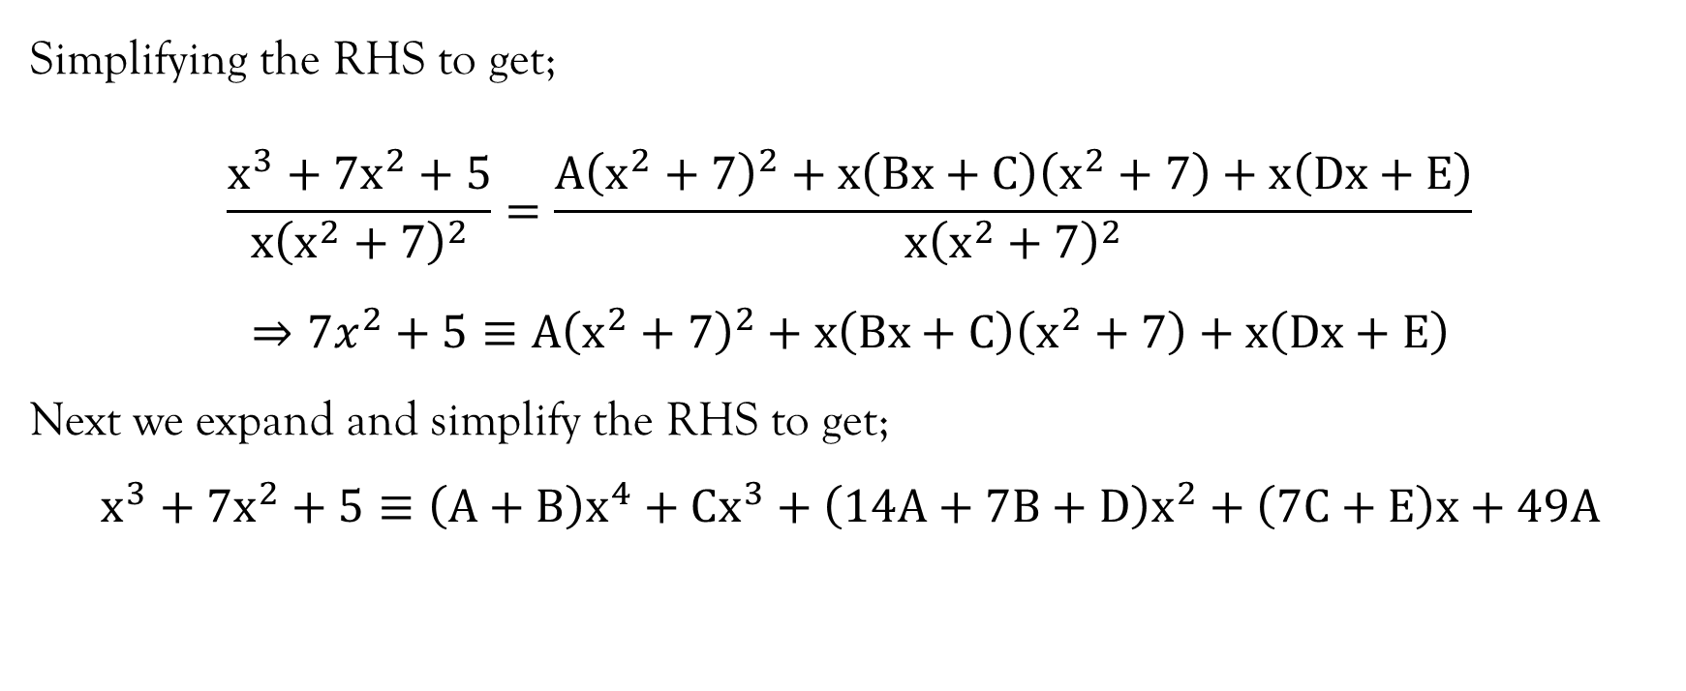
Example 1…contd…

Slide 20
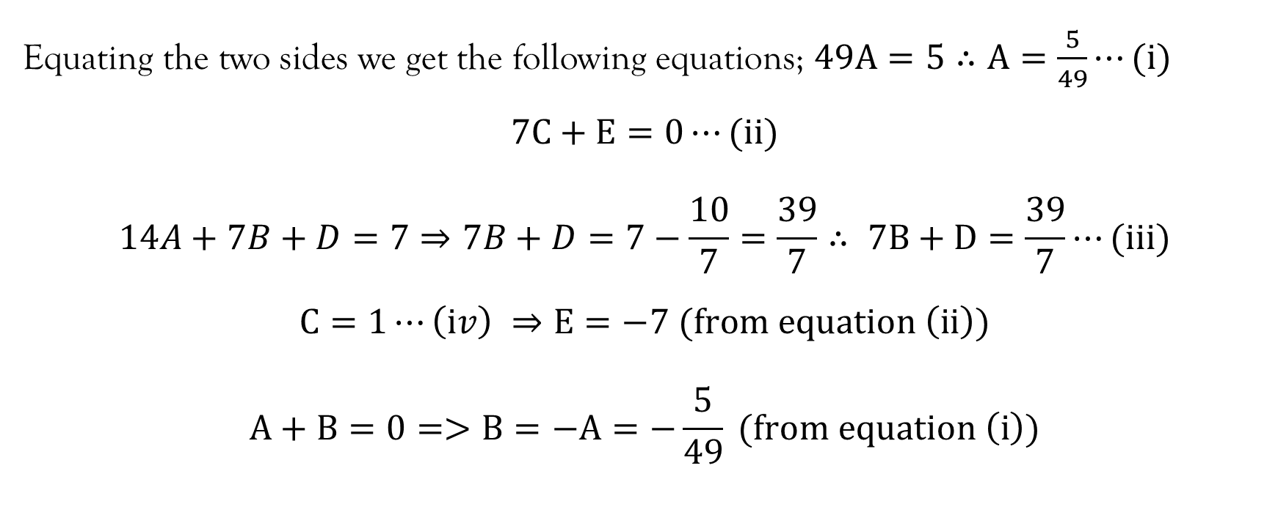
Example 1…contd…

Slide 21
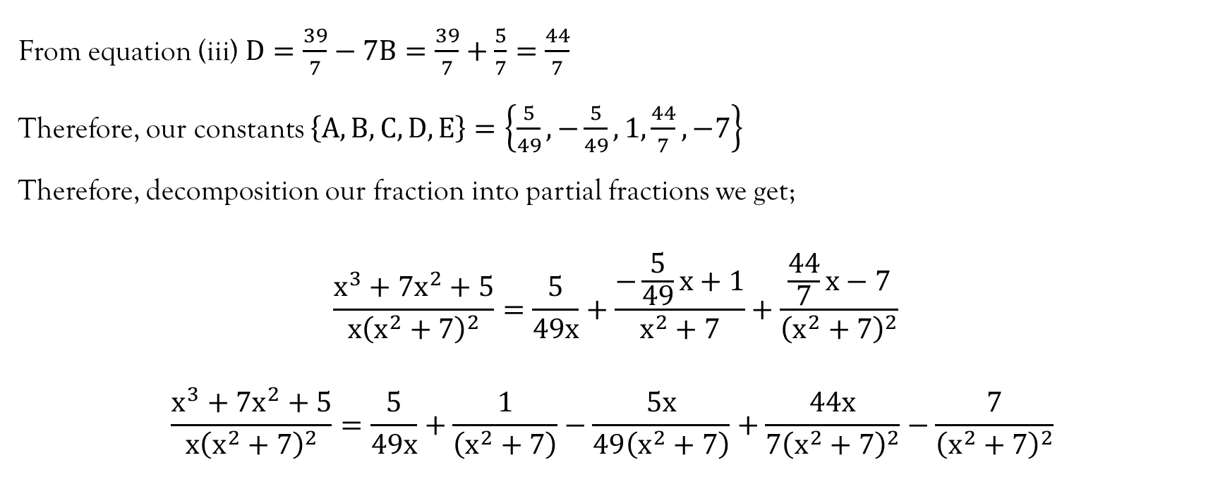
Example 1…contd…

Slide 22
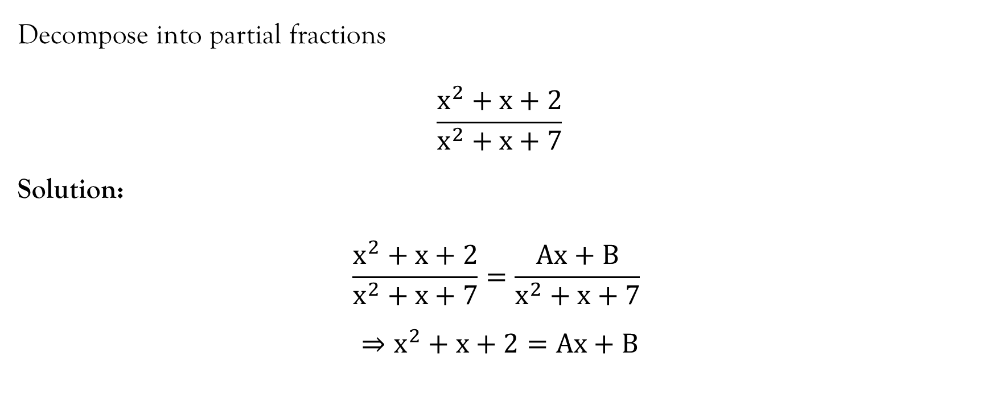
Example 2

Slide 23
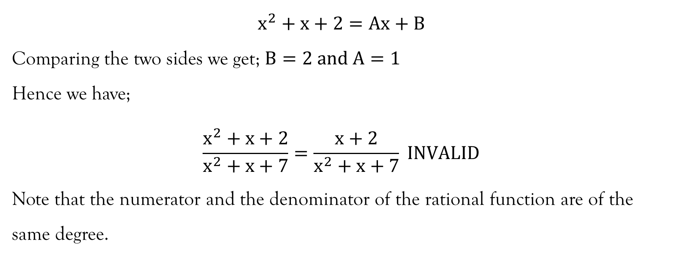
Example 2…contd…

Slide 24
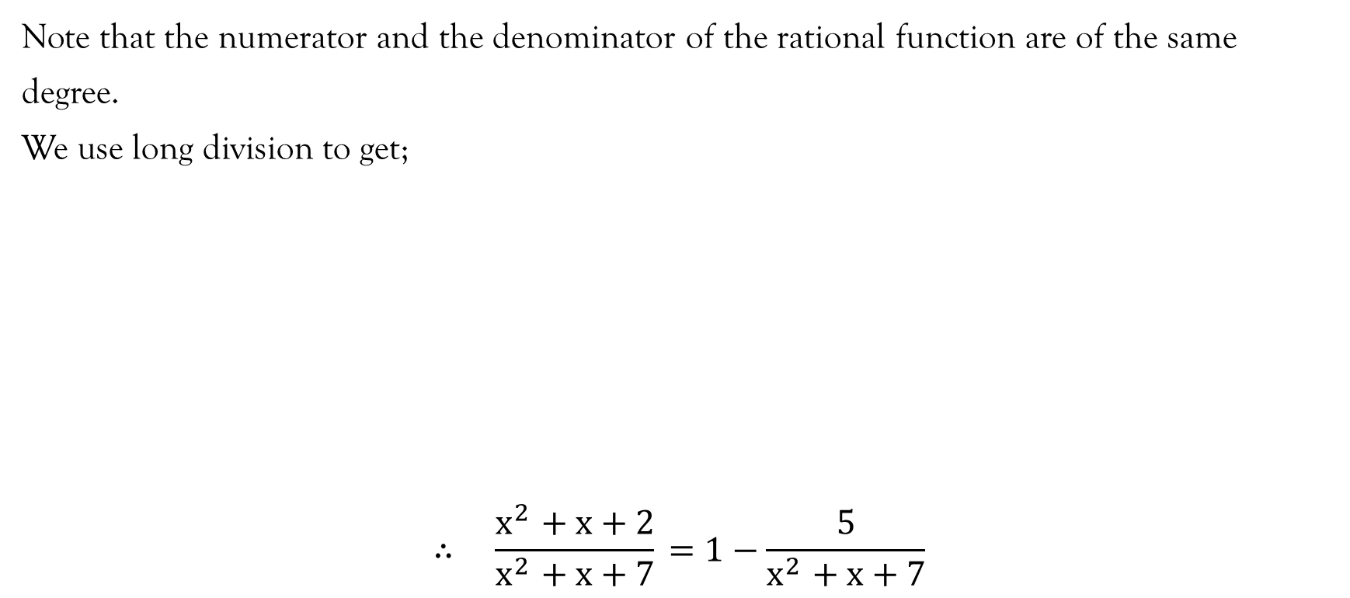
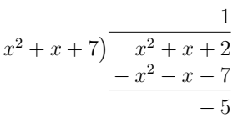
Example 2…contd…

Slide 25
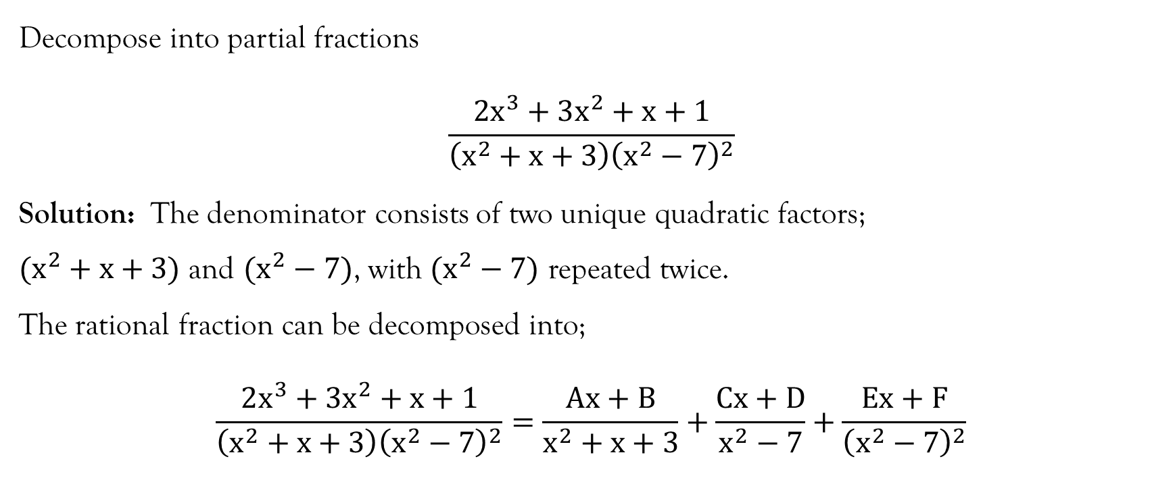
Example 3

Slide 26
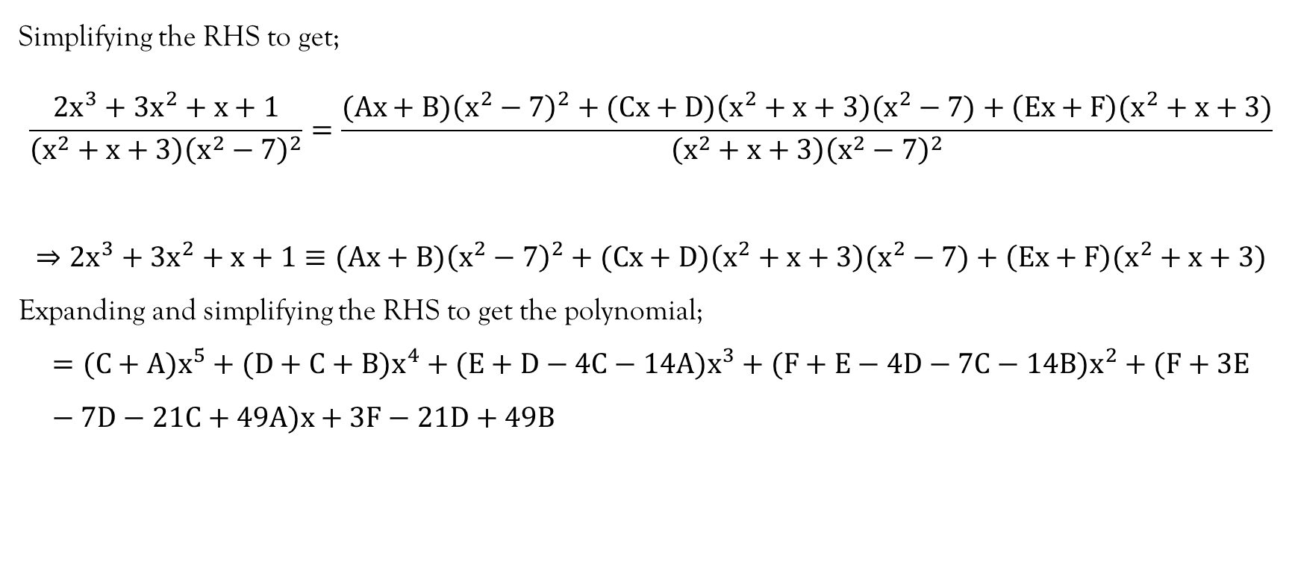
Example 3…contd…

Slide 27
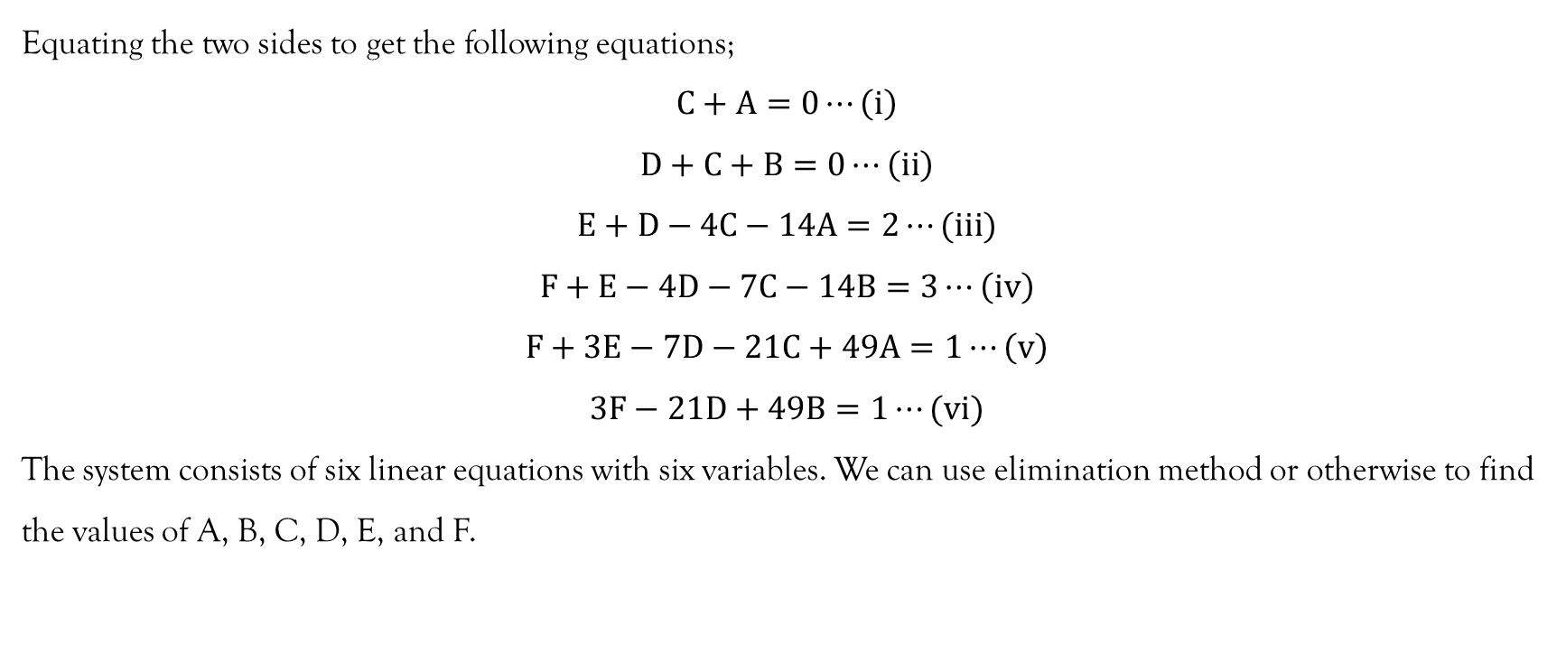
Example 3…contd…

Slide 28
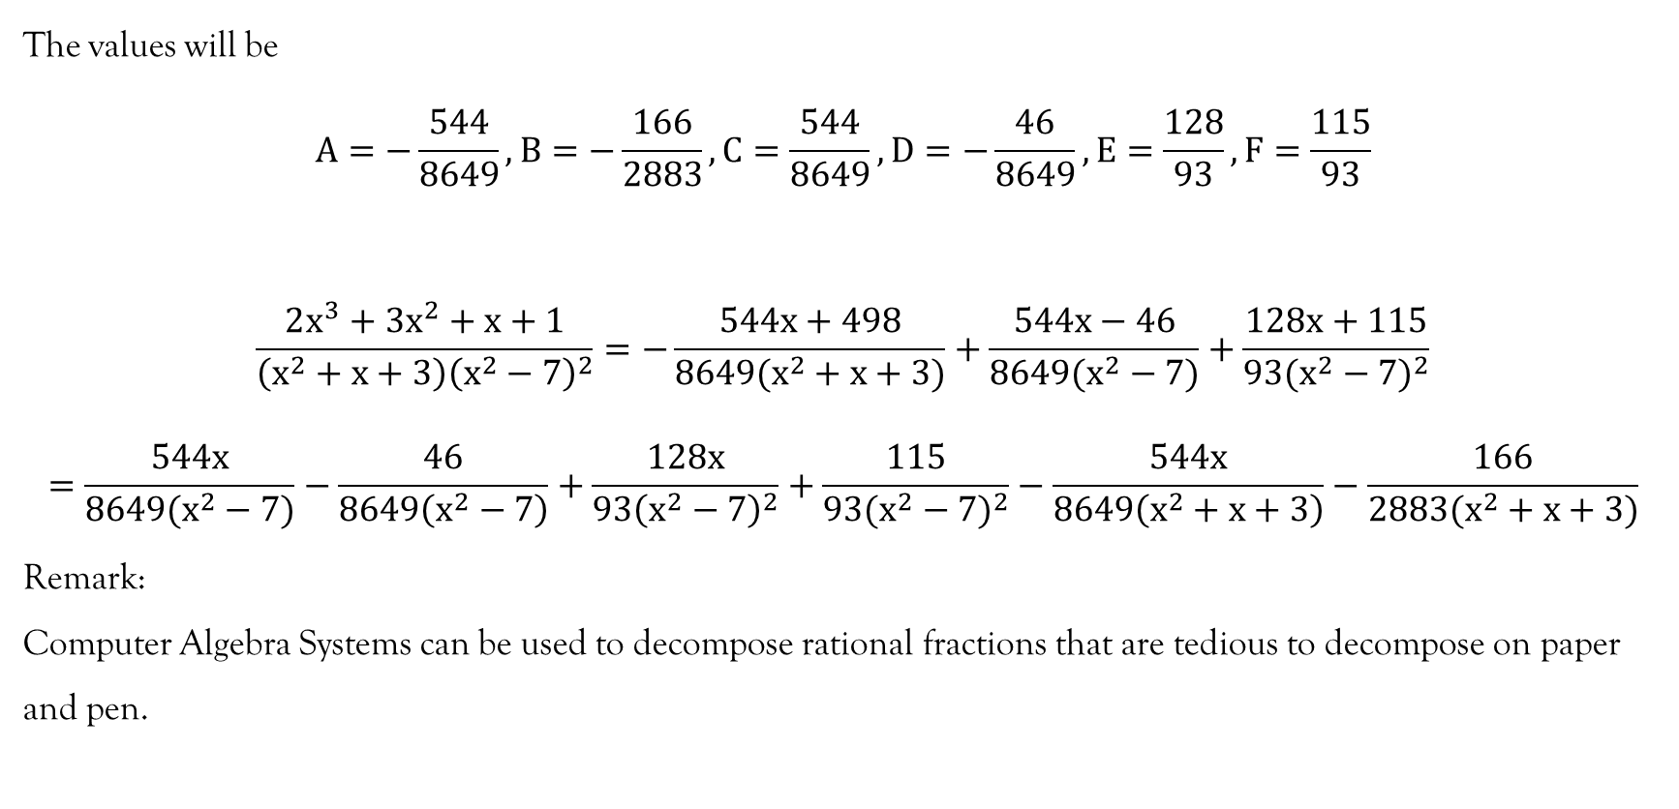
Example 3…contd…

Slide 29
References
Kahenya, P. (2017). Foundation Maths. LAP Lambert Academic Publishers.
Murray, S., & Robert, M. (2009). College Algebra. McGraw-Hill.
Stewart, J. (2012). Calculus (7th ed.). BROOKS/COLE Cengage Learning

Slide 30
End of Lecture 7
Thank you!

