Slide 1
Mathematics for Science
Lecture 8
Trigonometric equations and solving triangles
Lecturer: Kahenya, N.P

Slide 2
Introduction to Lecture 8
This lecture will introduce trigonometric equations and solving triangles.
These concepts are relevant to geometry, calculus, and solving real-life problems.

Slide 3
Intended learning outcomes
At the end of this lecture, you will be able to;
  Solve trigonometric equations.
  Solve triangles.

Slide 4
Further readings
The lecture notes can be complemented with relevant topics from;
Stewart (2012)
Swokowski & Cole (2009) and
(Lumen, n.d.).

Slide 5
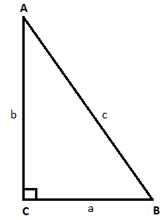
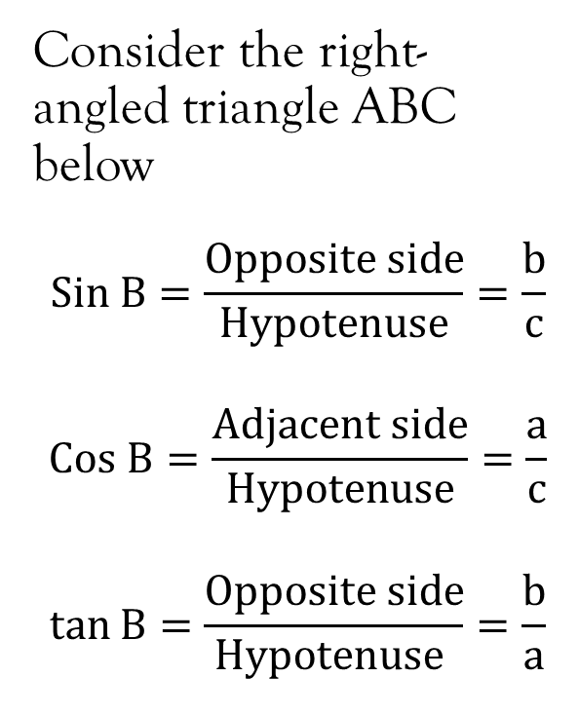
Basic trigonometric ratios

Slide 6
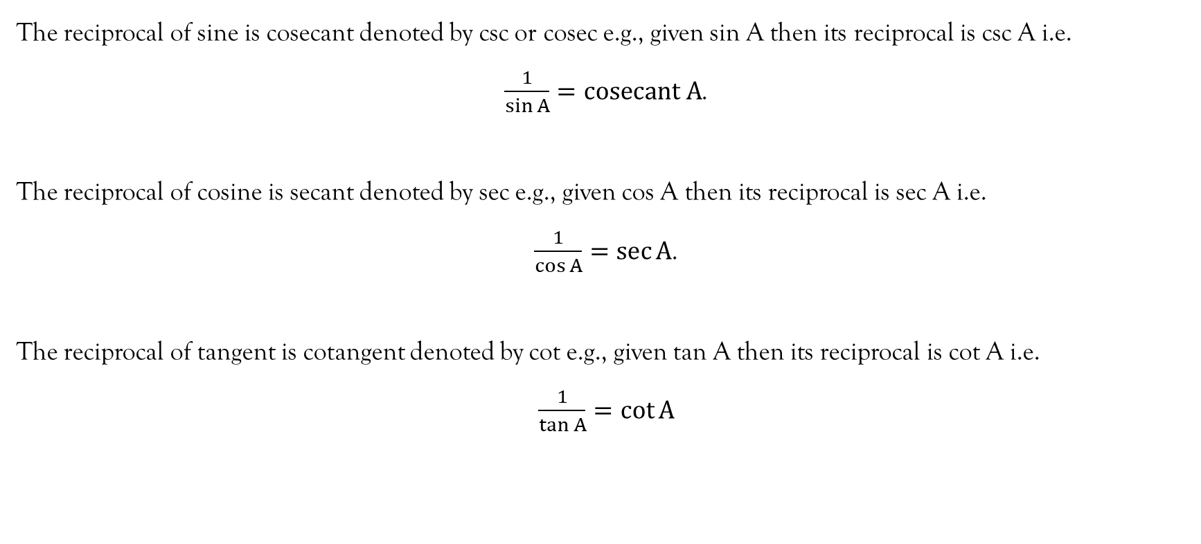
Reciprocal ratios

Slide 7
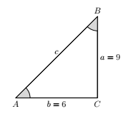
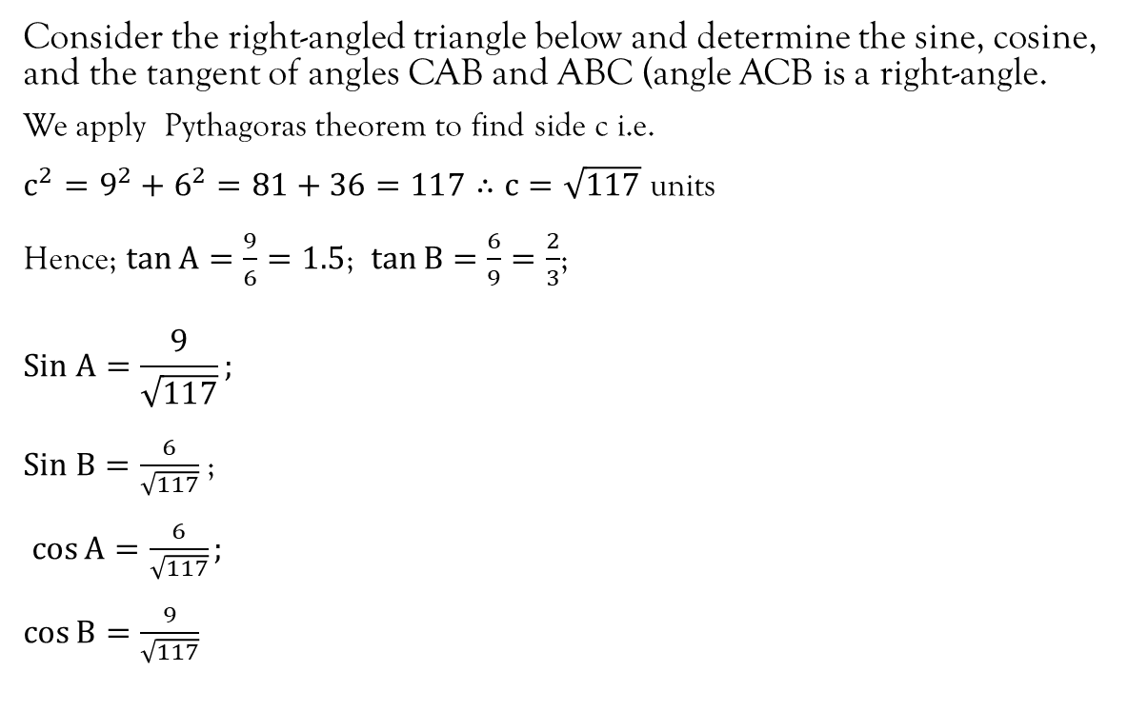
Example 1

Slide 8
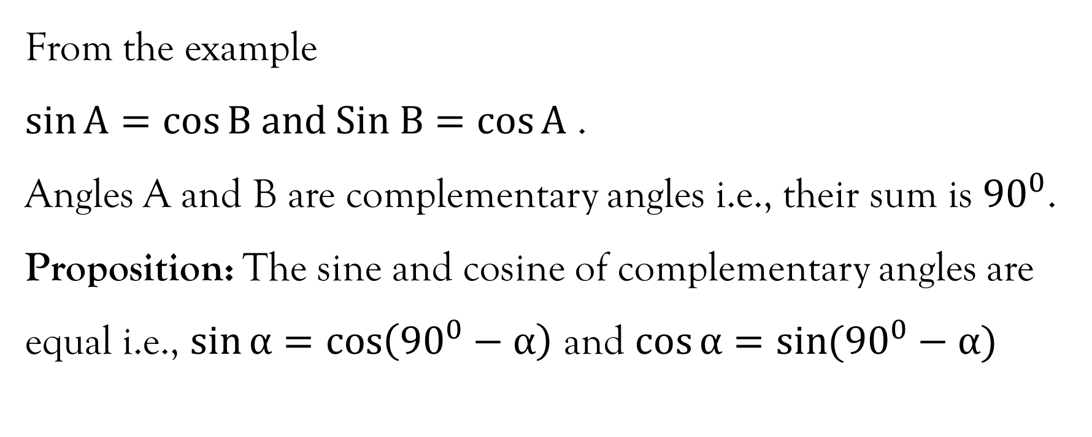
Remark 1

Slide 9
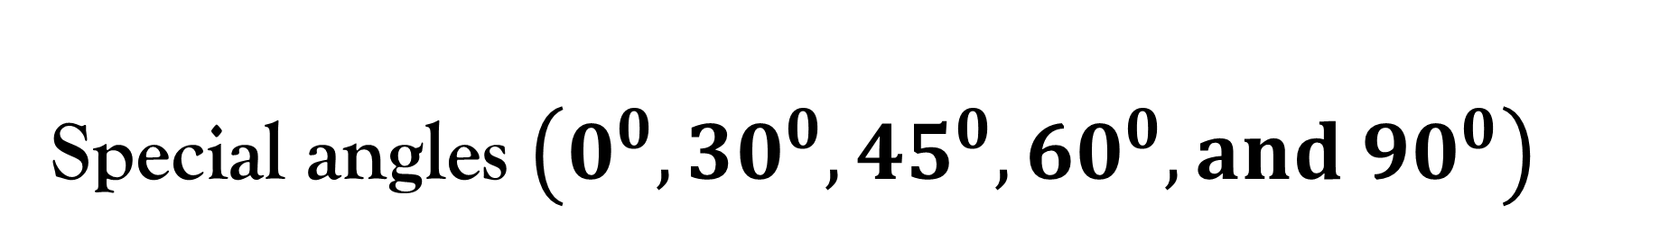
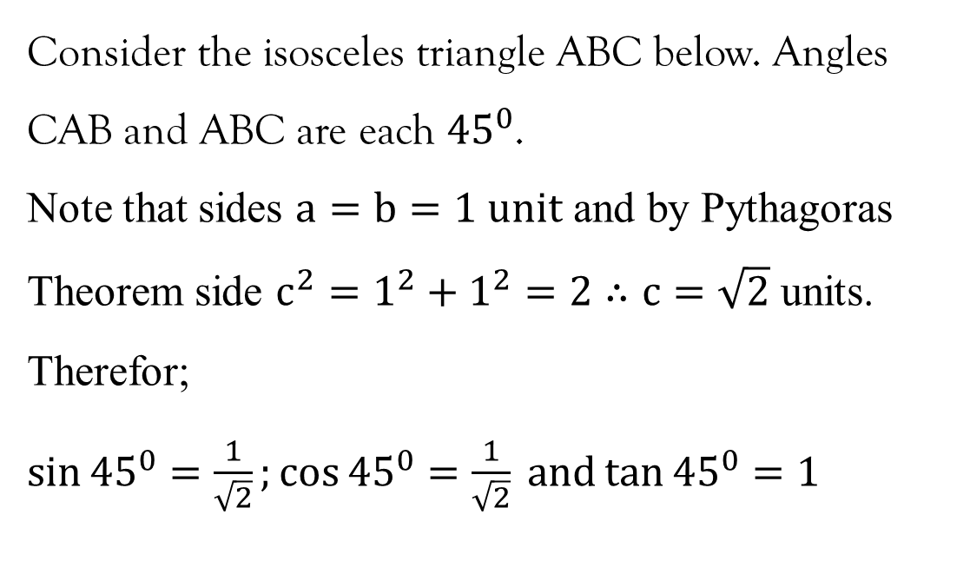
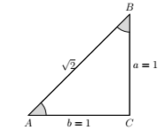

Slide 10
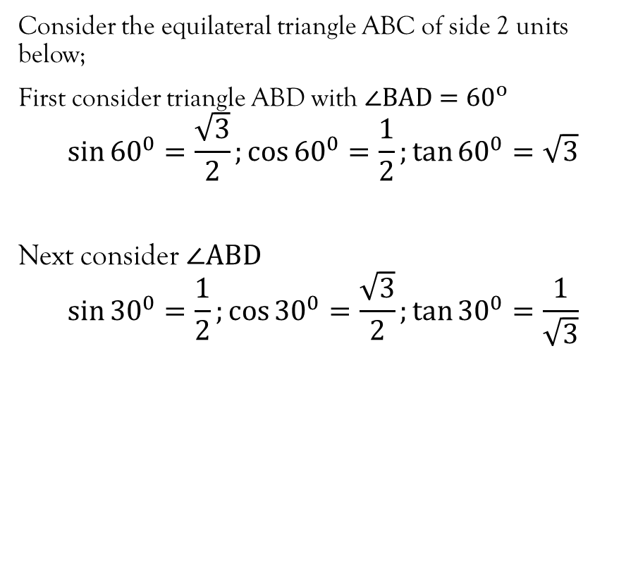
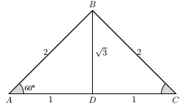
Special angles…contd…

Slide 11
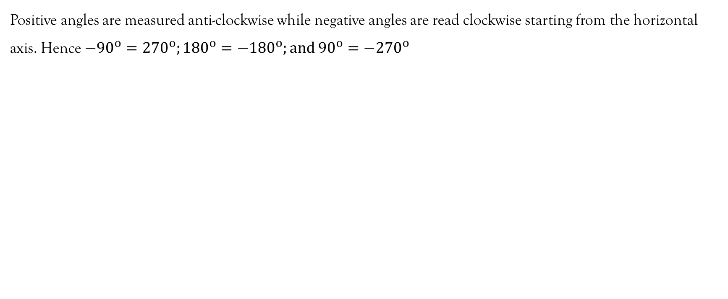
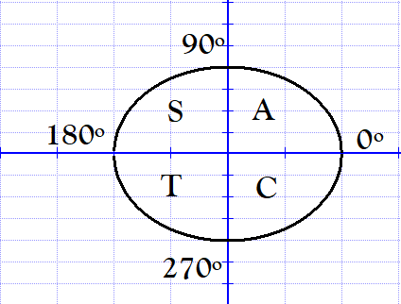
Positive and negative angles

Slide 12
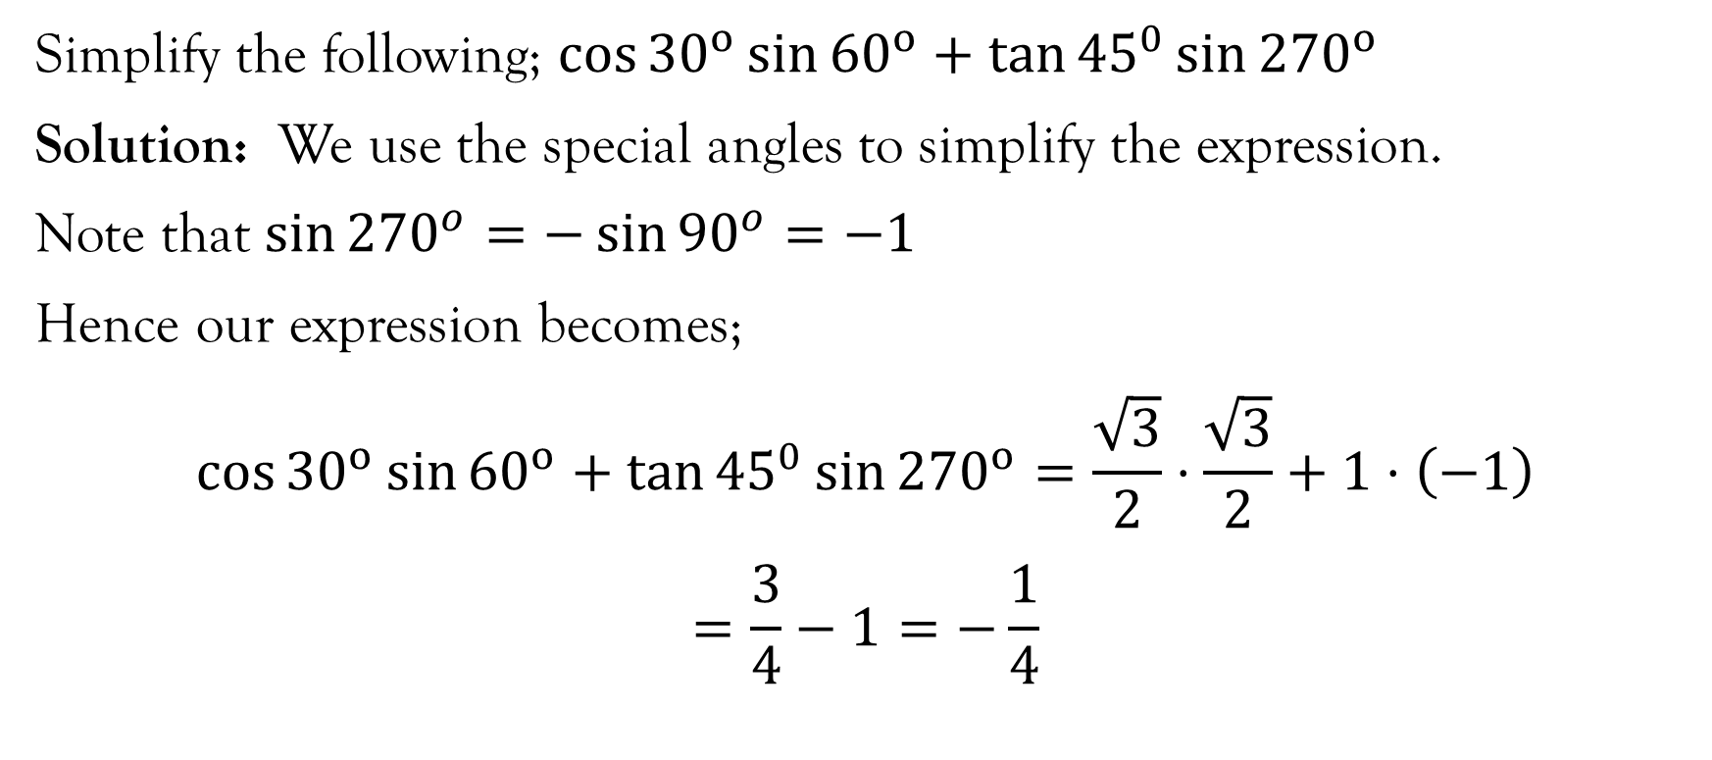
Example 1

Slide 13
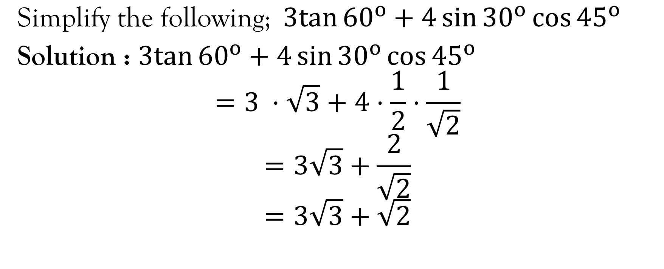
Example 2

Slide 14
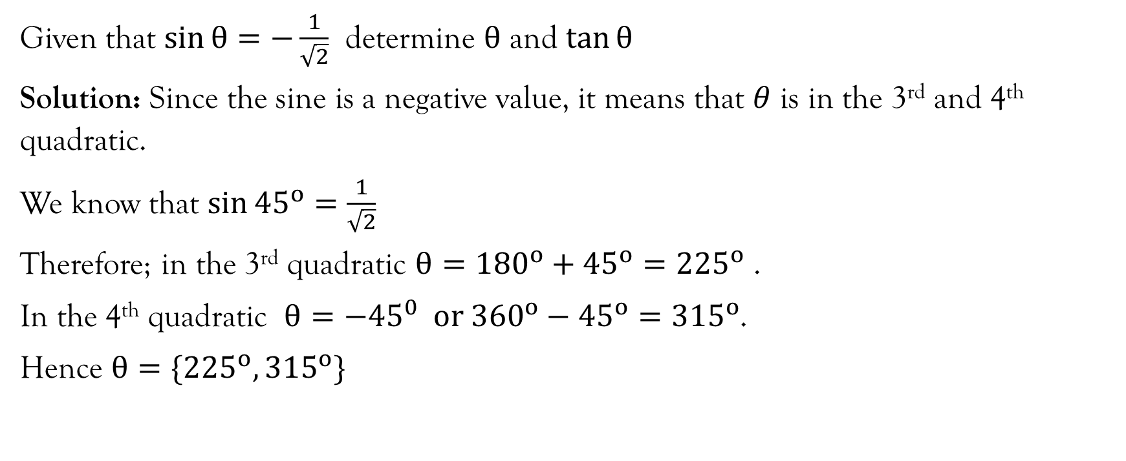
Example 2

Slide 15
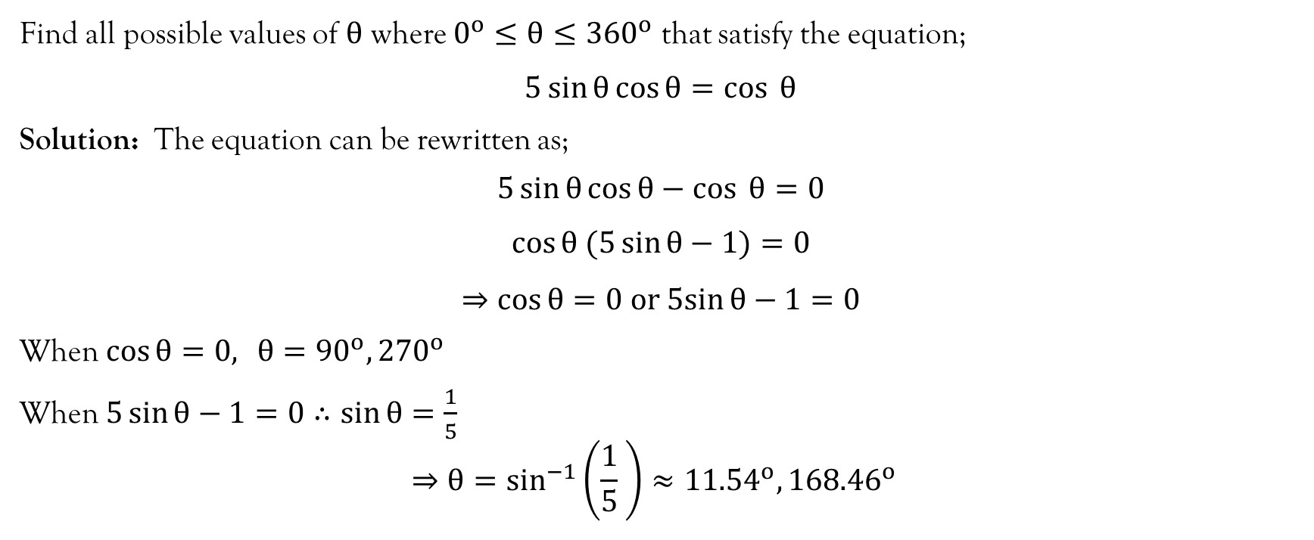
Example 3

Slide 16
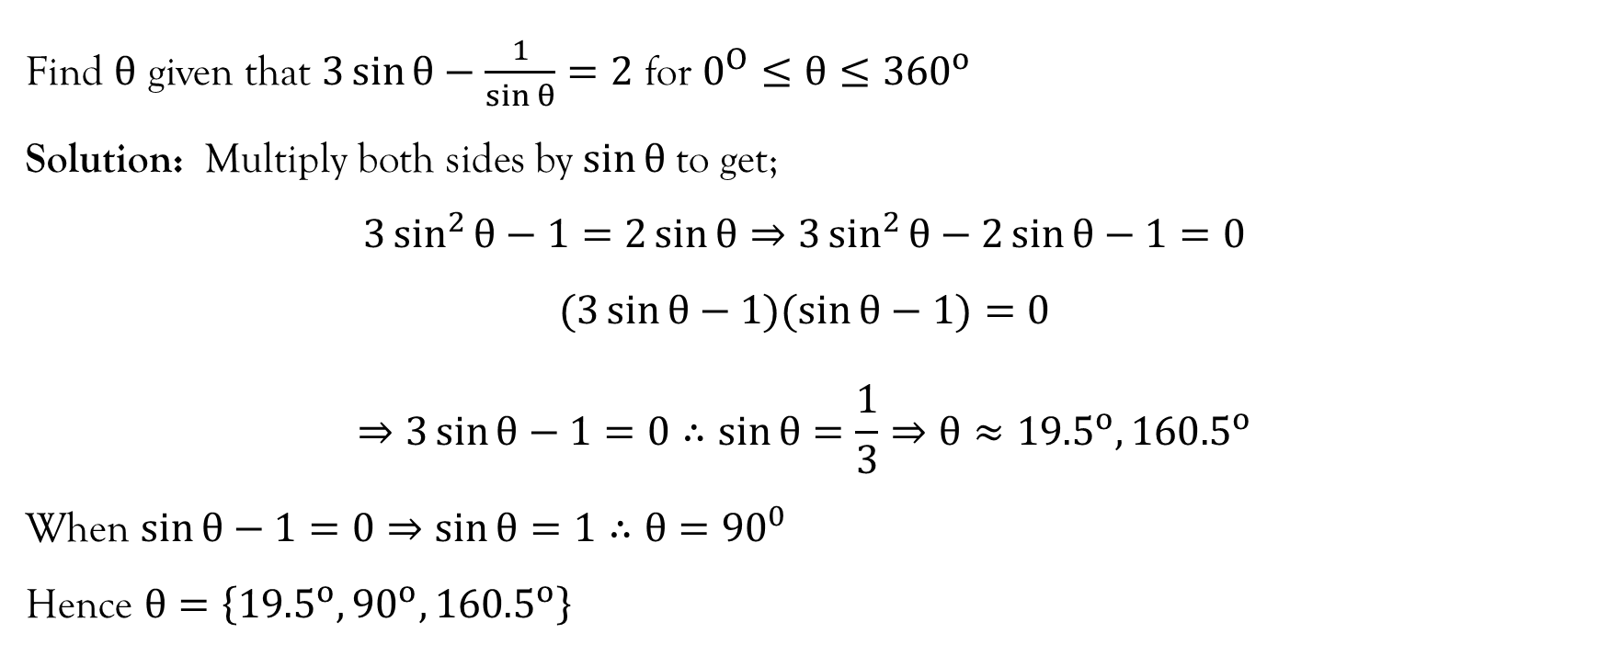
Example 4

Slide 17
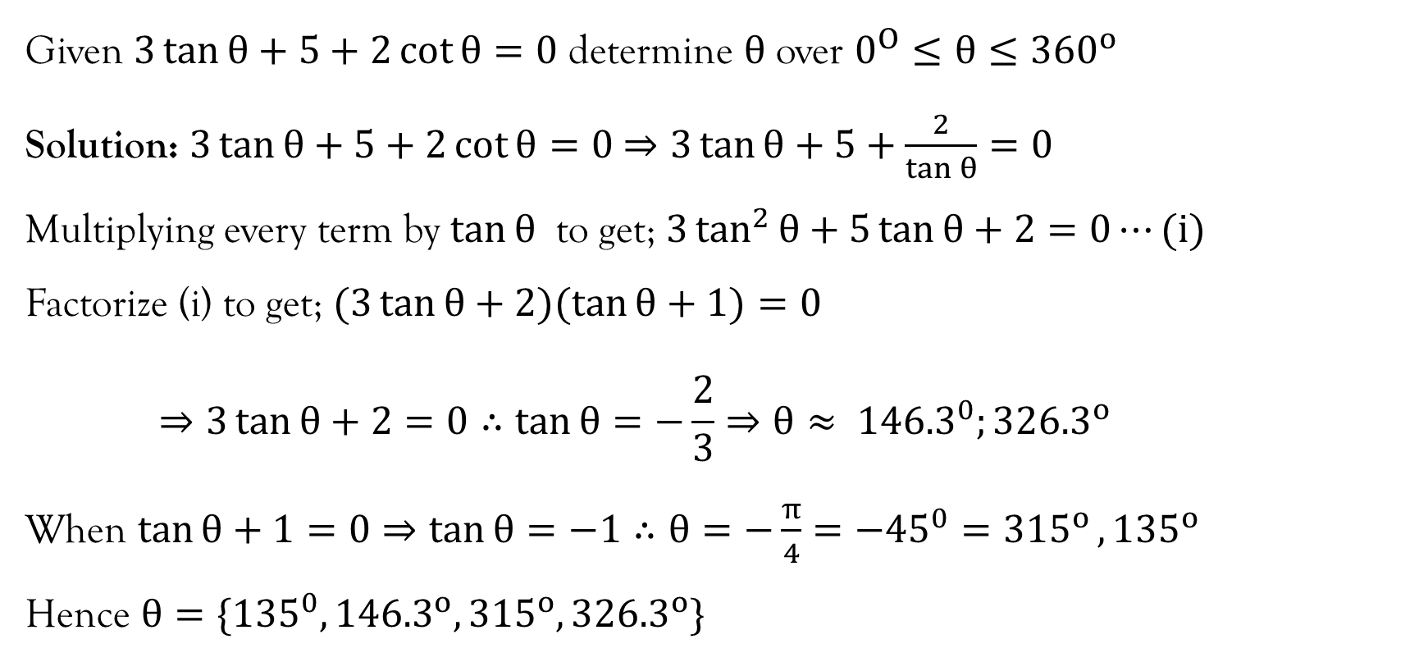
Example 5

Slide 18
Solving triangles
The process of finding the unknown sides and angles of a triangle is called solving the triangle.
To solve a triangle, one may apply one or a combination of the following; the sine rule, cosine rule, or the Pythagoras theorem and the trigonometric ratios in case it is a right-angled triangle.

Slide 19
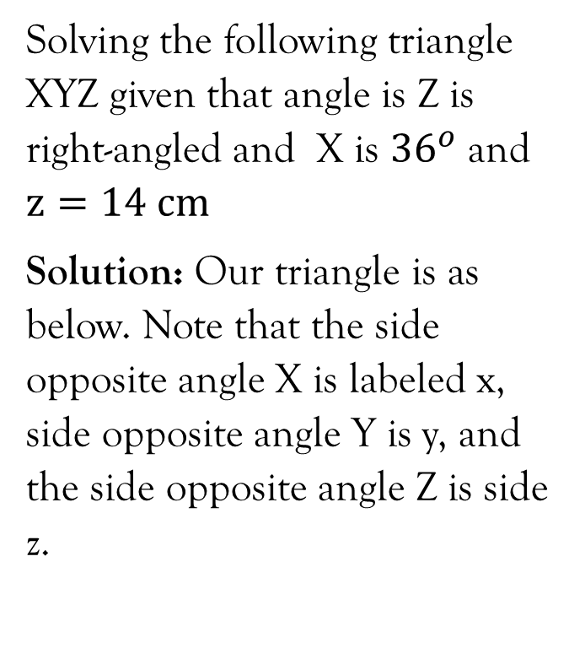
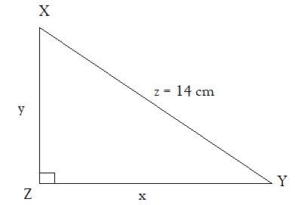
Example 1

Slide 20
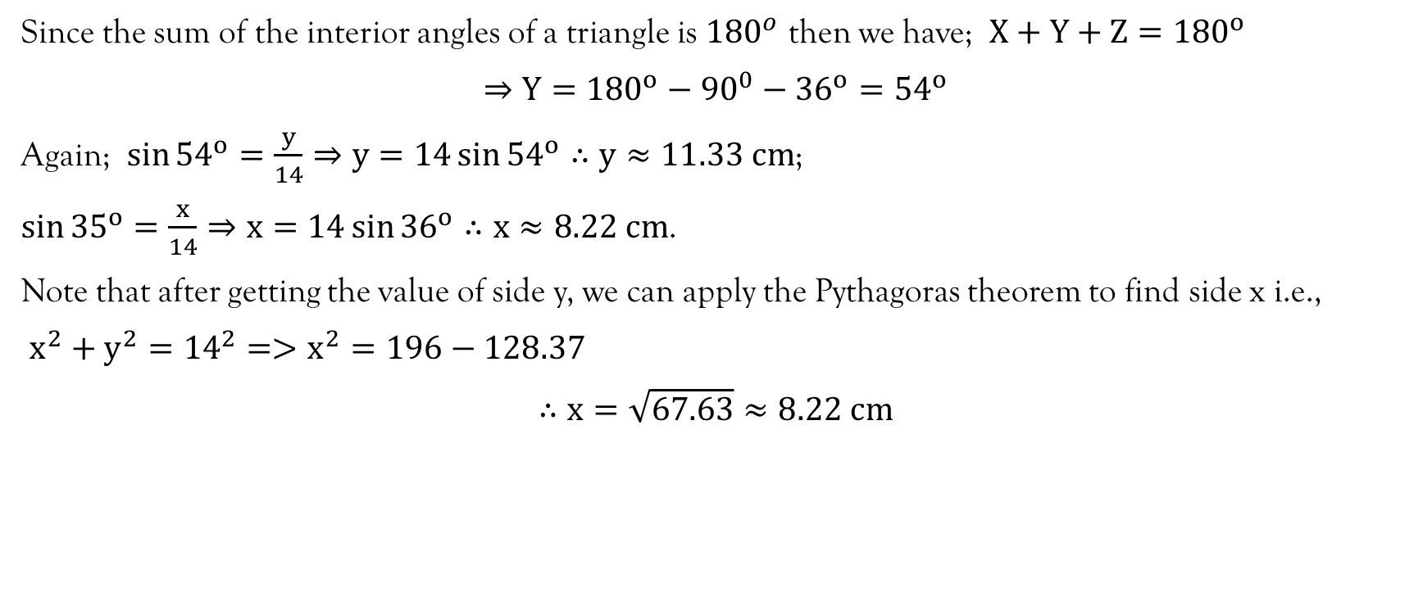
Example 1…contd…

Slide 21
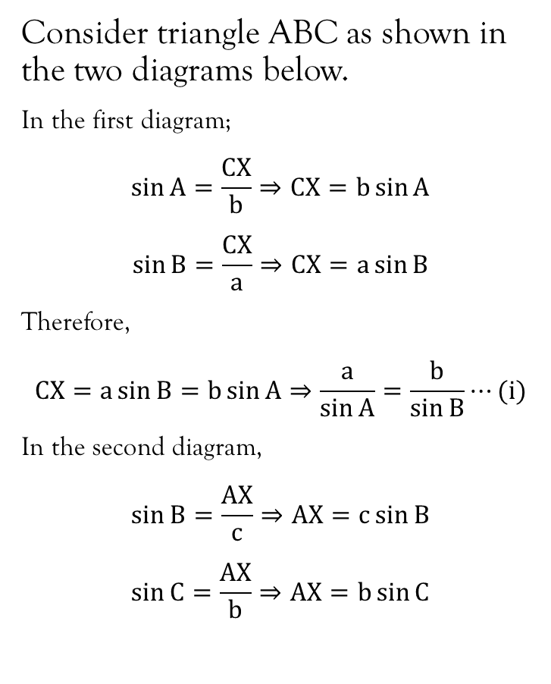
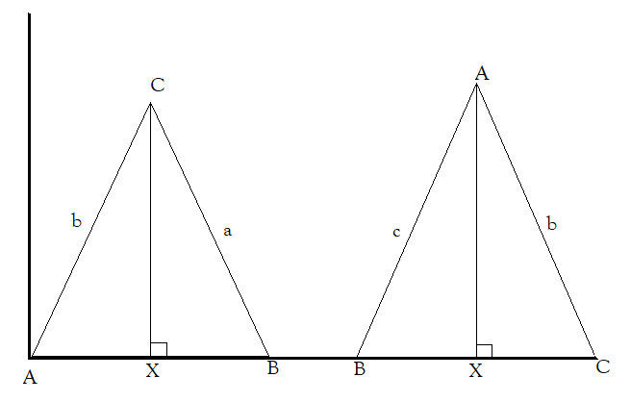
Sine Rule

Slide 22
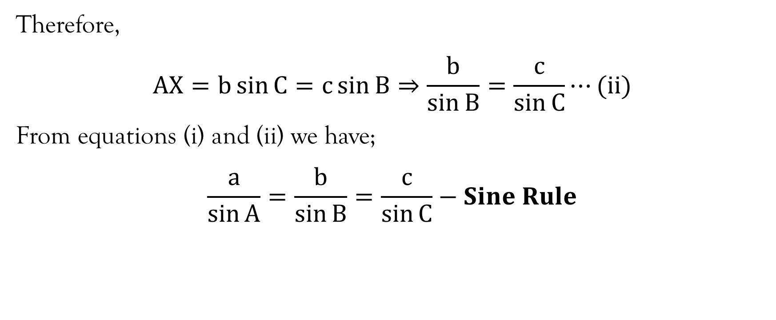
Sine Rule…contd…

Slide 23
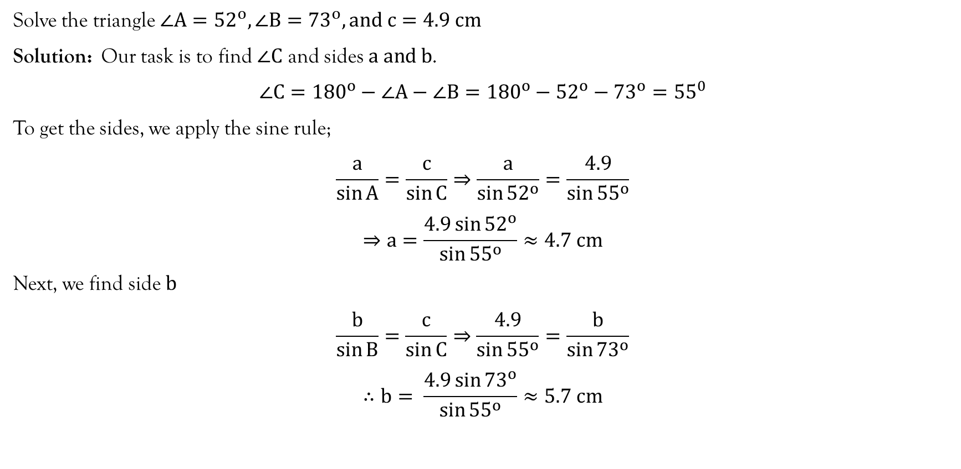
Example 1

Slide 24
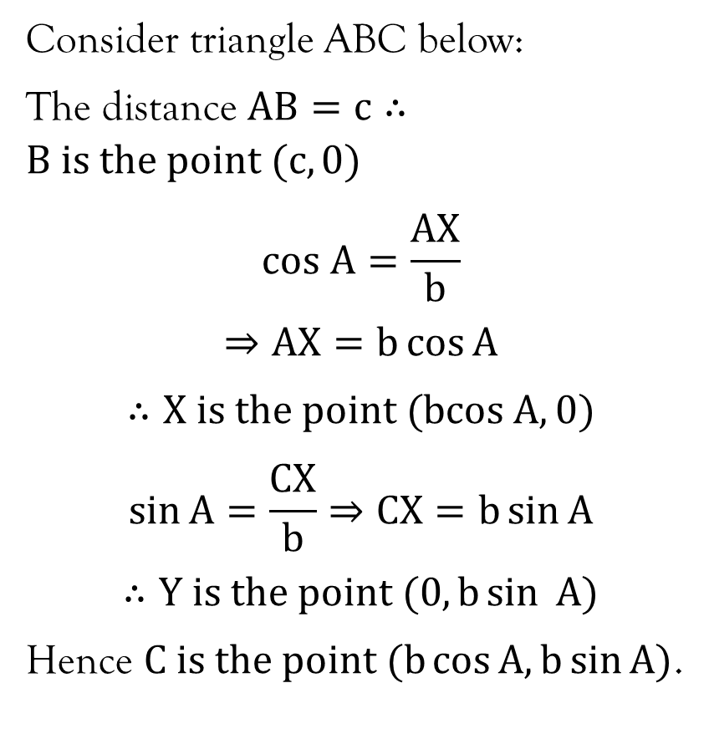
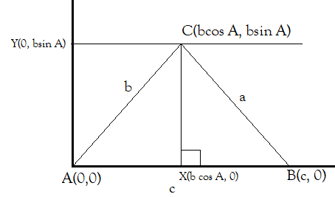
Cosine rule

Slide 25
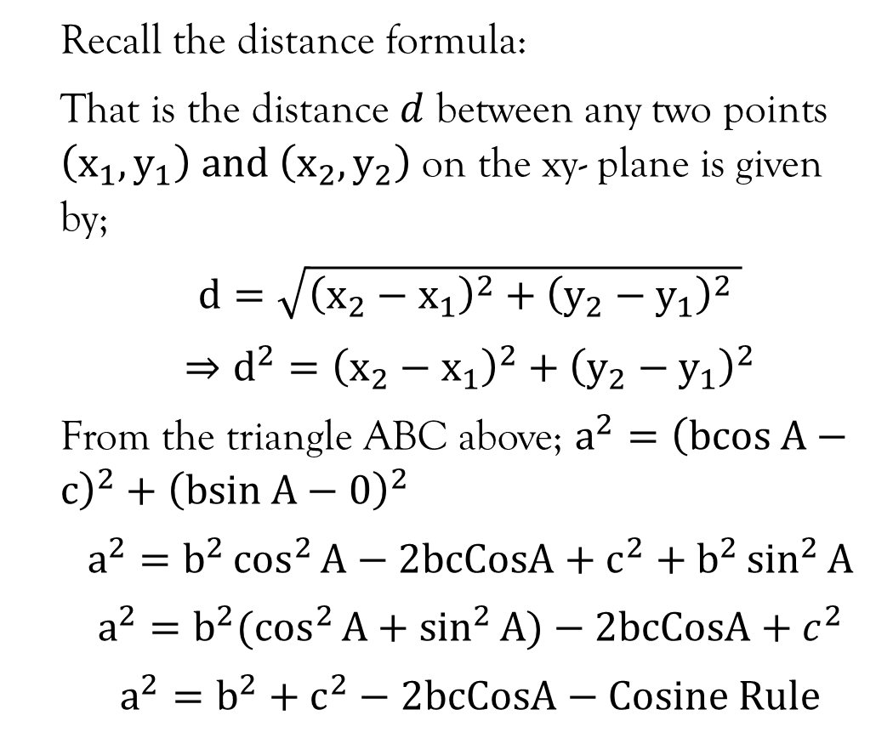
Cosine rule…contd…

Slide 26
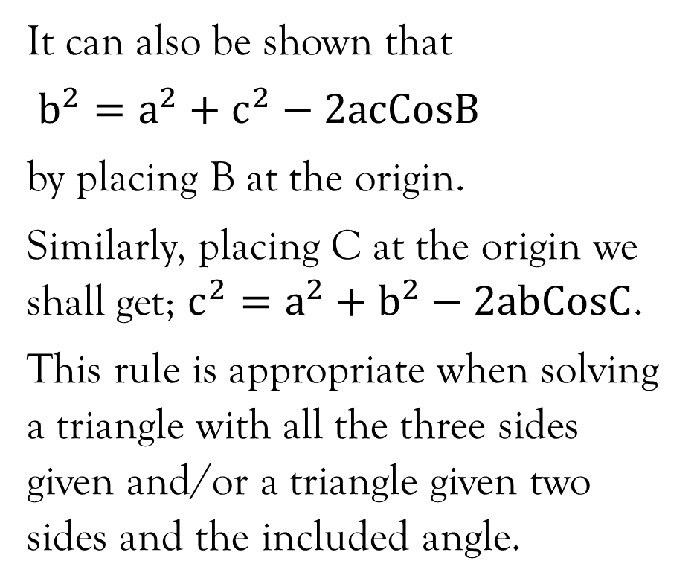
Cosine rule…contd…

Slide 27
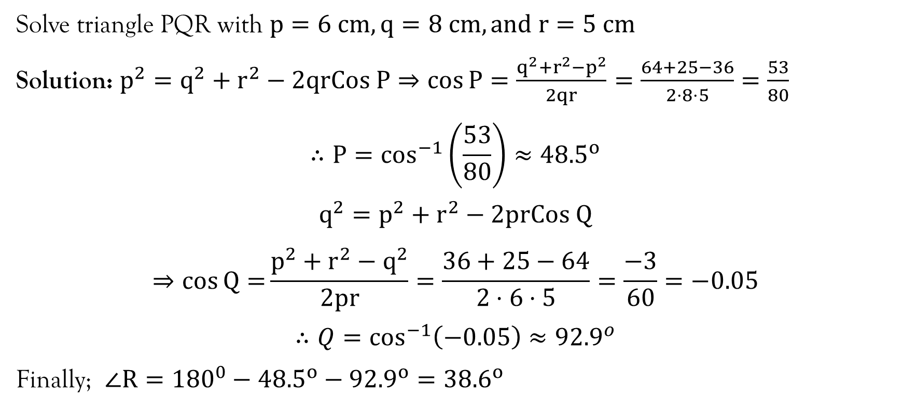
Example 1

Slide 28
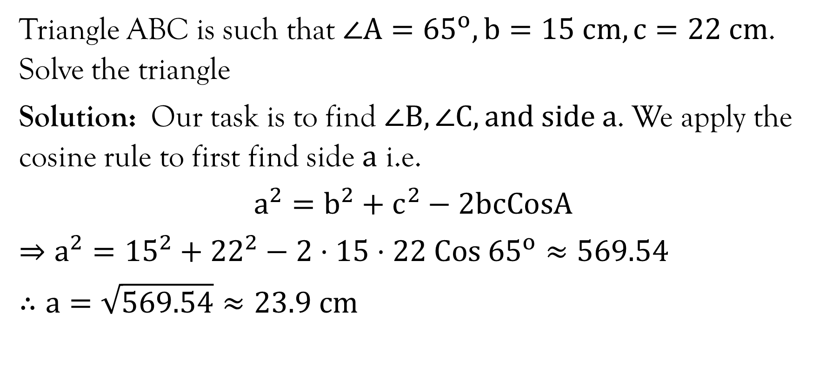
Example 2

Slide 29
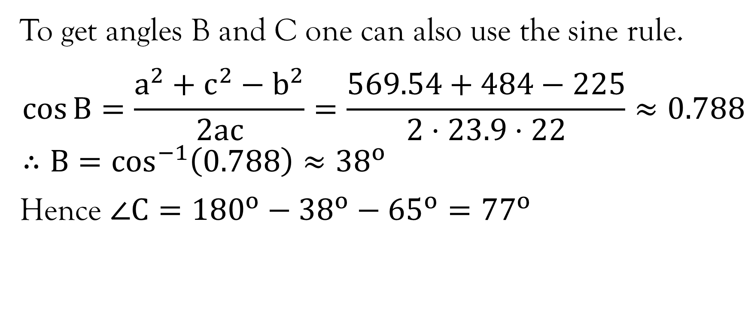
Example 2…contd…

Slide 30
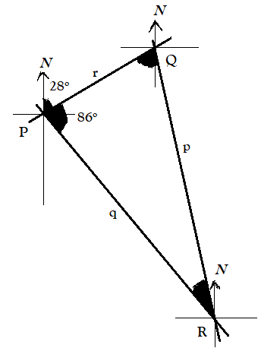
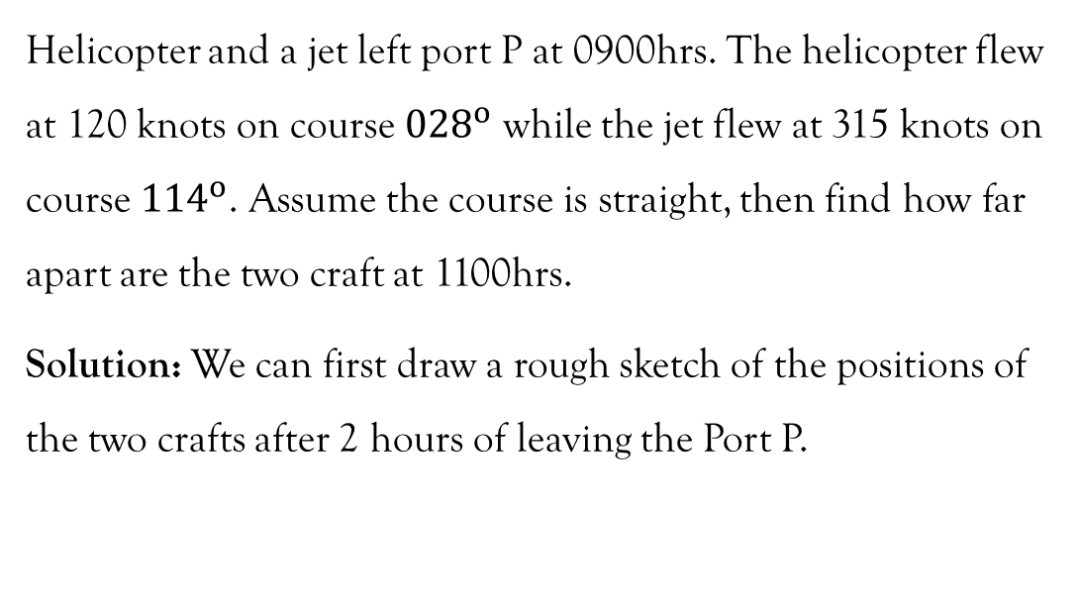
Example 8

Slide 31
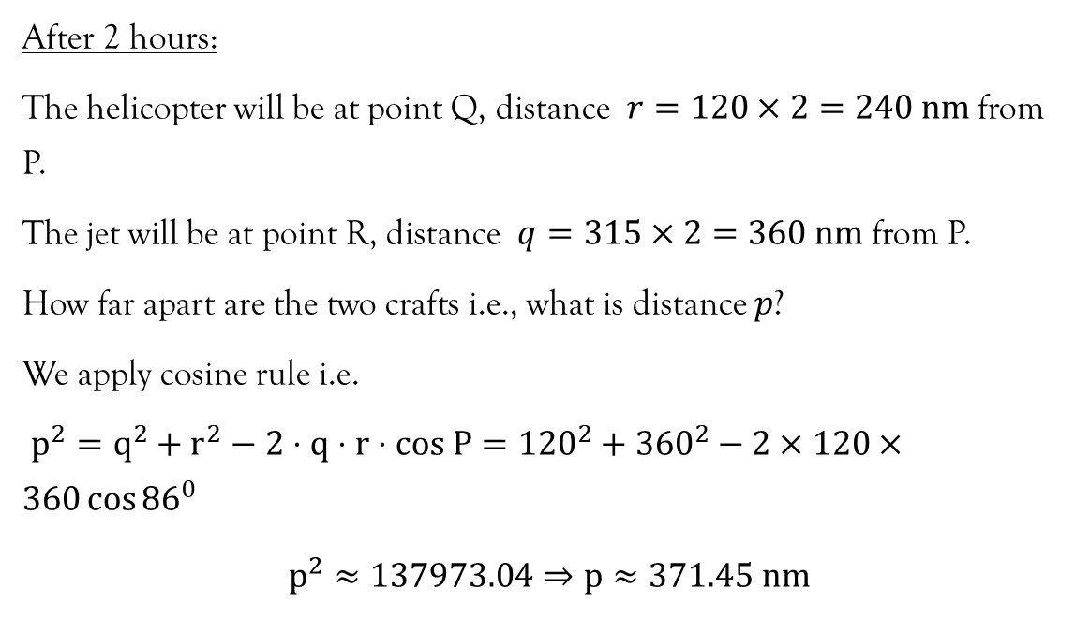
Example 8

Slide 32
References
Lumen. (n.d.). Solving Trigonometric Equations. https://courses.lumenlearning.com/precalctwo/chapter/solving-trigonometric-equations/
Stewart, J. (2012). Calculus (7th ed.). BROOKS/COLE Cengage Learning.
Swokowski, E., & Cole, J. A. (2009). Algebra and Trigonometry with Analytical Geometry. BROOKS/COLE Cengage Learning.

Slide 33
End of Lecture 8
Thank you!

