Slide 1
Mathematics for Science
Lecture 9
Trigonometrical Identities and Formulae
Lecturer: Kahenya, N.P

Slide 2
Introduction to Lecture 9
This lecture is a continuation of lecture 8.
It will introduce trigonometrical identities and formulae. These concepts are relevant to calculus.

Slide 3
Intended learning outcomes
At the end of this lecture, you will be able to;
Identify trigonometrical identities and formulae.
Simplify and apply trigonometrical identities and formulae in solving equations.
Prove trigonometric identities.

Slide 4
Further readings
The lecture notes can be complemented with relevant topics from Stewart (2012), Swokowski & Cole (2009).

Slide 5
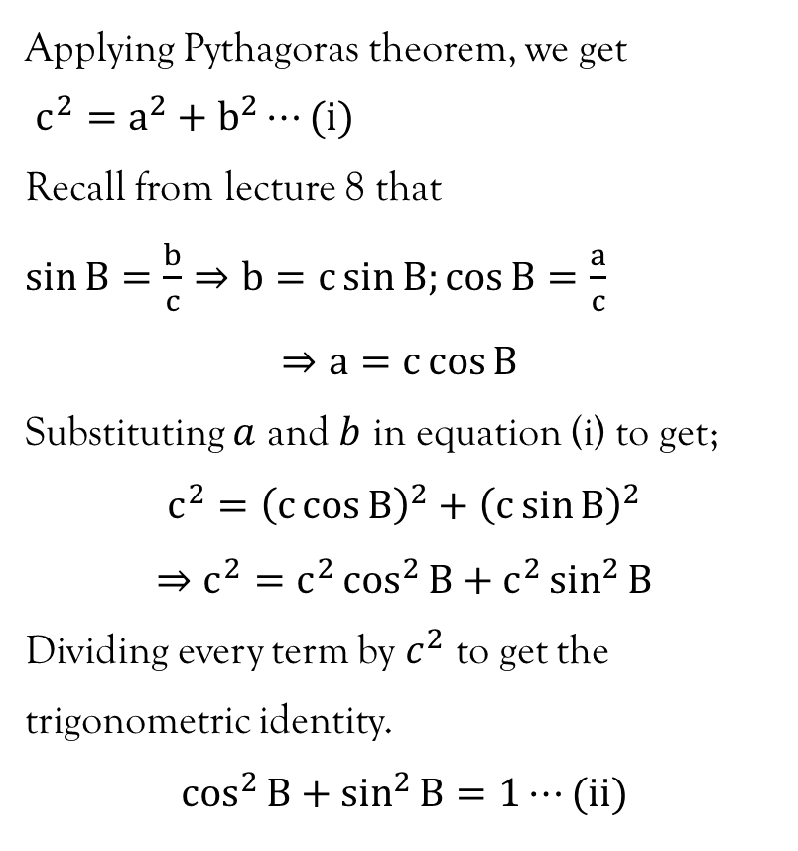
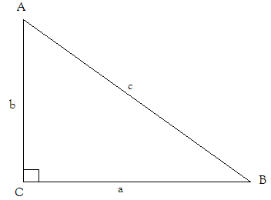
Basic trigonometric identities

Slide 6
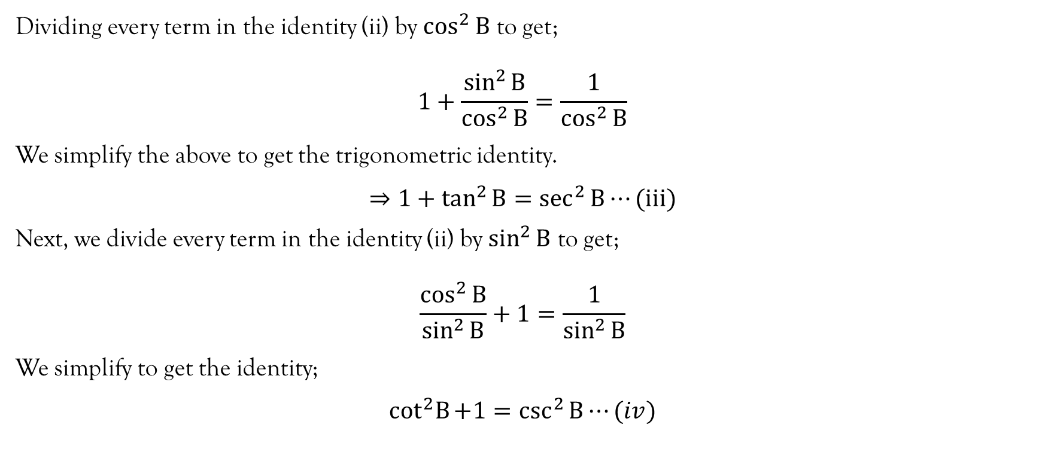
Basic trigonometric identities…contd…

Slide 7
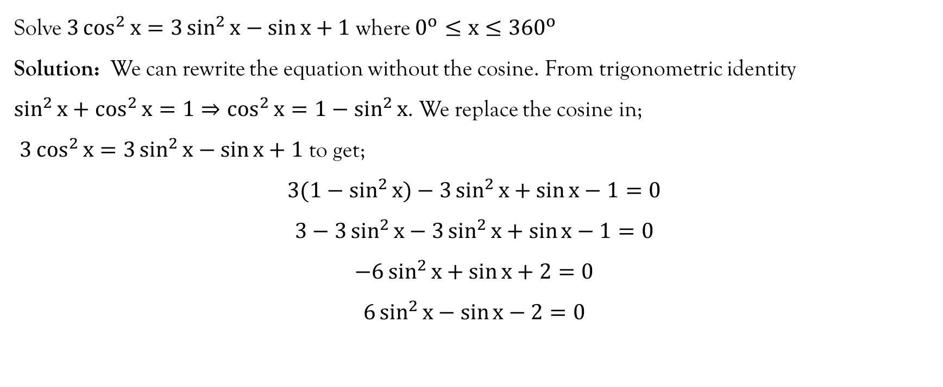
Example 1

Slide 8
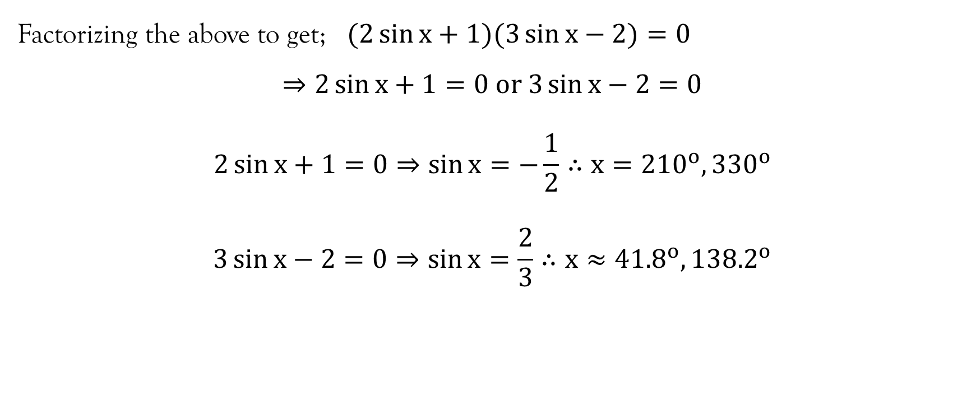
Example 1…contd…

Slide 9
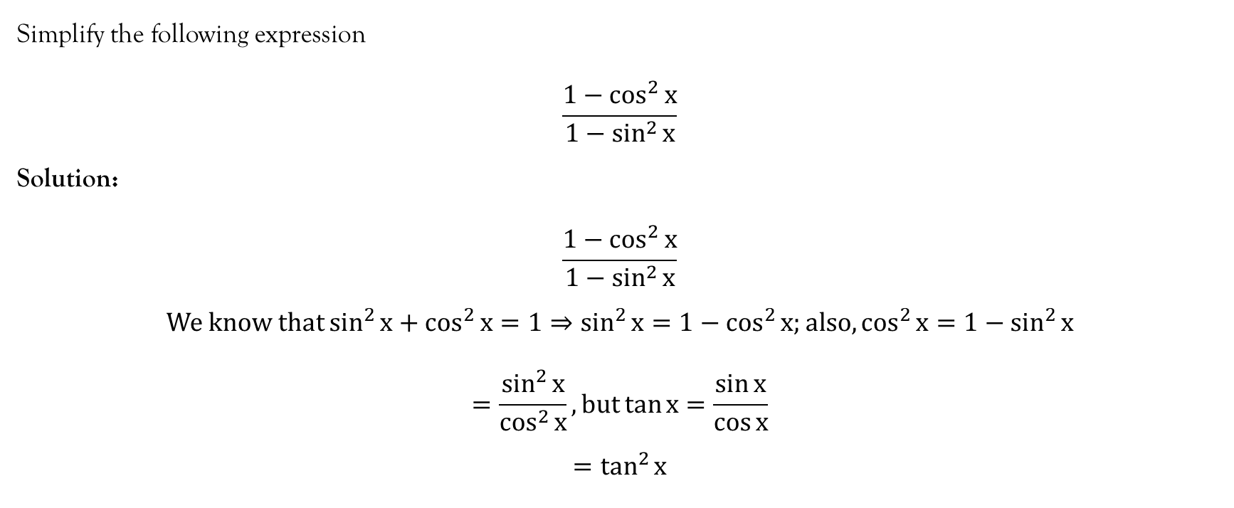
Example 2

Slide 10
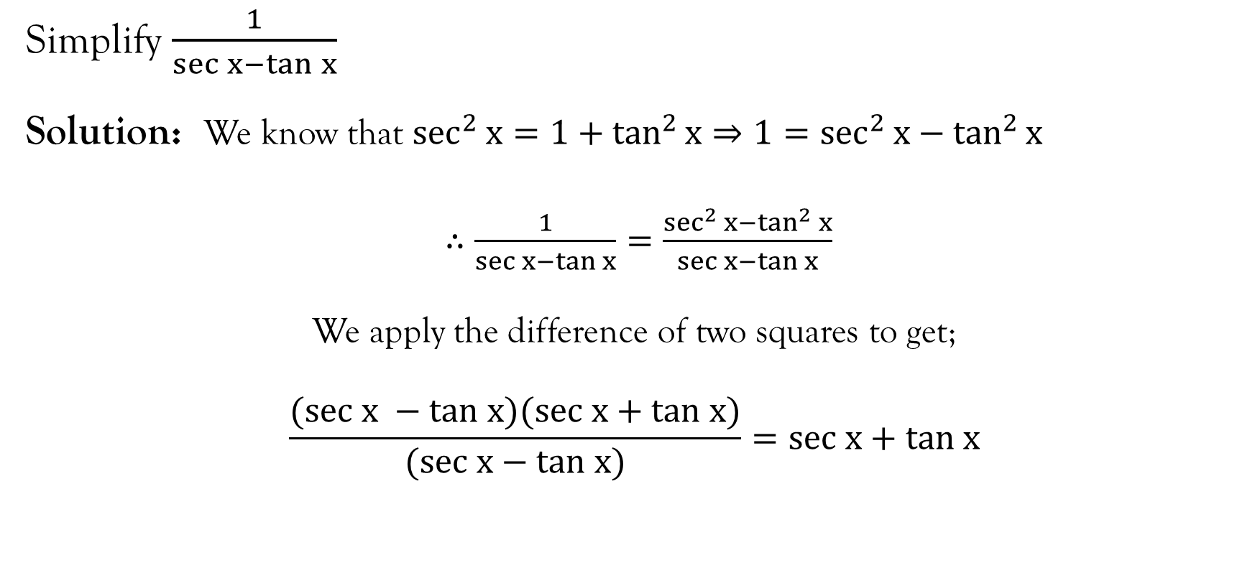
Example 3

Slide 11
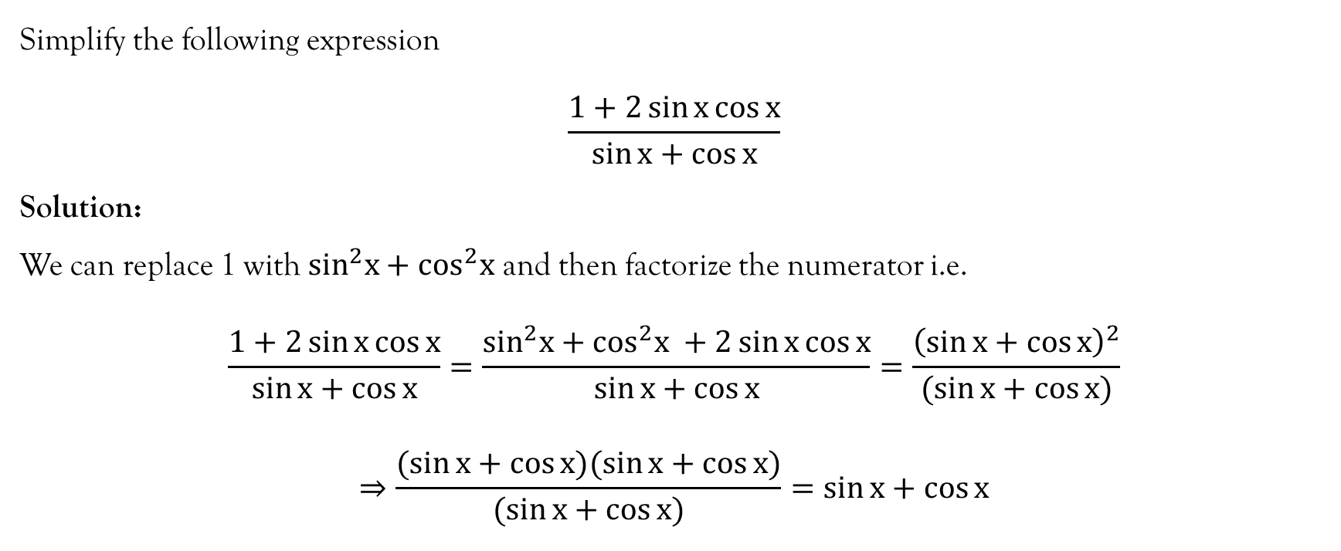
Example 4

Slide 12
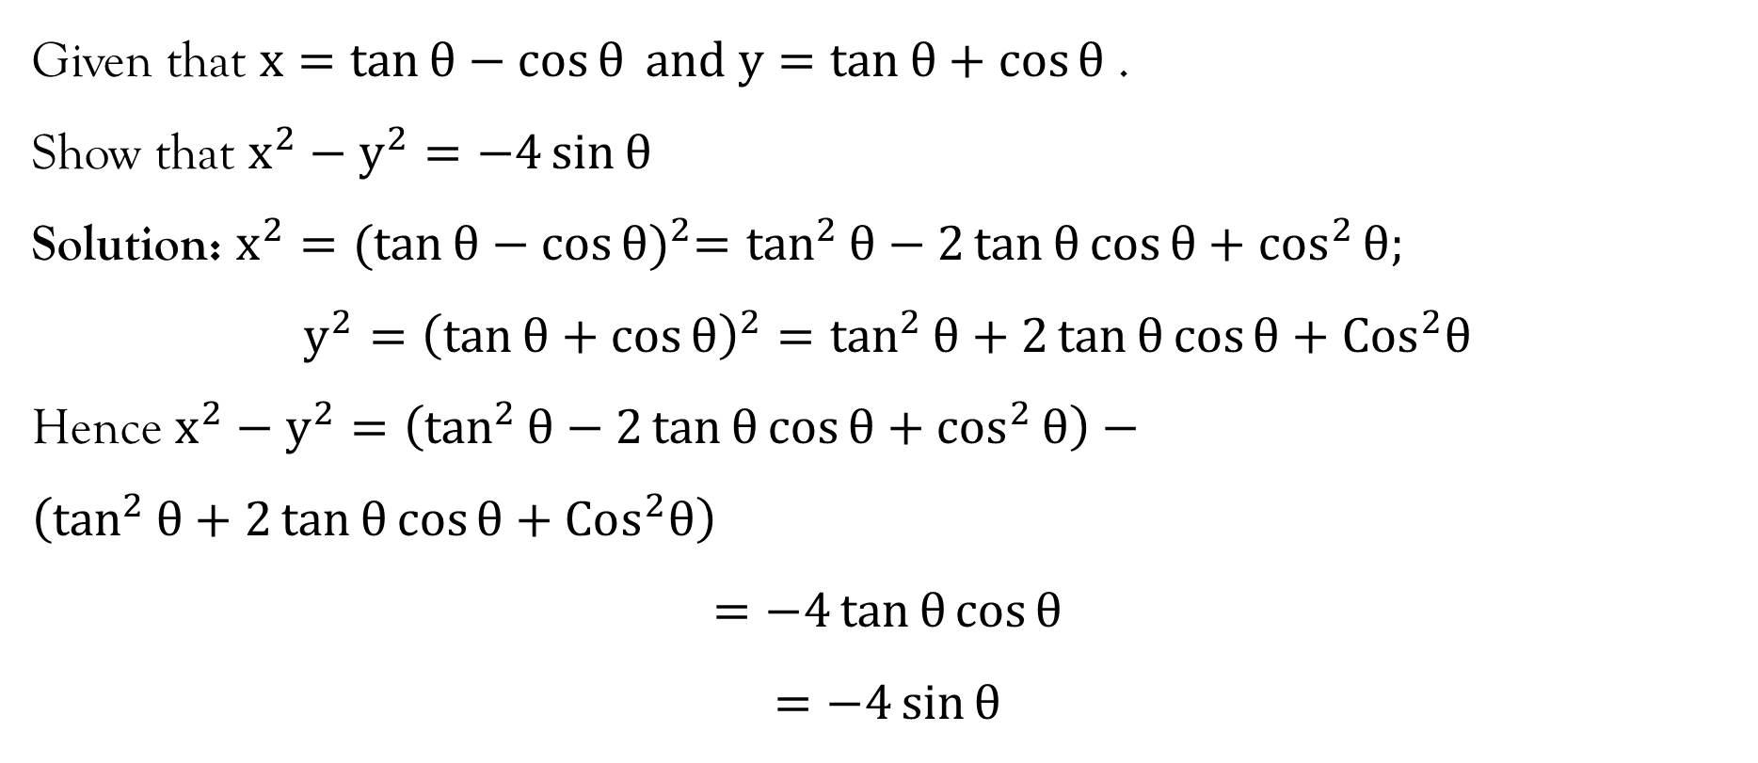
Example 5

Slide 13
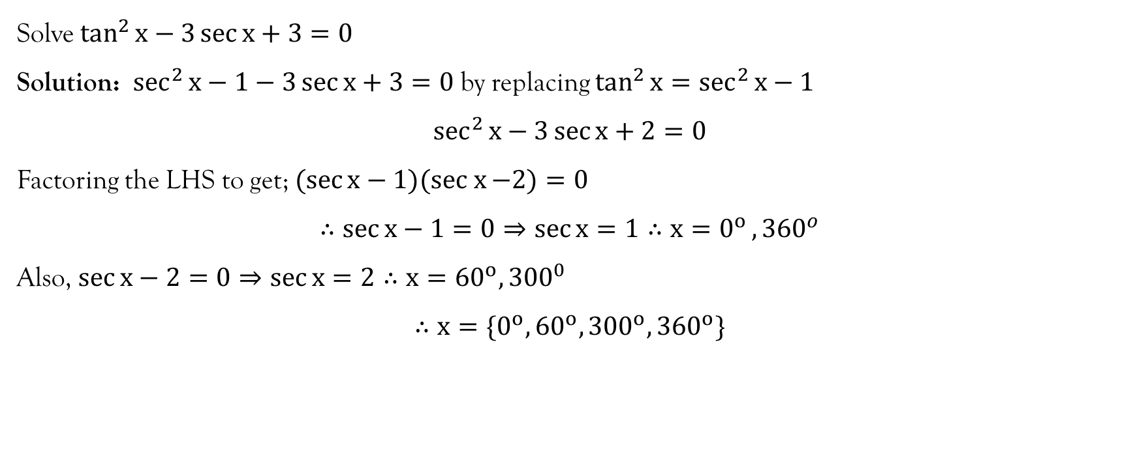
Example 6

Slide 14
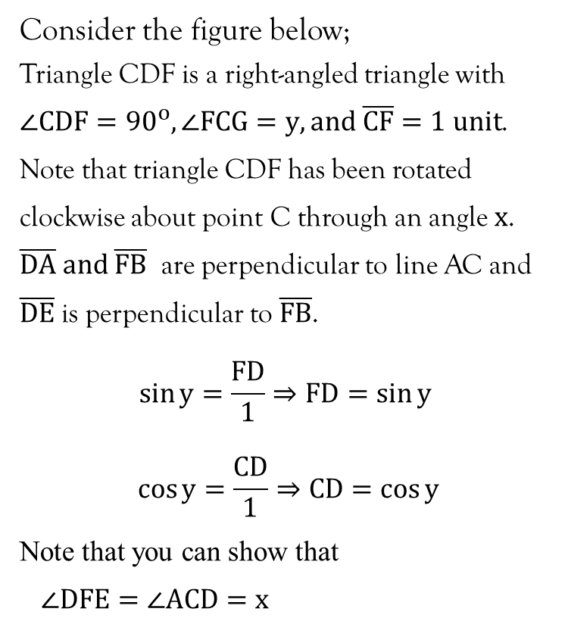
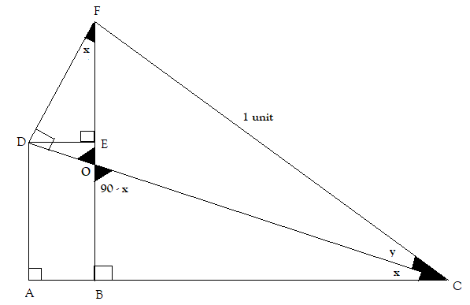
Compound angle formulae

Slide 15
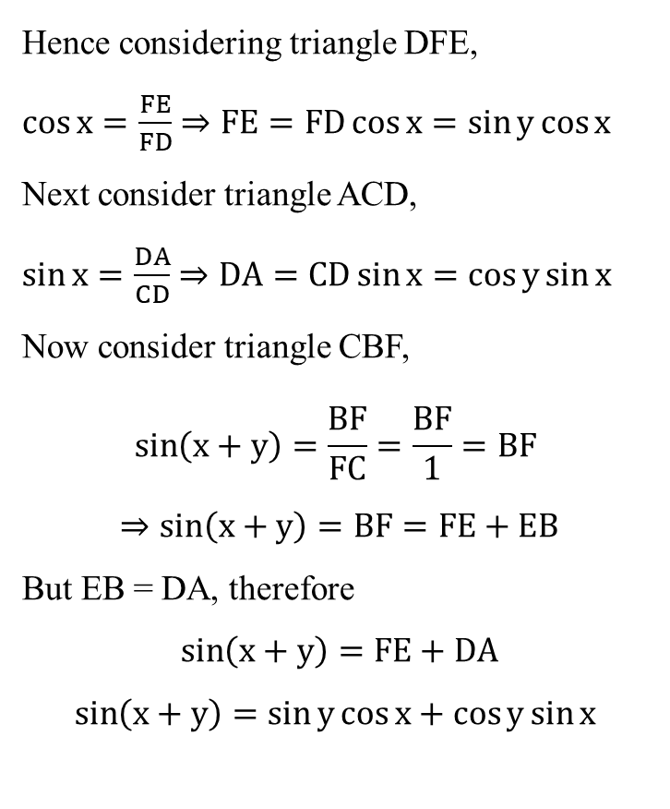
Compound angle formulae…contd…

Slide 16
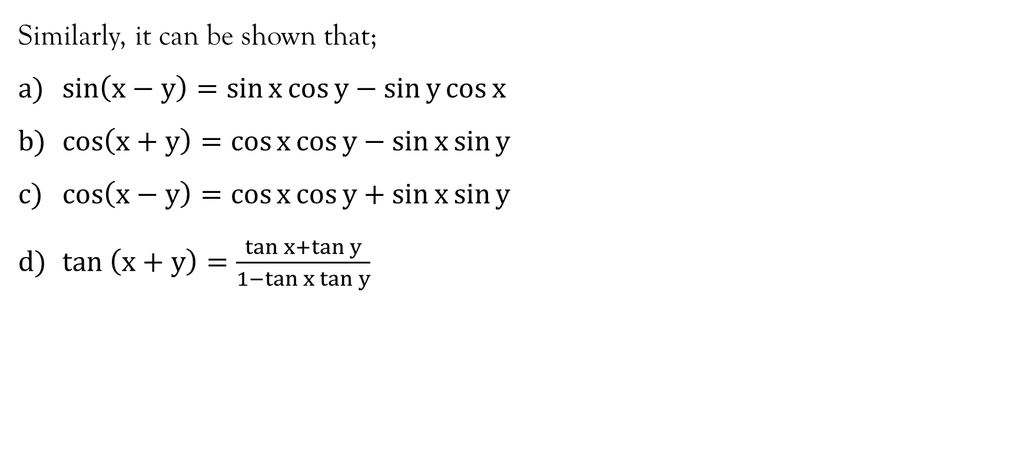
Compound angle formulae…contd…

Slide 17
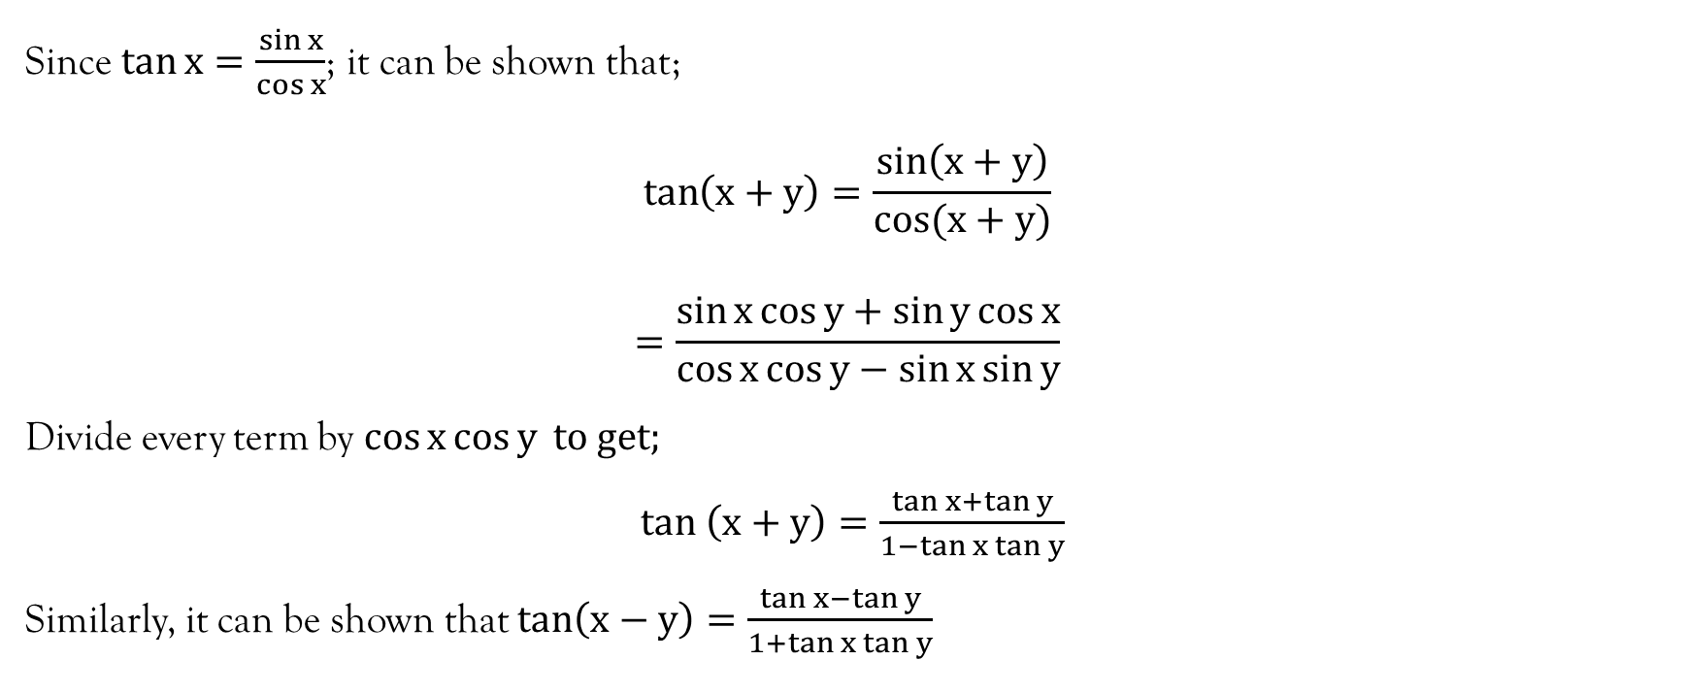
Compound angle formulae…contd…

Slide 18
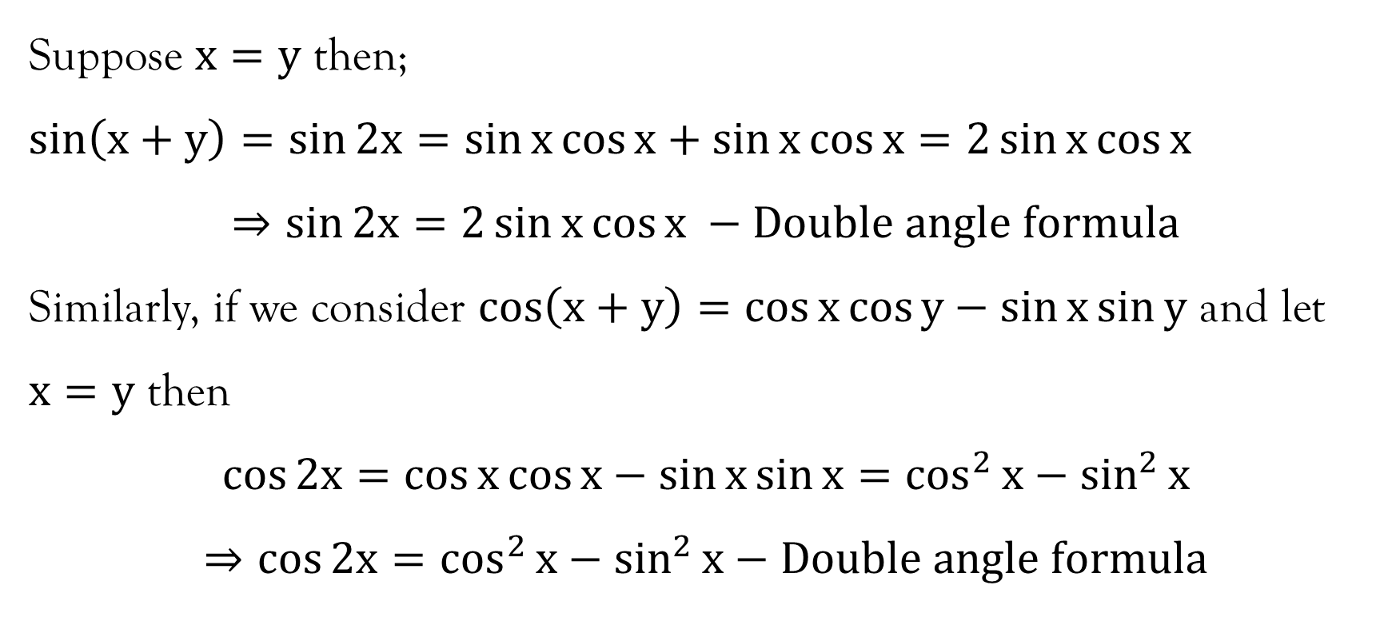
Double-angle formulae

Slide 19
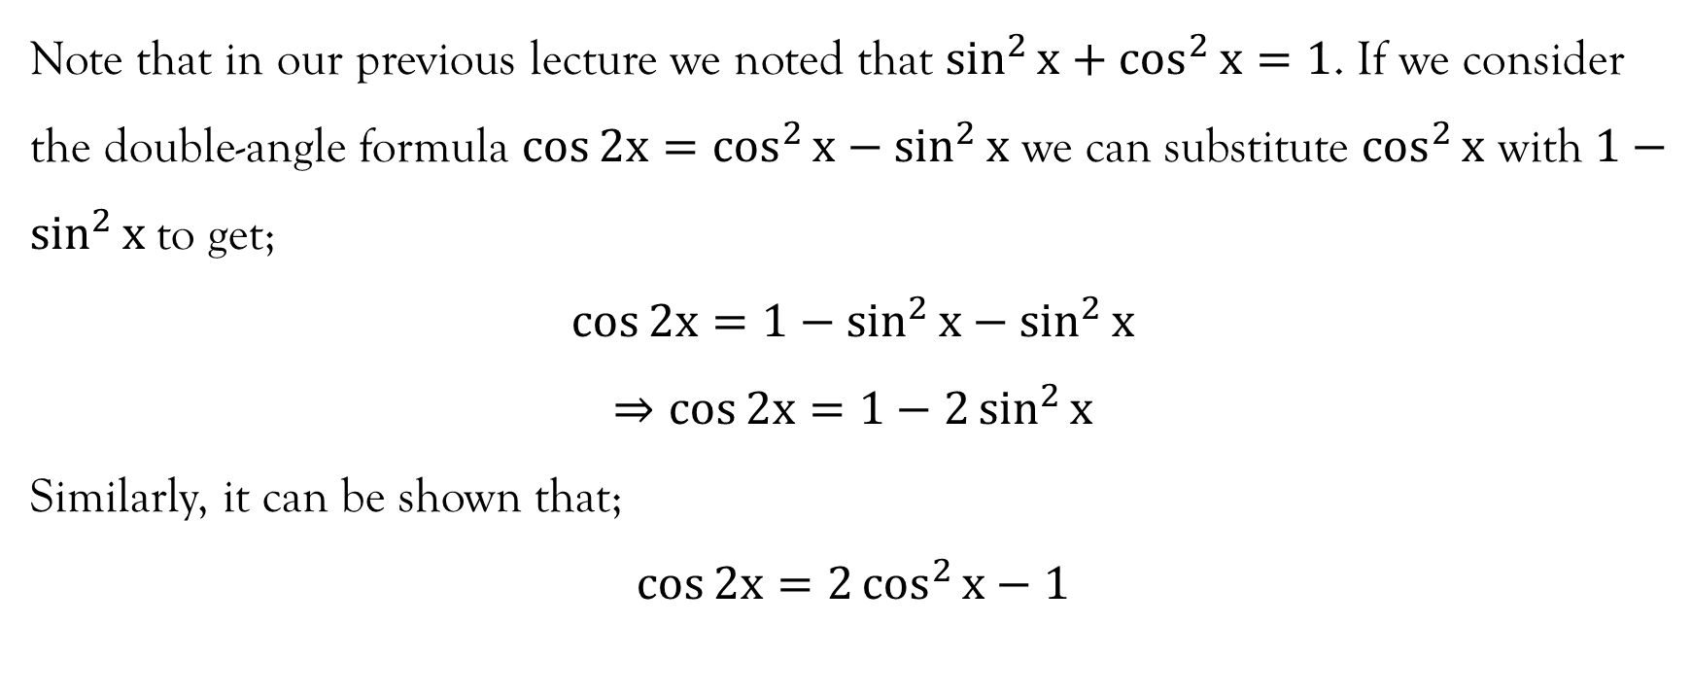
Double-angle formulae…contd…

Slide 20
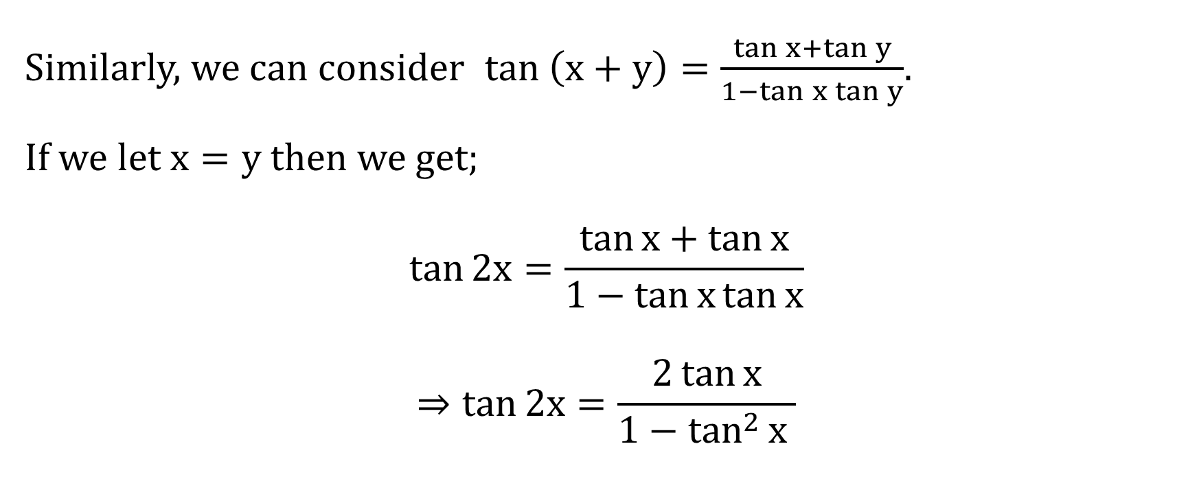
Double-angle formulae…contd…

Slide 21
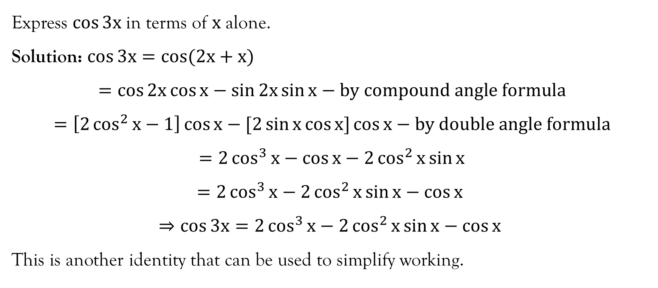
Example 1

Slide 22
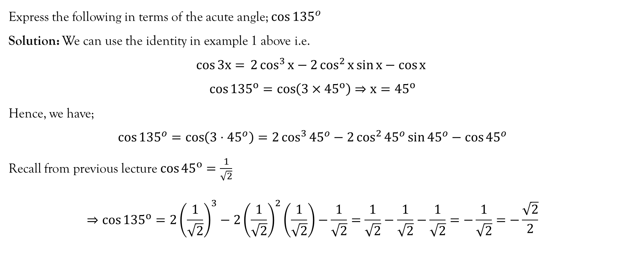
Example 2

Slide 23
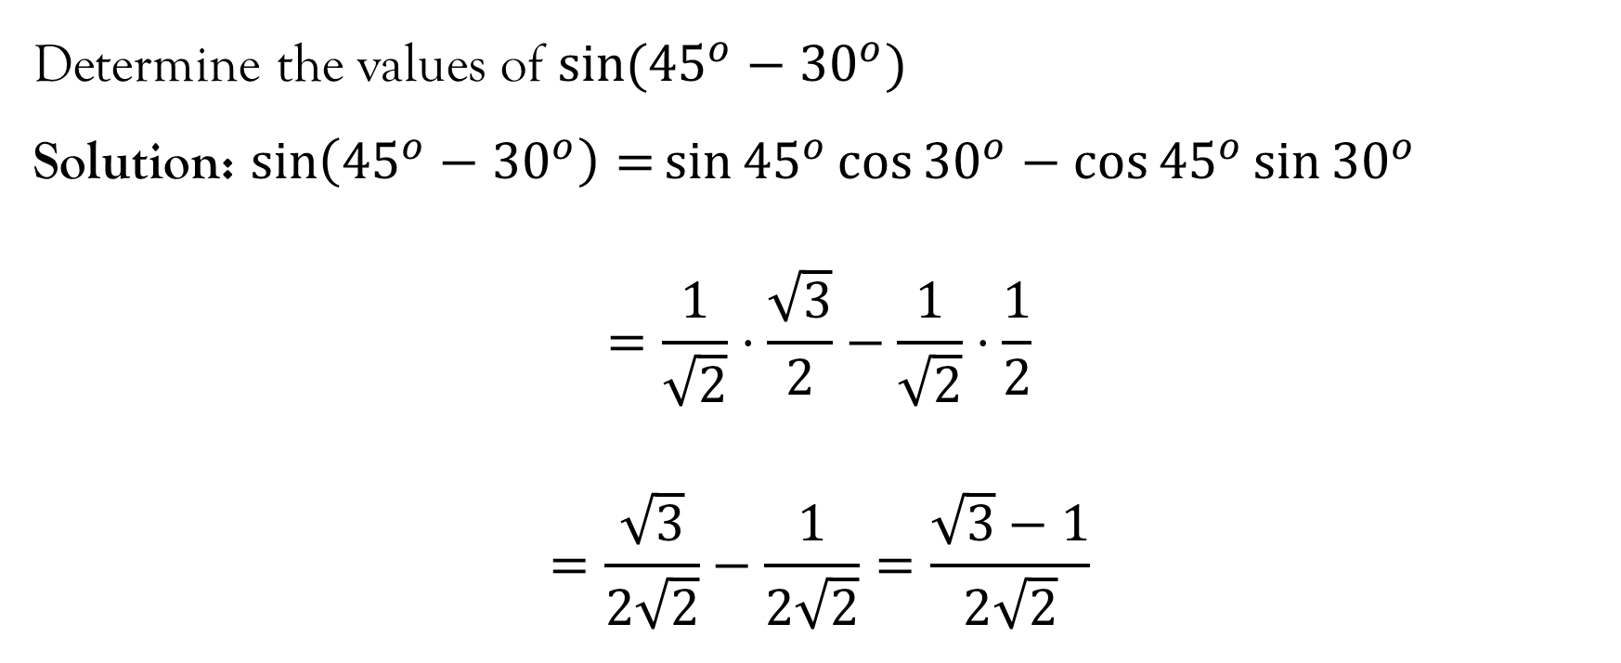
Example 3

Slide 24
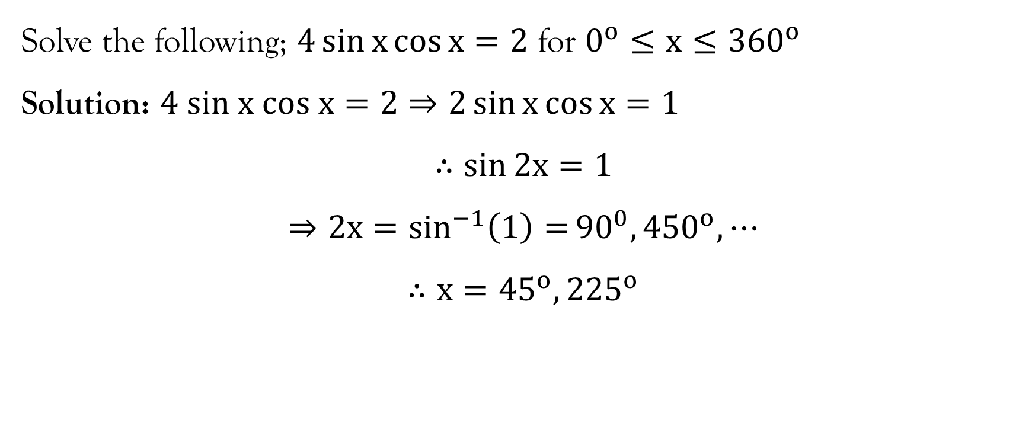
Example 4

Slide 25
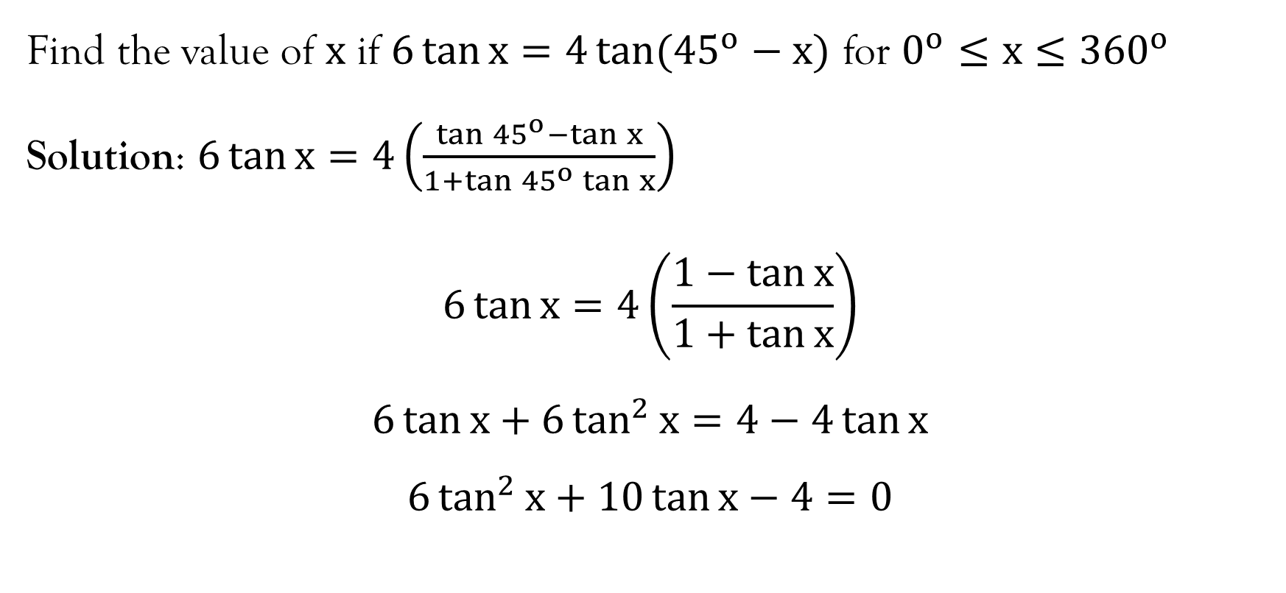
Example 5

Slide 26
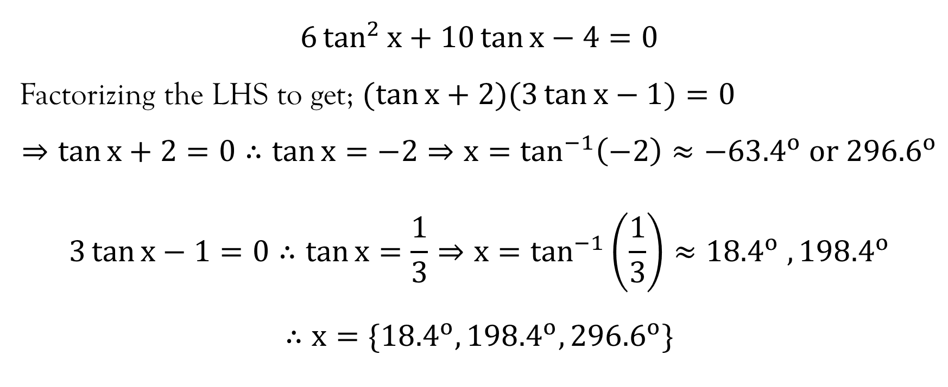
Example 5…contd…

Slide 27
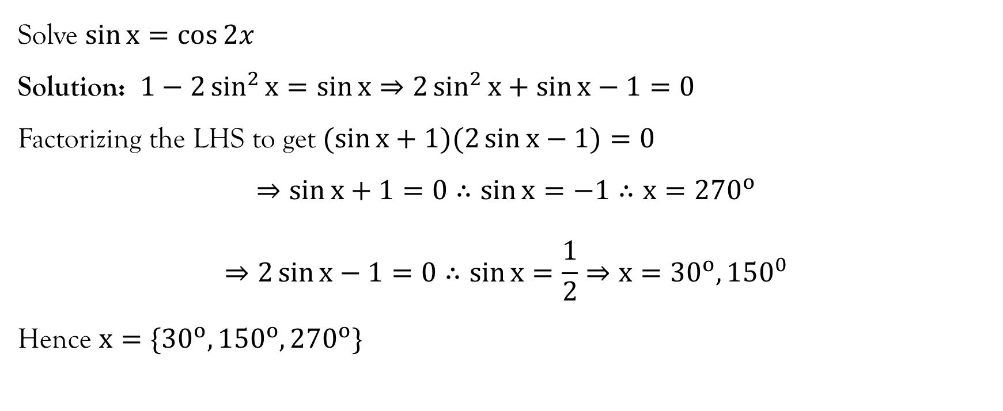
Example 6

Slide 28
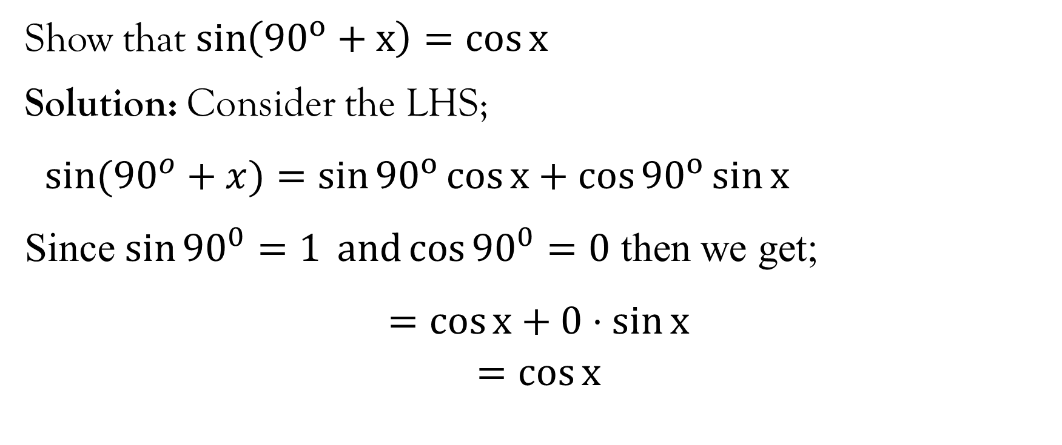
Example 7

Slide 29
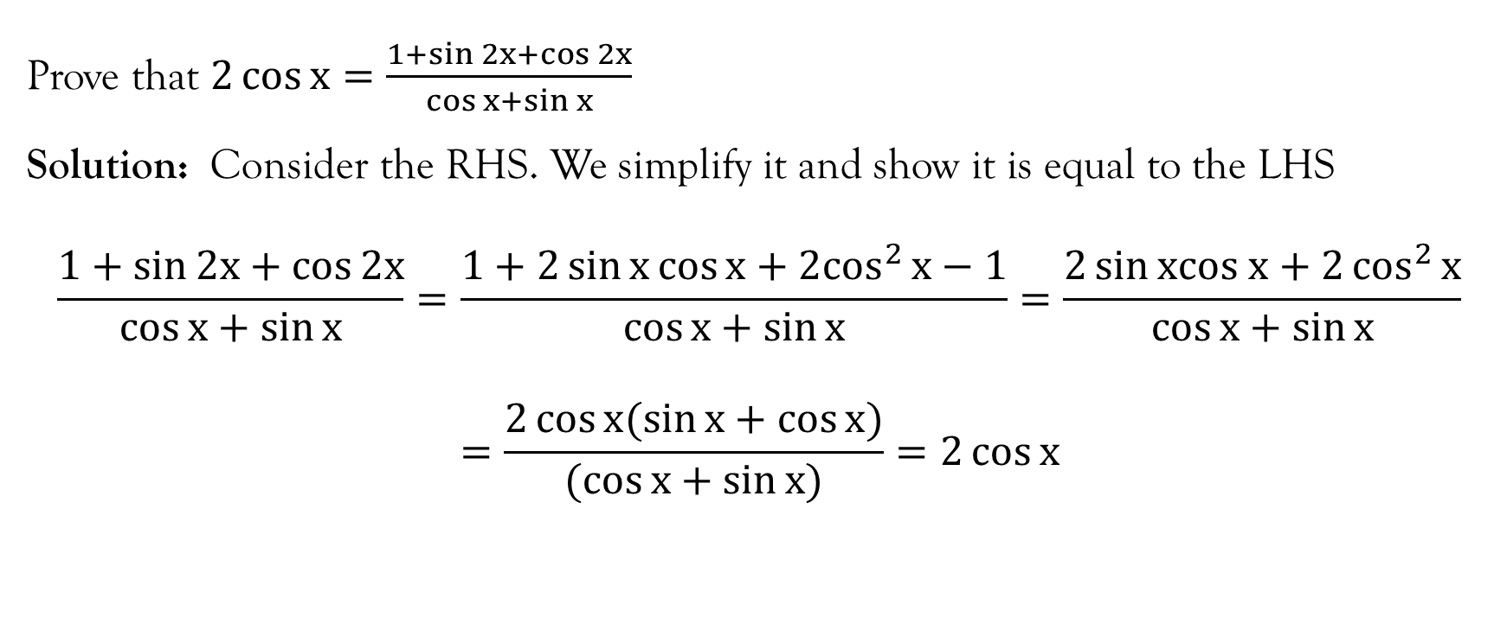
Example 8

Slide 30
References
Stewart, J. (2012). Calculus (7th ed.). BROOKS/COLE Cengage Learning.
Swokowski, E., & Cole, J. A. (2009). Algebra and Trigonometry with Analytical Geometry. BROOKS/COLE Cengage Learning.

Slide 31
End of Lecture 9
Thank You

