Slide 1
Mathematics for Science
Lecture 11
Permutation Functions
Lecturer: Kahenya, N.P

Slide 2
Introduction to Lecture 11
This lecture is a continuation of Lecture 10.
The lecture will introduce the concept of permutations as functions.
These concepts are relevant to understanding concepts in discrete mathematics and modern algebra (abstract algebra especially group and ring theory).

Slide 3
Intended learning outcomes
At the end of this lecture, you will be able to;
Define a permutation function.
Carry out operations involving permutations functions.

Slide 4
Definition
A bijection or a one-to-one and onto mapping, from a set X to itself is called a permutation of X.

Slide 5
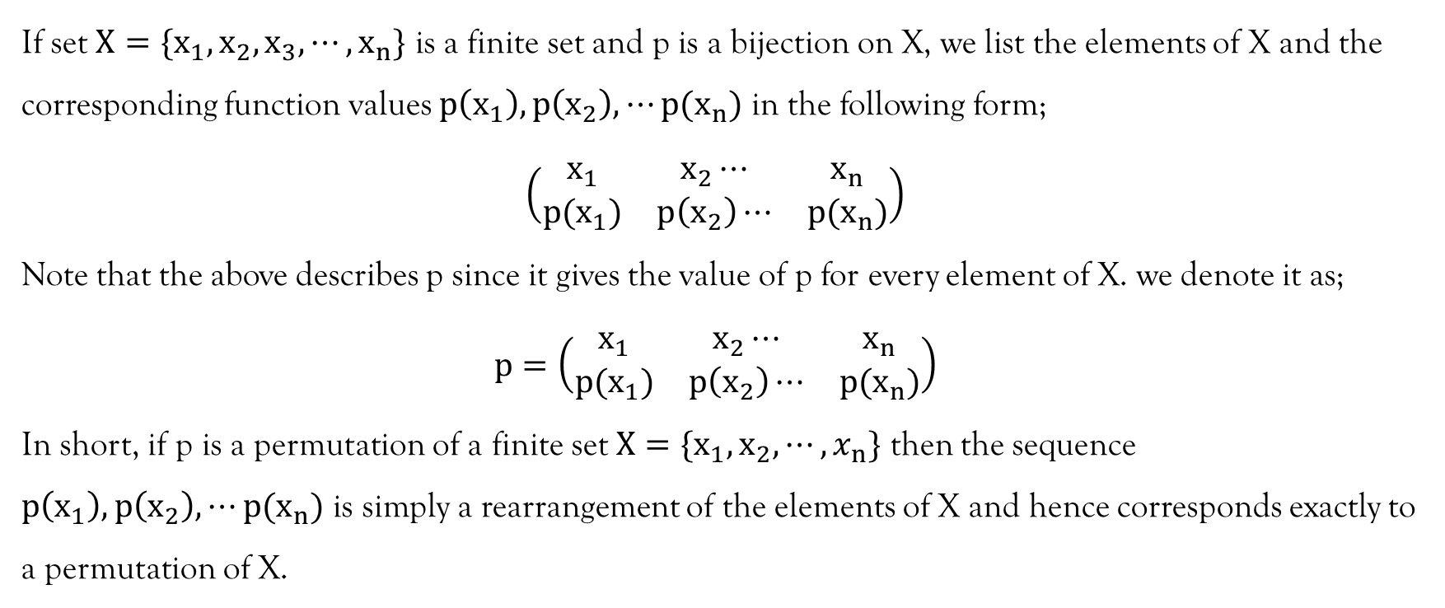
Definition

Slide 6
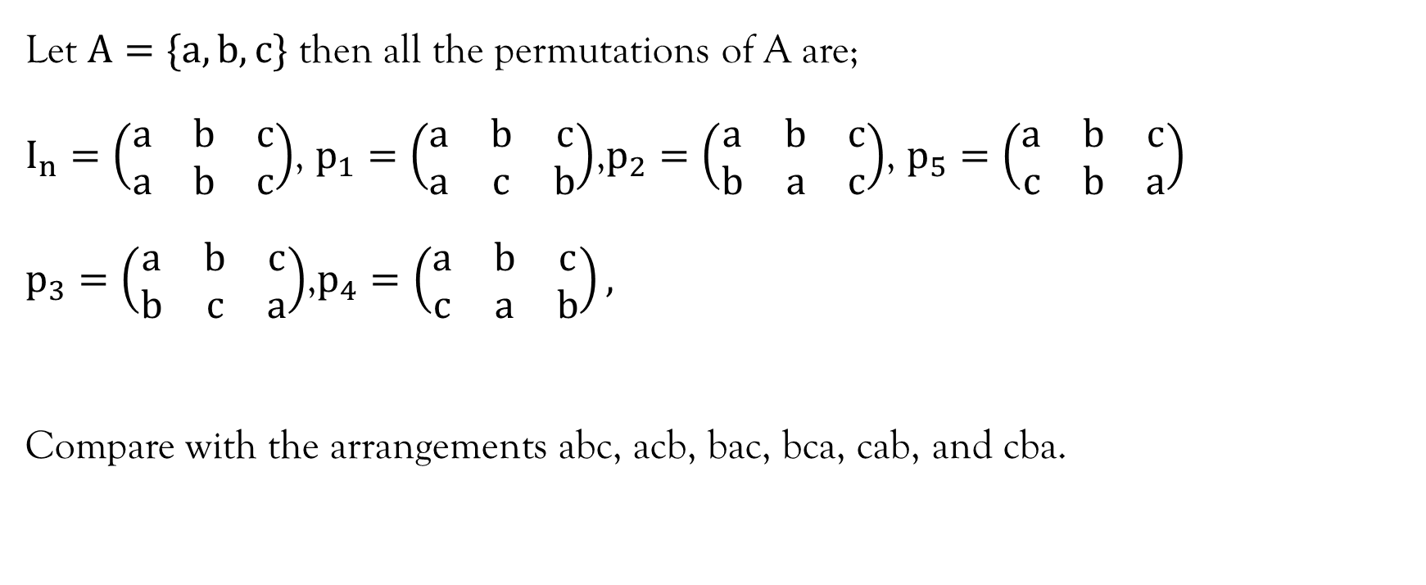
Example 1

Slide 7
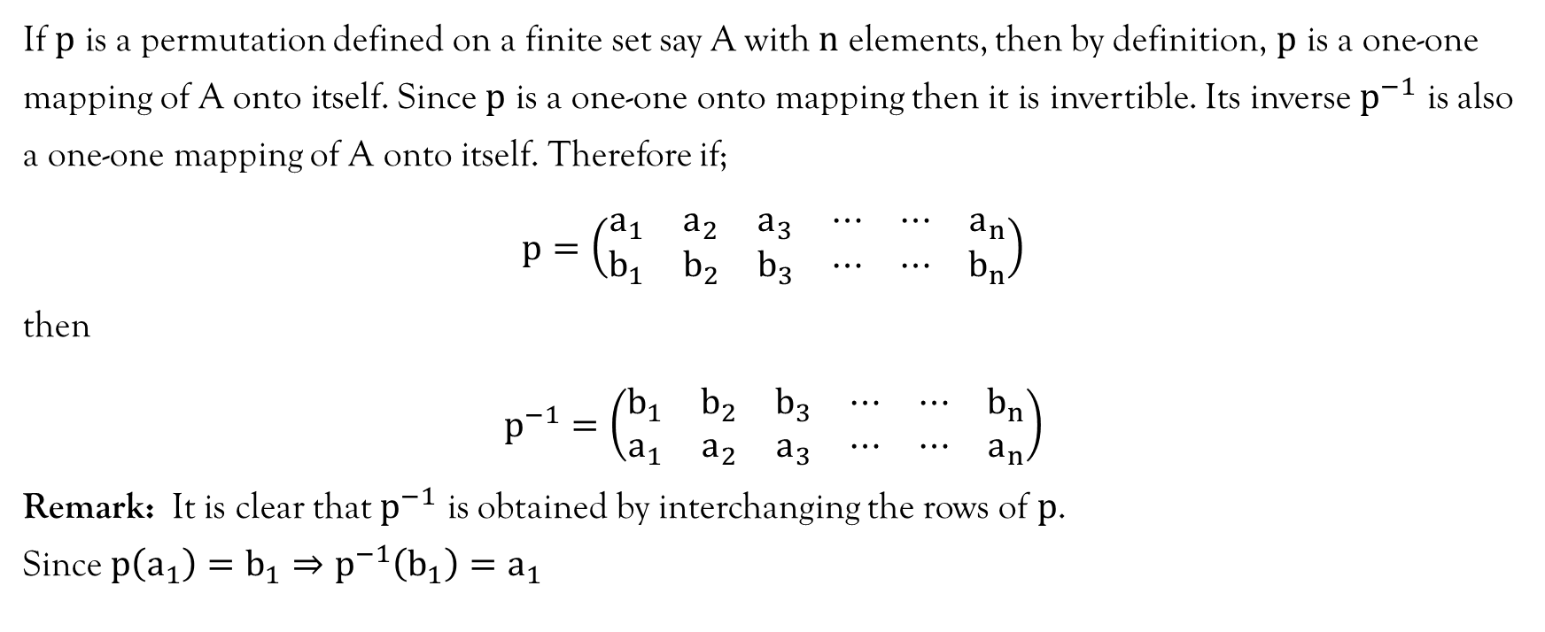
Inverse Permutation

Slide 8
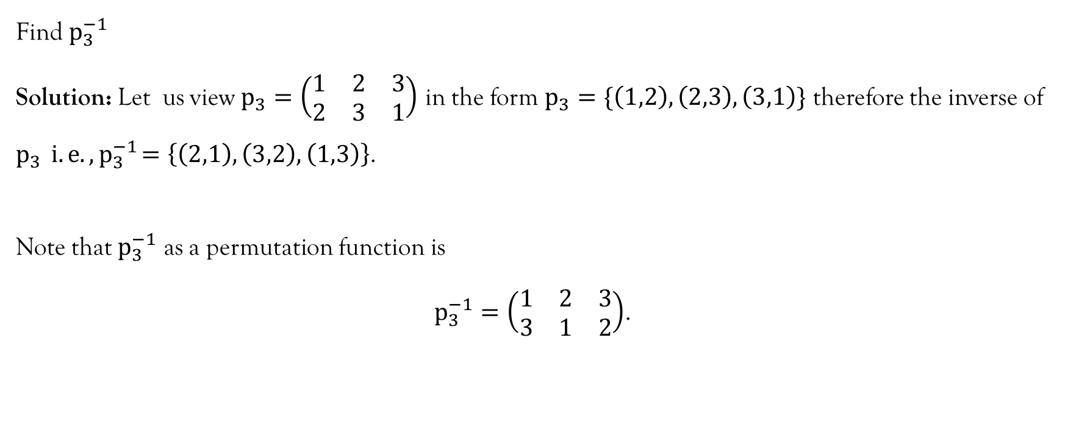
Example 2

Slide 9
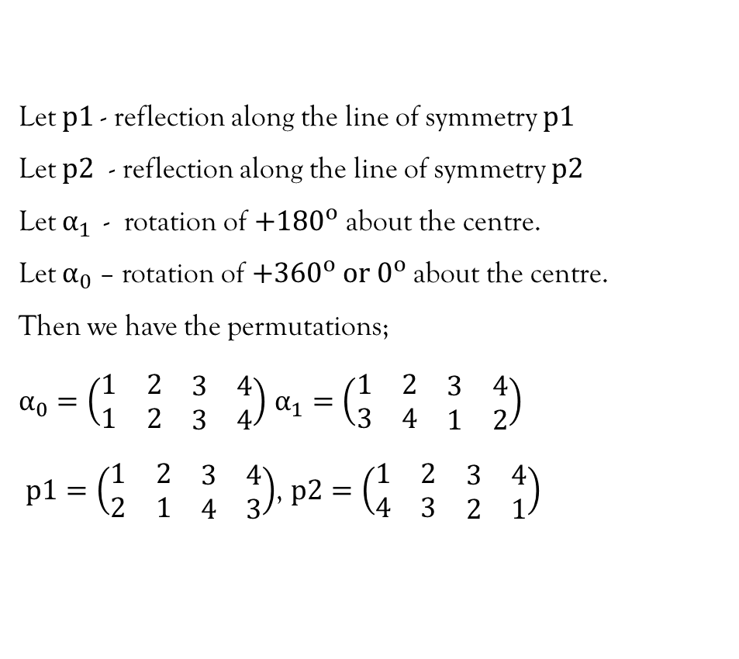
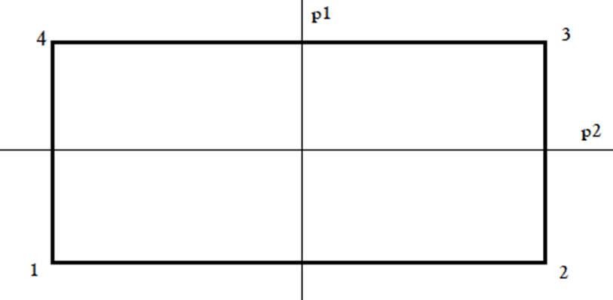
Example 3: Consider the rectangle with vertices 1,2,3,and 4 as shown below;

Slide 10
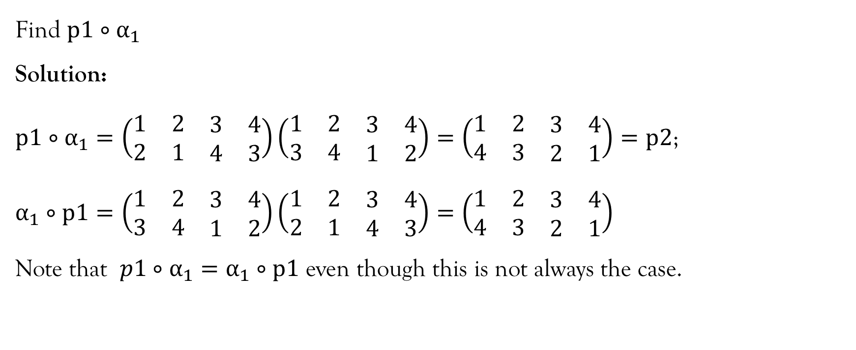
Example 3…contd…

Slide 11
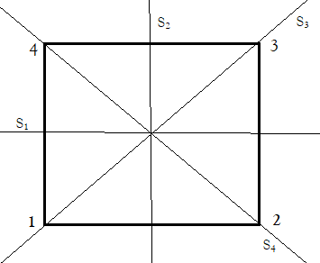
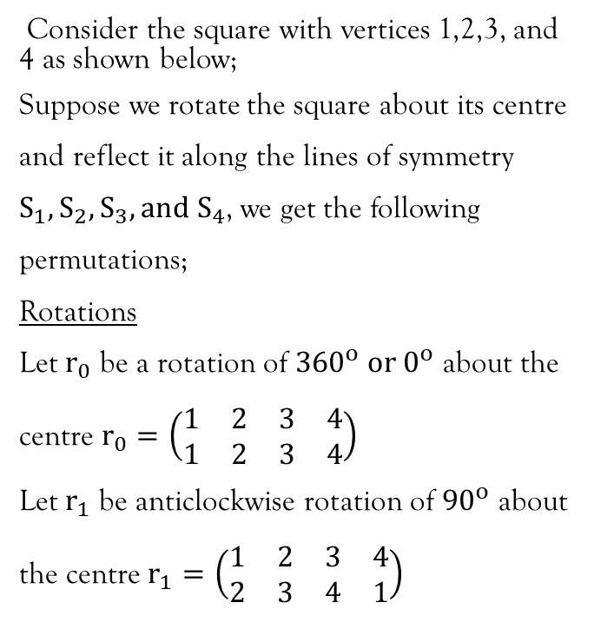
Example 4

Slide 12
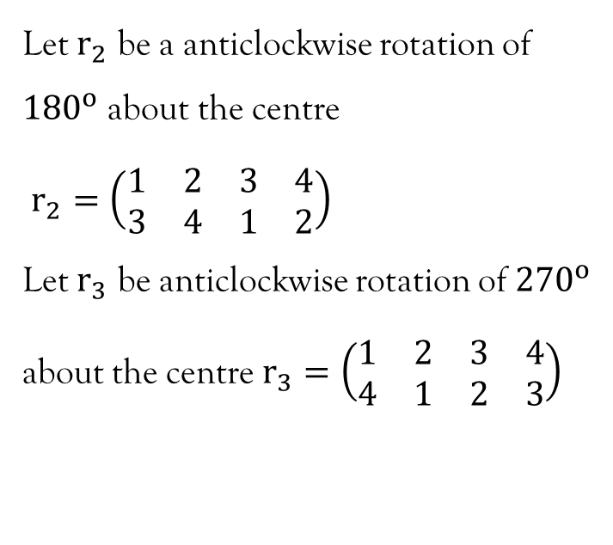
Example 4…Contd…

Slide 13
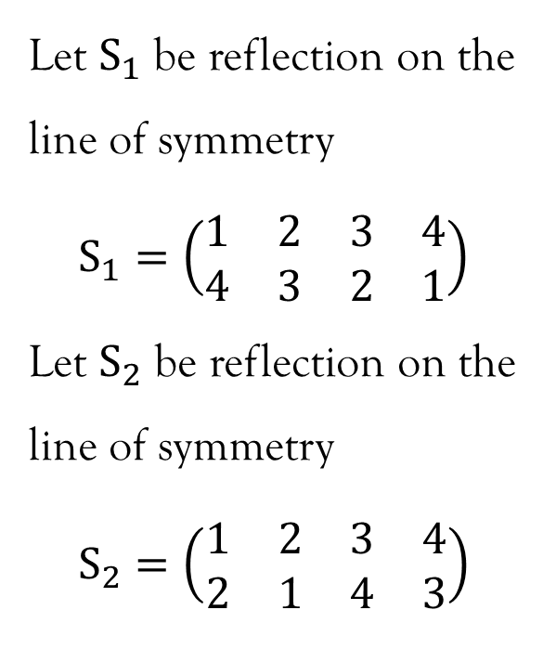
Example 4…contd…

Slide 14
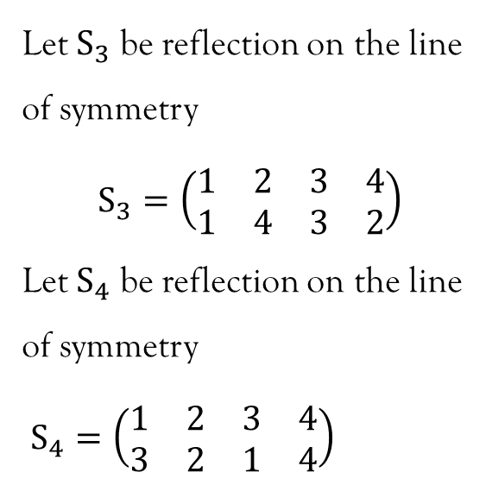
Example 4…contd…

Slide 15
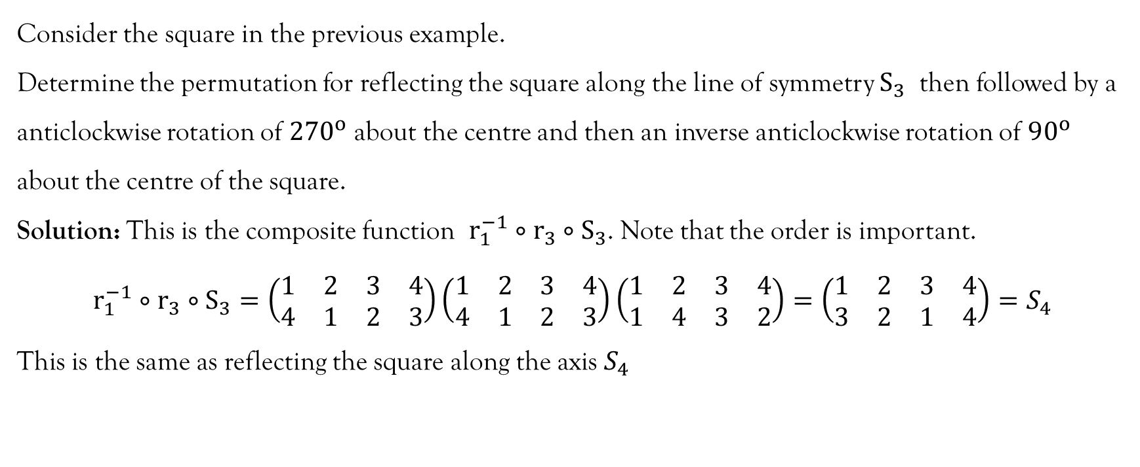
Example 5

Slide 16
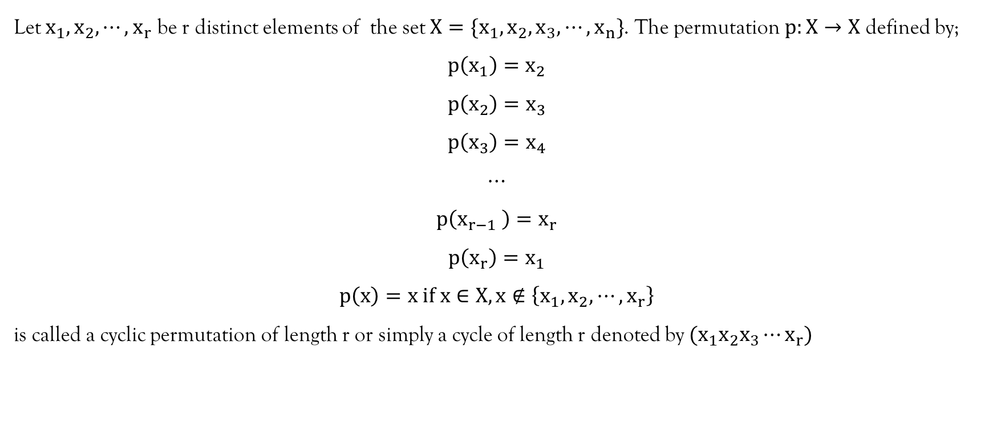
Cyclic permutation

Slide 17
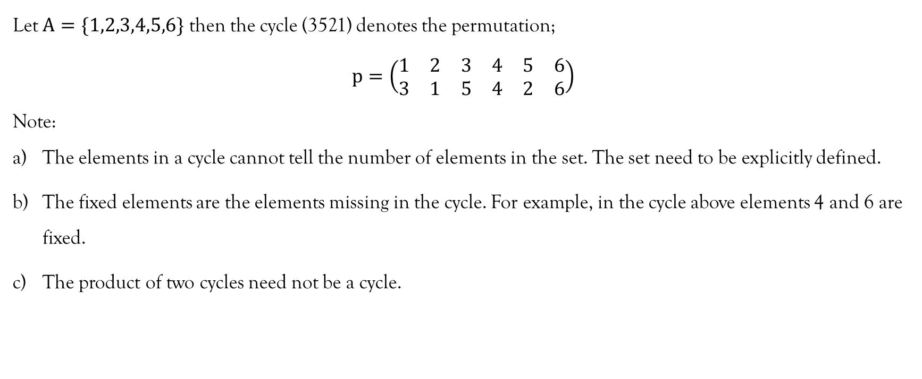
Example 1

Slide 18
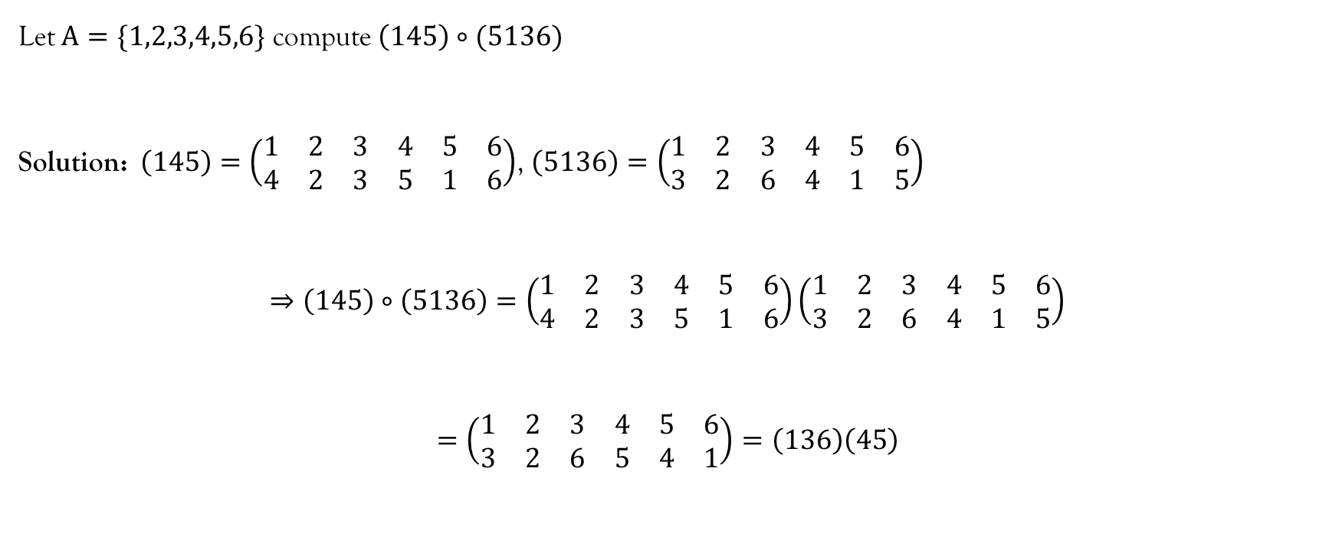
Example 2

Slide 19
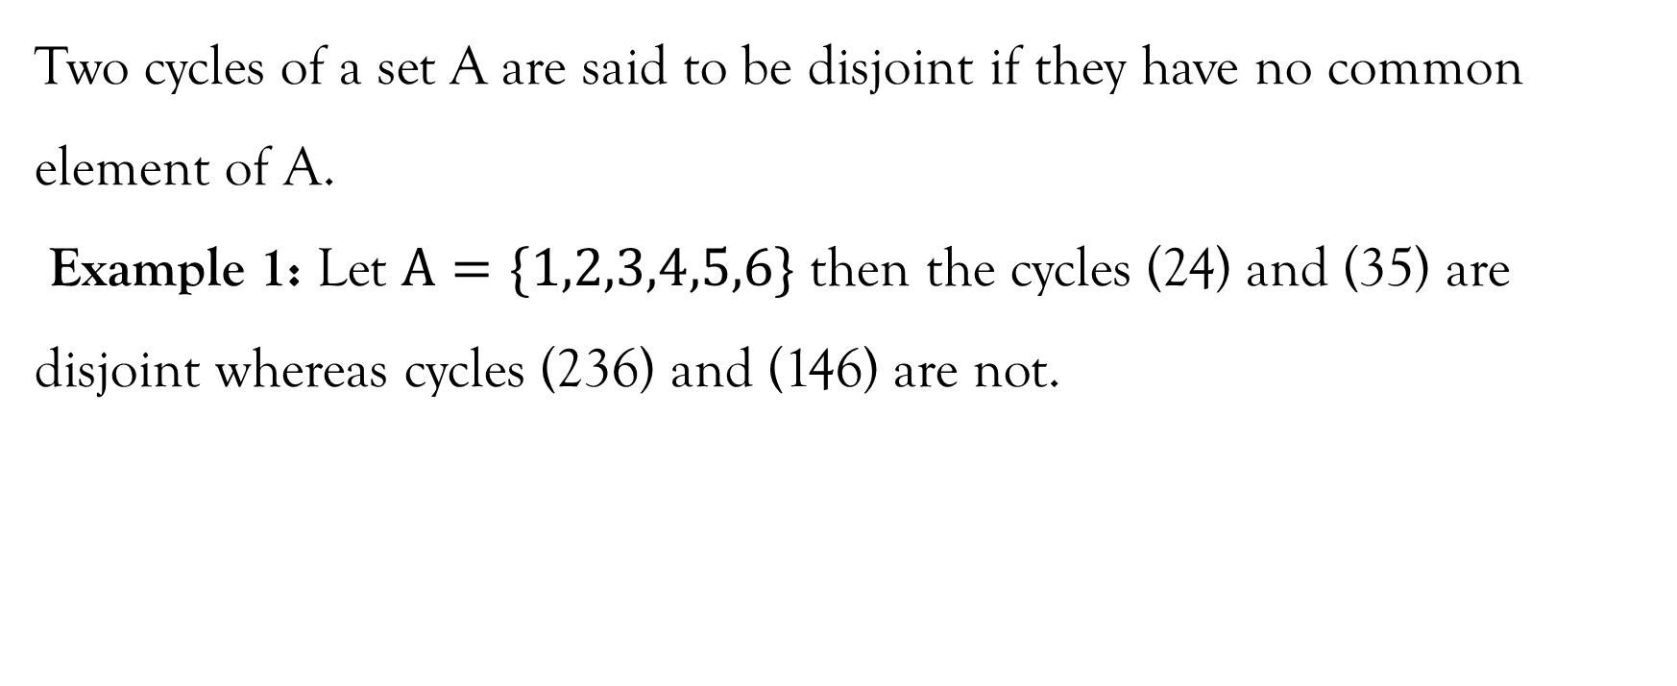
Disjoint cycles

Slide 20
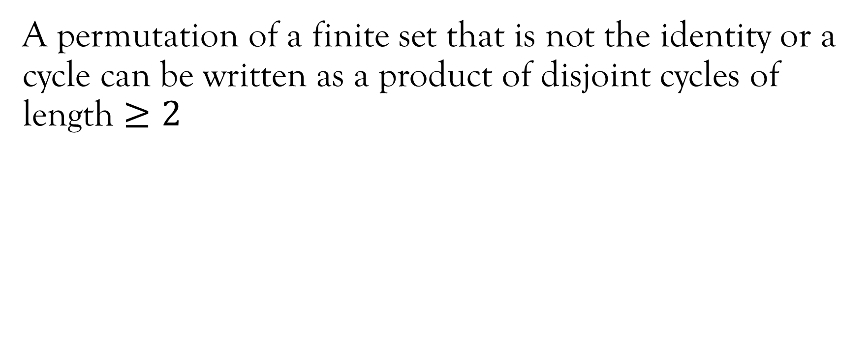
Theorem 1

Slide 21
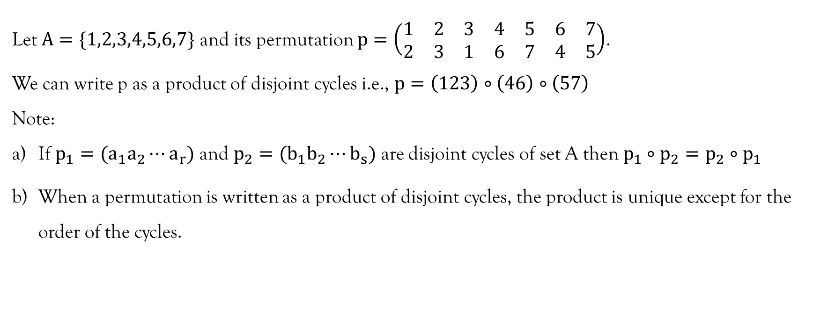
Example 1

Slide 22
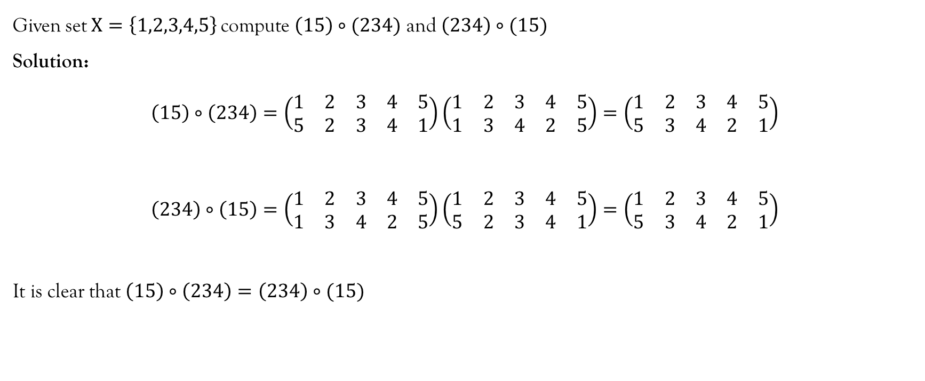
Example 2

Slide 23
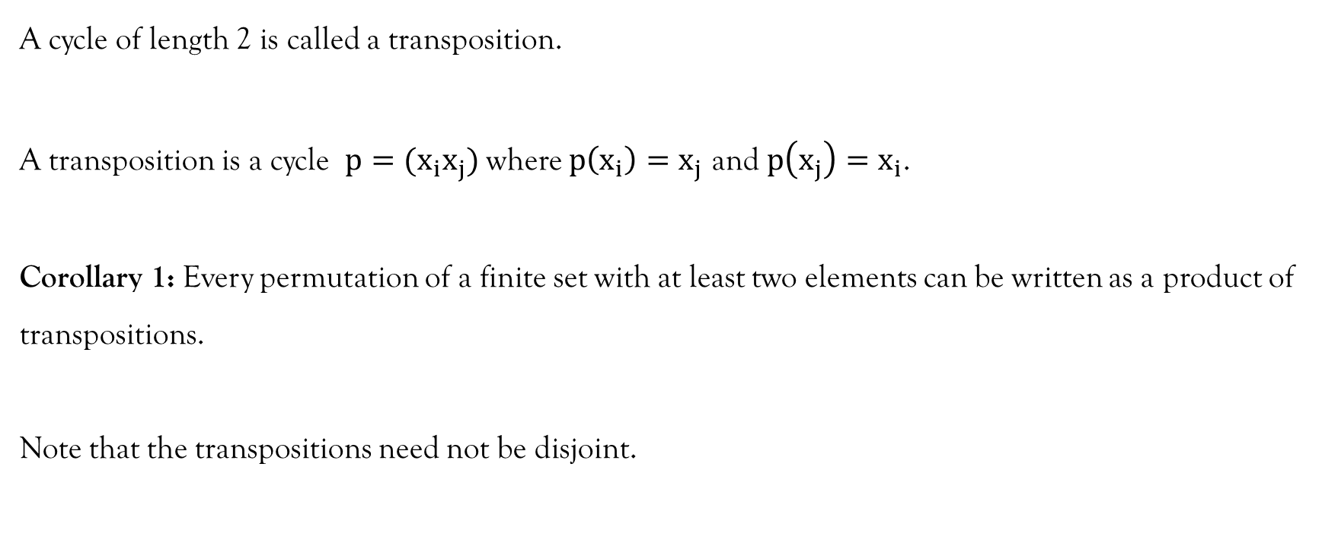
Transposition

Slide 24
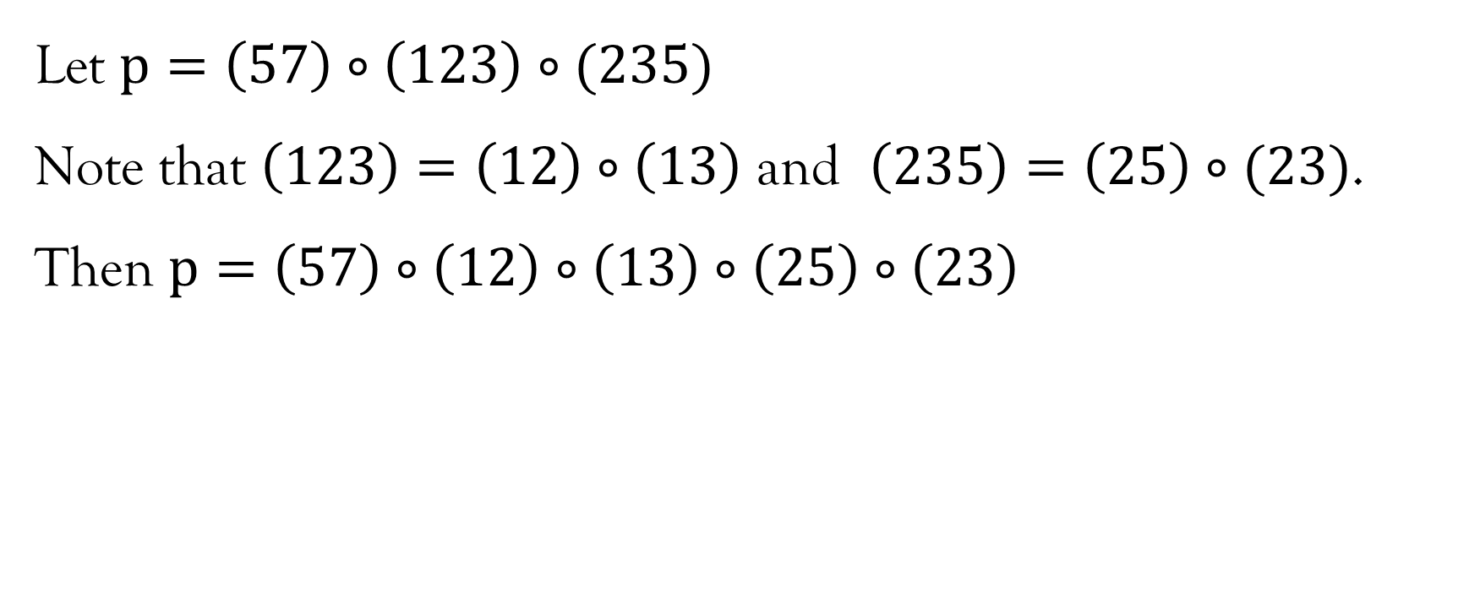
Example 1

Slide 25
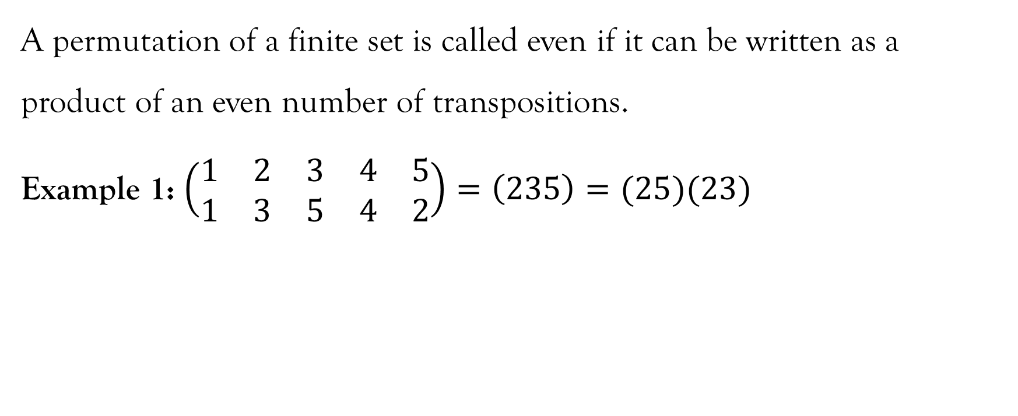
Even Permutation

Slide 26
Odd Permutation
A permutation of a finite set is called odd if it can be written as a product of an odd number of permutations.

Slide 27
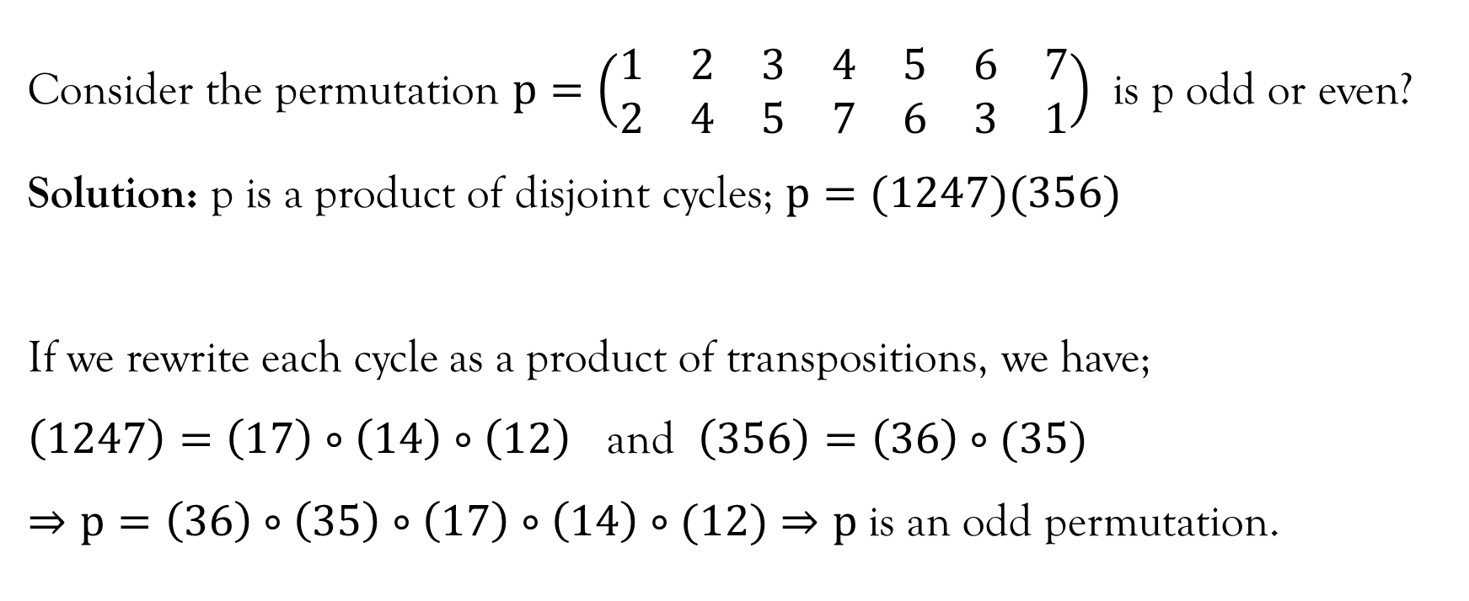
Example 1

Slide 28
Permutation group
A permutation group of a set A is a set of permutations of A that forms a group under function composition.

Slide 29
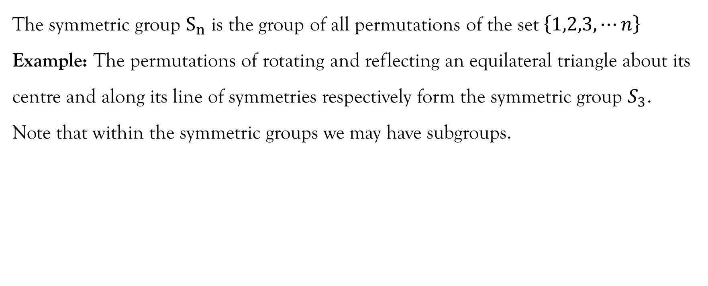
Symmetric Groups

Slide 30
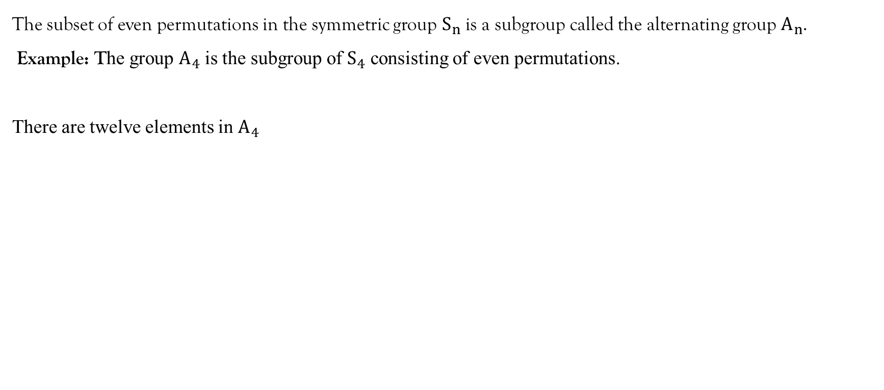
Alternating group
I | (12)(34) | (13)(24) | (14)(23)
(123) | (132) | (124) | (142)
(134) | (143) | (234) | (243)

Slide 31
References
Judson, T. W., & Beezer, R. A. (2018). Abstract Algebra: Theory and Application. http://abstract.pugetsound.edu/
Pinter, C. C. (2010). A book of Abstract Algebra (2nd ed.). Dover Publications, Inc. http://www2.math.umd.edu/~jcohen/402/Pinter Algebra.pdf
William, G. J., & Nicholson, K. W. (2004). Modern Algebra with applications (2nd ed.). John Wiley & Sons, Inc.

Slide 32
End of Lecture 11
Thank you!

