Slide 1
Mathematics for Science
Lecture 13
Introduction to mathematical induction
Lecturer: Kahenya, N.P

Slide 2
Introduction to Lecture 13
The lecture will introduce one of the methods of indirect proof i.e. proof by mathematical induction.
The principle of mathematical induction is used to establish the truth of propositions or statements that are defined over the set of positive integers or natural numbers.

Slide 3
Intended learning outcomes
At the end of this lecture, you will be able to;
Define the principle of mathematical induction.
Apply the principle of mathematical induction to prove theorems.

Slide 4
Further readings
The lecture notes can be complemented with relevant topics from (Kahenya, 2017; Mott et al., 2004; Murray & Robert, 2009; Stewart, 2012)

Slide 5
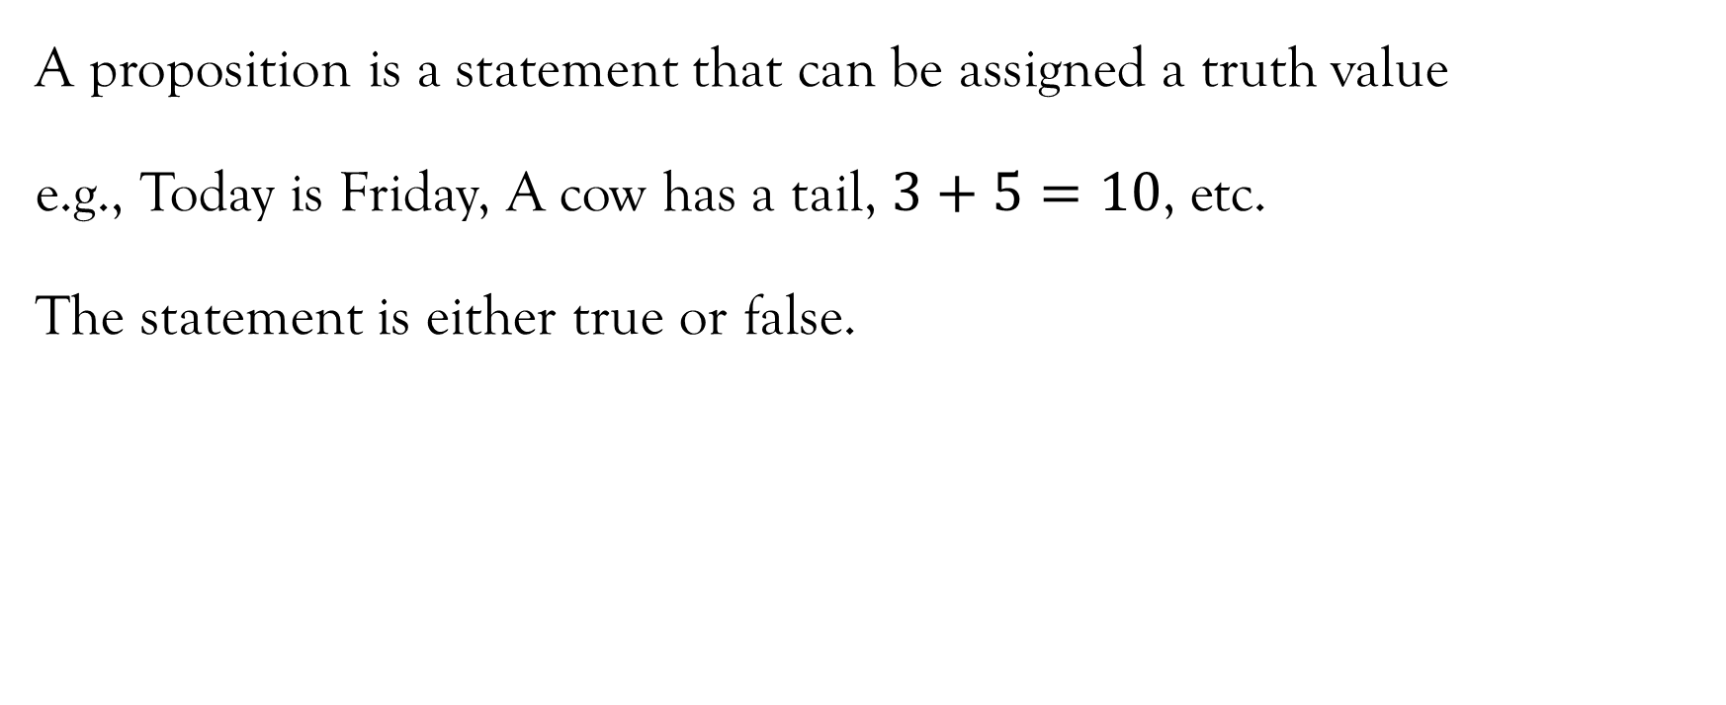
Definition 1

Slide 6
Definition 2
A theorem is a proposition that has been proved to be true.
e.g. the Pythagoras theorem, the Fermat’s little theorem etc.

Slide 7
Definition 3
Reasoning can be viewed as drawing of inferences or conclusions from known or assumed facts.
Deductive reasoning is the type of logic (science of correct reasoning that is fundamental to critical thinking and problem solving) that involves the application of a general statement to a specific case i.e., from general to specific.
On the other hand, inductive reason is drawing conclusions from a specific case i.e. from specific to general.

Slide 8
Example 1
An example of deductive reasoning (from GENERAL to SPECIFIC) is the use of a formula to solve a particular problem
e.g., we use the general quadratic formula to solve specific problems involving quadratic equations.

Slide 9
Example 2
An example of an inductive reasoning (from SPECIFIC to GENERAL) is where we use a SAMPLE to make conclusions or generalization of the entire POPULATION.

Slide 10
Definition 4
An argument is a structure that consists of PREMISES or ASSUMPTIONS and a CONCLUSION.
Example1: If it rains Otieno will go to the market. It rained. Therefore, Otieno did not go to the market.
This is an argument with two assumptions: If it rains Otieno will go to the market, and It rained. The conclusion is: Otieno did not go to the market.

Slide 11
Definitions
A proof is an argument that is used to establish the truth of a theorem.
There exists different methods of mathematical proofs for establish the truth value of theorems. Generally, there exists direct and indirect methods of proof that can be used under varying circumstances.
In methods of direct proof, one starts with the hypothesis of an implication and then shows that the conclusion is true.
Some important methods of indirect proofs include proof by contradiction, proof by contrapositive, and proof by mathematical induction.

Slide 12
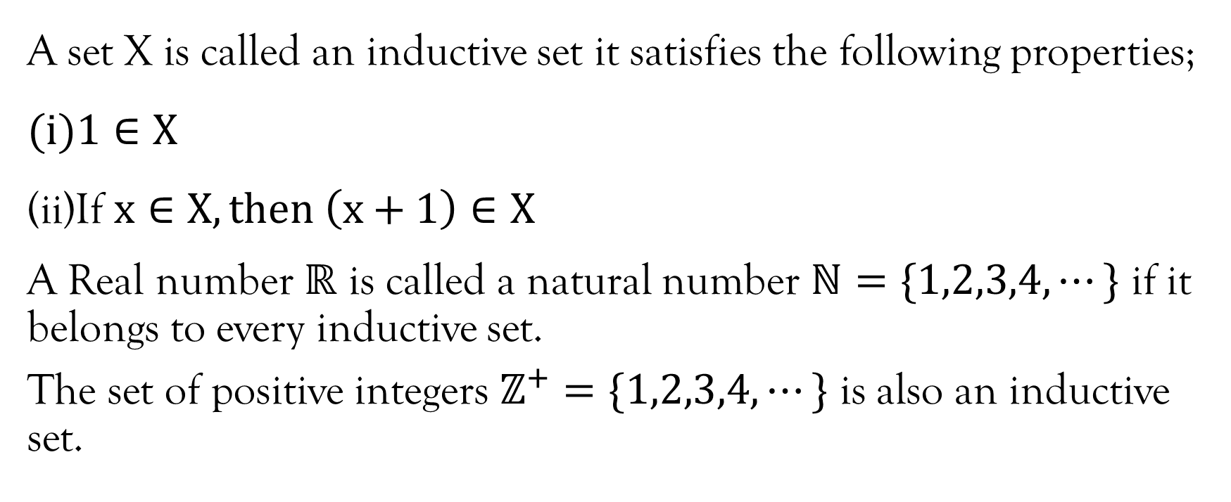
An inductive set

Slide 13
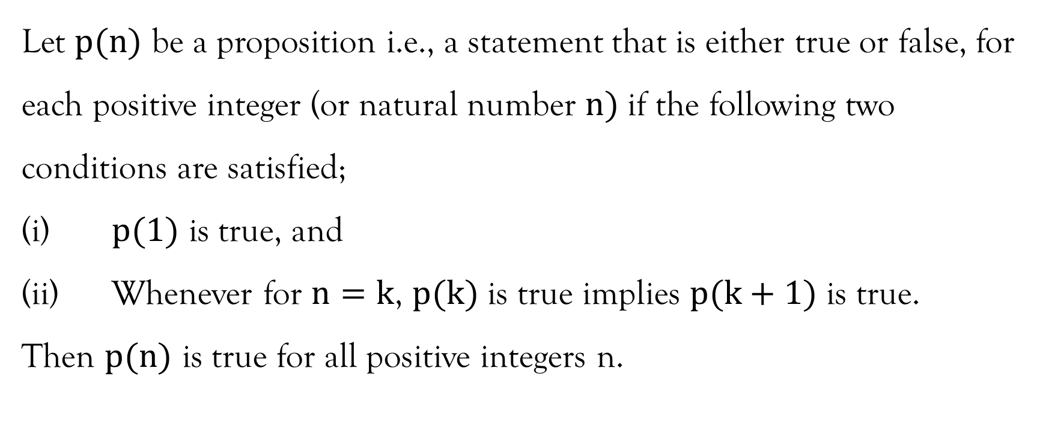
Principle of mathematical induction

Slide 14
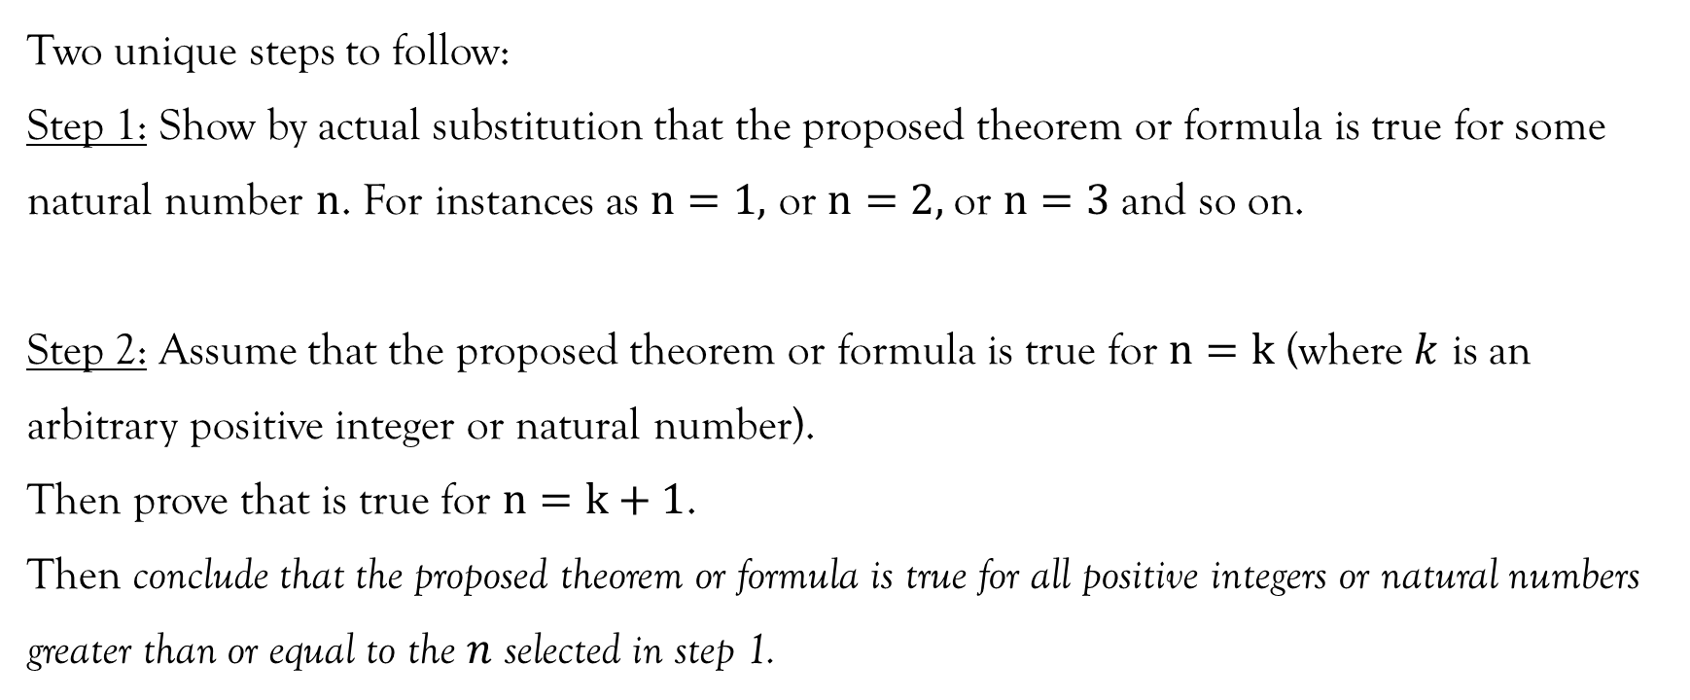
Steps to follow when proving by mathematical induction

Slide 15
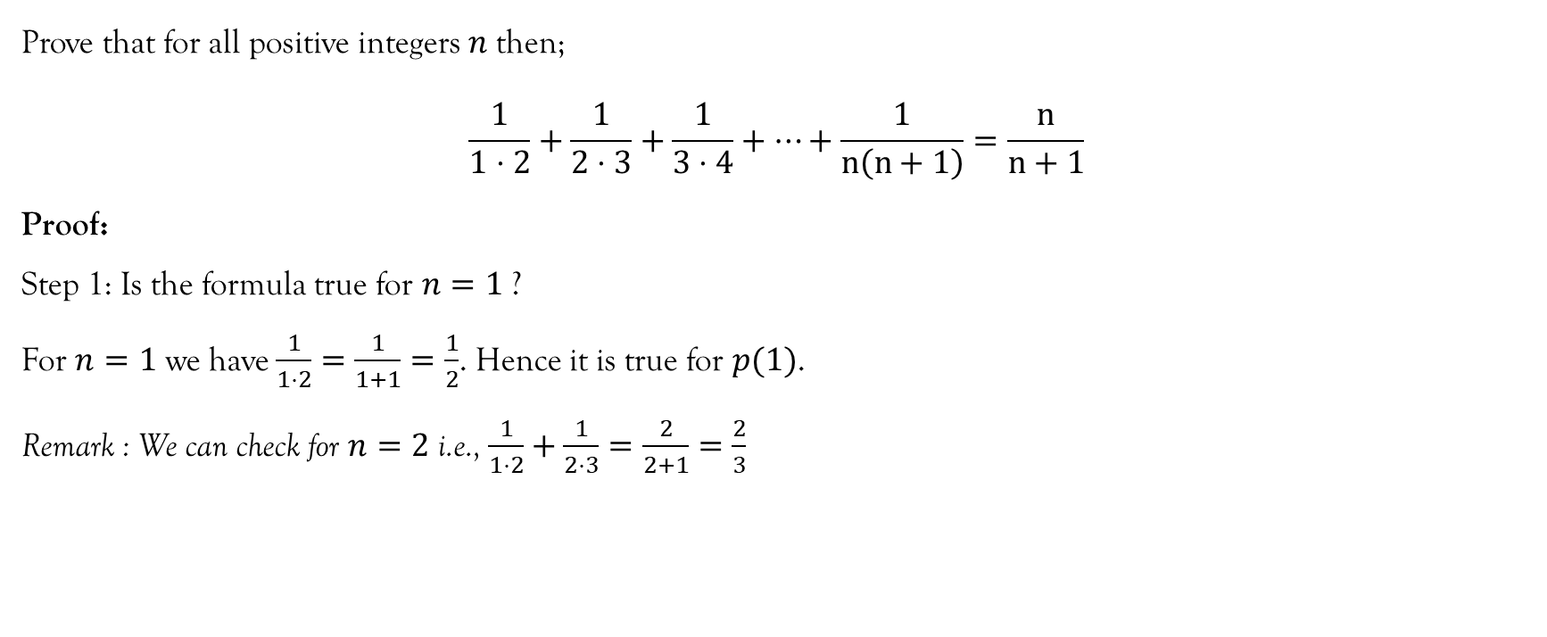
Example 1

Slide 16
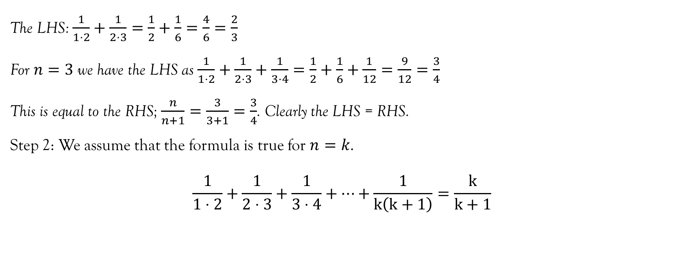
Example 1…contd…

Slide 17
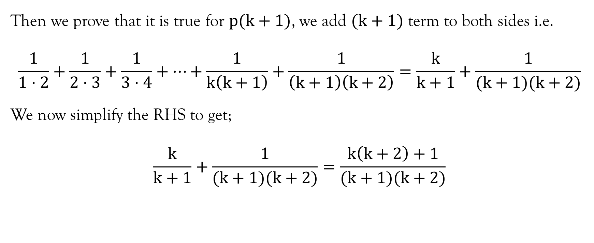
Example 1…contd…

Slide 18
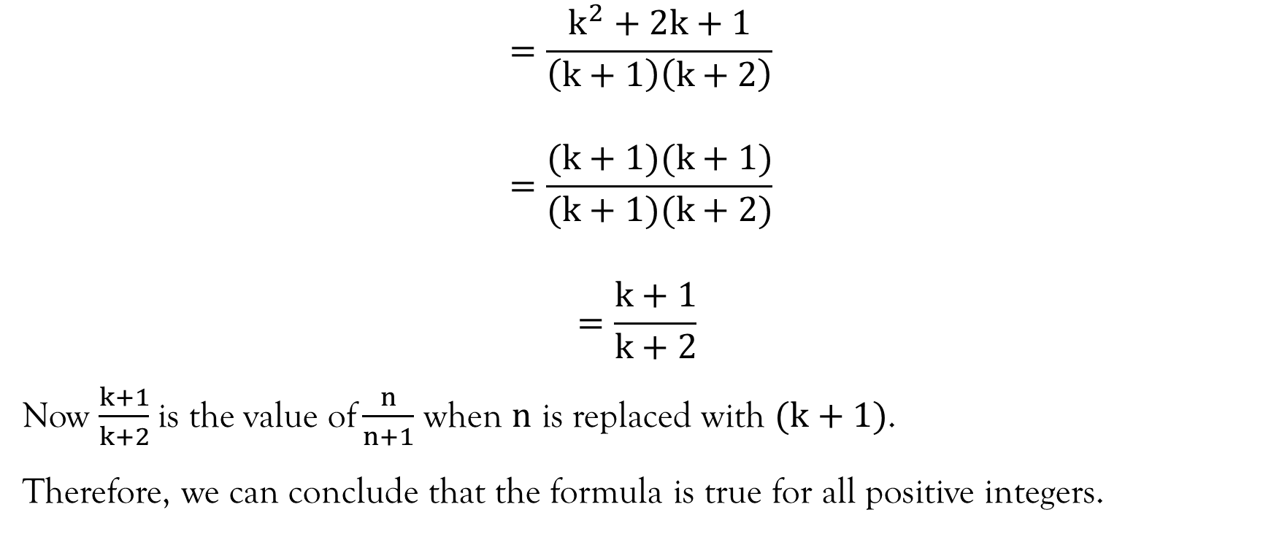
Example 1…contd…

Slide 19
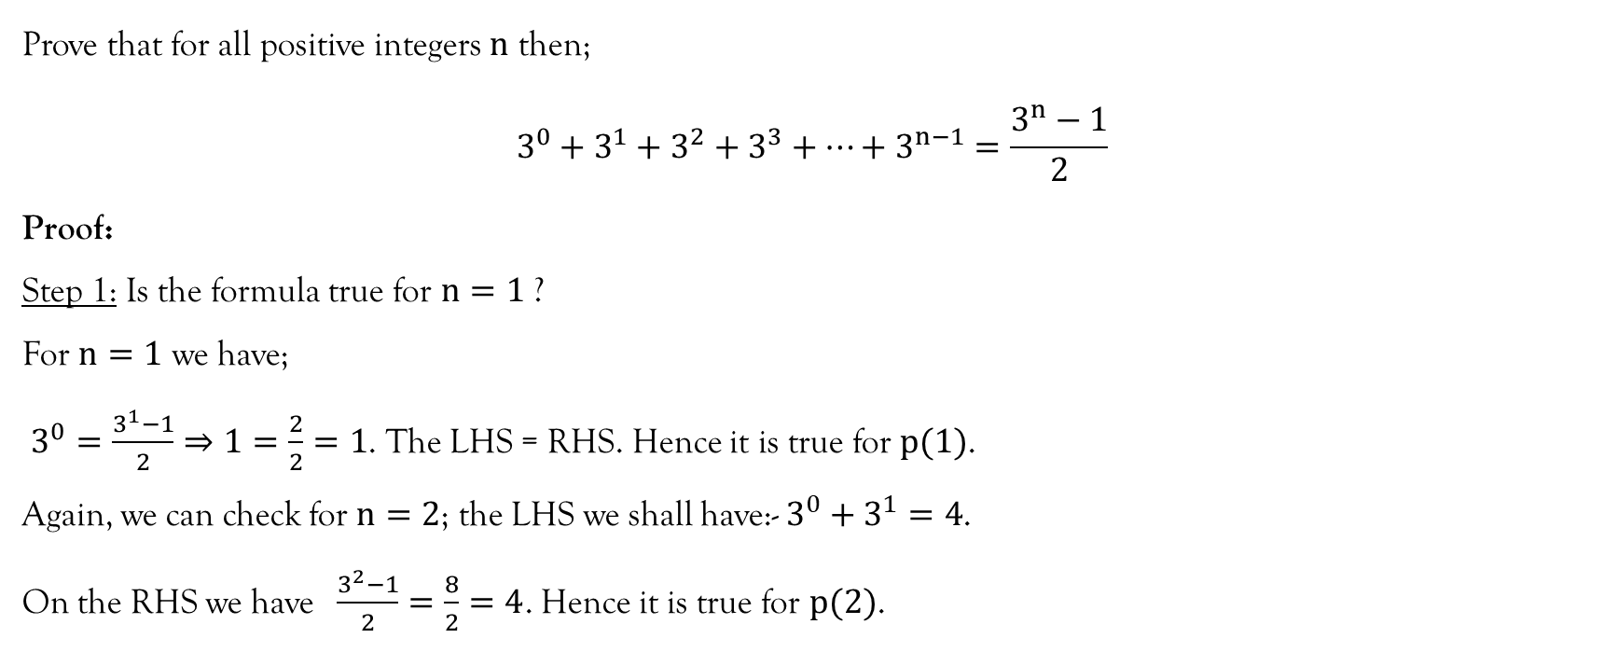
Example 2

Slide 20
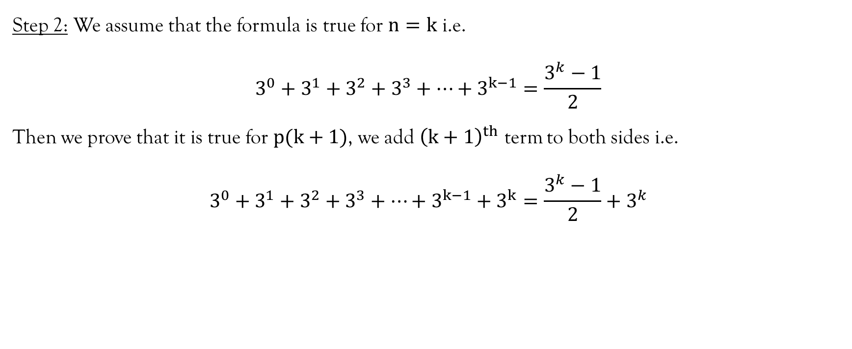
Example 2…contd…

Slide 21
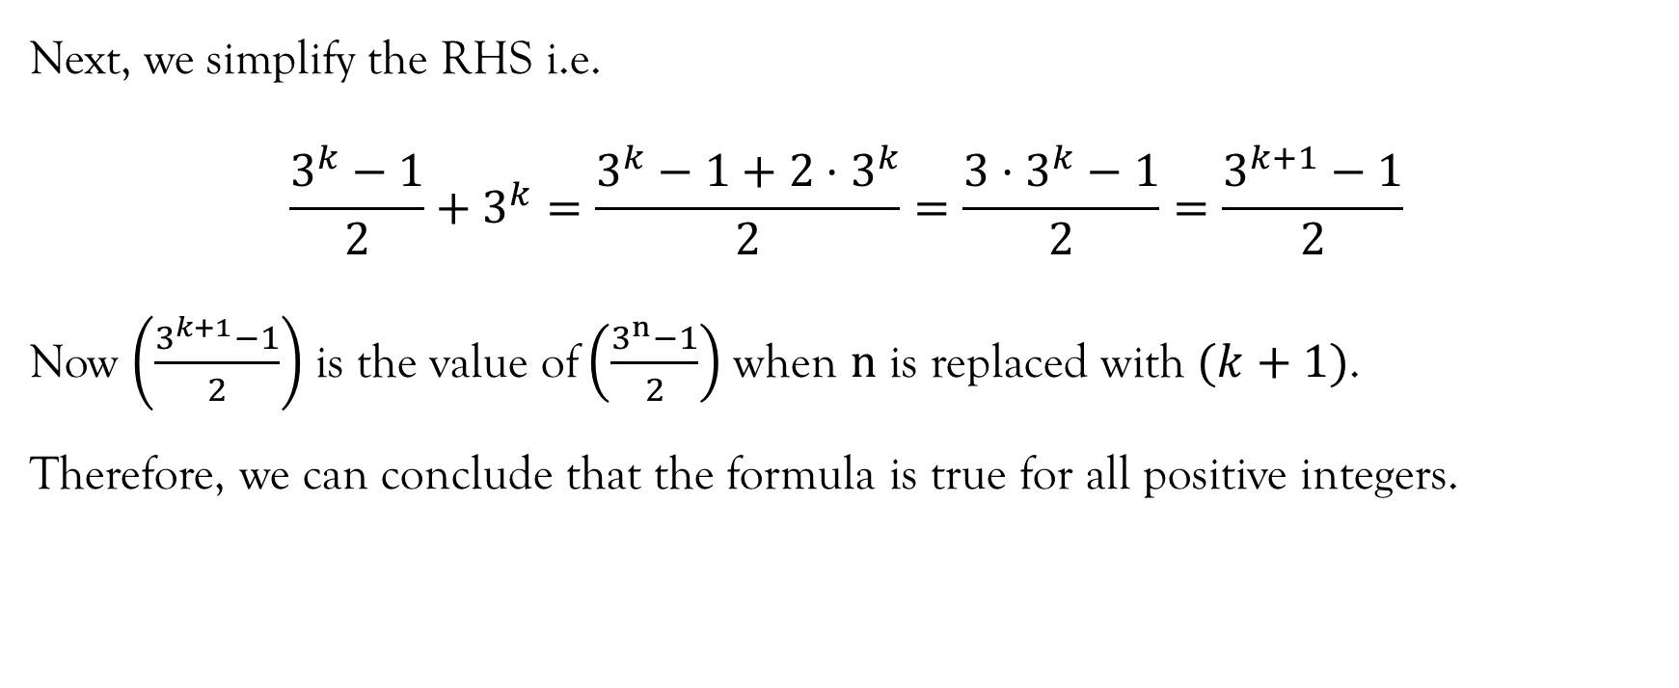
Example 2…contd…

Slide 22
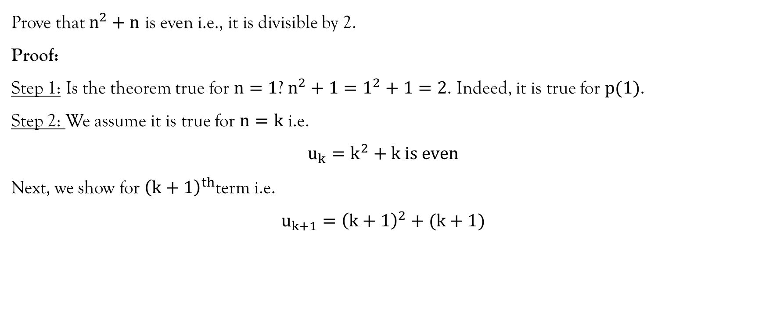
Example 3

Slide 23
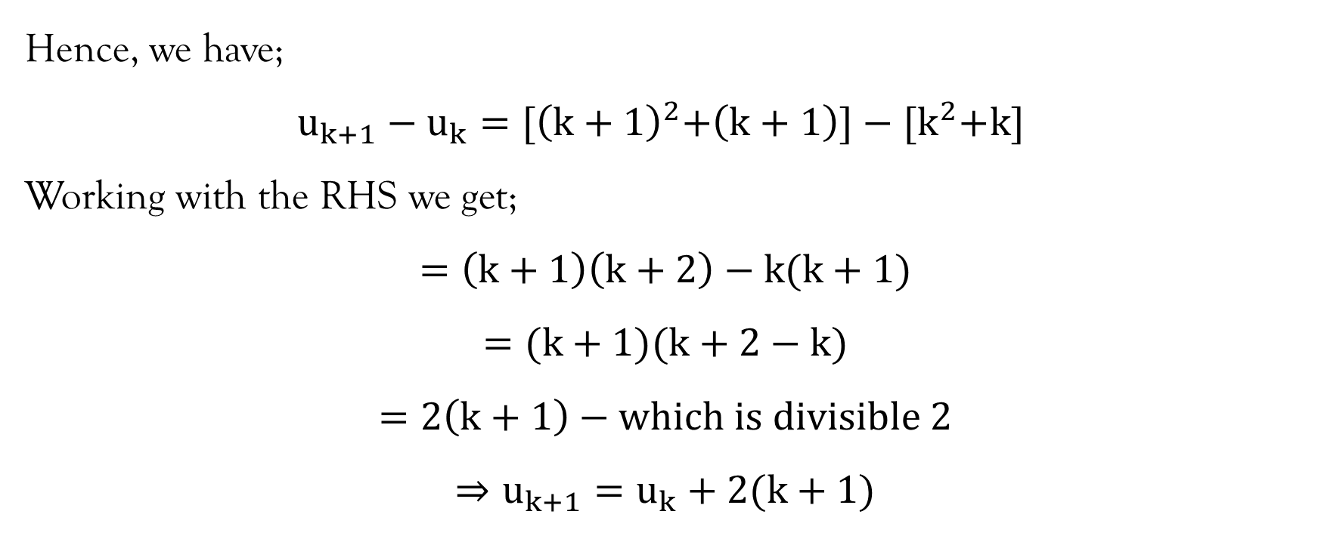
Example 3…contd…

Slide 24
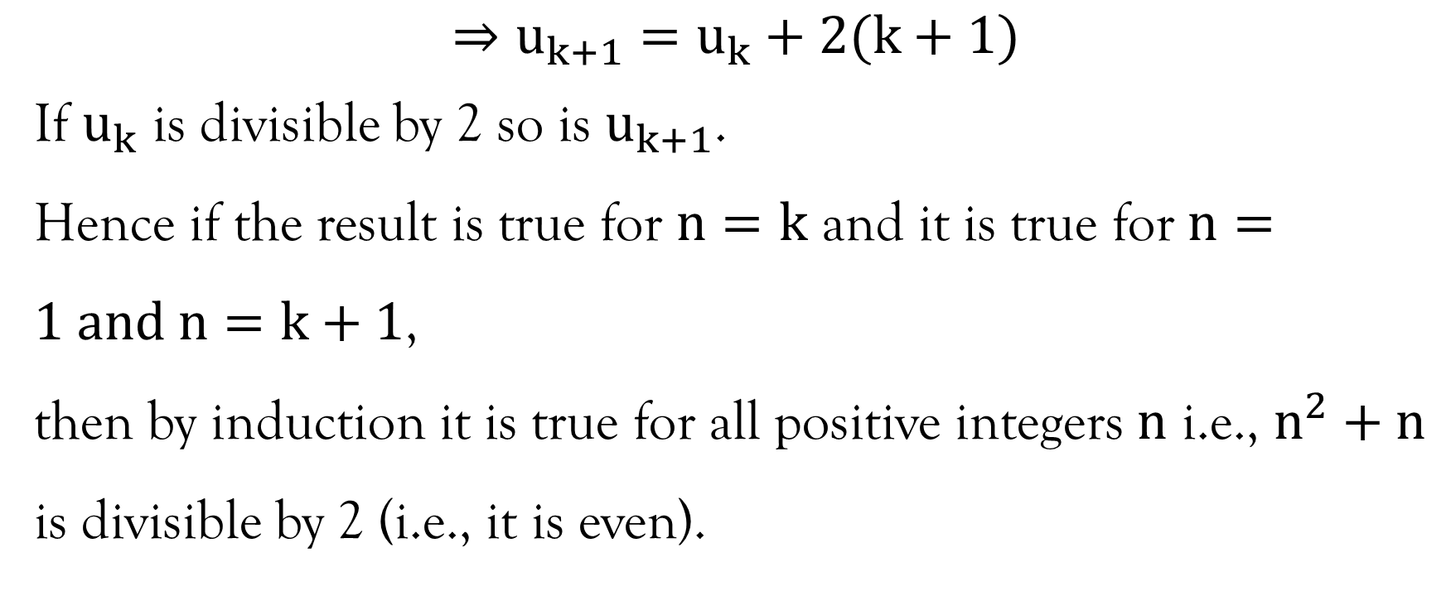
Example 3…contd…

Slide 25
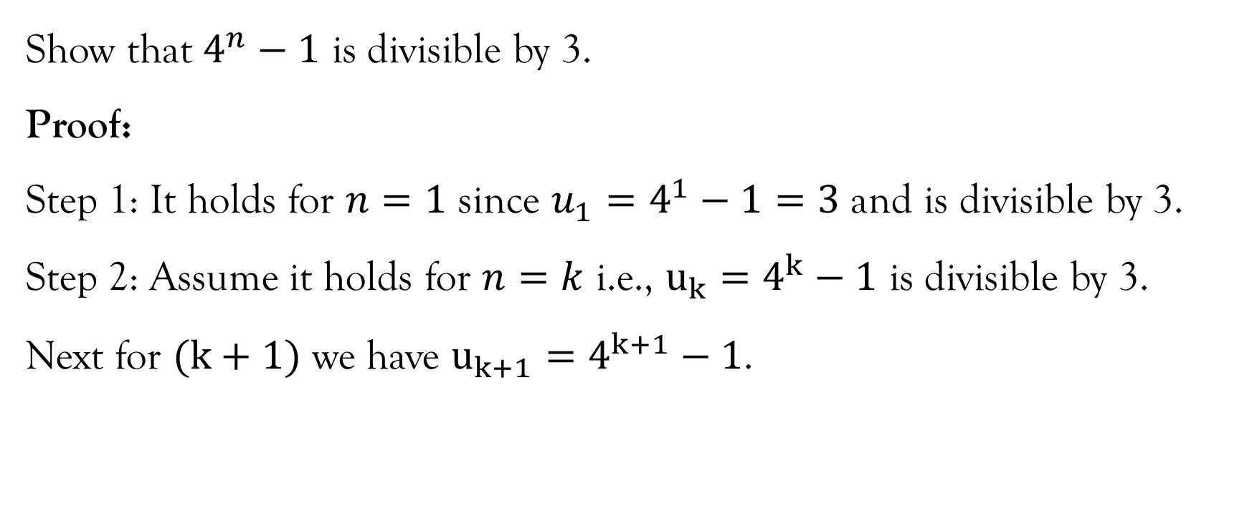
Example 4

Slide 26
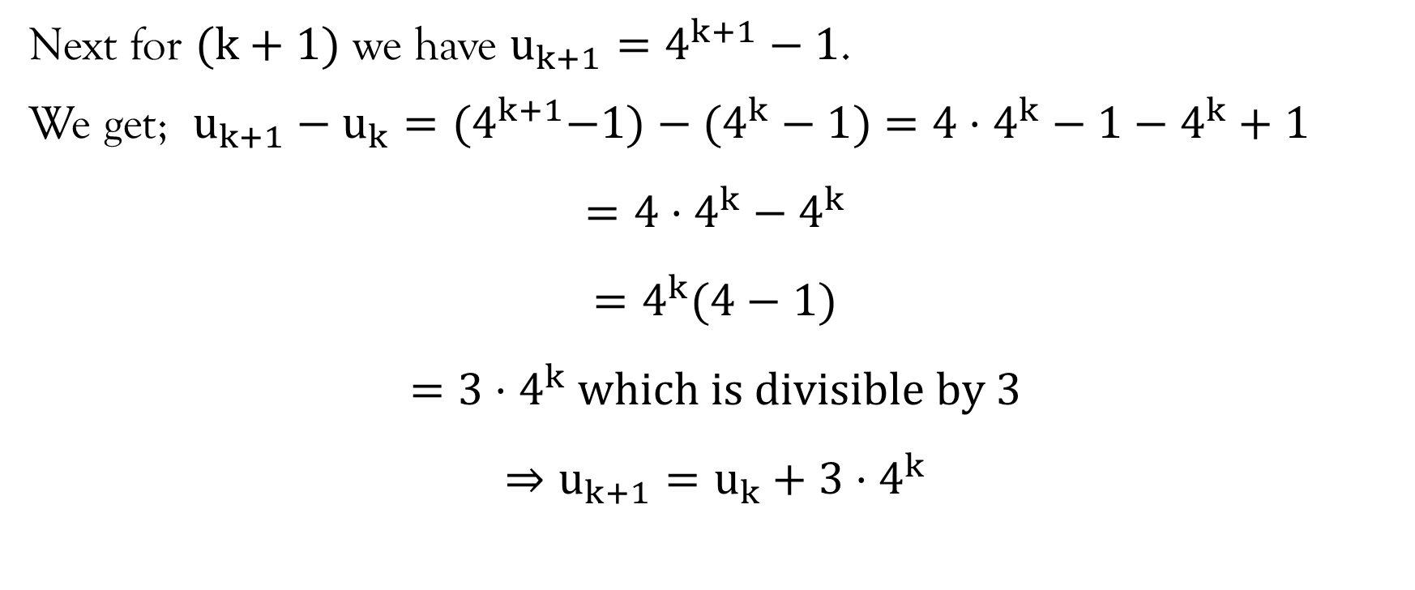
Example 4…contd…

Slide 27
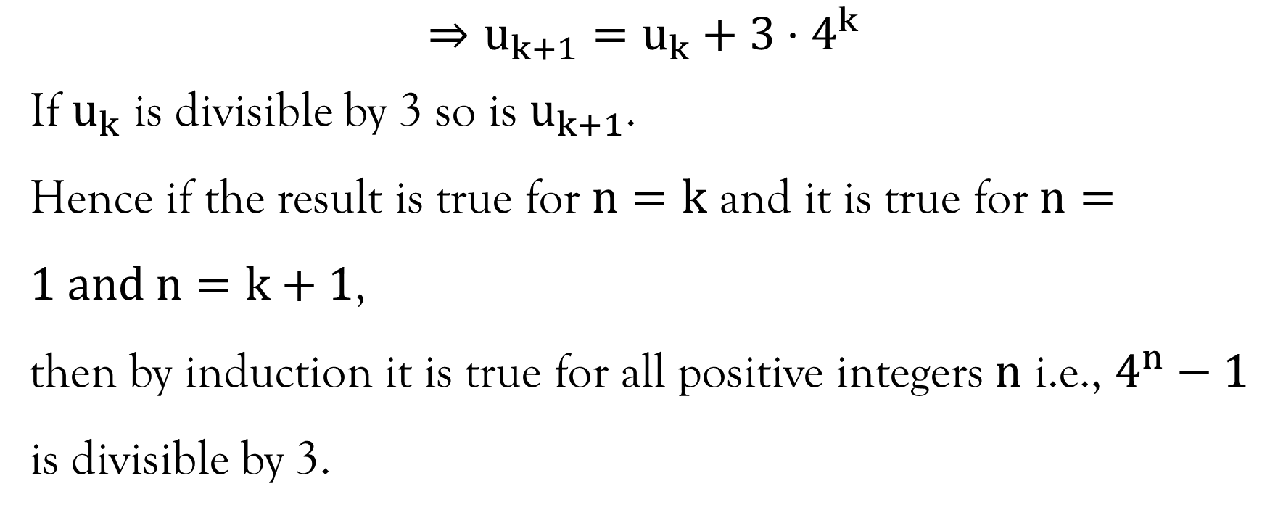
Example 4…contd…

Slide 28
References
Kahenya, P. (2017). Foundation Maths. LAP Lambert Academic Publishers.
Mott, J. L., Kandel, A., & Baker, T. P. (2004). Discrete Mathematics for Computer Scientists & Mathematicians (second). Prentice Hall of India.
Murray, S., & Robert, M. (2009). College Algebra. McGraw-Hill.
Stewart, J. (2012). Calculus (7th ed.). BROOKS/COLE Cengage Learning.

Slide 29
End of Lecture 13
We look at the past lectures 1 - 12

Slide 30
Lecture 1 - 4
Lecture 1: Arithmetic of complex numbers
Lecture 2: Polar equations and graphs
Lecture 3: Conic sections: Circles and parabolas
Lecture 4: Ellipses and hyperbolas

Slide 31
Lecture 5 - 8
Lecture 5: Polynomials: Remainder and factor theorem
Lecture 6: Decomposing rational functions: CASE I and II
Lecture 7: Decomposing rational functions: CASE III and IV
Lecture 8: Trigonometric equations and solving triangles

Slide 32
Lecture 9 - 12
Lecture 9: Trigonometrical identities and formula
Lecture 10: Introduction to permutations
Lecture 11: Permutation functions
Lecture 12: Introduction to combinations

Slide 33
End of Mathematics for Science Lectures
Thank You!

