Slide 1
MARKETING OF FINANCIAL SERVICES
LECTURE 10: Service Quality and Productivity in Financial Services Marketing
DR. John Kamau

Slide 2
Introduction
Welcome to week 10 lecture!
We have now covered over 80 % of our lectures in this course
It gives me great joy that we have walked together so far and look forward to completing the course in the next three weeks
Having looked at the marketing mix elements , we now turn to a very important aspect of financial service marketing “ the service quality”
.

Slide 3
Intended learning outcomes
At the end of this lecturer, you will be able to:
a) Define quality in service offerings
b) Describe service quality dimensions
c) Discuss service quality delivery gaps
d) Examine ways of service recovery
.

Slide 4
Customer satisfaction and service quality
Customers expect quality service in any financial institution.
Quality is a major determinant of customer satisfaction.
Satisfaction is the degree to which service delivered meets customer expectation.
Customer satisfaction is determined by factors such as service features, customer emotions, attributions for service success or failure, perceptions of equity or fairness, other consumers, family members and co-workers.
.

Slide 5
Benefits of customers satisfaction
Higher customer satisfaction
Positive word of mouth
Good publicity
Repeated purchases
Increases in market share.
.

Slide 6
Demands for customers satisfaction
Need to understanding customers’ needs
Specifying quality standards
Designing service delivery systems and procedures
Implementing suitable human resources policies
Developing a service quality information system to assess the firm’s overall performance.
.

Slide 7
Definition of service quality
Various definitions of quality have been put in place.
Crosby, (1984) defines quality as ‘conforming to requirements’ implying that organizations must establish requirements and specifications
Juran (1982) views it as ‘fitness for use’. Which basically looks at ways of satisfying customers’ needs.
.

Slide 8
Definition of service quality
Garvin (1988) in attempting to define quality developed various perspectives on quality such as:
The transcendent view (innate mark of excellence)
The product-based approach (quality as a precise and measurable variable)
User-based definition (quality lies in the eyes of the beholder).
Value based approach (affordable excellence).
.

Slide 9
Definition cont.
From the various definition we can define quality financial services as perceived affordable excellent services that meets or exceeds customer expectation.
This implies that financial customer has certain expectation depending on how much they are willing to spend and that if the service provider meets or exceed the expectation then they will perceive that the quality of service is high.
.

Slide 10
Dimension of services quality
Various scholars such as Zeithaml and Bitner (2000), Gronroos (1984) and Johnson, Silvestro, Fitzgerald and Voss, (1990) have identified various dimensions of a service.
For purpose of this class we will discuss quality dimensions highlighted by Parasuraman, Zeithaml and Berry (1985; 1988), who developed 10 dimesions of service quality
.

Slide 11
Dimensions cont.
a) Reliability: This is the ability of financial institutions to perform the promised service dependably and accurately.
It is particularly important that these firms deliver core attributes of services to meet customer expectation and beyond.
b) Responsiveness: The willingness to help customers and to provide prompt service.
Employees must show attentiveness, flexibility, and improve speed of service delivery depending on customer’s request.
.

Slide 12
Dimensions cont.
c)Tangibles: This has to do with appearance of physical facilities, equipment, personnel, and communication materials in the service center.
The size and shape of the building, location, equipment being used, the dressing of staff delivering the service all of which will communicate to them about service quality.
Maintain state of the art facilities to create right impression about service quality.
.

Slide 13
Dimensions cont.
d) Communication: Keeping customers informed in a language they can understand.
e) Credibility: The ability to convey honest, trust and confidence.
The suppliers of such services must live to this customers expectation by the way they conduct business, the language they use, level of consistency and they way they interact with the customers.
.

Slide 14
Dimensions cont.
f) Security: The physical, financial and confidentiality.
The financial service provider must demonstrate to the customer that they are safe inside service facilities and that their accounts are also safe.
This is a big concern in days of cyber crimes and hacking of accounts due to technological developments.
.

Slide 15
Dimensions cont.
g)Competence: The service employees must demonstrate to customers that they have the required skills and knowledge to serve their customers.
This is done by ensuring that they consistently give correct information, respond appropriately to customer queries, and in case of a technical problem, they can easily solve it or refer it to the right person.
.

Slide 16
Dimensions cont.
h) Courtesy: This is expression of politeness, respect, and friendliness to customers by the employees.
The financial customers have expectation that they would be welcomed warmly in financial institution and treated with respect by financial services provider.
The financial service provider must demonstrate that they care and are concerned about their customers well-being.
.

Slide 17
Dimensions cont.
i) Empathy: The provision of caring, individualized attention to customers.
In this context the service provider must not give programmed solution to all customers but must show they understand each customer and treat them differently.
j) Access: The ease of approach and contact.
The service employee must be approachable and easy to talk to as they deal with customers.
.

Slide 18
Summary of service dimensions
1. Reliability – delivering on promises
2. Responsiveness i.e., being willing to help
3.Assurance –Inspiring trust and confidence
4. Empathy- Treating customers as individuals
5. Tangibles –physical representation.
Employees are familiar with these dimensions
Live a lifestyle that has these values
.

Slide 19
Underlying values
Love and appreciate customers
Consistency in lifestyle
Keep the firms core values
Long term perspective
Understand the environment
Decisiveness on the side of employee
Team spirit
.

Slide 20
How to acquire pre-requisite values
Become aware of them by through various forums
Have a strong desire to live and practice them
Research more on these values and how to live them
Have conversations on these values with friends’, colleagues and family
Meditate on these dimensions more and more
.

Slide 21
Service Delivery and Design Gaps
The service delivery and design gaps arise from the believe that a financial service provider or any other service business desires to offer consistency service to its customers all the time.
However due to human error, there are many gaps that arise between service delivered and customer expectation.
The theory of service gaps was developed by Zeithaml, berry, and Parasuraman (1985) and enhanced by lovelock (1994).
The gap model identifies seven service gaps that a financial service provider encounters and how to close them
.

Slide 22
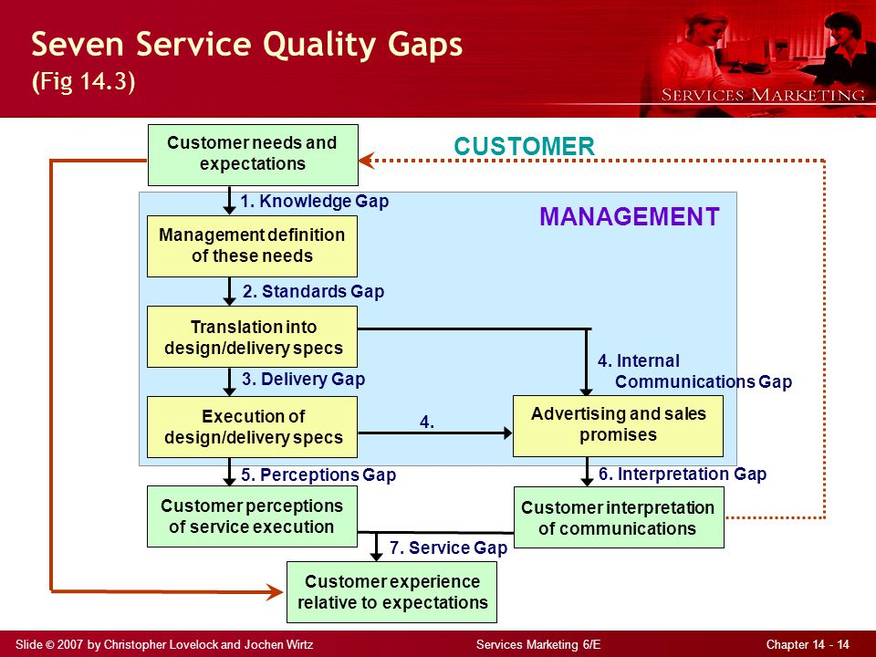
Service gap models
.
Adapted from: Lovelock C.& Wirtz J (2004) Services Marketing, 5th Edition. International Journal of Service Industry Management

Slide 23
Service gaps
1. The knowledge gap is the difference between what service providers believe customers expect and customers’ actual needs and expectations.
Source: poor customer relationship management inward-outward thinking rather than vice versa, due to failure to listen to customers complaints and poor communication between management and frontline staff.
Gap closed by appropriate philosophy, market research and enhanced communication between management and staff
.

Slide 24
Service gaps cont.
2) The standards gap is the difference between management’s perceptions of customer expectations and the quality standards established for service delivery.
Source: misunderstanding of customer needs and wants.
Closed by: proper communication within the financial institution, top management commitment to quality as defined by customers, training all the players and also Standardizing repetitive tasks
.

Slide 25
Service gaps cont.
3) The delivery gap is the difference between specified delivery standards and the service provider’s actual performance on these standards.
Source deficiencies in human resources policies, failure to match supply to demand, employee lack of knowledge of the product and lack of cohesive teamwork to deliver the product or service.
Closed through proper training and empowering of employees as well as schemes to retain highly knowledgeable employees
.

Slide 26
Service gaps cont.
4)The communications gap is the difference between what the company’s advertising and sales personnel think are the product’s features, performance, and service quality level and what the company can deliver.
Source: due to poor communication within
closed by enhancing communication employee's participation in developing promotion strategy and management of customers expectations .
.

Slide 27
Service gaps cont.
5) The perceptions gap is the difference between what is, in fact, delivered and what customers perceive they have received (because they are unable to accurately evaluate service quality).
Source: the influences exerted from the customer side (personal needs, recommendations, and past experience) and the shortfalls (gaps) on the part of the service provider in service delivery process.
Closed by manage customers expectation and ensure our staff follow the laid down procedure in service delivery
.

Slide 28
Service gaps cont.
6) The interpretation gap is the difference between what a service provider’s communication efforts (in advance of service delivery) promise and what a customer thinks were promised by these communications.
This implies that the customer may have misunderstood the promises made and therefore raised expectations beyond what was promised.
Closed through scrutiny of promotion and pretesting any advertising to ensure the customers interpret it accurately.
.

Slide 29
Service gaps cont.
7) The service gap is the difference between what customers expect to receive and their perceptions of the service that is delivered.
It arises from other gaps or simply because the customer misinterprets service quality.
This gap is closed by ensuring all other six gaps are closed to avoid losses that would come from misunderstanding of service quality.
.

Slide 30
Service Recovery
Service failure is a common problem among financial services providers.
Consumers feel problem failure when :
Services are unavailable as promised
Delivered too late or slowly
The outcomes are incorrect or poorly executed
Employees are rude or uncaring
.

Slide 31
Service Recovery
Service failure can lead:
Customer defection
Negative word of mouth advertising
Customers may take legal address
Complain through consumer rights organizations.
The financial service marketer may not want to engage in these activities and therefore will try to avoid coming to this point.
.

Slide 32
Service Recovery
Service recovery has strong impact on customer satisfaction loyalty, positive word of mouth all of which may translate into higher profitability for financial institutions.
Well executed services boost employee morale and is an impetus for better performance in future.
Financial service provider must strive to ensure that the service provided excites customers but incase of failure, they will do everything to recover the service.
A firm requires well document procedure for service recovery.
.

Slide 33
Service Recovery strategies
1. Make the service fail-safe-do it right the first time! this is the best approach in service recovery.
The marketer ensure they do things right the first time and consequently there is no need for service recovery.
2. Encourage and track complaints: the financial institution endeavors to track all complaints, address them and resolve the problem.
Its also important to try and anticipate problems before they come so that we can address them.
.

Slide 34
Service Recovery strategies
3. Act quickly: the financial institution must act quickly to address any service failure to minimize customer frustrations.
Delays are sometime more frustrating and can result in customers defections easily.
4. Empower Employees: Employees must be trained and empowered to solve problems as they occur.
Many employees are able to address most customers complaints and therefore the need to empower them and minimize bureaucracies in addressing these issues.
.

Slide 35
Service Recovery strategies
5. Provide adequate explanations: the service provider must ensure there is adequate explanation as to why the failure occurred and how that will be addressed in future.
6.Treat customers fairly. Let them feel that despite the problem they have been treated fairly and that every effort is being put in place to avoid service failure.
Fair treatment is an essential component of an effective service recovery strategy.
.

Slide 36
Service Recovery strategies
7. Cultivate Relationships with Customers: this is a sure way of building confidence with the customer and ensuring that the firm is willing to address service failures.
Calling the customers and assuring them that the problem is being addressed will go a long way in maintaining relationship with the customers.
8.Other strategies including learning from recovery experience and from lost customer
.

Slide 37
References
Crosby, P. (1984) Quality without Tears: The Art of Hassle-Free Management. McGraw-Hill, New York.
Garvin, D.A. (1988) Managing Quality: The Strategic and Competitive Edge. The Free Press, New York.
Grönroos (2000) Service Management and Marketing, John Wiley&Sons, Ltd.
Johnson, Silvestro, Fitzgerald and Voss, (1992) Towards a Classification of Service Processes Journal of Service Industry Management; 3, 3;pp 62
Juran J.M (1982) Quality Improvement. Juran Institute, New York.

Slide 38
References
Lovelock C (1994). Product Plus: How Product + Service = Competitive Advantage, New York, McGraw-Hill,
Lovelock C. Wirtz J. (2011) Services Marketing People, Technology, Strategy. Pearson Education, Inc., publishing as Prentice Hall, One Lake Street, Upper Saddle River, New Jersey
Parasuraman A., Zeithaml V.A, Berry L.L, (1985) A Conceptual Model of Service Quality and Its Implications for Future Research, Journal of Marketing,
Zeithaml V.A, Berry L.L, Parasuraman A. (1988), Communication and Control Processes in the Delivery of Services, Journal of marketing,
Zeithaml V.A., Bitner M.J, (2000) Services Marketing. Integrating Customer Focus Across the Firm, Irwin McGraw-Hill.

Slide 39
End
Thank you
.

