Slide 1
MARKETING OF FINANCIAL SERVICES
LECTURE 13:Ethics in marketing of financial services
DR. John Kamau

Slide 2
Introduction
Welcome to week thirteen lecture!
Congratulations! For coming to the last lecture in this course
I do recognize the effort required to go through a course and finish and therefore thank you for the effort
it is my sincere hope that we have attained the course objectives and now you can now tackle marketing of financial services effectively
.

Slide 3
Introduction
In this last lecture we want to discuss the underlying philosophies for marketing of financial services.
We will examine ethics in business in general and then narrow down to financial services marketing
I do hope that you will evaluate yourself and ensure that you comply with ethical requirements as far as marketing of financial services I concerned
.

Slide 4
Intended learning outcomes
At the end of this lecturer, you will be able to:
a) Define ethics in business context
b) Discuss alternative views(reference points) on ethics
c) Critically examine ethical issues on 7Ps of marketing of a service
Determine ways of maintaining high ethical standards in a financial institution
.

Slide 5
Definition of Ethics
Studies on ethics are normally very controversial because of lack of reference point as to what is considered ethical behavior and one that is not ethical.
Ethics is defined as a set of rules or moral principles that helps a person to distinguish between right and wrong (Velasquez, 1996).
Marketing ethics investigate morality of marketing practices with respect to 4Ps such as safety of products, fair pricing, truthfulness of claims advertised and bias in distribution (Smith & Quelch, 1996).
.

Slide 6
Reference Points for Ethical Behavior
According to Schermerhorn and Bachrach (2015). there are several approaches to what is generally considered ethical or unethical.
1. Utilitarian view
this holds the view that a behavior is considered ethical if it delivers the greatest good to the greatest number of people.
This view ignores individual feelings, beliefs, values, and thoughts and only looks at what is accepted by the majority.
.

Slide 7
Reference points for ethical behavior cont.
2. The moral right view:
this view considers the fundamental rights of all human beings irrespective of their location.
These rights have to do with respecting individual privacy, due process, free speech, free consent, health and safety, freedom of conscience, among others.
This school of thought will approve any behavior that considers the fundamental rights of all individuals in the society.
.

Slide 8
Reference points for ethical behavior cont.
3. Individual view:
this school of thought consider behavior that promote one’s long-term self-interest as ethical.
The school prohibits consideration of short-term interests and requires any individual to think about the long-term effect of their behaviors and actions.
.

Slide 9
Reference points for ethical behavior cont.
4. The justice view:
according to the advocates of this view a behavior is considered ethical if it shows fairness and impartiality.
This will depend on ethical code or other guiding principle in a particular situation.
.

Slide 10
Reference points for ethical behavior cont.
5. Universal approach:
this school of thought hold the view that employees of any institution should choose a course of action that they believe would apply to all people under all situations.
Borrowing from the Holy Book (The Bible), it has the implication that one should do unto others as they would have them done unto them’.
.

Slide 11
Reference points for ethical behavior cont.
6 Compensatory justice:
this view holds that if distributive and procedural justice approaches fail, those hurt by the inequitable distribution of rewards are compensated.
This compensation often takes the form of money or takes any other form.
.

Slide 12
Factors influencing ethical behavior among employees
A) The person
General make-up of a person’s character
The family influence
Religion values
Personal standards and principles of life.
An individual who has well established value system will be predictable in different situations and positions as far as his conduct is concerned.
.

Slide 13
Factors influencing ethical behavior among employees cont.
B) The organization
The organization’s policies
Code of conduct of the organization
The behavior of supervisor and colleagues
the culture of the organization.
.

Slide 14
Factors influencing ethical behavior among employees cont.
C) The environment:
Governmental regulations,
Norms and values of society
The ethical climate of industry.
The financial sector has very clearly laid procedures of doing business which also informs individuals on how to conduct themselves.
.

Slide 15
Ethical Dilemmas
An ethical dilemma is a situation that although offering potential benefit or gain is also unethical (Stonner 1989).
Discrimination: may be based on race, religion, gender, age or other non-job relevant criteria.
Sexual harassment: inappropriate comments, action regarding sexuality, request for sexual favors
.

Slide 16
Ethical Dilemmas cont.
Conflicts of interest: may take form of gifts and other corrupt practices.
Customer confidence: arises from access to privileged information
Organizational resources: may take form of misuse of organizational resources
.

Slide 17
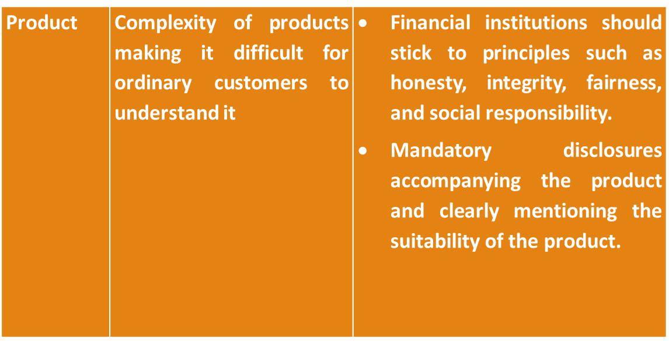
Ethical issues in 7ps of marketing of financial services
.
Adapted from: Jahan M (2020) Ethical issues in marketing of Financial Services

Slide 18
Ethical issues in 7ps of marketing of financial services cont.
Price | Unjust and excessive amounts of interest/charges. Pushing customers towards irresponsible credit usage Deductions without customer’s consent Hidden charges | Clear disclosure of the charges associated with all financial products and services .
.
Adapted from: Jahan M (2020) Ethical issues in marketing of Financial Services

Slide 19
Ethical issues in 7ps of marketing of financial services cont.
Place/ Distribution | Misrepresentation of facts about the product by salespeople Vulnerability to cyber thefts and privacy breaches Frequent breakdown of the ATMs | Salespeople to be barred from using deceptive techniques Financial institution to own up problems arising from use of vulnerable technology
.
Adapted from: Jahan M (2020) Ethical issues in marketing of Financial Services

Slide 20
Ethical issues in 7ps of marketing of financial services cont.
Promotion | Hiding of facts regarding the financial product by salespeople Aggressive selling of a product to the customer. Misleading claims in the advertisements and falsification of information | Disclosure of all facts about a product Honest summary of the risk and return associated with a financial product/service The financial institution should take responsibility for misleading claims and any false information given
.
Adapted from: Jahan M (2020) Ethical issues in marketing of Financial Services

Slide 21
Ethical issues in 7ps of marketing of financial services cont.
People | Complicating the design of the product/service to oversell its usefulness at a premium. Aggressive selling of irrelevant and unsuitable products. High handedness of the staff Citing of procedural protocol to avoid complete disclosure of facts | View customers as partners in business Disclose facts about financial products Train staff on taking responsibility
.
Adapted from: Jahan M (2020) Ethical issues in marketing of Financial Services

Slide 22
Ethical issues in 7ps of marketing of financial services cont.
Processes | Complex processes that drain customers energy Constant change of terms and conditions to suit the interests of the bank Spinning customer from one executive to another | Design service processes with customer in mind Inform customers before changing terms and conditions Clear procedure of resolving customer problems
.

Slide 23
Ethical issues in 7ps of marketing of financial services cont.
Physical evidence | Use of high quality and expensive infrastructure in prime locations but giving misleading information | Avoid all deception through use of high-quality infrastructure
.
Adapted from: Jahan M (2020) Ethical issues in marketing of Financial Services

Slide 24
The Challenge of “Jay Customers”
Ethical issues are not witnessed on the side of financial service provider employees only.
There are also practices from financial customers that require mention and how to deal with them.
Though customer is the king, sometimes his behavior is not right and should be addressed before it becomes a big challenge to a financial institution.
According to Lovelock and Wirtz (2004), jay customer refers to one who acts in a thoughtless or abusive way, causing problems for the firm, employees, and other customers.
.

Slide 25
The Challenge of “Jay Customers” cont.
1. The thief:
This kind of customer has no intention of paying and sets out to steal services (or to pay less than full price through whichever means possible.
In financial institution thieves try to use fraudulent forms of payment, such as stolen credit cards or checks drawn on accounts without any funds.
Cybercrime resulting in losses of billions is also categorized under the category of jay customers.
.

Slide 26
The Challenge of “Jay Customers” cont.
2. The rule breaker
This constitutes customers who don’t wish to abide by the law.
Customers should be educated on all procedures so that they can follow them properly.
Where legal action needs to be taken against rule breakers, the same should be done to secure the financial institution from such customers.
.

Slide 27
The Challenge of “Jay Customers” cont.
3. The belligerent
this is the customer who will insult and threaten everyone because of a problem in service delivery such as machine breakdown or delays.
Service personnel are often abused and may even experience physical attack.
Employees also need to be trained on how to defuse anger, anxiety, comfort distress and to be calm particularly when there is good reason for the customer to be upset with the organization’s performance.
.

Slide 28
The Challenge of “Jay Customers” cont.
4. The family feuders:
People who get into arguments with other customers who sometimes are their relatives within service facilities.
Employee intervention may calm the situation or make it worse.
Employee should be trained on how to handle such cases.
.

Slide 29
The Challenge of “Jay Customers” cont.
5. The vandal:
These are customers who destroy service facilities intentionally either because they are drunk or just find pleasure in engaging in destructive behavior.
Disgruntled employees have also been known to commit sabotage.
There are also occasions when unhappy customers, feeling mistreated by the service provider, try to take revenge in some way.
These customers should be dealt with according to the financial institution policy on such matters.
.

Slide 30
The Challenge of “Jay Customers” cont.
6. The deadbeat:
These are customers who fail to pay for services already received.
It’s important to furnish them with the right information before engagement and clarify payment mode to avoid losing money.
.

Slide 31
Maintaining high ethical standards
1. Ethics training
It seeks to help people understand the ethical aspects of decision-making and to incorporate high ethical standards into their daily behavior.
The training in form of participative program is designed to help people deal with ethical issues while under pressure.
.

Slide 32
Maintaining high ethical standards cont.
2. Whistleblower protection
whistleblower is a person who exposes the misdeed of other organizations to preserve wasteful, harmful or illegal act.
They face the risks of impaired career progress and other forms of organization retaliation up to and including termination.
The government and some organizations have developed laws to protect whistleblower from the wrath of organizations concerned.
.

Slide 33
Maintaining high ethical standards cont.
3. Ethical role model
Top managers should serve as role models of appropriate ethical behavior for the entire organization.
Not only must their day-to-day behavior be the epitome (essence) of high ethical conduct, but top managers must also communicate similar expectation throughout the organization and reinforce positive results.
Junior managers must take the lead in determining ethical behaviors for their employees.’
.

Slide 34
Maintaining high ethical standards cont.
4. Codes of ethics
This is a written document that states values and ethical standards intended to guide the behavior of employees.
They are found in professional organization such as engineering, medicines, law and public accounting.
Specific issues addressed include workplace diversity, bribes and kickbacks, political contributions, the honesty of book of record, customer-supplier relationship and the confidentiality of corporate information.
.

Slide 35
References
Jahan M (2020) Ethical issues in marketing of Financial Services – with special reference to banking. Journal of Critical Review, ISSN- 2394-5125 VOL 7, ISSUE 08.
Velasquez, M. (1996). Business ethics, the social sciences, and moral philosophy. Social Justice Research. 9. 97-107.
Quelch, J.A., & Smith, N.C. (1996). Ethics in Marketing. New York : McGraw Hill
Garriga, E., and Mele, D., (2004). Corporate Social Responsibility Theories: Mapping the Territory, Journal of Business Ethics, 53, 51-71.
Garriga and Mele, 2007) Utilitarian, Managerial and Relational Theories of Corporate Social Responsibility, International Journal of Management Reviews
Lovelock and Wirtz (2004), Lovelock C. Wirtz J. (2011) Services Marketing People, Technology, Strategy. Pearson Education, Inc., publishing as Prentice Hall, One Lake Street, Upper Saddle River, New Jersey
.

Slide 36
End
Thanks
.

