Slide 1
Course Title:
FUNDAMENTAL OF THERMODYNAMICS AND
HEAT TRANSFER
Lecture – 7 (Week 7)
First Law of Thermodynamics
Kathmandu Engineering College
Dr. Lila Raj Koirala

Slide 2
Learning Objective of Lecture:
To impart a great deal of knowledge to undergraduate students on the following topics:
First Law of Thermodynamics
First Law of Thermodynamics for a Control Mass
Conservation Principle of Mass for a Control Mass
Conservation Principle of Energy for a Control Mass

Slide 3
Learning Objective of Lecture:
First Law of Thermodynamics for a Control Mass Undergoing Cyclic Process
Applications of First Law of Thermodynamics for a Control Mass in different Non-flow Processes
Some Examples Illustrating Use of First Law of Thermodynamics for a Control Mass

Slide 4
First Law of Thermodynamics:
Energy can neither be created nor be destroyed, but can be conserved [1].
First law is based on the conservation principles.
It gives the mathematical expression for the effect of the interactions between the system and surrounding on the stored energy (total energy) of the system.
In closed system (control mass), interactions can take place only in the form of energy transfer (work transfer and heat transfer).

Slide 5
First Law of Thermodynamics:
Therefore, first law for a control mass can be explained with reference to conservation of energy only.
In an open system (control volume), interactions can take place both by the mass transfer and energy transfer.
Hence, the first law is explained with reference to both mass and energy conservation principles for a control volume.

Slide 6
First Law of Thermodynamics for a Control Mass:
Conservation of Mass for a Control Mass:
Control mass is a system in which energy transfer can take place but mass transfer cannot. Hence, conservation of mass for a control mass can be stated as
Total mass of a control mass always remains constant [2].
Mathematically,
m = Constant

Slide 7


Conservation of Mass for a Control Mass:
For any process between state 1 and 2,
In terms of rate,

Slide 8
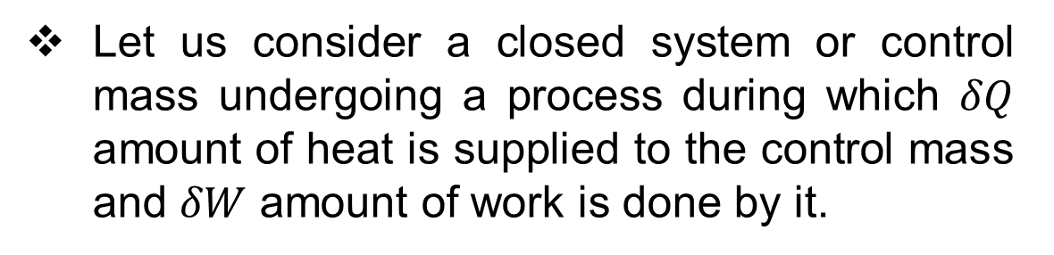
Conservation of Energy for a Control Mass:
Let us consider a closed system or control mass undergoing a process during which $δQ$ amount of heat is supplied to the control mass and $δW$ amount of work is done by it.

Slide 9

Conservation of Energy for a Control Mass:
Following three conditions are possible:
δQ < δW ⇒ E of system decreases.
δQ > δW ⇒ E of system increases.
III. δQ = δW ⇒ E of system remains constant.
All three conditions can be expressed as:

Slide 10

Conservation of Energy for a Control Mass:
This explanation can be generalized as conservation of energy for a control mass and summarized in a statement as
The change in total energy of a control mass is equal to the heat supplied to the control mass minus the work produced by the control mass [2].
For any process 1-2 between state 1 and 2,

Slide 11

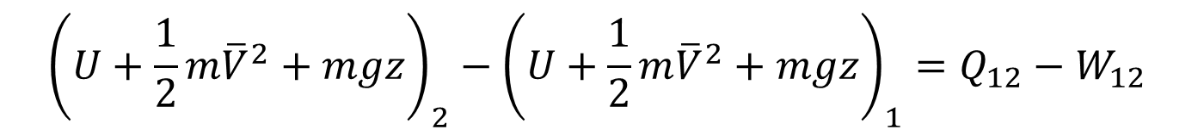
Conservation of Energy for a Control Mass:
In terms of rate,
Substituting expression for total energy
$${ \left(U+KE+PE\right)}_{2}−{\left(U+KE+PE\right)}_{1}=Q_{12}−W_{12}$$
$${\left(U+\frac{1}{2}m{\overline{V}}^{2}+mgz\right)}_{2}−{\left(U+\frac{1}{2}m{\overline{V}}^{2}+mgz\right)}_{1}=Q_{12}−W_{12}$$

Slide 12
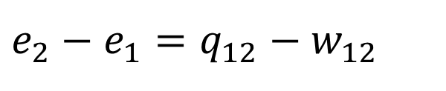
Conservation of Energy for a Control Mass:
On a specific basis above equations can be written as
$de=δq−δw$
$e_{2}−e_{1}=q_{12}−w_{12}$
$({u+\frac{1}{2}{\overline{v}}^{2}+gz)}_{2}−({u+\frac{1}{2}{\overline{v}}^{2}+gz)}_{1}=q_{12}−w_{12}$

Slide 13


Conservation of Energy for a Control Mass:
Most common example of a control mass is a piston cylinder device and for a stationary piston cylinder device the changes in potential energy and kinetic energy are negligible in comparison to the change in internal energy.
Therefore, for the piston cylinder devices,
It can also be rearranged for the heat transfer as

Slide 14
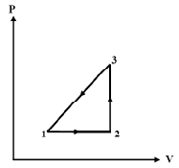
Conservation of Energy for a Control Mass Undergoing a Cycle:
For a cyclic process,
the initial state of the system is restored by a number of different processes in series.
initial and final states are identical.

Slide 15


Conservation of Energy for a Control Mass Undergoing a Cycle:
Taking cyclic integral
For a cyclic process,
Then the above equation reduces to

Slide 16

Conservation of Energy for a Control Mass Undergoing a Cycle:
It can also be expressed in the equivalent form as
For a control mass undergoing a power cycle, the heat transferred to the control mass is equal to the net work done by the control mass [2].
For a control mass undergoing a refrigeration cycle, the heat rejected by the control mass is equal to the net work done on the control mass [2].

Slide 17
Applications of First Law of Thermo-dynamics for Control Mass in different Non-flow Processes:
1. Isochoric Process:
For an isochoric or a constant volume process (dV = 0), there is no displacement work transfer, then from first law,
As

Slide 18
2. Isobaric Process:
For an isobaric or a constant pressure process, displacement work transfer is given as
Now, from first law:
As

Slide 19


3. Isothermal Process:
For an isothermal or a constant temperature process, displacement work transfer is given as
The change in internal energy of an ideal gas during an isothermal or a constant temperature process is zero. Hence, from first law,
As

Slide 20


4. Polytropic Process:
Work transfer and the change in internal energy of an ideal gas during a polytropic process are given as
From first law:
And using,

Slide 21
4. Polytropic Process:
where C_{n} is the polytropic specific heat
By using the relation,
=

Slide 22

EXAMPLE-1.Temperature Rise due to Slapping:
Imagine you had the unfortunate occasion of being slapped by an angry person, which caused the temperature of the affected area of your face to rise by 1.8°C. Assuming the slapping hand has a mass of 1.2 kg and about 0.15 kg of the tissue on the face and the hand is affected by the incident, estimate the velocity of the hand just before impact. Take the specific heat of the tissue to be 3.8 kJ/kg °C [3].
Source: [3]

Slide 23
Solution:
Given,
. Change of Temperature, ∆T = 1.8ºC
. Mass of hand, m_{h} = 1.2 kg
. Mass of tissue, m = 0.15 kg
Specific heat of the tissue, c_{v} = 3.8 kJ/kg °C
Assumptions:
1. The hand is brought to a complete stop after the impact.
2. The face takes the blow without significant movement.

Slide 24
Assumptions:
3. No heat is transferred from the affected area to the surroundings, and thus the process is adiabatic.
4. No work is done on or by the system.
5. The potential energy change is zero, ∆PE = 0.

Slide 25
Analysis:
First, we identify the system, draw a sketch of it, and state our observations about the specifics of the problem.
We take the hand and the affected portion of the face as the system.
This is a closed system since it involves a fixed amount of mass (no mass transfer).

Slide 26
Analysis:
We observe that the kinetic energy of the hand decreases during the process, as evidenced by a decrease in velocity from initial value to zero, while the internal energy of the affected area increases, as evidenced by an increase in the temperature.
There seems to be no significant energy transfer between the system and its surroundings during this process.

Slide 27
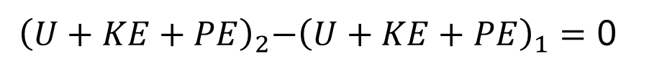
Under the stated assumptions and observations, the energy balance on the system can be expressed as
$${ \left(U+KE+PE\right)}_{2}−{\left(U+KE+PE\right)}_{1}=Q_{12}−W_{12}$$
${ \left(U+KE+PE\right)}_{2}−{\left(U+KE+PE\right)}_{1}=$ 0
Using
and

Slide 28
Solving for the velocity and substituting the given quantities, the impact velocity of the hand is determined to be
= 41.35 m/s
Discussion:
The decrease in the kinetic energy of the hand must be equal to the increase in the internal energy of the affected area.

Slide 29
Example - 2. Application of First Law of Thermodynamics for a Cyclic Process:
For the cycle shown in figure below, determine the work output and heat transfer.

Slide 30
Solution:
Given,
At state 1:
Pressure, P₁ = 100 kPa
Volume, V₁ = 0.08 m³
At state 2:
Pressure, P₂ = 800 kPa
Volume, V₂ = 0.08 m³
At state 3:
Pressure, P₃ = P₁= 100 kPa
Analysis:
As the process 1 – 2 is a constant volume process, work done is zero. Hence,
W₁₋₂ = 0

Slide 31
Since the process 2 - 3 is an isothermal process, volume at state 3 can be calculated as
=
= 0.64 m³
Work done during the isothermal process 2 - 3 is determined as
= 133.084 kJ

Slide 32
As the process 3 – 1 is a constant pressure process, work done is calculated as
W₃₋₁ = P₃ (V₁ − V₃) = 100 x (0.08 − 0.64) = − 56 kJ
Then, the net work done is determined as
W_{net} = W₁₋₂ + W₂₋₃ + W₃₋₁
= 0 + 133.084 + (−56) = 77.084 kJ
Discussion:
From first law of thermodynamics for a cyclic process the net work transfer is equal to the net heat transfer, so
Q_{net} = W_{net} = 77.084 kJ

Slide 33
References:
[1] Thermodynamics: An Engineering Approach: Cengel Y. A. and Boles M. A., McGraw-Hill Education, New York, 2018.
[2] Fundamentals of Thermodynamics & Heat Transfer: Luintel M.C., Heritage Publishers & Distributors Pvt. Ltd., Kathmandu, Nepal, 2016.
[3] Introduction to Thermodynamics and Heat Transfer: Cengel Y. A., McGraw-Hill Companies, ISBN: 0 – 390 - 86122-7, 2008.

Slide 34
Thank You

