Slide 1
Course Title:
FUNDAMENTAL OF THERMODYNAMICS AND
HEAT TRANSFER
Lecture – 8 (Week 8)
First Law of Thermodynamics
Kathmandu Engineering College
Dr. Lila Raj Koirala

Slide 2
Learning Objective of Lecture:
To impart a great deal of knowledge to undergraduate students on the following topics:
First Law of Thermodynamics for a Control Volume
Conservation Principle of Mass for a Control Volume
Expression for Mass Flow Rate
Conservation Principle of Energy for a Control Volume

Slide 3
Learning Objective of Lecture:
Control Volume Analysis
Steady State Analysis
Unsteady State Analysis
Example Illustrating Use of First Law of Thermodynamics for a Control Volume

Slide 4
First Law of Thermodynamics for a Control Volume:
Any control volume (open system) can interact with its surroundings by energy transfer as well as mass transfer.
Conservation of Mass for a Control Volume:

Slide 5
Conservation of Mass for a Control Volume:
Conservation of mass for a control volume can be stated as
The change in mass within a control volume is equal to the mass entering into the control volume minus the mass leaving the control volume [1].

Slide 6



Conservation of Mass for a Control Volume:
On a rate basis,
where,

Slide 7
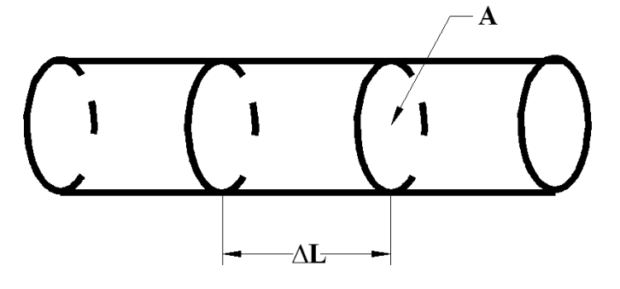

Expression for Mass Flow Rate:
Total mass of the fluid crossing the section of length ΔL is given by

Slide 8




Expression for Mass Flow Rate:
The mass flow rate is then given by
where is the volumetric flow rate of the fluid.
Conservation of mass can be expressed as

Slide 9
Conservation of Energy for a Control Volume:
Along with heat transfer and work transfer, mass transfer also affects the total energy of a control volume.
Mass entering into the control volume increases the total energy of the system where as mass leaving from the control volume decreases the total energy of the system.

Slide 10
Following three conditions are possible in mass flow:
Ein < Eout ⇒ E of system decreases.
Ein > Eout ⇒ E of system increases.
Ein = Eout ⇒ E of system remains constant.

Slide 11
Conservation of Energy for a Control Volume:
All three conditions can be expressed as:
The change in total energy of the control volume can be caused due to net energy of mass flow and energy interactions through the boundary, i.e.

Slide 12
Conservation of Energy for a Control Volume:
Conservation of energy for a control volume can be stated as:
The change in total energy of a control volume is equal to the net energy transported by the fluid into the control volume plus the heat transferred to the control volume minus the work done by the control volume [1].

Slide 13

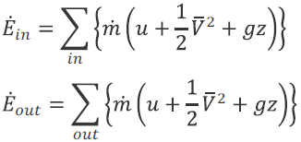


Conservation of Energy for a Control Volume:
On rate basis,
where
Heat transfer always occurs due to the difference in temperature between the system and the surroundings whether it’s a control mass or control volume, i.e.,

Slide 14

Conservation of Energy for a Control Volume:
But the total work transfer associated with a control volume includes various modes of work transfer such as flow work, shaft work, expansion/ compression work, etc, i.e.,
Work transfer is composed of flow work due to flow of fluid at inlets/outlets and real boundary works,

Slide 15


Conservation of Energy for a Control Volume:
Energy (work) required for the displacement of the fluid is given as

Slide 16

Conservation of Energy for a Control Volume:
Specific flow work or flow work per unit mass of the fluid is
Therefore, the rate of flow work is evaluated as
Now, the total flow work for the control volume is the sum of the flow work at the inlets and the flow work at the outlets with consideration of sign convention, i.e.

Slide 17


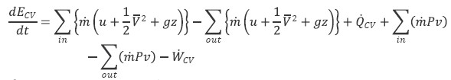
Conservation of Energy for a Control Volume:
Then, general expression for total work transfer is given by
where
Then general energy equation for control volume reduces to

Slide 18
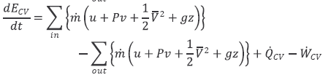

Conservation of Energy for a Control Volume:
Substituting,
h = u + Pv

Slide 19
Control Volume Analysis:

Slide 20
Control Volume Analysis:
Uniform system: the properties of the system at a particular instant of time do not vary with space.
Non-uniform system: the properties of the system at a particular instant of time vary with space.
Steady state system: the properties of the system at a particular point do not vary with time.
Unsteady state system: the properties of the system at a particular point vary with time.

Slide 21
Steady State Analysis:
Properties (total mass and total energy) of the control volume should not change with time.
Analysis of the long-term operation of a control volume where no mass or energy accumulates or dissipates within the control volume.
For example, uniform motion of a fan at a constant velocity.

Slide 22


Steady State Analysis:
Mathematically,
For devices having single inlet and single outlet,

Slide 23



Steady State Analysis:

Slide 24
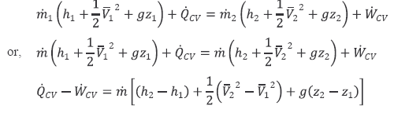
Steady State Analysis:
For devices having single inlet and single outlet, energy equation reduces to
∴

Slide 25
Unsteady State Analysis:
Properties (total mass and total energy) change with time, i.e., total mass and total energy of the system is function of time.
Analysis of the control volume when there is an accumulation (storage) or dissipation of the mass or energy within the control volume and their time variations at the inlets and outlets.
For examples, filling and discharging of a gas cylinder, start-up and shut-down period of a device such as of a fan.

Slide 26



Unsteady State Analysis:
Integrating mass conservation equation

Slide 27
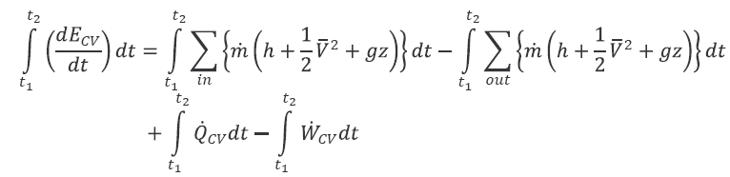
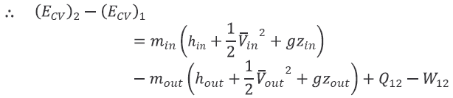
Unsteady State Analysis:
Integrating energy conservation equation

Slide 28
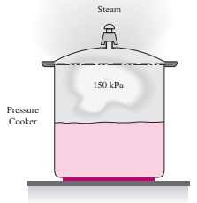
Example: Application of First Law of Thermodynamics for a Control Volume:
Energy Transport by Mass:
Steam is leaving a 4-L pressure cooker whose operating pressure is 150 kPa. It is observed that the amount of liquid in the cooker has decreased by 0.6 L in 40 min after the steady operating conditions are established, and the cross-sectional area of the exit opening is 8 mm². Determine
Source: [2]

Slide 29
Energy Transport by Mass:
(i) the mass flow rate of the steam and the exit velocity,
(ii) the total and flow energies of the steam per unit mass,
(iii) the rate at which energy leaves the cooker by steam [2].

Slide 30
Solution:
Given:
Operating pressure, P = 150 kPa
Change of volume of liquid, ∆V_{l} = 0.6 L
Time, ∆t = 40 min
Area of exit, A = 8 mm²
Assumptions:
1. The flow is steady, and the initial start-up period is disregarded.
2. The kinetic and potential energies are negligible and thus they are not considered.

Slide 31
Assumptions:
3. Saturation conditions exist within the cooker at all times so that steam leaves the cooker as a saturated vapor at the cooker pressure.
Properties:
From the steam table the properties of the saturated liquid and saturated vapor at pressure 150 kPa are:
v_{l} = 0.001053 m³/kg
v_{g} = 1.1595 m³/kg
u_{g} = 2519.4 kJ/kg
h_{g} = 2693.4 kJ/kg

Slide 32
Analysis:
Saturation conditions exist in a pressure cooker at all times after the steady operating conditions are established.
Hence, the liquid has the properties of saturated liquid and the exiting steam has the properties of saturated vapor at the operating pressure.
The evaporated mass of liquid,
= 0.5698 kg

Slide 33
(i) The mass flow rate of the exiting steam,
Kg/s
and the exit velocity,
= 34.41 m/s
(ii) The flow energy per unit mass,
= 2693.4 – 2519.4 = 174 kJ/kg
As h = u + Pv

Slide 34
and the total energy per unit mass,
e = hg + ke + pe = hg = 2693.4 kJ/kg
As the kinetic and potential energies are neglected.
(iii) Now, the rate at which energy is leaving the cooker by steam is given by
= 0.64 kW

Slide 35
Discussion:
The numerical value of the energy leaving the cooker with steam alone does not mean much since this value depends on the reference point selected for enthalpy (it could even be negative).
The significant quantity is the difference between the enthalpies of the exiting vapor and the liquid inside (i.e. h_{lg} = h_{g} – h_{l}) since it relates directly to the amount of energy supplied to the cooker.

Slide 36
References:
[1] Fundamentals of Thermodynamics & Heat Transfer: Luintel M.C., Heritage Publishers & Distributors Pvt. Ltd., Kathmandu, Nepal, 2016.
[2] Introduction to Thermodynamics and Heat Transfer: Cengel Y. A., McGraw-Hill Companies, ISBN: 0 – 390 - 86122-7, 2008.

Slide 37
Thank You

