Slide 1
Course Title:
FUNDAMENTAL OF THERMODYNAMICS AND
HEAT TRANSFER
Lecture – 13 (Week 13)
Thermodynamic Cycles
Kathmandu Engineering College
Dr. Lila Raj Koirala

Slide 2
Learning Objective of Lecture:
To impart a great deal of knowledge to undergraduate students on the following topics:
Classification of Practical Thermodynamic Cycles
Air Standard Brayton Cycle
Rankin Cycle
Air Standard Internal Combustion Cycles
Operation of Four Stroke Engines

Slide 3
Classification of Thermodynamic Cycles:
According to Power (Work)
Power Cycle:
Produces power or delivers work to the surroundings when the cycle is executed.
Operates the heat engine.
Network is always positive.
Common examples: Brayton cycle, Otto cycle, Diesel cycle, Rankine cycle, etc.

Slide 4
Refrigeration Cycle:
Power should be supplied to execute the cycle.
Operates the heat pump and refrigerator.
Network is always negative.
Most common example: Vapor compression refrigeration cycle.

Slide 5
2. According to Working Substance
Gas Cycle:
The working substance remains in gaseous state throughout the cycle.
Common examples: Brayton cycle, Otto cycle, Diesel cycle, etc.
Vapor cycle:
The working substance can undergoes phase change (from liquid to vapor or vapor to liquid) throughout the cycle.
Most common example: Rankine cycle.

Slide 6
3. According to Working Principle:
Closed Cycle:
The working substance is continuously circulated in the cycle and does not need replenishment.
Most of the steam power cycles and refrigeration cycles are closed type.

Slide 7
Open Cycle:
The working substance may be thrown into environment after completion of each cycle and a fresh charge of the working substance enters the cycle again for next cycle, i.e.
cycle exhausts are emitted into atmosphere and cycle starts again with a fresh charge of air.
Most of the internal combustion engines and gas turbines work on open cycle.

Slide 8
4. According to Combustion Location
Internal Combustion Cycle:
The combustion takes place inside the power producing unit.
Examples: Otto cycle and Diesel cycle.
External Combustion Cycle:
The combustion takes place outside the power producing unit.
Examples: Brayton cycle and Rankine cycle.

Slide 9
Common Features of Power Cycles:
All practical cycles undergo the following processes in series:
compression, heat addition, expansion and heat rejection.
For ideal analysis of all power cycles, expansion and compression processes are assumed to be isentropic processes.

Slide 10
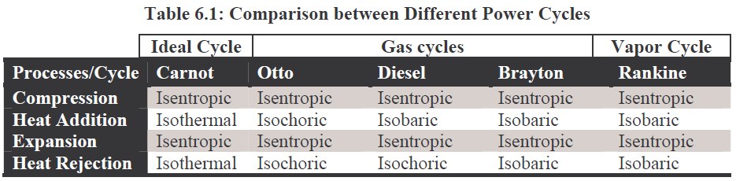
Common Features of Power Cycles:
Hence, the practical power cycles can be differentiated only with reference to the conditions at which heat is supplied to the system and heat is rejected by the system.
[1]

Slide 11
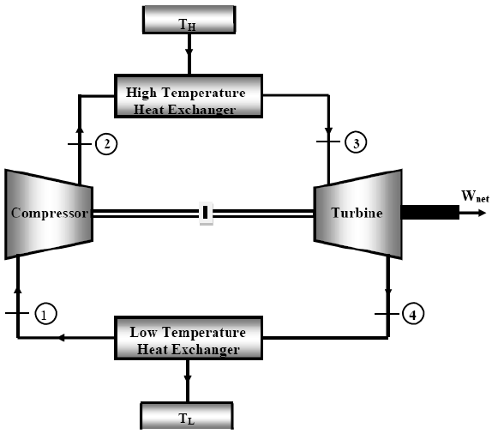
Air Standard Brayton Cycle:
An ideal model for the power cycle consisting of a gas turbine.
Consists of two isentropic and two isobaric processes.
Source:[1]

Slide 12
Process 1 - 2 (Isentropic Compression)
Low pressure and low temperature air at exit of low temperature heat exchanger is supplied to the compressor where it is compressed and delivered to the high temperature heat exchanger.
Compression in the compressor is assumed to an isentropic process.
During isentropic compression
pressure increases, temperature increases.
specific volume decreases and entropy remains
constant.

Slide 13
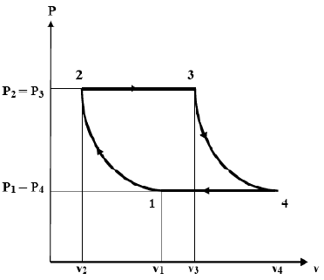
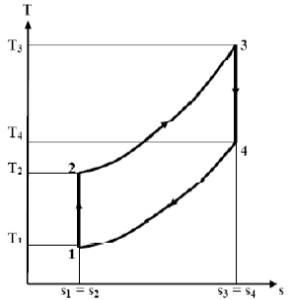
Process 1 - 2 (Isentropic Compression)
=

Slide 14
Process 2-3 (Isobaric Heat Addition)
Heat is supplied to the high temperature heat exchanger from an external source and the working substance is heated under constant pressure.
During the constant pressure heating:
specific volume, temperature and entropy of the air increases.

Slide 15
Process 2-3 (Isobaric Heat Addition)
=

Slide 16
Process 3 - 4 (Isentropic Expansion)
High temperature and high pressure air leaving the high temperature heat exchanger is supplied to the turbine.
The turbine produces work by consuming energy carried by the air at the turbine inlet.
Expansion in the turbine is assumed to be an isentropic.
During an isentropic expansion
pressure further decreases, temperature decreases
specific volume further increases and entropy
remains constant.

Slide 17
Process 3 - 4 (Isentropic Expansion)
=

Slide 18
Process 4 - 1 (Isobaric Heat Rejection)
Exit air from the turbine is delivered to the low temperature heat exchanger where it rejects heat to the low temperature sink such that its initial state is restored.
Heat rejection process occurs at constant pressure during which specific volume, temperature and entropy of the air decreases.

Slide 19
Process 4 - 1 (Isobaric Heat Rejection)
=

Slide 20
Efficiency of Brayton Cycle
Work produced by the turbine per kg of air is given by
Work consumed by the compressor per kg of air is given by
During the cycle some part of the work produced by the turbine is utilized to run the compressor.

Slide 21
The ratio of the compressor work to the turbine work is known as back work ratio (w_{C} / w_{T}).
Hence, the net work delivered to surroundings is given by
Heat supplied to the air in the high temperature heat exchanger is given by

Slide 22


Efficiency of the Brayton cycle is then given by
This equation requires temperatures of each state to determine the efficiency of the cycle.

Slide 23


We can further simplify it to reduce the number of required variables. To do this, applying pressure – temperature relationship for isentropic compression process 1 - 2 and isentropic expansion process 3 - 4,

Slide 24



Equating these two equations,
Now using componendo and dividendo,

Slide 25



Efficiency can then be expressed as
We can express efficiency in terms of pressure ratio as

Slide 26
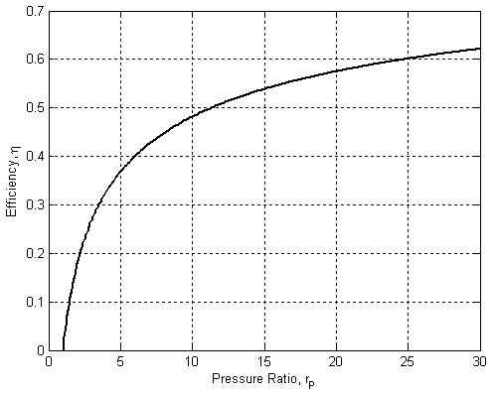
Source: [2]

Slide 27
Although high pressure ratio is desirable for high efficiency but in reality high pressure ratio causes high temperature and there is a limitation to which a real turbine blade can withstand maximum temperature or pressure.
In real gas turbine cycle pressure ratio is usually between to 10 to 16 [1].

Slide 28
Rankine Cycle
An ideal model for the power cycle consisting of a steam turbine.
Consists of two isentropic and two isobaric processes.
Source: [1]

Slide 29
Process 1 - 2 (Isentropic Pumping)
Low pressure saturated liquid from the low pressure condenser is supplied to the high pressure boiler with the help of a pump.
Pumping process is assumed to an isentropic process.
During the pumping process, working substance remains in liquid state, its specific volume remains almost constant, pressure increases and entropy remains constant.

Slide 31
Process 2 - 3 (Isobaric Heat Addition)
Heat is supplied to the boiler from an external source and the boiler produces steam by heating the liquid water. Heat addition in the boiler occurs at constant pressure.
Hence, during the constant pressure heating, specific volume, temperature and entropy of the steam increases.
The state of the steam is generally assumed as saturated vapor, but if the rate of heat supply to the boiler is increased, the steam at the boiler outlet may be superheated.

Slide 33
Process 3 - 4 (Isentropic Expansion)
High temperature and high pressure steam produced by the boiler is supplied to the steam turbine which produces work by consuming energy carried by the steam.
The process occurring in the turbine is assumed to be an isentropic expansion.
During the isentropic expansion
• pressure and temperature of the steam further decrease,
• its specific volume further increases,
• entropy of the system remains constant.

Slide 35
Process 4 - 1 (Isobaric Heat Rejection)
The steam from the turbine exit is delivered to the condenser where it rejects heat to its surroundings (cooling water) and gets condensed back into the saturated liquid.
Heat rejection in the condenser occurs at constant pressure during which
• specific volume, and entropy of the steam decreases,
• temperature remains constants.

Slide 37
Rankine Cycle with Superheated Vapor at Turbine Inlet

Slide 38
Efficiency of Rankine Cycle
Work produced by the turbine per kg of steam is given by
Work consumed by the pump per kg of steam is given by
During steady state operation of the cycle, some part of the work produced by the turbine is utilized to run the pump. Hence, the work delivered to the surroundings is given by

Slide 39

Heat supplied to the steam in the boiler is given by
Efficiency of the Rankine cycle is then given by

Slide 40
Air Standard Internal Combustion Cycle:
Source: [4]

Slide 41

Mean Effective Pressure (MEP):
It is one of the parameter used for the comparison of different internal combustion cycles.
It is defined as the magnitude of the constant pressure that would produce same work as that produced by the actual pressure varying cycle.
= MEP x Piston area x Stroke = MEP x Displacement volume

Slide 42
Illustration of Mean Effective Pressure (MEP):
Source: [4]

Slide 43
Air Standard Internal Combustion Cycle
Operation of Four Stroke Petrol Engines
In case of petrol engines, a mixture of fuel and air is compressed within the cylinder during compression stroke.
After compression fuel is ignited by the electric spark produced by the spark plug.
Therefore, petrol engine is also called spark ignition (SI) engine.

Slide 44
Operation of Four Stroke Diesel Engine
In case of diesel engines, only air is compressed within the cylinder during the compression stroke.
At the end of the compression stroke, diesel is injected into high temperature air, and it gets self burnt.
Therefore, diesel engine is also called compression ignition (CI) engine.

Slide 45
Operation of a Four Stroke Engine
Suction Stroke
Compression Stroke

Slide 46
Operation of a Four Stroke Engine
Power Stroke
Exhaust Stroke

Slide 47
References:
[1] Fundamentals of Thermodynamics & Heat Transfer: Luintel M.C., Heritage Publishers & Distributors Pvt. Ltd., Kathmandu, Nepal, 2016.
[2] Thermal Science and Engineering: Dr. Kumar D.S., S. K. Kataria & Sons, India, 2009.
[3] A Textbook of Engineering Thermodynamics: Rajput R. K., Laxmi Publications Pvt. Ltd. 113, Golden House, Daryaganj, New Delhi – 110002, India, 2010.
[4] Thermodynamics: An Engineering Approach: Cengel Y. A. and Boles M. A., McGraw-Hill Education, New York, 2018.

Slide 48
Thank You

