Slide 1
Course Title:
FUNDAMENTAL OF THERMODYNAMICS AND
HEAT TRANSFER
Lecture – 15 (Week 15)
Heat Transfer
Kathmandu Engineering College
Dr. Lila Raj Koirala

Slide 2
Learning Objective of Lecture:
To impart a great deal of knowledge to undergraduate students on the following topics:
Introduction to Heat Transfer
Basic Concepts and Modes of Heat Transfer, Governing Laws of Heat Transfer

Slide 3
One Dimensional Steady State Heat Conduction through a Plane Wall and Radial Steady State Heat Conduction through a Hollow Cylinder
Heat Flow through Composite Structures; Composite Plane Walls and Multilayered Tubes
Example Illustrating Heat Loss from a Person

Slide 4
Heat transfer:
Heat transfer is the transfer of energy because of temperature difference and it always flows from high temperature to low temperature.
It is three dimensional and time dependent i.e., temperature in a medium varies with position as well as time.
Heat transfer in a medium is said to be steady if the temperature at any particular point does not vary with time, and unsteady or transient when it varies with time.

Slide 5
Heat transfer:
Most of the engineering disciplines have application of heat transfer to design appropriate cooling systems such as in transformer, integrated circuits etc.
Mechanical engineers/energy experts may find its application for the design of boilers, refrigerators, heat exchangers etc., for the storage, transfer and use of cryogenic substances, for designing different types of collectors for solar thermal applications.

Slide 6
Thermodynamics VS Heat Transfer:
Thermodynamics
Heat transfer
1. The science of thermodynamics deals with the amount of heat transfer as a system undergoes a process from one equilibrium state to another, and makes no reference to how long the process will take.
1. But in engineering, we are often interested in the rate of heat transfer and spatial variation of temperature, which is the topic of the science of heat transfer.

Slide 7
Thermodynamics
Heat transfer
2. It deals with the equilibrium states of a system.
2. It occurs only when a system is in a non-equilibrium state.
3. There should not be a temperature gradient.
3. Heat transfer takes place only when there is temperature gradient.

Slide 8
Modes of Heat Transfer:
According to the physical mechanism and the governing law associated with them, heat transfer is classified into three modes:
Conduction
Convection
Radiation

Slide 9
Conduction:
The heat is conducted in solids by two mechanisms namely by lattice (crystal) vibration and free electrons movement.
However, there is no actual movement of molecules or atoms themselves in the heat conduction.
During the lattice vibration, the faster vibrating lattices in the hottest part of a body transfer heat by impacting some of their energy to adjacent lattices.
Free electrons move about in the lattice structure of the material which transports heat from high temperature region to the low temperature region.

Slide 10
Convection:
Convection heat transfer occurs in fluid medium and heat is transferred by the actual movement of the molecules.
It is the mode of energy transfer between a solid surface and the adjacent liquid or gas that is in motion.
Convection depends on the properties of fluid and is independent of the properties of the material of the solid surface. However, the geometry of the solid surface influences the flow of fluid.

Slide 11
Radiation:
Radiation heat transfer can occur without any medium and heat is transferred in the form of electromagnetic wave (EMW).
In fact, the heat transfer by radiation or radiation exchange between two bodies occurs most effectively in vacuum where no conduction and convection heat transfer take place.
All bodies having surface temperature above absolute zero temperature (above 0 Kelvin) are capable of emitting radiant heat energy.

Slide 12
The mechanism of the heat transfer by radiation from a hot body to a cold body consists of following three phases:
(i) Conversion of heat energy of the hot body into electromagnetic waves.
(ii) Movement of photons from the hot body to the cold body through intervening space.
(iii) Reconversion of electromagnetic waves into heat energy of the cold body.

Slide 13
Spectrum of electromagnetic radiation:
Source: [1]

Slide 14
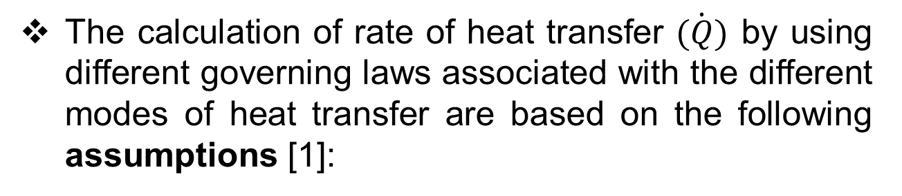
Governing Laws of Heat Transfer
The calculation of rate of heat transfer $\dot{(Q)}$ by using different governing laws associated with the different modes of heat transfer are based on the following assumptions [1]:
(i) The heat transfer takes place under steady state conditions.
(ii) The heat flow is unidirectional.

Slide 15
Assumptions:
(iii) There is no internal heat generation.
(iv) The bounding surfaces are isothermal in character.
(v) The material is homogeneous and isotropic, i.e., the value of thermal conductivity is constant in all directions.

Slide 16


Fourier’s Law of Conduction:
Magnitude of conduction heat transfer is given by Fourier’s law of heat conduction which states as:
The rate of flow of heat per unit area (heat flux) through a homogeneous solid is directly proportional to the temperature gradient within the solid material.

Slide 17


Newton's law of cooling for Convection:
Magnitude of convection heat transfer is given by Newton's law of cooling which states as:
The rate of heat flow per unit area (heat flux) is directly proportional to the temperature difference between a solid surface and an adjacent fluid.

Slide 18
The heat transfer coefficient h depends on [1]
the thermodynamic and transport properties (e.g. density, viscosity, specific heat and thermal conductivity of the fluid),
the geometry of the solid surface,
the nature of fluid flow (laminar or turbulent), and
the prevailing thermal conditions.

Slide 19

Stefan-Boltzmann law of Radiation:
Magnitude of the radiation heat transfer by a surface is given by Stefan-Boltzmann law which states as:
The maximum rate of heat radiated per unit area (heat flux) by a surface is directly proportional to the fourth power of the absolute surface temperature.

Slide 20
Radiation:
When a surface of emissivity Ɛ and surface area A_{s} at a thermodynamic temperature T_{s} is completely enclosed by a much larger surface or a black body at thermodynamic temperature T_{surr} separated by a gas such as air that does not intervene with radiation, the net rate of radiation heat transfer between these two surfaces is given by

Slide 21
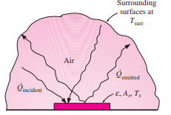
Source: [2]

Slide 22
  One Dimensional Steady State Heat Conduction through a Plane Wall
Let us consider steady heat conduction through the plane walls of a building.
Heat is continuously lost to the surroundings through the wall during a winter day.
Source: [2]

Slide 23
It can be observed that heat transfer through the wall is in the perpendicular direction to the wall surface, and no significant heat transfer takes place in the wall in other directions.
The heat conduction through the wall can be modeled as one dimensional and steady state. By using Fourier’s law,

Slide 24

Integrating above equation with boundary conditions, from x = 0 where T (0) = T1 to X = L where T (L) = T2, we get
,

Slide 25

Hence, the magnitude of the rate of heat transfer by conduction through a plane wall is given by
This equation indicates that the rate of heat transfer by conduction through a plane wall is proportional to the average thermal conductivity, the wall area, and the temperature difference, but is inversely proportional to the wall thickness.

Slide 26
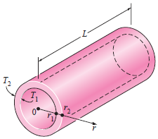
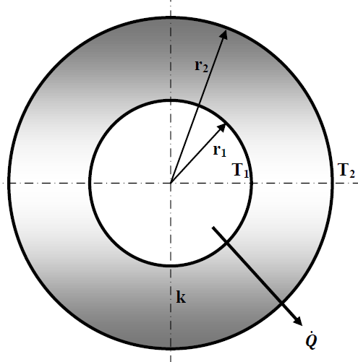
Radial Steady State Heat Conduction through a Hollow Cylinder
Source: [2]

Slide 27



The heat conduction through the pipe can be modeled as the steady one dimensional and Fourier’s law of heat conduction can be applied as
The heat transfer area A depends on radius r and it varies in the direction of heat transfer. Thus, putting

Slide 28




Integrating this equation with applying the boundary conditions:
Hence, the magnitude of rate of radial heat conduction through a hollow cylinder is given by

Slide 29
Heat Conduction through Composite Structures
Different arrangements of different materials with different thermal properties designed for a particular application is known as a composite structure.

Slide 30
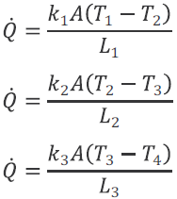
Composite Plane Wall:
For steady state heat transfer, heat flowing through each layer should be same, i.e.;

Slide 31
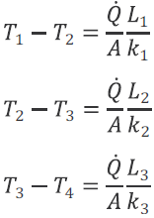
Rearranging the above equations for the temperature differences,

Slide 32


Adding above equations,
Rearranging the above equation, we get an expression for conduction heat transfer through a composite plane wall as,

Slide 33
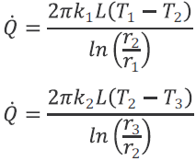

Composite Hollow Cylinder:
For steady state heat transfer, heat flowing through each layer should be same, i.e.;

Slide 34
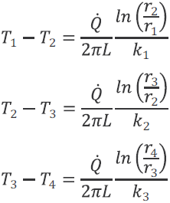
Rearranging the above equations for the temperature differences,

Slide 35

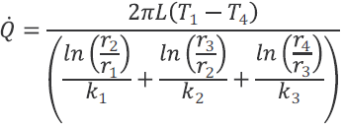
Adding above equations,
Rearranging the above Equation, we get an expression for conduction heat transfer through a composite cylinder as,

Slide 36
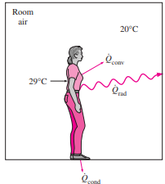
Example: Heat Loss from a Person
Consider a person standing in a room at 20°C. Determine the total rate of heat transfer from this person if the exposed surface area and the average outer surface temperature of the person are 1.6 m² and 29°C, respectively, and the convection heat transfer coefficient is 6 W/m^{2 .}°C. The emissivity of the person is 0.95 [2].
Source: [2]

Slide 37
Solution: Given,
Room Temperature, T_{surr} = 20ºC
Body Temperature, T_{s} = 29ºC
Convection Heat Transfer Coefficient, h = 6 W/m².ºC
Stefan Boltzmann Constant,
= 5.67 x 10 ⁻⁸ W/m²K⁴
Emissivity of Person, Ɛ = 0.95
Surface Area, A_{s} = 1.6 m²

Slide 38
Assumptions:
1. Steady state operating conditions exist.
2. The person is completely surrounded by the interior surfaces of the room.
3. The surrounding surfaces are at the same temperature as the air in the room.
4. Heat conduction to the floor through the feet is negligible.

Slide 39
Analysis:
The heat transfer between the person and the air in the room will be by convection (instead of conduction) since it is conceivable that the air in the vicinity of the skin or clothing will warm up and rise as a result of heat transfer from the body, initiating natural convection currents.
Thus, the rate of convection heat transfer from the person to the air in the room is
= 86.4 W

Slide 40
The person will also lose heat by radiation to the surrounding wall surfaces. Considering the assumptions given above, the net rate of radiation heat transfer from the person to the surrounding walls, ceiling, and floor is
= 81.713 W

Slide 41
The rate of total heat transfer from the body is determined by adding these two quantities:
= 86.4 + 81.713 = 168.113 W
Discussion:
The heat transfer would be much higher if the person were not dressed since the exposed surface temperature would be higher. Thus, an important function of the clothes is to serve as a barrier against heat transfer.

Slide 42
Heat transfer through the feet to the floor by conduction, which is usually very small, is neglected.
Heat transfer from the skin by perspiration, which is the dominant mode of heat transfer in hot environments, is not considered here.

Slide 43
References:
[1] A Textbook of Engineering Thermodynamics: Rajput R. K., Laxmi Publications Pvt. Ltd. 113, Golden House, Daryaganj, New Delhi – 110002, India, 2010.
[2] Heat and Mass Transfer: A Practical Approach: Cengel Y. A., Tata McGraw-Hill Publishing Company Limited, New Delhi, India, 2007

Slide 44
THANK YOU

