Slide 1
Course Title:
FUNDAMENTAL OF THERMODYNAMICS AND
HEAT TRANSFER
Lecture – 16 (Week 16)
Heat Transfer
Kathmandu Engineering College
Dr. Lila Raj Koirala

Slide 2
Learning Objective of Lecture:
To impart a great deal of knowledge to undergraduate students on the following topics:
Electrical analogy for thermal resistance
Combined heat transfer and overall heat transfer coefficient for plane wall and tube

Slide 3
Nature of Convection:
Free and Forced Convection
Heat Radiation:
Types of Bodies with respect to Radiation:
Black Body, White Body and Gray Body
Radiation surface properties

Slide 4
Electric Analogy for Thermal Resistance
More complex heat transfer problems involving both series and parallel arrangements can be solved by using an electric analogy, i.e.,
by converting the given problem into an equivalent electrical circuit and applying the appropriate network theorem.

Slide 5


We can express heat transfer equation as Ohm’s law in electricity:
e

Slide 6
This shows that Current (I) flows due to the difference in electrical potential (ΔV) and the property of the substance by virtue of which it opposes the flow of current through it is called the electrical resistance (R_{e}).
Similarly, heat (Q) flows due to the difference in temperature (ΔT) and the property of the substance by virtue of which it opposes the flow of heat through it is called the thermal resistance (R_{th}).

Slide 7



Thermal Resistance of a Plane Wall
Source: [1]

Slide 8

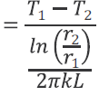

Thermal Resistance of a Hollow Cylinder
Source: [1]

Slide 9



Thermal Resistance of a Convective Layer
Source: [1]

Slide 10


Thermal Resistance of a Radiative Layer
Source: [1]

Slide 11
    Applications of Electrical Analogy Approach in Heat Transfer through Composite Structures:
Heat Transfer through a Composite Plane Wall in Series Arrangement

Slide 12

In this case same amount of heat flows through each layer; hence all thermal resistances are arranged in series.
When heat flows through a thermal resistance, there will be temperature drop (analogous to voltage drop in case of electric circuit).
Thermal resistances for each layers of the plane wall are given as

Slide 13


Equivalent thermal resistance is then given as
Then overall heat transfer for a composite plane wall is given by

Slide 14
Heat Transfer through a Composite Hollow Cylinder in Series Arrangement

Slide 15




In this case also same amount of heat flows through each layer; hence all thermal resistances are arranged in series.
Thermal resistances for each layers of the hollow cylinder are given as

Slide 16
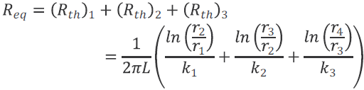
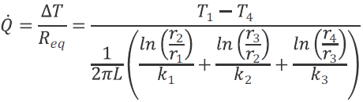
Equivalent thermal resistance is then given as
Then overall heat transfer for a composite hollow cylinder is given by

Slide 17
Heat Transfer through Composite Structure in Combined Series - Parallel Arrangement
Source: [1]

Slide 18
Thermal resistance circuit or electric analogy approach becomes more suitable when the composition or structure of the wall becomes more complex.
This means the thermal resistance concept is appropriate to solve steady heat transfer problems that involve a combined series- parallel arrangements as shown in above figure.

Slide 19

The total thermal resistance for the given circuit is then derived as
Thermal resistances for each layer of the plane wall and for the convective layer are given as

Slide 20

Then rate of overall heat transfer for a composite plane wall in the combined series-parallel arrangement is given by

Slide 21
Combined Heat Transfer and Overall Heat Transfer Coefficient for a Plane Wall and Tube
In reality, all modes of heat transfer will present, whenever there exists a temperature difference e.g. conduction, convection and radiation modes of the heat transfer
Among these modes, we will consider the problems involving conduction and convection only.

Slide 22
Plane Wall Subjected to Convective Medium on Both Sides
Source: [1]

Slide 23




For steady state heat transfer, heat flowing through each layer should be same, i.e.;
Rearranging the above equations for the temperature differences,

Slide 24


Adding above equations,
Rearranging the above equation, an expression for rate of the overall heat transfer for combined conduction and convection heat transfer can be derived as,

Slide 25

Above equation can also be expressed in simpler form in an analogous manner to Newton’s law of cooling as
Where |  | is called overall heat transfer coefficient

Slide 26
Tube (Hollow Cylinder) Subjected to Convective Medium on Both Sides
Source: [1]

Slide 27




For steady state heat transfer, heat flowing through each layer should be same, i.e.;
Rearranging the above equations for the temperature differences,

Slide 28

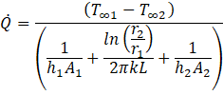
Adding above equations,
Rearranging the above equation, an expression for overall heat transfer for combined conduction and convection heat transfer can be derived as,

Slide 29


This can also be expressed as
Or,
Above equation can also be expressed in the simpler form in an analogous manner to Newton’s law of cooling as
or,

Slide 30




where,
and
are called inside overall heat transfer coefficient and outside overall heat transfer coefficient respectively.
Substituting A₁ = 2πr₁L and A₂ = 2πr₂L
and

Slide 31
  Nature of Heat Convection:
Free convection
Forced convection
It is the heat transfer process in which flow of fluid is caused by density gradient.
It is the heat transfer process in which flow of fluid is caused by some external devices such as pump, fan, blower etc.
Mass flow rate of fluid is usually low during the free convection.
Mass flow rate of fluid is comparatively higher in forced convection.

Slide 32
  Nature of Heat Convection:
Free convection
Forced convection
Rate of heat transfer is usually very low.
Rate of heat transfer is relatively higher.
For example: Cooling of a room without a fan by natural circulation of air.
For example: Cooling of a room by a fan.

Slide 33
Heat Radiation:
Heat (thermal) radiation is the energy emitted by the surface of matter in the form of electromagnetic waves (or photons).
During the radiation heat transfer the thermal energy of the source gets converted into energy in the form of electromagnetic waves or photons.
The waves or photons can travel through space and strike other receiving body resulting in absorption of part of energy carried by these photons and gets reconverted into the thermal energy of the receiving body.

Slide 34
    Concept of a Black Body:
The concept of a black body is an idealization with which the radiation characteristics of real bodies can be conveniently compared.
Source: [2]

Slide 35
A black body has the following properties [2]:
It absorbs all the incident radiation energy falling on it and does not transmit or reflect it regardless of wavelength and direction.
It has an emissivity value of unity and therefore emits maximum amount of heat radiation at all wavelengths at any specified surface temperature.
The radiation energy emitted by a black body is independent of direction.

Slide 36
Distribution of spectral emissive power of a black body with wavelength at different surface temperatures:
Source: [1]

Slide 37
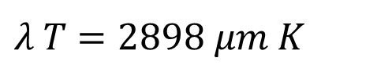
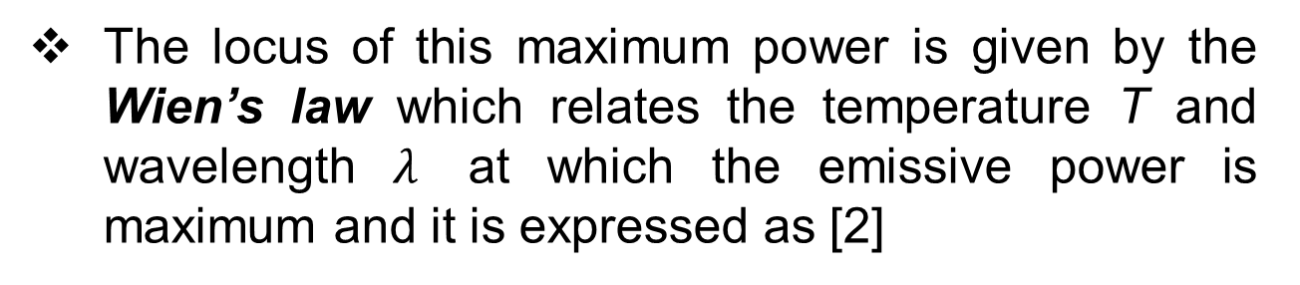
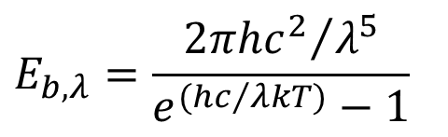
According to Planck’s law for black body radiation the emissive power per unit area per unit wavelength which is also called spectral radiance is given by [2]
$$E_{b,λ}=\frac{{2πhc^{2}}/{λ^{5}}}{e^{({hc}/{λkT)}}−1}$$
The locus of this maximum power is given by the Wien’s law which relates the temperature T and wavelength $λ$ at which the emissive power is maximum and it is expressed as [2]
$λ T=2898 μm K$

Slide 38
    Types of Bodies with respect to Radiation
The bodies are classified according to their radiation surface properties.
Black Body
A black body is one which neither reflects nor transmits any part of the incident radiation energy but absorbs all of it regardless of the wavelength, α = ε = 1.

Slide 39
Variation of Emissivity with Wavelength for Different Bodies:
Source: [3]

Slide 40
Grey Body
A grey body is defined as a hypothetical body with constant surface absorptivity (and then emissivity) over all wavelengths and temperatures like black body.
But its emissivity and therefore emissive power is less than that of a black body, ε < 1.

Slide 41
Variation of Spectral Emissive Power with Wavelength for Different Bodies:
Source: [4]

Slide 42
White Body
A white body is defined as a hypothetical body whose surface reflects the entire radiation energy incident on its surface.
Hence, a white body surface does not absorb and transmit the radiation energy incident on its surface and has a reflectivity value of unity, ρ = 1.
Opaque Body
A body is said to be an opaque body if no incident radiation energy is transmitted through it.

Slide 43
Hence, for the opaque body, τ = 0. Thick solids and liquids are usually considered as opaque.
Transparent Body
A body is said to be a transparent body if all the incident radiation energy is transmitted through it. For the transparent body, τ = 1.
Gases and their mixture (air) have a transmissivity value of unity and therefore considered as transparent.

Slide 44
    Radiation Surface Properties:
When a surface received the incident radiation energy three things happen; a part of it is reflected back, a part is transmitted through and the remaining part is absorbed depending upon the characteristics of the surface.
Source: [2]

Slide 45

By using the conservation of energy principle for any given surface,
Here α, ρ and τ are the radiation surface properties known as absorptivity, reflectivity and transmissivity of a surface respectively. Thus, the sum of absorptivity, reflectivity and transmissivity must be equal to unity for any surface.

Slide 46
Kirchhoff’s Law:
The emissivity and the absorptivity of a surface at a given temperature and wavelength are equal. α = ε
Emissivity (ε)
Emissivity of a surface is the ratio of the energy radiated by a surface to energy radiated by a black body surface at the same temperature. Its value is in the range 0 ≤ ε ≤ 1.

Slide 47
A blackbody is perfect emitter, so it has emissivity value 1.
.
.
A real body surface has emissivity value less than 1 (ε < 1).
Absorptivity (α)
It is defined as the ratio of the radiation energy absorbed by a surface to the total radiation energy incident on the surface . Like emissivity, its value ranges 0 ≤ α ≤ 1.

Slide 48
Reflectivity (ρ)
Reflectivity of a surface is defined as the ratio of the radiation energy reflected by a surface to the total radiation energy incident on the surface ( .
Transmissivity (τ)
It is defined as the ratio of the radiation energy traversing through the surface to the total radiation energy incident on the surface .

Slide 49
References:
[1] Heat and Mass Transfer: A Practical Approach: Cengel Y. A., Tata McGraw-Hill Publishing Company Limited, New Delhi, India, 2007
[2] A Textbook of Engineering Thermodynamics: Rajput R. K., Laxmi Publications Pvt. Ltd. 113, Golden House, Daryaganj, New Delhi – 110002, India, 2010.

Slide 50
References:
[3] https://topex.ucsd.edu/rs/Lec06.pdf, Viewed [June, 2022].
[4]
https://www.omega.de/literature/transactions/volume1/
theoretical2.html, Viewed [June, 2022].

Slide 51
THANK YOU

