Slide 1
Information Resource Management(IRM)
Lecture 8
Managing Knowledge
Lecturer: Dr. Gakwaya Nkundimana Joel

Slide 2
Contents outline
INTRODUCTION TO MANAGING KNOWLEDGE
what is knowledge management
THE GOAL OF KNOWLEDGE MANAGEMENT
TYPES OF KNOWLEDGE
EXAMPLE OF KNOWLEDGE MANAGEMENT
KNOWLEDGE MANAGEMENT PROCESS
1. gathering
2. storage and organization
3. distribution
4. use
KNOWLEDGE MANAGEMENT METHODS
BENEFITS OF MANAGING KNOWLEDGE
CHALLENGES OF MANAGING KNOWLEDGE

Slide 3
What is managing knowledge
Is a process of sharing, defining, structuring, retaining, sharing the knowledge and experience of employees within an organization.

Slide 4
What is managing knowledge(Cont)
The knowledge they share include:
technical resources
frequently asked questions
training documents
people skills.
Managing knowledge use Data mining to provide easy access to users

Slide 5
the goal of knowledge management
Improving organizational efficiency
saving knowledge in an easily accessible form

Slide 6
the goal of knowledge management
THIS GOAL IS ACHIEVED BY:
Capturing and organizing knowledge in a knowledge management system to address specific business tasks and projects.
Sharing knowledge with others who can benefit from it.
Improving processes and technology to provide easy access to knowledge
And promoting the generation of new knowledge for continual learning.

Slide 7

Types of knowledge
Explicit knowledge
Tacit knowledge
Implicit knowledge

Slide 8
Explicit knowledge
Knowledge that can be easy is codified and taught
It is found in : books, files, folders, documents, databases and how-to videos
Most easily extracted and handled by a knowledge management system.

Slide 9
Tacit knowledge
This type of knowledge is intuitive in nature
It is based on experience and practice and often helps in achieving long-term goals
Difficult to share
There is no easy way to extract it like with explicit knowledge
Examples of tacit knowledge are “know-hows”, innovative thinking, and understanding body language.

Slide 10
Implicit knowledge
knowledge that explains how best to implement explicit knowledge
For example, consider discussing a task with an experienced co-worker
The experienced employee utilizes and shares their implicit knowledge to improve how the team operates.

Slide 11
Examples of knowledge management
Staff retiring :
Employee transfer or promotion

Slide 12
The knowledge management process
There are four key knowledge management processes. These include:
Knowledge gathering : This includes entering data, scanning, pulling information from various sources
Knowledge storage and organization : This step in the process includes cataloguing and indexing content in a knowledge management system to find it
Knowledge distribution : This provides a way for users to access the information, including FAQs, training videos, white papers and manuals.
Knowledge use : Once information is distributed to users, they need to put it into action

Slide 13
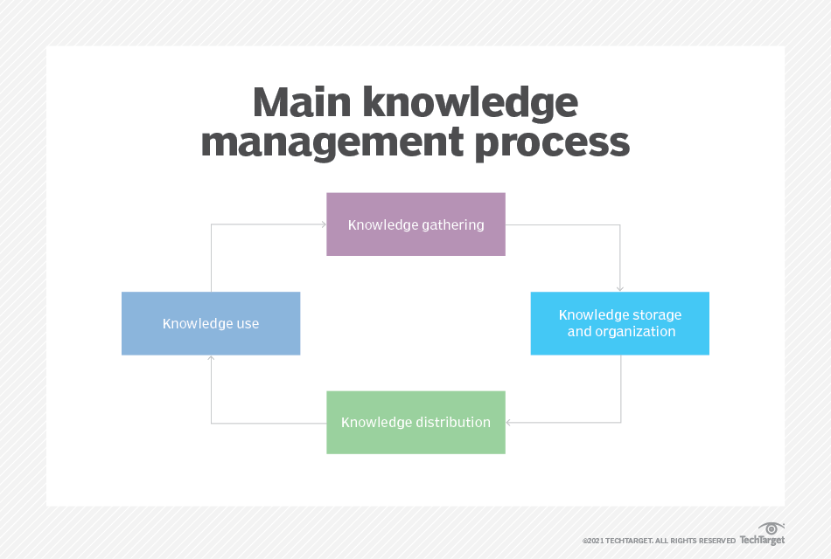
The knowledge management process
Figure1 produced by techtarget 2001

Slide 14
Knowledge management methods
Tutoring & training, communities of practice, and Q&A
Documentations, guides, guidelines, FAQ, and tutorials
Forums, intranets, and collaboration environments
Learning and development environments
Case studies
Webinars

Slide 15
Tutoring & training, communities of practice, and Q&A
Involve transferring information directly from the knowledge holder to other employees.
through in-person tutoring, company-wide training sessions, online chats, and group discussions
Pros:
Questions can be immediately answered
Clarifications can be made if the material is not understood
Brainstorming sessions can be facilitated, taking advantage of the combined power of the group’s experience and knowledge
In-person learning tends to be remembered more clearly

Slide 16
Tutoring & training, communities of practice, and Q&A (Cont)
Cons:
It can be time-consuming and take away from the tasks the knowledge holder is trying to complete
A system of expertise location can be time-consuming to build and maintain
It can be challenging to document and save for future use
Difficulty finding the right expert with good communication skills and knowledge of the company
You can lose the knowledge if the knowledge holder leaves the company

Slide 17
Documentations, guides, guidelines, FAQ, and tutorials
Written communications
Written communications are great for storing and transferring knowledge.
Uses Text-based knowledge management
With text-based knowledge management, a system to store, categorize and navigate subjects is always available.
Pros:
The company has an invaluable source of information of up to date information
Easy to find and share online (when organized well)
Can easily combine multiple people’s expertise into one packet

Slide 18
Documentations, guides, guidelines, FAQ, and tutorials(Cont)
Cons:
Requires a lot of time to create and keep up-to-date
Must be appropriately managed to ensure relevant knowledge is easily found
Requires infrastructure (internet access, etc.)
It takes time to consume

Slide 19
Forums, intranets, and collaboration environments
These online resources spark conversation and bring many knowledge holders into the same place.
Pros:
Collaboration drives innovation
Many experts can be brought together into one place, no matter their location globally
Facilitating contact with remote teams helps teamwork and knowledge transfer

Slide 20
Forums, intranets, and collaboration environments (Cont)
Cons:
It can be a chaotic, noisy environment
Knowledge is not actively being vetted as it is added to discussions
Searching through many messages and threads for relevant answers is time-consuming
Messages and threads might not be archived

Slide 21
Learning and development environments
Creating an environment where learning is considered an asset and will continuously drive employees to educate themselves.
Pros:
Motivated employees can develop themselves at will
Training pathways can be set out
Wide range of resources available to produce a constant flow of fresh content
The structure allows for easier discovery of subjects
Authoring tools available such that internal experts can build company-specific courses
Analytic tools are available to help find knowledge gaps inside the company

Slide 22
Learning and development environments(Cont)
Cons:
Requires a lot of effort to develop and maintain in house
Readily available solutions may be too generic to add real value for your company
Content must be created and continually updated
Requires an influential learning culture to motivate staff to participate

Slide 23
Case studies
These in-depth studies into particular areas that serve as complete guides to a subject.
Learning from case study
Looking at the actions taken, the results they produce, and any lessons learned is extremely valuable.
Pros:
Allow for complete documentation and archiving of lessons learned
Easily shareable
Efficient for communicating complex information

Slide 24
Case studies (cont)
Cons:
It takes a lot of time and skill to create
The case study may have limitations or require approval from the parties involved
Can be too specialized to apply the knowledge broadly
In fast-paced fields that are constantly innovating, case studies can become out of date quickly

Slide 25
Webinars
Online seminars can be beneficial in widely disseminating ideas throughout teams, branches, or the entire company.
Pros:
Accessible for all interested employees to attend
Potential for interactivity where attendees can ask questions specific to issues they are having
Can be recorded and reused

Slide 26
Webinars (cont)
Cons:
Planning, finding the right speakers, and settling on a topic is time-consuming
Requires organization
External experts can cost a lot
Requires time to find answer

Slide 27
Benefits of knowledge management
Faster decision-making
Efficient access to knowledge and information
Increased collaboration and idea generation
Enhanced communication throughout your organization
Improved quality of information and data
More security for intellectual property
Optimized training

Slide 28
challenges of Managing knowledge
Motivation
Keeping up with technology
Security.
Keeping information up to date.

Slide 29
challenges of Managing knowledge (cont)
Motivation.
Employees are often set in their own ways
Managers find it difficult to motivate employees to change
their habits
Managers fail to motivate employee to share knowledge in a common workspace.
Keeping up with technology.
Constant change of technology
The latest updates and tools.

Slide 30
challenges of Managing knowledge (cont)
Security.
To protect person information, user permissions and security levels must be set to proper level
Keeping information up to date.
Like technology, information, too, changes at a rapid pace. It is necessary to keep it fresh and relevant.

Slide 31
Reference
lavi, M., and Leidner, E.D. (2002). Knowledge Management and Knowledge Systems. In Barnes Stuart (ed) Knowledge Management Systems: Theory and Practice, Thomsen Learning 2002
Al-Hakim, L.A.Y. and Hassan, S. (2011), 'The role of middle managers in knowledge management implementation for innovation enhancement', International Journal of Innovation, Management and Technology, vol. 2, no. 1, pp.86-94.
Allameh, S.M., Zare, S.M., and Davoodi, S.M.R. (2011) 'Examining the Impact of KM Enablers on Knowledge Management Processes', Procedia Computer Science, vol 3, pp. 1211-1223.
Altaher, A.M. (2010) 'Knowledge Management Process Implementation 2011', International Journal of Digital Society (IJDS), Vol. 1, Issue 4, December, pp. 265-271

