Slide 1
Information Resource Management(IRM)
Lecture 9
Enhancing Decision Making
Lecturer: Dr. Gakwaya Nkundimana Joel

Slide 2
CONTENTS OUTLINE
LESSON OBJECTIVES
DECISION MAKING AND DECISION-SUPPORT SYSTEMS
DECISION MAKING AND INFORMATION SYSTEMS
Types of decision
1. unstructured decision
2. structured decision
3.semi-structured decision
Four stages of the decision-making process
SYSTEM FOR DECISION SUPPORT
DECISION MAKING IN THE REAL WORLD
TRENDS INDECISION SUPPORT AND BUSINESS INTELLIGENCE
DIFFERENCE BETWEEN MANAGEMENT INFORMATION SYSTEM (MIS) AND DECISION SUPPORT SYSTEMS (DSS)
TYPES OF DECISION SUPPORT SYSTEMS (DSS)
GROUPE DECISION SUPPORT SYSTEMS (GDSS)
EXECUTIVE SUPPORT SYSTEM (ESS)

Slide 3
OBJECTIVES
Describe different types of decisions and the decision-making process
Evaluate the role of information systems in helping people working individually and in a group make decisions more efficiently
Demonstrate how executive support systems can help senior managers make better decisions

Slide 4
DECISION MAKING AND DECISION-SUPPORT SYSTEMS
Business intelligence enables firms to:
Amass information
Develop knowledge about operations
Change decision-making behavior to achieve profitability and other business goals

Slide 5
Decision Making and Information Systems
Decision-Making Levels:
Senior management
Middle management and project teams
Operational management and project teams
Individual employees

Slide 6
Decision Making and Information Systems(Cont)
Senior managers:
  Make many unstructured decisions
  E.g. Should we enter a new market?
Middle managers:
  Make more structured decisions but these may include unstructured components
  E.g. Why is order fulfillment report showing decline in Minneapolis?
Operational managers, rank and file employees
  Make more structured decisions
  E.g. Does customer meet criteria for credit?

Slide 7
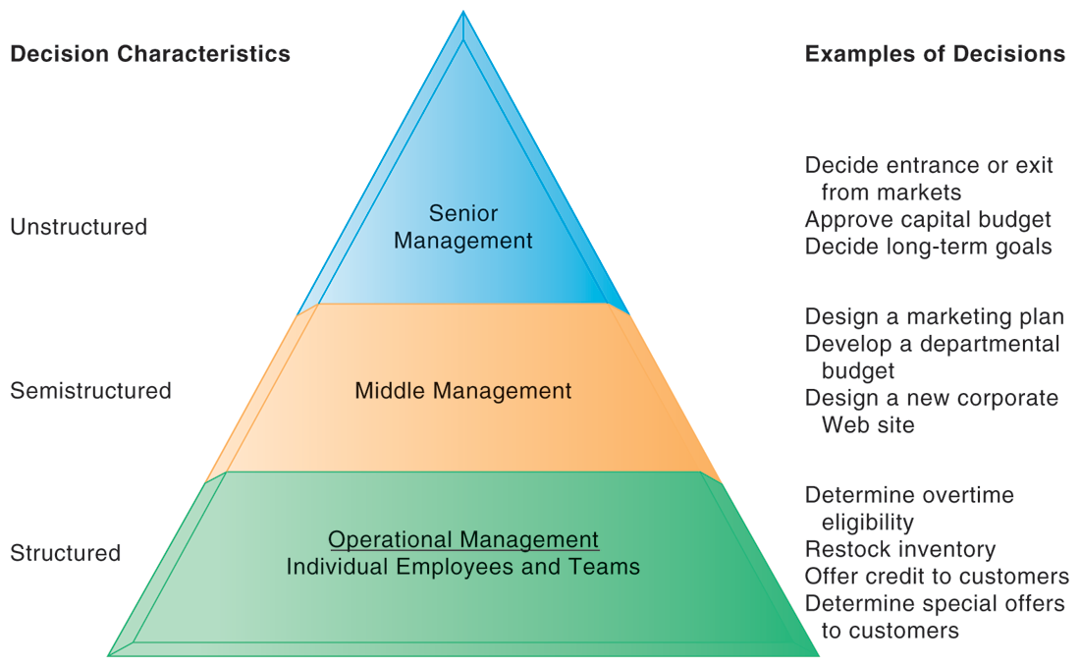
Decision Making and Information Systems(Cont)
Figure 1 show the pyramid of decision hierarchy within organization. Produced by Laudon in Management Information System,2017

Slide 8
Decision Making and Information Systems(Cont)
Types of Decisions
Unstructured Decisions
Structured decisions
Semi structured decisions

Slide 9
Decision Making and Information Systems(Cont)
Unstructured decisions
Novel, non-routine decisions requiring judgment and insights
Examples: Approve capital budget; decide corporate objectives
Structured decisions
Routine decisions with definite procedures
Examples: Restock inventory; determine special offers to customers
Semi structure decisions
Only part of decision has clear-cut answers provided by accepted procedures
Examples: Allocate resources to managers; develop a marketing plan

Slide 10
DECISION MAKING AND DECISION-SUPPORT SYSTEMS(cont)
4 stages of the decision making process
  Intelligence
    Discovering, identifying, and understanding the problems occurring in the organization
  Design
    Identifying and exploring solutions to the problem
  Choice
    Choosing among solution alternatives
  Implementation
    Making chosen alternative work and continuing to monitor how well solution is working

Slide 11
DECISION MAKING AND DECISION-SUPPORT SYSTEMS(cont)
4 stages of the decision-making process
2. design
solution discovery: what are the possible solution?
1. Intelligence
Problem discovery: what is the problem?
4. Implementation
Solution Testing
is the solution working?
Can we make it work better?
3. Choice
Choosing solutions: what is the best solution?

Slide 12
Systems for Decision Support
There are four kinds of systems that support the different levels and types of decisions:
Management Information Systems (MIS)
Decision-Support Systems (DSS)
Executive Support Systems (ESS)
Group Decision-Support Systems (GDSS)

Slide 13
Decision Making in the Real World
In the real world, investments in decision-support systems do not always work because of
Information quality: Accuracy, integrity, consistency, completeness, validity, timeliness, accessibility
Management filters: Biases and bad decisions of managers
Organizational inertia: Strong forces within organization that resist change

Slide 14
Trends in Decision Support and Business Intelligence
The rise of client/server computing, the Internet, and Web technologies made a major impact on systems that support decision making.
Six Major Trends:
Detailed enterprise-wide data
Broadening decision rights and responsibilities

Slide 15
Trends in Decision Support and Business Intelligence (Cont)
Intranets and portals
Personalization and customization of information
Extranets and collaborative commerce
Team support tools

Slide 16
The Difference between MIS and DSS
Management Information Systems:
Primarily address structured problems
Provides typically fixed, scheduled reports based on routine flows of data and assists in the general control of the business

Slide 17
SYSTEMS FOR DECISION SUPPORT
Decision Support Systems:
Support semi structured and unstructured problems
Greater emphasis on models, assumptions, ad-hoc queries, display graphics
Emphasizes change, flexibility, and a rapid response

Slide 18
Types of Decision-Support Systems
Model-driven DSS:
Primarily stand-alone systems
Use a strong theory or model to perform “what-if” and similar analyses

Slide 19
SYSTEMS FOR DECISION SUPPORT
Data-driven DSS:
Integrated with large pools of data in major enterprise systems and Web sites
Support decision making by enabling user to extract useful information
Data mining: Can obtain types of information such as associations, sequences, classifications, clusters, and forecasts

Slide 20
SYSTEMS FOR DECISION SUPPORT
Components of DSS
DSS database: A collection of current or historical data from a number of applications or groups
DSS software system: Contains the software tools for data analysis, with models, data mining, and other analytical tools
DSS user interface: Graphical, flexible interaction between users of the system and the DSS software tools

Slide 21
SYSTEMS FOR DECISION SUPPORT
Model: An abstract representation that illustrates the components or relationships of a phenomenon
Statistical models
Optimization models
Forecasting models
Sensitivity analysis (“what-if” models)

Slide 22
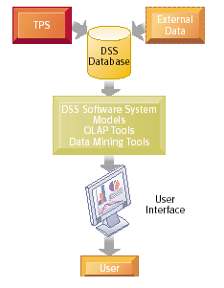
SYSTEMS FOR DECISION SUPPORT
Figure 2 of Overview of a Decision-Support System produced by paginas,2014

Slide 23
SYSTEMS FOR DECISION SUPPORT
Business Value of DSS
Providing fine-grained information for decisions that enable the firm to coordinate both internal and external business processes much more precisely
Helping with decisions in
Supply chain management
Customer relationship management

Slide 24
SYSTEMS FOR DECISION SUPPORT
Business Value of DSS (Continued)
Pricing Decisions
Asset Utilization
Data Visualization: Presentation of data in graphical forms, to help users see patterns and relationships
Geographic Information Systems (GIS): Special category of DSS that display geographically referenced data in digitized maps

Slide 25
SYSTEMS FOR DECISION SUPPORT
Web-Based Customer Decision-Support Systems
DSS based on the Web and the Internet can support decision making by providing online access to various databases and information pools along with software for data analysis
Some of these DSS are targeted toward management, but many have been developed to attract customers.

Slide 26
GROUP DECISION-SUPPORT SYSTEMS
What Is a GDSS?
Group Decision-Support System (GDSS) is an interactive computer-based system used to facilitate the solution of unstructured problems by a set of decision makers working together as a group.

Slide 27
GROUP DECISION-SUPPORT SYSTEMS
Three Main Components of GDSS:
Hardware (conference facility, audiovisual equipment, etc.)
Software tools (Electronic questionnaires, brainstorming tools, voting tools, etc.)
People (Participants, trained facilitator, support staff)

Slide 28
GROUP DECISION-SUPPORT SYSTEMS
Overview of a GDSS Meeting
In a GDSS electronic meeting, each attendee has a workstation.
The workstations are networked and are connected to the facilitator’s console, which serves as the facilitator’s workstation and control panel, and to the meeting’s file server.
All data that the attendees forward from their workstations to the group are collected and saved on the file server.

Slide 29
GROUP DECISION-SUPPORT SYSTEMS
Business Value of GDSS
Traditional decision-making meetings support an optimal size of three to five attendees. GDSS allows a greater number of attendees.
Enable collaborative atmosphere by guaranteeing contributor’s anonymity.
Enable non attendees to locate organized information after the meeting.

Slide 30
Executive support systems (ESS)
1. Designed to help executives focus on important performance indications
2. Balanced scorecard method:
• Measures outcomes on four dimensions:
Financial
Business process
Customer
Learning & growth
• Key performance indicators (KPIs) measure each dimension
3. In developing an ESS, first concern is for senior executives and consultants to develop scorecard and then to automate flow of information for each KPI

Slide 31
references
Adams and Graham, “Integration, knowledge creation and B2B governance: The role of resource hierarchies in financial performance”. Industrial Marketing Management, 63 (2017), pp. 179-191
Alvi “Managing organizational knowledge”. Framing the domains of IT management: Projecting the future through the past , (2000), pp. 15-28
Barker “Management of knowledge creation and sharing to create virtual knowledge-sharing communities: A tracking study”. Journal of Knowledge Management, 19 (2015), pp. 334-350
Kenneth C. Laudon and Jane P. Laudon “Management Information Systems”, 5th Edition Pearson, 2018

