Slide 1
Information Resource Management(IRM)
Lecture-11
Data Visualization and Geographics System

Slide 2
outline
What is data visualization and why?
History of data Visualization
Benefit of Data visualization
Information Delivery
  Dashboard
  Interactive Reports
Data analytics
  Data Visualization
  Data Discovery
  Geospatial and GIS
Data Integrations
  Data Mashup
  Geographic Information System(GIS)

Slide 3
What is visualization?
visualization is the practice of transforming information into a visual context, such as a chart, diagram, or graph, in order to make data easier for the user to understand and extract useful information from.
Two types of visualization
  Data visualization
  Information visualization

Slide 4
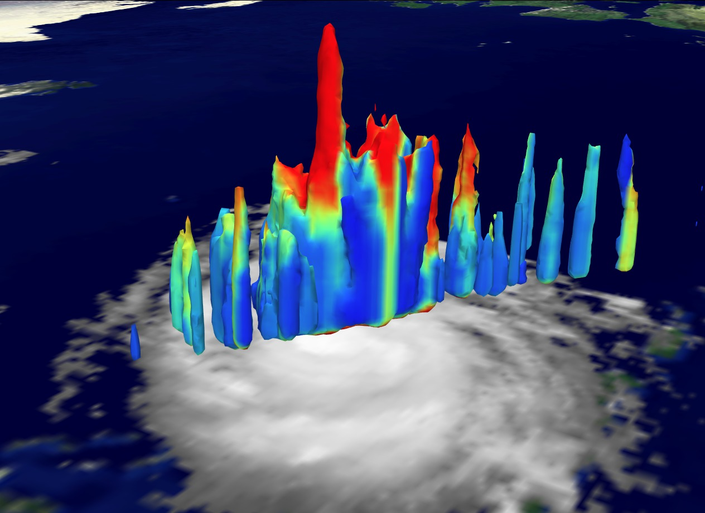
Scientific visualization
process of graphically displaying real or simulated scientific data.
  Surface rendering
  Volume rendering
  animation
A high angle view of the 18 km Hurricane Bonnie cloud tower. Image from NASA Scientific Visualization Studio

Slide 5
Data Vs Information visualization
Data visualization is a graphic representation that expresses the significance of data.
Data visualization is for identifying the notable highlights of a data set. Data visualization permits to explore, investigate or modify.
Information visualization is the aftereffect of such examinations.

Slide 6
Benefits Of Data Visualization
The primary goal of data visualization is to communicate information clearly and effectively through graphical means.
The ability to assimilate information quickly, improve ideas, and make faster decisions.
A better understanding of the next steps that must be taken to improve the organization.
A better ability to keep the audience's attention with information they can understand.

Slide 7
Why data visualization is such a powerful tool
Intuitive: Presenting a graph as a node-link structure instantly makes sense, even to people who have never worked with graphs before.
Fast: It is fast because our brains are great at identifying patterns, but only when data is presented in a tangible format. Armed with visualization, we can spot trends and outliers very effectively.

Slide 8
Cont’
Flexible: The world is densely connected, so as long as there is an interesting relationship in your data somewhere, you will find value in graph visualization.
Insightful: Exploring graph data interactively allows users to gain more in-depth knowledge, understand the context and ask more questions, compared to static visualization or raw data.

Slide 9
common types of data visualization
Graph
Chart(line, pie,area)
Plot
Maps
Infographics
Time series

Slide 10
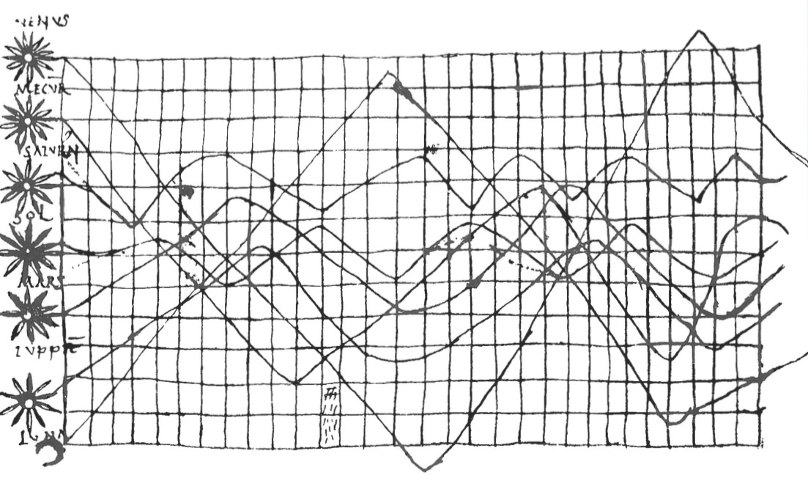
Data Viz in the 10th Century
From Funkhouser 1936
Notes:
10th century
What do you see here. What works. What does not?

Slide 11

Early maps. Little information beyond intersections – 1546 from Pedrus Apenius
Notes:
Early maps. Little information beyond intersections – 1546 from Pedrus Apenius
What do you get from this?

Slide 12
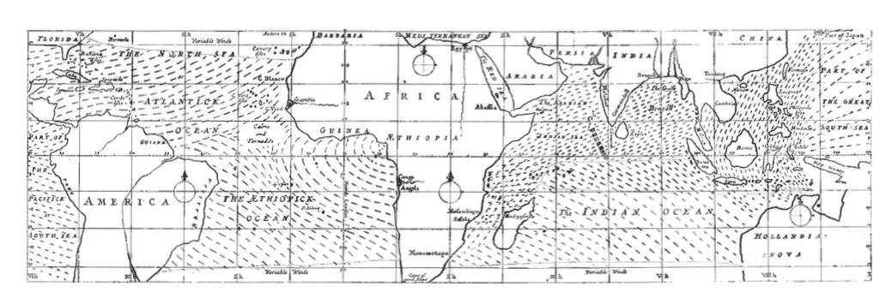
Maps as Rich Information Source
Edmond Halley 1686
Notes:
Edmond Halley 1686

Slide 13
Data Viz in a Nutshell
History
Graphical Basics
Minimalist principles

Slide 14
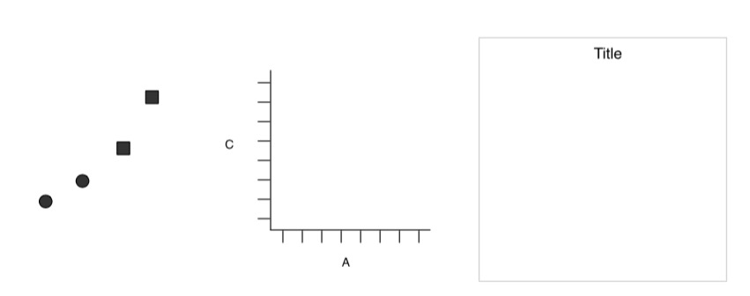
Elements of a Plot
Geometric Objects
Scales & Coordinates
Annotations
Wickham 2010

Slide 15
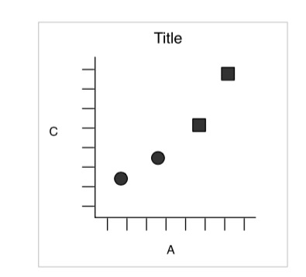
Elements of a Plot
Wickham 2010

Slide 16
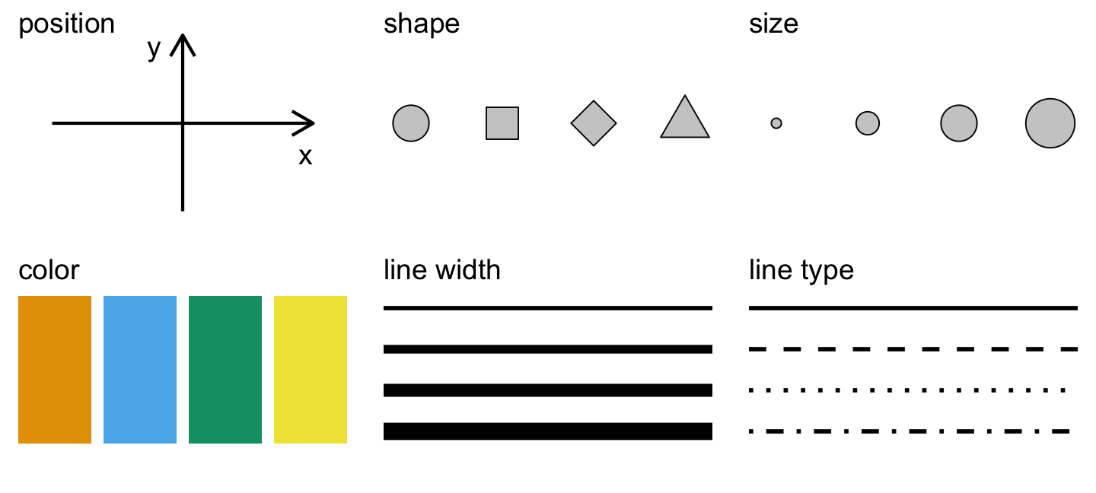
Aesthetics of a Plot
Wilke 2018

Slide 17
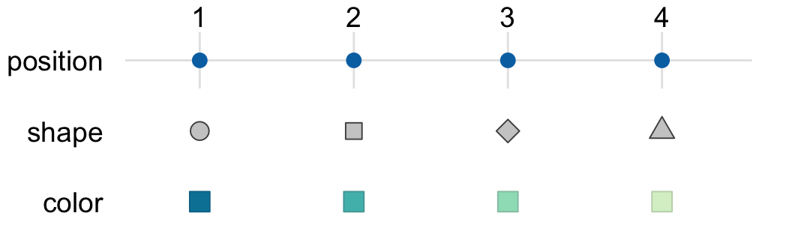
Aesthetics Map Data to Visual Representation
Wilke 2018

Slide 18
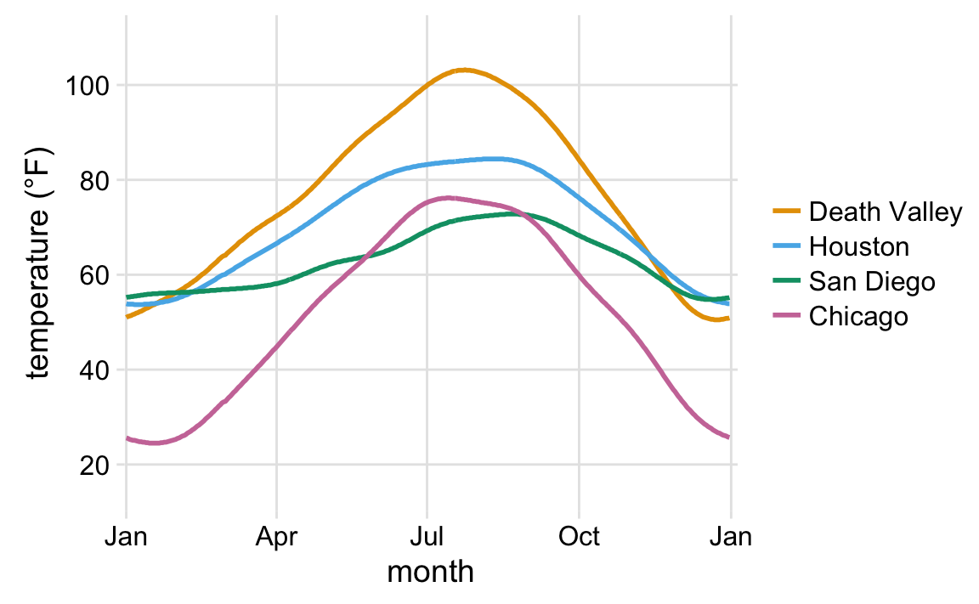
Aesthetics Map Data to Visual Representation
Wilke 2018
Notes:
What do you see here? What’s the story and how do the aesthetics tell it?

Slide 19
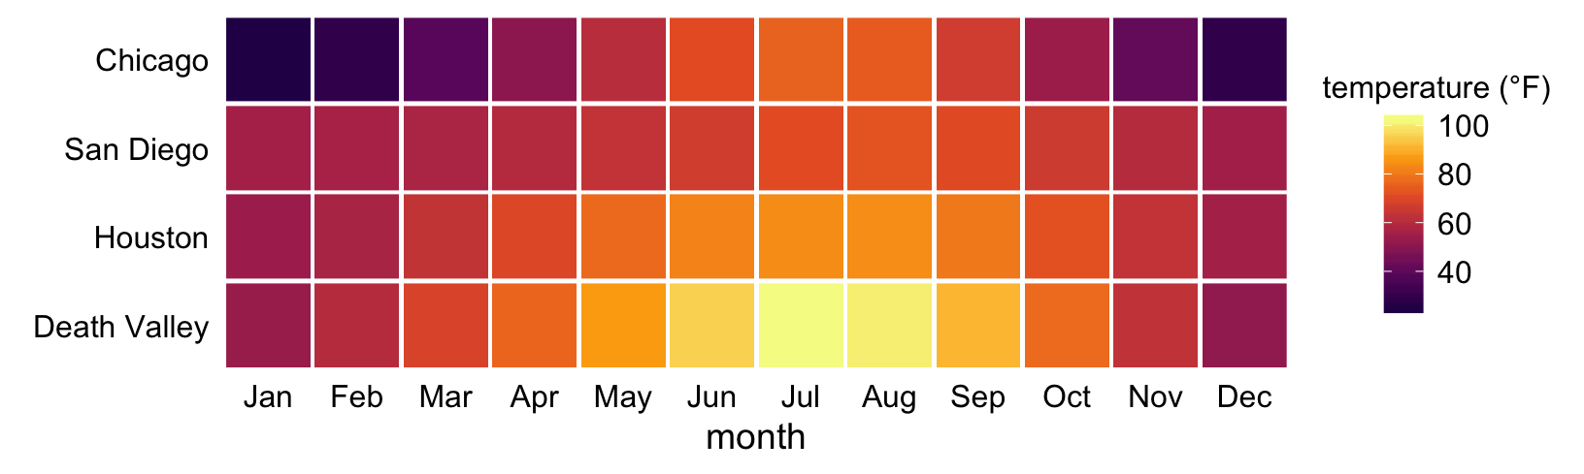
Aesthetics Map Data to Visual Representation
Wilke 2018
Notes:
This is the same data
What do you see here? What’s the story and how do the aesthetics tell it?

Slide 20
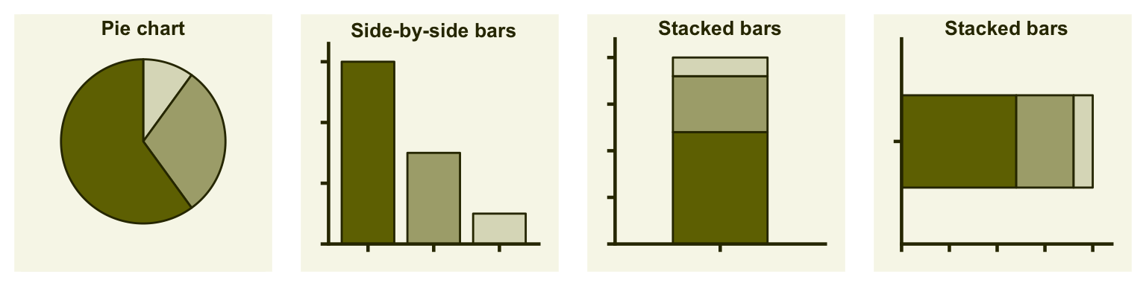
Types of Visualizations: Proportions
Wilke 2018
Notes:
Costs and benefits of each

Slide 21
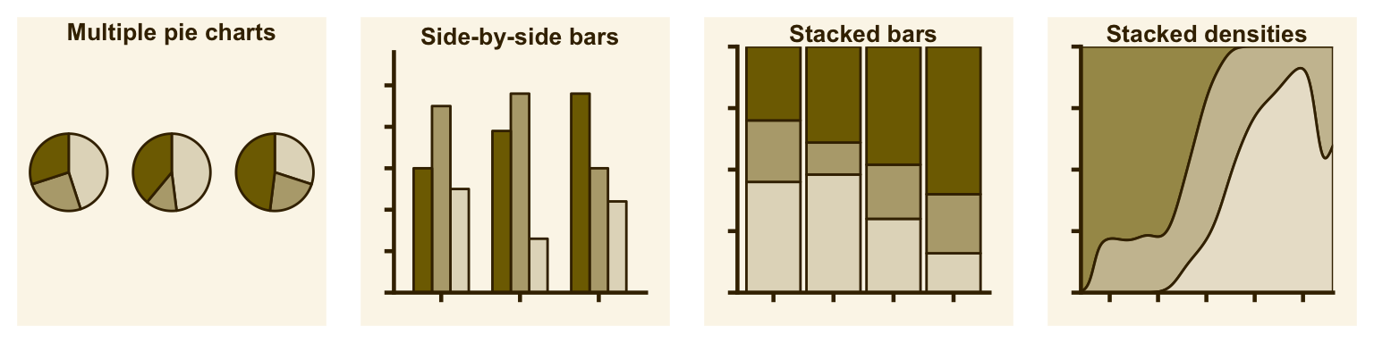
Types of Visualizations: Multiple Proportions
Wilke 2018
Notes:
Costs and benefits of each

Slide 22
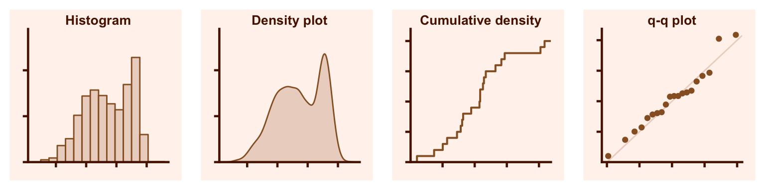
Types of Visualizations: Distributions
Wilke 2018

Slide 23
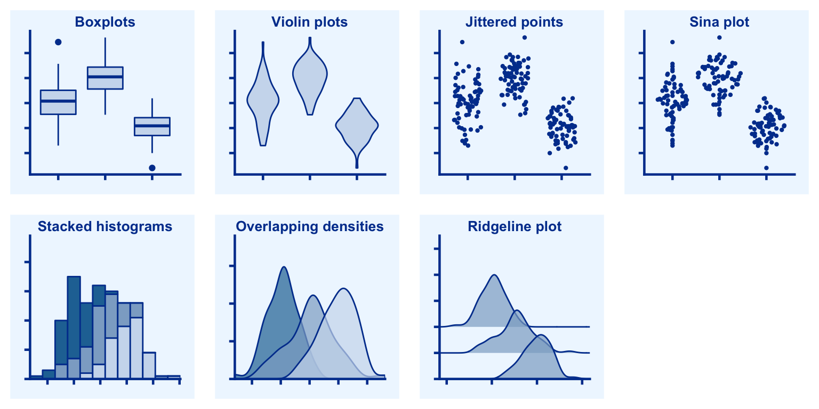
Types of Visualizations: Multiple Distributions
Wilke 2018

Slide 24
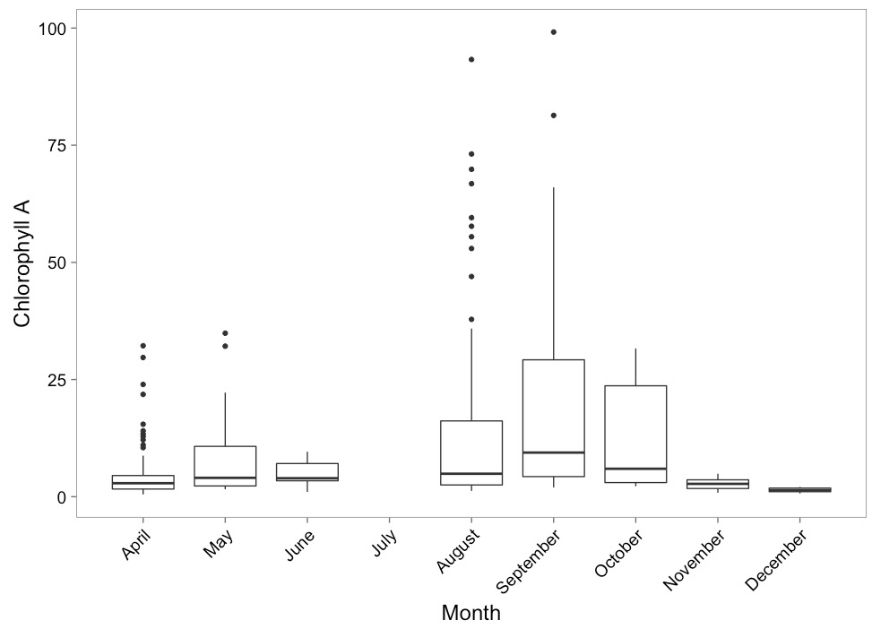
Boxplots to Show Variation

Slide 25
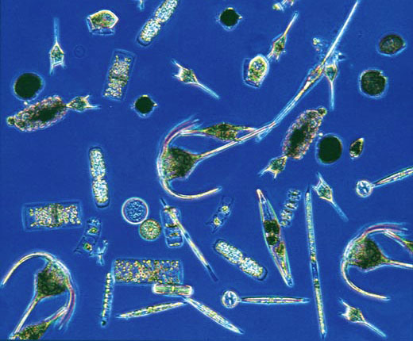
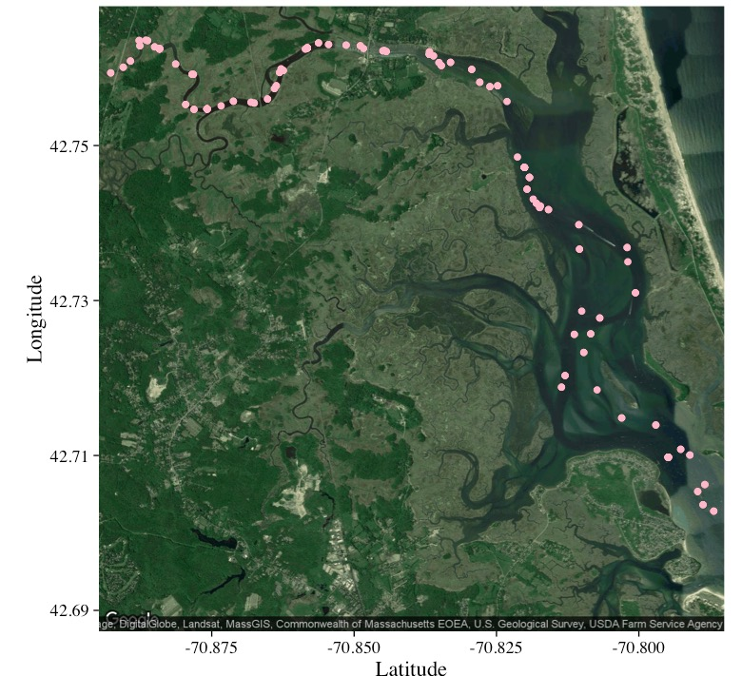
Combining Data Sources and Maps
Chlorophyll a
Abundance of taxonomic groups
Temperature
Salinity
Hopkinson and Hobbie 2012 http://ecosystems.mbl.edu/PIE/data/EST/EST-PR-ChemTax.html

Slide 26
Information Delivery
Information delivery refers to:
Dashboards : A range of visualizations, such as charts, gauges, heat maps, and geographic maps, enables users to quickly draw conclusions and monitor key performance indicators. These can be presented in the context of a single chart or in a collection of visualizations in a dashboard.
Reports: This is a tabular display of data, often with numerical figures and grouped within categories. Interactivity can include drop-downs and filters for users to view specific slices of data.

Slide 27

Information delivery Cont’
Dashboard gives broad overview of the customer service experience in your organization
It uses AI to provide insights into which topics are generating highest volume

Slide 28
Information delivery Cont’
Mobile: Capabilities are made available to users on mobile devices, ensuring accurate visual display of information as well as compatibility with mobile device features such as touch input.
Scheduling and exports: Dashboards and reports can be scheduled for delivery, used in conjunction with thresholds/alerts, or exported to other formats for printing or offline access.

Slide 29
Advantage of Geospatial Data
Geospatial data are very useful in data visualization for creating more accurate and predictions of trends
It can help organization better prepare for change and determine future action
It can help to understand how event are unfolding and how to react to those events

Slide 30
Data mashup
Data mashups combine business data and applications from multiple sources typically a mix of internal data and application with externally source data in order to create an integrated experience
Data mashups rely on Extract Transform and Load (ETL) from a data warehouse
Enables the building of complex queries by nonexperts with a drag and drop query building tool

Slide 31
Geographic Information System
Geographic information system GIS captures, manages, analyzes and displays multidimensional geographic data called Geospatial data
GIS can connect to the location-tracking devices and apps

Slide 32
Geospatial Data
Geospatial Data gathers, manipulates and displays geographics information system (GIS) data and imagery including GPS and Satellite photographs
Geospatial Data rely on geographic coordinates and specific identifiers such as zip code, street address etc.

Slide 33
Reference
Baldwin, G, “dashboards in actions.” Health Data management. 2011
https://www.sas.com/en_th/insights/big-data/data-visualization.html
Kieran Healy, “Data Visualization: a practical introduction”,Princeton university press, 2019

