Slide 1
COMMUNICATION SKILLS
Chapter XII: Revision
Lecturer: Protais Niyonshima

Slide 2
Objectives
By the end of this session, a learner will be able to:
Describe the content captured in the module of Communication Skills.

Slide 3
What is Communication?
The word communication is from the verb ‘communicate’ which is historically related to the word ‘common’. Communicate is from the Latin verb communicare, which means ‘to share’ or ‘to make common’. In communication, therefore, we shape a common sense by sharing information. (Karl, 2000).

Slide 4
Cont’
One can define communication as an action of sending, giving or exchanging information. Oxford Dictionary (1998) explains communication as an activity through which people express ideas and feelings or give information.
Although most people are born with physical ability to talk, not all can communicate. Therefore, people can acquire Communication Skills.
Birvenu (1987) states that communication is the process of transmitting feelings, attitudes, facts, beliefs as well as ideas between living beings.

Slide 5
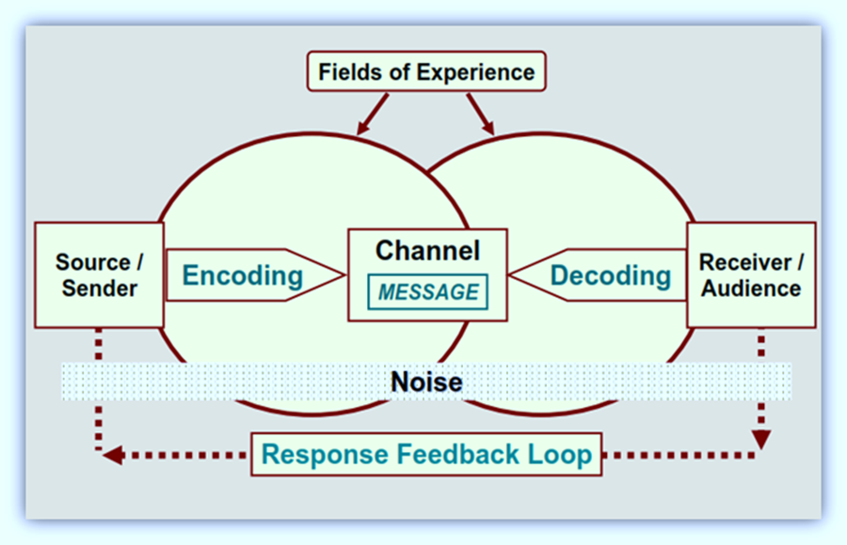
Elements of a communication process
Image Source: Akhil T. (2012). The Communication Process. Link: /http://shillongsultans.blogspot.com/2012/11/chapter-5-communication-process.html

Slide 6
Types of Communication
People communicate with each other in a number of ways depending on the message to be delivered and its context.
The choice of communication channel and style of communicating play a big role in communication, thus a variety of types of communication.

Slide 7
Types of communication by basing on communication channels
Verbal Communication
Nonverbal Communication

Slide 8
Types of Communication by basing on Style and Purpose
By basing on style and purpose, there are two main categories of communication:
Formal Communication
Informal Communication

Slide 9
Style of Communication
When we communicate, we apply different ways and approaches to ensure a safe delivery of the message. Depending on the situation, the style of communication varies. Let’s us see the styles of communication.

Slide 10
1. Assertive communication
This is the most effective form of communication. Assertive communication is simply how we naturally express ourselves when our self-esteem is intact. Thus, we communicate our needs clearly and consider a win/win situation.
This style helps us to respect our limits and refuse to be pushed beyond them just because someone else wants or needs something from us. However, assertive communication is the style most people use least.

Slide 11
2. Aggressive Communication
This style always involves manipulation. The user attempts to make a person do what he/she wants by inducing guilt (hurt) or by using intimidation and control tactics (anger). He/she puts focus on how and when his/her needs can be met.

Slide 12
3. Passive Communication
This style bases on compliance and hopes to avoid confrontation at all costs. Thus, the user doesn’t talk much, and he/she asks very few and does very little to limit problems.
The users believe that it is safer not to react and better to disappear than to stand up and be noticed.

Slide 13
4. Passive-Aggressive Communication
This is a combination of styles, passive-aggressive avoids direct confrontation (passive), but attempts to get even through manipulation (aggressive). It is mainly characterized by a pattern of passive hostility and an avoidance of direct communication.

Slide 14
The Process of Listening
Receiving
Responding
Filtering
Evaluating
Understanding
Remembering

Slide 15
Levels of listening
Active listening
Protective listening
Partial listening
Preferential listening

Slide 16
Oral Communication
Oral Communication involves a verbal transmission of information and ideas from one individual or a group of people to another. Depending on the situation, Oral Communication can be either formal or informal.
Informal types of oral communication include:
  Face-to-face conversation
  On-phone conversation
  Discussions
Formal types of oral communication include:
  Presentations
  Classroom lectures
  Speech at a given ceremony

Slide 17
Reading
Reading is a cognitive process of decoding symbols to get meaning from a written text.
In an academic setting, reading is one of the most important activities done by scholars. Reading helps to acquire knowledge and skills and get information that is fundamental to one’s intellectual growth.

Slide 18
Why reading?
Reading is:
Fundamental to function in today’s society.
Vital in finding a good job.
Important in developing one’s mind.
Useful in discovering new things.
Important in developing imagination.
Necessary developing creative side of people.
Fundamental in developing a good self image.

Slide 19
Writing
Writing is the process of arranging letters, symbols to express an idea, to deliver a message. In addition, writing is the art of expressing views, ideas, and thoughts in written forms. Although writing seems easy while thinking about it, many times, it results in unorganized and scattered pieces of information on paper. Sometimes such information confuses the audience/reader.
Producing an effective written document requires to pay attention to grammar and vocabulary, and apply writing skills.

Slide 20
Importance of Writing Skills
Writing is the vital means of communication mostly in a formal setting. Writing skills are essential element of communication in terms of precision, correctness, exactness, sureness, efficiency, and accuracy and reach to a greatly wider audience than within face-to-face or phone communications.
Good writing skills are essential for success in a workplace. Producing a poor written document full of typos, grammatical errors, and poorly constructed sentences gives an image of how one can handle other related tasks, whereas a quality document can also influence how he/she is perceived.

Slide 21
Non-verbal Communication
Non-verbal communication is the transfer of information through the use of body language including eye contact, facial expressions, gestures and more. For instance, a smile when you meet someone expresses friendliness, acceptance and openness.
In almost every communication situation, everyone uses non-verbal communication all the time whether he/she knows it or not.
Non-verbal communication depends on seeing and analyzing physical movements as opposed to verbal communication, or language use to transfer information be it written, spoken or transmitted through sign language.

Slide 22
Cont’
Non-verbal communication is done without using any oral or written word. It uses various non-verbal cues such as physical movements, tasks, colors, signs, symbols, signals charts, etc. they help to express emotions, feelings, attitude or information.
Though there is no word used in non-verbal communication, it can effectively communicate many human feelings more accurately than verbal methods of communication.
Generally, common types of non-verbal communication are eye contact, facial expressions, gestures, posture and body orientation, touch, para-linguistic, and silence.

Slide 23
Cont’
Bambaeeroo & Shokrpour (2017) states that non-verbal communication includes all behaviors performed in the presence of others or perceived either consciously or unconsciously.

Slide 24
Importance of non-verbal communication
Non-verbal communication is very essential as it gives us important information about a situation including how a person might be feeling, how someone has perceived information and how to deal with a person or group of people.
Focusing on the ability to read nonverbal communications is an invaluable skill it can be developed at every stage of one’s career.

Slide 25
Organisational Communication
At a workplace, an organizational communication is basically the exchange of information, ideas, and views within and outside the organization/company. It is applied in different found in various places such as hospitals, churches, government agencies, military organization, and academic institutions.
Every organization whether a business or non-business has some specific goals and stakeholders and it has a way of communication that helps to attain its goals.
Successful organizational communication leads to tremendous achievements within an organization.

Slide 26
Cont’
Briefly, organizational communication refers to the forms and channels of communication among members of organizations.

Slide 27
The importance of organizational communication
To promote motivation by informing and clarifying employees about tasks to be done and related instructions.
To serve as a source of information to the organizational members.
To play an important role in altering individual’s attitudes.
To boost socialization among employees.
To assist in controlling process.

Slide 28
Culture and communication
In today's business and Internet-based world, communication with individuals from all over the world has never been easier – or more important to a business's bottom line.
While language barriers can technically be overcome by translators, these individuals often overlook the subtle nuances that make cultures and communication unique.
In order to be effective in relationships with other cultures, one has to move above and beyond mere language to embrace deeper, more personal world views.

Slide 29
Steps to embrace cultural differences in communication
Step One – Acknowledge Cultural Differences
Step Two – Share the Blame
Step Three – Never Make Assumptions
Step Four – Don't Rely Solely on Generalizations
Step Five – Learn the Basics

Slide 30
Communication in preparation for a career
Communication is a strong tool that plays an important role in opening doors of one’s career.
Communication helps broaden your reach by building contacts with individuals relevant to your school or workplace. E
Emails, phone calls, private conversations and traditional letters can help you arrange internships, receive grant money for research, be invited to speak at a trade conference or shadow a company leader for the day.

Slide 31
Cont’
Most of the times, getting hired requires a process of being assessed to determine one’s competences and potentials. The assessment is done though many ways:
Writing and submitting documents such as a motivation letter, a CV, etc.
After being shortlisted, a candidate is invited to a written and/or oral exam
After meeting all requirements, a candidate gets hired.

Slide 32
Barrier to effective communication
Communication is crucial to the existence and survival of humans as well as an individual. In other words, communication is the exchange of information between two entities.
A communication barrier is anything that comes in the way of receiving and understanding messages that one sends to another to convey his ideas, thoughts, or any other kind of information.
These various barriers of communication block or interfere with the message that someone is trying to send.

Slide 33
Categorization of barriers to communication.
Types of Barriers
Physical Noise
Technical Noise
Psychological Noise
Poor Timing
Perceptual Bias
Lack of Interest
Psychological Bias
Information Overload

Slide 34
References
Martin, J.N. & Nakayama, T.K. (2000). Intercultural communication in contexts. New York, NY McGraw-Hill.
Alptekin, C. (2002). Towards intercultural communicative competence in ELT. ELT Journal 56(1), 57–64.
Byram, M. (1997). Teaching and assessing intercultural communicative competence. Bristol, UK: Multilingual Matters
Byram, M. (2009). The intercultural speaker and pedagogy of foreign language education. In D.K. Deardorff (Ed.), The Sage handbook of intercultural competence (pp. 321–332) Los Angeles, CA: Sage.
Kohn, K. (2013, March). Intercultural communicative competence: an English as a lingua franca perspective. Paper presented at TESOL Arabia, Dubai, UAE.

Slide 35
Cont’
Martin, J.N. & Nakayama, T.K. (2000). Intercultural communication in contexts. New York, NY McGraw-Hill.
Alptekin, C. (2002). Towards intercultural communicative competence in ELT. ELT Journal 56(1), 57–64.
Byram, M. (1997). Teaching and assessing intercultural communicative competence. Bristol, UK: Multilingual Matters
Byram, M. (2009). The intercultural speaker and pedagogy of foreign language education. In D.K. Deardorff (Ed.), The Sage handbook of intercultural competence (pp. 321–332) Los Angeles, CA: Sage.
Kohn, K. (2013, March). Intercultural communicative competence: an English as a lingua franca perspective. Paper presented at TESOL Arabia, Dubai, UAE.

Slide 36
Thank you!

