Slide 1
COURSE NAME: MACHINE TOOLS
Lecture 7: PERFORM TAPER TURNING, KNURLING AND THREADING OPERATIONS ON LATHE MACHINE
Lecturer: HABANABAKIZE THEOPHILE

Slide 2
OUTLINE
Introduction
Taper Turning Operation
Knurling operation
Threading operation

Slide 3
VII. 1 Taper turning
Taper turning is a machining operation, which means that the diameter of cylindrical workpieces gradually decreases from one part to another. The taper can be external or internal. If the workpiece is taped outward, it has an outer taper. If it is taped inward, it has an internal taper. The workpiece must be positioned in such a way as to make the taper such that the axis of rotation is at the angle to an axis of the bend.

Slide 4
a. Condition for Taper turning operation
In simple linear turns, the cutting tool moves along a line parallel to the axis of the workpiece so that the finished workpieces always have the same diameter. However, when cuttings the taper, the tool will move at an angle relative to the workpiece’s axis, resulting in the taper.
Therefore, to rotate the taper, the workpieces must be installed on the lathe so that axis of rotations are at an angle to the axis of the lathe, or the cuttings tool moves a lathe at an angle relative to the axis of the bend. When the diameters of a piece change uniformly from one end to the other, the pieces are called a taper.

Slide 5
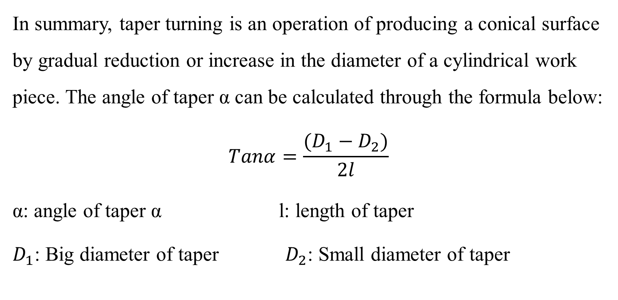

Slide 6
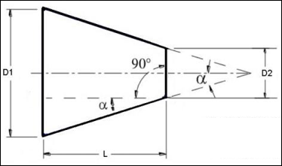
b. Taper turning illustration
D1: Big diameter of tapered portion
D2: Small diameter of tapered portion
L: Length of tapered portion
α: Angle of taper
Source: https://www.theengineerspost.com/lathe-machine-operations/
A ”taper” is the uniform increase or decrease in the diameter of the workpiece and measured along with its length.

Slide 7
c. Methods of Taper Turning
The following are the different types of taper turning methods on lathe machine.
Tailstock Set Over Method
Compound Rest Method
Taper Turning Attachment Method
Form Tool Method
Combining Feeds Method

Slide 8
i. Compound rest swivel method
Here the workpiece rotates and the tool is fed at an angle by swivelled compound rest. The base of the compound rest is graduated in degrees.
The taper angle is the angle at which the compound rest to be rotated is calculated by using the formula tanα = D-d/2l, where, D= bigger diameter, d = smaller diameter, l = length of the workpiece.
Compound rest can be swivelled to the required angle α. Once the compound rest is set to a particular angle then the tool is moved by compound rest and wheel.

Slide 9
ii. Taper turning attachment method
This method is similar to the compound rest method.
Here the job or workpiece rotates and the tool is fed at the taper angle α.
In this, arrangement, which has guide block graduated in degrees, with the help of this the block can be required taper angle to the lathe axis.
The taper angle is calculated similarly to the compound rest method using the formula: tanα = D-d / 2l.

Slide 10
Advantages of taper turning attachment:
Internal tapers can be obtained accurately.
Large size tapers can be easily obtained.
Once the attachment is set the taper turning operation can do at a faster rate.
By setting the taper angle to ‘zero’ we can carry out plain turning.
Disadvantages of taper turning attachment:
It requires additional mounting facilities.
Fitting and removing attachment consume more time.
The attachment has to take large forces.

Slide 11
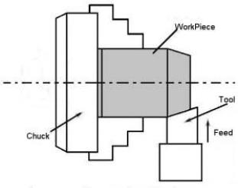
iii. Form tool method
Here the taper length obtain is equal to the width of the form tool. To obtain the required size of the taper the form tool is fed slowly straight into the workpiece by operating the cross slide perpendicular to the lathe axis.
This is the simplest method of taper turning. It is limited to obtain small taper length such as chamfering the side of the workpiece. The method is done at a faster rate.
Fig.1. Form tool method
Source: https://www.theengineerspost.com/lathe-machine-operations/

Slide 12
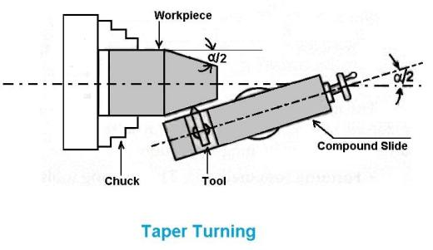
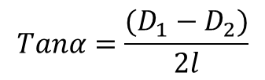
iv. Combined feeds method
The combined feed is made with the movement of a tool in longitudinal and lateral direction simultaneously while moving the workpiece.
The taper, which we are going to obtain, is equal to the resultant to the magnitude of the longitudinal and lateral feeds. Changing the feeds rates in both directions can change the direction and the taper angle.
Fig.2. Combined feeds method
Source: https://www.theengineerspost.com/lathe-machine-operations/

Slide 13
v. Tailstock set over method:
Here the workpiece on the job is tilted at the required taper angle. The tool is fed parallel to the axis.
The tilting of the workpiece or the job to the required taper angle is achieved by the movement of the tailstock with the help of tailstock set over the screw. This method is useful for small tapers.

Slide 14
d. Taper turning Calculations
Example 1
An Aluminum workpiece of 200 mm long is to be taper turned over 150 mm of its length, knowing that its big diameter is 60 mm and small diameter should be 30 mm; calculate the taper turning angle in degree.
Given data:
L: length of the workpiece=200 mm
L: Length of taper part in mm =150 mm
D: Big diameter=60 mm
d: small diameter=30 mm

Slide 15
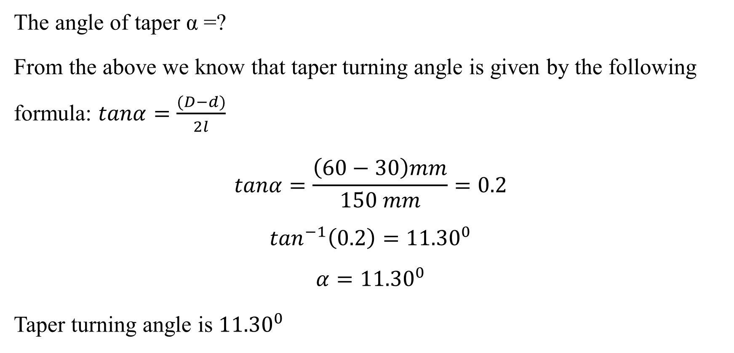
Asked :

Slide 16
Taper turning Calculations Cont’d
Example 2
An Aluminum workpiece of 0.12 m long is to be taper turned at an angle of 14.03⁰; calculate the small diameter of the workpiece if its big diameter is 4.5 cm and the length of taper is 0.3 dm.
Given data:
L: length of the workpiece= 0.12 m=120 mm
L: Length of taper part in mm = 0.3 dm=30 mm
D: Big diameter= 4.5 cm=45 mm
α: Angle of the taper =14.03⁰

Slide 17
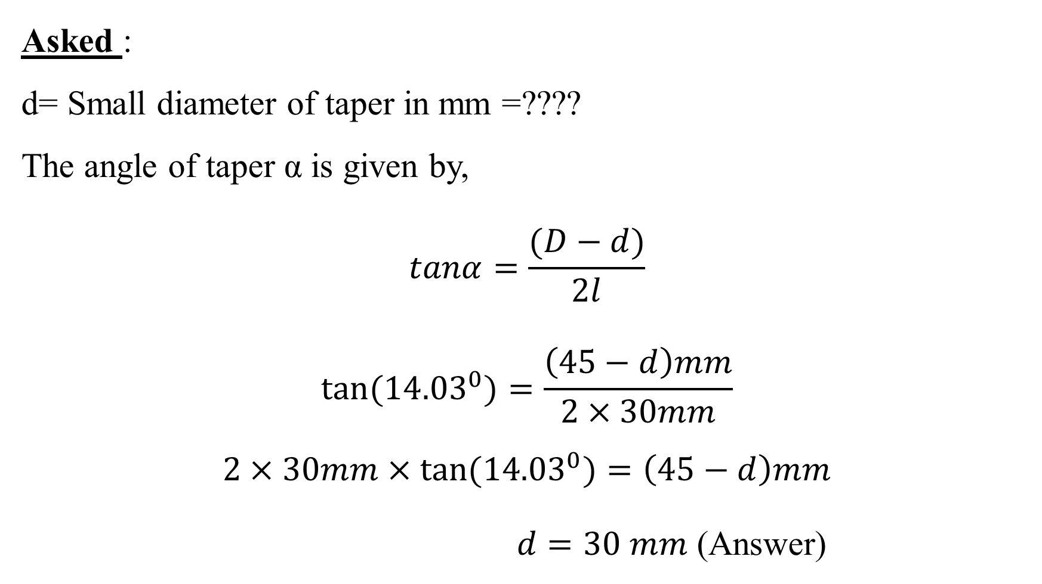

Slide 18
VII.2 Threads
a. Definition of Threads
Threads are spiral grooves of equal measurement or shapes made on a round cylindrical piece or pipe are known as threads. In other words, spiral grooves of equal pitch and equal depth made on the parallel round cylindrical surface or conical round surface are called threads.

Slide 19
It is the important operation in the lathe to obtain the continuous ‘‘helical grooves” or ‘‘threads’’.
When the threads or helical grooves are formed on the out surface of the workpiece is called ‘‘external thread cutting’’. When the threads or helical grooves are formed on the inner surface of the workpiece is called ‘‘internal thread cutting’’. The workpiece is rotating between the two centres i.e., live centre and dead centre of the lathe.

Slide 20
b. Types of threads
There are many types of threads but this lecture will focus on the eight following different types of threads:
1. Right-hand threads
2. Left-hand threads
3. taper threads
4. "V" shape threads
5. Metric or International Threads
6. British Standard Threads
7. Square Threads
9. Worm Threads

Slide 21
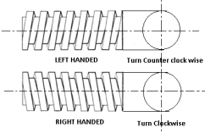
1. Right and Left threads
Right threads are inclined towards the right-hand side. These are tightened in a clockwise movement. These are known as right-hand threads.
Left threads are inclined towards the left hand. These are tightened in anticlockwise movement. For example, on a screw with left-hand threads, threads are so cut that the bolt, screw, or nut has to be turned in a counter-clockwise motion to engage or tighten it. Their use is comparatively less.
Fig.3. Right and Left threads
Source: https://www.theengineerspost.com/types-of-threads/

Slide 22

2. Taper Threads
Threads cut on around but taper surface is called taper threads. These are sued for shafts like buffing spindles. These threads can be right hand or left hand.
The above threads are used for the following purpose:
1. To join two parts of a machine like nut-bolt and stud.
2. To get mechanical livers for lifting weights, such as chain pulleys, jacks etc.
3. For accuracy in precision instruments like micrometres.
4. In jobs of power transfer.
5. To control or reduce speed.
Fig.4. Taper Threads
Source: https://www.theengineerspost.com/types-of-threads/

Slide 23
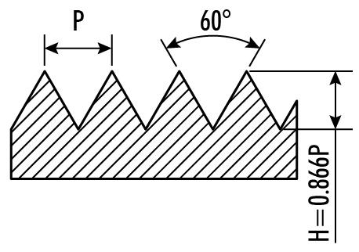
3. "V" Shape Threads
This type of threads is in the shape of the English alphabet "V". It is most widely used. This types of threads can be cut or made by tap, die, lathe machine and milling etc. These threads are made of different standards. The following types are mostly used.
Fig.5. "V" Shape Threads
Source: https://www.theengineerspost.com/types-of-threads/

Slide 24
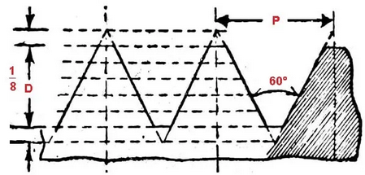
4. Metric or International Threads
These threads are made on jobs of 0°25 mm to 300 mm in diameter. Its angle is at 60°. Its screw is flat and the root is round. According to I.S. 1330-1958, these are written prior to the letter M and figure written after "M" indicates pitch such as -M20 X 2.5. It means the number of threads is 20 per inch and its pitch is 2.5 mm.
This types of the thread were originally adopted in 1898 to 1908 in central France. With the passage of time, other international countries also started using it. The Indian standards institute has also adopted this thread.
Thread Angle = 60°
Crest and root = 0. 125 X pitch
Pitch =1/T.P.I. ( in mm)
T.P.I: stands for threads per inch
Fig.6. Metric or International Threads
Source: https://www.theengineerspost.com/types-of-threads/

Slide 25
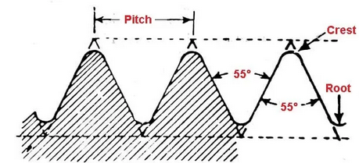
5. British Standard Whitworth Threads
This type of threads is originated from great Britain. sir joseph Whitworth, a citizen of Great Britain invented this thread in 1841. This thread was to provide the facility of interchangeability. It is used in ordinary nut-bolts and other jobs. Its angle is 55°. Its crest, as well as root, are in round shape. It's known as B.S.W. Thread.
Fig.7. British Standard Whitworth Threads
Source: https://www.theengineerspost.com/types-of-threads/
Thread angle= 55 °
Pitch = 1/T.P.I
Depth = Pitch X 0.6403
Radius = Pitch X 0.1373
Core dia = D- (1.28 X Pitch)
(D= outer dia of bolt)

Slide 26
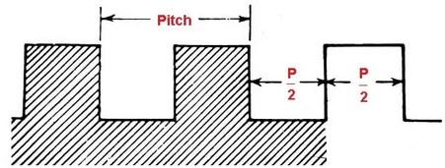
Fig.8. Square Threads
6. Square Threads
This thread has a very powerful root. ITs make up is square. These threads are used for lifting heavy loads, transfer of power, to exert pressure, screw jack, lead screw of machines, press machines and vice spindle instruments. Their specific measurement and number per inch are not fixed.
Source: https://www.theengineerspost.com/types-of-threads/
Thread Angle = 90°
Depth of Thread = 0.5 X Pitch
Crest and Root = 0.5 X 5

Slide 27
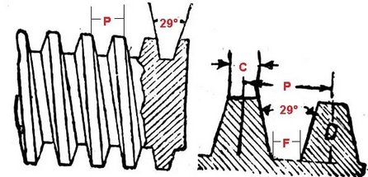
7. Worm Threads
Their shape is almost similar to Acme Threads but these are deeper than Acme threads. Their angle is also at 29 °. This thread is used in worm wheel of motor vehicles for the transfer of power at 90°. As three teeth of worm wheel fit into the shaft with worm threads, they fit well.
Fig.9.Worm Threads
Source: https://www.theengineerspost.com/types-of-threads/
Thread Angle = 29°
Depth of Thread = 0.6866 X Pitch
Root = 0.32 X Pitch
Crest = 0.335 X Pitch.

Slide 28
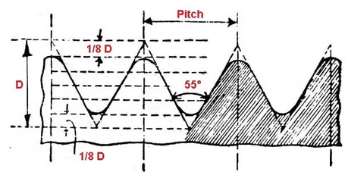
8. British Standard Fine Thread
In shape, this thread is similar to B.S.W. thread. The angle of this thread is also 55° but the number of thread per inch is more i.e the thickness of threads is less. This makes the grip more strong. Nut bolts having this thread are used where is more vibration.
Fig.10.British Standard Fine Thread
Source: https://www.theengineerspost.com/types-of-threads/

Slide 29
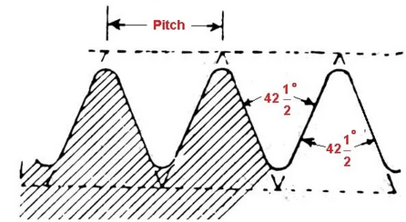
9. British Association Threads
This type of thread is of every think make-up. It is used in small and tiny electrical and mechanical instruments like radio, television, electrical goods, meters and watches. The angle of these threads is 47 1/2°. These can be used for 1/2" or 6 mm nut bolts. These are recoghinsed through numbers, which range between 0 to 12. number 0 = 0. 236" or 6 mm. Number 12 = 0.0511" or 1.3 mm.
Fig.11.British Association Threads
Source: https://www.theengineerspost.com/types-of-threads/
Thread Angle = 47 1/2"
Depth of thread = 0.6 X Pitch
Pitch = 1/T.P.I
D = 1.36 X Pitch

Slide 30
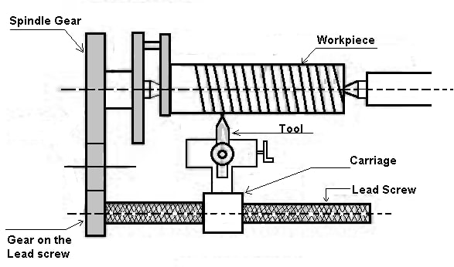
c. Threading operation
Here the tool is moved longitudinally to obtain the required type of the thread. When the tool is moved from right to the left we get the left-hand thread. Similarly, when the tool is moved from left to the right we get the right-hand thread.
Here the motion of the carriage is provided by the lead screw. A pair of change gears drives the lead screw and by rotating the handle the depth of cut can be controlled.
Fig.12. Threads cutting
Source: https://www.theengineerspost.com/lathe-machine-operations/

Slide 31
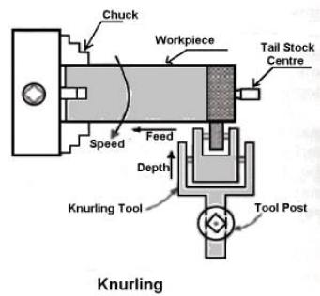
VII.3 Knurling operation
a. Definition of knurling
Knurling is an operation of obtaining a diamond shape on the workpiece for the gripping purpose. This is done to provide a better gripping surface when operated by hands. It is done using a knurling tool. The tool consists of a set of hardened steel roller, and it is held rigidly on the toolpost.
Fig.13. Knurling operation

Slide 32
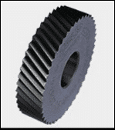
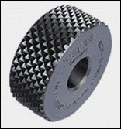
b. Difference between cut and form knurling
 | Cut knurling | Form knurling
Material processed | Virtually any material including plastic and cast iron | Cold forming material with thick wall at any position
Impact on material of work piece | less or no deformation | Increase the outer diameter
Lathe knurling parameters | Allow higher cutting speed and feed | Slower cutting speed and feed rate
Impact on lathe | Less pressure on lathe | Apply great pressure on lathe
https://www.meetyoucarbide.com/what-is-knurling/

Slide 33
Knurling operation Cont’d
Knurling is done at the lowest speed available on a lathe. It is done on the handles and also in case of ends of gauges. The feed varies from 1 to 2 mm per revolution. Two or three cuts may be necessary to give the full impression.
To make a knurl pattern, the workpiece is secured in straight direction on a lathe machine, the knurling tools are held on the knurl holder that attached to the worktable, then the knurling tool will move forward to the workpiece.
Knurling is done through the displacement of the lathe parts when the knurl tool is pressed against the surface of a rotating material blank.

Slide 34
c. Steps to perform knurling operation
Install the workpiece.
Install the knurling tool.
Clamp the workpiece and tool firmly.
Select low cutting speed and large feed.
Start the spindle of the machine tool.
Apply sufficient coolant to the knurled cutter.
Move the knurled tooling to cut into the workpiece and apply pressure until a diamond pattern is made.
Adjust the knurling tool visually to deflect it by a small angle

Slide 35
d. Applications of Knurling
Knurling has a huge range of applications in daily use. It’s primarily used for:
Decorative purposes
Serration surfaces that are keyed or locked together in unit assemblies
To improve the grip of hand tools

Slide 36
Besides aesthetics, knurling is also used for other practical purposes like improved grip. Hand tools like hammers, wrenches often have a knurled handle to improve stability and performance while using it. Here’s an example. Consider a hammer with a smooth handle. The smooth surface is prone to slipping easily, leading to accidents. On the other hand, consider a hammer with a textured handle. The knurled handle protects against slippage, helping users have a steady grip.

Slide 37
Reference
Boljanovic, V. (2009) Metal Shaping Processes: Casting and Molding; Particulate Processing; Deformation Processes; and Metal Removal (p333-334). Industrial Press, Inc. New York
Trent, E., & Wright, P. (2000). Metal Cutting (4th ed) (p.14) Butterworth–Heinemann.
Fritz Klocke: Manufacturing Processes 1 - Cutting, Springer, 2011, p. 95
Trent, Wright: Metal Cutting. Butterworth Heinemann, 2000, 4. edition , p. 132-250
Fritz Klocke: Manufacturing Processes 1 - Cutting, Springer, 2011, p. 95-196Graham
T. Smith: Cutting Tool Technology - Industrial Handbook, Springer, 2008, p. 1-32
https://www.theengineerspost.com/lathe-machine-operations
https://www.aloktools.com/guide-to-knurls-and-knurling-tools/
https://www.theengineerspost.com/types-of-threads/

Slide 38
THANK YOU

