Slide 1
COURSE NAME: MACHINE TOOLS
Lecture 8: CALCULATION ON TURNING OPERATIONS: MATERIAL REMOVAL RATE AND POWER
Lecturer: HABANABAKIZE THEOPHILE

Slide 2
OUTLINE
Introduction
Material Removal Rate
Cutting force Calculation
Power consumption

Slide 3
VIII.1 Introduction
Previous lecture discussed various topic related to lathe machine operations. There following important machining operations which was described and calculated in the previous lecture such as: taper turning, knurling and threading.
This lecture will be about the explanation and calculation of Material Removal Rate, cutting force and power required to perform machining operation

Slide 4
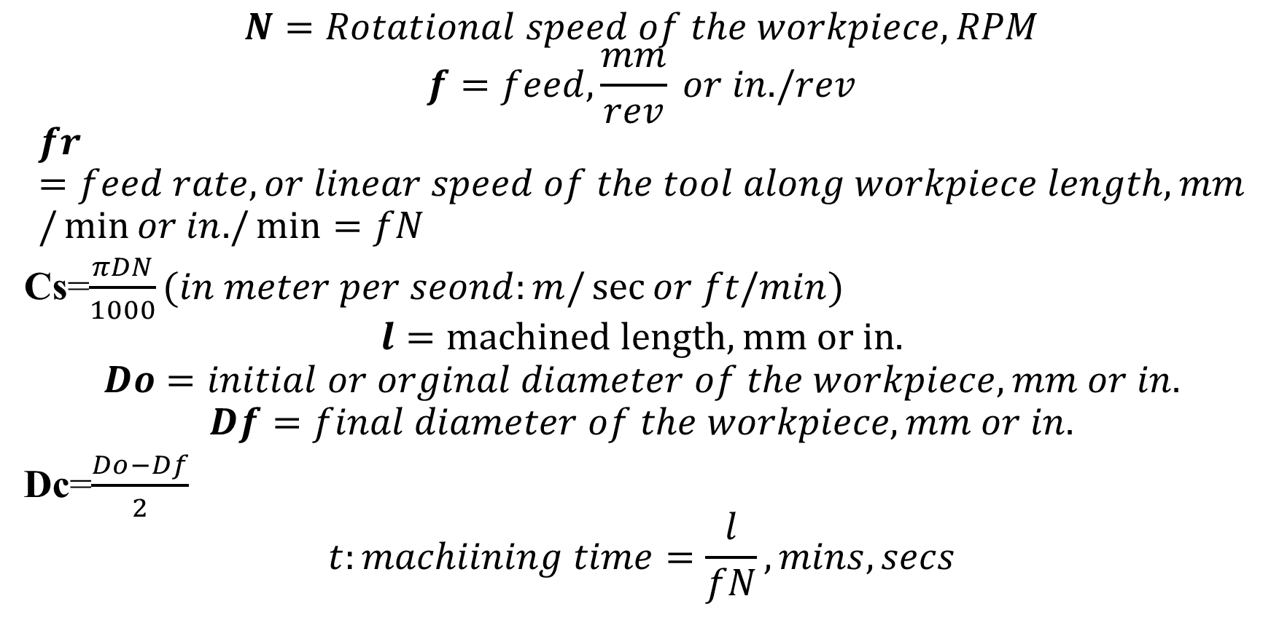
The summary of turning formula

Slide 5
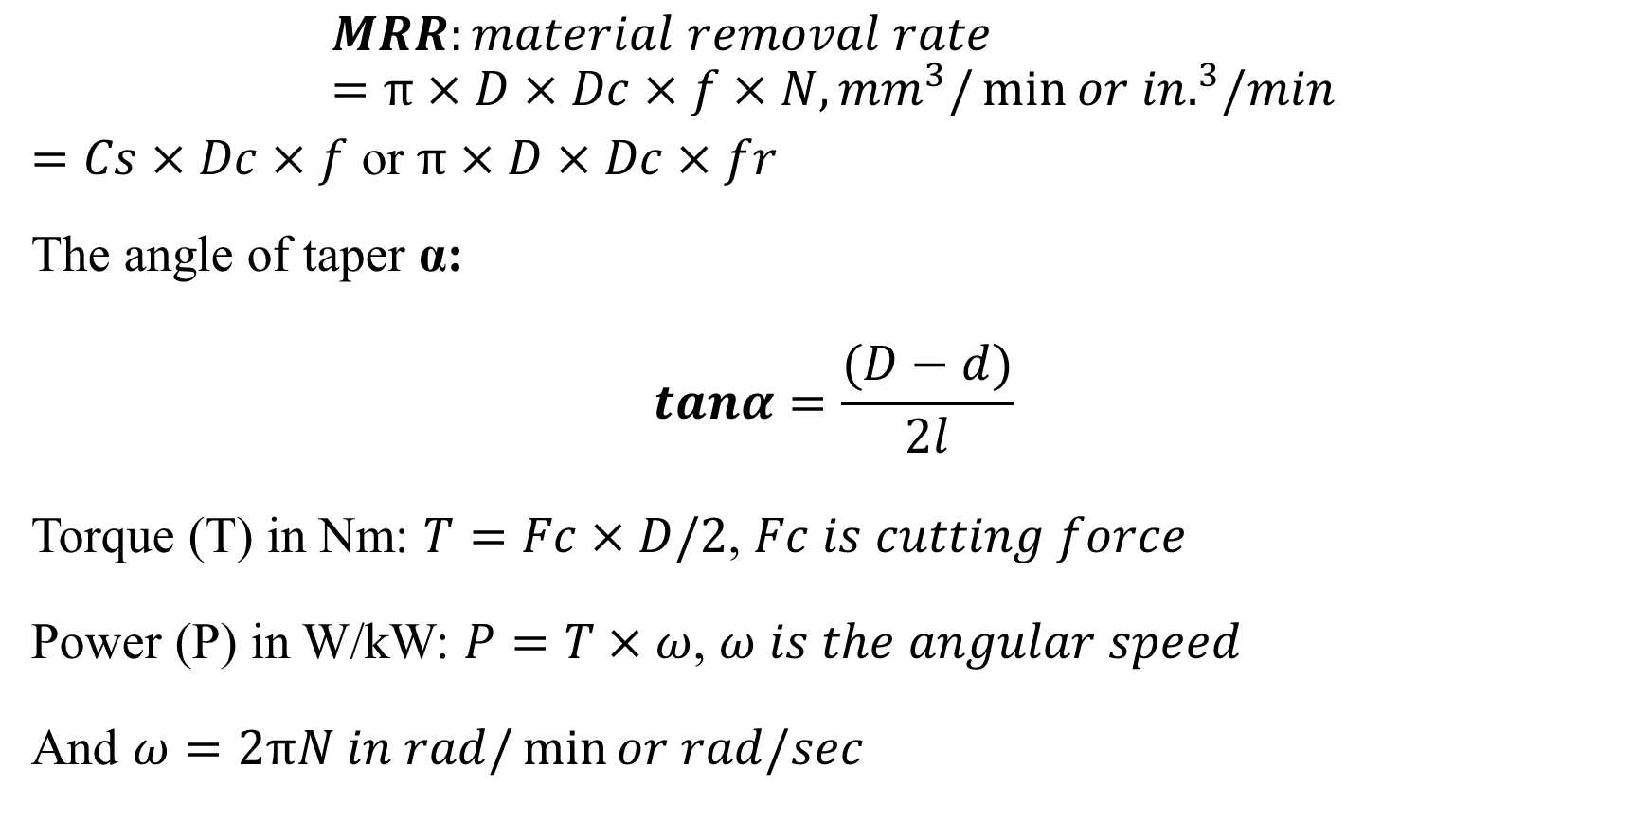
The summary of turning formula Cont’d

Slide 6
The formulas summarized in the above slides are known as turning formulas. These formulas help lathe machining operation activities for using them the operator can monitor effectively machining parameters (spindle speed, workpiece material, cutting speed, feed, depth of cut). For the same material cutting speed reduces as the size increases and it increases as the size reduces.

Slide 7
VIII.2 Material Removal Rate
Example 1
A cylindrical stainless steel rod of 150 mm length and 12 mm diameter is being reduced in diameter to 11 mm by turning on a lathe. The spindle rotates at 400 rpm, and the tool is travelling at an axial speed of 0.2 m/min. Calculate:
Feed
Depth of cut
The cutting speed
The material removal rate MRR

Slide 8
Given that:
l: 150 mm
Do: 12 mm
Df: 11 mm
fr: 0.2 m/min
N: 400 rpm
Question:
f=???
Dc=???
Cs=???
MRR=???

Slide 9
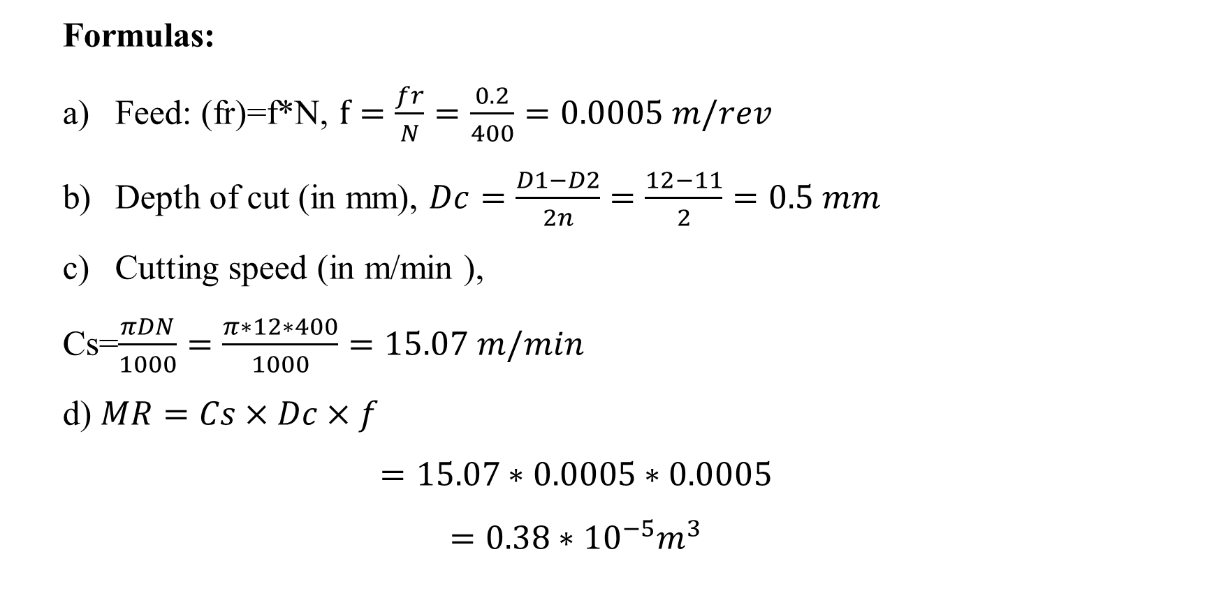

Slide 10
VIII.3 Power consumption in machining process
In machining process , power is defined as the amount of energy transferred per unit of time. In the case of conventional machining, the electrical network passes energy to the spindle’s electric motor, which passes it to the cutting tool. The cutting tool uses this energy to extract material from a workpiece.

Slide 11
Power consumption in machining process Cont’d
Assuming the efficiency of the machine is 100%, the power required to remove the material is the same as the power used by the machine’s motor. Each machine has a maximum power limit that it can handle. Therefore, it is helpful to calculate the power required to perform a machining operation such as milling or turning and compare it to our machine’s ability.

Slide 12
VIII.3.1 Factors affecting Cutting power
By understanding each parameter’s effect on machining power consumption, we can decide what to change when we want to optimize an application for less power consumption.
a) Raw Material:
The workpiece material type is by far the most significant factor. The specific cutting force (KC) ranges from 700 MPa for Aluminum up to 3,500 Mpa for nickel-based alloys. Machining a stock of Inconel will consume 400% more power than aluminum (At the same cutting conditions).

Slide 13
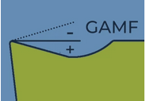
Factors affecting Cutting power Cont’d
b) Rake Angle:
Every single degree of rake angle(GAMF) increases/decreases the power consumption by about 1%. Radial rake angles range from +20° on high positive inserts up to -20° for inserts with a K-land. Therefore, the maximum potential of rake angle influence is 40%.
Fig. Rake Angle
https://www.machiningdoctor.com/calculators/machining-power/#factors-affecting-cutting-power

Slide 14
c) Approach Angle:
The approach angle on most cutting tools is 90°. However, there are many tools with 45° and high feed cutters with approach angles as low as 12°. As the angle decreases, chip thickness is reduced. Since the chip thickness is one of the components of the formula of the specific cutting force (see above), it indirectly influences also the required machining power. As the approach angle decreases, the machining power rises. The maximum potential of approach angle influence is 30%.

Slide 15
VIII.4 Specific-Energy Requirements in Machining Operations
Machining process is a dynamic system, which cuts work piece material with cutter, fixture, lubricating oil and coolant, and finally obtains the semi-finished or finished products. All of the process stages need to consume energy. In metal machining the specific energy consumption expresses the required energy consumption when cutting unit volume material, that is why it is expressed in W-s/mm³.

Slide 16
The table below includes specific-energy requirement in for different types of metals and metal alloys
Approximate Specific-Energy Requirements in Machining Operations
Material | Specific energy (W-s/mm³)
Aluminum alloys | 0.4–1.1
Cast irons | 1.6–5.5
Copper alloys | 1.4–3.3
High-temperature alloys | 3.3–8.5
Titanium Alloy | 3.0 -- 4.1
Magnesium alloys | 0.4–0.6
Nickel alloys | 4.9–6.8
Refractory alloys | 3.8–9.6
Stainless steels | 3.0–5.2
Steels | 2.7–9.3
Titanium alloys | 3.0–4.1
Table.1. Approximate Specific-Energy Requirements in Machining Operations

Slide 17
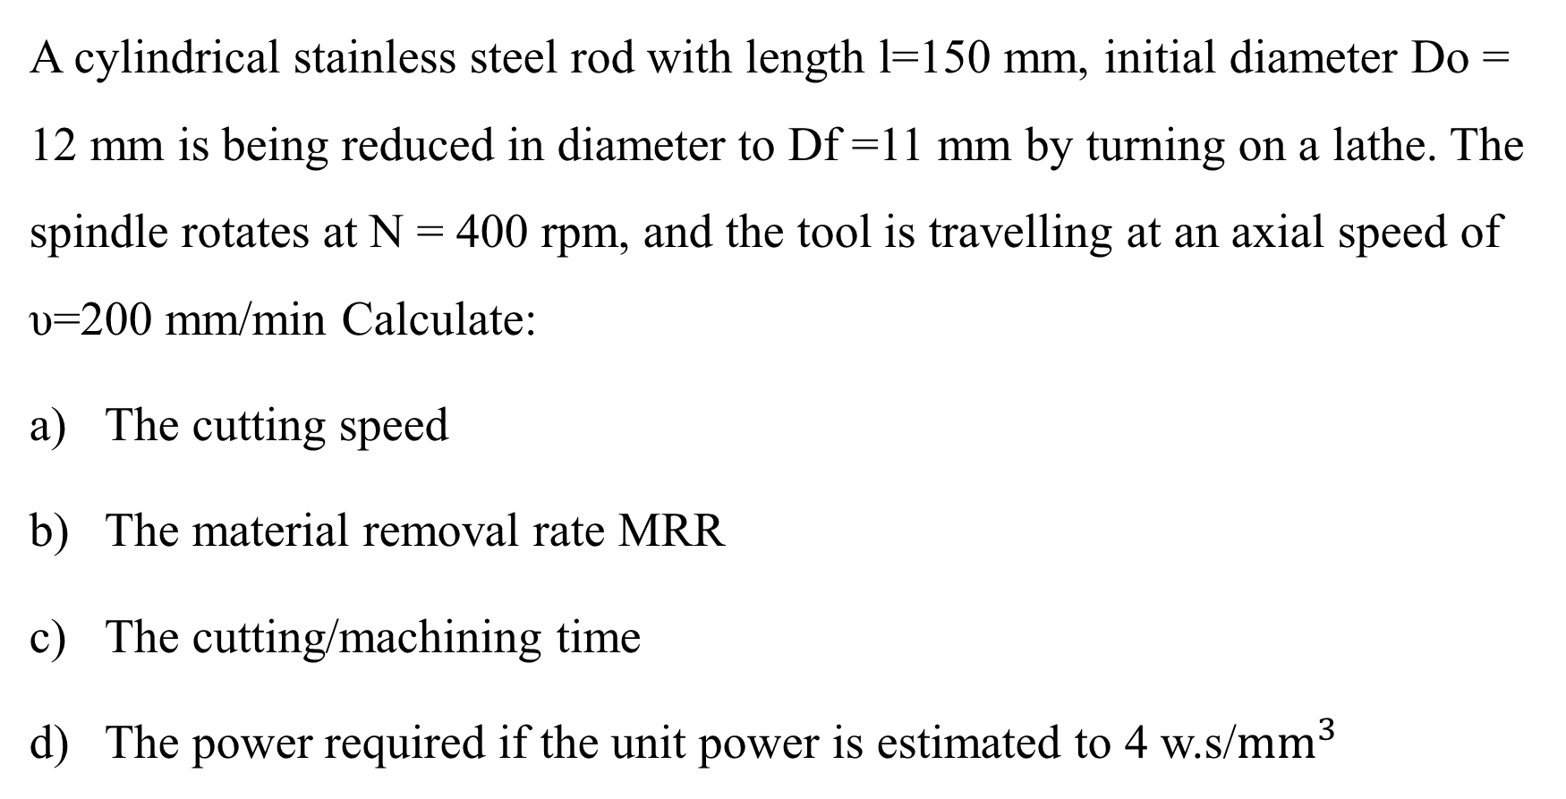
Example 1

Slide 18
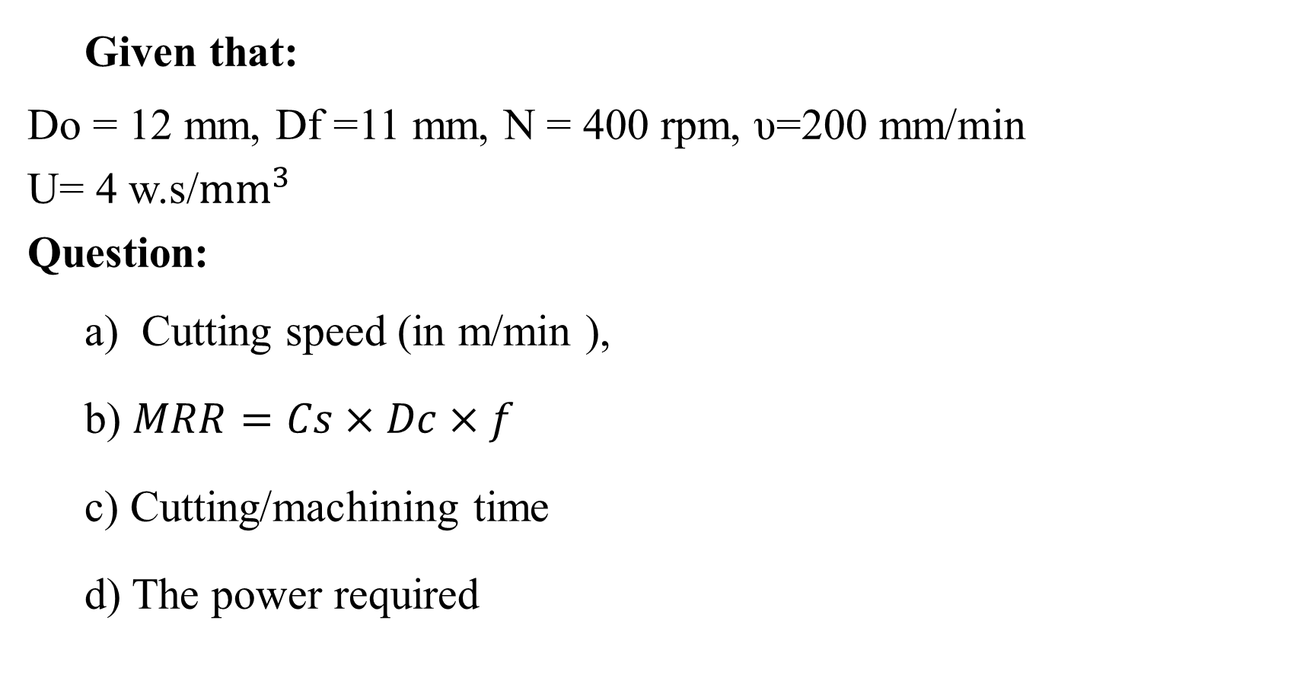

Slide 19
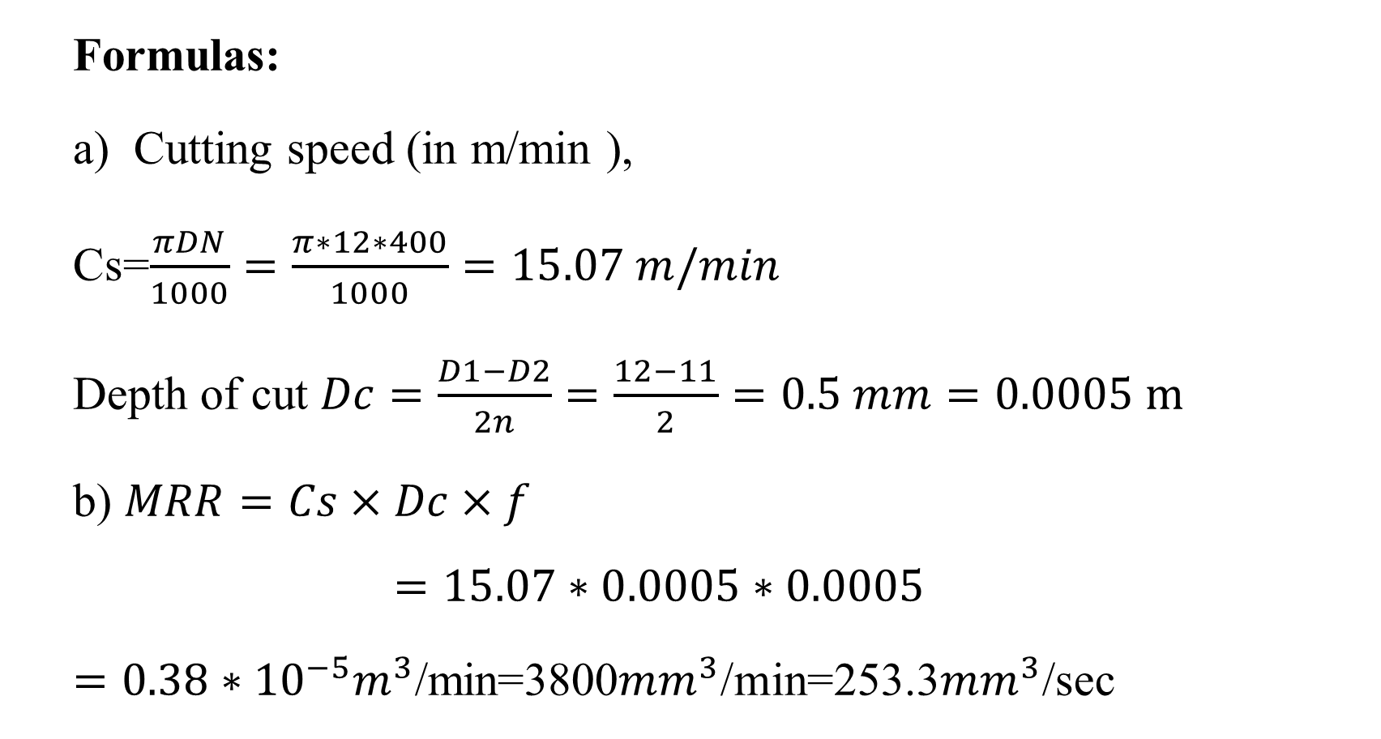

Slide 20
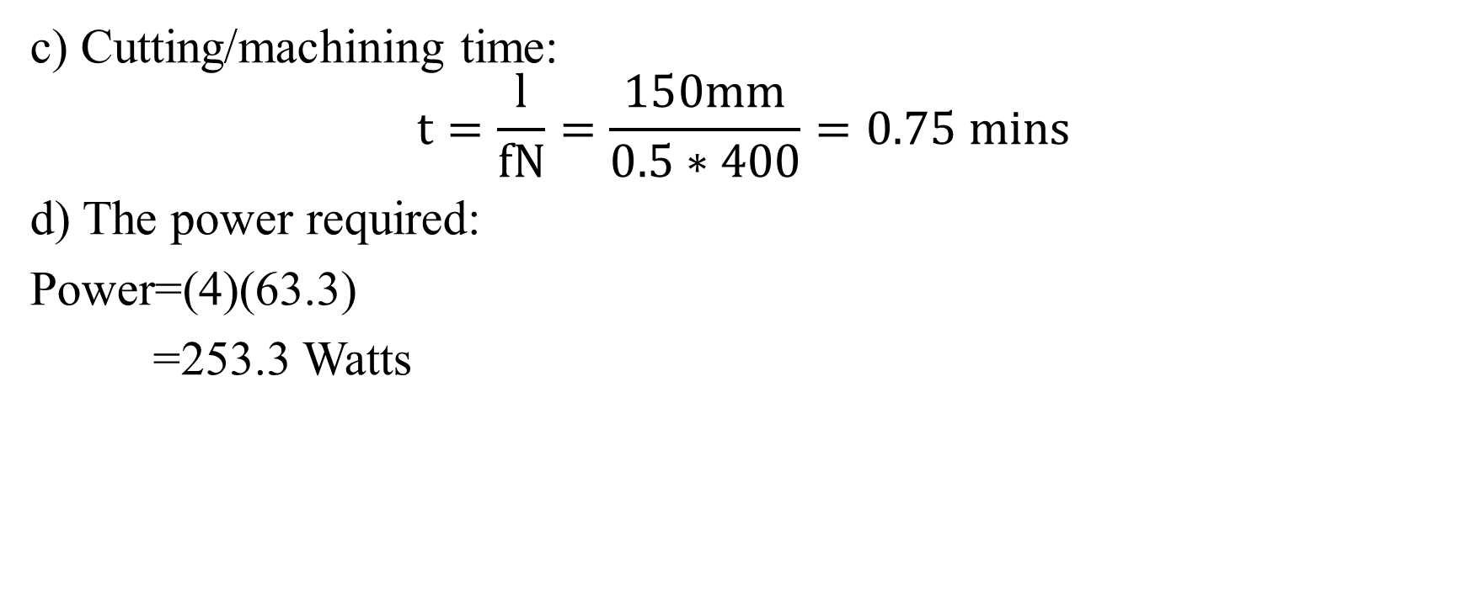

Slide 21
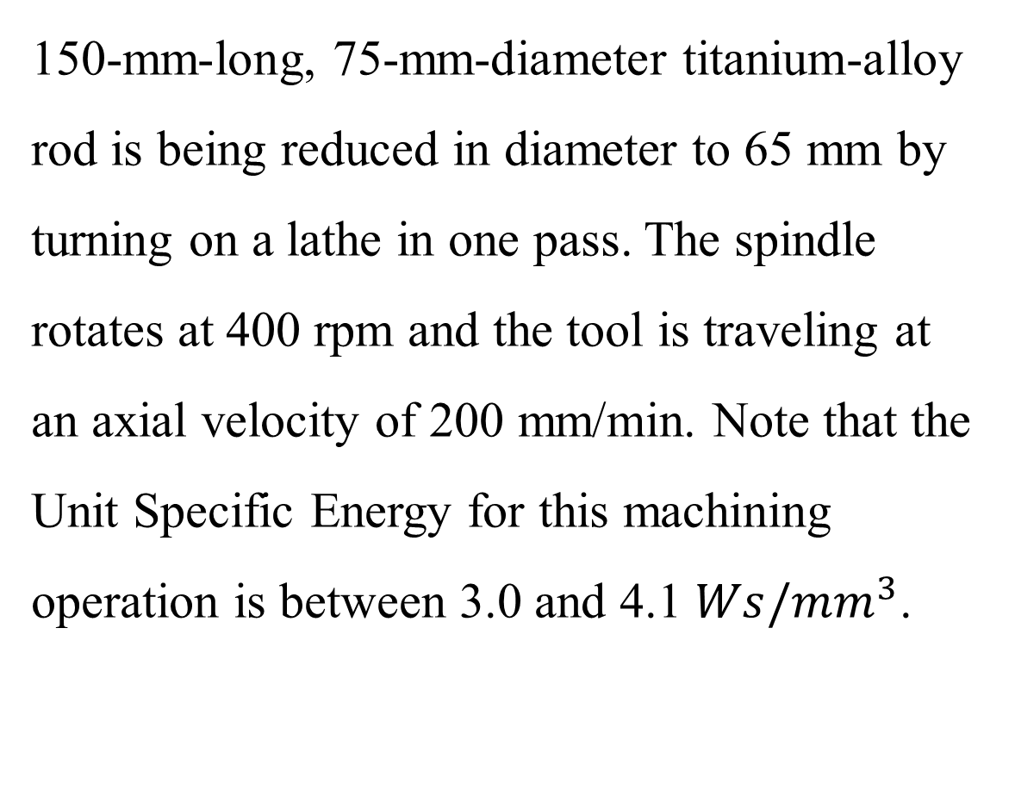
Example 1
Calculate:
The cutting speed,
Material removal rate,
Time of cut,
Power required, and
The cutting force.

Slide 22
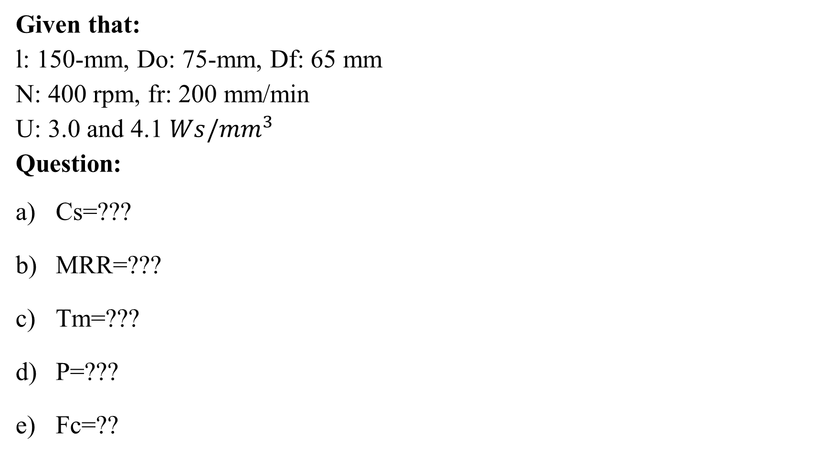

Slide 23
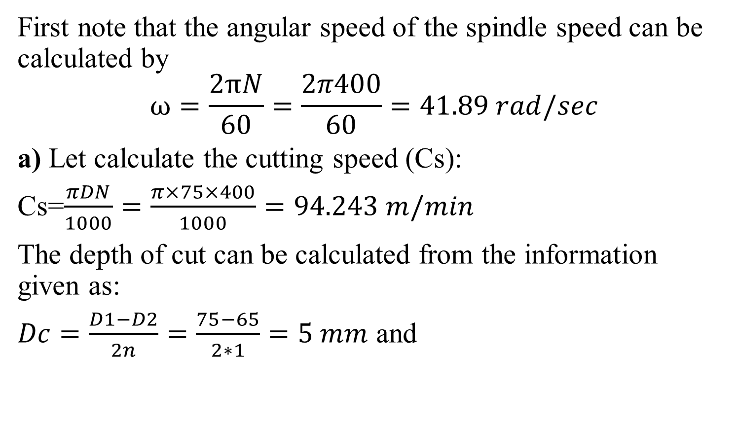

Slide 24
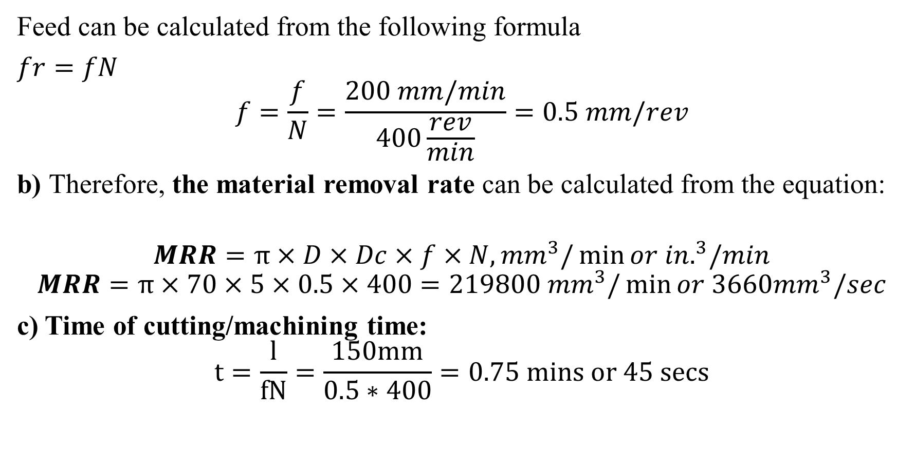

Slide 25
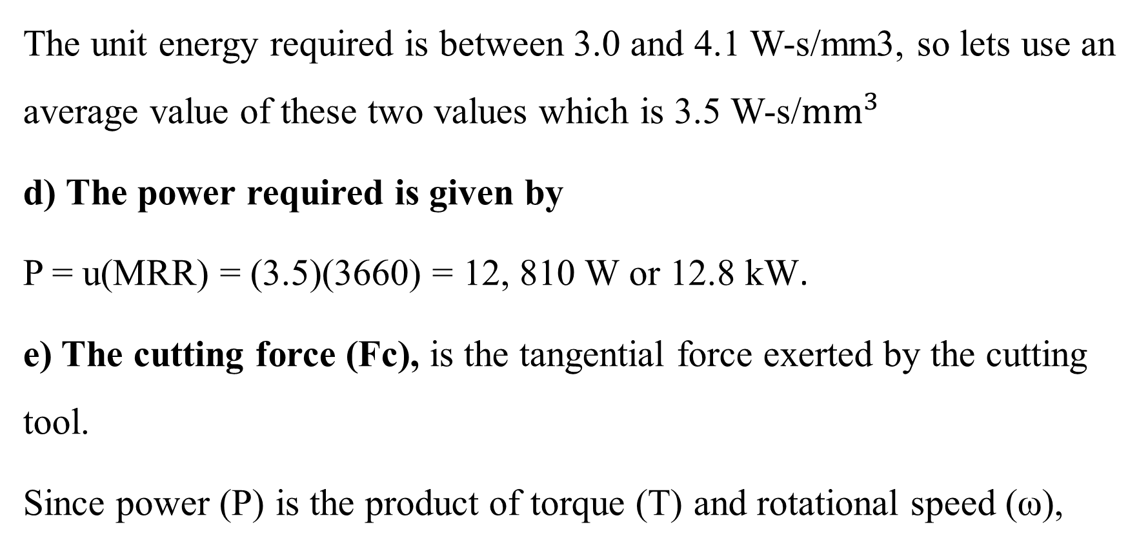

Slide 26
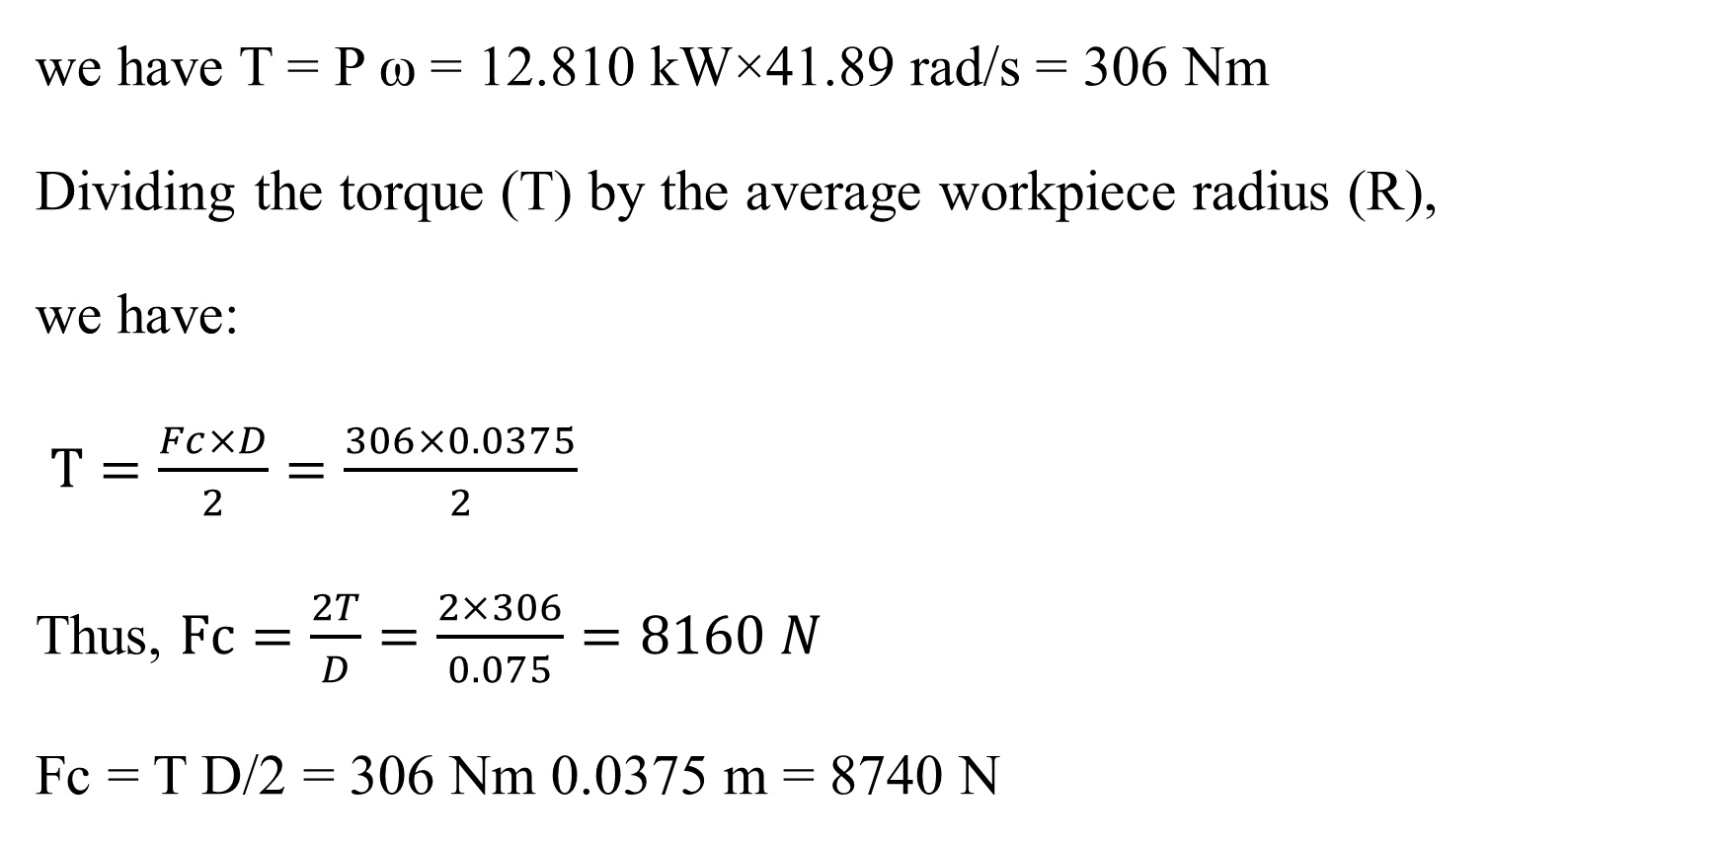

Slide 27
Example 2
A 125 mm-long, 10 mm-diameter 304 stainless-steel rod is being reduced in diameter to 9 mm by turning on a lathe. The spindle rotates at N = 360 rpm, and the tool is traveling at an axial speed of 175 mm/min. Calculate the cutting speed, material-removal rate, cutting time, power dissipated, and cutting force if the unity energy required is between 3.0 and 5.2 W-s/mm³

Slide 28
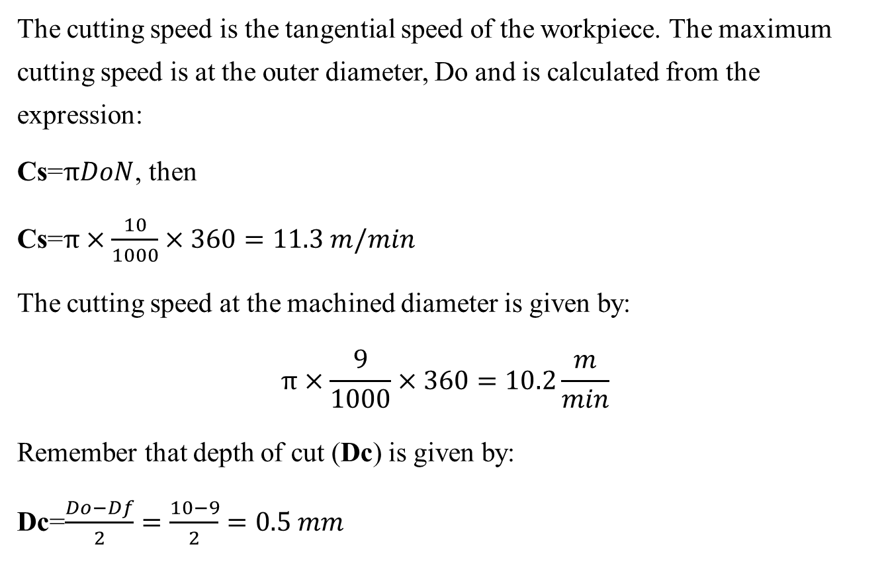
The answer

Slide 29
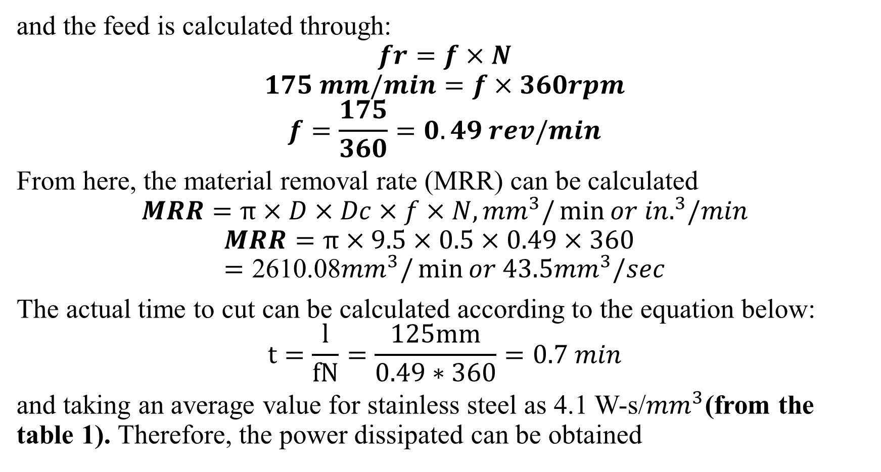

Slide 30
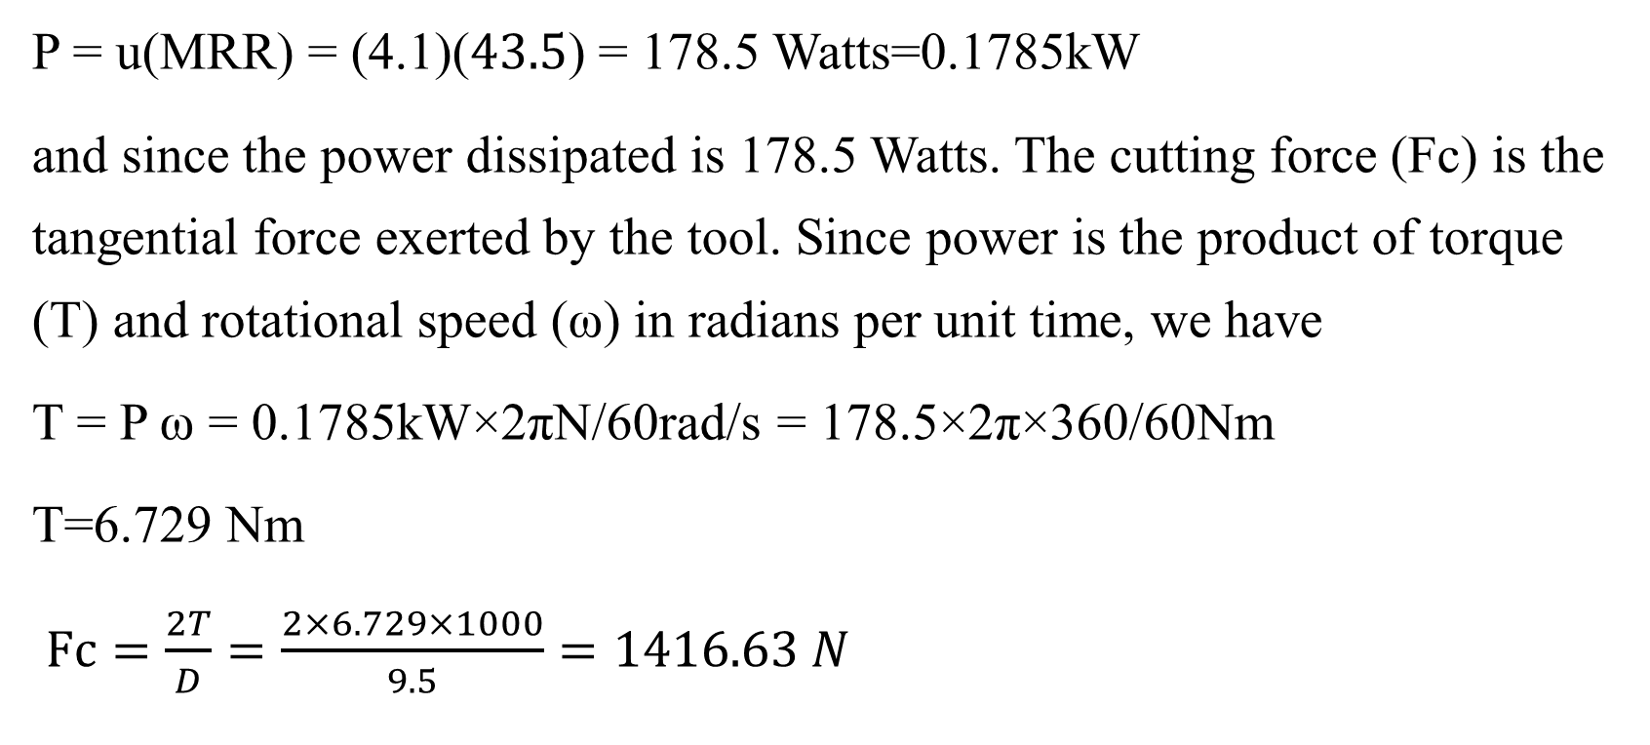

Slide 31
Reference
Boljanovic, V. (2009) Metal Shaping Processes: Casting and Molding; Particulate Processing; Deformation Processes; and Metal Removal (p333-334). Industrial Press, Inc. New York
Trent, E., & Wright, P. (2000). Metal Cutting (4th ed) (p.14) Butterworth–Heinemann.
Fritz Klocke: Manufacturing Processes 1 - Cutting, Springer, 2011, p. 95
Trent, Wright: Metal Cutting. Butterworth Heinemann, 2000, 4. edition , p. 132-250
Fritz Klocke: Manufacturing Processes 1 - Cutting, Springer, 2011, p. 95-196Graham
T. Smith: Cutting Tool Technology - Industrial Handbook, Springer, 2008, p. 1-32
Zheng, G. (2018). S e n s o r s & T r a n s d u c e r s Specific Energy Consumption Prediction Method Based on Machine Tool Power Measurement (p.1), Shandong University of Technology, Zibo 255049, China.
https://www.machiningdoctor.com/calculators/machining-power/#what-is-machining-power

Slide 32
THANK YOU

