Slide 1
COURSE NAME: MACHINE TOOLS
Lecture 9: CONSTRUCTION AND WORKING PRINCIPLE OF MILLING MACHINE TOOL
Lecturer: HABANABAKIZE THEOPHILE

Slide 2
OUTLINE
Introduction
Main parts of milling machine and their functions
Types of milling machines
Methods of milling
Working principle of milling machine

Slide 3
IX.1. Introduction
Milling is the cutting operation that removes metal by feeding the work against a rotating cutter having single or multiple cutting edges. Flat or curved surfaces of many shapes can be machined by milling with good surface finish and accuracy. A milling machine may also be used for drilling, slotting, making a circular profile and gear cutting by having suitable attachments.

Slide 4
Introduction Cont’d
Milling also can be defined as a metal cutting operation in which the excess material from the work piece is removed by rotating multipoint cutting tool called milling cutter. A milling machine is a machine tool that removes metal as the work is fed against a rotating multipoint cutter. The milling cutter rotates at high speed and it removes metal at a very fast rate with the help of multiple cutting edges.

Slide 5
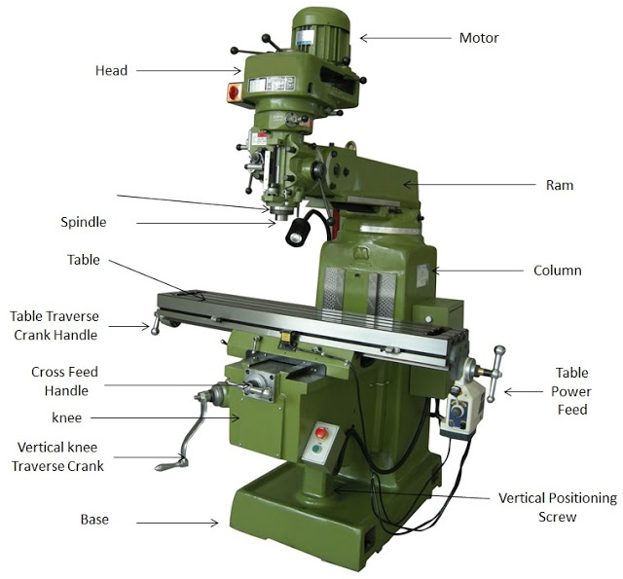
IX.2. Main parts of milling machine and their functions
https://id.images.search.yahoo.com/yhs/search;_ylt=Awrx5kqc9IxizUkA6QH3RQx.;_ylu=Y29sbwMEcG9zAzEEdnRpZAMEc2VjA3BpdnM-?p=Main+parts+of+milling+machine&type=zxy_a864b661f5f4a3135f&param1
Fig. 1: Vertical Milling machine and its parts

Slide 6
Main parts of milling machine and their functions Cont’d
The previous figure shows Vertical milling machine; the broad classification of milling machines are of two types:
Vertical milling machine
Horizontal milling machine
Vertical and Horizontal milling machine have the same parts and perform the same functions as it is shown on the figure 2.

Slide 7
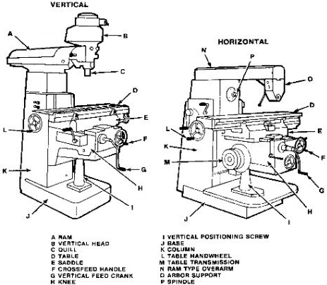
Source: https://id.images.search.yahoo.com/yhs/search;_ylt=Awrx5kqc9IxizUkA6QH3RQx.;_ylu=Y29sbwMEcG9zAzEEdnRpZAMEc2VjA3BpdnM-?p=Main+parts+of+milling+machine&type=zxy_a864b661f5f4a3135f&param1
From fig.2 it is clear that there are parts which are indicated using the same letter; those parts are the same and they perform the same function as it is will be discussed in the following slides.
Fig.2: Vertical and Horizontal Milling Machine

Slide 8
Main parts of milling machine and their functions Cont’d
As it was shown on fig.1 and fig.2, milling machine (horizontal or vertical) has several parts but the main ones where other parts are fixed are the following:
Column and Base.
Knee
Saddle and Swivel Table

Slide 9
Main parts of milling machine and their functions Cont’d
Power Feed mechanism
Table
Spindle
Over Arm / Overhanging Arm
Arbor Support, and
Ram

Slide 10
Main parts of milling machine and their functions Cont’d
1. Base:
It is the foundation part of a milling machine. All other parts are jointed on it. It carries the entire load so it should have high compressive strength so it is made by cast iron. It also works as reservoir of cutting fluid.
2. Column:
Column is another foundation part of milling machine. It is mounted vertically on the base. It supports the knee, table etc. Work as housing for the all the other driving member.it is a hollow member which contains driving gears and sometimes motor for spindle and the table.

Slide 11
Main parts of milling machine and their functions Cont’d
3. Knee:
Knee is the first moving part of milling machine. If is mounted on the column and moves along the sideways situated over the column. It is made by cast iron and moves vertically on sideways. It moves up and down on sideways which change the distance between tool and workpiece. It is driven by mechanically or hydraulically.

Slide 12
Main parts of milling machine and their functions Cont’d
4. Saddle:
It is placed between table and the knee and work as intermediate part between them. It can move transversally to the column face. It slides over the guide ways provided situated on the knee which is perpendicular to the column face. The main function of it is to provide motion in horizontal direction to work piece. It is also made by cast iron.

Slide 13
Main parts of milling machine and their functions Cont’d
5. Table:
Table is situated over the knee. It is the part of machine which holds the work piece while machining. It is made by cast iron and have T slot cut over it. The work piece clamp over it by using clamping bolts. The one end of clamping bolt fix into this slot and other is fix to work piece which hold the work piece. It can provide three degree of freedom to work piece.
It provides vertical motion by moving the knee up and down.
It provides horizontal motion by the feed screw.
It provides horizontal (transverse) motion by moving the saddle.

Slide 14
Main parts of milling machine and their functions Cont’d
6. Overhanging arm:
It is situated over the column on horizontal milling machine. It is overhang over the column surface and other end supports the arbor. It is made by cast iron.
7. Arbor:
It is a mechanical part on which is used as extension part of the spindle in horizontal milling machine. It is fitted on the spindle whenever required. It holds the tool and moves it in correct direction.

Slide 15
Main parts of milling machine and their functions Cont’d
8. Spindle:
Spindle is the main part of the machine which hold tool at right place in vertical milling machine and hold arbor in horizontal milling machine. It is a moving part which is in rotary motion. It is motor driven and drives the tool. It has a slot on the front end of it. The cutting tool fix in that slot.

Slide 16
Main parts of milling machine and their functions Cont’d
9. Arbor Supports:
This are used to support arbor at right place. One end of this support is jointed at the overhanging arm and another is jointed with arbor.
10. Milling head:
It is upper section of vertical milling machine. It consist spindle, driving motor and other controlling mechanism.

Slide 17
Main parts of milling machine and their functions Cont’d
11. Ram:
Ram is work as overhanging arm in vertical milling machine. One end of the arm is attached to the column and other end to the milling head.

Slide 18
IX.3. Difference between Horizontal and vertical milling machine
No | Horizontal | Vertical
1 | Spindle is horizontal and parallel to the worktable. | Spindle is vertical and perpendicular to the worktable.
2 | Cutter cannot be moved up and down | Cutter can be moved up and down.
3 | Cutter is mounted on the arbor | Cutter is directly mounted on the vertical spindle.
4 | Spindle cannot be tilted at a certain angle. | Spindle can be tilted for angular cutting.
5 | Operations such as plain milling, gear cutting, form milling, straddle milling, gang milling etc., can be performed. | Operations such as slot milling, T-slot milling, angular milling, flat milling etc., can be performed and also drilling, boring and reaming can be carried out.

Slide 19
IX.4. Working principle of Milling machine
The workpiece is held on a worktable of milling machine. The table movement controls the feed of the workpiece against the rotating milling cutter. The milling cutter is fixed on a spindle or arbor which revolves at desired speed. The workpiece moves against the cutter and remove the metal from the surface in order to produce the desired shape. During milling machining operations the coolant/cutting fluid must be supplied continuously in other to facilitate machining activity.

Slide 20
IX.5. Setup For Milling Operation
The success of any milling operation depends, before setting up a job, be sure that the to a great extent, upon judgment in setting up the job, workpiece, the table, the taper in the spindle, selecting the proper milling cutter, and holding the cutter by the best means under the circumstances.

Slide 21
Setup For Milling Operation Cont’d
Some fundamental practices have been proved by experience to be necessary for and the arbor or cutter shank are all clean and good results on all jobs. Some of these practices are mentioned below:
Before setting up a job, be sure that the workpiece, table, the taper in the spindle, and the arbor or cutter shank are free from chips, nicks, or burrs.

Slide 22
Setup For Milling Operation Cont’d
Do not select a milling cutter of larger diameter than is necessary.
Check the machine to see if it is in good running order and properly lubricated, and that it moves freely, but not too freely in all directions.
Consider direction of rotation. Many cutters can be reversed on the arbor, so be sure you know whether the spindle is to rotate clockwise or counterclockwise.
Feed the workpiece in a direction opposite the rotation of the milling cutter (conventional milling).

Slide 23
Setup For Milling Operation Cont’d
Do not change feeds or speeds while the milling machine is in operation.
When using clamps to secure a workpiece, be sure that they are tight and that the piece is held so it will not spring or vibrate under cut.
Use a recommended cutting oil liberally.
Use good judgment and common sense in planning every job, and profit from previous mistakes.
Set up every job as close to the milling machine spindle as circumstances will permit.

Slide 24
IX.6. Advantages of Milling machine
Following are the advantages of the Milling machine:
The size and durable construction of the milling machine give tremendous support to handle large and heavier machines without damaging itself.
It provides flexible computer control options for cutting purposes.
It reduces the chances of human errors.
It assures accurate cuts.
Availability of customization.

Slide 25
Advantages of Milling machine Cont’d
Use of multiple cutters.
It can do multiple cuts simultaneously.
Milling is perfect for producing individual pieces in small or large batches.
It has the capability of producing complicated shapes, using multi-tooth and single point cutting tools.
The operation costs can be controlled to a great extent if general-purpose cutters and equipment are used.
Greater precision in the finishing of the work compared to other machines.

Slide 26
IX.7. Disadvantages of Milling machine
There are several disadvantages to milling machines:
The cost of the milling machine is high.
As milling cutters cost high, the investment for procuring tools is more.
The production cost will increase if we carry out the operations performed in a shaper or a drilling machine with a milling machine.
The workers who operate milling machines need proper training

Slide 27
IX.8. Application of Milling machine
The applications of Milling Machine are as follows.
The milling machine is used for making various types of gears.
It is generally used to produce slots or grooves in workpieces.
It can able to machine flat surfaces and irregular surfaces too.
It is used in industries to produce complex shapes.
It is used in Institutions or colleges to conduct lab tests on a milling machine.

Slide 28
IX.9. Preliminary operations
The various duties of the milling machine operator can be classified as preliminary operations and machining operations. Several preliminary operations are necessary before the machine can be started.
a) Cleaning
Cleaning of the milling machine cannot be emphasized too strongly. The machine should be cleaned both before and after using.. Accuracy and durability of the machine depend on its being keit clean; this applies to all machine tools

Slide 29
Preliminary operations Cont’d
If a milling machine is cleaned as soon as possible after use, it can be kept clean more easily than if chips and coolant are allowed to accumulate for long periods of time. A clean machine is usually in better mechanical condition than one in which dirt has been allowed to accumulate. This is because chips that build up on a dirty machine can clog oil channels, mar the bearing surfaces of the column or knee, and interfere with accurate adjustments of the fixtures and work. Oil holes that have become clogged with gummy oil can be flushed with gasoline; this will not injure the bearings.

Slide 30
Preliminary operations Cont’d
b) Oiling the Machine
Apply a few drops of oil to each bearing at frequent intervals, rather than a flood of lubricant at long or irregular intervals. Most bearings can hold only a few drops, and an excess of oil runs out and is lost. It is always safest to purchase a lubricant that is reliable, rather than experiment with less expensive machinery oils. It is less expensive to use a good oil than to risk damage to bearings from overheating or scoring.

Slide 31
Preliminary operations Cont’d
The more recently designed milling machines are equipped with automatic lubricating systems that ensure a constant supply of clean lubricants at important points. This relieves the machine operator of much of the oiling problem, but the oil level in machine reservoirs should be checked at regular intervals.

Slide 32
IX.10. Preliminary operations Cont’d
Many machines equipped with automatic lubrication include oil filters in the system. All oil must pass through the filters each time it is circulated. The filters should be checked regularly to determine whether they are functioning properly. When the filter becomes clogged, the bearings can become dry, even though the oil is bypassed around the filter. The two abovementioned preliminary operations are very important just to insure safe working condition of milling machine.

Slide 33
IX.11. Safety Precautions to operate milling machine
First, the operator should understand thoroughly the construction and operating action of the machine before attempting its operation. This is important not only for the operation but also because it lessens the chances of the machine itself being damaged seriously. The following suggestions should be carefully noted and remembered while operating milling machine. These suggestions also can be applied to any other machine in the machine shop.

Slide 34
Safety Precautions to operate milling machine Cont’d
Do not move an operating lever without knowing in advance the action that is going to take place.
Never toy with the control levers or carelessly turn the handles of the milling machine while it is stopped.
Do not lean against, or rest the hands on, a moving table; if it is necessary to touch a moving member, make sure of the direction in which it is moving.

Slide 35
Safety Precautions to operate milling machine Cont’d
Do not attempt to cut without being sure that the work is held securely in the vise or fixture and that the holding member is fastened to the machine table.
Remove chips with a brush or other suitable means-never with the fingers or hands.
Before operating a milling machine, study it thoroughly. Then, if an emergency should arise, the machine can be stopped immediately.
Stay clear of the milling cutters; do not touch a cutter, even while it is not moving, unless there is good reason to do so, and then be careful.

Slide 36
References
Miller. R & Richard.M.M (2004). Machine Shop Tools and operations(5th Edition) (p 233-241). Wiley Publishing, Inc. Canada.
Trent, E., & Wright, P. (2000). Metal Cutting (4th ed) (p.14) Butterworth–Heinemann.
Fritz Klocke: Manufacturing Processes 1 - Cutting, Springer, 2011, p. 95
Trent, Wright: Metal Cutting. Butterworth Heinemann, 2000, 4. edition , p. 132-250
Fritz Klocke: Manufacturing Processes 1 - Cutting, Springer, 2011, p. 95-196Graham
T. Smith: Cutting Tool Technology - Industrial Handbook, Springer, 2008, p. 1-32
https://www.engineeringchoice.com/milling-machine/
https://id.images.search.yahoo.com/yhs/search;_ylt=Awrx5kqc9IxizUkA6QH3RQx.;_ylu=Y29sbwMEcG9zAzEEdnRpZAMEc2VjA3BpdnM-?p=Main+parts+of+milling+machine&type=zxy_a864b661f5f4a3135f&param1
https://id.images.search.yahoo.com/yhs/search;_ylt=Awrx5kqc9IxizUkA6QH3RQx.;_ylu=Y29sbwMEcG9zAzEEdnRpZAMEc2VjA3BpdnM-?p=Main+parts+of+milling+machine&type=zxy_a864b661f5f4a3135f&param1
https://studentlesson.com/the-working-principle-of-milling-machine/

Slide 37
THANK YOU

