Slide 1
COURSE NAME: MACHINE TOOLS
Lecture 10: MILLING MACHINE OPERATIONS: FACE, SIDE, PLAIN,STRADDLE AND ANGULAR MILLING
Lecturer: HABANABAKIZE THEOPHILE

Slide 2
OUTLINE
Introduction
Up milling and Down milling
Types of Milling Cutters
Selection principle of milling cutter
Milling operations

Slide 3
X.1 Introduction
There are various milling machine operations used for different kinds of jobs. Depending on the direction of the cutter rotation and direction of work-piece feed, you can classify the milling process as Up (which is also called conventional) milling and Down (which is also called climb) milling. Each one of these milling process has its advantages as well as disadvantages as it is going to be highlighted in the next slides.

Slide 4
X.2 Up and down milling
Up (conventional) milling: Here the direction of your work-piece feed is opposite to the direction of the milling cutter.
Down (climb) milling: Here the directions of your work-piece feed and the direction of the milling cutter are the same.

Slide 5
a. Comparison between Up and down milling
When you do the up-milling or conventional milling, the cutting forces tend to lift the work-piece and the table on which your work-piece is mounted; up-milling is favourable to the cutter since the starting load on the cutter teeth is at the minimum, however, it results in bad surface finish. You generally use the up-milling process for rough milling and on machines that are sturdy and can withstand the cutting forces.

Slide 6
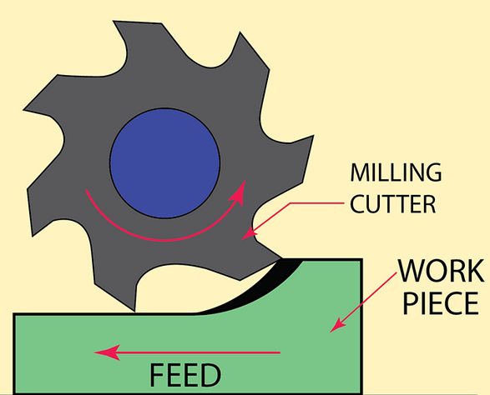
b. Schematic illustration of up (conventional)milling
Metal is removed by cutter rotating against the direction of travel of the workpiece.
Needs stronger holding of the job.
Chip thickness is minimum at the start of cut and maximum at the end of the cut.
Disadvantage- tendency to lift work from the fixtures and poor surface finish.
Fig.1 Up (conventional)milling
Source: https://finemetalworking.com/wp-content/uploads/up-milling.png

Slide 7
Down milling
In climb milling (down-milling), the cutting forces push the work-piece downwards and this helps in milling thin work-pieces and also results in good surface finish. However, Sudden and maximum load on your milling cutter at the start of down-milling is not favorable to the cutter.

Slide 8
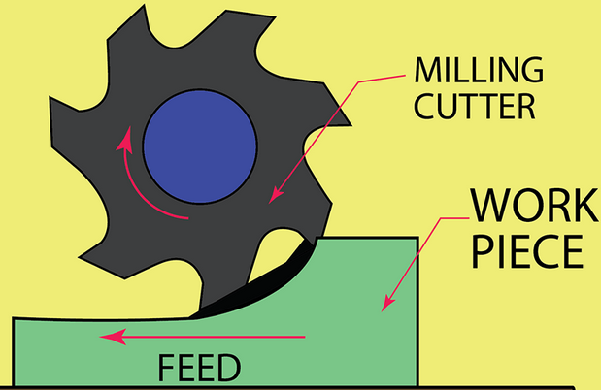
c. Schematic illustration of Down (climb)milling
Metal is removed by cutter rotating in the same direction of travel of the workpiece.
Teeth cut downward instead of upwards.
Chip thickness is maximum at the start of cut and minimum at the end of cut.
Less friction involved
Better surface finish.
Less power consumption.
Fig.2 Down (climb)milling
Source: https://finemetalworking.com/wp-content/uploads/up-milling.png

Slide 9
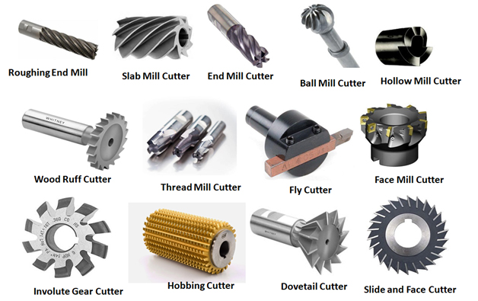
X.3 Types of Milling Cutters Used in Machining Process
Fig.3 Types of Milling Cutters Used in Machining Process
Source: https://www.machinemfg.com/milling-cutters-types-uses-and-selection-principles/

Slide 10
X.4 Selection principle of milling cutter
a. selection of milling cutter diameter
The selection of milling cutter diameter varies greatly due to different products and production batches.
The choices of tool diameter mainly depends on the specification of the equipment and the machining size of the workpiece
b. Plane milling cutter
When selecting the diameter of face milling tool, it is mainly considered that the power required by the tool should be within the power range of machine tool, or it can be according to the diameter of machine tool spindle.
The diameter of face milling cutter can be selected according to D= 1.5d (where d is the diameter of spindle).
In mass production, the tool diameter can also be selected according to 1.6 times of the cutting width of the workpiece.

Slide 11
c. End mill
The selection of end mill cutter diameter shall mainly consider the requirements of workpiece processing size to ensure that the power required by the cutter is within the rated power range of the machine tool.
If it is small diameter end mill, the main consideration should be whether the maximum number of revolutions of the machine tool can reach the maximum cutting speed of the tool (60m/min)
d. Slotting knife
The diameter and width of the slot milling shall be selected according to the size of the workpiece to be machined, and its cutting power shall be within the allowance power of the machine tool.

Slide 12
e. Selection of milling cutter blade
For finishing, it is best to use a grinding blade. This kind of blade has a good dimensional accuracy, so milling is the positioning accuracy of cutting edge, which can obtain better machining accuracy and surface roughness.
For rough machining, it is best to pressing blades, which can reduce the processing cost.
The dimensional accuracy and sharpness of the pressing blade are worse than those of the grinding blade, but the edge strength of the pressing blade is better. It is impact resistant during rough machining, and can withstand large cutting depth and large feed.

Slide 13
c. Sharp large rake blades can be used for milling viscous materials such as stainless steel. Through the cutting action of the sharp blade, the friction between the blade and the workpiece material is reduced, and the chips can leave the front end of the blade faster.
f. Selection of milling cutter blade
First of all, the number of teeth must be considered when selecting milling cutter.
The size of tooth pitch will determine the number of cutter teeth involved in cutting at the same time, and affect the smoothness of cutting and the requirements for the cutting speed of the machine tool.
Rough tooth milling cutter is mostly used for rough machining because it has a large chip removal groove.
At the same feed rate, the cutting load per tooth of the coarse tooth milling cutter is greater than that of the dense tooth milling cutter.

Slide 14
b. During finish milling, the cutting depth is shallow, generally 0.25-064mm. It is recommended to select dense tooth milling cutter.
c. In the process of heavy rough milling, the excessive cutting force will lead to the chatter of machine tools with low rigidity.
This chatter will lead to the edge collapse of cemented carbide blade, which will shorten the tool life.
Using coarse tooth milling cutter can reduce the requirement of machine tool power.

Slide 15
When choosing milling cutter for ordinary milling machine, the following parameter must comprehensively be considered: milling material and hardness and the specifications of milling cutter, such as edge length, tool length, edge diameter, shank diameter,…
High speed milling cutters are usually suitable for ordinary milling machines, while cemented carbide cutters are preferred for CNC milling machines.

Slide 16
X.5 Operations that can be performed on milling machine
Plain or slab milling
Face milling
End milling
Side milling
Slot milling
Angular milling
Form milling
Straddle milling

Slide 17
Operations that can be performed on milling machine Cont’d
Gang milling
Slitting or saw milling
Gear cutting
Key way milling
String milling
Profile milling
Thread milling
Helical milling
Cam milling

Slide 18
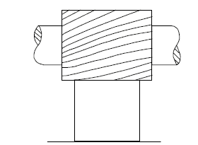
1. Plain Milling
Plain Milling or slab milling is milling of flat surfaces where the axis of the cutter is kept parallel to the surface being milled. It is also known as surface milling or slab milling. The plain milling cutter is used for plain milling.
Fig.4 Plain Milling
Source: https://learnmech.com/milling-machine-operations-with-diagrams/

Slide 19
Plain milling is the most common type of milling machine operation. Plain milling is performed to produce a plain, flat, horizontal surface parallel to the axis of rotation of a plain milling cutter.
To perform this operation, the work and the cutter are secured properly on the machine. The depth of cut is set by rotating the vertical feed screw of the table. And the machine is started after selecting the right speed and feed.

Slide 20
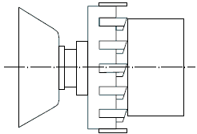
Fig.5 Face Milling
2. Face Milling
This makes the flat surface at the face of the workpiece. Face milling is done on the surface of the workpiece which is placed perpendicular to the axis of the cutter. This operation is done performed by a face milling cutter mounted on a stub arbor.
Source: https://learnmech.com/milling-machine-operations-with-diagrams/

Slide 21
Face milling Cont’d
Face milling is the simplest milling machine operation. This operation is performed by a face milling cutter rotated about an axis perpendicular to the work surfaces.
The operation is carried in plain milling, and the cutter is mounted on a stub arbor to design a flat surface. The depth of the cut is adjusted by rotating the cross-feed screw of the table.

Slide 22
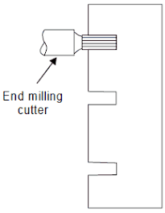
3. End milling
The end milling is the operation of producing a flat surface that may be vertical, horizontal, or at an angle in reference to the table surface. The cutter used is an end mill. The end milling cutters are also used for the production of slots, grooves, or keyways. A vertical milling machine is more suitable for end milling operation.
Fig.6 End milling
Source: https://learnmech.com/milling-machine-operations-with-diagrams/

Slide 23
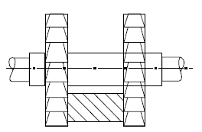
4. Side Milling
In this process, the flat vertical surfaces produce at the side of a workpiece. This process is done with a side milling cutter.
Side milling is the operation of producing a flat vertical surface on the side of a workpiece by using a side milling cutter. The depth of cut is set by rotating the vertical feed screw of the table.
Fig.7 Side milling
Source: https://learnmech.com/milling-machine-operations-with-diagrams/

Slide 24
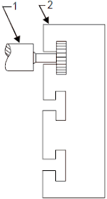
5. Slot milling
This operation is used to produce keyways, grooves, and slots on the workpiece.
The operation of producing keyways, grooves, and slots of varying shapes and sizes can be performed in a milling machine. It is done by using a plain milling cutter, a metal slitting saw, an end mill, or a side milling cutter.
Milling cutter
Workpiece
Fig.8 Slot milling
Source: https://learnmech.com/milling-machine-operations-with-diagrams/

Slide 25
The open slots can be cut by a plain milling cutter, a metal slitting saw, or a side milling cutter. The closed slots are produced by using end mills. A dovetail slot or T-slot is manufactured by using special types of cutters designed to give the required shape to the workpiece.
The second slot is cut at right angles to the first slot by feeding the work past the cutter. A woodruff key is designed by using a woodruff key slot cutter. Standard keyways are cut on the shaft by using side milling cutters or end mills. The cutter is set exactly at the centerline of the workpiece and then the cut is taken.

Slide 26
6. Angular milling
Angular milling is the operation of producing an angular surface on a workpiece other than at right angles of the axis of the milling machine spindle. An angular groove may be single or double angle and may be of varying included angle according to the type and contour of the angular cutter used. One simple example of angular milling is the production of V-blocks.

Slide 27
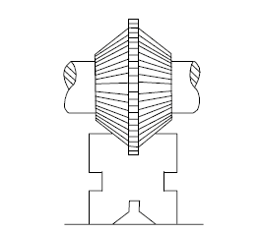
It is used to mill flat surfaces which are neither parallel nor perpendicular to the axis of the milling cutter. It is also known as angle milling. The single-angle milling cutter is used to perform this operation.
Fig.9 Angular milling
https://learnmech.com/milling-machine-operations-with-diagrams/

Slide 28
7. Form milling
Form milling is the operation of producing irregular contours by using form cutters. The irregular shape may be convex, concave, or of any other shape. After machining, the formed surface is inspected by a template gauge. The cutting rate for form milling is 20% to 30% less than that of plain milling.

Slide 29
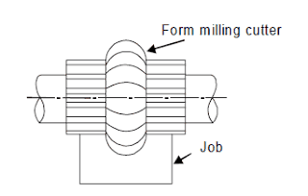
This operation is used for machining special contour composed of curves, straight lines, or entirely of curves at the single cut. The convex, concave, and corner rounding milling cutters are used in this operation.
Fig.10 Form milling
https://learnmech.com/milling-machine-operations-with-diagrams/

Slide 30
8. Straddle Milling
Straddle milling is the operation of producing a flat vertical surface on both sides of a workpiece by using two side milling cutters mounted on the same arbor.
In this process, the two-side milling cutter is used to machine two opposite sides of a workpiece.

Slide 31
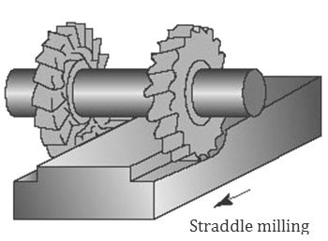
Distance between the two cutters is adjusted by using suitable spacing collars/spacers. Straddle milling is commonly used to design a square or hexagonal surfaces.
Fig.11 Straddle milling
https://learnmech.com/milling-machine-operations-with-diagrams/

Slide 32
References
Miller. R & Richard.M.M (2004). Machine Shop Tools and operations(5th Edition) (p241-265). Wiley Publishing, Inc. Canada.
Boljanovic, V. (2009) Metal Shaping Processes: Casting and Molding; Particulate Processing; Deformation Processes; and Metal Removal (p347-356). Industrial Press, Inc. New York
https://www.machinemfg.com/milling-cutters-types-uses-and-selection-principles/
http://uhv.cheme.cmu.edu/procedures/machining/ch8.pdf

Slide 33
THANK YOU

