Slide 1
COURSE NAME: MACHINE TOOLS
Lecture 11: MILLING MACHINE OPERATIONS: GANG, FORM, PROFILE, END, GEAR MILLING, etc.
Lecturer: HABANABAKIZE THEOPHILE

Slide 2
OUTLINE
Introduction
Other Milling operations
Milling hexagon
Cutting oil
Direction of feed
Care and Maintenance of Milling Cutters
Standards milling machine arbor
Indexing
XI.9 Rotary table or circular milling attachment
Methods of mounting the workpiece

Slide 3
XI.1 Introduction
In the previous lecture (lecture 10), we have seen milling machine operations such as: face, side, end, slot, angular, form and straddle. All the operations which can be performed on milling are not limited to the operations which were discussed in lecture 10 but there are other operations as they are going to be discussed in the next slides. Don’t be surprised when you come across with operation which is not mentioned here because depending on the book you are reading operations can be different in names but be the same in practice and some were not given here but the most useful operations were explained .

Slide 4
XI.2 Other milling machine operations
Gang milling
Slitting or saw milling
Gear cutting
Key way milling
String milling
Profile milling
Thread milling
Helical milling
Cam milling

Slide 5
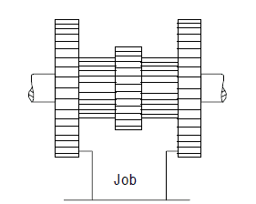
a. Gang milling
It is a method of milling utilizing two or more cutters simultaneously having the same or different diameters mounted on the arbor of the milling machine.
As the name indicates, this operation produces several surfaces of a workpiece simultaneously using a gang of milling cutters. During this operation, the workpiece mounted on the table is fed against the revolving milling cutters.
Fig.1 Gang milling
Source: https://learnmech.com/milling-machine-operations-with-diagrams/

Slide 6
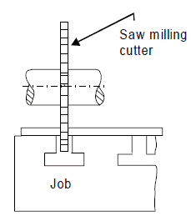
b. Saw milling
It is a method of producing deep slots and cutting materials into the required length by slitting saws.
Saw milling operation produces narrow slots or grooves into the workpiece using the saw milling cutter.
This operation is also used to cut the workpiece into two equal or unequal pieces which cut is also known as “parting off”
Fig.2 Saw milling
Source: https://learnmech.com/milling-machine-operations-with-diagrams/

Slide 7
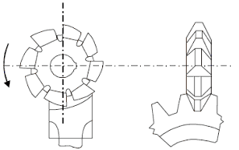
c. Gear cutting milling
Spur, helical gears are cut on a milling machine with the help of an indexing mechanism.
The operation of gear cutting is cutting of equally spaced, identical gear teeth on a gear blank by handling it on a universal dividing head and then indexing it. The cutter used for this operation is cylindrical type or end mill type. The cutter selection also depends upon tooth profile and their spacing.
Fig.3 Gear cutting milling
Source: https://learnmech.com/milling-machine-operations-with-diagrams/

Slide 8
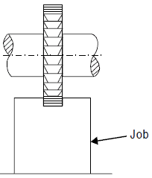
d. Keyway milling
The operation of producing keyways, grooves, slots of varying shapes and sizes is called slot milling operation. Slot milling operation can use any type of milling cutter like plain milling cutter, metal slitting saw, or side milling cutter. Selection of a cutter depends upon type and size of slot or groove to be produced.
Keyways for shaft or hub are produced by these operations
Fig.4 Keyway milling
Source: https://learnmech.com/milling-machine-operations-with-diagrams/

Slide 9
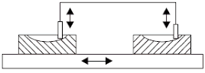
e. Profile milling
In this operation a template of complex shape or master die is used. A tracer and milling cutter are synchronized together concerning their movements. Tracer reads the template or master die and milling cutter generates the same shape on the workpiece. Profile milling is an operation used to generate the shape of a template or die.
It is the operation of reproduction of an outline of a template or complex shape of a master die on a workpiece.
Fig.5 Profile milling
Source: https://learnmech.com/milling-machine-operations-with-diagrams/

Slide 10
f. Thread Milling Operation
The operation thread milling produces threads using thread milling centers. This operation needs three simultaneous movements revolving movement of cutter, simultaneous longitudinal movement of cutter, feed movement to the workpiece through a table.
For each thread, the revolving cutter is fed longitudinally by a distance equal to the pitch of the thread. The depth of the cut is normally adjusted equal to the full depth of threads.

Slide 11
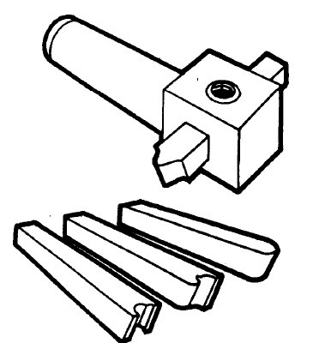
g. Fly Cutting
Fly cutting, which is also called single-point milling, is one of the most versatile milling operations. It is done with a single-point cutting tool shaped like a lathe tool bit. It is held and rotated by a fly cutter arbor. You can grind this cutter to almost any form that you need, as shown in Figure.
Fig.6 Fly Cutting
Source: https://learnmech.com/milling-machine-operations-with-diagrams/

Slide 12
h. Fly cutting
Formed cutters are expensive. There are times when you need a special form cutter for a very limited number of parts. It is more economical to grind the desired form on a lathe-type tool bit than to buy a pre-ground form cutter, which is very expensive and usually suitable only for one particular job.

Slide 13
i. Drilling
The milling machine may be used effectively for drilling, since the accurate location of the hole may be secured utilizing the feed screw graduations. Spacing holes in a circular path, such as the holes in an index plate, may be accomplished by indexing with the index head positioned vertically.
Twist drills may be supported in drill chucks fastened in the milling machine spindle or mounted directly in milling machine collets or adapters. The workpiece to be drilled is fastened to the milling machine table by clamps, vises, or angle plates.

Slide 14
j. Boring
Various types of boring tool holders may be used for boring on the milling machine. the boring tools being provided with either straight shanks to be held in chucks and holders or taper shanks to fit collets and adapters. The two attachments most commonly used for boring are the fly cutter arbor and the offset boring head.
The single-edge cutting tool used for boring on the milling machine is the same as a lathe cutter bit. Cutting speeds feeds, and depth of cut should be the same as that prescribed for lathe operations.

Slide 15
k. Cam Milling Operation
The operation cam milling is used to produce the cam on the milling machine. In this operation cam blank is mounted at the end of the dividing head spindle and the end mill is held in the vertical milling attachment.

Slide 16
l. Helical Milling Operation
Helical milling produces helical flutes or grooves on the periphery of a cylindrical or conical workpiece. This is performed by swivelling the table to the required helix angle, then rotating and feeding the workpiece against revolving cutting edges of the milling cutter. Helical gears and drills and reamers are made by this operation.

Slide 17
Helical Milling Operation Cont’d
The two side milling cutters are separated by spacers, washers, and shims so that the distance between the cutting teeth of each cutter is
exactly equal to the width of the workpiece area required. When cutting a square by this method, two opposite sides of the square are cut, and then the spindle of the indexing fixture or the swivel vise is rotated 90°, and the other two sides of the workpiece are straddle milled

Slide 18
XI.3 Milling hexagon
In this case a hexagon is being cut, but the same operation may be applied to cutting squares or splines on the end of a cylindrical workpiece. Straddle milling has many useful applications introduction
machining. Parallel slots of equal depth can be milled by using
straddle mills of equal diameters. The workpiece is usually mounted between centers in the indexing fixture or mounted vertically in a swivel vise.

Slide 19
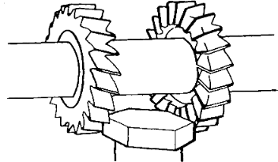
Milling hexagon Cont’d
The two side milling cutters are separated by spacers, washers, and shims so that the distance between the cutting teeth of each cutter is
exactly equal to the width of the workpiece area required. When cutting a square by this method, two opposite sides of the square are cut, and then the spindle of the indexing fixture or the swivel vise is rotated 90°, and the other two sides of the workpiece are straddle milled
Fig.7 Milling hexagon
Source:http://uhv.cheme.cmu.edu/procedures/machining/ch8.pdf

Slide 20
XI. 4 Cutting oil
The major advantage of using a coolant or cutting oil is that it dissipates heat, giving longer life to the cutting edges of the teeth and lead to the production of a good surface finish. The oil also lubricates the cutter face and flushes away the chips, consequently reducing the possibility of marring the finish. The cutting oil or coolant should be directed by means of coolant drip can, pump system, or coolant mist mix to the point where the cutter contacts the workpiece. Regardless of method used, the cutting oil should be allowed to flow freely over the workpiece and cutter.

Slide 21
a. Types of cutting oils
Cutting oils are basically water-based soluble oils, petroleum oils, and synthetic oils. Water-based coolants have excellent heat transfer qualities; other oils result in good surface finishes. In general, a simple coolant is all that is required for roughing. Finishing requires a cutting oil with good lubricating properties to help produce a good finish on the workpiece. Plastics and cast iron are almost always machined dry

Slide 22
XI.5 Direction of feed
It is usually regarded as standard practice to feed the workpiece against the milling cutter. When the workpiece is fed against the milling cutter. the teeth cut under any scale on the workpiece surface and any backlash in the feed screw is taken up by the force of the cut. As an exception to this recommendation. it is advisable to feed with the milling cutter when cutting off stock or when milling comparatively deep or long slots.

Slide 23
Direction of feed Cont’d
The direction of cutter rotation is related to the manner in which the workplace is held. The cutter should rotate so that the piece springs away from the cutter; then there will be no tendency for the force of the cut to loosen the piece. No milling cutter should ever be rotated backward; this will break the teeth. If it is necessary to stop the machine during a finishing cut, the power feed should never be thrown out, nor should the workpiece be fed back under the cutter unless the cutter is stopped or the workpiece lowered. Never change feeds while the cutter is rotating.

Slide 24
XI.6 Care and Maintenance of Milling Cutters
The life of a milling cutter can be greatly prolonged by intelligent use and proper storage. General rules for the care and maintenance of milling cutters are given below.
New cutters received from stock are usually wrapped in oil paper which should not be removed until the cutter is used.
Take care to operate the machine at the proper speed for the cutter being used, as excessive speed will cause the cutter to wear rapidly from overheating.

Slide 25
Care and Maintenance of Milling Cutters Cont’d
Take care to prevent the cutter from striking the hard jaws of the vise, chuck, clamping bolts, or nuts.
Whenever practical, use the proper cutting oil on the cutter and workpiece during operations, since lubrication helps prevent overheating and cutter wear.
Keep cutters sharp. Dull cutters require more power to drive and this power, being transformed into heat, softens the cutting edges. Dull cutters should be marked as such and set aside for grinding.

Slide 26
Care and Maintenance of Milling Cutters Cont’d
Thoroughly clean and lightly coat milling cutters with oil before storing.
Place cutters in drawers or bins so that their cutting edges will not strike each other.
Hang small cutters on hooks or pegs, and set large cutters on end. Place taper and straight shank cutters in separate drawers, bins, or racks
provided with suitable sized holes to receive the shanks.
Never operate a cutter backwards. Due to the clearance angle, the cutter will rub, producing a great deal of friction. Operating the cutter backward may result in cutter breakage

Slide 27
XI.7 Standard Milling Machine Arbor
The standard milling machine arbor has a tapered, cylindrical shaft with a standard milling taper on the driving end and a threaded portion on the opposite end to receive the arbor nut. One or more milling cutters may be placed on the straight cylindrical portion of the arbor and held in position by sleeves and the arbor nut. The standard milling machine arbor is usually splined and keys are used to lock each cutter to the arbor shaft. These arbors are supplied in three styles, various lengths and, standard diameters.

Slide 28
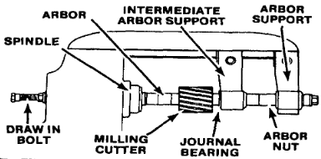
Standard Milling Machine Arbor Cont’d
The most common way to fasten the arbor in the milling machine spindle is to use a draw bar. The bar threads into the
taper shank of the arbor to draw the taper into the spindle and hold it in place. Arbors secured in this manner are removed by backing out the draw bar and tapping the end of the bar to loosen the taper.
Fig.8 Arbor installation
Source:http://uhv.cheme.cmu.edu/procedures/machining/ch8.pdf

Slide 29
XI.8 Indexing
Indexing is the process of evenly dividing the circumference of a circular workpiece into equally spaced divisions, such as in cutting gear teeth, cutting splines, milling grooves in reamers and taps, and spacing holes on a circle. The index head of the indexing fixture is used for this purpose
a. Index Head
The index head of the indexing fixture contains an indexing mechanism which is used to control the rotation of the index head spindle to space or divide a workpiece accurately

Slide 30
A simple indexing mechanism consists of a 40-tooth worm wheel fastened to the index head spindle, a single-cut worm, a crank for turning the worm shaft, and an index plate and sector. Since there are 40 teeth in the worm wheel, one turn of the index crank causes the worm, and consequently, the index head spindle to make 1/40 of a turn; so 40 turns of the index crank revolve the spindle one full turn

Slide 31
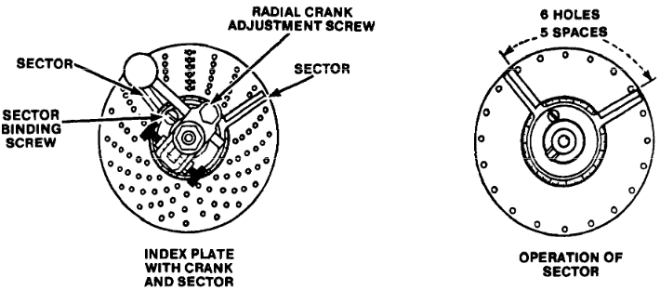
b. Index plate
The indexing plate is a round plate with a series of six or more circles of equally spaced holes; the index pin on the crank can be inserted in any hole in any circle. With the interchangeable plates regularly furnished with most index heads, the spacing necessary for most gears, bolt heads, milling cutters, splines, and so forth can be obtained.
Fig.9 Index plate
Source: http://uhv.cheme.cmu.edu/procedures/machining/ch8.pdf

Slide 32
c. Indexing fixture
The index fixture consists of an index head, also called a dividing head, and footstock which is similar to the tailstock of a lathe. The index head and footstock attach to the worktable of the milling machine by T-slot bolts. An index plate containing graduations is used to control the rotation of the index head spindle. The plate is fixed to the index head, and an index crank, connected to the index head spindle by a worm gear and shaft..

Slide 33
Indexing fixture Cont’d
Workpieces are held between centers by the index head spindle and footstock.
Workpieces may also be held in a chuck mounted to the index head spindle or may be fitted directly into the taper spindle recess of some indexing fixtures. There are many variations of the indexing fixture.

Slide 34
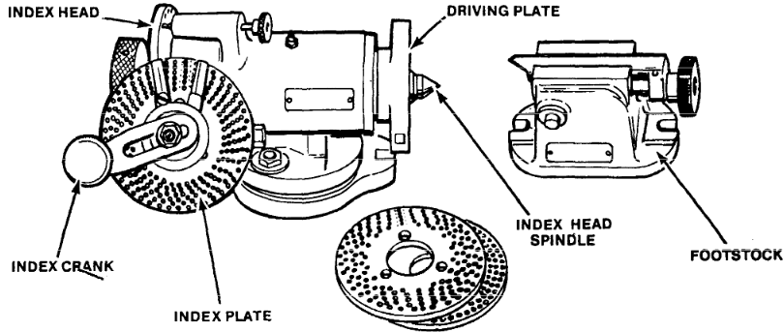
Indexing fixture Cont’d
Universal index head is the name applied to an index head designed to permit power drive of the spindle so that helixes may be cut on the milling machine. Gear cutting attachment is another name applied to an indexing fixture; in this case, one that is primarily intended for cutting gears on the milling machine.
Fig.10 Indexing fixture
Source:http://uhv.cheme.cmu.edu/procedures/machining/ch8.pdf

Slide 35
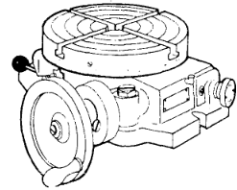
XI.9 Rotary table or circular milling attachment
This attachment consists of a circular worktable containing T-slots for mounting workplaces. The circular table revolves on a base attached to the milling machine worktable. The attachment can be either hand or power driven, being connected to the table drive shaft if power driven. It may be used for milling circles, angular indexing, arcs, segments, circular slots, grooves, and radii, as well as for slotting internal and external gears. The table of the attachment is divided in degrees
Fig.11 Rotary table
Source: http://uhv.cheme.cmu.edu/procedures/machining/ch8.pdf

Slide 36
XI.10 Methods of mounting workpieces
Clamping Workpieces to the Table
When clamping a workpiece to the worktable of the milling machine, the table and the workpiece should be free from dirt and burrs. Workpieces having smooth machined surfaces may be camped directly to the table, provided the cutter does not come in contact with the table surface during milling. When clamping workplaces with unfinished surfaces in this way, the table face should be protected from damage by using a shim under the workpiece. Paper, plywood, and sheet metal are shim materials.

Slide 37
Clamping Workpieces to the Table Cont’d
Clamps should be located on both sides of the workpiece if possible to give a full bearing surface. These clamps are held by T-slot bolts inserted in the T-slots of the table. Clamp supports must be the same height as the workpiece. Never use clamp supports that are lower than the workpiece. Clamping bolts should be placed as near to the workpiece as possible so that the full advantage of the fulcrum principle may be obtained.

Slide 38
2. Clamping a Workpiece to the Angle Plate
Workpieces clamped to the angle plate may be machined with surfaces parallel, perpendicular, or at an angle to a given surface. When using this method of holding a workpiece, precautions should be taken similar to those mentioned for clamping work directly to the table. Angle plates are either adjustable or nonadjustable and are generally held in alignment by keys or tongues that fit into the table T-slots.

Slide 39
3. Clamping Workpieces in Fixtures
Fixtures are generally used in production work where a number of identical pieces are to be machined. The design of the fixture depends upon the shape of the piece and the operations to be performed. Fixtures are always constructed to secure maximum clamping surfaces and are built to use a minimum number of clamps or bolts in order to reduce the setup time required. Fixtures should always be provided with keys to assure positive alignment with the table T-slots.

Slide 40
4. Holding Workpieces Between Centers
Workpieces mounted between centers are fixed to the index head spindle by means of a lathe dog. The bent tail of the dog should be fastened between the setscrews provided in the driving center clamp in such a manner as to avoid backlash and prevent springing the mandrel. When milling certain types of workpieces, a milling machine dog is held in a flexible ball joint which eliminates shake or spring of the dog or the workpiece. The flexible ball joint allows the tail of the dog to move in a radius along the axis of the workpiece, making it particularly useful in the rapid milling of tapers.

Slide 41
5. Clamping a Workpiece to the Angle Plate
Workpieces clamped to the angle plate may be machined with surfaces parallel, perpendicular, or at an angle to a given surface. When using this method of holding a workpiece, precautions should be taken similar to those mentioned for clamping work directly to the table. Angle plates are either adjustable or nonadjustable and are generally held in
alignment by keys or tongues that fit into the table T-slots.

Slide 42
6. Clamping Workpieces in Fixtures
Fixtures are generally used in production work where a number of identical pieces are to be machined. The design of the fixture depends upon the shape of the piece and the operations to be performed. Fixtures are always constructed to secure maximum clamping surfaces and are built to use a minimum number of clamps or bolts in order to reduce the setup time required. Fixtures should always be provided with keys to assure positive alignment with the table T-slots

Slide 43
Reference
Miller. R & Richard.M.M (2004). Machine Shop Tools and operations(5th Edition) (p241-265). Wiley Publishing, Inc. Canada.
Boljanovic, V. (2009) Metal Shaping Processes: Casting and Molding; Particulate Processing; Deformation Processes; and Metal Removal (p347-356). Industrial Press, Inc. New York
https://www.machinemfg.com/milling-cutters-types-uses-and-selection-principles/
http://uhv.cheme.cmu.edu/procedures/machining/ch8.pdf

Slide 44
THANK YOU

