Slide 1
COURSE NAME: MACHINE TOOLS
Lecture 12: MACHINE TOOLS PREVENTIVE MAINTENANCE.
Lecturer: HABANABAKIZE THEOPHILE

Slide 2
Outline
Introduction to Maintenance
Preventive Maintenance
Objectives Preventive Maintenance
Advantages and Disadvantages of Preventive Maintenance
Preventive maintenance planning
Types of preventive maintenance
Benefits Preventive Maintenance

Slide 3
XII.1 Introduction
a. Definition of maintenance
Maintenance is a set of organised activities that are carried out in order to keep an item in its best operational condition with minimum cost acquired.
Activities of maintenance function could be either repair or replacement activities, which are necessary for an item to reach its acceptable productivity condition and these activities, should be carried out with a minimum possible cost.

Slide 4
XII.2 Objectives of maintenance
Maximising production or increasing facilities availability at the lowest cost and at the highest quality and safety standards.
Reducing breakdowns and emergency shutdowns.
Optimising resources utilisation.
Reducing downtime.
Improving spares stock control

Slide 5
Objectives of maintenance Cont’d
Improving equipment efficiency and reducing scrap rate.
Minimising energy usage.
Optimising the useful life of equipment.
Providing reliable cost and budgetary control.
Identifying and implementing cost reductions.

Slide 6
XII.3 Preventive maintenance
Preventive maintenance can be defined as follows: Actions performed on a time- or machine-run-based schedule that detect, preclude, or mitigate degradation of a component or system with the aim of sustaining or extending its useful life through controlling degradation to an acceptable level. (It is performed before the failure has occurred). While preventive maintenance is not the optimum maintenance program, it does have several advantages over that of a purely reactive program.

Slide 7
Preventive maintenance Cont’d
By performing the preventive maintenance as the equipment designer envisioned, it will extend the life of the equipment closer to design. This translates into money savings. Preventive maintenance (lubrication, filter change, etc.) will generally run the equipment more efficiently resulting in dollar savings. While it will not prevent equipment catastrophic failures, it will decrease the number of failures. Minimizing failures translate into maintenance and capital cost savings.

Slide 8
XII.4 Advantages and disadvantages of preventive maintenance
a. Advantages of preventive maintenance
Cost effective in many capital-intensive processes.
Flexibility allows for the adjustment of maintenance periodicity.
Increased component life cycle.
Energy savings.
Reduced equipment or process failure.
Estimated 12% to 18% cost savings over reactive maintenance program.

Slide 9
b. Disadvantages of preventive maintenance
Catastrophic failures still likely to occur.
Labor intensive.
Includes performance of unneeded maintenance.
Potential for incidental damage to components in conducting unneeded maintenance.

Slide 10
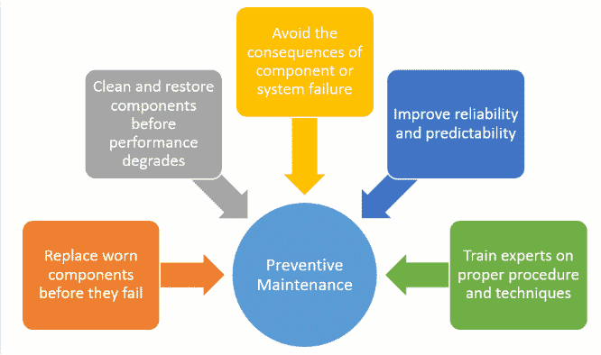
XII.5 Preventive maintenance planning

Slide 11
XII.6 The types of preventive maintenance
Periodic maintenance
Meter/Performance-based maintenance
Predictive maintenance
Failure-finding maintenance
Prescriptive maintenance
Risk-based maintenance
Time-based maintenance

Slide 12
1. Periodic maintenance
Periodic maintenance, or time-based maintenance, is performed on assets at scheduled intervals throughout the calendar year. It could be done annually, quarterly, monthly, or weekly. The easiest way to determine how often to update asset parts is to check the manufacturer’s guidelines. Each piece of equipment comes with specific maintenance recommendations designed to extend lifespans

Slide 13
Periodic maintenance Cont’d
These guidelines are based on the manufacturer’s Mean Time Between Failure (MTBF), or the average time a machine is operating between stops. If similar models worked efficiently for X amount of time before maintenance task A was needed, we can conclude your machine will follow a similar pattern. Companies that track their own MTBFs can finetune their periodic maintenance schedules with even higher levels of accuracy. While periodic maintenance works great for regularly used equipment, it’s ineffective on machines that are only used once in a while.

Slide 14
Periodic maintenance Cont’d
Additionally, periodic maintenance can include the subcategories of failure finding maintenance (FFM) and risk-based maintenance (RBM). FTM is the process of checking for malfunctioning “hidden parts” that exist as safety mechanisms.

Slide 15
Periodic maintenance Cont’d
For example:
Pressure valves function to prevent machines from overheating. Regularly servicing such unseen parts can provide some peace of mind that assets are safeguarded from larger failures. Alternatively, RBM represents the philosophy of prioritizing high-risk PM tasks over low-risk PM tasks in the face of limited resources. All of these maintenance scheduling methods are useful measures for reducing the likelihood of age-related equipment failure and can be used simultaneously.

Slide 16
Periodic maintenance Cont’d
Examples of Periodic Maintenance
Cleaning corrosion
Checking bearing grease
Changing lubricating oils
Replacing filter components
Checking pressure / temperature gauges
Pros: Minimal costs to begin, no additional equipment required.
Cons: Risk of performing unnecessary activities.

Slide 17
2. Meter-based maintenance
This type of maintenance is also called performance-based maintenance, this type of preventive maintenance involves reading a meter to know whether an asset requires attention.
To carry out this strategy, you would typically need to measure things like hours used, the pressure generated, and the like. Obviously, you would also need to service the meters on a regular basis to ensure they produce accurate readings.

Slide 18
Meter-based maintenance Cont’d
Some examples of preventive maintenance under this type include the following:
Maintaining oil filters every X number of weeks
Changing the gears or belts every X number of months/years
Swap out parts of a machine every X number of hours
Conveyor belt machines with maximum run times
Reading a gauge to ensure it is within a safe range

Slide 19
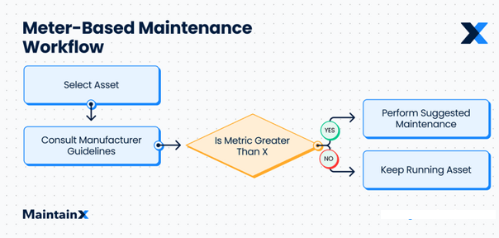
Meter-based maintenance Cont’d
Source: www.getmaintainx.com

Slide 20
3. Predictive maintenance
Predictive maintenance aims to optimize your routine maintenance activities by allowing you to perform them at the right level frequency. Sometimes, a commercial facility manager will conduct preventive maintenance too often or not enough. With predictive maintenance, you can eliminate that problem.

Slide 21
Predictive maintenance Cont’d
Predictive maintenance involves inspecting the condition of your assets. And, in that way, it is similar to condition-based maintenance. The difference, though, is that condition-based monitoring relies on results, whereas predictive maintenance relies on data with the help of sensor devices.
When a sensor notices a flaw with a piece of equipment, it will automatically create a work order and delegate it to a technician. Of course, this requires the use of a computerized maintenance management system (CMMS).

Slide 22
Predictive maintenance Cont’d
Here are some predictive maintenance examples:
Machine sensor can measure the vibration and temperature of a machine and alert staff if there are abnormalities
A smart system that monitors the ventilation in a building by tracking humidity and temperature
Thermal sensors that can detect when a piece of equipment is in danger of overheating

Slide 23
Predictive maintenance Cont’d
Advantages | Disadvantages
Increased component operational life/available | Increased investment of diagnostic equipment
Allows for pre-emptive corrective action | Increased staff training for analysing data
Decreased part and labour cost | Saving not readily visible without a baseline/history
Energy saving

Slide 24
4. Failure-finding maintenance
Failure-finding maintenance involves checking a device, usually one of a protective nature, to make sure it is still functional. A protective device is something that tells you when there is a problem. It can also take the form of a device that immediately halts a process to prevent compounding the problem.

Slide 25
Failure-finding maintenance Cont’d
Among the types of preventive maintenance, failure-finding is quite unique because it does not typically involve replacing any components. Instead, it involves actually activating the device to ensure it still works. Failure-finding maintenance addresses hidden problems rather than more obvious ones.
Here are some preventive maintenance examples under this type:
Switching a fire alarm on to ensure it still works
Checking the operation of a backup generator

Slide 26
5. Prescriptive maintenance
Prescriptive maintenance also uses data but takes it to the next level. This strategy incorporates machine learning, advanced analytics, and even artificial intelligence to come up with predictions about maintenance. Using all of this, the sophisticated software evaluates the condition of your assets, analyses risks, and generates recommendations based on data gathered.
This type of preventive maintenance is fairly new to the industry, which is why it is not yet readily available. Additionally, it requires a heavy investment, making it all the more inaccessible to most companies.

Slide 27
6. Risk-based maintenance
As its name suggests, risk-based maintenance is a type of preventive maintenance that analyses the levels of risk related to the asset with the goal of reducing mechanical breakdowns. By assessing risk levels, you can aptly determine which assets will need attention first.
Risk-based maintenance applies the Pareto principle, otherwise known as the 80-20 rule. According to this principle, 80 percent of failures stem from 20 percent of causes. As such, you must concentrate on these areas to minimize malfunctions.

Slide 28
7. Time-based maintenance
Time-based maintenance, also known as calendar-based maintenance, is perhaps one of the most prevalent types of preventive maintenance commercial facilities utilize today.
It involves adhering to a set schedule to perform maintenance activities, usually dependent on the recommendations of the supplier or manufacturer. Though, it is not uncommon for companies to tweak their schedules based on past asset performance.

Slide 29
Benefits of Preventive Maintenance
1. Saves Money
2. Saves Energy, improves performance
3. More maintenance, less repair
4. Keep Employees happy, comfortable
Prevents costly repair
Saves in utility costs
Reduces operating costs
Maximize efficiency
Improves system reliability
Reduces energy use and expenses
Increases equipment life pan
Reduces risk of catastrophic failure
Reduces need for costly emergency repair
Supports healthy, productive and safe environments
Helps avoid work disruption
Addresses issues before they become urgent

Slide 30
Reference
NASA. 2000. Reliability Centered Maintenance Guide for Facilities and Collateral Equipment. National Aeronautics and Space Administration, Washington, D.C.
Vilarinho, S.; Lopes, I.; Oliveira, J.A. Preventive maintenance decisions through maintenance optimization models: A case study. Procedia Manuf. 2017, 11, 1170–1177.
K. Das, R.S. Lashkari and S. Sengunpta, Machine reliability and preventive maintenance planning for cellular manufacturing systems, European Journal of Operational Research, Vol. 183, 2007, pp. 162-180.
M. Almomani, A. Abdelhadi, H.Seifoddini and Y.Xiaohang, Preventive maintenance planning using group technology: A case study at Arab Potash Company, Jordan, Journal of Quality in Maintenance Engineering, Vol. 18, 2012, Issue 4, pp. 472-480.
https://limblecmms.com/blog/machine-tools-maintenance/

Slide 31
THANK YOU

