Slide 1
FUNDAMENTALS
OF ELECTRONICS
WEEK 7_LECTURE 7:
DESCRIPTION AND APPLICATIONS OF ACTIVE DEVICES/
PART 2: TRANSISTORS
Lecturer: NSABIMANA Camille, B.Sc. Eng., M.Sc. IT

Slide 2
Content
Description of different types of transistor:
        BJT (NPN and PNP)
        FET (JFET and MOSFET)
        UJT
        IGBT
Selection of transistor based On:
          Specifications & ratings
          Applications

Slide 3
Definition of Active Devices
An active device is any type of circuit component with the ability to electrically control electric charge flow (electricity controlling electricity). In order for a circuit to be properly called electronic, it must contain at least one active device.

Slide 4
Identification of different types of transistor
BJT
A Bipolar Junction Transistor (also known as a BJT or BJT Transistor) is a three-terminal semiconductor device consisting of two p-n junctions which are able to amplify or magnify a signal. It is a current controlled device. The three terminals of the BJT are the base, the collector and the emitter. A BJT is a type of transistor that uses both electrons and holes as charge carriers.
A signal of small amplitude if applied to the base is available in the amplified form at the collector of the transistor. This is the amplification provided by the BJT. Note that it does require an external source of DC power supply to carry out the amplification process.
There are two types of bipolar junction transistors – NPN transistors and PNP transistors. A diagram of these two types of bipolar junction transistors is given below.

Slide 5
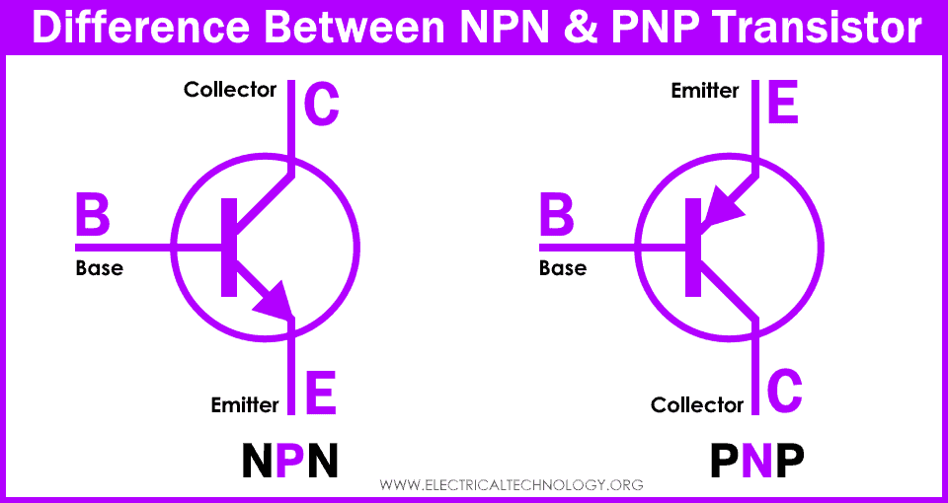
BJT Bi-polar Junction Transistor symbols
Source: https://www.electricaltechnology.org/2021/04/difference-npn-pnp-transistor.html

Slide 6
BJT Cont’
From the above figure, we can see that every BJT has three parts named emitter, base and collector. J_{E} and J_{C} represent the junction of emitter and junction of collector respectively. Now initially it is sufficient for us to know that emitter based junction is forward biased and collector-base junctions are reverse biased. The next topic will describe the two types of these transistors.
The modes of operation for this type of transistors. The modes are:
    A: Common Base (CB) mode
    B: Common Emitter (CE) mode
    C: Common Collector (CC) mode
All three types of modes are shown below:

Slide 7
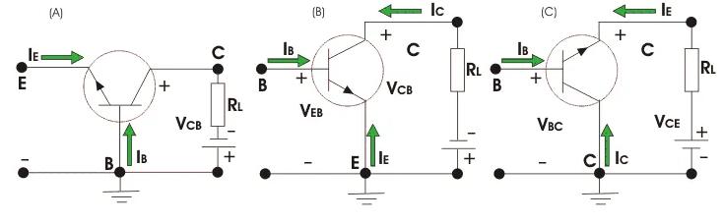
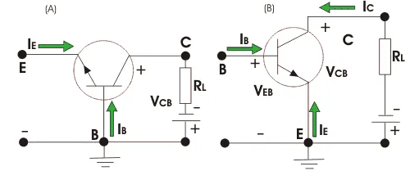
BJT Cont’
Source: https://www.physics-and-radio-electronics.com/electronic-devices-and-circuits/transistors/bipolarjunctiontransistor/bjtoperationmodes.html

Slide 8
BJT Cont’
The transistor can be operated in three modes:
  Cut-off mode
  Saturation mode
  Active mode
In order to operate transistor in one of these regions, we have to supply dc voltage to the npn or pnp transistor. Based on the polarity of the applied dc voltage, the transistor operates in any one of these regions.
Applying dc voltage to the transistor is nothing but the biasing of transistor.

Slide 9
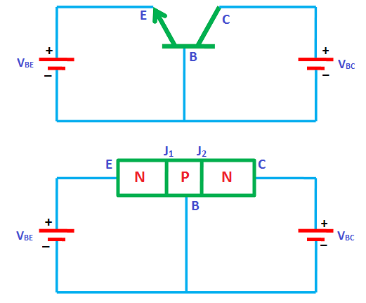
Cutoff mode
Source: https://www.physics-and-radio-electronics.com/electronic-devices-and-circuits/transistors/bipolarjunctiontransistor/bjtoperationmodes.html

Slide 10
Cutoff mode cont’
In the cutoff mode, both the junctions of the transistor (emitter to base and collector to base) are reverse biased. In other words, if we assume two p-n junctions as two p-n junction diodes, both the diodes are reverse biased in cutoff mode. We know that in reverse bias condition, no current flows through the device. Hence, no current flows through the transistor. Therefore, the transistor is in off state and acts like an open switch.
The cutoff mode of the transistor is used in switching operation for switch OFF application.

Slide 11
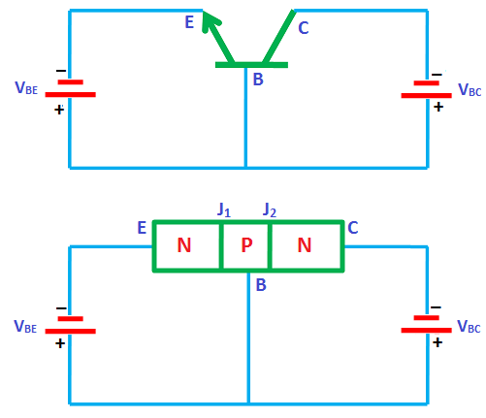
Saturation mode
In the saturation mode, both the junctions of the transistor (emitter to base and collector to base) are forward biased. In other words, if we assume two p-n junctions as two p-n junction diodes, both the diodes are forward biased in saturation mode. We know that in forward bias condition, current flows through the device. Hence, electric current flows through the transistor.
Source: https://www.physics-and-radio-electronics.com/electronic-devices-and-circuits/transistors/bipolarjunctiontransistor/bjtoperationmodes.html

Slide 12
Saturation mode cont’
In saturation mode, free electrons (charge carriers) flows from emitter to base as well as from collector to base. As a result, a huge current will flow to the base of transistor.
Therefore, the transistor in saturation mode will be in on state and acts like a closed switch.
The saturation mode of the transistor is used in switching operation for switch ON application.
From the above discussion, we can say that by operating the transistor in saturation and cutoff region, we can use the transistor as an ON/OFF switch.

Slide 13
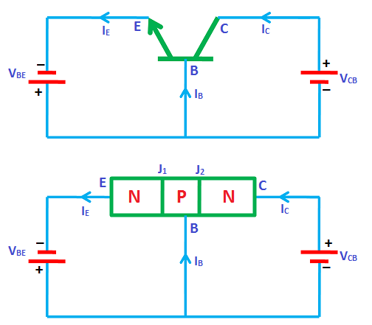
Active mode
In the active mode, one junction (emitter to base) is forward biased and another junction (collector to base) is reverse biased. In other words, if we assume two p-n junctions as two p-n junction diodes, one diode will be forward biased and another diode will be reverse biased.
Source: https://www.physics-and-radio-electronics.com/electronic-devices-and-circuits/transistors/bipolarjunctiontransistor/bjtoperationmodes.html

Slide 14
Active mode cont’
The active mode of operation is used for the amplification of current.
From the above discussion, we can say that the transistor works as an ON/OFF switch in saturation and cutoff modes whereas it works as an amplifier of current in active mode.

Slide 16
FET
A Field Effect Transistor (FET) is a three terminal device namely the source, drain and gate. It is made of one basic p-n junction. It is also called a Junction Field Effect Transistor (JFET).
FET has the following terminal:
Source: It is the terminal through which the majority carriers enter the channel, is called the source terminal S and the conventional current entering the channel at S is designated as I_{S.}
Drain : It is the terminal through which the majority carriers leave the channel, is called the drain terminal D and the conventional current leaving the channel at D is designated as I_{D}. The drain-to-source voltage is called V_{DS}, drives the drain current I_{D}.

Slide 17
FET (cont’)
Gate: There are two internally connected heavily doped impurity regions formed by alloying, by diffusion, or by any other method available to create two P-N junctions. These impurity regions are called the gate G. A voltage V_{GS} is applied between the gate and source in the direction to reverse-bias the P-N junction. Conventional current entering the channel at G is designated as I_{G}.
Channel: It is the space between the source and drain, sandwiched between the two gates is called the channel and the majority carriers move from source to drain through this channel.
The field effect transistor (FET) has, by virtue of its construction and biasing, large input impedance which may be more than 100 megaohms. The FET is generally much less noisy than the ordinary or bipolar transistor.

Slide 18
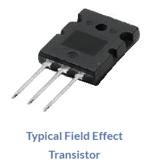
Types of FET
There are two basic types of field effect transistors
(i) Junction Field Effect Transistor (JFET)
(ii) Metal-Oxide Semiconductor FET (MOSFET)
The need for FET arose because there were many functions in which bipolar transistors were unable to replace vacuum tubes. Owing to their extremely high input impedance, FET
devices are more like vacuum tubes than are
bipolar devices and hence are able to take over
many vacuum-tube functions.

Slide 19
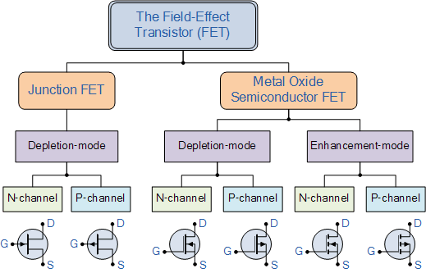
Types of FET
Source: https://www.electronics-tutorials.ws/transistor/tran_8.html

Slide 20
JUNCTION FIELD EFFECT TRANSISTOR (JFET)
A JFET consists of a p-type or n-type bar containing two pn junctions at the sides as shown in figure below. The bar forms the conducting channel for the charge carriers. If the bar is of n-type, it is called n-channel JFET as shown in Figure below (i) and if the bar is of p-type, it is called p-channel JFET as shown in Figure (ii).
The two pn junctions forming diodes are connected internally and a common terminal called gate is taken out. Other terminals are source and drain taken out from the bar as shown. Thus a JFET has essentially three terminals gate (G), source (S) and drain (D).

Slide 21
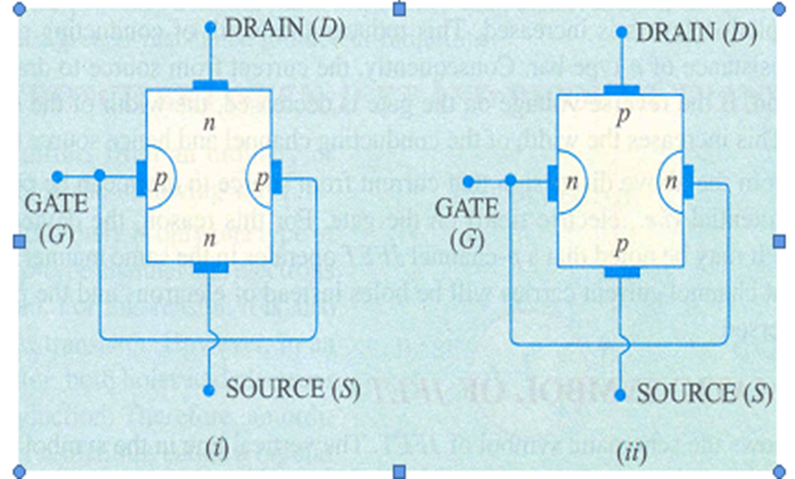
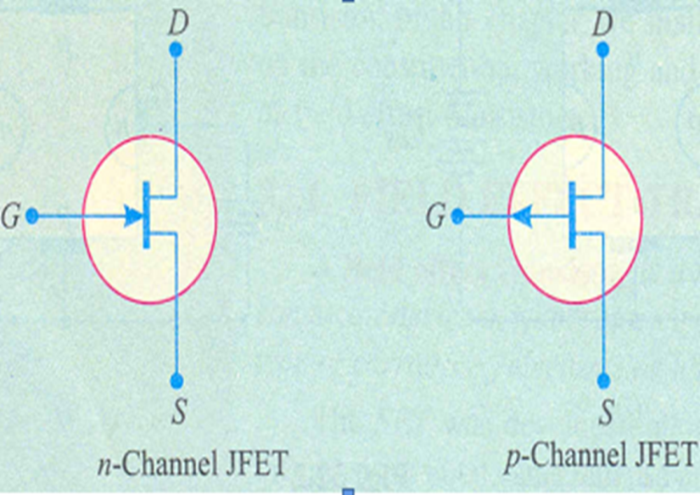
JFET(cont’d)
SCHEMATIC SYMBOL OF JFET
Source: Starting Electronics, Keith Brindley (Fourth Edition), published by Elsevier Ltd, 2011.

Slide 22
METAL OXIDE SEMICONDUCTOR FET (MOSFET)
Metal oxide semiconductor field effect transistor is an important semiconductor device and is widely used in may circuit applications. n-channel MOSFET is similar to JFET except with the following modifications:
i) There is only a single p-region. This region is called substrate.
ii) A thin layer of metal oxide (usually silicon dioxide ) is deposited over the left side of the channel. A metallic gate is deposited over the oxide layer. As silicon dioxide (SiO₂) is an insulator, therefore, gate is insulated from the channel. For this reason, MOSFET is sometimes called insulated gate FET.
iii) Like a JFET, a MOSFET has three terminals source, gate and drain.
They are o two types:
n-channel MOSFET and p-channel MOSFET.

Slide 23
Difference between N and P-channel MOSFET
What is the difference between N and P-channel MOSFET?
N-Channel MOSFETs use electron flow as the charge carrier. P-Channel MOSFETs use hole flow as the charge carrier, which has less mobility than electron flow. And therefore, they have higher resistance and are less efficient. In other words, a P-Channel MOSFET will get hotter than an N-Channel MOSFET with higher loads.
Notes:
Difference between Depletion MOSFET and Enhancement MOSFET
https://electricalsimple.blogspot.com/2017/07/depletion-and-enhancement-mosfet-difference.html#:~:text=In%20Enhancement%20MOSFET%2C%20the%20channel,of%20construction%20of%20MOSFET%20itself.

Slide 24
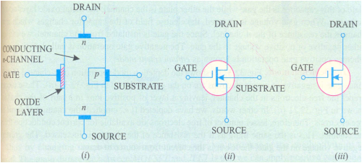
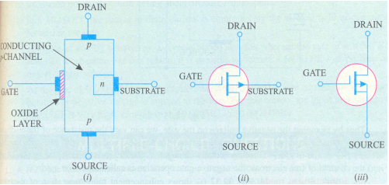
MOSFET
n-channel MOSFET
p-channel MOSFET
Source: Starting Electronics, Keith Brindley (Fourth Edition), published by Elsevier Ltd, 2011.

Slide 25
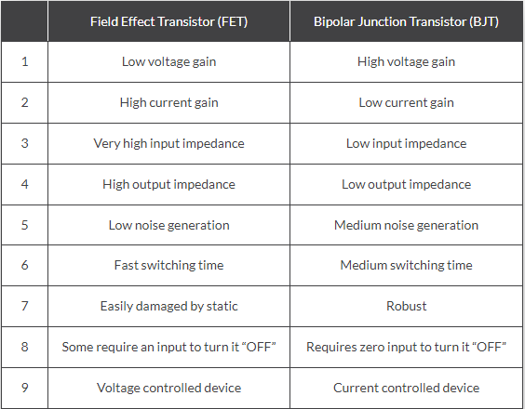
Difference between BJT and FET
Source: https://www.electronics-tutorials.ws/transistor/tran_8.html

Slide 26
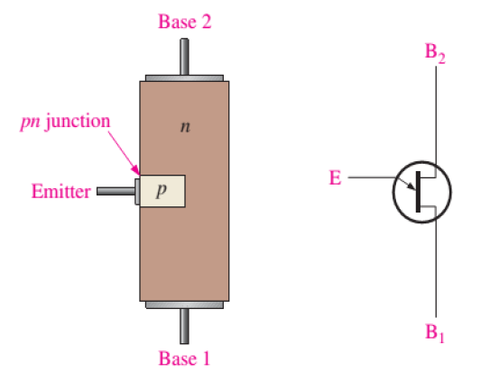
UJT
The UJT is a three-terminal device. It is composed of a bar of N-type silicon with a P-type connection in the middle. The connections at the ends of the bar are known as bases B₁ and B₂; the P-type mid-point is the emitter.
Source: https://electricalfundablog.com/unijunction-transistor-ujt-construction-working-characteristics-curve-applications/

Slide 27
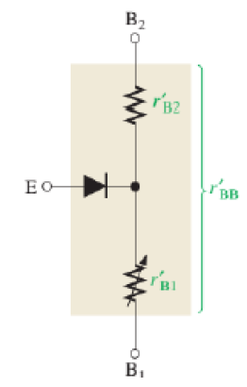
UJT Equivalent circuit
The equivalent circuit for the UJT is shown. The total resistance between the base terminals is the sum of the dynamic resistances r'_{B1} and r'_{B2} and is called the interbase resistance r'BB. The ratio η = r'_{B1} /r'_{BB} is called a
UJT standoff ratio.
When the emitter voltage reaches V_{P} (the peak point), the UJT "fires", where
V_{P} = V_{Pn} + η V_{BB}
Source: https://electricalfundablog.com/unijunction-transistor-ujt-construction-working-characteristics-curve-applications/

Slide 28
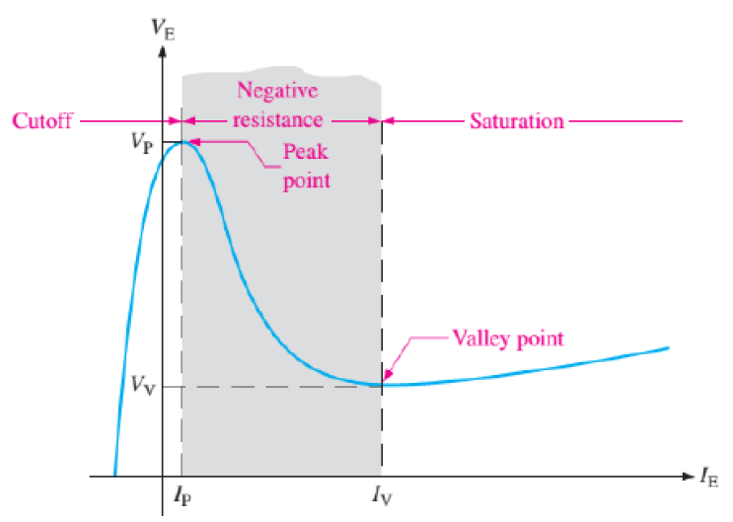
UJT Characteristic curve
The UJT operates in a negative resistance region up to a certain value of I_{E} (valley point). Beyond the valley point, the device is in saturation, and V_{E} increases very little with an increasing I_{E}.
Source: https://electricalfundablog.com/unijunction-transistor-ujt-construction-working-characteristics-curve-applications/

Slide 29
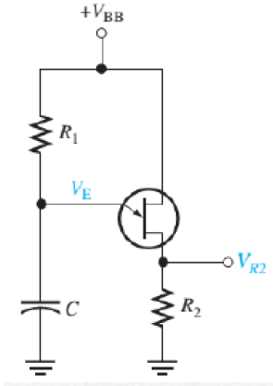
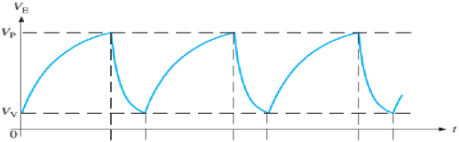
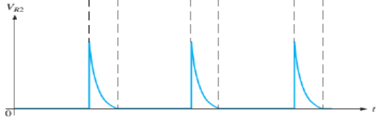
UJT Applications
The UJT can be used as a trigger device for SCRs and triacs. Other applications include nonsinusoidal oscillators, sawtooth generators, phase control, and timing circuits. The figure shows a UJT relaxation oscillator as an example of one application.
Source: https://electricalfundablog.com/unijunction-transistor-ujt-construction-working-characteristics-curve-applications/

Slide 30
UJT Applications
When dc power is applied, the capacitor C charges until it reaches the peak-point voltage. At this point, the pn junction becomes forward-biased, and the emitter characteristic goes into the negative resistance region. The capacitor quickly discharges through the forward-biased junction.
When the capacitor voltage decreases to the valley-point voltage the UJT turns off, the capacitor begins to charge again, and the cycle is repeated. During the discharge time of the capacitor, the UJT is conducting.

Slide 31
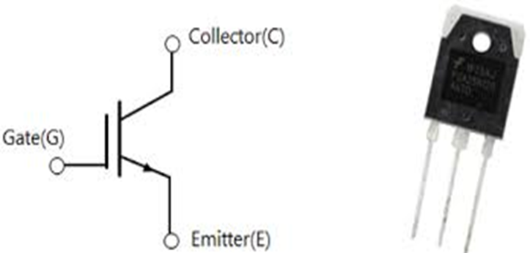
IGBT (INSULATED GATE BIPOLAR TRANSISTOR)
IGBT stand for Insulated Gate Bipolar Transistor. It is a three terminal semiconductor switching device that can be used for fast switching with high efficiency in many types of electronic devices.
IGBT requires only a small voltage to maintain conduction in the device unlike in BJT. The IGBT is a unidirectional device that is, it can only switch ON in the forward direction. This means current flows from the collector to the emitter unlike in MOSFET, which are bi-directional.
Source: https://www.electronics-tutorials.ws/power/insulated-gate-bipolar-transistor.html

Slide 32
IGBT cont’
IGBT is a three terminal power semiconductor switch used to control the electrical energy.
Both Power BJT and Power MOSFET have their own advantages and disadvantages.
BJTs have lower conduction losses in on state condition, but have longer turn off time.
MOSFETs have higher on state conduction losses and have lower turn on and turn off times.
The combination of BJT and MOSFET monolithically leads to a new device called Insulated Gate Bipolar Transistor.

Slide 33
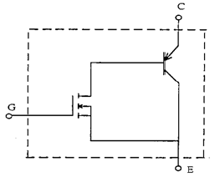
IGBT cont’
The other names of this device are GEMFET (Gain-Enhanced Modulated FET), COMFET (Conductivity Modulated Field Effect Transistor), IGT (Insulated Gate Transistor), bipolar mode MOSFET, bipolar MOS Transistor.
It has superior on-state characteristics, good switching speed and excellent safe operating area.
Source: https://www.electronics-tutorials.ws/power/insulated-gate-bipolar-transistor.html

Slide 34
IGBT cont’
IGBT applications :
  DC and AC motor drives,
  Medium power supplies,
  Solid state relays,
  Inverters, UPS,
  welder equipments,
  Robotics
  Etc.

Slide 35
Selection of transistor based on
Specifications & rating
Type number
Polarity
NPN and PNP
Material
Breakdown voltage
Collector emitter current saturation
Current gain
Frequency transition
Power dissipation
Transistor coding and marking schemes
eg;BC107,BC109,2N2222A
Continuous Collector current (IC) is 3A.
Collector-Emitter voltage (VCE) is 50 V.
Collector-Base voltage (VCB) is 50 V.
Emitter Base Voltage (VBE) is 4V.
DC Current Gain (hfe): 35 to 320.

Slide 36
Selection of transistor based on
Applications
Transistors are commonly used in digital circuits as electronic switches which can be either in an "on" or "off" state, both for high-power applications such as switched-mode power supplies and for low-power applications such as logic gates. They are also used in:
      Amplifiers
      Limiting power levels
      etc.

Slide 37
Selection of thyristors based on
Specifications& rating
Voltage Ratings of SCR
The voltage capability of the SCR should not be exceeded during the operation even for short periods. So the SCR is assigned with different voltage ratings, which are the maximum voltages at which the SCR can function normally without breakdown of junctions. These are assigned in both blocking states of an SCR and can withstand against voltage transients. The various voltage ratings of an SCR are given below.
Peak Working Forward-blocking Voltage V_{DWM}
It specifies the maximum instantaneous value of forward blocking voltage across the SCR excluding all surge and repetitive transient voltages. Beyond this value of the voltage the SCR cannot withstand during its operation.

Slide 38
References
Fundamentals of electronics. Book 1, Electronic devices and circuit applications, Thomas F. Schubert, Jr. and Ernest M. Kim.,an Rafael, California (1537 Fourth Street, San Rafael, CA 94901 USA) : Morgan & Claypool, 2014.
Principles of Electrical Engineering. Wiley., 1922.
Starting Electronics, Keith Brindley (Fourth Edition), published by Elsevier Ltd, 2011.
https://www.electricaltechnology.org/2021/04/difference-npn-pnp-transistor.html
https://www.physics-and-radio-electronics.com/electronic-devices-and-circuits/transistors/bipolarjunctiontransistor/bjtoperationmodes.html
https://www.electronics-tutorials.ws/transistor/tran_8.html
https://electricalfundablog.com/unijunction-transistor-ujt-construction-working-characteristics-curve-applications/
https://www.electronics-tutorials.ws/power/insulated-gate-bipolar-transistor.html

