Slide 1
FUNDAMENTALS
OF ELECTRONICS
WEEK 8_LECTURE 8:
DESCRIPTION AND APPLICATIONS OF ACTIVE DEVICES/
PART 3: THYRISTORS
Lecturer: NSABIMANA Camille, B.Sc. Eng., M.Sc. IT

Slide 2
Content
Description of different types of thyristors:
    Diac
    Triac
    SCR
    MCT
    GTO
    SCS
Selection of thyristors based on:
    Specifications and ratings
    Applications

Slide 3
Description of different types of thyristors
Thyristors are four-layer PNPN power semiconductor devices used as electronic switches. Their main advantage is that they can convert and control large amounts of power in AC or DC systems while using very low power for control. This chapter will introduce the thyristor family, which includes the silicon controlled rectifier (SCR), the gate-turnoff thyristor (GTO), the triac, the diac, UJT, PUT and the MOS-controlled thyristor (MCT).
The SCR is the most important member of the family and it is emphasized in this chapter. SCRs are widely used in such applications as regulated power supplies, static switches, choppers, inverters, cycloconverters, heaters, lighting, and motor control.

Slide 4
SCR(Silicon Controlled Rectifier)
The SCR had its roots in the 4-layer diode. By adding a gate connection, the SCR could be triggered into conduction. The SCR is the most widely used thyristor. It can switch very large currents on and off.
The SCR can be turned on by exceeding the forward breakover voltage or by gate current. The gate current controls the amount of forward breakover voltage required for turning it on.
The SCR is far more useful than a four-layer diode because the gate triggering is easier than breakover triggering.

Slide 5
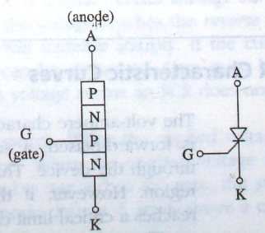
SCR structure and symbol
Source: Fundamentals of electronics. Book 1, Electronic devices and circuit applications, Thomas F. Schubert, Jr. and Ernest M. Kim.,an Rafael, California (1537 Fourth Street, San Rafael, CA 94901 USA) : Morgan & Claypool, 2014.

Slide 6
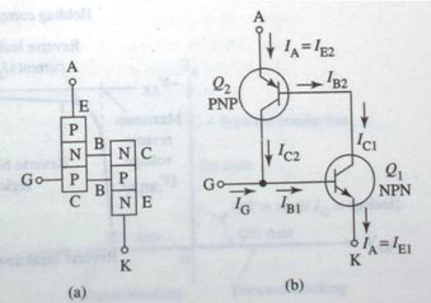
Two-Transistor Model of the SCR
Source: Fundamentals of electronics. Book 1, Electronic devices and circuit applications, Thomas F. Schubert, Jr. and Ernest M. Kim.,an Rafael, California (1537 Fourth Street, San Rafael, CA 94901 USA) : Morgan & Claypool, 2014.

Slide 7
Two-Transistor Model of the SCR
The collector of Q1 is the base of Q2, and the base of Q1 is the collector of Q2. A positive voltage on the gate forward-biases the base-emitter junction of transistor Q1, turning it on. This allows current through the NPN collector (the PNP base). If the SCR anode is positive, the PNP emitter-base junction is forward-biased, turning it on.
After the PNP transistor is turned on, it in turn supplies the NPN with base current. This regenerative process, called latching, continues until both transistors are driven into saturation. Removal of the gate voltage will not turn the SCR off. Ql supplies Q2 with base current and Q2 supplies Q1 with base current. The SCR remains on until its principal current (current from anode to cathode) is interrupted.

Slide 8
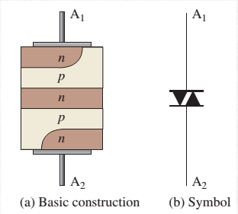
DIAC
The diac is a thyristor that acts like two back-to-back 4-layer diodes. It can conduct current in all direction.
The terminals are equivalent and labeled A₁ and A₂.
Source: https://www.cselectricalandelectronics.com/difference-between-scr-diac-triac/

Slide 9
DIAC cont’
The top and bottom layers contain both N and P materials. The right side of the stack can be regarded as a PNPN structure with the same characteristics as a four-layer diode, while the left side is an inverted four-layer diode having an NPNP structure.
Conduction occurs in a diac when the breakover voltage is reached with either polarity across the two terminals. Once breakover occurs, current is in a direction depending on the polarity of the voltage across the terminals.
The diac remains in conduction as long as the current is above the holding current, I_{H}.

Slide 10
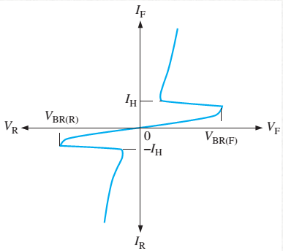
V_I Characteristic curve
Source: https://www.cselectricalandelectronics.com/difference-between-scr-diac-triac/

Slide 11
DIAC cont’
The top and bottom layers contain both n and p materials.
The right side of the stack can be regarded as a pnpn structure with the same characteristics as a four-layer diode, while the left side is an inverted four-layer diode having an npnp structure.
Conduction occurs in a diac when the breakover voltage is reached with either polarity across the two terminals. Once breakover occurs, current is in a direction depending on the polarity of the voltage across the terminals. The diac remains in conduction as long as the current is above the holding current, IH.

Slide 12
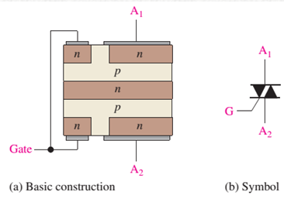
TRIAC
Basically, a triac can be thought as two SCRs connected in parallel and in opposite directions with a common gate terminal. Unlike the SCR, the triac can conduct current in either direction when it is triggered on, depending on the polarity of the voltage across its A₁ and A₂ terminals.
Source: https://www.cselectricalandelectronics.com/difference-between-scr-diac-triac/

Slide 13
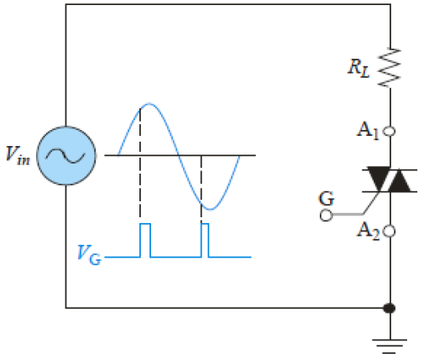
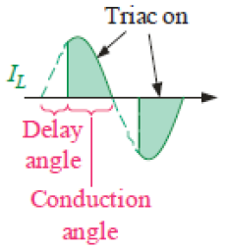
Triac Applications
Like the SCR, triacs are also used to control average power to a load by the method of phase control. The triac can be triggered such that the ac power is supplied to the load for a controlled portion of each half-cycle.
Source: https://www.cselectricalandelectronics.com/difference-between-scr-diac-triac/

Slide 14
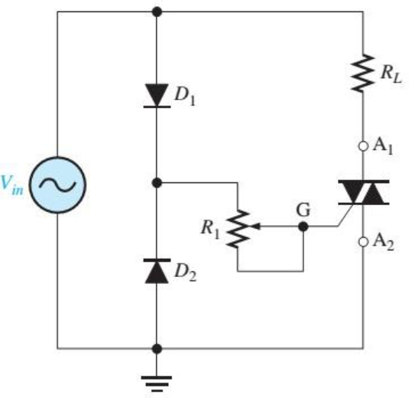
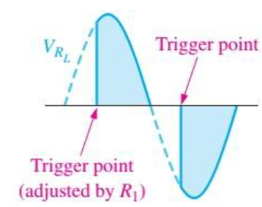
Triac Applications cont’d
Source: https://www.cselectricalandelectronics.com/difference-between-scr-diac-triac/

Slide 15
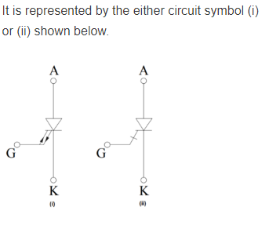
GTO
A Gate Turn off Thyristor or GTO is a three terminal, bipolar (current controlled minority carrier) semiconductor switching device. Similar to conventional thyristor, the terminals are anode, cathode and gate as shown in figure. As the name indicates, it has gate turn off capability.
These are capable not only to turn ON the main current with a gate drive circuit, but also to turn it OFF. A small positive gate current triggers the GTO into conduction mode and also by a negative pulse on the gate, it is capable of being turned off. Observe in below figure that the gate has double arrows on it which distinguish the GTO from normal thyristor. This indicates the bidirectional current flow through the gate terminal.
Source: https://electronics-club.com/gate-turn-off-thyristor-gto-switching-performance/

Slide 16
GTO Principle of Operation
The turn ON operation of GTO is similar to a conventional thyristor. When the anode terminal is made positive with respect to cathode by applying a positive gate current, the hole current injection from gate forward bias the cathode p-base junction.
This results in the emission of electrons from the cathode towards the anode terminal. This induces the hole injection from the anode terminal into the base region. This injection of holes and electrons continuous till the GTO comes into the conduction state.
In case of thyristor, the conduction starts initially by turning ON the area of cathode adjacent to the gate terminal. And thus, by plasma spreading the remaining area comes into the conduction.
The GTO can be turned OFF by the application of reverse gate current which can be either step or ramp drive. The GTO can be turned OFF without reversing anode voltage. The dashed line in the figure shows i-v trajectory during the turn OFF for an inductive load. It should be noted that during the turn OFF, GTO can block a rated forward voltage only.

Slide 17
Gate Turn-Off Thyristor Applications
Due to the advantages like excellent switching characteristics, no need of commutation circuit, maintenance-free operation, etc makes the GTO usage predominant over thyristor in many applications. It is used as a main control device in choppers and inverters. Some of these applications are:
  AC drives
  DC drives or DC choppers
  AC stabilizing power supplies
  DC circuit breakers
  Induction heating
  And other low power applications

Slide 18
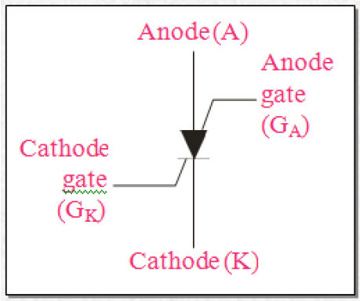
SCS
The silicon-controlled switch(SCS) is similar in construction to the SCR. The SCS, however, has two gate terminals, the cathode gate and the anode gate. The SCS can be turned on and off using either gate terminal.
Source: https://www.allaboutcircuits.com/textbook/semiconductors/chpt-7/silicon-controlled-switch-scs/

Slide 19
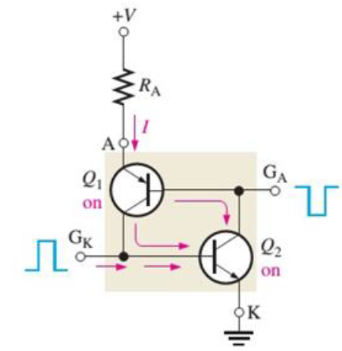
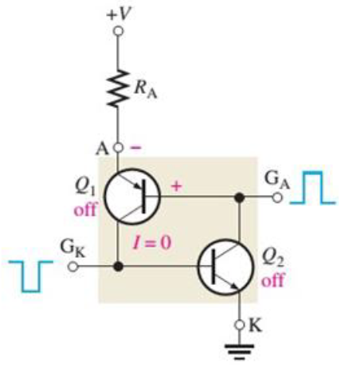
SCS equivalent circuit
Source: https://www.allaboutcircuits.com/textbook/semiconductors/chpt-7/silicon-controlled-switch-scs/

Slide 20
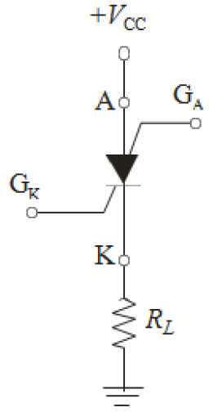
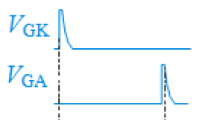
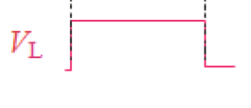
DC source controlling by using SCS
Source: https://www.allaboutcircuits.com/textbook/semiconductors/chpt-7/silicon-controlled-switch-scs/

Slide 21
MCT
The MOS controlled thyristor (MCT) is a power switch with a MOS gate for turn-on and turn-off. It is derived from a thyristor by adding the features of a MOSFET. It is an improvement over a thyristor with a pair of MOSFETs to turn-on and turn-off current.
Out of many semiconductor controlled devices, MCT is considered to be the latest. The device is basically a thyristor with two MOSFET’s built into the gate structure. A MOSFET is used for turning ON the MCT and another one is used for turning it OFF. The device is mostly used for switching applications and has other characteristics like high frequency, high power, and low conduction drop and so on. An MCT combines the feature of both conventional four layer thyristor having regenerative action and MOS- gate structure. In this device, all the gate signals are applied with respect to anode, which is kept as the reference. In a normally used SCR, cathode is kept as the reference terminal for gate signals.

Slide 22
MCT Cont’
An MOS-controlled thyristor (MCT) is a voltage-controlled fully controllable thyristor, controlled by MOSFETs (metal-oxide-semiconductor field-effect transistors). It was invented by V.A.K. Temple in 1984, and was principally similar to the earlier insulated-gate bipolar transistor (IGBT). MCTs are similar in operation to GTO thyristors, but have voltage controlled insulated gates. They have two MOSFETs of opposite conductivity types in their equivalent circuits. One is responsible for turn-on and the other for turn-off. A thyristor with only one MOSFET in its equivalent circuit, which can only be turned on (like normal SCRs), is called an MOS-gated thyristor.
Positive voltage on the gate terminal with respect to the cathode turns the thyristor to the on state.
Negative voltage on the gate terminal with respect to the anode, which is close to cathode voltage during the on state, turns the thyristor to the off state.

Slide 23
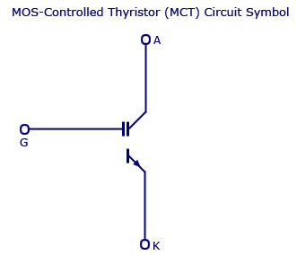
MCT Cont’
Advantages of MCT
Low forward conduction drop
Fast TURN-ON and then OFF times
Low switching losses
High gate input impedance
Source: https://www.circuitstoday.com/mos-controlled-thyristor-mct

Slide 24
Selection of thyristors based on
Specifications& rating
Voltage Ratings of SCR
The voltage capability of the SCR should not be exceeded during the operation even for short periods. So the SCR is assigned with different voltage ratings, which are the maximum voltages at which the SCR can function normally without breakdown of junctions. These are assigned in both blocking states of an SCR and can withstand against voltage transients. The various voltage ratings of an SCR are given below.
Peak Working Forward-blocking Voltage V_{DWM}
It specifies the maximum instantaneous value of forward blocking voltage across the SCR excluding all surge and repetitive transient voltages. Beyond this value of the voltage the SCR cannot withstand during its operation.

Slide 25
Selection of thyristors based on
Specifications& rating cont’
Peak Repetitive Forward-blocking Voltage V_{DRM}
It is the maximum transient voltage that the SCR can block during it’s the forward blocking state repeatedly or periodically. This is specified with a specific biasing resistance between cathode and gate or at a maximum permissible junction temperature with gate circuit open.
This voltage V_{DRM} is encountered or appeared across the SCR , when the SCR is turned OFF or commutated or due to diodes in the converter circuit. During the turn OFF process, an abrupt change in reverse recovery current causes to create a voltage spike, which is responsible of V_{DRM} to appear across the SCR.
Peak Non-repetitive or Surge Forward-blocking Voltage V_{DSM}
This is the maximum instantaneous value of forward surge voltage across the SCR that is of non-repetitive. This V_{DSM} is less than the forward break over voltage V_{BO} and this value is in the range about 130 percent of V_{DRM}.

Slide 26
Selection of thyristors based on
Specifications& rating cont’
Peak Working Reverse Voltage V_{RWM}
This is the maximum instantaneous value of reverse voltage across the SCR excluding all surge and repetitive transient voltages. This V_{RWM} is equal to the maximum negative value of the supply voltage wave shown in figure.
Voltage Safety Factor V_{f}
Generally, the operating voltage of the SCR is kept below the V_{RSM} to avoid the damage to the SCR due to uncertain conditions. Therefore, the voltage safety factor relates the operating voltage and V_{RSM} and is given as
V_{f} = V_{RSM} / (RMS value of the input voltage * √2)

Slide 27
Selection of thyristors based on
Specifications& rating cont’
Peak Repetitive Reverse Voltage V_{RRM}
It is occurrence of the maximum reverse transient voltage repeatedly or periodically across the SCR in the reverse direction at permissible maximum junction temperature. Beyond this rating the SCR may get damaged due to excessive junction temperature. This voltage is also appeared due to the same reason as of V_{DRM}.
Peak Non-repetitive or Surge Reverse Voltage V_{RSM}
It refers to the maximum value of reverse transient voltage across the SCR that is of non-repetitive. This V_{RSM} is less than the reverse break over voltage V_{BR} and this value is in the range about 130 percent of V_{RRM}. The surge voltage ratings V_{DSM} and V_{RSM} can be increased by connecting a diode of equal current rating in series with the SCR.
The above discussed voltage ratings are belonging to the forward and reverse blocking states with which the SCR is able to withstand with gate open.

Slide 28
Selection of thyristors based on
Specifictions& rating cont’
Gate Triggering Voltage V_{GT}
This is the minimum voltage required by the gate to produce the gate trigger current.
Forward dv/dt Rating
This is the maximum rate of rise of anode voltage that will not trigger the SCR without any gate pulse or signal. If this value is more than the specified value, the SCR may be switched ON. The SCR in forward blocking mode is analogous to the capacitor with a dielectric.
So , the charging current flows through it when the applied voltage is increased. If the rate of rise of voltage is more, sufficient charges will flow through the junctions J₂ of the SCR and hence the SCR will be turned ON without any gate signal.
This type of triggering is called as false triggering and in practice it is not employed. Also, this rating depends on the junction temperature. If the junction temperature is high, the dv/dt rating of the SCR is lower and vice-versa.

Slide 29
Selection of thyristors based on
Specifications& rating cont’
Current Ratings of SCR
Basically an SCR is a unilateral device and hence average current rating is assigned to it (while RMS current rating is assigned to bilateral devices). An SCR has low thermal capacity and short time constant. This means the junction temperature exceeds its rated value even for short over current.
This may lead to damage the SCR. Therefore, current ratings must be properly selected for long life of SCR , as the junction temperature depends on the current handled by it. Let us look at various current ratings of an SCR.
Average ON-state Current Rating I_{TAV}
This is the maximum repetitive average value of forward current that can flow through the SCR such that the maximum temperature and RMS current limits are not exceeded. The forward voltage drop across the SCR is very low when it is in conduction mode. So the power loss in the thyristor is entirely depends on the forward current I_{TAV}.

Slide 30
Selection of thyristors based on
Specifications& rating cont’
ON-state Voltage V_{T}
This is the voltage drop between the anode and cathode with specified junction temperature and ON-state forward current. Generally, this value is in the order of 1 to 1.5 Volts.
RMS ON-state Current I_{TRMS}
This is the maximum repetitive RMS current specified at a maximum junction temperature that can flow through the SCR. For a direct current, both RMS and average currents are same. However, this rating is important for SCRs subject to low duty waveforms with peak currents. And also this rating is required to prevent excessive heating in leads, metallic joints and interfaces of SCR.
Surge Current Rating I_{TSM}
It specifies the maximum non-repetitive or surge current that the SCR can withstand for a limited number of times during its life span. The manufacturers specify the surge rating to accommodate the abnormal conditions of SCR due to short circuits and faults. If the peak amplitude and the number of cycles of the surge current are exceeded, the SCR may get damaged.

Slide 31
Selection of thyristors based on
Specifications& rating cont’
Surge Current Rating I_{TSM}
It specifies the maximum non-repetitive or surge current that the SCR can withstand for a limited number of times during its life span. The manufacturers specify the surge rating to accommodate the abnormal conditions of SCR due to short circuits and faults. If the peak amplitude and the number of cycles of the surge current are exceeded, the SCR may get damaged.
I²_{t} Rating
This rating is used to determine the thermal energy absorption of the device. This rating is required in the choice of a fuse or other protective equipment employed for the SCR. This is the measure of the thermal energy that the SCR can absorb for a short period of time before clearing the fault by the fuse.
It is the time integral of the square of the maximum instantaneous current. For a reliable protection of SCR by the fuse or other protective equipment, the I²_{t} rating of the fuse (or any other protective equipment) must be less than the I²_{t} rating of the SCR.

Slide 32
Selection of thyristors based on
Specifications& rating cont’
di/dt Rating
It is the maximum allowable rate of rise of anode to cathode current without any damage or harm to an SCR. If the rate of rise of anode current is very rapid compared to the spreading velocity of the charge carriers, local hot spots are created due to concentration of carriers (on account of high current density) in the restricted area of the junctions.
Latching Current I_{L}
It is the minimum ON state current required to maintain the SCR in ON state after gate drive has been removed. After turning ON of the SCR, the anode current must be allowed to build up such that the latching current is attained before the gate pulse is removed. Otherwise the SCR will be turned OFF if the gate signal is removed.

Slide 33
Selection of thyristors based on
Specifications& rating cont’
Holding Current I_{H}
This is the minimum value of the anode current below which SCR stops conducting and turns OFF. The holding current is associated with turn OFF process and usually it is a very small value in the range of mill amperes.
Gate Current I_{G}
As the gate current is more, earlier will be the turn ON of the SCR and vice-versa. However, safety limits must be provided for gate by specifying maximum and minimum gate currents. For controlling the SCR, gate current is applied to the gate terminal. This gate current is divided into two types; minimum gate current I_{Gmin} and maximum gate current I_{Gmax}.
The minimum gate current I_{Gmin} is the current required by the gate terminal to turn ON the SCR where as I_{Gmax} is the maximum current that can be applied safely to the gate. Between these two limits the conduction angle of the SCR is controlled.

Slide 34
Selection of thyristors based on
Specifications& rating cont’
Temperature Rating of SCR
The forward and reverse blocking capability of the SCR is determined by junction temperature T_{j}. If the maximum junction temperature is exceeded, the SCR will be driven to conduction state even without any gate signal. This upper limit of T_{j} is imposed by considering the temperature dependence on break over voltage, thermal stability and turn OFF time.
And also an upper storage temperature limit T_{s} is also required to limit thermal stresses on silicon crystal, lead attachments and encapsulating epoxy. Excess of these two temperature limits may cause unreliable operation of an SCR. In some cases, upper storage temperature limit is higher than the operating temperature limit of an SCR.
Power Ratings of SCR
The power dissipation in the SCR produces a temperature rise in the junction regions. The dissipation of power in the SCR includes forward power dissipation; turn ON and OFF losses and gate power dissipation.

Slide 35
Selection of thyristors based on
Specifications& rating cont’
Gate Power Dissipation P_{G}
This rating defines both forward or reverse peak power and the average power applied to the gate. If these ratings are exceeded, considerable damage occurs to the gate. Therefore, while calculating the voltage and currents applied, the width of gate pulses has to be considered (because the peak power is the function of time). For pulse type triggering, gate losses are negligible whereas gate signals with a high duty cycle, the gate losses becomes more significant.
Average Power Dissipation P_{av}
It is the multiplication of the average anode current and forward voltage drop across the SCR. This is the major source of junction heating in an SCR for normal duty cycle operations. The peak power from a given source must not exceed the average power dissipation rating to maintain the safety of the device.

Slide 36
Selection of thyristors based on
Specifications& rating cont’
Turn ON and Turn OFF Time Ratings
The turn ON time is the time interval between the instant at which the gate signal is applied and the instant at which the ON-state current reaches 90 percent of its final value. Shorter will be the turn ON time if the gate drive is increased. This turn ON time is valid only for resistive load because the rate of rise of anode current is slow in inductive load.
Therefore, the turn ON time does not indicate the time in which the device stays ON if the gate signal is removed. And if the load is resistive, turn ON time surely, indicates the time interval in which the SCR stays ON even the gate is removed.
Turn OFF time is the time interval between the instant at which the anode current goes zero or negative and the instant positive voltage is reapplied to the SCR. For fast switching SCRs both turn ON and OFF time values are very low.

Slide 37
Selection of thyristors based on
Applications
Thyristors may be used in power-switching circuits, relay-replacement circuits, inverter circuits, oscillator circuits, level-detector circuits, chopper circuits, light-dimming circuits, low-cost timer circuits, logic circuits, speed-control circuits, phase-control circuits, etc.
On each application, you need to choose the corresponding application basing on the needed specifications or ratings.

Slide 38
References
Fundamentals of electronics. Book 1, Electronic devices and circuit applications, Thomas F. Schubert, Jr. and Ernest M. Kim.,an Rafael, California (1537 Fourth Street, San Rafael, CA 94901 USA) : Morgan & Claypool, 2014.
Principles of Electrical Engineering. Wiley., 1922.
Starting Electronics, Keith Brindley (Fourth Edition), published by Elsevier Ltd, 2011.
https://www.myelectrical2015.com/2017/10/structure-equivalent-circuit-and.html
https://www.myelectrical2015.com/2017/10/structure-equivalent-circuit-and.html
https://www.cselectricalandelectronics.com/difference-between-scr-diac-triac/
https://electronics-club.com/gate-turn-off-thyristor-gto-switching-performance/
https://www.allaboutcircuits.com/textbook/semiconductors/chpt-7/silicon-controlled-switch-scs/
https://www.circuitstoday.com/mos-controlled-thyristor-mct

