Slide 1
FUNDAMENTALS
OF ELECTRONICS
WEEK 9_LECTURE 9:
DESCRIPTION AND APPLICATIONS OF ACTIVE DEVICES/
PART 4: SPECIAL DEVICES
Lecturer: NSABIMANA Camille, B.Sc. Eng., M.Sc. IT

Slide 2
Content
Description of special devices:
    Relay
    Opto-coupler
    Electronic switches
    Buzzer

Slide 3
Relay
Relays are the switches which aim at closing and opening the circuits electronically as well as electromechanically. It controls the opening and closing of the circuit contacts of an electronic circuit. When the relay contact is open (NO), the relay isn’t energize with the open contact. However, if it is closed (NC), the relay isn’t energize given the closed contact. However, when energy (electricity or charge) is supplied, the states are prone to change.
Relay is also a switch that connects or disconnects two circuits. But instead of manual operation a relay is applied with electrical signal, which in turn connects or disconnects another circuit.

Slide 4
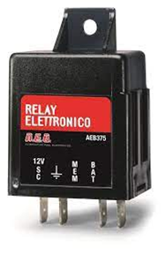
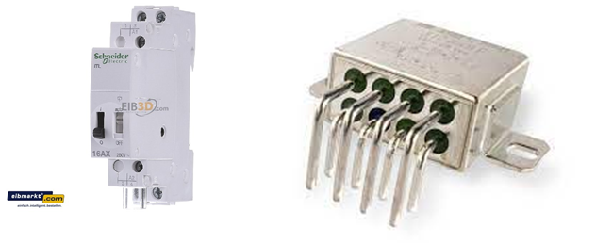
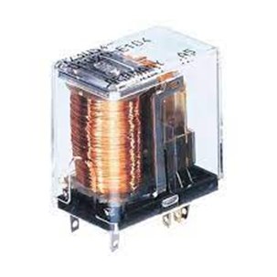
FIGURE: RELAY

Slide 5
Relays cont’
It uses electromagnetism to convert small electrical stimuli into larger currents. These conversions occur when electrical inputs activate electromagnets to either form or break existing circuits
Types of relay: Electromagnetic Relays, Electronic Relays, Latching Relays, Non-Latching Relays.

Slide 6
Relays cont’
Relays are normally used in the control panels, manufacturing and building automation to control the power along with switching the smaller current values in a control circuit. However, the supply of amplifying effect can help control the large amperes and voltages because if low voltage is applied to the relay coil, a large voltage can be switched by the contacts.
If preventive relays are being used, it can detect overcurrent, overload, undercurrent, and reverse current to ensure the protection of electronic equipment. Last but not the least; it is used to heat the elements, switch on audible alarms, switch the starting coils, and pilots the lights.

Slide 7
Types of Relay
In addition to the electromechanical and electromagnetic relay, there is a wide variety of relays with different working principles; principles of operation and polarity.
Electrothermal Relay: When two different material gets in contact, a bimetallic strip is formed, and when it is energized, it bends. This bending allows the users to make contact connections.
Electromechanical Relay: When different mechanical parts are connected on the basis of the electromagnet, contact connection is established.

Slide 8
Types of Relay cont’
Solid State Relay: The relay uses semiconductor devices to make a connection to ensure the effectiveness, efficiency, and easiness of the switching speed. This is commonly used for two reasons; faster-switching process and durability.
Hybrid Relay: It is the name given to the solid-state and electromechanical relays

Slide 9
What are the applications of relays?
The typical applications of electromechanical relays include motor control, automotive applications such as an electrical fuel pump, industrial applications where control of high voltages and currents is intended, controlling large power loads, and so on.

Slide 10
Selection criteria for relays
Coil: Coil voltage; maximum continuous voltage; response voltage and pick-up current; drop-off voltage and dropout current.
Contacts: Contact arrangement; contact loading; contact material; service life; contact resistance; isolation requirements; limiting continuous current.
Switching time: Response time; drop-out time; switching frequency; bounce time.
Mechanical properties: Vibration resistance; shock resistance; size and space.

Slide 11
    OPTO-COUPLER
An opto-coupler, photo coupler, or optical isolator) is an electronic component that transfers electrical signals between two isolated circuits by using light. Opto -isolators prevent high voltages from affecting the system receiving the signal.
A current is first applied to the Opto-coupler, which makes the infrared LED emit a light that's proportional to the current. When the light hits the photosensitive device, it switches on and starts to conduct a current as any ordinary transistor might.

Slide 12
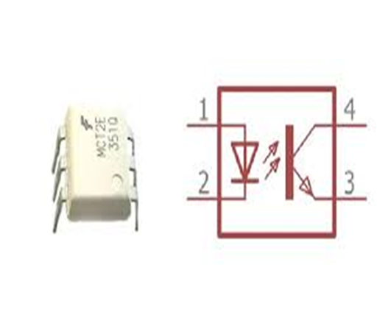
Figure: Optocoupler
Source: https://www.jameco.com/Jameco/workshop/Howitworks/what-is-an-optocoupler-and-how-it-works.html

Slide 13
Optocoupler cont’
An optocoupler (also called optoisolator) is a semiconductor device that allows an electrical signal to be transmitted between two isolated circuits. Two parts are used in an optocoupler: an LED that emits infrared light and a photosensitive device that detects light from the LED. Both parts are contained within a black box with pins for connectivity. The input circuit takes the incoming signal, whether the signal is AC or DC, and uses the signal to turn on the LED.
The photosensor is the output circuit that detects the light and depending on the type of output circuit, the output will be AC or DC. Current is first applied to the optocoupler, making the LED emit an infrared light proportional to the current going through the device. When the light hits the photosensor a current is conducted, and it is switched on. When the current flowing through the LED is interrupted, the IR beam is cut-off, causing the photosensor to stop conducting.

Slide 14
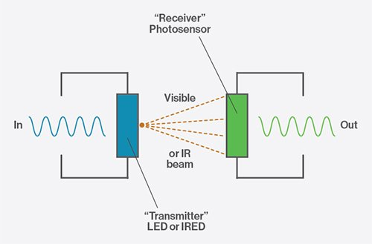
Figure: Optocoupler
Source: https://www.jameco.com/Jameco/workshop/Howitworks/what-is-an-optocoupler-and-how-it-works.html

Slide 15
Configurations of optocouplers
There are four configurations of optocouplers, the difference being the photosensitive device used. Photo-transistor and Photo-Darlington are typically used in DC circuits, and Photo-SCR and Photo-TRIAC are used to control AC circuits.
In the photo-transistor optocoupler, the transistor could either be PNP or NPN. The Darlington transistor is a two transistor pair, where one transistor controls the other transistor’s base. The Darlington transistor provides high gain ability.

Slide 16
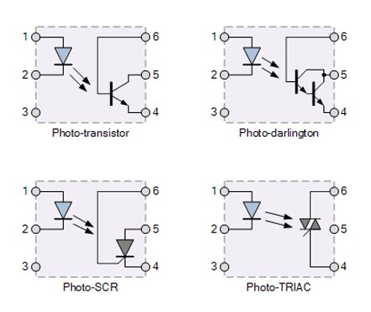
Figure: Configurations of optocouplers
Source: https://www.jameco.com/Jameco/workshop/Howitworks/what-is-an-optocoupler-and-how-it-works.html

Slide 17
Optocoupler cont’
The term optocoupler and optoisolator are often used interchangeably, but there is a slight difference between the two. The distinguishing factor is the voltage difference expected between the input and the output. The optocoupler is used to transmit analog or digital information between circuits while maintaining electrical isolation at potentials up to 5,000 volts. An optoisolator is used to transmit analog or digital information between circuits where the potential difference is above 5,00 volts.
An Optocoupler Can Effectively:
Remove electrical noise from signals
Isolate low-voltage devices from high-voltage circuits. The device is able to avoid disruptions from voltage surges (ex: from radio frequency transmissions, lightning strikes, and spikes in a power supply)
Allow the usage of small digital signals to control larger AC voltages

Slide 18
What are the applications of optocoupler?
Common applications for opto-couplers include microprocessor input/output switching, DC and AC power control, PC communications, signal isolation and power supply regulation which suffer from current ground loops, etc.
The electrical signal being transmitted can be either analogue (linear) or digital (pulses).

Slide 19
    Electronic switches
An electronic switch is an electronic component or device that can switch an electrical circuit, interrupting the current or diverting it from one conductor to another.
The negative terminal connects to the charge, and the electrons drive through the circuit. The load receives the current and returns it via the positive terminal to the power source.

Slide 20
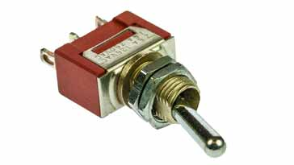
Types of electronic switches
There is a large variety of different types of electronics switches. Each of these types of switch operates in a slightly different manner and can be used for different applications.
Toggle switch: The toggle switch is usually a two position switch. The internal construction includes a spring such that it is held firmly in the position to which it has been switched. The figure below shows a miniature toggle switch.
Source: https://www.electronics-notes.com/articles/electronic_components/electromechanical-electronics-switches/switch-basics.php

Slide 21
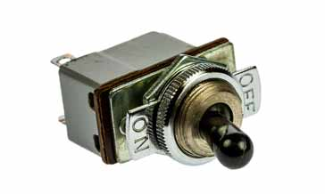
Types of electronic switches cont’
This type of switch for electronics applications is often used for switching items on or off. Occasionally toggle switches are available with a centre "off" position.
Many versions are able to withstand switching 250 VAC at current levels of around 1 amp, but with the number of cheap options available, it is always best to check as lower cost / quality items could be dangerous if used beyond their ratings. The figure below shows Mains capable toggle switch:
Source: https://www.electronics-notes.com/articles/electronic_components/electromechanical-electronics-switches/switch-basics.php

Slide 22
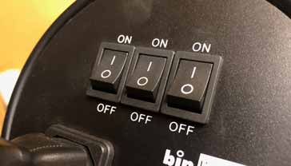
Types of electronic switches cont’
Push button switch: Push button switches are used in many electronic circuits. These electronic switches are often used when a push action is required to give a momentary connection. Alternatively they can be used to provide a push on - push off action.
Rocker switch: In many ways rocker switches are similar to toggle switches. They are widely used for mains on-off functions and have a two position capability.
Source: https://www.electronics-notes.com/articles/electronic_components/electromechanical-electronics-switches/switch-basics.php

Slide 23
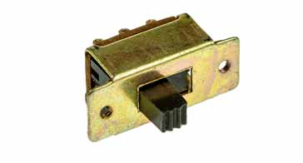
Types of electronic switches cont’
Rotary switch: As the name implies, rotary switches are operated by turning a knob. Selecting the correct position enables the relevant connections to be made. As rotary switches can have many positions, they enable a particular point to be connected to one of a number of other points in the electronics circuit.
These rotary switches are normally used for signal switching, so they are normally used only for low voltage and current applications - they are not normally suitable for high voltages and currents.
Slider switch:
Source: https://www.electronics-notes.com/articles/electronic_components/electromechanical-electronics-switches/switch-basics.php

Slide 24
Types of electronic switches cont’
DIP switch: DIP or dual-inline-package switches consist of a series of switches, typically 2, 4, 8, etc in a dual in line IC style package. The switches are typically very small rocker switches, but being a series of switches in line, they can be sued for pre-setting a digital input to an item of electronics equipment. Often they are sued for configuring settings like start up or default settings on some equipment.
There are many types of electronics switches used in circuits and equipment. These types represent some of the major electronics switches in use, although there are naturally many other types available.

Slide 25
    BUZZER
A buzzer or beeper is an audio signaling device, which may be mechanical, electromechanical, or piezoelectric (piezo for short).
uses of buzzers and beepers include alarm devices, timers, and confirmation of user input such as a mouse click or keystroke.
When current is applied to the buzzer it causes the ceramic disk to contract or expand. Changing the This then causes the surrounding disc to vibrate. That's the sound that you hear. By changing the frequency of the buzzer, the speed of the vibrations changes, which changes the pitch of the resulting sound.

Slide 26
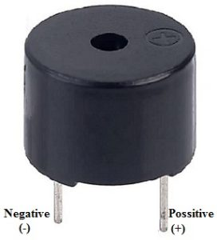
Figure: Buzzer
Source: https://www.elprocus.com/buzzer-working-applications/
The pin configuration of the buzzer is shown below. It includes two pins namely positive and negative. The positive terminal of this is represented with the ‘+’ symbol or a longer terminal. This terminal is powered through 6Volts whereas the negative terminal is represented with the ‘-‘symbol or short terminal and it is connected to the GND terminal.

Slide 27
Types of Buzzer
A buzzer is available in different types which include the following.
      Piezoelectric
      Electromagnetic
      Mechanical
      Electromechanical
      Magnetic
Piezoelectric
As the name suggests, the piezoelectric type uses the piezoelectric ceramic’s piezoelectric effect & pulse current to make the metal plate vibrate & generate sound. This kind of buzzer is made with a resonance box, multi resonator, piezoelectric plate, housing, impedance matcher, etc. Some of the buzzers are also designed with LEDs.
The multi resonator of this mainly includes ICs and transistors. Once the supply is given to this resonator, it will oscillate and generates an audio signal with 1.5 to 2.kHz. The impedance matcher will force the piezoelectric plate to produce sound.

Slide 28
Types of Buzzer cont’
Electromagnetic
This type of buzzer is made with a magnet, solenoid coil, oscillator, housing, vibration diaphragm, and magnet. Once the power supply is given, the oscillator which produces the audio signal current will supply throughout the solenoid coil to generate a magnetic field.
Sometimes, the vibration diaphragm will vibrate & generates sound under the magnet & solenoid coil interaction. The frequency range of this ranges from 2 kHz to 4kHz.
Mechanical
These types of buzzers are subtypes of electromagnetic, so the components used in this type are also similar. But the main difference is that the vibrating buzzer is placed on the outside instead of the inside.

Slide 29
Types of Buzzer cont’
Electromechanical
The designing of these types of buzzers can be done with a bare metal disc & an electromagnet. The working principle of this is similar to magnetic and electromagnetic. It generates sound throughout the disc movement & magnetism.
Magnetic
Like a piezo type, magnetic is also used to generate a sound but they are different due to core functionality. The magnetic type is more fixed as compared to the piezo type because they work through a magnetic field.
Magnetic buzzers utilize an electric charge instead of depending on piezo materials to generate a magnetic field, after that it permits another element of the buzzer to vibrate & generate sound.
The applications of magnetic buzzers are similar to the piezo type in household devices, alarms such as watches, clocks & keyboards.

Slide 30
Working Principle
The working principle of a buzzer depends on the theory that, once the voltage is given across a piezoelectric material, then a pressure difference is produced. A piezo type includes piezo crystals among two conductors.
Once a potential disparity is given across these crystals, then they thrust one conductor & drag the additional conductor through their internal property. So this continuous action will produce a sharp sound signal.

Slide 31
Advantages and Disadvantages of a buzzer
Advantages
The advantages of a buzzer include the following.
Simply Compatible
Frequency Response is Good
Size is small
Energy Consumption is less
The Range of Voltage usage is Large
Sound Pressure is high
Disadvantages
The disadvantages of the buzzer include the following.
Controlling is a little hard
Generates Annoying Sound
Training is necessary to know how to repair the condition without just turning off.

Slide 32
Applications of the buzzer
The applications of the buzzer include the following:
Communication Devices
Electronics used in Automobiles
Alarm Circuits
Portable Devices
Security Systems
Timers
Household Appliances
Electronic Metronomes
Sporting Events
Annunciator Panels
Game Shows

Slide 33
References
Fundamentals of electronics. Book 1, Electronic devices and circuit applications, Thomas F. Schubert, Jr. and Ernest M. Kim.,an Rafael, California (1537 Fourth Street, San Rafael, CA 94901 USA) : Morgan & Claypool, 2014.
Principles of Electrical Engineering. Wiley., 1922.
Starting Electronics, Keith Brindley (Fourth Edition), published by Elsevier Ltd, 2011.
https://www.jameco.com/Jameco/workshop/Howitworks/what-is-an-optocoupler-and-how-it-works.html /
https://www.electronics-notes.com/articles/electronic_components/electromechanical-electronics-switches/switch-basics.php
https://www.elprocus.com/buzzer-working-applications/

