Slide 1
FUNDAMENTALS
OF ELECTRONICS
WEEK 10_LECTURE 10:
DESCRIPTION OF AMPLIFIERS
Lecturer: NSABIMANA Camille, B.Sc. Eng., M.Sc. IT

Slide 2
Content
Definition of amplifier
Describe types of amplifiers based on:
    Stages
        Single stage
        Multi-stage
    Classes
    Input and Output parameters
Description of amplifier application
    Audio application
    Video application
    Microwave application

Slide 3
Definition of amplifier
An amplifier is one of the most commonly used electronic devices in the world. It’s a basic building block of a vast number of circuits, and comes in various forms.
Amplifiers can be defined simply as an electronic device that increases the power of a signal. In other words, it increases the amplitude of a signal, and makes it stronger than the given input.

Slide 4
Important Characteristics of an Amplifier
The quality of an amplifier is measured by a series of specifications called figures of merit. They are as follows:
  Bandwidth: The frequency range at which the amplifier can operate.
  Noise: The amount of unwanted extra information included in the output.
  Skew Rate: The maximum rate of change of output.
  Gain: Perhaps the most important, the ratio between the magnitudes of input and output signals.
Stability: The ability to provide constant and reliable output.
Linearity: The degree of proportionality between input and output signals.
Efficiency: Another very important characteristic, it is the ratio between the output power and power consumed.
Output Dynamic Range: Ratio between the largest and smallest useful output levels.

Slide 5
Types of Amplifiers
This part deals with the description of different types of amplifiers based on:
    Stages
        Single stage
        Multi-stage
    Classes
    Input and Output parameters

Slide 6
Types of amplifiers based on Stages
        Single stage Amplifier
When in an amplifier circuit only one transistor is used for amplifying a weak signal, the circuit is known as single stage amplifier.
However, a practical amplifier consists of a number of single stage amplifiers and hence a complex circuit. Therefore, such a complex circuit can be conveniently split into several single stages and can be effectively analysed.

Slide 7
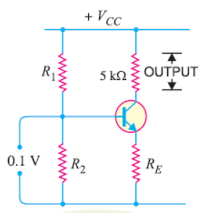
        Single stage Amplifier
The fig. shows a single stage transistor amplifier.
When a weak a.c. signal is applied to the base of the transistor, a small base current starts flowing in the input circuit.
Due to transistor action, a much larger (β times the base current) a.c. current flows through the the load Rc in the output circuit.
Since the value of load resistance Rc is very high, a large voltage will drop across it.
Thus, a weak signal applied in the base circuit appears in amplified form in the collector circuit. In this way the transistor acts as an amplifier.
Source: https://electronicspost.com/single-stage-transistor-amplifier/

Slide 8
Multistage Amplifier
In many of the practical applications, the output of a single-stage amplifier is not sufficient to provide the required bandwidth or gain. So, the enhance either power or voltage gain, the multistage amplifier is required. These kinds of amplifier circuits hold the ability to offer augmented specifications and enhance the circuit performance and so preferred as fundamental building circuits for the development of complicated amplifier networks.
When the output of the previous stage is connected as an input to the following stage through a coupling device, it is termed as a multistage amplifier. For the purpose of coupling, either a transformer or capacitor is used. So, the procedure of connecting two amplifier levels with a cascading tool is also specified as Cascading. The below picture clearly depicts how the amplifiers are connected.

Slide 9

Multistage Amplifier cont’
Source: https://www.allaboutcircuits.com/worksheets/multi-stage-transistor-amplifiers/
And from the above diagram, the gain of the circuit is the multiplication of all the individual stages where it is given by:
V_{M} = V_{M1} × V_{M2}
Where ‘V_{M}’ is the overall voltage gain of the circuit
‘V_{M1}’ is the voltage gain of the first amplifier and ‘V_{M2}’ is the voltage gain of the second amplifier.
For instance, when a circuit has ‘n’ stages, then the overall voltage gain is the product of all the individual stages present in the circuit.
V_{M} = V_{M1} × V_{M2}……………. V_{Mn}

Slide 10
Multistage Amplifier Types
When the amplifiers are connected using a coupling device, it is termed as interstage coupling. The type of coupling decides the classification of the multistage amplifier and those are as follows:
Direct coupling
Transformer coupling and
Capacitor coupling

Slide 11
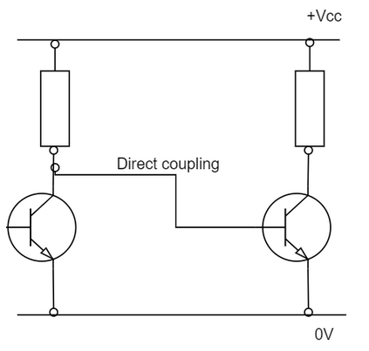
Direct Coupling (DC)
In a few of the amplifiers, both AC and DC are connected between the amplifier stages. Whereas in the direct coupling, the collector stage output has a direct connection (or through resistance) with the base stage and this does not show any blockage to DC. The direct coupling type permits the amplification of extremely minimal frequency values along with 0Hz. Mostly, wideband amplifiers employ this type so as to remove the usage of capacitors, because capacitors may cause increased frequency instability conditions. With this, there might have changes in the output gain at few frequency levels.
Multistage amplifiers that are coupled through this approach need to have good stability mainly in correspondence with temperature changes. Even a minimal variation in the biasing conditions at the transistor base will deliver extremely high changes at the collector. This will generate an error (error means the variation in the correct voltage and the estimated collector voltage level).
Source: https://www.allaboutcircuits.com/worksheets/multi-stage-transistor-amplifiers/

Slide 12
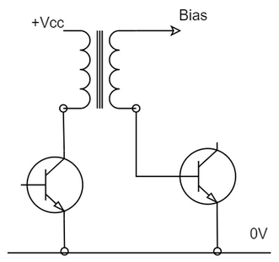
Transformer Coupling
In this type of coupling, the current flow at the collector of one stage will stream via the primary winding of the transformer. This stimulates signal voltage to the secondary winding which is connected at the input of the following stage. This signal is connected to the DC biasing at the base end of the following stage.
Here, DC is obstructed and the AC signals are cascaded, and the ratio of transformer turns might be even employed to offer impedance matching between the amplifier stages. This coupling type is most appropriate for the RF amplifiers as the reason that the size of the transformer can be maintained so small.
Source: https://www.allaboutcircuits.com/worksheets/multi-stage-transistor-amplifiers/

Slide 13
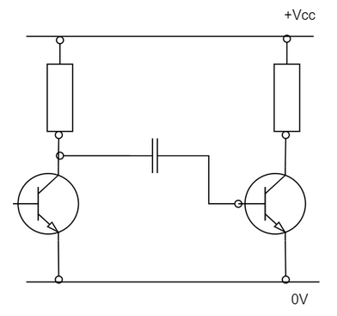
Capacitor Coupling
This type of coupling method offers electrical separation (which means blockage of DC) between the cascaded stages and permits the AC signals. This scenario permits for a various base and the collector voltages on the cascaded stages and minimizes any kind of DC stability complications.
Through this approach, the capacitor reactance should be so minimal at the low signal frequency range where this not extensively minimize signal in between the stages.
Source: https://www.allaboutcircuits.com/worksheets/multi-stage-transistor-amplifiers/

Slide 14
The multistage amplifier applications
The multistage amplifier applications can be found in various industries in various scenarios and those are:
Employed in the conditions when perfect impedance matching is required
Used in the applications when correct frequency response is necessary
These amplifiers are also used for DC isolation purposes
Applications those need enhanced gain, and good flexibility
Enhanced bandwidth
Multistage amplifiers designed with MOSFET devices are also employed in many applications
Audio transformers
Microphones
Multistage amplifier cascading is used for high-voltage and high-speed applications

Slide 15
Types of amplifiers based on Classes
Often confused as the only categories of amplifiers, they are actually types of power amplifiers and are classified on the basis of the proportion of the input cycle during which the amplifier is giving an output.
The proportion of the active input cycle is also known as conduction angle. For example, a 360 degrees conduction angle means that the device is always on, a conduction angle of 180 degrees means that the device is on only for half of each cycle. Now, the different types of power amplifiers are described below:

Slide 16
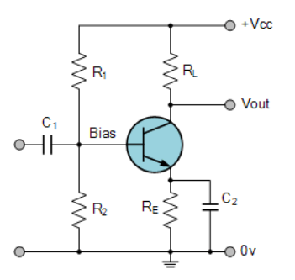
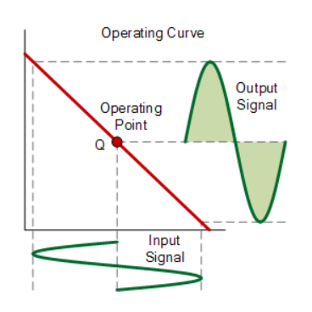
Class A Power Amplifier
Source: https://www.electronics-tutorials.ws/amplifier/amplifier-classes.html

Slide 17
Class A Amplifier cont’
An amplifier that conducts during the full cycle, or has a conducting angle of 360 degrees is known as a Class A power amplifier. It is the simplest and most common type of power amplifier, because of low signal distortion levels. It has its fair share of disadvantages though, and is generally not used in high power applications. Some of its characteristics are:
Low signal distortion levels
Simple design
The device is always conducting due to amplifying element bias
No turn on time or charge storage problems
Quite stable
Highest linearity
Low efficiency due to being on all the time, around the vicinity of 25-50%
High heat output during operation

Slide 18
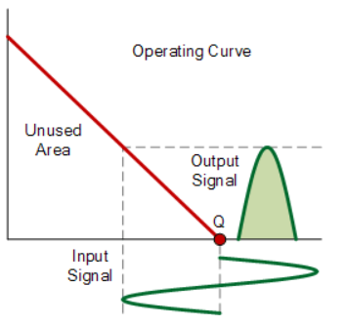
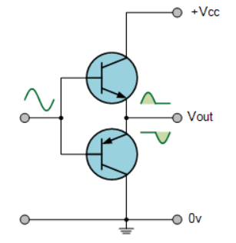
Class B Power Amplifier
Source: https://www.electronics-tutorials.ws/amplifier/amplifier-classes.html

Slide 19
Class B Amplifier cont’
Class B Power Amplifiers, unlike Class A, work for only half of each input cycle, which means they have a conducting angle of 180 degrees. In simple words, these amplifiers amplify only half of the input cycle. On paper that probably sounds unusable, but in reality, it’s quite different. A Class B amplifier consists of a positive and negative transistor, which run alternatively, amplifying the positive and negative cycle respectively, which in the end is combined to form a full output cycle. It’s a more efficient design, and has its own set of advantages and disadvantages compared to the Class A power amplifier. It’s characterized by:
Uses 2 complementary transistors, one each for the positive and negative cycle
Much higher efficiency, around 75-78.5%
Lesser heat output
Stable and reliable
Requires at least 0.7 V to start conducting, which means anything under it doesn’t register, so cannot be used for precise applications
Combines 2 half cycles to form one full cycle

Slide 20
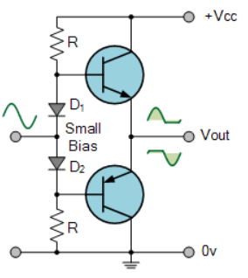
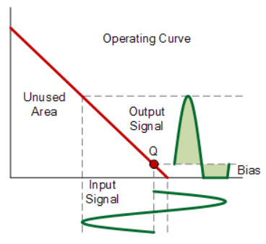
Class AB Power Amplifier
Source: https://www.electronics-tutorials.ws/amplifier/amplifier-classes.html

Slide 21
Class AB Amplifier cont’
A Class AB Power Amplifier is, as the name suggests, a mix of Class A and Class B power amplifiers. Like the Class B amplifier, it also uses 2 conducting elements (transistors), but they both run at the same time. This eliminates the ‘dead zone’ from -0.7 V to + 0.7 V seen in the Class B power amplifier. But in this case, while each transistor conducts for more than a half cycle, they conduct less than a full cycle completely. So the conduction angle is somewhere around 180 degrees and 360 degrees, commonly shown as 270 degrees in some cases. Here are it’s characteristics:
Uses 2 transistors that work together
Each transistor is active for slightly less than a full cycle but more than a half cycle
Combines Class A and Class B characteristics
No crossover distortion
Fairly efficient, at around 50-60%
Most common audio amplifier design

Slide 22
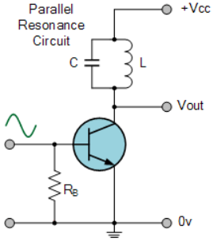
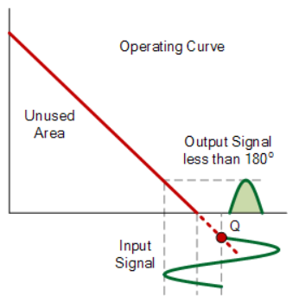
Class C Power Amplifier
Source: https://www.electronics-tutorials.ws/amplifier/amplifier-classes.html

Slide 23
Class C Amplifier cont’
A Class C Power Amplifier is something of an oddity compared to the other 3 types listed above. It’s the most efficient, but has the lowest operating cycle and linearity. Since it’s heavily biased, it stays on for less than half of an input cycle, and thus has a conducting angle somewhere around the vicinity of 90 degrees. This results in the high efficiency mentioned above, but also causes high distortion in the output signal, so Class C amplifiers are usually not used as audio amplifiers. They’re used in certain radio frequency applications where efficiency is key. Its most important characteristics are:
Least linear among power amplifiers
Very high efficiency of around 80-90%
High output distortion
Two operating modes, tuned and untuned
Low power dissipation

Slide 24
Class D Power Amplifier
And finally, we have Class D Power Amplifiers, which sometimes aren’t considered among the 4 mentioned above. It’s a non-linear switching amplifier in which the two transistors function as switches instead of linear gain devices. It converts the analog signal into digital via pulse width modulation, pulse density modulation or something similar before being amplified. The end result is a cycled output with high efficiency and gain, without too much distortion. Although originally used to control motors, they are now used as audio power amplifiers as well. Contrary to popular belief, the ‘D’ in the name doesn’t stand for digital, because the converted signal is pulse width modulated analog, and not pulse width modulated digital. It is characterized by:
High efficiency, can theoretically be 100%
Low power dissipation
Low power consumption
More complex than other types of power amplifiers
Precise and accurate output

Slide 25
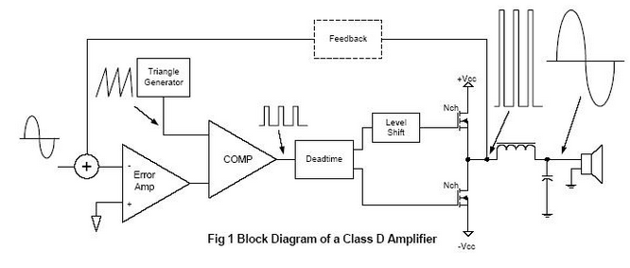
Class D Amplifier cont’
Source: https://www.electronics-tutorials.ws/amplifier/amplifier-classes.html

Slide 26
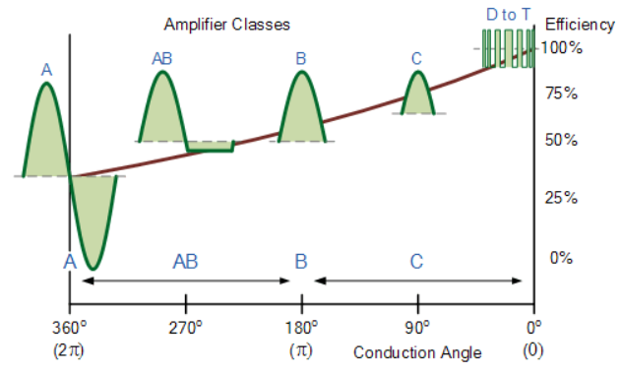
Class of Amplifier cont’
Source: https://www.electronics-tutorials.ws/amplifier/amplifier-classes.html

Slide 27
    Types of amplifiers based on Input and Output parameters
Although amplifiers are sometimes classified according to input and output parameters (we’ll get to that), there are 4 basic types, which are:
Current Amplifier: As the name suggests, an amplifier that makes the given input current higher. It is characterized by a low input impedance and high output impedance.
Voltage Amplifier: An amplifier that amplifies given voltage for a larger voltage output. It is characterized by a high input impedance and low output impedance.
Transconductance Amplifier: An amplifier that changes output current according to changing input voltage.
Transresistance Amplifier: An amplifier that changes output voltage according to changing input current. It is also known as a current-to-voltage converter.

Slide 28
Description of amplifier applications
    Audio application
The circuit of the audio amplifier consists of a transistor a device to apply the input signals and a speaker at the output. The transistors are connected based on the necessity. The important factors that need to be considered while designing a audio amplifier is gain,noise, frequency response and distortion. Higher the gain higher will be the distortion and noise however a negative feedback would reduce the gain of the amplifier.

Slide 29
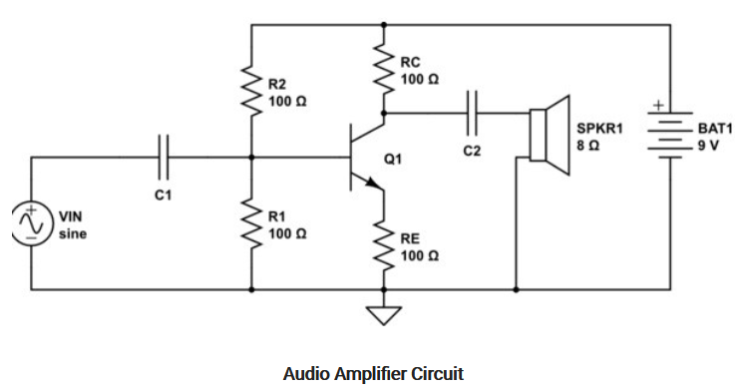
    Figure: Audio amplifier circuit
Source: https://www.watelectronics.com/audio-amplifier-circuit-working-and-applications/

Slide 30
Audio Amplifier Working
The working of the amplifier is not on a single stage. This amplification of the audio signals is carried out in various stages. Based on the criteria of the hall, infrastructure, and the impedance value the amplification of the signals takes place. The power generated at the output of these amplifiers depends upon its utility.
The input signal is applied with the help of any mike and as it reaches the transistor the movements of majority and the minority carriers takes place. If the transistor is of n-p-n-type, in that case, the connections of the supply are provided in such a way that the width of the depletion region should be less which indicates that the transistor should be in fully conducting mode.
The amplifiers can be designed with multiple transistors in it. Based on these movements of the carriers the signal reaches to its destination. This process signal reaching to the destination with the replica of the input signal but boosted in terms of strength is known as amplification.

Slide 31
    Audio application cont’
Applications
There are various usages of audio amplifiers. Some of them are listed as follows:
In the sound systems, these amplifiers are most widely used.
In various instruments that relate to music, these amplifiers are installed.
In the radio signals broadcasting these amplifiers are used.
The signal transmission for long-distance communication is the most amplifiers that are utilized.
For the wireless transmission of the signals, audio amplification is required.

Slide 32
    Video application
The R1-R2 divider network adjusts the DC level of the video, while the R5-R6 divider network adjusts the gain. You may replace both the dividers with two 4.7-kilo-ohm (or 5-kilo-ohm) trimpots for proper adjustment of the DC level and the gain. The 75-ohm resistor (R3) may be discarded if you feed the video from a high-output-impedance stage.
Although the resistive load in the collector of the transistor provides reasonably good bandwidth, a peaking coil of 20 to 30 uH can be added in series with R4 to improve its performance at higher frequencies. With 1VPk-Pk signal as the input, the given circuit outputs 3.5VPk-Pk maximum amplitude at 6.25 MHz without the peaking coil.

Slide 33
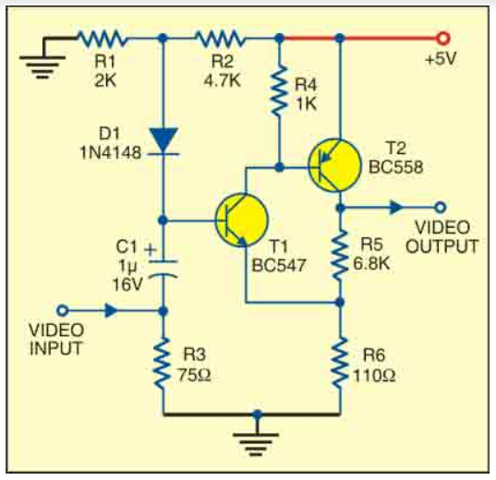
Simple video amplifier
Source: https://www.electronicsforu.com/electronics-projects/simple-video-amplifier

Slide 34
    Microwave application
Microwave amplifiers combine active elements with passive transmission line circuits to provide functions critical to microwave systems and instruments.
The history of microwave amplifiers begins with electron devices using resonant or slow-wave structures to match wave velocity to electron beam velocity.

Slide 35
Application of Microwave amplifiers
Low Noise Amplifier: Boosting Received signal
Power Amplifier: Boosting signal for transmission
Linear Signal Amplifier: Offsetting system losses
Driver Amplifier: Generating LO Driving signals

Slide 36
References
Fundamentals of electronics. Book 1, Electronic devices and circuit applications, Thomas F. Schubert, Jr. and Ernest M. Kim.,an Rafael, California (1537 Fourth Street, San Rafael, CA 94901 USA) : Morgan & Claypool, 2014.
Principles of Electrical Engineering. Wiley., 1922.
Starting Electronics, Keith Brindley (Fourth Edition), published by Elsevier Ltd, 2011.
https://www.allaboutcircuits.com/worksheets/multi-stage-transistor-amplifiers/
https://electronicspost.com/single-stage-transistor-amplifier/
https://www.electronics-tutorials.ws/amplifier/amplifier-classes.html
https://www.watelectronics.com/audio-amplifier-circuit-working-and-applications/
https://www.electronicsforu.com/electronics-projects/simple-video-amplifier

