Slide 1
FUNDAMENTALS
OF ELECTRONICS
WEEK 11_LECTURE 11:
DESCRIPTION OF LINEAR INTEGRATED CIRCUITS
Lecturer: NSABIMANA Camille, B.Sc. Eng., M.Sc. IT

Slide 2
Content
Introduction to linear ICs
Proper description of linear ICs based on:
  Their packages
    Monolithic ICs
    Thick-film ICs
    Thin-film ICs
    Hybrid ICs

Slide 3
Content
  Their Chip size and integration
    SSI
    MSI
    LSI
    VLSI
    ULSI
Description of Advantages and disadvantages of linear ICs

Slide 4
Introduction to linear ICs
A linear integrated circuit is an integrated circuit based on an amplifier. The meaning of "linear" used to indicate that the response relationship of the amplifier to the input signal is usually linear.

Slide 5
Introduction to linear ICs
Every electronic appliance we use in our day-to-day life, such as mobile phones, laptops, refrigerators, computers, televisions, and all other electrical and electronic devices are manufactured with some simple or complex circuits.
Electronic circuits are realized using multiple electrical and electronic components connected with each other by connecting wires or conducting wires for the flow of electric current through the multiple components of the circuit, such as resistors, capacitors, inductors, diodes, transistors, and so on.

Slide 6
Introduction to linear ICs
. The circuits can be classified into different types based on different criteria, such as, based on connections: series circuits and parallel circuits; based on the size and manufacturing process of the circuit: integrated circuits and discrete circuits; and, based on signal used in the circuit: analog circuits and digital circuits.
This article discusses an overview of different types of integrated circuits and their applications.

Slide 7
Types of Integrated Circuits
Integrated circuits are of two types:
Analog Integrated Circuits, and
Digital Integrated Circuits.

Slide 8
Analog Integrated Circuits
Integrated circuits that operate over an entire range of continuous values of the signal amplitude are called as Analog Integrated Circuits. These are further classified into the two types as discussed here:
Linear Integrated Circuits − An analog IC is said to be Linear, if there exists a linear relation between its voltage and current. IC 741, an 8-pin Dual In-line Package (DIP)op-amp, is an example of Linear IC.
Radio Frequency Integrated Circuits − An analog IC is said to be Non-Linear, if there exists a non-linear relation between its voltage and current. A Non-Linear IC is also called as Radio Frequency IC.

Slide 9
Digital Integrated Circuits
If the integrated circuits operate only at a few pre-defined levels instead of operating for an entire range of continuous values of the signal amplitude, then those are called as Digital Integrated Circuits.

Slide 10
Mixed Signal ICs
Mixed Signal Integrated Circuit is a kind of ICs where both Digital and Analog ICs are combine on a single chip.

Slide 11
Proper description of linear ICs based on: their packages
  In simple word, they are identified as follows:
  Monolithic – active & passive on same chip
  Thick-thin film – used for passive only
  Hybrid – two or more monolithic ICs combined
Thin and Thick ICs:
In thin or thick film ICs, passive components such as resistors, capacitors are integrated but the diodes and transistors are connected as separate components to form a single and a complete circuit. Thin and thick ICs that are produced commercially are merely the combination of integrated and discrete (separate) components.

Slide 12
Proper description of linear ICs based on: their chip size and integration cont’
Thin and Thick ICs
Thick and thin ICs have similar characteristics, similar appearance except the method of film deposition. Method of deposition of films distinguished Thin ICs from Thick ICs.
Thin film ICs are made by depositing films of a conducting material on a glass surface or on a ceramic base. By varying the thickness of the films deposited on the materials having different resistivity, Passive electronic components like resistors and capacitors can be manufactured.
In Thick film ICs, silk printing technique is used to create the desired pattern of the circuit on a ceramic substrate. Thick-film ICs are sometimes referred to as printed thin-film.

Slide 13
Proper description of linear ICs based on: their chip size and integration cont’
Monolithic ICs
In monolithic ICs, the discrete components, the active and the passive and also the interconnections between them are formed on a silicon chip.
The word monolithic is actually derived from two Greek words “mono” meaning one or single and Lithos meaning stone. Thus monolithic circuit is a circuit that is built into a single crystal.
A dual in-line package, or dual in-line pin package is an electronic component package with a rectangular housing and two parallel rows of electrical connecting pins. The package may be through-hole mounted to a printed circuit board or inserted in a socket.

Slide 14
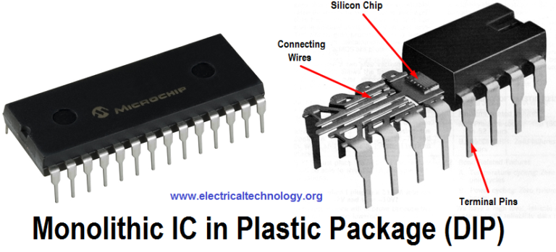
Figure: Monolithic in DIP
Source: https://www.electricaltechnology.org/2015/04/types-of-ics-classification-of-integrated-circuits-and-their-limitation.html

Slide 15
Proper description of linear ICs based on: their chip size and integration cont’
Hybrid or Multi chip ICs
As the name implies, “Multi”, more than one individual chips are interconnected. The active components that are contained in this kind of ICs are diffused transistors or diodes. The passive components are the diffused resistors or capacitors on a single chip.
These components are connected by metallised patterns. Hybrid ICs are widely used for high power-amplifier applications from 5W to more than 50W. Its performance is better than that of monolithic ICs.

Slide 16
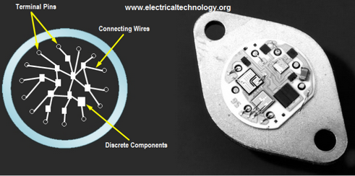
Figure: Hybrid or Multi chip ICs
Source: https://www.electricaltechnology.org/2015/04/types-of-ics-classification-of-integrated-circuits-and-their-limitation.html

Slide 17
  Proper description of linear ICs based on: their chip size and integration
Below is the classification of different types of ICs basis on their chip size:
SSIC (Small Scale Integrated Circuits)
MSIC (Medium Scale Integrated circuits)
LSIC (Large Scale Integrated Circuits)
VLSIC (Very Large Scale Integrated circuits)
ULSIC (Ultra Large Scale Integrated circuits)

Slide 18
Proper description of linear ICs based on: their chip size and integration cont’
Small-scale Integration consists of only a few transistors (tens of transistors on a chip), these ICs played a critical role in early aerospace projects.
Medium-scale Integration consists of some hundreds of transistors on the IC chip developed in the 1960s and achieved better economy and advantages compared to the SSI ICs.
Large-scale Integration consists of thousands of transistors on the chip with almost the same economy as medium-scale integration ICs. The first microprocessor, calculator chips, and RAMs of 1Kbit developed in the 1970s had below four thousand transistors.

Slide 19
Proper description of linear ICs based on: their chip size and integration cont’
Very Large-scale Integration consists of transistors from hundreds to several billion in number.(Development period: from the 1980s to 2009)
Ultra large-scale Integration consists of transistors in excess of more than one million, and later wafer-scale integration (WSI), system on a chip (SoC), and three-dimensional integrated circuit (3D-IC) were developed.

Slide 20
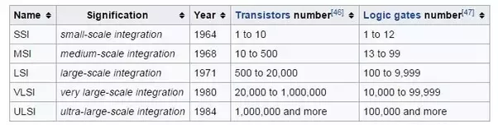
Proper description of linear ICs based on: their chip size and integration cont’
Source: https://www.electricaltechnology.org/2015/04/types-of-ics-classification-of-integrated-circuits-and-their-limitation.html

Slide 21
Proper description of linear ICs based on: their chip size and integration cont’
Below is the classification of different types of ICs basis on their chip size.
SSI: Small scale integration. 3 – 30 gates per chip.
MSI: Medium scale integration. 30 – 300 gates per chip.
LSI: Large scale integration. 300 – 3,000 gates per chip.
VLSI: Very large scale integration. More than 3,000 gates per chip

Slide 22
Advantages of linear ICs
Integrated circuits offer many advantages. They are discussed below:
Compact size − For a given functionality, you can obtain a circuit of smaller size using ICs, compared to that built using a discrete circuit.
Lesser weight − A circuit built with ICs weighs lesser when compared to the weight of a discrete circuit that is used for implementing the same function of IC. using ICs, compared to that built using a discrete circuit.

Slide 23
Advantages of linear ICs cont’
Low power consumption − ICs consume lower power than a traditional circuit, because of their smaller size and construction.
Reduced cost − ICs are available at much reduced cost than discrete circuits because of their fabrication technologies and usage of lesser material than discrete circuits.
Increased reliability − Since they employ lesser connections, ICs offer increased reliability compared to digital circuits.
Improved operating speeds − ICs operate at improved speeds because of their switching speeds and lesser power consumption.

Slide 24
Disadvantages of linear ICs
The major disadvantages of integrated circuits over those made by interconnecting discrete components are as follows:
In an IC the various components are part of a small semiconductor chip and the individual component or components cannot be removed or replaced, therefore, if any component in an IC fails, the whole IC has to be replaced by a new one.
Operation at low voltage as ICs function at fairly low voltage.

Slide 25
Disadvantages of linear ICs cont’
Quite delicate in handling as these cannot withstand rough handling or excessive heat.
High grade P-N-P assembly is not possible.
Low temperature coefficient is difficult to be achieved.
Large value of saturation resistance of transistors.
Voltage dependence of resistor and capacitors.

Slide 26
Limitation for different types of ICs
Despite the advantages that ICs provide us with, it have limitations some of which are:
Limited power rating
It operates at low voltage
High grade of PNP is not possible
It produces noise during operation
Its components such as resistors and capacitors are voltage dependent
It is delicate i.e it cannot withstand rough handling etc.

Slide 27
References
Fundamentals of electronics. Book 1, Electronic devices and circuit applications, Thomas F. Schubert, Jr. and Ernest M. Kim.,an Rafael, California (1537 Fourth Street, San Rafael, CA 94901 USA) : Morgan & Claypool, 2014.
Principles of Electrical Engineering. Wiley., 1922.
Starting Electronics, Keith Brindley (Fourth Edition), published by Elsevier Ltd, 2011.
https://www.electricaltechnology.org/2015/04/types-of-ics-classification-of-integrated-circuits-and-their-limitation.html

