Slide 1
FUNDAMENTALS
OF ELECTRONICS
WEEK 12_LECTURE 12:
DESCRIPTION OF LINEAR INTEGRATED CIRCUITS APPLICATIONS
Lecturer: NSABIMANA Camille, B.Sc. Eng., M.Sc. IT

Slide 2
Content
Application of linear ICs
  Op-amp
  Timer
  Filters
  Voltage regulators
  Oscillators

Slide 3
Description of Linear ICs applications
Op-amp
Operational amplifiers are linear devices that have all the properties required for nearly ideal DC amplification and are therefore used extensively in signal conditioning, filtering or to perform mathematical operations such as add, subtract, integration and differentiation.
An Operational Amplifier, or op-amp for short, is fundamentally a voltage amplifying device designed to be used with external feedback components such as resistors and capacitors between its output and input terminals. These feedback components determine the resulting function or “operation” of the amplifier and by virtue of the different feedback configurations whether resistive, capacitive or both, the amplifier can perform a variety of different operations, giving rise to its name of “Operational Amplifier”.

Slide 4
Op-amp Cont’
n Operational Amplifier is basically a three-terminal device which consists of two high impedance inputs. One of the inputs is called the Inverting Input, marked with a negative or “minus” sign, ( – ). The other input is called the Non-inverting Input, marked with a positive or “plus” sign ( + ).
  A third terminal represents the operational amplifiers output port which can both sink and source either a voltage or a current. In a linear operational amplifier, the output signal is the amplification factor, known as the amplifiers gain ( A ) multiplied by the value of the input signal and depending on the nature of these input and output signals, there can be four different classifications of operational amplifier gain.

Slide 5
Op-amp Cont’
Voltage – Voltage “in” and Voltage “out”
Current – Current “in” and Current “out”
Transconductance – Voltage “in” and Current “out”
Transresistance – Current “in” and Voltage “out”
Since most of the circuits dealing with operational amplifiers are voltage amplifiers, we will limit the tutorials in this section to voltage amplifiers only, (Vin and Vout).
The output voltage signal from an Operational Amplifier is the difference between the signals being applied to its two individual inputs.

Slide 6
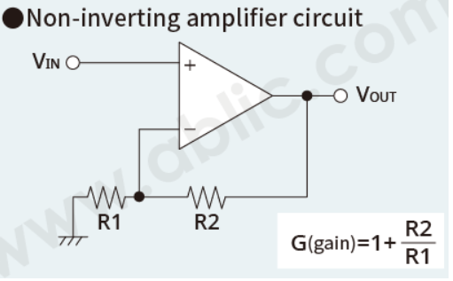
Op-Amp Circuit examples
.
We describe here some typical operational amplifier applications
Non-inverting amplifier circuit
It is a circuit for amplifying and outputting input signals.
V_{OUT}=(1+R2/R1)×V_{IN}
Source: https://www.ablic.com/en/semicon/products/analog/opamp/intro/

Slide 7
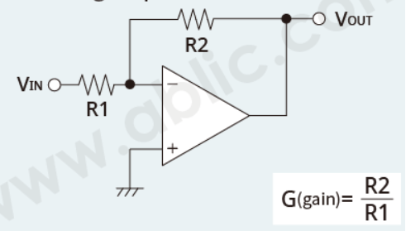
Op-Amp Circuit examples cont’
Inverting amplifier circuit
An inverting amplifier circuit is indicated by a minus sign. If the V_{IN} voltage increases, the V_{OUT} voltage decreases.
V_{OUT}=-R2/R1×V_{IN}
Source: https://www.ablic.com/en/semicon/products/analog/opamp/intro/

Slide 8
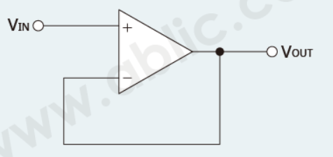
Op-Amp Circuit examples
Voltage follower circuit
This is a non-inverting amplifier circuit where R2 is short-circuited (R2=0Ω) and R1 is open (R1=infinity). Since V_{OUT}=(1+R2/R1)×V_{IN}= (1+0Ω/∞)×V_{IN}=V_{IN}, the output is the same voltage as the input signal. A voltage follower is used as a buffer circuit to convert the impedance or to separate circuits.
V_{OUT}=V_{IN}
Source: https://www.ablic.com/en/semicon/products/analog/opamp/intro/

Slide 9
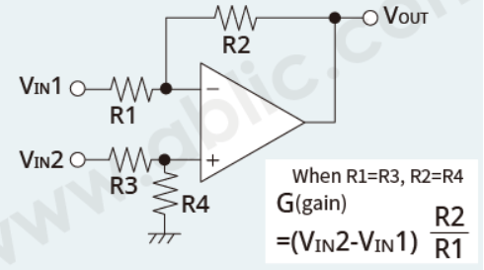
Differential amplifier circuit
This is a circuit for amplifying and outputting the difference between two input signals.
V_{OUT}=R2/R1×(V_{IN}2-V_{IN}1)
Source: https://www.ablic.com/en/semicon/products/analog/opamp/intro/

Slide 10
Timer
Timers are those circuits, which provide periodic signals to a digital system which change the state of that system. In other words, those circuits, which work on the base of multivibrator changes or a device, which can be used as multivibrator is called Timer.
What is 555 Timer IC?
555 Timer is a digital monolithic integrated circuit (IC) which may be used as a clock generator. In other words, 555 Timer is a circuit which may be connected as a stable or monostable multivibrator. In more simple words, 555 Timer is a monolithic timing circuit, which can produce accurate timing pulses with 50% or 100% duty cycle.
555 Timer is a versatile and most usable device in the electronics circuits and designs which work for both stable and monostable states. It may provide time delay from microseconds up to many hours.
555 timer is a very cheap IC which works for wide range of potential difference (typically, from 4.5 to 15V DC) and the different provided input voltages do not affect the timer output.
Notes:
https://www.elprocus.com/brief-about-ic-555-timer/

Slide 11
Features of 555 Timer IC
There are two types of 555 timer based on its nomenclature – NE 555 Timer and SE 555 Timer. While NE 555 timer can be used in the temperature range from 0 to 70°C, the SE 555 Timer can be used in the temperature range from -55°C to 125°C and has a temperature stability of 0.005% per 0C..
it can be operated of different power supplies ranging from 5 Volts to 18 Volts.
It can be used either as a pulse generator or an oscillator by operating it in different modes.
The name 555 comes from the fact that it contains three 5 Kilo-Ohm resistors in series to form the voltage divider pattern.

Slide 12
Features of 555 Timer IC cont’
It can drive both Transistor-Transistor Logic (TTL) due to its high output current and CMOS logic circuits.
It has high output current and adjustable duty cycle.
555 timer can be operated in both astable and monostable modes.
The output of 555 timer can source or absorb current up to 200mA sinking or sourcing current to the load.
It contains 24 transistors, 2 diodes and 17 resistors.
555 timer is available as an 8-Pin Dual in Line Package (DIP), 8-Pin Metal Can or 14-Pin Dual in Line Package (DIP).

Slide 13
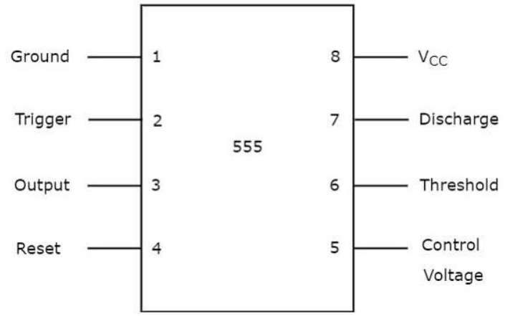
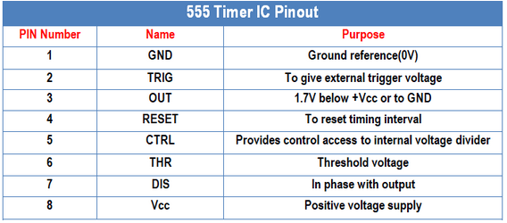
Pin Diagram
The 555 Timer IC is an 8 pin mini Dual-Inline Package (DIP). The pin diagram of a 555 Timer IC is shown in the following figure:
Source: https://www.electricaltechnology.org/2014/12/555-timer.html/

Slide 14
The functions of each of the eight pins:
Ground: Pin 1 is connected to ground.
V_{CC}: Pin 8 is connected to the positive supply voltage. This voltage must be at least 4.5 V and no greater than 15 V. It’s common to run 555 circuits using four AA or AAA batteries, providing 6 V, or a single 9 V battery.
Output: Pin 3 is the output pin. The output is either low, which is very close to 0 V, or high, which is close to the supply voltage that’s placed on pin 8. The exact shape of the output — that is, how long it’s high and how long it’s low, depends on the connections to the remaining five pins.
Trigger: Pin 2 is the trigger, which works like a starter’s pistol to start the 555 timer running. The trigger is an active low trigger, which means that the timer starts when voltage on pin 2 drops to below one-third of the supply voltage. When the 555 is triggered via pin 2, the output on pin 3 goes high.
Discharge: Pin 7 is called the discharge. This pin is used to discharge an external capacitor that works in conjunction with a resistor to control the timing interval. In most circuits, pin 7 is connected to the supply voltage through a resistor and to ground through a capacitor.

Slide 15
The functions of each of the eight pins:
Threshold: Pin 6 is called the threshold. The purpose of this pin is to monitor the voltage across the capacitor that’s discharged by pin 7. When this voltage reaches two thirds of the supply voltage (Vcc), the timing cycle ends, and the output on pin 3 goes low.
Control: Pin 5 is the control pin. In most 555 circuits, this pin is simply connected to ground, usually through a small 0.01 μF capacitor. (The purpose of the capacitor is to level out any fluctuations in the supply voltage that might affect the operation of the timer.)
Reset: Pin 4 is the reset pin, which can be used to restart the 555’s timing operation. Like the trigger input, reset is an active low input. Thus, pin 4 must be connected to the supply voltage for the 555 timer to operate. If pin 4 is momentarily grounded, the 555 timer’s operation is interrupted and won’t start again until it’s triggered again via pin 2.

Slide 16
Applications of 555 timer IC:
555 Timer IC is a useful precision timing device produces single pulses or as an oscillator producing a string of stabilized waveform of any particular duty cycles.
It can be used in one-shot or delay timers to produce a time delay.
It can be used in LED or flash lamps to turn the lamp on for a specified time.
IT can be used in tone generation or logic clocks
It can be used in power supplies and converters etc.

Slide 17
  Filters
Filters are electronic circuits that remove any unwanted components or features from a signal. In simple words, you can understand it as the circuit rejects certain band of frequencies and allows others to pass through. They are widely used in Instrumentation, Electronics and Communication Systems especially in Signal and Image processing systems.
Filter is mainly classified into two types:
Active Filter
Passive Filter
Active Filters
Filter Circuit which consists of active components like Transistors and Op-amps in addition to Resistors and Capacitors is called as Active Filter.
Passive Filters
Filter circuit which consists of passive components such as Resistors, Capacitors and Inductors is called as Passive Filter.

Slide 18
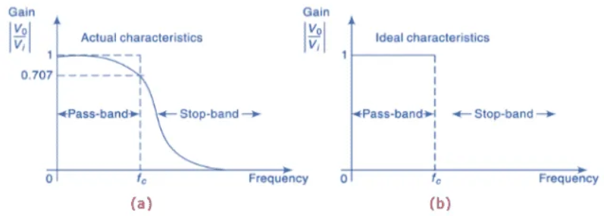
Low Pass Filters
It is a type of Filter which attenuates all the frequencies above the cut-off frequencies. It provides a constant output (gain) from zero to cut-off frequency.
Fig. – Low Pass Filter Characteristics (a) Actual (b) Ideal
Source: https://www.electronics-tutorials.ws/filter/filter_3.html

Slide 19
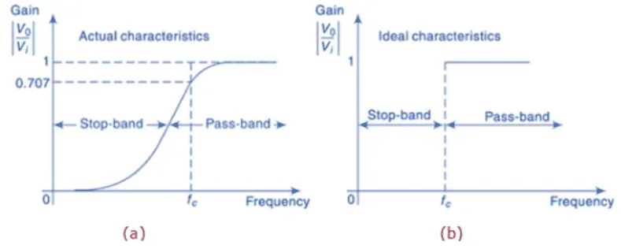
High Pass Filters
It is a type of Filter which attenuates all the frequencies below the cut-off frequencies. It provides a constant output (gain) above the cut-off frequency.
Fig. – High Pass Filter Characteristics (a) Actual (b) Ideal
Source: https://www.electronics-tutorials.ws/filter/filter_3.html

Slide 20
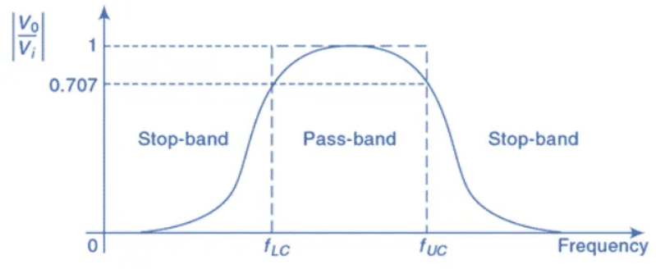
Band Pass Filters
It is a type of filter which allows specific Band of frequencies to pass through and all other frequencies outside the band are attenuated.
Fig. – Band Pass Filter Characteristics
Source: https://www.electronics-tutorials.ws/filter/filter_3.html

Slide 21
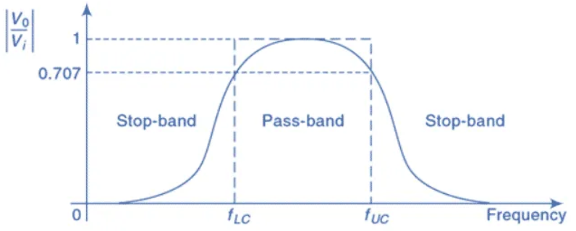
Band Stop Filters
Specific Band of frequencies gets rejected and allows passing of frequencies outside the Band.
Fig. – Band Stop Filter Characteristics
Source: https://www.electronics-tutorials.ws/filter/filter_3.html

Slide 22
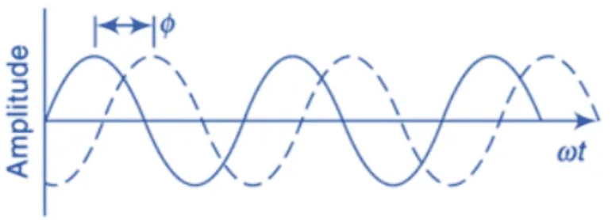
All Pass Filters
It is a type of filter which passes all frequencies equally. It is also known as Phase-Shift filter, time-delay filter as the output voltage shifts in phase with respect to input voltage but they are equal in magnitude.
Fig. – All Pass Filter Characteristics
Source: https://www.electronics-tutorials.ws/filter/filter_3.html

Slide 23
Applications of Filters
Frequency filters have so many applications in our livelihood; some of these applications are given below;
The tuner in radio: The bandpass filter in the tuner of the radio allows a fixed frequency to the output speaker.
Treble & bass of the speaker: The bass has lower frequencies & treble has higher frequencies. They are separated using high pass & low pass filter and are separately routed to corresponding bass speaker & treble speaker for clear music.
Anti-Aliasing: it is a low pass filter that filters out the high-frequency components from a signal before sampling. It prevents the aliasing component form being sampled.
Notch Filter: they are band rejects filters with a narrow bandwidth that filter out any interfering signal.
Power Supply Smoothing: The output of the power supply which is a rectifier has an AC ripple in it. These frequencies are filtered out using a low pass filter which results in smoothing the output signal.
Noise suppression: They are used in communication systems for noise removal from the received signals.

Slide 24
Voltage regulators
The function of a voltage regulator is to maintain a constant DC voltage at the output irrespective of voltage fluctuations at the input and (or) variations in the load current. In other words, voltage regulator produces a regulated DC output voltage.
Voltage regulators are also available in Integrated Circuits (IC) forms. These are called as voltage regulator ICs.
Types of Voltage Regulators
There are two types of voltage regulators:
Fixed voltage regulator
Adjustable voltage regulator

Slide 25
Voltage regulators cont’
Fixed voltage regulator
A fixed voltage regulator produces a fixed DC output voltage, which is either positive or negative. In other words, some fixed voltage regulators produce positive fixed DC voltage values, while others produce negative fixed DC voltage values.
78xx voltage regulator ICs produce positive fixed DC voltage values, whereas, 79xx voltage regulator ICs produce negative fixed DC voltage values.
The following points are to be noted while working with 78xx and 79xx voltage regulator ICs −
“xx” corresponds to a two-digit number and represents the amount (magnitude) of voltage that voltage regulator IC produces.
Both 78xx and 79xx voltage regulator ICs have 3 pins each and the third pin is used for collecting the output from them.
The purpose of the first and second pins of these two types of ICs is different −
  The first and second pins of 78xx voltage regulator ICs are used for connecting the input and ground respectively.
  The first and second pins of 79xx voltage regulator ICs are used for connecting the ground and input respectively.

Slide 26
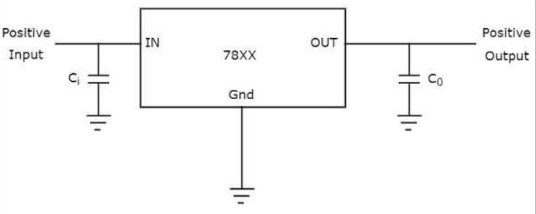
Voltage regulators cont’
Examples
7805 voltage regulator IC produces a DC voltage of +5 volts.
7905 voltage regulator IC produces a DC voltage of -5 volts.
The following figure shows how to produce a fixed positive voltage at the output by using a fixed positive voltage regulator with necessary connections.
In the above figure that shows a fixed positive voltage regulator, the input capacitor C_{i} is used to prevent unwanted oscillations and the output capacitor, C₀ acts as a line filter to improve transient response.
Note − an get a fixed negative voltage at the output by using a fixed negative voltage regulator with suitable connections.
Source: https://instrumentationtools.com/voltage-regulators/

Slide 27
Voltage regulators cont’
Adjustable voltage regulator
An adjustable voltage regulator produces a DC output voltage, which can be adjusted to any other value of certain voltage range. Hence, adjustable voltage regulator is also called as a variable voltage regulator.
The DC output voltage value of an adjustable voltage regulator can be either positive or negative.
LM317 voltage regulator IC
LM317 voltage regulator IC can be used for producing a desired positive fixed DC voltage value of the available voltage range.
LM317 voltage regulator IC has 3 pins. The first pin is used for adjusting the output voltage, second pin is used for collecting the output and third pin is used for connecting the input.
The adjustable pin (terminal) is provided with a variable resistor which lets the output to vary between a wide range.

Slide 28
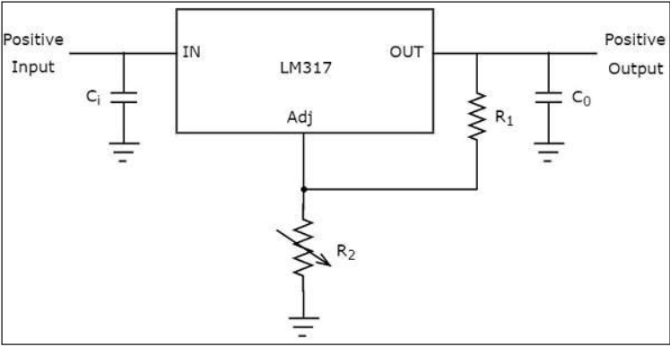
Voltage regulators cont’
The above figure shows an unregulated power supply driving a LM 317 voltage regulator IC, which is commonly used. This IC can supply a load current of 1.5A over an adjustable output range of 1.25 V to 37 V.
Source: https://instrumentationtools.com/voltage-regulators/

Slide 29
Oscillators
An oscillator is a circuit which produces a continuous, repeated, alternating waveform without any input. Oscillators basically convert unidirectional current flow from a DC source into an alternating waveform which is of the desired frequency, as decided by its circuit components.
The wave shape and amplitude are determined by the design of the oscillator circuit and choice of component values.
The frequency of the output wave may be fixed or variable, depending on the oscillator design.

Slide 30
Sine Wave Oscillators.
These circuits ideally produce a pure sine wave output having a constant amplitude and stable frequency. The type of circuit used depends on a number of factors, including the frequency required. Designs based on LC resonant circuits or on crystal resonators are used for ultrasonic and radio frequency applications, but at audio and very low frequencies the physical size of the resonating components, L and C would be too big to be practical.
For this reason a combination of R and C is used to a control frequency.

Slide 31
LC oscillators
Inductors and capacitors are combined in a resonating circuit that produces a very good shape of sine wave and has quite good frequency stability.
That is, the frequency does not alter very much for changes in the D.C. supply voltage or in ambient temperature, but it is relatively simple, by using variable inductors or capacitors, to make a variable frequency (tuneable) oscillator. LC oscillators are extensively used in generating and receiving RF signals where a variable frequency is required.

Slide 32
RC (or CR) oscillators
At low frequencies such as audio the values of L and C needed to produce a resonating circuit would be too large and bulky to be practical. Therefore resistors and capacitors are used in RC filter type combinations to generate sine waves at these frequencies, however it is more difficult to produce a pure sine wave shape using R and C.
These low frequency sine wave oscillators are used in many audio applications and different designs are used having either a fixed or variable frequency.

Slide 33
Crystal oscillators
At radio frequencies and higher, whenever a fixed frequency with very high degree of frequency stability is needed, the component that determines the frequency of oscillation is usually a quartz crystal, which when subjected to an alternating voltage, vibrates at a very precise frequency.
The frequency depends on the physical dimensions of the crystal, therefore once the crystal has been manufactured to specific dimensions, the frequency of oscillation is extremely accurate. Crystal oscillator designs can produce either sine wave or square wave signals, and as well as being used to generate very accurate frequency carrier waves in radio transmitters, they also form the basis of the very accurate timing elements in clocks, watches, and computer systems.

Slide 34
Relaxation oscillators
These oscillators work on a different principle to sine wave oscillators. They produce a square wave or pulsed output and generally use two amplifiers, and a frequency control network that simply produces a timing delay between two actions. The two amplifiers operate in switch mode, switching fully on or fully off alternately, and as the time, during which the transistors are actually switching, only lasts for a very small fraction of each cycle of the wave, the rest of the cycle they "relax" while the timing network produces the remainder of the wave. An alternative name for this type of oscillator is an "astable multivibrator", this name comes from the fact that they contain more than one oscillating element.
There are basically two oscillators, i.e. ''vibrators'', each feeding part of its signal back to the other, and the output changes from a high to a low state and back again continually, i.e. it has no stable state, hence it is astable. Relaxation oscillators can be built using several different designs and can work at many different frequencies. Astables may typically be chosen for such tasks as producing high frequency digital signals. They are also used to produce the relatively low frequency on-off signals for flashing lights.

Slide 35
Sweep oscillators
A sweep waveform is another name for a saw-tooth wave. This has a linearly changing (e.g increasing) voltage for almost the whole of one cycle followed by a fast return to the wave’s original value. This wave shape is useful for changing (sweeping) the frequency of a voltage-controlled oscillator, which is an oscillator that can have its frequency varied over a set range by having a variable ‘sweep’ voltage applied to its control input. Sweep oscillators often consist of a ramp generator that is basically a capacitor charged by a constant value of current.
Keeping the charging current constant whilst the charging voltage increases, causes the capacitor to charge in a linear fashion rather than its normal exponential curve. At a given point the capacitor is rapidly discharged to return the signal voltage to its original value. These two sections of a saw-tooth wave cycle are called the sweep and the fly-back.

Slide 36
References
Fundamentals of electronics. Book 1, Electronic devices and circuit applications, Thomas F. Schubert, Jr. and Ernest M. Kim.,an Rafael, California (1537 Fourth Street, San Rafael, CA 94901 USA) : Morgan & Claypool, 2014.
Principles of Electrical Engineering. Wiley., 1922.
Starting Electronics, Keith Brindley (Fourth Edition), published by Elsevier Ltd, 2011.
https://www.ablic.com/en/semicon/products/analog/opamp/intro/
https://www.electricaltechnology.org/2014/12/555-timer.html
https://www.electronics-tutorials.ws/filter/filter_3.html
https://instrumentationtools.com/voltage-regulators/
https://learnabout-electronics.org/Oscillators/osc10.php

