Slide 1
Mathematics for Science
Lecture 3
Conic Sections and their application: Circles and Parabolas
Lecturer: Kahenya, N.P

Slide 2
Introduction to lecture 3
This lecture will introduce the conic sections and in particular circles and parabolas.
The application of circles to various structures in the real world is almost obvious.
Parabolic shapes have been used to design satellites disks, spotlights reflectors among many other applications.
Intended learning outcomes
At the end of this lecture, you will be able to;
Define conic sections .
Solve problems involving equations of circles and parabolas.

Slide 3
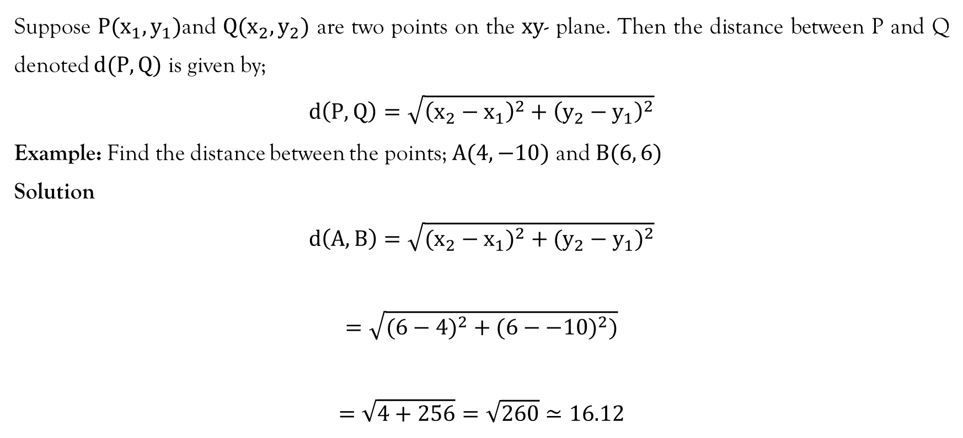
Distance Formula
Suppose $P(x_{1},y_{1})$and $Q(x_{2},y_{2})$ are two points on the $xy$- plane. Then the distance between P and Q denoted $d(P,Q)$ is given by;
$$d\left(P,Q\right)=\sqrt{{\left(x_{2}−x_{1}\right)}^{2}+{\left(y_{2}−y_{1}\right)}^{2}}$$
Example: Find the distance between the points; $A(4,−10)$ and $B(6, 6)$
Solution
$$d\left(A,B\right)=\sqrt{(x_{2}−x_{1})^{2}+(y_{2}−y_{1})^{2}}$$
$$=\sqrt{(6−4)^{2}+(6−−10)^{2})}$$
$$=\sqrt{4+256}=\sqrt{260}≃16.12$$

Slide 4
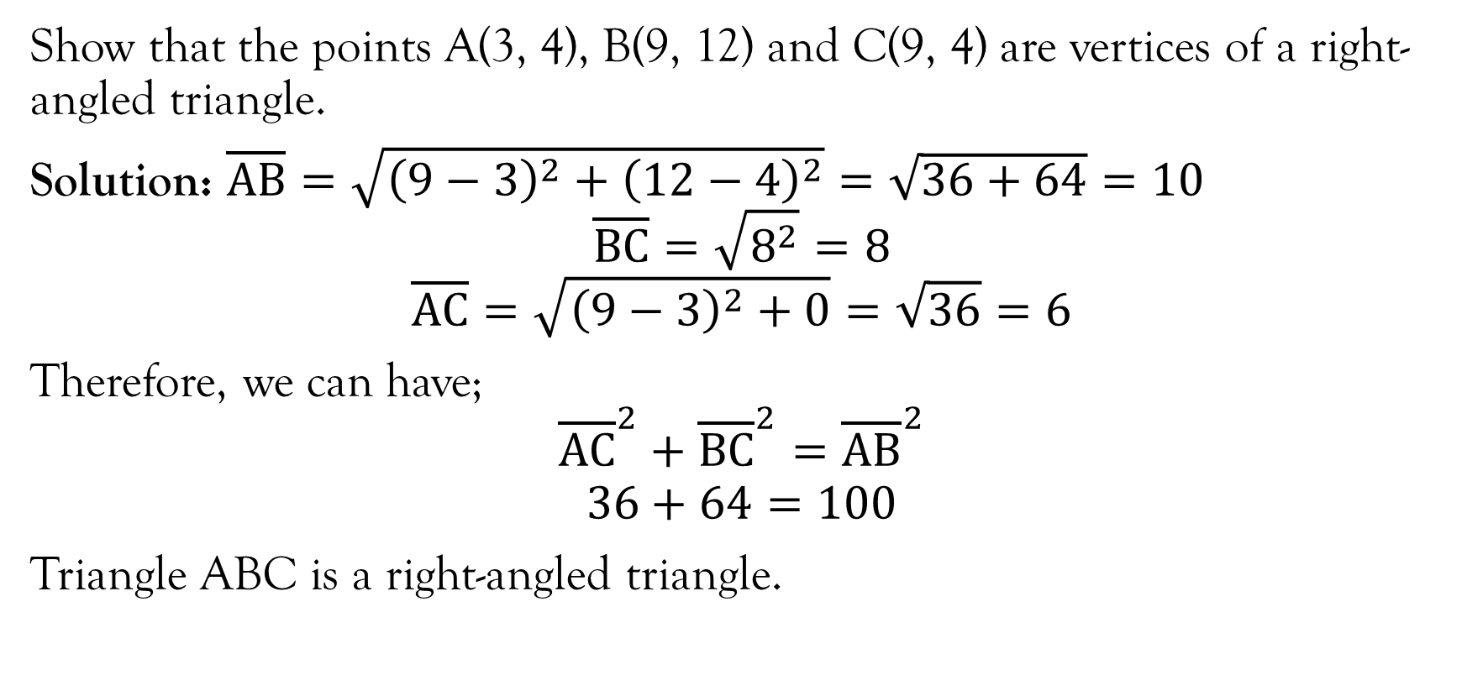
Example
Show that the points A(3, 4), B(9, 12) and C(9, 4) are vertices of a right-angled triangle.
Solution: $\overline{AB}=\sqrt{{\left(9−3\right)}^{2}+{\left(12−4\right)}^{2}}=\sqrt{36+64}=10$
$$\overline{BC}=\sqrt{8^{2}}=8$$
$$\overline{AC}=\sqrt{{\left(9−3\right)}^{2}+0}=\sqrt{36}=6$$
Therefore, we can have;
$${\overline{AC}}^{2}+{\overline{BC}}^{2}={\overline{AB}}^{2}$$
$$36+64=100$$
Triangle ABC is a right-angled triangle.

Slide 5
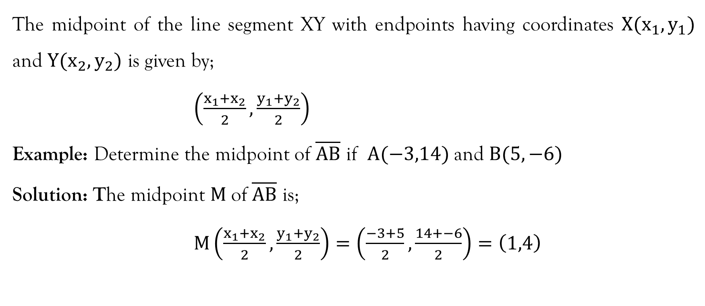
Mid-Point Formula
The midpoint of the line segment XY with endpoints having coordinates $X(x_{1},y_{1})$ and $Y(x_{2},y_{2})$ is given by;
$\left(\frac{x_{1}+x_{2}}{2},\frac{y_{1}+y_{2}}{2}\right)$
Example: Determine the midpoint of $\overline{AB}$ if $A(−3,14)$ and $B(5,−6)$
Solution: The midpoint $M$of $\overline{AB}$ is;
$M\left(\frac{x_{1}+x_{2}}{2},\frac{y_{1}+y_{2}}{2}\right)=\left(\frac{−3+5}{2},\frac{14+−6}{2}\right)=\left(1,4\right)$

Slide 6
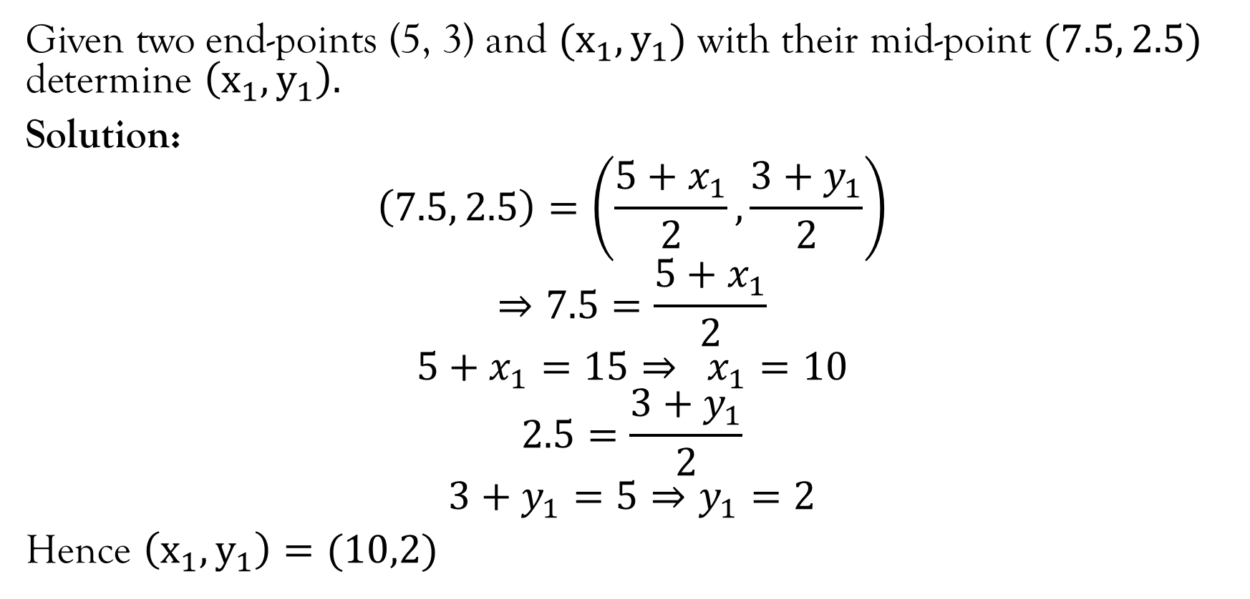
Example
Given two end-points (5, 3) and $(x_{1},y_{1})$ with their mid-point $(7.5, 2.5)$ determine $\left(x_{1},y_{1}\right).$
Solution:
$$\left(7.5, 2.5\right)=\left(\frac{5+x_{1}}{2},\frac{3+y_{1}}{2}\right)$$
$$⇒7.5=\frac{5+x_{1}}{2}$$
$$5+x_{1}=15⇒ x_{1}=10$$
$$2.5=\frac{3+y_{1}}{2}$$
$$3+y_{1}=5⇒y_{1}=2$$
Hence $\left(x_{1},y_{1}\right)=(10,2)$

Slide 7
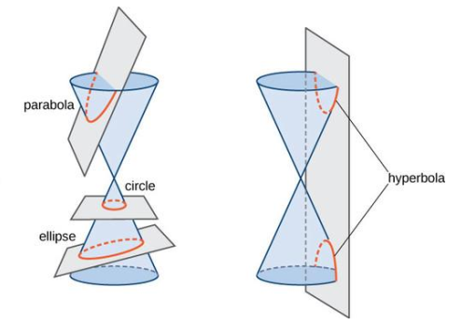
Conic Sections
Conic sections circles, ellipses, parabolas, and hyperbola are graphs that results from the intersections of a plane and a right circular cone.
Source: https://courses.lumenlearning.com/boundless-algebra/chapter/introduction-to-conic-sections/

Slide 8
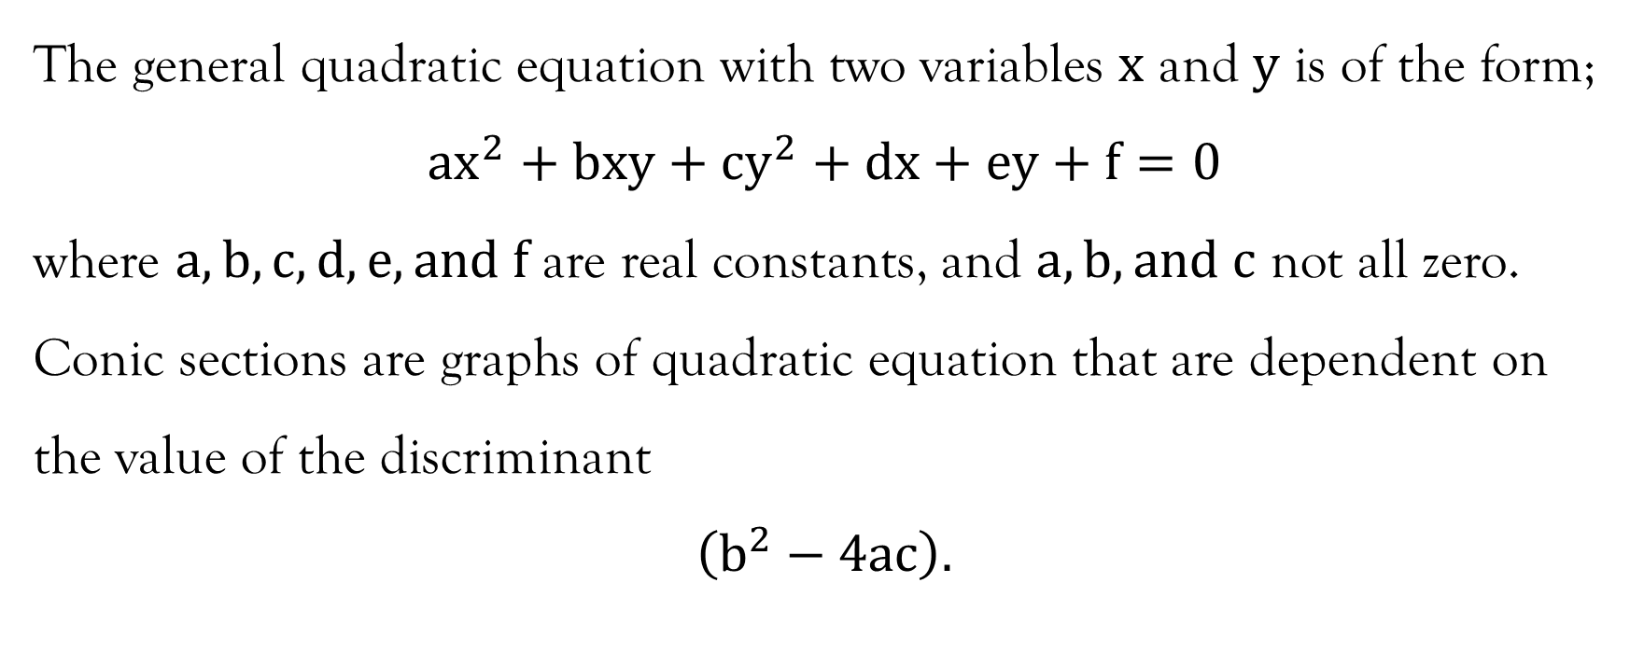
General quadratic equation
The general quadratic equation with two variables $x$ and $y$ is of the form;
$$ax^{2}+bxy+cy^{2}+dx+ey+f=0$$
where $a,b,c,d,e,and f$ are real constants, and $a,b, and c$ not all zero.
Conic sections are graphs of quadratic equation that are dependent on the value of the discriminant
$$\left(b^{2}−4ac\right).$$

Slide 9
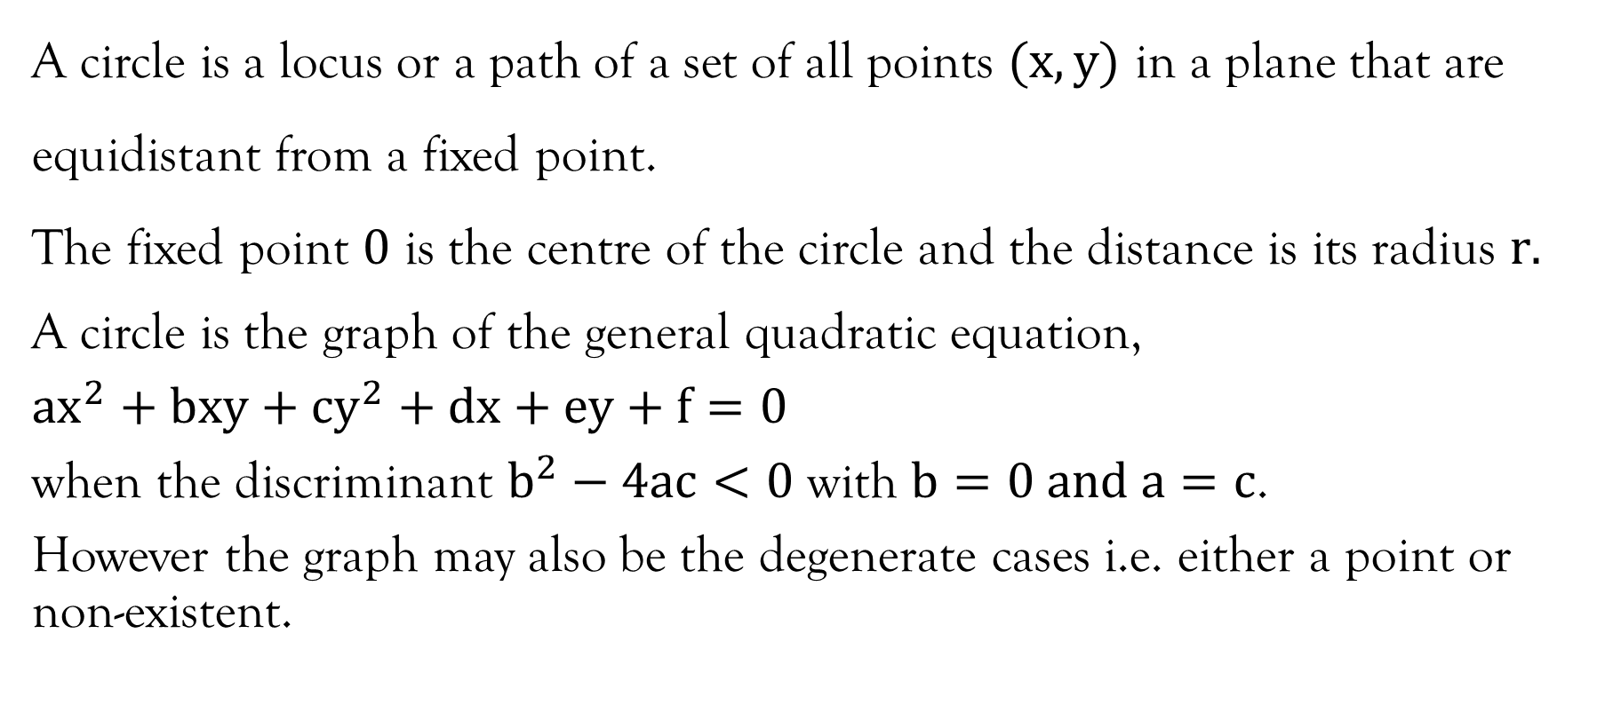
Circle
A circle is a locus or a path of a set of all points $(x,y)$ in a plane that are equidistant from a fixed point.
The fixed point $0$ is the centre of the circle and the distance is its radius $r.$
A circle is the graph of the general quadratic equation,
$ax^{2}+bxy+cy^{2}+dx+ey+f=0$
when the discriminant $b^{2}−4ac<0$ with $b=0 and a=c$.
However the graph may also be the degenerate cases i.e. either a point or non-existent.

Slide 10
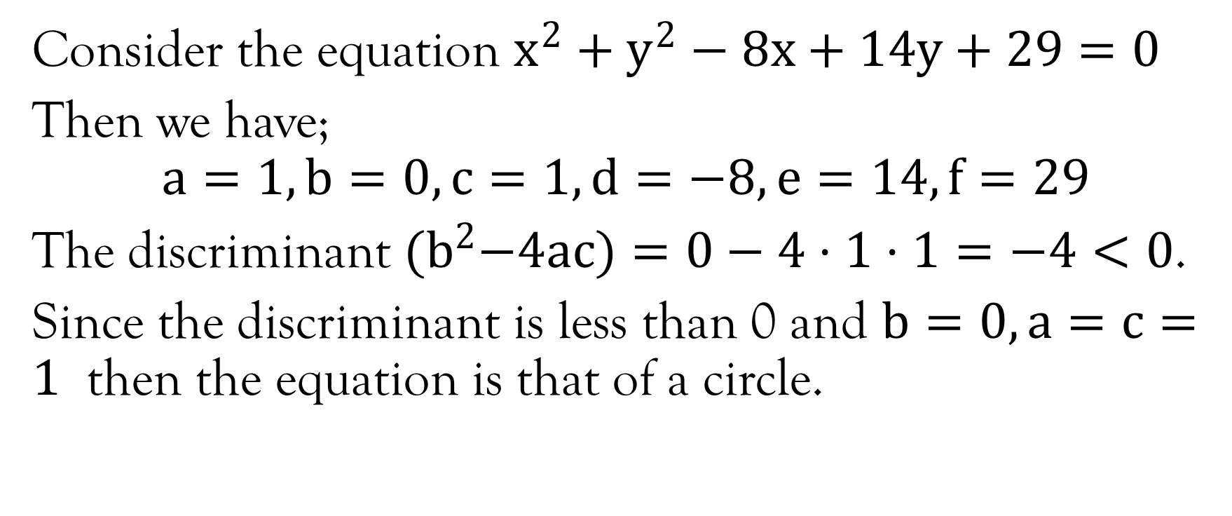
Example 1
Consider the equation $x^{2}+y^{2}−8x+14y+29=0$
Then we have;
$$a=1, b=0,c=1, d=−8, e=14, f=29$$
The discriminant ${(b}^{2}−4ac)=0−4⋅1⋅1=−4<0$.
Since the discriminant is less than 0 and $b=0, a=c=1$ then the equation is that of a circle.

Slide 11
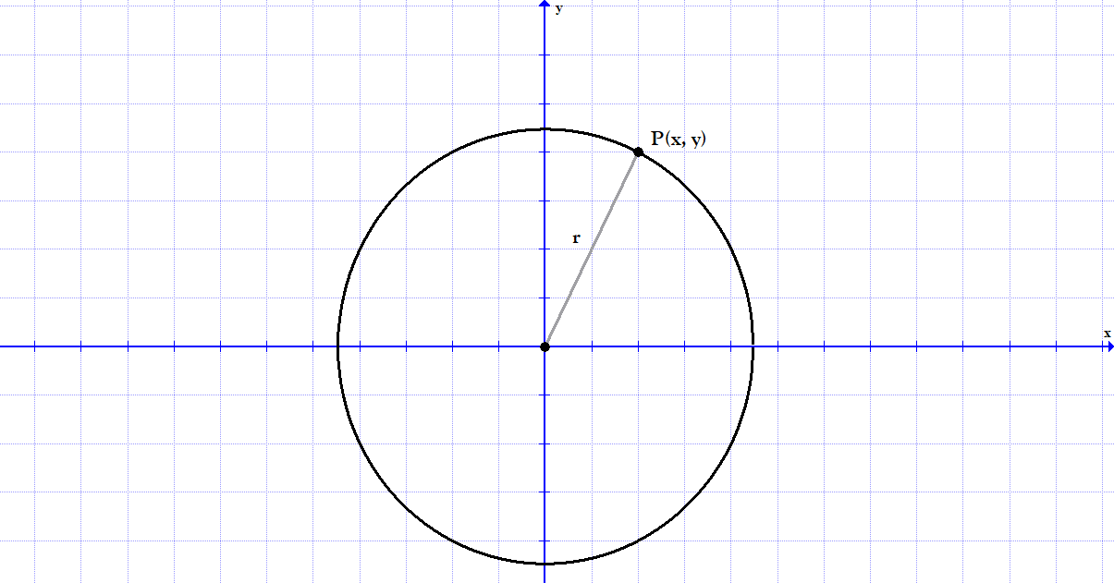
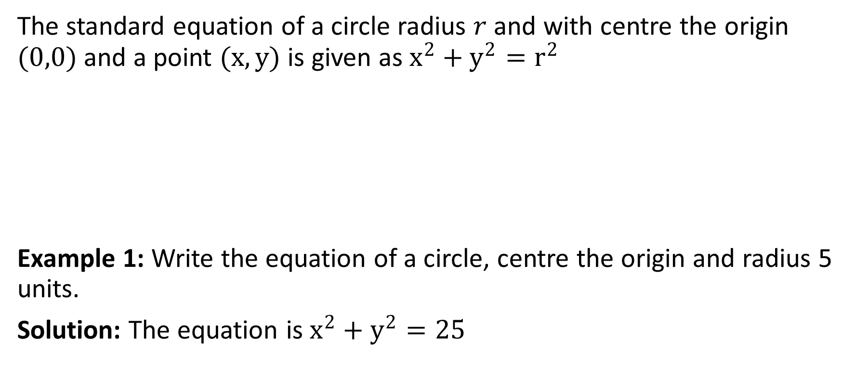
Equation of a circle
The standard equation of a circle radius $r$ and with centre the origin $(0,0)$ and a point $(x,y)$ is given as $x^{2}+y^{2}=r^{2}$
Example 1: Write the equation of a circle, centre the origin and radius 5 units.
Solution: The equation is $x^{2}+y^{2}=25$

Slide 12
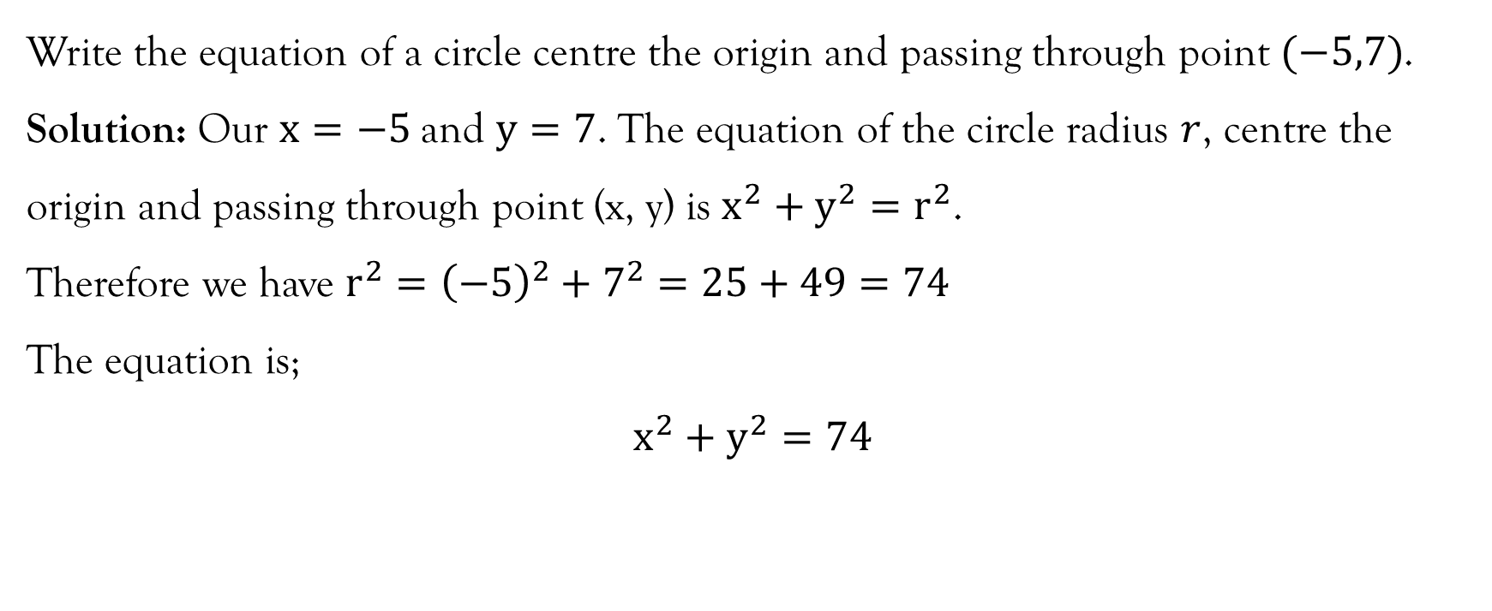
Example
Write the equation of a circle centre the origin and passing through point $(−5,7)$.
Solution: Our $x=−5$and $y=7$. The equation of the circle radius $r$, centre the origin and passing through point (x, y) is $x^{2}+y^{2}=r^{2}$.
Therefore we have $r^{2}={\left(−5\right)}^{2}+7^{2}=25+49=74$
The equation is;
$$x^{2}+y^{2}=74$$

Slide 13
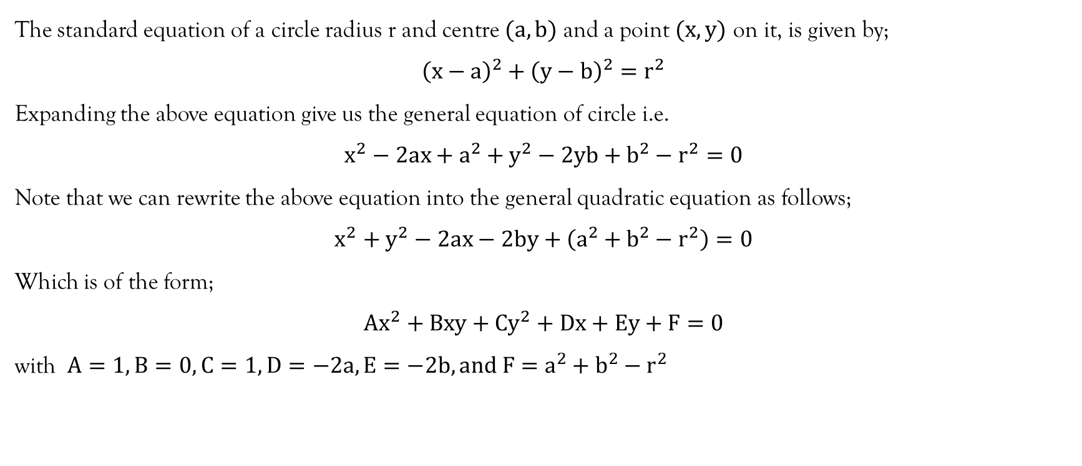
Equation of a circle centre (a, b)
The standard equation of a circle radius r and centre $(a,b)$ and a point $(x,y)$ on it, is given by;
$${\left(x−a\right)}^{2}+{\left(y−b\right)}^{2}=r^{2}$$
Expanding the above equation give us the general equation of circle i.e.
$$x^{2}−2ax+a^{2}+y^{2}−2yb+b^{2}−r^{2}=0$$
Note that we can rewrite the above equation into the general quadratic equation as follows;
$$x^{2}+y^{2}−2ax−2by+\left(a^{2}+b^{2}−r^{2}\right)=0$$
Which is of the form;
$$Ax^{2}+Bxy+Cy^{2}+Dx+Ey+F=0$$
with $A=1, B=0,C=1, D=−2a, E=−2b, and F=a^{2}+b^{2}−r^{2}$

Slide 14
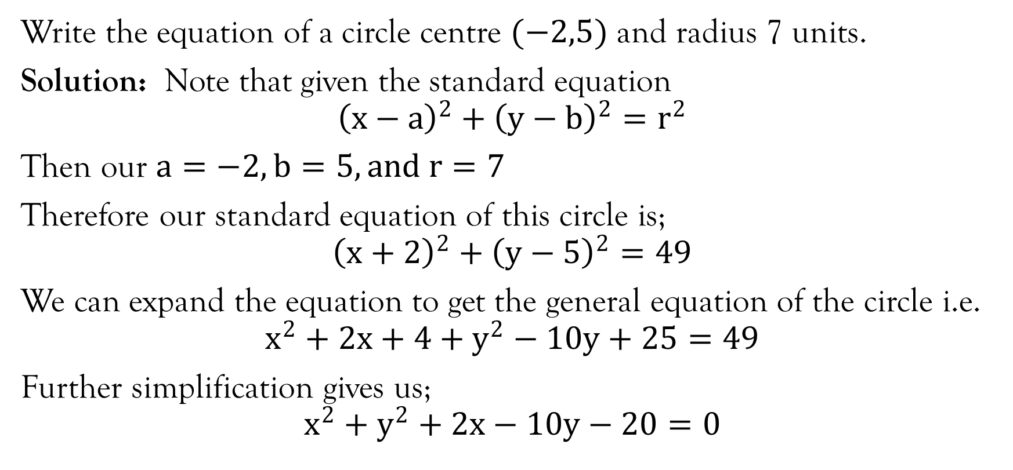
Example 1:
Write the equation of a circle centre $(−2,5)$ and radius 7 units.
Solution: Note that given the standard equation
$${\left(x−a\right)}^{2}+{\left(y−b\right)}^{2}=r^{2}$$
Then our $a=−2, b=5, and r=7$
Therefore our standard equation of this circle is;
$${\left(x+2\right)}^{2}+{\left(y−5\right)}^{2}=49$$
We can expand the equation to get the general equation of the circle i.e.
$$x^{2}+2x+4+y^{2}−10y+25=49$$
Further simplification gives us;
$$x^{2}+y^{2}+2x−10y−20=0$$

Slide 15
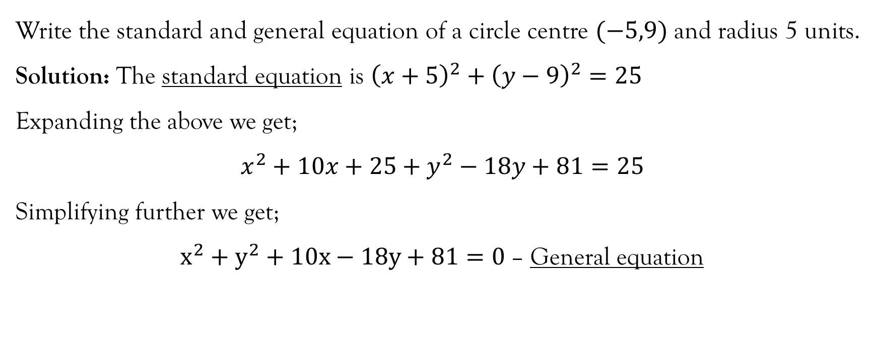
Example
Write the standard and general equation of a circle centre $(−5,9)$ and radius 5 units.
Solution: The standard equation is ${\left(x+5\right)}^{2}+{\left(y−9\right)}^{2}=25$
Expanding the above we get;
$$x^{2}+10x+25+y^{2}−18y+81=25$$
Simplifying further we get;
$x^{2}+y^{2}+10x−18y+81=0$ – General equation

Slide 16
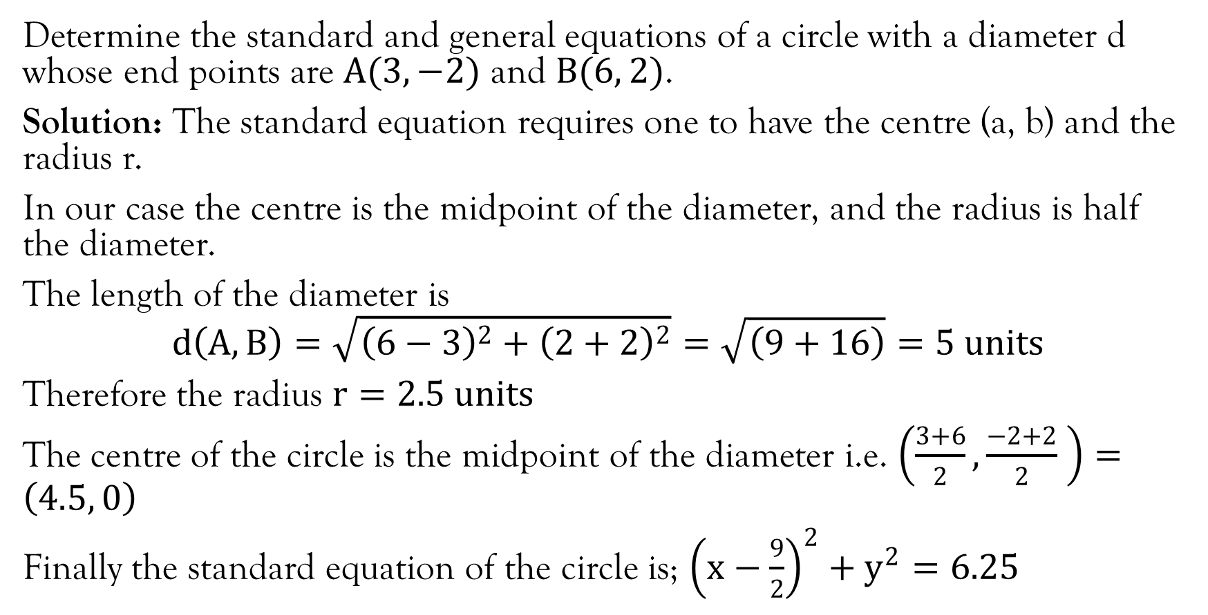
Example
Determine the standard and general equations of a circle with a diameter d whose end points are $A(3, −2)$ and $B(6, 2)$.
Solution: The standard equation requires one to have the centre (a, b) and the radius r.
In our case the centre is the midpoint of the diameter, and the radius is half the diameter.
The length of the diameter is
$$d\left(A,B\right)=\sqrt{{\left(6−3\right)}^{2}+{\left(2+2\right)}^{2}}=\sqrt{\left(9+16\right)}=5 units$$
Therefore the radius $r=2.5 units$
The centre of the circle is the midpoint of the diameter i.e. $\left(\frac{3+6}{2},\frac{−2+2}{2} \right)=\left(4.5, 0\right)$
Finally the standard equation of the circle is; ${\left(x−\frac{9}{2}\right)}^{2}+y^{2}=6.25$

Slide 17
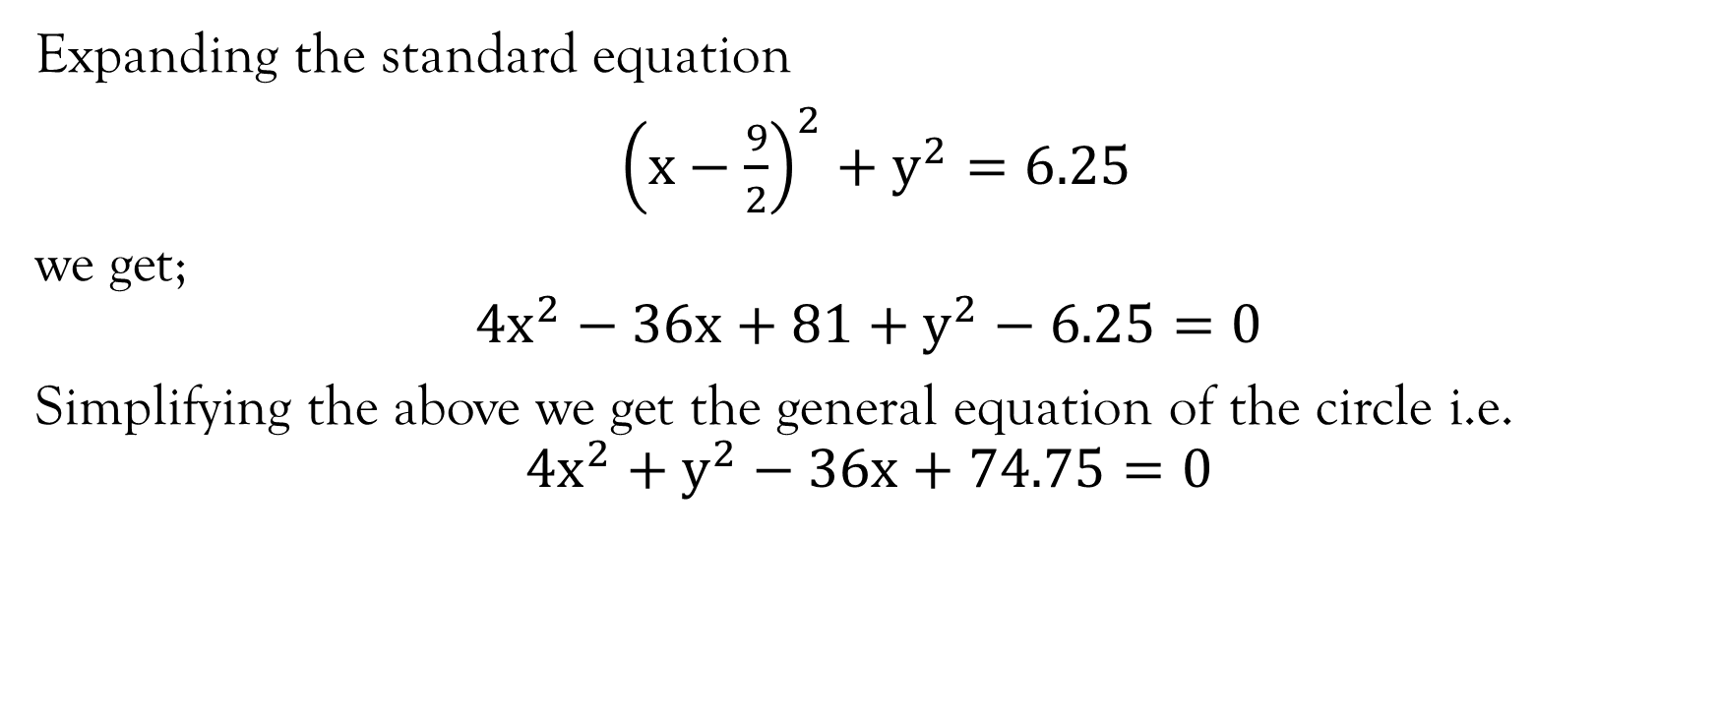
Example contd…
Expanding the standard equation
${\left(x−\frac{9}{2}\right)}^{2}+y^{2}=6.25$
we get;
$$4x^{2}−36x+81+y^{2}−6.25=0$$
Simplifying the above we get the general equation of the circle i.e.
$$4x^{2}+y^{2}−36x+74.75=0$$

Slide 18
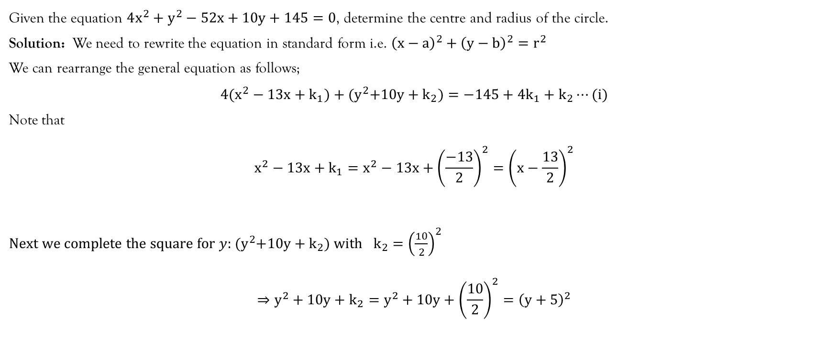
Example
Given the equation $4x^{2}+y^{2}−52x+10y+145=0$, determine the centre and radius of the circle.
Solution: We need to rewrite the equation in standard form i.e. ${\left(x−a\right)}^{2}+{\left(y−b\right)}^{2}=r^{2}$
We can rearrange the general equation as follows;
$$4(x^{2}−13x+k_{1})+{(y}^{2}+10y+k_{2})=−145+{4k}_{1}+k_{2}⋯(i)$$
Note that
$$x^{2}−13x+k_{1}=x^{2}−13x+{\left(\frac{−13}{2}\right)}^{2}={\left(x−\frac{13}{2}\right)}^{2}$$
Next we complete the square for $y$: ${(y}^{2}+10y+k_{2}) with$ $k_{2}={\left(\frac{10}{2}\right)}^{2}$
$$⇒y^{2}+10y+k_{2}=y^{2}+10y+{\left(\frac{10}{2}\right)}^{2}={\left(y+5\right)}^{2}$$

Slide 19
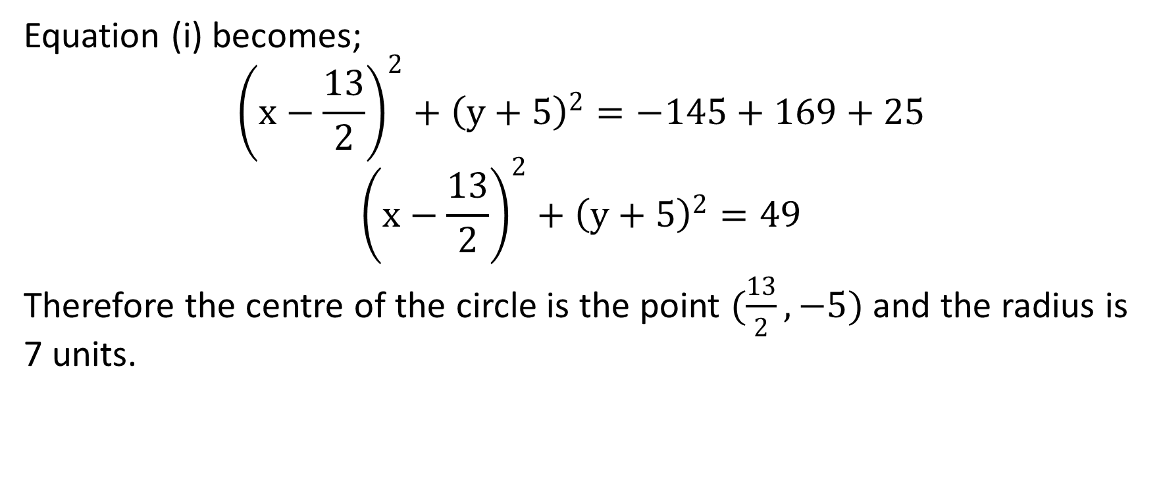
Example contd…
Equation (i) becomes;
$${\left(x−\frac{13}{2}\right)}^{2}+{\left(y+5\right)}^{2}=−145+169+25$$
$${\left(x−\frac{13}{2}\right)}^{2}+{\left(y+5\right)}^{2}=49$$
Therefore the centre of the circle is the point $(\frac{13}{2}, −5)$ and the radius is 7 units.

Slide 20
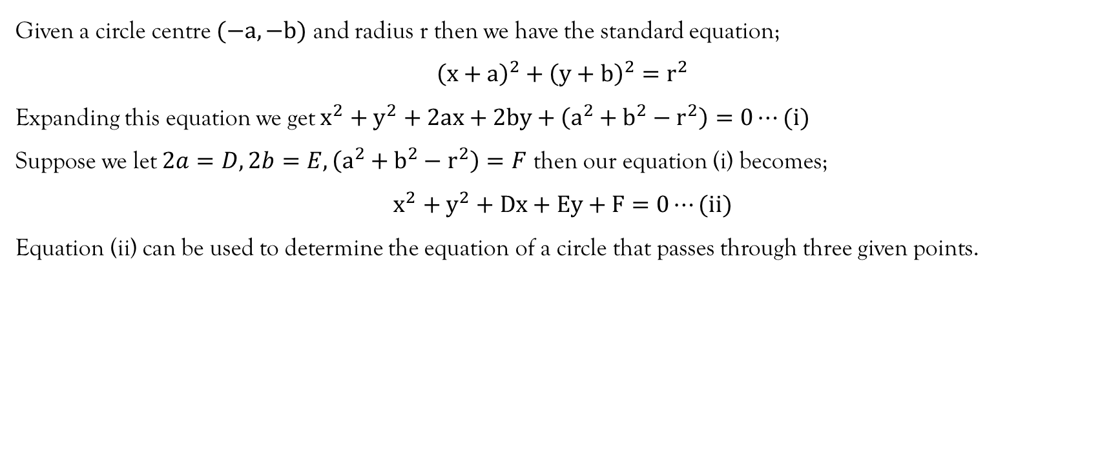
Circle Passing Through Three Given Points
Given a circle centre $(−a,−b)$ and radius r then we have the standard equation;
$${\left(x+a\right)}^{2}+{\left(y+b\right)}^{2}=r^{2}$$
Expanding this equation we get $x^{2}+y^{2}+2ax+2by+\left(a^{2}+b^{2}−r^{2}\right)=0⋯(i)$
Suppose we let $2a=D, 2b=E, \left(a^{2}+b^{2}−r^{2}\right)=F$ then our equation (i) becomes;
$$x^{2}+y^{2}+Dx+Ey+F=0⋯(ii)$$
Equation (ii) can be used to determine the equation of a circle that passes through three given points.

Slide 21
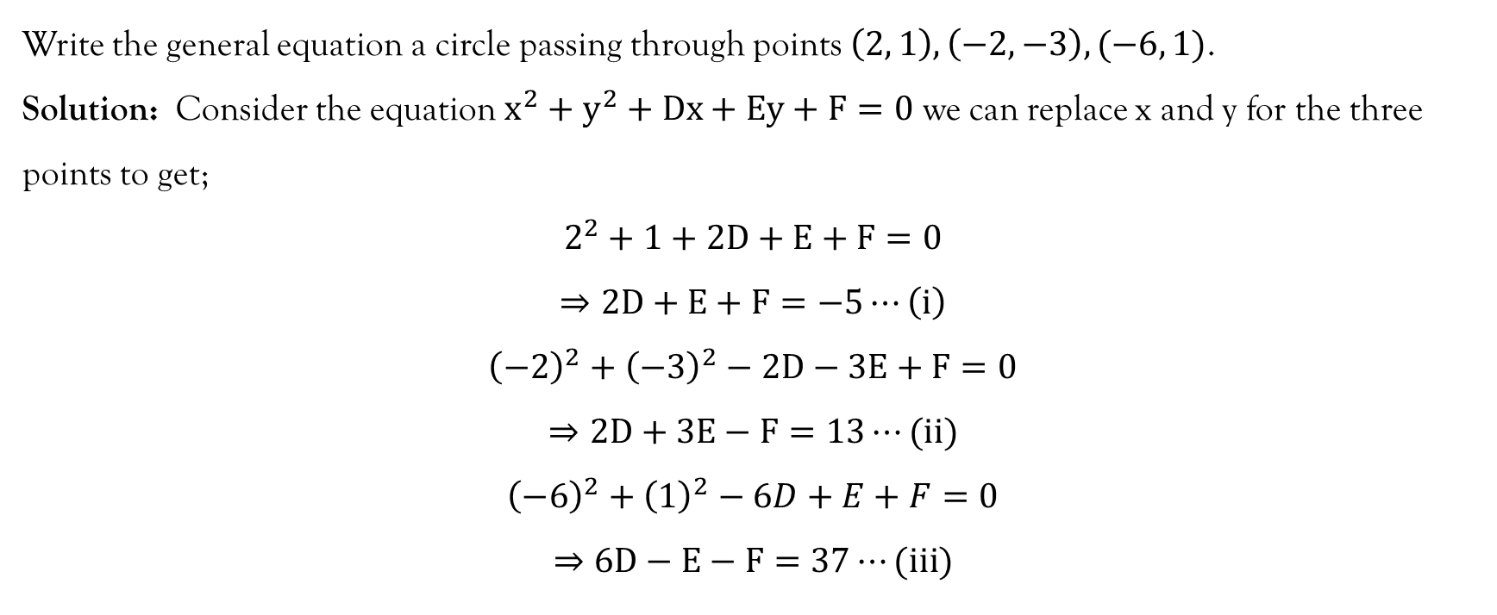
Example
Write the general equation a circle passing through points $\left(2, 1\right), \left(−2, −3\right), (−6, 1)$.
Solution: Consider the equation $x^{2}+y^{2}+Dx+Ey+F=0$ we can replace x and y for the three points to get;
$$2^{2}+1+2D+E+F=0$$
$$⇒2D+E+F=−5⋯\left(i\right)$$
$${\left(−2\right)}^{2}+{\left(−3\right)}^{2}−2D−3E+F=0$$
$$⇒2D+3E−F=13⋯(ii)$$
$${\left(−6\right)}^{2}+{\left(1\right)}^{2}−6D+E+F=0$$
$$⇒6D−E−F=37⋯(iii)$$

Slide 22
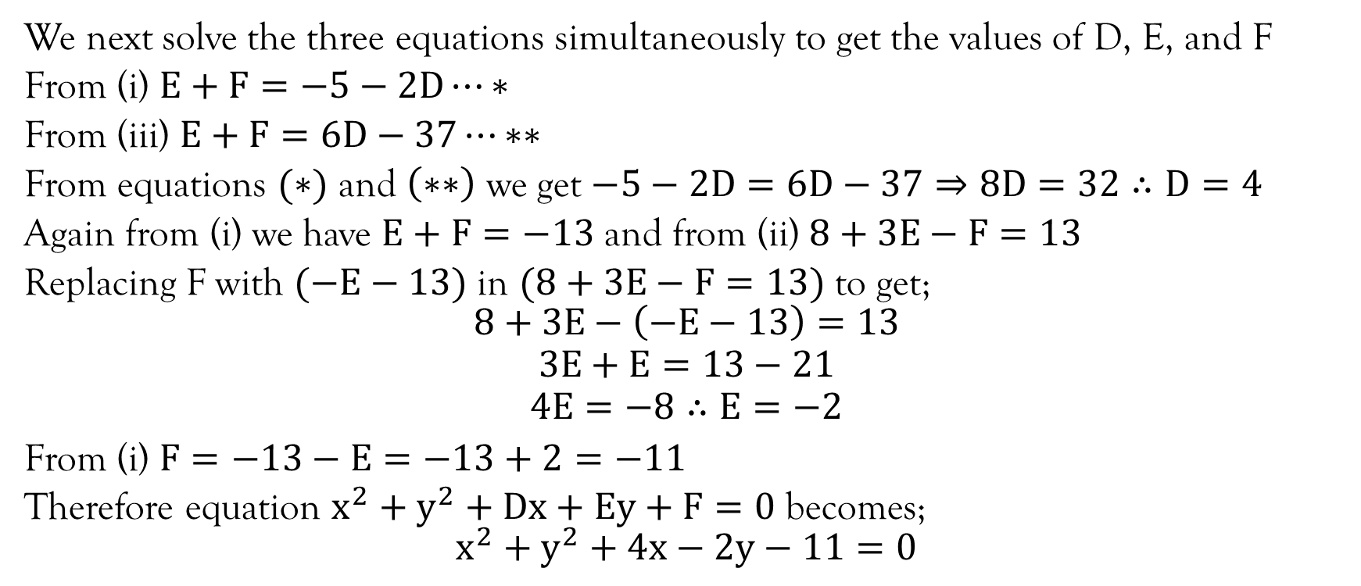
Example Contd…
We next solve the three equations simultaneously to get the values of D, E, and F
From (i) $E+F=−5−2D⋯∗$
From (iii) $E+F=6D−37⋯∗∗$
From equations $(∗)$ and $\left(∗∗\right)$ we get $−5−2D=6D−37⇒8D=32∴D=4$
Again from (i) we have $E+F=−13$ and from (ii) $8+3E−F=13$
Replacing F with $(−E−13)$ in $(8+3E−F=13)$ to get;
$$8+3E−\left(−E−13\right)=13$$
$$3E+E=13−21$$
$$4E=−8∴E=−2$$
From (i) $F=−13−E=−13+2=−11$
Therefore equation $x^{2}+y^{2}+Dx+Ey+F=0$ becomes;
$$x^{2}+y^{2}+4x−2y−11=0$$

Slide 23
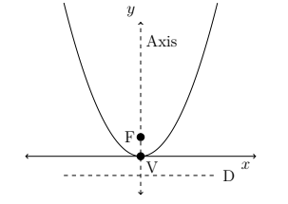
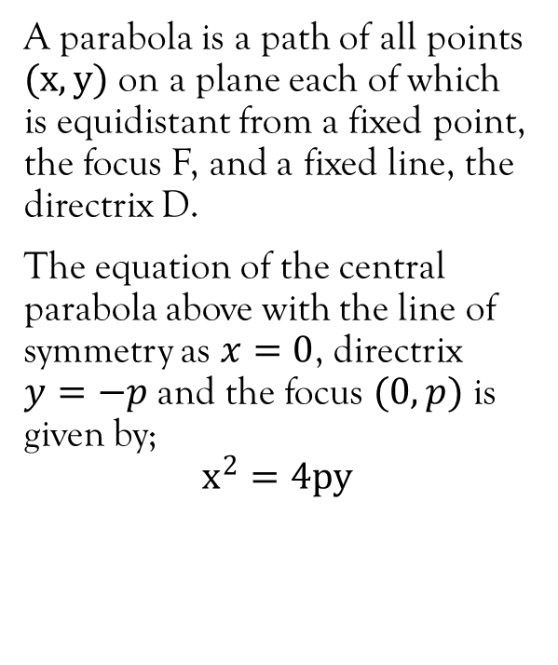
Parabola
A parabola is a path of all points $(x,y)$ on a plane each of which is equidistant from a fixed point, the focus F, and a fixed line, the directrix D.
The equation of the central parabola above with the line of symmetry as $x=0$, directrix $y=−p$ and the focus $(0, p)$ is given by;
$$x^{2}=4py$$

Slide 24
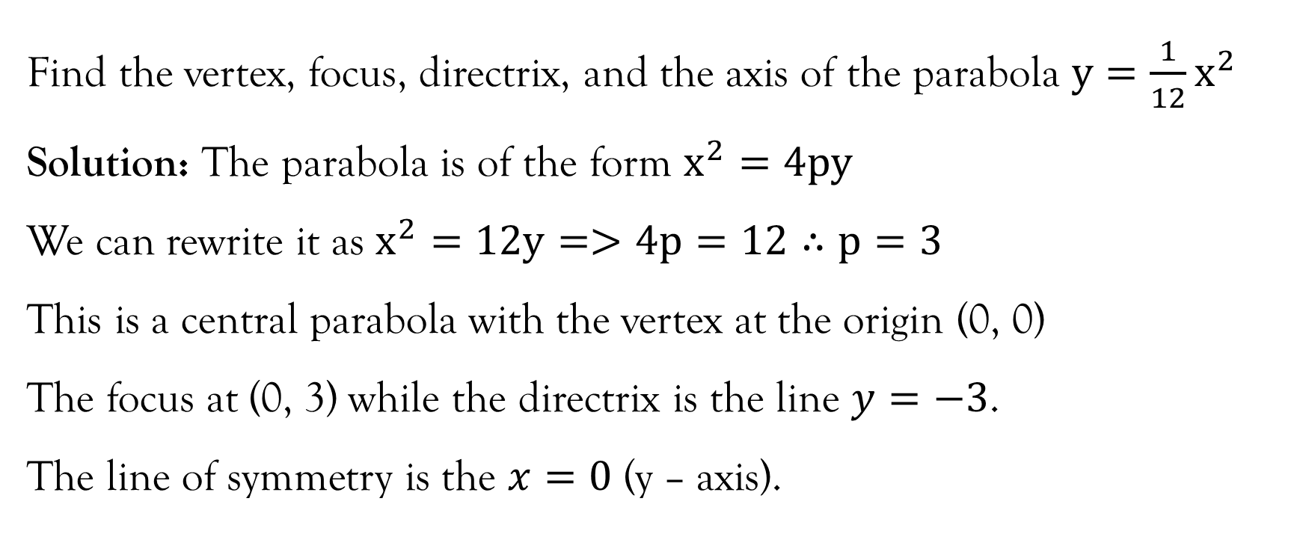
Example
Find the vertex, focus, directrix, and the axis of the parabola $y=\frac{1}{12}x^{2}$
Solution: The parabola is of the form $x^{2}=4py$
We can rewrite it as $x^{2}=12y=>4p=12∴p=3$
This is a central parabola with the vertex at the origin (0, 0)
The focus at (0, 3) while the directrix is the line $y=−3$.
The line of symmetry is the $x=0$ (y – axis).

Slide 25
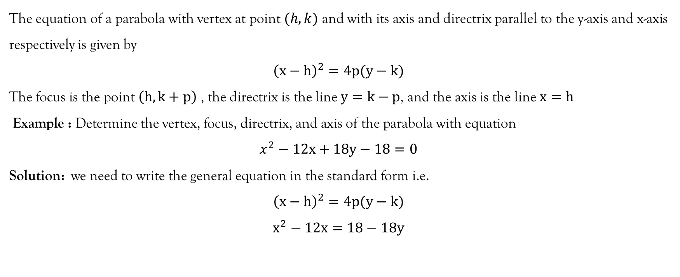
Definition
The equation of a parabola with vertex at point $(h,k)$ and with its axis and directrix parallel to the y-axis and x-axis respectively is given by
$${\left(x−h\right)}^{2}=4p(y−k)$$
The focus is the point $\left(h, k+p\right)$ , the directrix is the line $y=k−p$, and the axis is the line $x=h$
Example : Determine the vertex, focus, directrix, and axis of the parabola with equation
$$x^{2}−12x+18y−18=0$$
Solution: we need to write the general equation in the standard form i.e.
$${\left(x−h\right)}^{2}=4p(y−k)$$
$$x^{2}−12x=18−18y$$

Slide 26
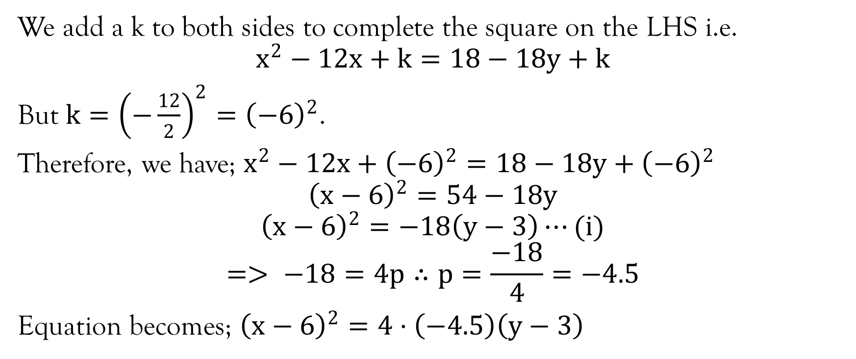
Example contd…
We add a k to both sides to complete the square on the LHS i.e.
$$x^{2}−12x+k=18−18y+k$$
But $k={\left(−\frac{12}{2}\right)}^{2}={\left(−6\right)}^{2}$.
Therefore, we have; $x^{2}−12x+{\left(−6\right)}^{2}=18−18y+{\left(−6\right)}^{2}$
$${\left(x−6\right)}^{2}=54−18y$$
$${\left(x−6\right)}^{2}=−18\left(y−3\right)⋯(i)$$
$$=> −18=4p∴p=\frac{−18}{4}=−4.5$$
Equation becomes; ${\left(x−6\right)}^{2}=4⋅\left(−4.5\right)\left(y−3\right)$

Slide 27
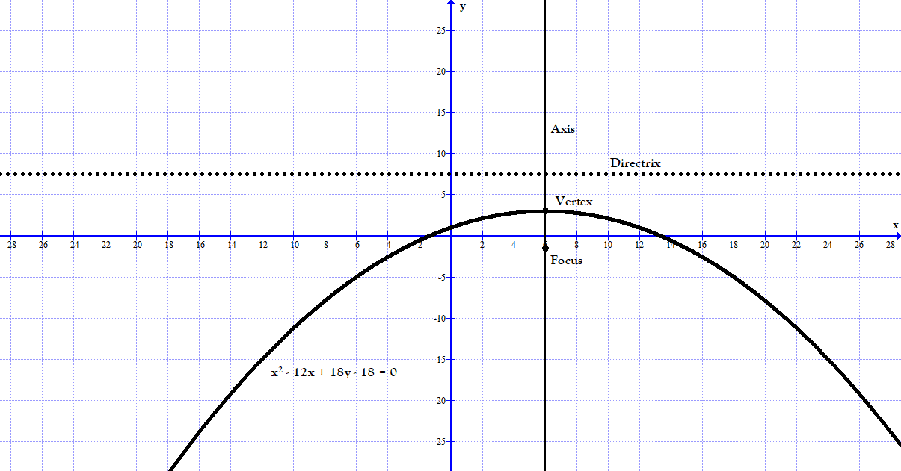

Slide 28
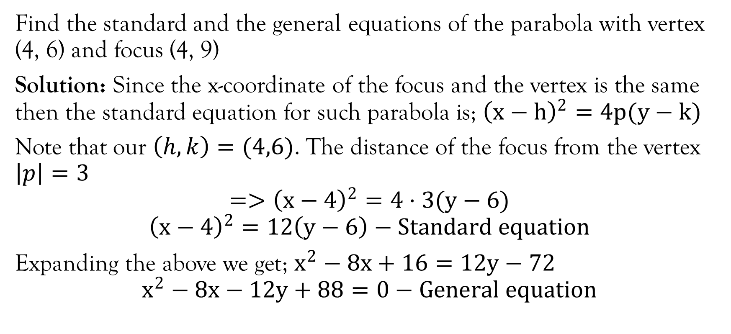
Example
Find the standard and the general equations of the parabola with vertex (4, 6) and focus (4, 9)
Solution: Since the x-coordinate of the focus and the vertex is the same then the standard equation for such parabola is; ${\left(x−h\right)}^{2}=4p(y−k)$
Note that our $\left(h,k\right)=(4,6)$. The distance of the focus from the vertex $\left|p\right|=3$
$$=>{\left(x−4\right)}^{2}=4⋅3(y−6)$$
$${\left(x−4\right)}^{2}=12\left(y−6\right)−Standard equation$$
Expanding the above we get; $x^{2}−8x+16=12y−72$
$$x^{2}−8x−12y+88=0−General equation$$

Slide 29
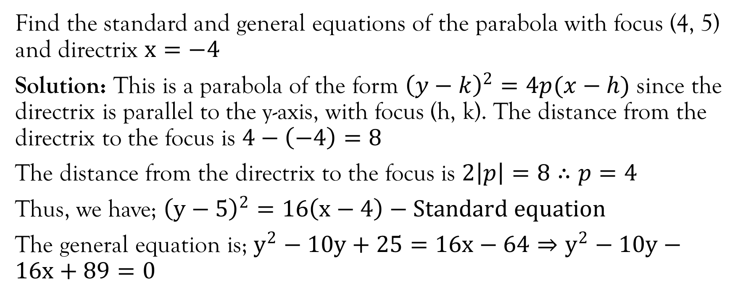
Example
Find the standard and general equations of the parabola with focus (4, 5) and directrix $x=−4$
Solution: This is a parabola of the form ${\left(y−k\right)}^{2}=4p(x−h)$ since the directrix is parallel to the y-axis, with focus (h, k). The distance from the directrix to the focus is $4−\left(−4\right)=8$
The distance from the directrix to the focus is $2\left|p\right|=8∴p=4$
Thus, we have; ${\left(y−5\right)}^{2}=16\left(x−4\right)−Standard equation$
The general equation is; $y^{2}−10y+25=16x−64⇒y^{2}−10y−16x+89=0$

Slide 30
References
Kahenya, P. (2017). Foundation Maths. LAP Lambert Academic Publishers.
Murray, S., & Robert, M. (2009). College Algebra. McGraw-Hill.
Stewart, J. (2012). Calculus (7th ed.). BROOKS/COLE Cengage Learning.
https://courses.lumenlearning.com/boundless-algebra/chapter/introduction-to-conic-sections/

Slide 31
End of lecture 3
Thank you

