Slide 1
CONSUMER BEHAVIOR
WEEK 2
MARKET SEGMENTATION,
TARGETING & POSITIONING
Dr. wanjiku kinyanjui

Slide 2
Learning Objectives
To understand how to segment markets along demographics, lifestyles, product benefits and usage
To understand how to identify, select, and reach target markets.
To understand real-time bidding as compared with market segmentation.
To understand the various positioning strategies a marketer can use

Slide 3
Definitions of key terms
Market segmentation – This is the process of splitting a market into smaller groups with similar product needs or identifiable characteristics, for the purpose of selecting appropriate target markets.
Targeting refers to an organization’s proactive selection of a suitable market segment (or segments) with the intention of heavily focusing the firm’s marketing offers and activities towards this group of related consumers.
Positioning (which is sometimes referred to as product positioning) is the target market’s perception of the product’s key benefits and features relative to the offerings of competitive products.

Slide 4
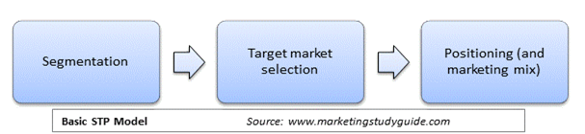
The STP PROCESS

Slide 5
Bases for Market Segmentation
I. DEMOGRAPHICS
Demographic segmentation divides consumers according to age, gender, ethnicity, income and wealth, occupation, marital status, household type and size, and geographical location. (Schiffman & Wisenbilt). The reason for using such variables for segmentation is due to the fact that they pose objectivity, they are empirical, and can be determined numerically. This can be measured in terms of age groups, income brackets, the number of years of education, number of family members, etc.

Slide 6
Age
Age influences a consumers’ buying priorities. For example, as a young student, would probably purchase of upscale sneakers, designer shirts and handbags and this would be highly criticized by parents and the older generation
  -Brands like Colgate use age to target children by offering toothpaste for the littlest children, without any artificial colors, preservatives, or Fluoride, they also offer Colgate fruit toothpaste designed for kids aged 2 and older

Slide 7
Gender
Today, gender roles have blurred, and gender is no longer an accurate way to distinguish among consumers in some product categories. For instance, Traditionally, women have been the primary users of hair and face-care products but now, more and more men have been using have been buying skin toners, aftershave creams, and moisturizers. Marketers have had to redesign the areas where men buy these products knowing that they may feel embarrassed to be seen buying them.

Slide 8
Social Class
Social Class is the division of members of a society into a hierarchy of distinct status classes, so that members of each class have relatively the same status and members of all other classes have either higher or lower status. Social class is determined by the level of education, occupation, and income , high-level occupations that produce high incomes require advanced education and are more prestigious than occupations requiring less education. Income determines the level of affordability of products and services but provides a more comprehensive profile of families when combined with age and education

Slide 9
ii. lifesyle
In marketing, lifestyles are also known as psychographics, and they include consumers’ activities, interests, and opinions. In consumer research, psychographics consists of variables like buying patterns, opinions about consumption and/or social issues, values, hobbies, leisure activities, and many other dimensions. Psychographics are versatile, loosely-defined, and together with demographics, provide marketers with richly descriptive profiles of target markets.

Slide 10
VAL’S
VALs- is a psychographic consumer segmentation that stands for Values, Attitudes and Lifestyles, it is a system owned by Strategic Business Insights and is based on eight pillars: innovators, thinkers, achievers, experiencers, believers, strivers, makers and survivors. VALS explains why different consumer groups exhibit different behaviors as well as why different consumer groups exhibit the same behaviors for different reasons.

Slide 11
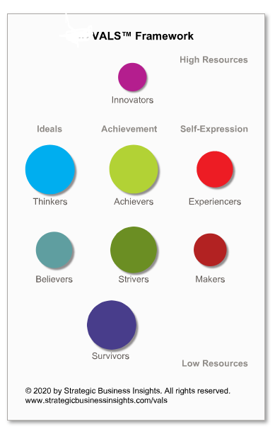
Innovators
Are people with considerable incomes and resources who value independence greatly. They are driven to pursue the finer things in life and have distinct own tastes in things

Slide 12
Thinkers
In the VALS paradigm, a well-educated professional is a great example of a Thinker. These are the individuals who have substantial resources and are knowledge-driven. These customers make thoughtful decisions and are well-informed about their environment. Due to their education, these consumers are more likely to embrace any societal change.

Slide 13
Believers
Thinkers make their own decisions, however believers are more social by nature and thus also believe other consumers. This is a minor distinction between thinkers and believers. Their resources are typically lesser, and they are also less likely to embrace innovation on their own. They represent the ideal group of word-of-mouth customers.

Slide 14
Achievers
Achievements clearly motivate achievers. These people aspire to succeed in both their personal and professional lives. They are therefore more likely to buy a brand that has proven successful over time. The achievers are regarded as high-resource customers, but they are also more willing to acquire a brand quickly if it is growing.

Slide 15
Strivers
These are low resource consumer groups that aspire to achieve anything and everything. These clients lack the means necessary to be achievers. However, because they share values with achievers, they belong under the striver category. A striver can progress to being an achiever if he can acquire the appropriate resources, such as a high income or social status

Slide 16
Experiences
This is a group of customers who have abundant resources but require a means of self-expression. Young adults dominate this group, which is made up of individuals who desire to experience being different. Early adopters who spend significantly on food, clothing, and other youthful things make up the majority of this customer group.

Slide 17
Makers
These consumers desire to express themselves, but their access to resources prevents them from doing so. As a result, they would be more concerned with creating a better family than going out and really spending more money. For the Makers, improving their family and selves becomes a means of self-expression.

Slide 18
Survivors
This consumer group has the fewest resources and is hence least likely to adopt any innovations. They become brand loyal customers since they are less inclined to frequently alter their behavior. Older people receiving pensions and living alone are an example of those who prioritize fundamental needs and are least likely to focus on anything else.

Slide 19
III. Geodemographics
This is a hybrid segmentation scheme based on the premise that people who live close to one another are likely to have similar financial means, tastes, preferences, lifestyles, and consumption habits. Geographical settings shape the ways people dress (clothing), the food they eat, transportation, and many other product choices.

Slide 20
PRIZM
In the US, marketers use a system known as PRIZM which combines demographics, consumer behavior and geographic data which is useful in identifying, understanding and reaching their customers and prospects. PRIZM stands for Potential Rating Index for Zip Markets and is built around geographic neighborhood data obtained through the United States Census.

Slide 21
prizm
The system classifies the households according to:
Lifestage groups—younger years, family life, and mature years—based on age, socioeconomic rank, and the presence of children at home.
Urbanization and affluence—urban, suburban, second city, and town and country— bused on urbanization and socioeconomic rank.
ConneXions determines the likelihood for segments to adopt technology.
P$YCLE focuses on households’
In the US, marketers use a system known as PRIZM which combines demographics, consumer behavior and geographic data which is useful in identifying, understanding and reaching their customers and prospects. PRIZM stands for Potential Rating Index for Zip Markets and is built around geographic neighborhood data obtained through the United States Census.

Slide 22
iv. Product Benefits
Benefit segmentation reflects the benefits that consumers seek because they represent unfilled needs. When buyers perceive that a given brand delivers a unique and prominent benefit they become loyal buyers. For example, Marketers of personal care products—such as shampoos, soaps, and toothpastes—create different offerings designed to deliver specific benefits. Colgate, probably the world’s most sophisticated marketer of personal care products, markets its offerings according to consumers’ need in caring for their teeth and maintaining oral hygiene

Slide 23
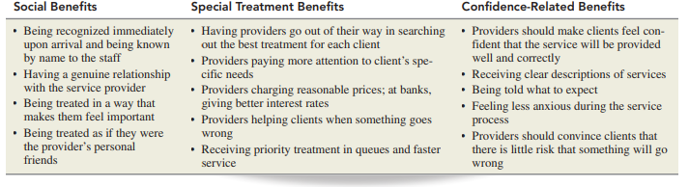
Types of benefits

Slide 24
Usage-rate segmentation
This reflects the differences among heavy, medium, and light users, as well as nonusers of a specific product, service, or brand. Marketers of many products, such as laundry detergent, beer, and dog food, have found that a relatively small group of heavy users accounts for a disproportionately large percentage of the total product usage.
Therefore, most detergent selling companies direct their advertising campaigns to heavy users rather than spend money trying to attract medium or light users. Research shows that targeting heavy users is more profitable than pursuing other users. However, catering to this segment requires a lot of expensive advertising because all competitors target the same heavy users.

Slide 25
Product awareness status represents the degree of consumers’ awareness of the product and its features, and whether or not they intend to buy it reasonably soon. A related factor is product involvement, which reflects the degree of personal relevance that the product holds for the consumer.
Usage-occasion segmentation recognizes that consumers purchase some products for specific occasions, like birthdays, travel, Valentine’s day, Christmas , Mother’s day etc.

Slide 26
Attributes of a good segment
Identifiable
Marketers divide consumers into separate segments on the basis of common or shared needs by using demographics, lifestyles, and other factors named “bases for segmentation.” Some segmentation factors, such as demographics (e.g., age, gender, ethnicity), are easy to identify, and others can be determined through questioning (e.g., education, income, occupation, marital status). Other features, such as the product benefits buyers seek and customers’ lifestyles, are difficult to identify and measure.

Slide 27
Profitable
To be a viable market, a segment must consist of enough consumers to target it profitably, as well as be stable and growing. A segment can be identifiable, but not large enough to be profitable. Marketers target consumer segments that are relatively stable in terms of lifestyles and consumption patterns (and are also likely to grow larger and more viable in the future) and avoid “fickle” segments that are unpredictable. For example, teenagers are a sizable and easily identifiable market segment, eager to buy, able to spend, and easily reached.

Slide 28
Reachable
To be targeted, a segment must be accessible, which means that marketers must be able to communicate with its consumers effectively and economically. With the diversification of magazines through online versions, the emergence of TV channels that target narrowly defined interests, and the growth of new media (e.g., sending ads to cell phones), marketers have more avenues for reaching unique segments and may do so with customized products and promotional messages. Whether in print or online, magazines and leading newspapers have been one of the best media used to reach narrowly defined market segments.

Slide 29
Real Time Bidding
Do you ever wonder why the same ad for a car or sneakers keeps popping up on your screen? It is because you were an impression and advertisers won bids to reach you with these ads. Advertisers bid on each impression and the winning advertiser’s ad is instantly displayed on the site that was offered for sale. In traditional advertising, marketers buy access to large segments of customers by, say, buying advertising space in a magazine or time on a TV show.
This is a technique that allows advertisers to reach the right user, in the right place, at the right time, and also sets the price that advertisers pay for each “eyeball” or “impression” .
This takes place when advertisers buy inventories of customers— termed impressions or eyeballs—on a per-impression basis, via programed instantaneous auction. An impression is a term for a customer that becomes available for real-time bidding online.

Slide 30
COLLECTING WEB DATA
Web crawlers are programs that capture content across the internet and transmit it to the data broker’s servers. The programs record websites that consumers visit so as to gain insights on consumers’ levels of engagement including which pages they look at, the frequency and length of their visits, and how often they return to buy again. Their lifestyles and personalities can also be derived from the contents of consumers’ blogs, tweets, and Facebook profiles. They also keep track of consumers’ purchases, items left unpurchased in shopping carts, and returns and exchanges.

Slide 31
Predictive analytics are measures that foresee consumers’ future purchases on the bases of past buying information and other data, as well as evaluate the impact of personalized promotions created from these predictions. Predictive analytics often focuses on noticing significant changes in consumers’ buying behavior.
Eg when a customer starts buying products that she had never bought before, predictive analytics signals that these purchases strongly show a change in behavior and marketers will start sending applicable promotional offers targeting that specific customer.
:

Slide 32
Behavioral biometrics—these chart unique patterns in the way people perform various activities, such as swiping the screen or even the way they walk while holding smartphones. Security experts maintain that how people perform these functions is very difficult to copy, especially when several metrics are combined. Marketers can use this to verify that customers interacting with their ads and apps are indeed those whom they had intended to reach.

Slide 33
TARGETING
It is process of reviewing market segments and deciding which one(s) to pursue. Once an organization has identified its most promising market segments, it must decide whether to target one segment or several segments
Each targeted segment will then receive a specially designed marketing mix — i.e., a specially tailored product, price, distribution network and/or promotional campaign

Slide 34
There are three basic types of strategies:
Undifferentiated strategy(mass marketing)- offer one product to entire market
Multisegment strategy(differentiated) – selec ting multiple segments, developing separate marketing strategies for each
Concentrated strategy(niche marketing) – selecting one segment, developing one marketing mix for that segment.

Slide 35
POSITIONING
It is establishing a differentiating image for a product or service in relation to its competition.
It involves deciding how the firm wants the company and its brands to be perceived and evaluated by target markets, it needs to differentiate the product from other products of the firm or its competition
The result of successful positioning is a distinctive brand image on which consumers rely in making product choices.
Product attributes
Price and quality
Use or application
User
Product class
Competitor '.
Technology

Slide 36
REFERENCES
McDougal, E.R, Syrdal,H.A, Gravois, R & Kemp, A (2021) Telling the tale: applying a strategic brand storytelling process for STP planning, Journal of Strategic Marketing, DOI: 10.1080/0965254X.2021.1892803
Schiffman L.G & Wisenblit J.L (2019) Consumer Behavior, 12th ed, Pearson, New York

